Slide 1
mCLASS®:IDEL®
Assess to inform instruction

Slide 2
Session Objectives
By the end of the session you will be able to:
Make a correlation between the mCLASS®:IDEL® and the Basic Early Literacy Skills
Perform the essential functions of your mobile device
Administer and score the mCLASS®:IDEL® assessment measures
View, navigate and analyze the mCLASS®:IDEL® Web reports
Identify the instructional needs of your students
Notes:
DIRECTIONS:
Review the session objectives with participants.

Slide 3
Norms
Participate actively
Take care of yourself
Monitor your technology
What is learned here, leaves here
Notes:
PARAPHRASE:
We have a lot to cover today, so let’s work together to help everything flow smoothly.
DIRECTIONS:
Read the information on the slide.
In addition to the above expectations, ask participants to:
Turn their cell phones on vibrate/silent.
Return from breaks at the assigned time.

Slide 4
Agenda
1 | Introduction
2 | mCLASS®:IDEL® Basics
3 | Fluidez en la Segmentación de Fonemas (FSF)
4 | Fluidez en el Nombramiento de las Letras (FNL)
5 | Fluidez en las Palabras sin Sentido (FPS)
6 | Fluidez en la Lectura Oral (FLO)
7 | Fluidez en el Recuerdo Oral (FRO)
8 | Fluidez en el Uso de las Palabras (FUP)
9 | mCLASS®:IDEL® Progress Monitoring
10 | Web Reports
11 | Wrap-Up and Support
Notes:
DIRECTIONS: Go quickly over Introduction and Basics Slides
Review agenda with participants.

Slide 5
Introduction
The right kind and quality of instruction delivered with
    The right level of intensity and duration to
    The right children at
      The right time.
        –Joseph K. Torgesen,
        Catch Them Before They Fall (1988)
Notes:
PARAPHRASE:
We speak with immediacy in our voice as we discuss high-risk student needs.
Joe Torgesen says it well when he states that we must provide targeted instruction for identified needs and that we must do it now!
Research validates this point.

Slide 6
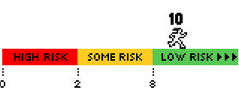
Introductory Activity
Record two goals for this training.
Notes:
ACTIVITY:
Time: 5 minutes
Materials: Chart paper, sticky notes
Grouping: Pairs, table groups, or whole group
Purpose: To establish a purpose for the session
Directions:
Prepare two charts:
Label one chart “Personal Goals” and the other “Campus or District Goals.”
Ask participants to record their goals on sticky notes.
Discuss both individual and group goals. Remind participants not to repeat goals.
Participants can place their personal and school/district goals on the charts for future reference.
Place notes on charts either as a group or during the first break, depending on the setup of the room.

Slide 7
IDEL Authors
IDEL
Indicadores Dinámicos
del Éxito en la Lectura
Dr. Doris Baker
Dr. Roland Good
Dr. Nancy Knutson
Dr. Jennifer Watson
Notes:
PARAPHRASE:
IDEL stands for Indicadores Dinámicos del Éxito en la Lectura.
Researchers Dr. Doris Baker, Dr. Roland Good, Dr. Nancy Knutson, and Dr. Jennifer Watson:
IDEL measures have similar scoring procedures as those found in DIBELS as DIBELS is based on the same scientific research.
IDEL is not a translation of DIBELS, but a reinvention of DIBELS.
IDEL measures were carefully designed to take into account the Spanish linguistic and orthographic systems.
For more information, please view technical report:
http://dibels.uoregon.edu/techreports/IDEL_Instructional_Rec.pdf
Baker, D. L., Cummings, K. D., Good, R. H., & Smolkowski, K. (2007). Indicadores dinámicos del éxito en la lectura (IDEL): Summary of decision rules for intensive, strategic, and benchmark instructional recommendations in kindergarten through third grade. (Technical Report No.1) Eugene, OR: Dynamic Measurement Group.

Slide 8
The Basic Early Literacy Skills
Phonemic
Awareness
Accuracy
and
Fluency
Comprehension
Alphabetic
Principle
Vocabulary
FSF
FLO FRO
50 spm
FPS
85 wpm
FUP
90 spm
40 wpm
65 wpm
EOY
Kindergarten
EOY
Grade 1
EOY
Grade 3
EOY
Grade 2
Notes:
PARAPHRASE:
Benchmark goals are minimal expectations.
Students performing below this level are at risk of reading difficulty.
We want all children reading well above the minimum in order to identify students at risk.
The arrows indicate cut points. Descending from the Critical Skills are the targeted skills for that grade and time of year.
The kindergarten goal for EOY is 50 spm on FSF.
When students move to Grade 1, the goal for attaining FPS at the end of year is 90 spm.
At EOY Grade 1, we begin assessing students in FLO with a words per minute (wpm) score.
EOY benchmark goal for Grade 1 is 40 wpm.
EOY goal for Grade 2 is 65 wpm.
EOY goal for Grade 3 is 85 wpm.
FUP currently does not have cut points.

Slide 9
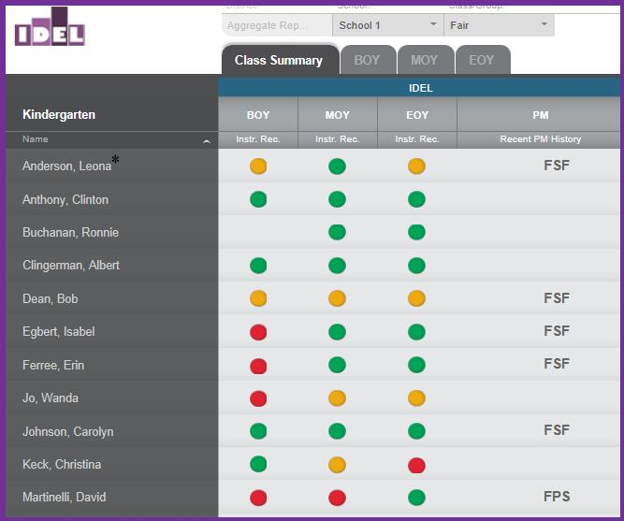
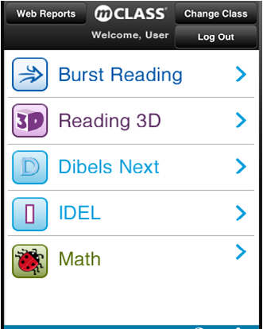
mCLASS®:IDEL® System
Mobile Device
https://mclass.amplify.com/assessment
Web Reports
https://mclass.amplify.com
Notes:
PARAPHRASE:
The mCLASS:IDEL system was created to be a practical tool for teachers, saving educators’ time and providing data to meet the needs of all students through instructional change.
The mCLASS solution consists of two components: the assessments on the device and the reports viewed on the Web.

Slide 10


Assessment Options
Benchmark
All students
Multiple measures
Three times a year
Identifies need for
Progress Monitoring
Progress Monitoring
Primarily high- and
some-risk students
Assessed every 1 to 4 weeks
Notes:
PARAPHRASE:
The mCLASS:IDEL System consists of the following:
Benchmark
All students in kindergarten through Grade 6 take the Benchmark assessment.
There are multiple measures administered three times a year.
Benchmark scores indicate students in need of Progress Monitoring.
Progress Monitoring
Primarily high- and some-risk students.
Students need Progress Monitoring frequently (every two weeks is recommended).

Slide 11
IDEL Check for Understanding
Phonemic Awareness
The ability to hear, identify, and manipulate
individual phonemes in spoken words
FNL (Fluidez en el Nombramiento
de las Letras)*
Alphabetic Principle
The systemic and predictable relationship
between written letters and spoken sounds
FUP (Fluidez en el Uso de las
Palabras)
FPS (Fluidez en las Palabras
Sin Sentido)
Accuracy and Fluency
The ability to read a text accurately and quickly
FSF (Fluidez en la Segmentación
de Fonemas)
Comprehension
The process of discerning meaning from spoken
language and/or print
FLO (Fluidez en la Lectura Oral)
FRO (Fluidez en el Recuento Oral)
+ FLO
Vocabulary
Understanding the words we must know to
communicate effectively
Notes:
DIRECTIONS:
This activity gives participants a chance to test their understanding of the IDEL vocabulary.
Allow participants five minutes to individually connect an IDEL measure to a (BELS) Basic Early Literacy Skill.
Facilitate discussion and re-emphasize initials and definitions when reviewing the answers.
Note: FLO is simply a measure of fluency and accuracy. Only in combination with FRO does it serve as part of the comprehension indicator.
There will be five lines that can be drawn between definitions and measures.
Answers:
FNL → Does not connect to a BELS
FUP → Vocabulary
FPS → Alphabetic Principle
FSF → Phonemic Awareness
FLO → Accuracy and Fluency
FRO + FLO → Comprehension

Slide 12
IDEL Check for Understanding
Phonemic Awareness
The ability to hear, identify, and manipulate
individual phonemes in spoken words
FNL (Fluidez en el Nombramiento
de las Letras)*
Alphabetic Principle
The systemic and predictable relationship
between written letters and spoken sounds
FUP (Fluidez en el Uso de las
Palabras)
FPS (Fluidez en las Palabras
Sin Sentido)
Accuracy and Fluency
The ability to read a text accurately and quickly
FSF (Fluidez en la Segmentación
de Fonemas)
Comprehension
The process of discerning meaning from spoken
language and/or print
FLO (Fluidez en la Lectura Oral)
FRO (Fluidez en el Recuento Oral)
+ FLO
Vocabulary
Understanding the words we must know to
communicate effectively
Notes:
DIRECTIONS:
Facilitate discussion and re-emphasize initials and definitions when reviewing the answers.
Note: FLO is simply a measure of fluency and accuracy. Only in combination with FRO does it serve as part of the comprehension indicator.
There will be five lines that can be drawn between definitions and measures.
Remember, Fluidez en el Nombramiento de las Letras (FNL) is not connected to a Basic Early Literacy Skill in beginning reading, but is considered a reliable indicator of risk.
Answers:
FNL → Does not connect to a BELS
FUP → Vocabulary
FPS → Alphabetic Principle
FSF → Phonemic Awareness
FLO → Accuracy and Fluency
FRO + FLO → Comprehension

Slide 13
Assessment Calendar
 | IDEL MEASURES
GRADE | FNL | FSF | FPS | FLO | FRO | FUP
K (BOY)
K (MOY)
K (EOY)
1 (BOY)
1 (MOY)
1 (EOY)
2 (BOY)
2 (MOY)
2 (EOY)
3 (BOY)
3 (MOY)
3 (EOY)
Notes:
PARAPHRASE:
This chart shows when to assess measures based on grade level and time of year.
Facilitate discussion.
What skills are most important for kindergarten?
What skills are most important for Grade 1?
What skills are most important for Grade 2?
What skills are most important for Grade 3?
How might the skills and various times of year at which they are assessed affect instruction?

Slide 14
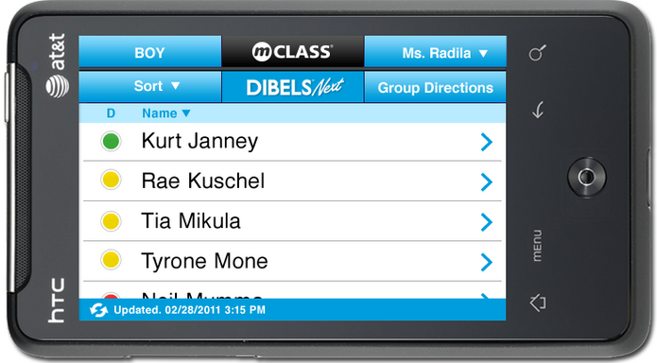
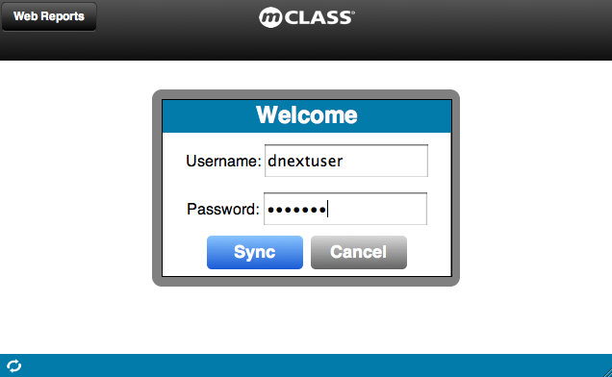
Sync A Mobile Device
Enter Username and Password.
Tap Sync.
If already
logged in, tap the sync icon.
Notes:
PARAPHRASE:
Users of the OWA on a netbook or tablet computer access IDEL using the Google Chrome browser.
Users of the OWA on an iOS device (iPod Touch, iPhone, iPad) use the Safari browser.
Every time a user logs out, the device will also sync.
It is best practice to sync manually.
If it’s been longer than 20 minutes since a password was entered, the user will be prompted to enter the password in order to sync or log out.

Slide 15
Agenda
1 | Introduction
2 | mCLASS®:IDEL® Basics
3 | Fluidez en la Segmentación de Fonemas (FSF)
4 | Fluidez en el Nombramiento de las Letras (FNL)
5 | Fluidez en las Palabras sin Sentido (FPS)
6 | Fluidez en la Lectura Oral (FLO)
7 | Fluidez en el Recuerdo Oral (FRO)
8 | Fluidez en el Uso de las Palabras (FUP)
9 | mCLASS®:IDEL® Progress Monitoring
10 | Web Reports
11 | Wrap-Up and Support
Notes:
DIRECTIONS:
Review agenda with participants.

Slide 16
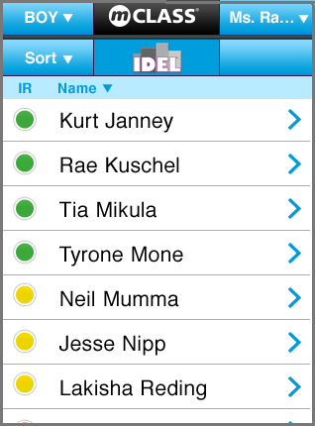
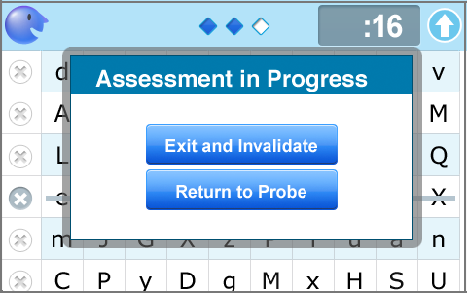
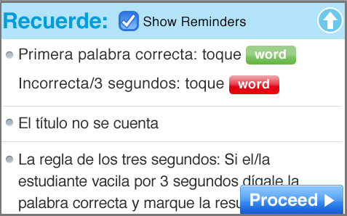
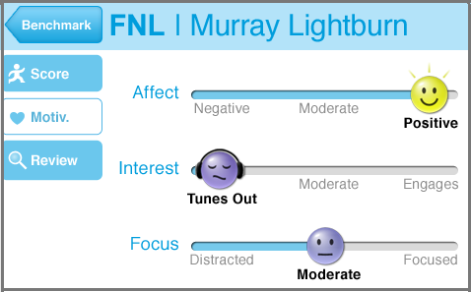
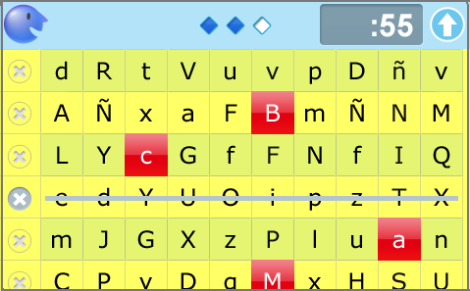
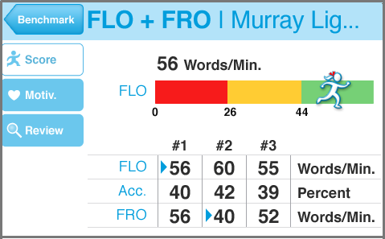
mCLASS®:IDEL® Basics
Basics
Notes:
PARAPHRASE:
This section reviews the basics of IDEL on the Device.
These are the common features of the mCLASS:IDEL assessment:
The Class List
Measure Instructions
Timing Features
The Results Screen
The Motivation Tab
The Invalidation Screen

Slide 17
Application Selection Screen
Go to mCLASS:Home
Select Demo
Class
Select
Application
Notes:
PARAPHRASE:
These options are available on the home screen of the OWA platform
Select Web Reports to go directly to the mCLASS login page. This is where you will go to access your web reports
Select Change Class to access your Demo Class. The Demo class is used to practice. Please note:
Practice data is not stored.
Practice can be easily reset.
Select the IDEL Application to launch IDEL.

Slide 18
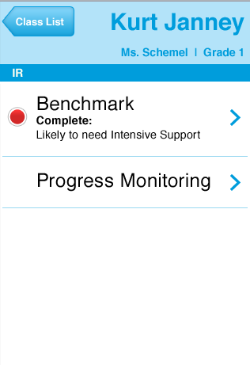
Application Selection Screen
Benchmark
Progress Monitoring
Notes:
PARAPHRASE:
Select the IDEL Application to access the application.
Use IDEL for Benchmark Assessment and Progress Monitoring. Please note: PM is used between benchmark windows
During this demonstration, we use the Benchmark button to demonstrate all features.

Slide 19
Class List
Assessment
period
Class List
Sort students by
Instructional
Recommendation
or First Name.
Notes:
PARAPHRASE:
Assessment Period: Select specific assessment window(s) (BOY, MOY, or EOY).
Class List: Select specific class(es) or your Demo Class.
Student List: Students here are listed by Instructional Recommendation. You can also sort by First Name.

Slide 20
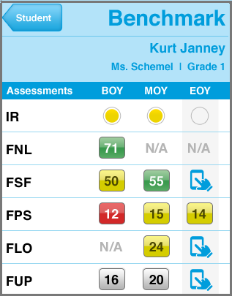
Measure Status Indicators
Instructional Recommendation
Measure results and IR Color
Assess Icon - Hand Touch
Measure yet to be administered.
Tap to begin assessment.
Notes:
PARAPHRASE:
You can review the Measure Status Indicators on the Student’s Benchmark screen.
Using the Instructional Recommendations, a color is assigned (red/yellow/green) to a student based on the assessment measures. The colors symbolize:
Green: At or Above Benchmark
Yellow: Below Benchmark
Red: Well Below Benchmark
FUP results are grey because FUP does not have benchmark goals.
N/A is displayed if an assessment is not part of the Benchmark administration.
The IR Color Dot at the top of each column is the IDEL Instructional Recommendation.
The IR a combination of multiple IDEL scores and provides the best overall estimate of the student’s early literacy skills and/or reading proficiency.
mCLASS:IDEL calculates the IDEL Instructional Recommendation for you.
The Assess icon (Hand Touch) appears in the row of every available Benchmark assessment. Tap Assess (Hand Touch) to begin the measure.

Slide 21
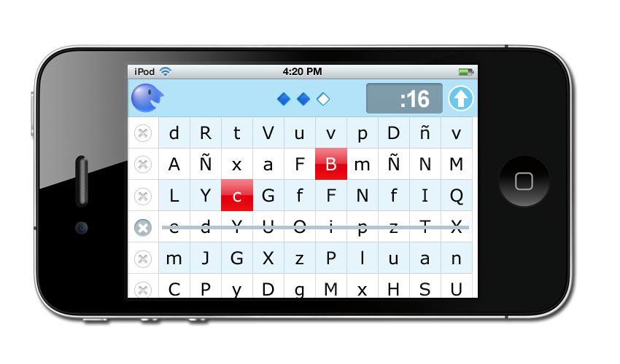
Mr. Say and Timers
Response
Timer
Digital
Timer
Mr. Say
Yellow Warning Screen
Notes:
PARAPHRASE:
Follow Mr. Say’s script to administer assessments.
The assessment has three timing features:
Digital timer: Located in the upper left and counts up from zero
Response timer: Designated by diamonds in the center of the header; monitor hesitations by watching the response timer’s diamonds light up at one-second intervals
Warning screen: At 55 seconds, the screen flashes yellow. The screen changes back to white and the digital timer flashes “done” when time is up.
When you tap Done, the student’s Results screen opens.

Slide 22

Fluency
IDEL measures are fluency based.
Score is the number of items answered correctly per minute.
Timing is essential to determine fluency.
Fluency is an indicator of reading success!
Notes:
PARAPHRASE:
Each IDEL measure has a fluency component and student scores are reported as the number of items correct per minute.
Accurate timing in IDEL is essential and easy due to the timer function in mCLASS:IDEL.
There is no need for a stopwatch as the Device does the timing and calculating.
Current educational research states that fluency plays a major role in and is a strong indicator of a child’s reading success.

Slide 23
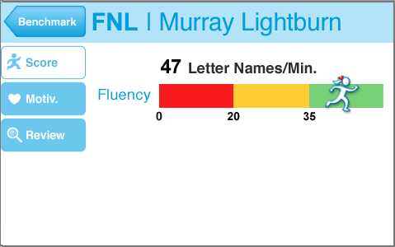
Results Screen Features: Score
Score
Risk Level
Notes:
PARAPHRASE:
After completing an assessment, the Results screen appears on the Device.
The Results screen summarizes the student’s performance on an individual measure.
The score is displayed above the fluency bar as letters or sounds per minute.
The running girl icon will be a physical representation of the numerical score as she jogs along the Risk Level bar.
Cut points, indicating number of items dividing Risk Levels, are labeled below the bar.
On the FSF Results screen, you can:
• Tap Motiv. to indicate the student's level of involvement during measure administration.
• Tap Review to review the student's responses and, if necessary, invalidate the measure.
• Tap Note to make a handwritten note pertaining to the student's performance on this measure. (Release scheduled for 2013-2014.)
• Tap Benchmark to return to the student's results.

Slide 24
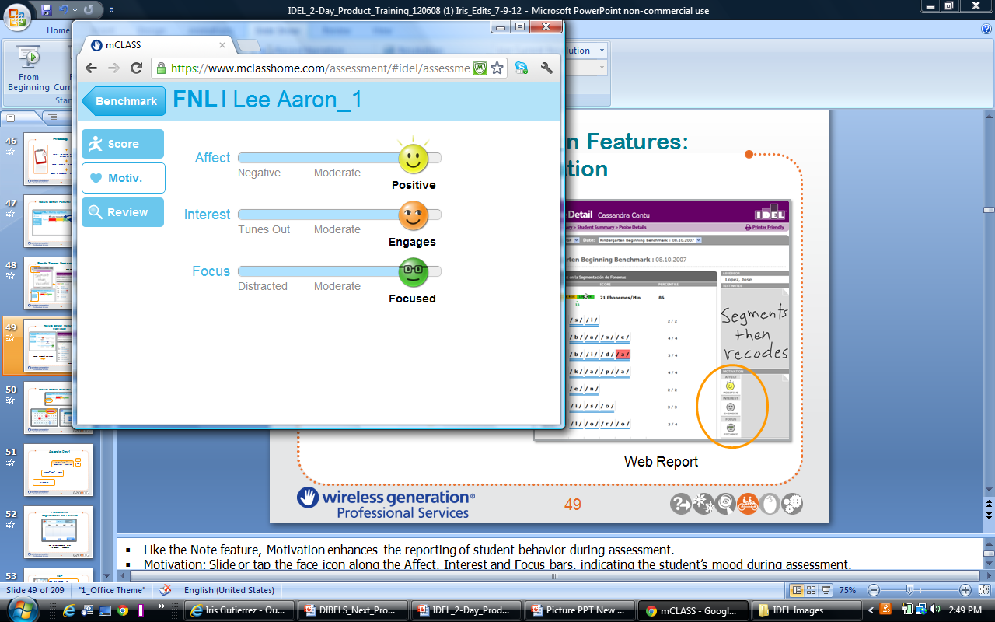
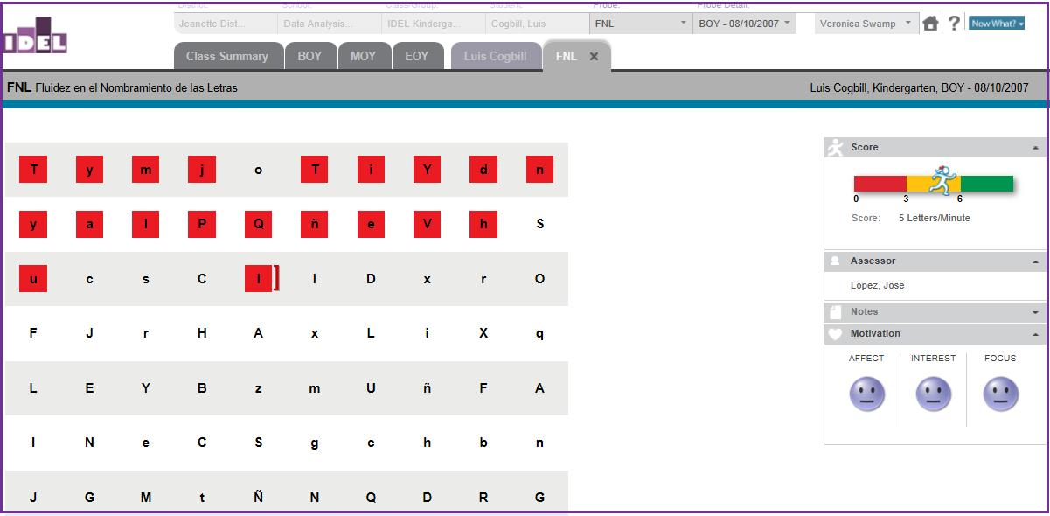
Results Screen Features: Motivation
Mobile Device
Web Report
Notes:
PARAPHRASE:
Motivation enhances the reporting of student behavior during assessment.
Motivation: Slide or tap the face icon along the Affect, Interest, and Focus bars, indicating the student’s mood during assessment.
For example, a Grade 1 student is assessed at BOY. During the assessment he had a negative attitude, was moderately interested, and seemed distracted. This would be documented by moving the face icon along the slider until the most fitting description appears.
Web report: Affect, Interest, and Focus are also displayed on the student’s Probe Details in the lower right-hand side.

Slide 25
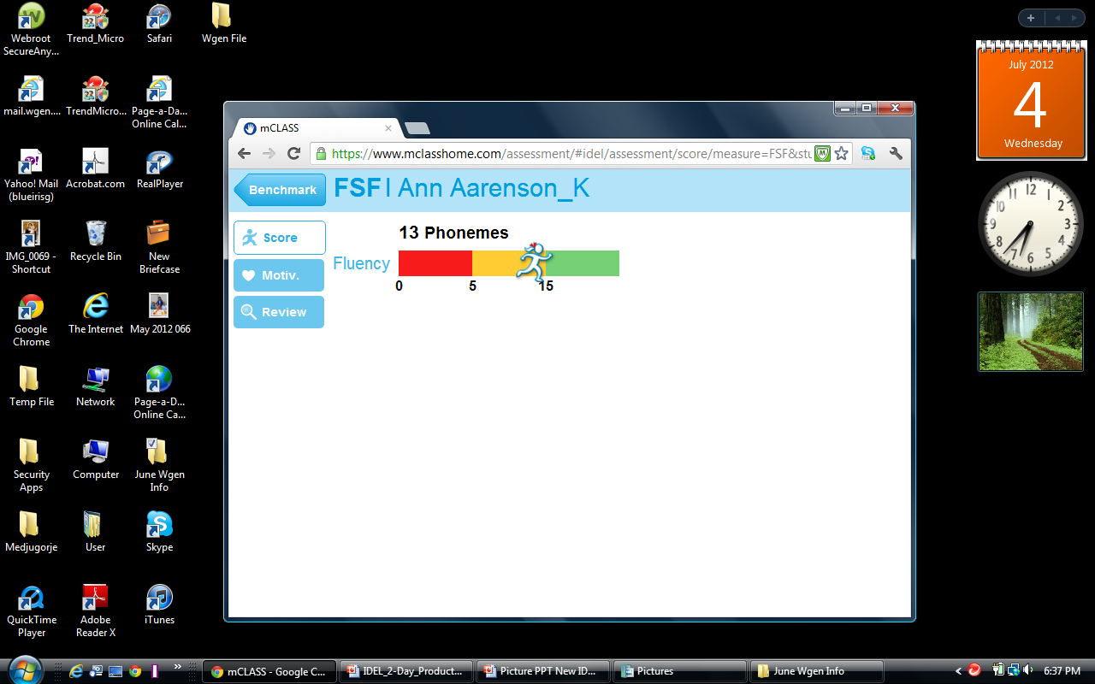
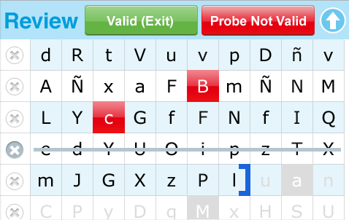
Results Screen Features: Review
After Assessment
During Assessment
Notes:
PARAPHRASE:
Tap these buttons to view and/or delete the probe after administration.
The Review Button provides a visual record of the student’s individual responses during assessment.
For example, you might review a student’s responses and decide that the probe is not reliable. You would then tap Probe Not Valid.
Reasons to invalidate a student’s probe would be due to intercom announcements, fire drills, or scoring errors that cannot be easily corrected.
If it is necessary to invalidate during a probe, tap the Arrow button on the upper right-hand corner and follow the invalidation procedure.
When the pop-up appears, tap Exit and Invalidate to delete that probe. The students’ benchmark screen opens and the invalidation is recorded so that this particular probe form is not administered again to that same student.

Slide 26
Agenda
1 | Introduction
2 | mCLASS®:IDEL® Basics
3 | Fluidez en la Segmentación de Fonemas (FSF)
4 | Fluidez en el Nombramiento de las Letras (FNL)
5 | Fluidez en las Palabras sin Sentido (FPS)
6 | Fluidez en la Lectura Oral (FLO)
7 | Fluidez en el Recuerdo Oral (FRO)
8 | Fluidez en el Uso de las Palabras (FUP)
9 | mCLASS®:IDEL® Progress Monitoring
10 | Web Reports
11 | Wrap-Up and Support
Notes:
DIRECTIONS:
Review agenda with participants.

Slide 27
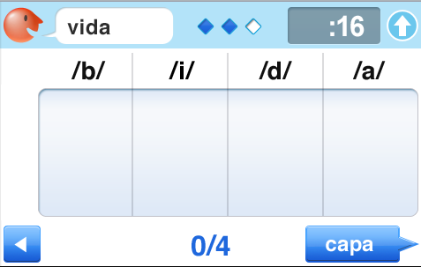
Fluidez en la
Segmentación de Fonemas
The ability to segment two- to five- phoneme words into individual phonemes
Notes:
PARAPHRASE:
This measure is Fluidez en la Segmentación de Fonemas (FSF), a measure of phonemic awareness.

Slide 28

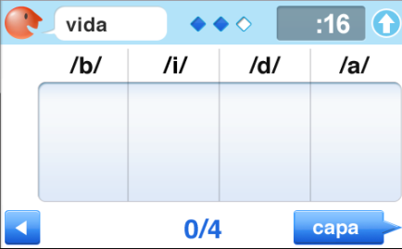
FSF
Basic Early Reading Skill:
Phonemic Awareness
Administered: BOY kindergarten
through EOY Grade 1
Goal: 50 phonemes per minute
by EOY kindergarten
Materials: Device
(auditory task)
Notes:
PARAPHRASE:
FSF is a student’s ability to segment two- to five-phoneme words into individual phonemes. It assesses the Basic Early Literacy Skill of Phonemic Awareness.
A phoneme is the smallest part of spoken language that makes a difference in the meaning of words (e.g., the word “if” has two phonemes, /i/ /f/).
Administered BOY kindergarten through EOY Grade 1.
Goals
15 phonemes/minute at BOY kindergarten
30 phonemes/minute at MOY kindergarten
50 phonemes/minute at EOY kindergarten
Dr. Roland Good’s quote for this EOY K goal is called the Rule of Chocolate: Research shows that 50 spm is enough for mastery and it is now time to blend and move on. In all other IDEL measures, though, you want to reach for above benchmark goals.
No student materials are needed for this measure.

Slide 29
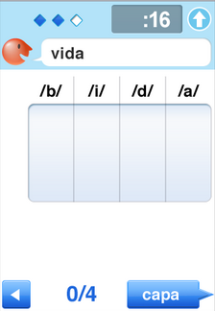
FSF Features
Timing Features:
  Starting timer
  Response timer
  Warning screen
Marking:
  Marking boxes
  Correct
  Incorrect
  Blended letter sounds
Observe:
  Location of score
  Location of next word
Notes:
DIRECTIONS:
Use a simulator or project your mobile device to demonstrate the measure.
Choose a demo student.
Demonstrate the items listed on the slide.
Participants score along with the trainer if they choose.
Pause/put down simulator or projected device while reviewing the next scoring slides.
NOTE:
“Removing markings” refers to tapping on the "x" on the left side of the screen to remove the respective row's marking.
The user can navigate back and forth between stated words to complete any markings.
After 60 seconds, Mr. Say wakes up, says “Stop,” and the Done button appears.
Once you tap Done, the result is captured and the device moves to the Results screen. No further edits are possible.
If the student is in the middle of a response at the end of one minute, you may allow the student to finish his/her response.
Stop marking where the minute ended and do not count any sound segments after the end of the minute.

Slide 30






FSF Common Scoring Rules
Self-Correction
Additions
Hesitation Rule
Discontinue
Rule
Schwa Sounds, Articulation, or Dialect Issues
Sound Elongation
Tap the segment that was marked incorrect
Make no mark.
After three seconds, score that word as incorrect and provide the next word.
The Device prompts you if there are no correct phonemes within the first five words.
Mark as correct.
Notes:
PARAPHRASE:
Self-Correction: Credit responses when students self-correct.
Additions: Do not penalize for additions. Do nothing to mark additions.
Hesitation: Give students as many opportunities as possible to demonstrate their skill. If a student hesitates on a sound or word for three seconds, score the word as incorrect and provide the next word.
Discontinue: Use when students have reached their frustration level. If the student doesn’t say any sound segments correctly in the first five words and the discontinue prompt appears, choose to continue or discontinue the assessment.
Schwa Sounds/Articulation/Dialect and Sound Elongation: Students are not penalized for attempting to isolate phonemes.
Although students are not penalized for any of the above, fluency is affected, making overall score lower.

Slide 31
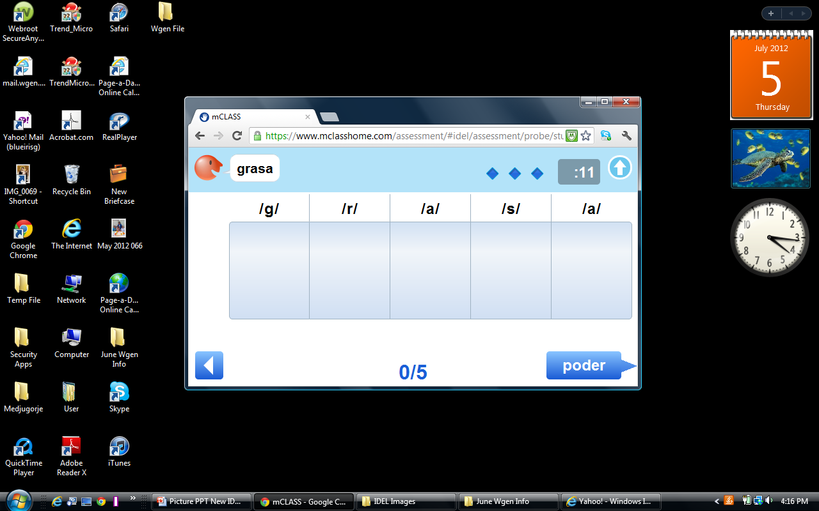
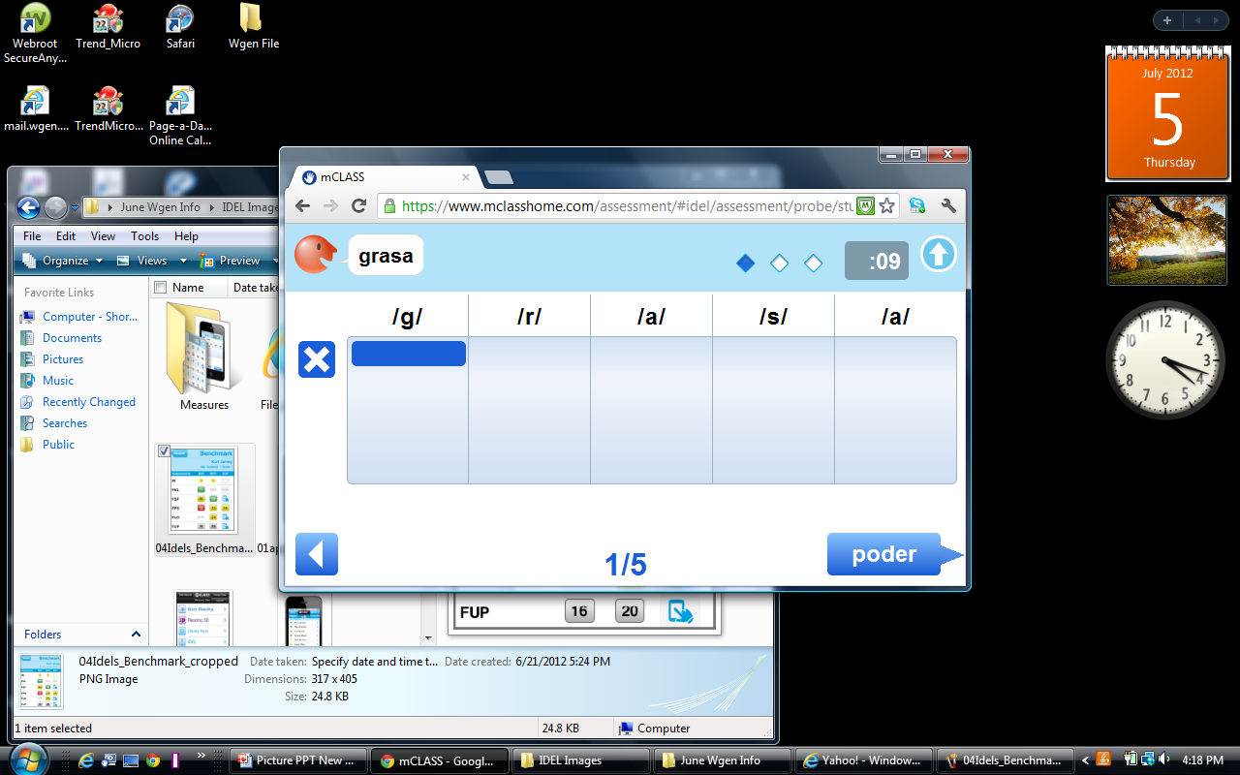
FSF Scoring Rules
Correct Individual Sound Segment
Tap to delete marking
Notes:
PARAPHRASE:
In this example, the word is “grasa.”
If the student were to say /g/, that would be a correct sound segment, or phoneme.
To mark a Correct Individual Sound Segment, or phoneme, tap or draw a line through the phoneme-marking box.
As you are scoring, note that the student response record appears to the left of the phoneme-marking box while a line appears within the marking box to illustrate exactly what the student said.
Tap on the X to delete markings if the student self corrects or the teacher makes a mistake in scoring.

Slide 32
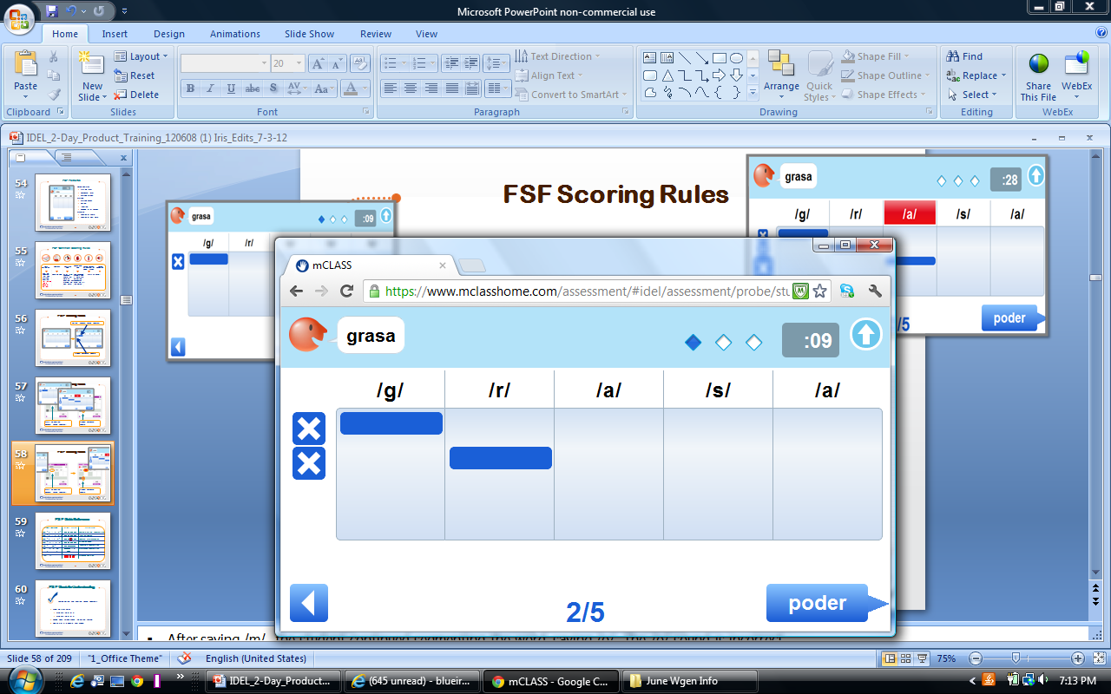
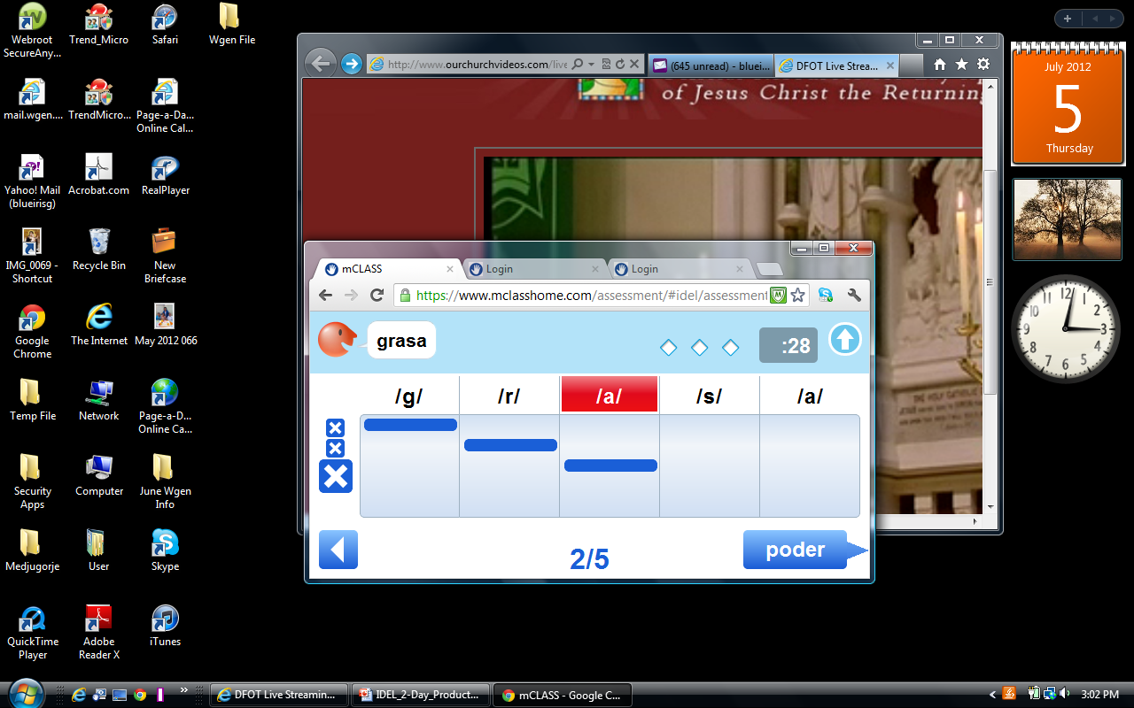
FSF Scoring Rules
Student response record of error
Mark incorrect individual sound segment
Notes:
PARAPHRASE:
After saying /g/ /r/, the student continued segmenting the word, saying /o/. The /o/ sound is incorrect.
To mark an incorrect individual sound segment, tap or underline the phoneme in the marking box.
Then, tap the sound segment located above the marking box to highlight it in red.
The student incorrect response record appears as red in the sound segment above the phoneme-marking box.
The student response is only marked with an X not differentiating whether the response was correct or incorrect.
Therefore, it is most important to tap the sound segments that are incorrect.

Slide 33
FSF Quick Reference
Student Response | Correct Scoring | Scoring Rule
(pino) “/p/ /i/ /n/ /o/” | /p/ /i/ /n/ /o/ | Complete,correct segmentation
(pino) “/p/ /i/ /n/ /o/ /s/” | /p/ /i/ /n/ /o/ | Insertion/addition
(pino) “/p/ /i/ ñ/ /o/” | /p/ /i/ /n/ /o/ | Segment mispronunciation
(cine) “/th/ /i/ /n/ /e/” | /c/ /i/ /n/ /e/ | Articulation/dialect
(tela) “/t/ /ela/” | /t/ /e/ /l/ /a/ | Incomplete segmentation
(tela) “/te/ /e/ /ela/” | /t/ /e/ /l/ /a/ | Overlapping segmentation
(tela) “/t/ /l/ /a/” | /t/ /e/ /l/ /a/ | Omission
(tres) “…” | /t/ /r/ /e/ /s/ | 3-second hesitation
Notes:
PARAPHRASE:
Omissions might indicate that the student is not stopping to think (e.g., if the word is “tela” and the student automatically replies “/t/ /l/ /a/,” this is an omission. There was no hesitation, the student simply left out a phoneme).
Three-second hesitations show that the student is thinking. These are marked as incorrect.
The difference in scoring will help identify the student’s response pattern.

Slide 34

FSF Check for Understanding
Scoring Correct and Incorrect Sound Segments
Listen to how the student segments each word.
Decide which screen shows the correct scoring.
Select Screen A or Screen B.
Discuss why.
Notes:
DIRECTIONS:
Have participants discuss by table, pairs, or alone.
Sound out how the student segments each word and have the participants do the following :
Listen to how the student segments the word.
Decide which screen shows the correct scoring.
Screen A or Screen B.
Discuss why.

Slide 35
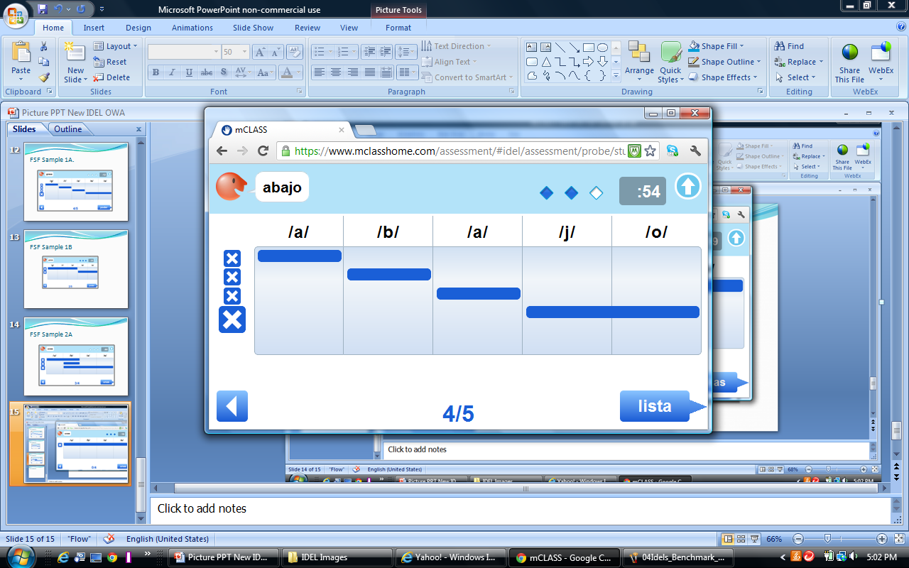
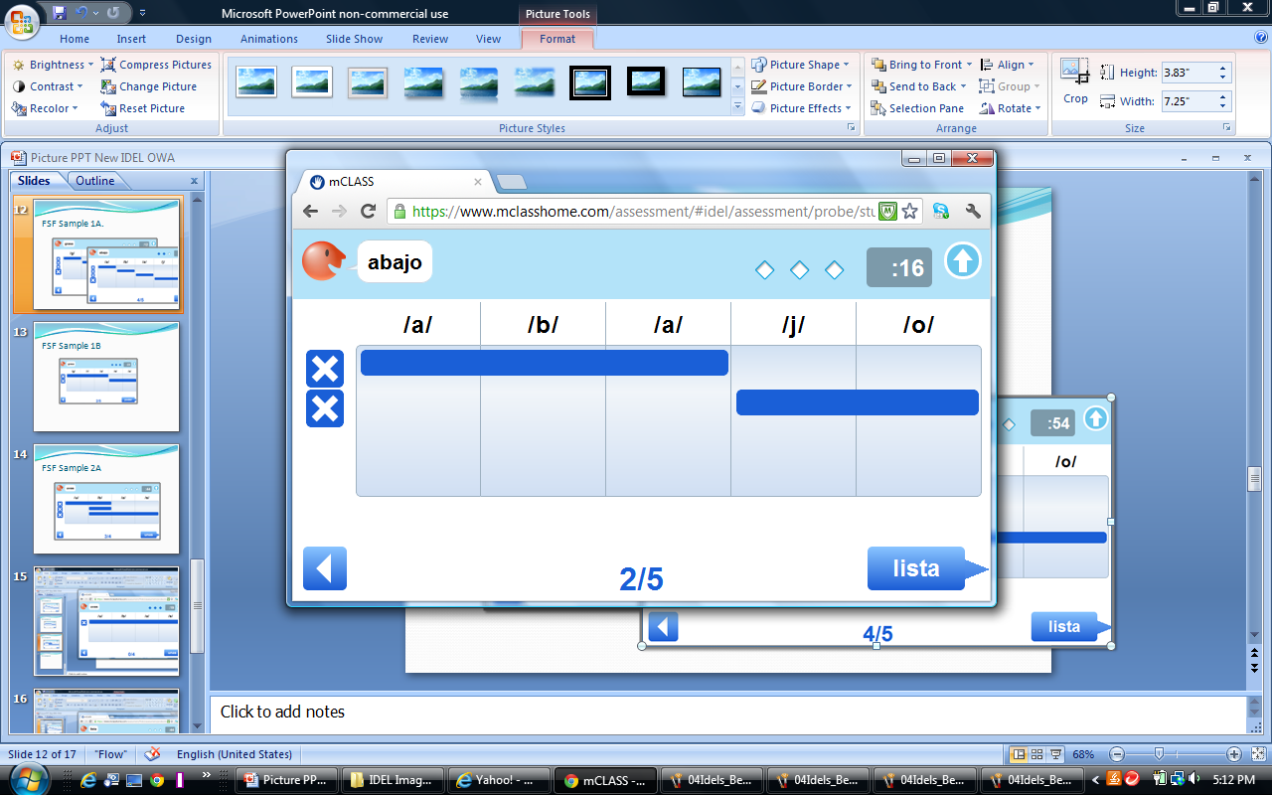
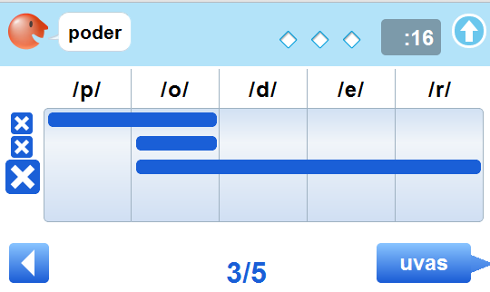
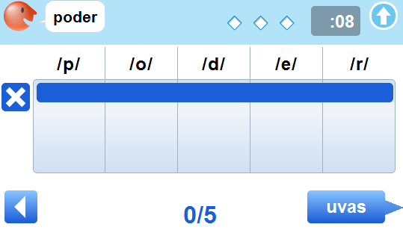
FSF Check for Understanding
/aba/ /jo/
A.
B.
/po//o//oder/
A.
B.
Notes:
PARAPHRASE:
If a student says “/aba//jo/,” blending sound segments together, which screen shows how to mark this answer? (Pause)
The correct answer is B.
To mark a Blended Sound Segment, draw a line from left to right through the boxes of any correctly blended sound segments. See Screen B for an example.
What if the word is “poder” and the student responds by overlapping some sound segments, as in /po//o//oder/? (Pause)
The correct answer is A.
The student overlapped the /o/ sound three times, so we put three lines beneath that sound segment.
In this example, there are four possible sound segments. The student received credit for the three sound segments produced.

Slide 36
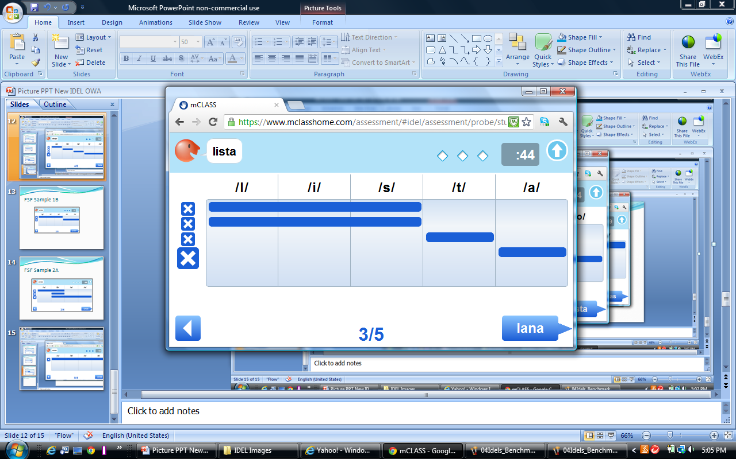
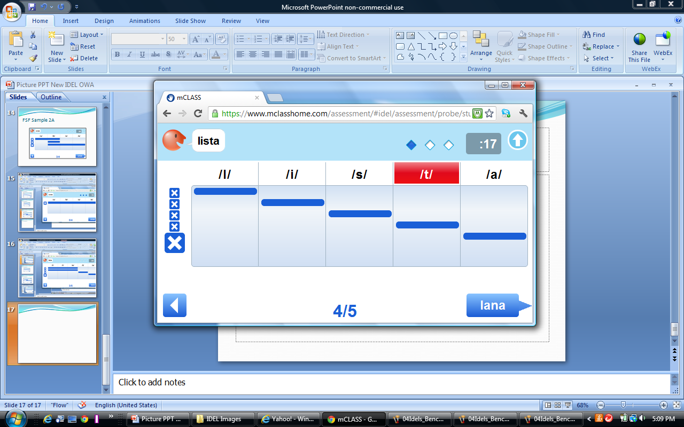
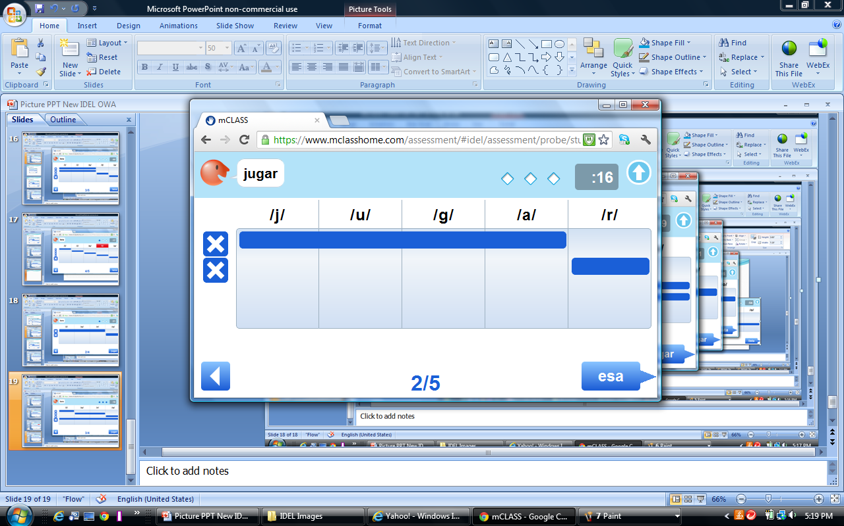
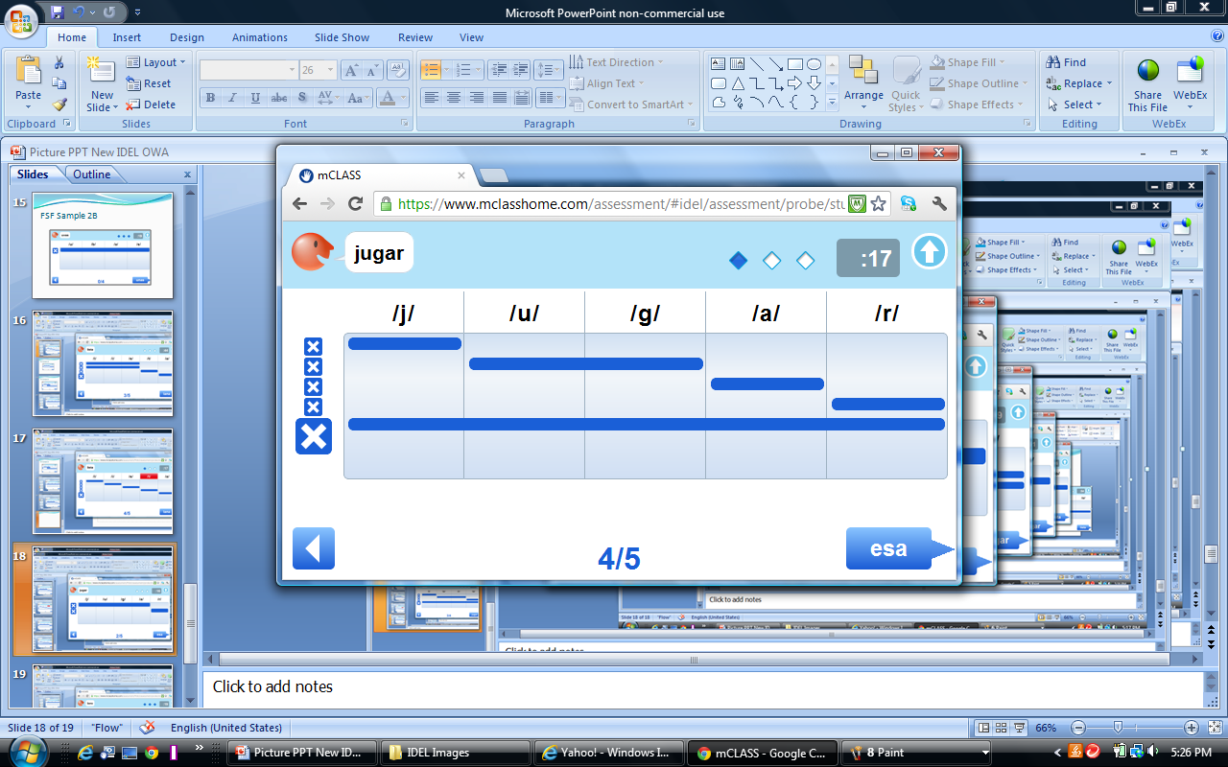
FSF Check for Understanding
/l/ /i/ /s/ /p/ /a/
A.
B.
/juga/ /r/
A.
B.
Notes:
PARAPHRASE:
If a child incorrectly pronounces a sound as they are segmenting a word, for instance, saying /l/ /i/ /s/ /p/ /a/ for “lista,” which of these screens would show how to score this?
The correct answer is B.
If the student mispronounces a sound, tap the sound segment.
The student said /p/ instead of /t/, so you tap /t/, indicating it as pronounced incorrectly.
What would the scoring look like if the student did not completely segment the word, saying /juga/ /r/ for “jugar”?
The correct answer is A.
When a child only partially segments each sound in a word, record each correct sound segment exactly as the student says it.

Slide 37
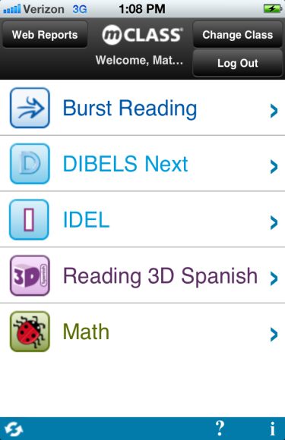
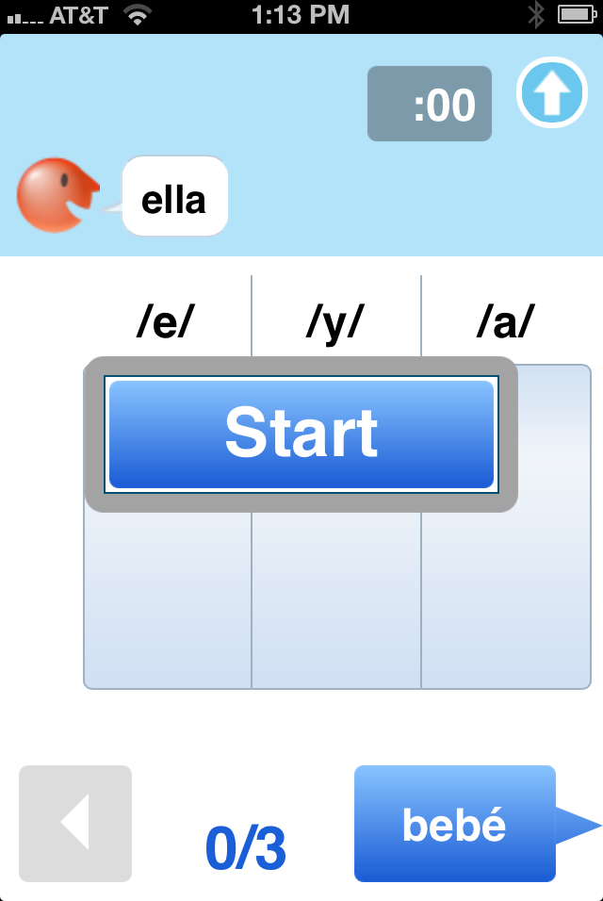

FSF Partner Practice #1
Partner A - Assessor
  Select Aaron_1, Lee.
  Select Benchmark.
  Under BOY, tap FSF.
  Read instructions on device.
  Score student responses.
  Record notes and motivational patterns.
Partner B - Student
  Read the script aloud.
  An ellipsis (…) = a 3-second hesitation.
Notes:
PARAPHRASE: Choose between Partner practice or doing the partner practice as TRAINER LED- in which case you would need to use the partner script from PAG. Audio practice is in deck in case there is time at the end of the session for further practice.
Explain to participants that here they will have an opportunity to practice.
They will work with a partner and take turns being the assessor and the student.
Review directions on the slide.
Explain that if they followed along on their Device during the previous demonstration, they will have to delete the probe in order to re-use the BOY benchmark form again. Follow directions on next slide if necessary.

Slide 38
FSF Practice #1
Assessor | Student | Scoring | Score | Rule
Practice questions | Answer the practice questions correctly
ella | /e/ /y/ /a/ | /e/ /y/ /a/ | 3/3 | Correct segmentation
bebé | /d/ /e/ /d/ /e/ | /b/ /e/ /b/ /e/ | 2/4 | Segment mispronunciation
grasa | /grasa/ | /g/ /r/ /a/ /s/ /a/ | 0/5 | Repeats word
poder | /po/ /d/ /der/ | /p/ /o/ /d/ /e/ /r/ | 3/5 | Overlapping segmentation
uvas | … | /u/ /b/ /a/ /s/ | 0/4 | 3-second hesitation
unas | /u/ /ña/ /s/ | /u/ /n/ /a/ /s/ | 2/4 | Segment mispronunciation, blend
Abajo | /a/ /b/ /a/ /jo/ | /a/ /b/ /a/ /j/ /o/ | 4/5 | Blend
lista | /l/ /i/ /sta/ /s/ | /l/ /i/ /s/ /t/ /a/ | 3/5 | Blend, insertion
lana | /l/ /an/ /na/ | /l/ /a/ /n/ /a/ | 3/4 | Overlapping segmentation
Notes:
DIRECTIONS:
Work in teams with Partner B acting as the student and Partner A as the assessor.
Review the directions for the practice activity (in the top quadrant of the grid).
Remind participants that they may use the Review, Motivation on each practice.
The student responses contain errors. The participant acting as the student should read the scripts as written.
The student response pattern should not be seen by the assessor.
Participants use the hard copy script in the training materials provided, but keep this slide visible during practice.
Using FSF Practice #1, pair up and complete.
When comparing practice scores, discuss the importance of inter-rater reliability.
Have participants compare Results screens for reliable scoring.
Circle the room and assist participants during activity.

Slide 39
FSF Practice #1
Assessor | Student | Scoring | Score | Rule
sala | /s/ /a/ | /s/ /a/ /l/ /a/ | 2/4 | Incomplete segmentation
avión | … | /a/ /b/ /i/ /ó/ /n/ | 0/5 | 3-second hesitation
gato | … | /g/ /a/ /t/ /o/ | 0/4 | 3-second hesitation
visa | /v/ /i/ /sa/ | /b/ /i/ /s/ /a/ | 3/4 | Blend
saca | /s/ /ac/ /ca/ | /s/ /a/ /k/ /a/ | 3/4 | Overlapping segmentation
pista | /b/ /p/ /is/ /ta/ | /p/ /i/ /s/ /t/ /a/ | 3/5 | Self-correction, overlapping segmentation
país | /p/ /a/ /ais/ | /p/ /a/ /i/ /s/ | 3/4 | Overlapping segmentation
plato | /pl/ /ae/ /to/ | /p/ /l/ /a/ /t/ /o/ | 2/5 | Blends, segment mispronunciation
desde | /de/ /de/ | /d/ /e/ /s/ /d/ /e/ | 2/5 | Omission, blends
doble | /do/ /ble/ | /d/ /o/ /b/ /l/ /e/ | 2/5 | Incomplete segmentation
Notes:
DIRECTIONS:
Facilitate discussion and answers questions upon completion.
If time allows, go through the pair practice more than once.

Slide 40
FSF Practice #2
Assessor | Student | Scoring | Score | Rule
Practice questions | Answer as incorrect
ella | /a/ /y/ /a/ | /e/ /y/ /a/ | 2/3 | Segment mispronunciation
bebé | /be/ /be/ | /b/ /e/ /b/ /e/ | 2/4 | Incomplete segmentation
grasa | /g/ /ra/ /asa/ | /g/ /r/ /a/ /s/ /a/ | 3/5 | Repeats segment
poder | /poder/ | /p/ /o/ /d/ /e/ /r/ | 0/5 | Repeats word
uvas | /u/ /ub/ /bas/ | /u/ /b/ /a/ /s/ | 3/4 | Overlapping segmentation
unas | /u/ /n/ /o/ /s/ | /u/ /n/ /a/ /s/ | 3/4 | Segment mispronunciation
abajo | /a/ … | /a/ /b/ /a/ /j/ /o/ | 1/5 | 3-second hesitation
lista | /lista/ | /l/ /i/ /s/ /t/ /a/ | 0/5 | No segmentation
lana | /lə/ /a/ /n/ /a/ | /l/ /a/ /n/ /a/ | 4/4 | Schwa sound
Notes:
DIRECTIONS:
If time allows continue with practice #2.
Have participants invalidate the measure and choose Reuse the Benchmark form to practice with the correct form.

Slide 41
FSF Practice #2
Assessor | Student | Scoring | Score | Rule
sala | /sa/ /la/ /s/ | /s/ /a/ /l/ /a/ | 2/4 | Blend, insertion
avión | /a/ /ks/ /i/ /o/ /n/ | /a/ /b/ /i/ /o/ /n/ | 4/5 | Segment mispronunciation
gato | /gato/ | /g/ /a/ /t/ /o/ | 0/4 | No segmentation
visa | /b/ /iiiissssaaa/ | /b/ /i/ /s/ /a/ | 4/4 | Sound elongation
saca | /sa/ /a/ /ca/ | /s/ /a/ /c/ /a/ | 3/4 | Overlapping segmentation
pista | /p/ /ista/ | /p/ /i /s/ /t/ /a/ | 2/5 | Incomplete segmentation
país | /pə/ /a/ /is/ | /p/ /a/ /i/ /s/ | 3/4 | Schwa sound, blend
plato | /p/ /lato/ | /p/ /l/ /a/ /t/ /o/ | 2/5 | Incomplete segmentation
desde | /des/ /de/ /de/ | /d/ /e/ /s/ /d/ /e/ | 2/5 | Repeated segment
doble | /d/ /o/ /d/ /l/ /e/ | /d/ /o/ /b/ /l/ /e/ | 4/5 | Segment mispronunciation
Notes:
DIRECTIONS:
Facilitate discussion and answers questions upon completion.

Slide 42

FSF Audio Practice (BOY)
Select Aashdown_1, Karen.
Choose Benchmark.
BOY Column.
Select FSF.
Proceed to start of measure.
Listen to audio recording.
Score student responses on device.
Record notes and student motivational patterns.
Notes:
DIRECTIONS:
Have participants score along with the audio clip.
Click to play the audio file - FSF Audio Practice mp3
Repeat if necessary for additional practice.

Slide 43
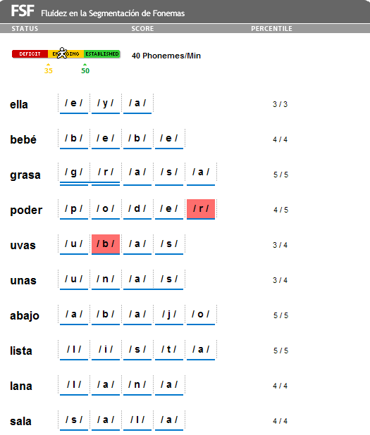
FSF Audio Practice Scoring
Notes:
PARAPHRASE:
This Web report is for BOY Grade 1.
Have participants discuss their scoring.
Repeat the audio file if necessary, to improve participants’ fluency in scoring.
The screen shot on this slide is from the mCLASS Home website. The format of the results on the Device looks different.
Open the Review Mode to view the Results screen.

Slide 44
FSF Check for Understanding
If a student self-corrects a phoneme, she does not receive credit unless the red phoneme box is tapped.
TRUE
Responses attributed to dialect are marked as incorrect.
FALSE
If a child does not respond correctly to any of the first five words, you are prompted to discontinue.
TRUE
Notes:
ACTIVITY: Thumbs Up, Thumbs Down
If a student self-corrects a phoneme, she does not receive credit unless the red marking box is deleted.
True.
Responses attributed to dialect are marked as incorrect.
False. Articulation and dialect issues are counted as correct if they are known and repeated often.
If a child does not respond correctly to any of the first five words, you are prompted to discontinue the assessment.
True.

Slide 45
Agenda
1 | Introduction
2 | mCLASS®:IDEL® Basics
3 | Fluidez en la Segmentación de Fonemas (FSF)
4 | Fluidez en el Nombramiento de las Letras (FNL)
5 | Fluidez en las Palabras sin Sentido (FPS)
6 | Fluidez en la Lectura Oral (FLO)
7 | Fluidez en el Recuerdo Oral (FRO)
8 | Fluidez en el Uso de las Palabras (FUP)
9 | mCLASS®:IDEL® Progress Monitoring
10 | Web Reports
11 | Wrap-Up and Support
Notes:
DIRECTIONS:
Review agenda with participants.

Slide 46
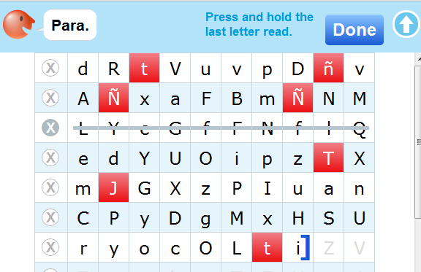
Fluidez en el Nombramiento de las Letras
The ability to recognize and name letters with fluency and automaticity
Notes:
PARAPHRASE:
This is the IDEL measure known as Fluidez en el nombramiento de las letras (FNL). It can also be called Fluidez en nombrar letras.

Slide 47
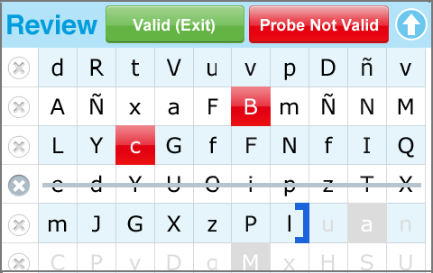

FNL
FNL does not connect to a Basic Early Reading Skill, but is a reliable indicator of risk.
Administered: BOY kindergarten through BOY Grade 1
Goal: 40 letters per minute by
EOY kindergarten
Materials: Device and
Student Materials booklet
Notes:
PARAPHRASE:
FNL does not connect to a BELS, but it is a reliable indicator of risk because it assesses a student’s ability to recognize and letter names of the alphabet fluently and with automaticity.
The ability to know the names of letters has been identified as a common skill readers possess.
FNL is administered BOY kindergarten through BOY Grade 1.
Goals
Goal = 6 letters/minute at BOY kindergarten.
Goal = 25 letters/minute at MOY kindergarten.
Goal = 40 letters/minute at EOY kindergarten.
Use the grade-level, color-coded booklets from the kit when administering this measure.

Slide 48
FNL Student Materials
Notes:
PARAPHRASE:
If participants have their kits, encourage them to look at the FNL forms for BOY, MOY, and EOY.
There are 10 letters in a row.
The font is Times New Roman, the most common form of print in literature.
There is no Progress Monitoring form for FNL. Unlike the other measures, the Benchmark form can be used repeatedly to assess the extent to which students are able to identify letters.

Slide 49
FNL Common Scoring Rules
Self-Correction
Hesitation Rule
Discontinue
Rule
Schwa Sounds, Articulation, or Dialect Issues
Tap the letter that was marked incorrect again.
After three seconds, provide correct letter, point to next letter and ask, “What letter?”
Device prompts you if student misses first ten letters.
Mark as correct.
Notes:
PARAPHRASE:
Self-Correction: Tap the letter that was marked incorrect again.
Hesitation Rule: After three seconds, provide correct letter, point to next letter and ask, “What letter?”
Discontinue Rule: Device prompts you if student misses first 10 letters.
Schwa Sounds, Articulation, Dialect Issues, and Elongation: Mark as correct.

Slide 50
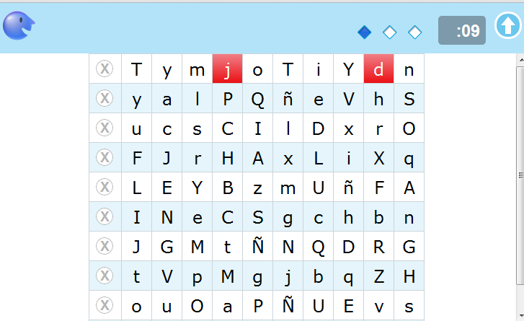
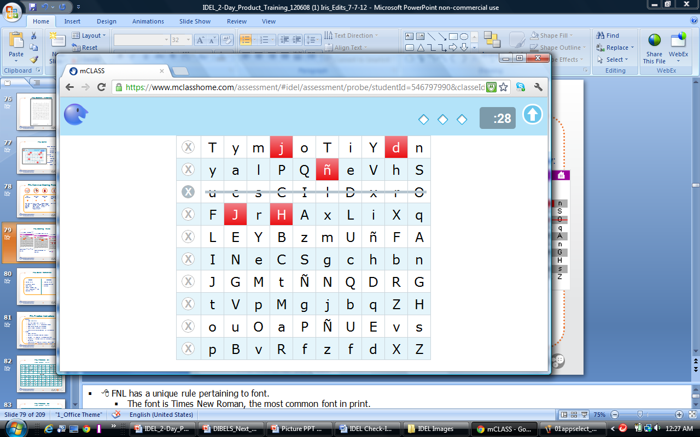
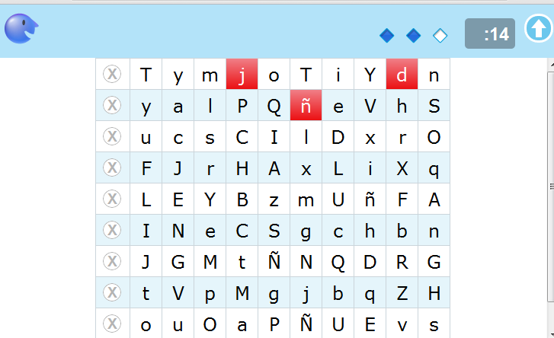
FNL Scoring Rules
If a student responds
“I”: Score either “I” or “l” as correct.
If a student skips a row:
Tap X.
If a student omits a letter: Score an omission as incorrect.
Notes:
PARAPHRASE:
FNL has a unique rule pertaining to font.
The font is Times New Roman, the most common font in print.
Some letters are similarly shaped and difficult to distinguish, such as the lowercase letter “l” and the uppercase letter “I.” Therefore a response of either letter is correct.
If a student omits a letter, it is scored as incorrect (e.g., the student says “y…a…l…P…Q…(pause)…e…V…h.” Tap the omitted ñ to score it as incorrect (it is then marked red).
If a student skips an entire row, tap the X at the beginning of the skipped row to draw a red line through that row.
This marking technique gives you very different information than if you had tapped on each letter, indicating that the student “missed” each letter.
Those 10 letters do not affect the student’s score because the final score is the number of letters correct in one minute.

Slide 51
FNL Quick Reference
Correct
Incorrect
Correct letter
Articulation and/or dialect issues
Similarly shaped font (e.g., uppercase “I” and lowercase “L”)
Incorrect letter
Three-second hesitation
Omission
Notes:
PARAPHRASE:
This slide shows the FNL scoring rules in chart form.

Slide 52
FNL Demo
Timing Features:
Starting timer
Response timer
Warning screen
Marking:
Correct
Incorrect
Skipped rows
Observe:
Placing bracket
Notes:
DIRECTIONS: Have participants follow along bc there is no practice.
Use your device to demonstrate the measure.
Demonstrate the items listed on the slide.
Participants may score along with the trainer if they choose.
Remind participants this is the Grade 1 BOY Benchmark form for FNL.
NOTE:
In the vertical position, some devices display one line of text in the student materials as two lines.
Remind participants that when administering IDEL® measures, teachers need a fully charged mobile device and student materials, when required.
Timing Features
Digital time: located in the upper-right corner and counts up from zero.
Response timer: Monitor hesitations by watching the response timer’s diamonds/circles light up at one-second intervals.
Warning screen: At 55 seconds, the screen flashes yellow. When time is up, the screen changes back to white and the digital timer flashes “done.”
Tap any letter the student identifies incorrectly or skips. The letter is scored as incorrect.
Draw line through any row the student skips by clicking or tapping on the "X". This row is not counted in the student’s score.
If a student self corrects, retap the letter to remove the red box. The letter is scored as correct.
To place the bracket, OWA users press and hold on the last letter read. The bracket can only be moved back but not forward by pressing and holding another letter.
No additional markings can be made once a bracket is placed.
Tap Done to move to the Results screen.

Slide 53

FNL Points to Remember
FNL is not one of The Basic Early Literacy Skills, but it is a reliable indicator of risk.
There are no Progress Monitoring forms for FNL.
The EOY Benchmark goal for kindergarten is 40 lpm.
Notes:
REVIEW:
NL assesses the students ability to name letters. It is not one of the Basic Early Literacy Skills but is a reliable indicator of risk.
There are no Progress Monitoring forms for FNL.
The EOY Benchmark goal for kindergarten is 40 lpm.
Encourage participants to record any additional notes of importance. Share, adhering to the no repeat rule.

Slide 54
Agenda
1 | Introduction
2 | mCLASS®:IDEL® Basics
3 | Fluidez en la Segmentación de Fonemas (FSF)
4 | Fluidez en el Nombramiento de las Letras (FNL)
5 | Fluidez en las Palabras sin Sentido (FPS)
6 | Fluidez en la Lectura Oral (FLO)
7 | Fluidez en el Recuerdo Oral (FRO)
8 | Fluidez en el Uso de las Palabras (FUP)
9 | mCLASS®:IDEL® Progress Monitoring
10 | Web Reports
11 | Wrap-Up and Support
Notes:
DIRECTIONS:
Review agenda with participants.

Slide 55
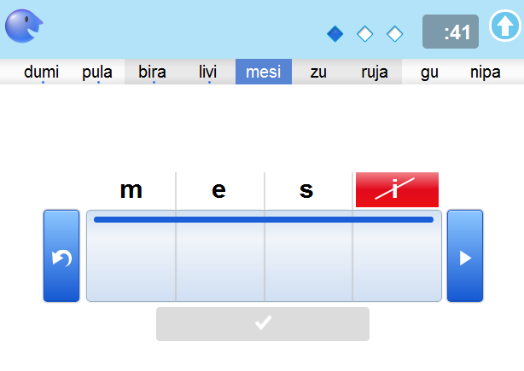
Fluidez en las
Palabras Sin Sentido
The ability to identify and blend letter sounds
Notes:
PARAPHRASE:
Fluidez en las palabras sin sentido assesses a student’s ability to identify and blend letter sounds. It uses make-believe words to determine if students understand the Alphabetic Principle.
The student is presented a sheet with randomly ordered Consonant/Vowel words with CV and CVCV patterned nonsense words and asked to produce verbally either the individual letter sound of each letter or read the whole nonsense word. Have the student sitting so that you can easily follow where the student is reading as you are scoring in case the student skips a row or losses his or her place.
For example, if the word is “bide” the student could say /b/ /i/ /d/ /e/ or say the word /bide/ to obtain a total of four letter-sounds correct. The student is allowed one minute to produce as many letter-sounds a he/she can and the final score is the number of letter-sounds produced correctly in one minute. Because the measure is fluency-based, students receive a higher score if they are recoding the words and a lower score if they are providing letter sounds in isolation.
The ultimate goal is for students to read nonsense words as whole words. And the reason for the nonsense words is that students are unable to use context to figure out the words. This is going to give you a true evaluation of a student’s ability to decode.

Slide 56

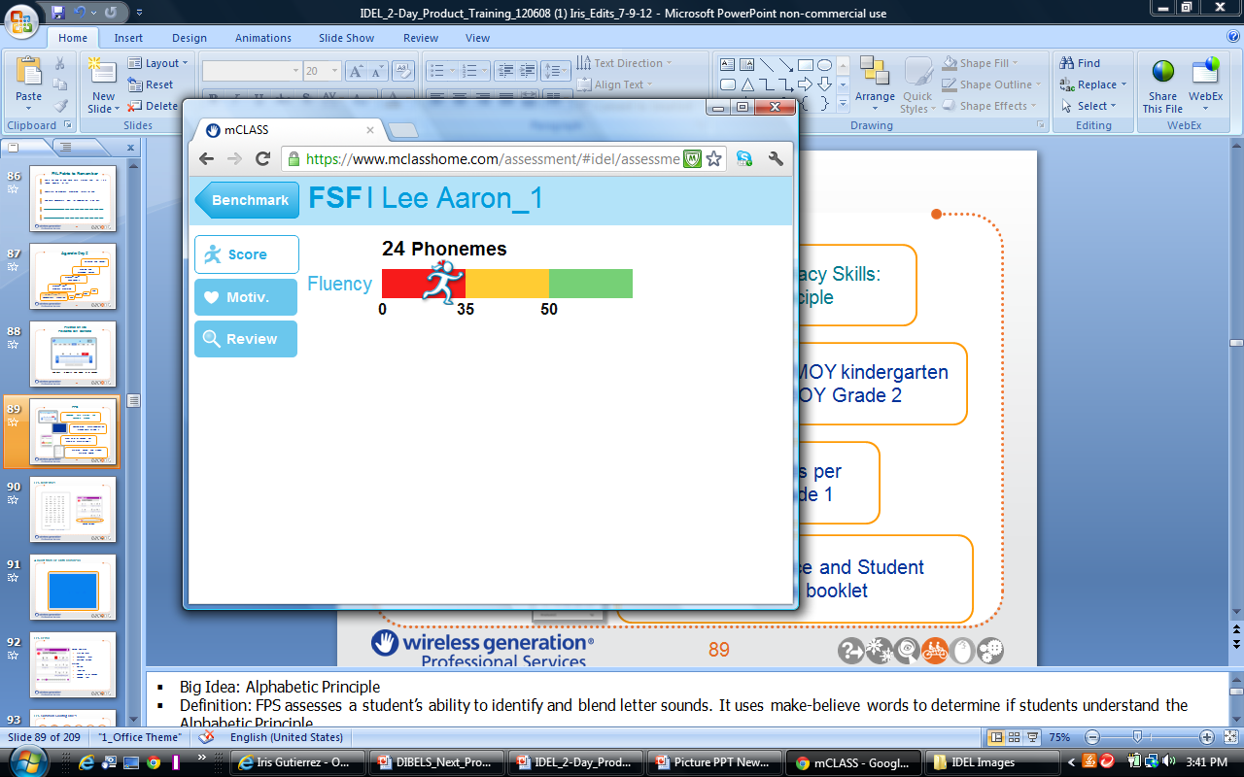
FPS
Beginning Early Literacy Skills: Alphabetic Principle
Administered: MOY kindergarten
through BOY Grade 2
Goal: 70 letter sounds per minute by MOY Grade 1
Materials: Device and Student Materials booklet
Notes:
PARAPHRASE:
BELS: Alphabetic Principle
Definition: FPS assesses a student’s ability to identify and blend letter sounds. It uses make-believe words to determine if students understand the Alphabetic Principle.
The FPS measure uses CVCV and CV nonsense words.
The goal is for student’s to read nonsense words as whole words, rather than segmenting them.
Administered MOY kindergarten through BOY Grade 2.
Goals
Goal = 20 letter sounds/minute at MOY kindergarten
Goal = 35 letter sounds/minute at EOY kindergarten
Goal = 35 letter sounds/minute at BOY Grade 1
Goal = 70 letter sounds/minute at MOY Grade 1
The grade-level, color-coded booklets from the kit are needed for administering this measure.

Slide 57
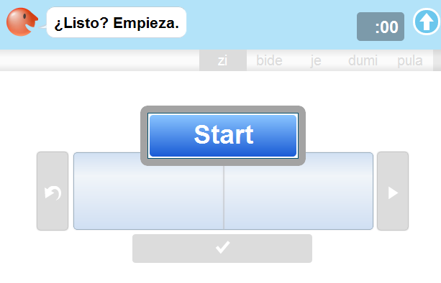
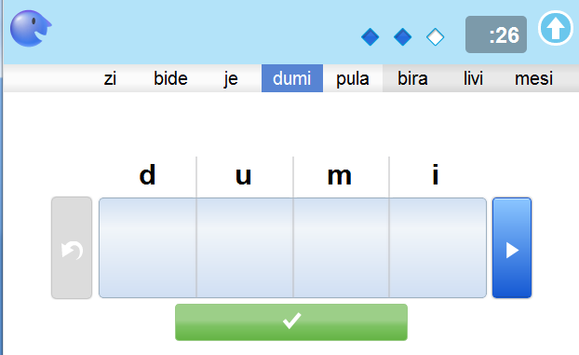
FPS Materials
Student Materials
Device Screen
Notes:
PARAPHRASE:
Student materials needed for this measure are in the grade-level, color-coded booklets from the kit for Benchmarking and Progress Monitoring.
If participants have their kits, encourage them to look at the FPS forms for BOY, MOY, and EOY.
The font is Times New Roman, the most common form for print.
There is also a helpful navigational tool in FPS. In the IDEL Student Materials booklet, there are five words per row that match the five words on the Device screen. If a student skips a row, tap the right arrow at the bottom of the screen or tap the next purple bead to navigate through the rows quickly.

Slide 58
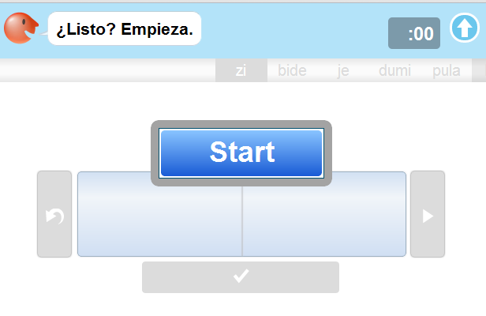
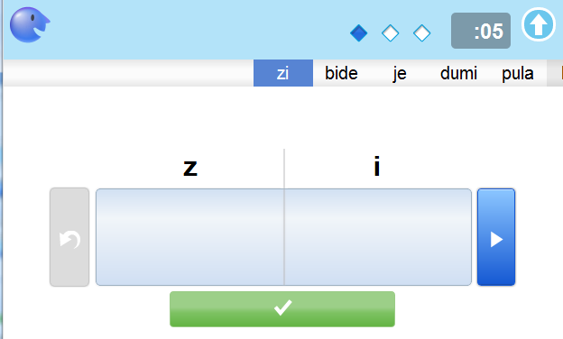
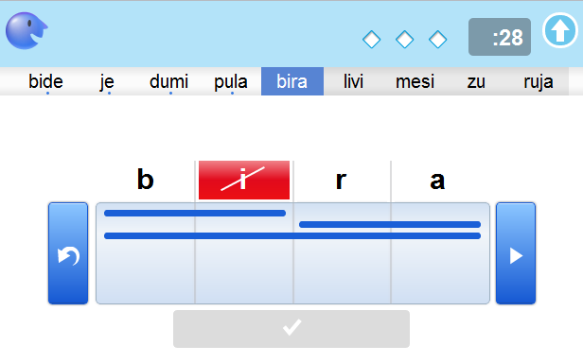
FPS Demo
Timing Features:
  Starting timer
  Response timer
  Warning screen
Marking:
  Correct
  Incorrect
  Blended letter sounds
  Skipped row
  Observe:
  Remove markings
  Scrolling word bar
  Five-word sets
Notes:
PARAPHRASE:
Either review the scoring rules step-by-step before demonstrating or reverse the process and demonstrate first.
Use your Device to demonstrate scoring the measure.

Slide 59
FPS Common Scoring Rules
Self-Correction
Additions
Hesitation Rule
Discontinue
Rule
Schwa Sounds, Articulation, or Dialect Issues
Sound Elongation
Tap on red phoneme or tap "Undo" arrow on the left of the marking boxes to undo the last action.
.
Make no mark.
After three seconds, score as incorrect and provide the next sound or word depending on the pattern of responses.
.
Device prompts you if first five words are incorrect.
Marked as correct.
Notes:
PARAPHRASE:
Discuss the FPS scoring rules, which are similar to the FSF scoring rules.
Self-Correction: Credit is given for self-corrected responses.
Additions or Omissions: Make no mark.
Hesitation: Give students as many opportunities as possible to demonstrate their skill. If a student hesitates on a sound or word for three seconds, score it as incorrect and provide the next word.
Discontinue: If the first five words are incorrect, the Device prompts you to discontinue.
Schwa Sounds/Articulation/Dialect and Sound Elongation: Students are not penalized.
Although students are not penalized for any of the above, fluency is affected, making their overall score lower.

Slide 60
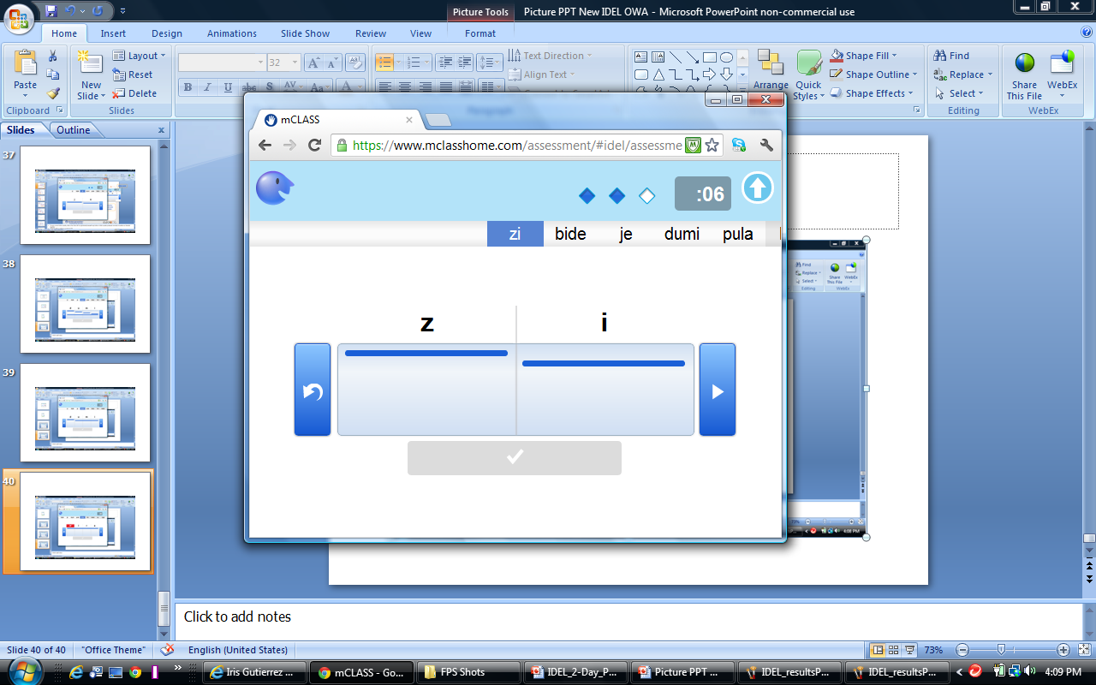


FPS Scoring Rules
Entire word
Sound-by-Sound
Sound-by-Sound and Recoded
Notes:
PARAPHRASE:
To score correct letter sounds, click on the box or draw a line from left to right directly beneath any letter or letter sounds produced correctly in isolation or blended together.
Scoring in FPS is similar to scoring in FSF.
As you saw with FSF, the students are awarded one point for each correct sound and zero for an incorrect response. You can score:
Sound-by-Sound
Entire Word – Note: If student says the entire word, you can just tap on the green button below the boxes.
Sound-by-Sound and Recoded
Remember the assessor prompts by sound or word, depending on how the student is responding.
Do you see the CVCV and CV pattern? All correct student responses are short vowels and hard consonants.

Slide 61



FPS Scoring Rules
Student says, “/z/ /i/”
  Mark z i
Student says, “/d/ /umi/”
  Mark d umi
Student says, “/nesi/”
  Mark mesi
  Tap /m/
Student says, “/tuja/”
  Mark ruja
  Tap /r/
Notes:
PARAPHRASE:
If the student says “/z/ /i/,” mark z i.
If the student says “/d/ /umi/,” mark d umi.
When letter sounds are attempted but not pronounced correctly, draw a line beneath all attempted sounds.
Tap incorrect letters to mark them in red.
If the student says /nesi/ for “mesi,” underline mesi, then tap the letter “m.”
If the student blends sounds together, draw a continuous line beneath the blended sounds.
If the student self-corrects within three seconds, trace the line from right to left across the appropriate boxes and tap the letter to remove the previous markings.

Slide 62



FPS Scoring Rules
Student says, “zi, bide, je, dumi, pula”
Mark zi, bide, je, dumi, pula
Student says, “/yo/”
  Mark gu
  Tap /g/ /u/
Student says, “/rojo/”
  Mark vifu
  Tap /v/ /i/ /f/ /u/
Notes:
PARAPHRASE:
If the student reads the whole word, draw a line under each word blended correctly, or you can just tap on the green button underneath the boxes.
If the student reads the whole word and it’s incorrect, draw a line under the word, then tap each of the letters to show incorrect sounds.
If the word is “gu” and the student says “/yo/,” draw a line beneath “gu” and tap both the g and u.
If the word is “vifu” and the students says “rojo”, underline “vifu” and tap v, i, f, u.

Slide 63



FPS Scoring Rules
Student says, “/g/ /gu/”
  Mark g gu
Student says, “omiz”
  Mark “z i m o”
  Tap /z/ /i/ /m/ /o/
Student says, “/o/ /m/ /i/ /z/” and points correctly to each letter
  Mark z i m o
Notes:
PARAPHRASE:
Letter sounds repeated multiple times are marked each time the student says them, but given credit only once.
For example, if the student says “/g/ /gu/,” you would underline the g and then underline the g and u together. The student receives credit for identifying both sounds, but only gets credit for the /g/ once.
If the student is reading whole words, the blended letter sounds must be correct and in the correct order for credit.
For example, if the student says, “omiz” for “zimo”, you would underline the whole word then tap each letter. This indicates the whole word was read but no credit was given.
This is because the student reading sounds as a “word” is at a different level of learning than the student who recognizes only “sounds.” This affects the proper individualized instruction.
A student who points to each letter while saying it gets the answer right even if the letters are said out of order. The purpose of this rule is to give students credit as they are beginning to learn individual letter-sound correspondences.
If the student does provide individual sounds or blends, note the behavior pattern on the Results screen. Use this information later to determine instructional changes.

Slide 64

Three-Second Hesitation
Sound-by-Sound
Student says, “/n/…” then hesitates three seconds.
Assessor says, “/e/” then points to “p” and asks, “¿Qué sonido?”
Student says, “/p/ /o/”.
Mark n e p o.
Notes:
PARAPHRASE:
If a student is providing letter sounds sound-by-sound, then hesitates for three seconds, score the letter sound as incorrect by tapping the letter. Point to the next letter immediately and ask, “¿Qué sonido?”
This prompt may be repeated each time the student hesitates for three seconds.

Slide 65



Scoring a Three-Second Hesitation Word-by-Word
Student says, “lede…” then hesitates three seconds.
Assessor says, “nole” then points to “peme” and asks, “¿Qué palabra?”
Tap each letter of nole.
Notes:
PARAPHRASE:
Rules for three-second hesitations:
Word-by-word
If a student is reading words word-by-word, then hesitates for three seconds, score the word as incorrect by tapping each letter. Provide the correct word, point to the next word and ask, “¿Qué palabra?”
This prompt may also be repeated.

Slide 66
FPS Check for Understanding
Pop Quiz
For each question, select the letter that represents your answer.
You have one minute for each question.
Notes:
DIRECTIONS:
Read the questions on the following slides.
Give participants 30 seconds to jot down a response to each question. Strictly adhere to this timing rule.
All answers are in the notes. Participants score their quizzes. Reward perfect scores with prizes.

Slide 67
FPS Check for Understanding
Which mark is correct if the student says, “/b/ /u/ /l/ /a/” for “pula”?
a. p u l a b. p u l a c. p u l a d. p u m a
Which mark is correct if the student says, “agum” for “muga”?
a. m u g a b. m u g a c. m u g a d. m u g a
Tap the at the bottom of the screen when student reads whole word.
a. arrow b. bead c. green button d. number
What does the assessor say when the student provides letter sounds, but then hesitates three seconds?
a. “¿Qué palabra?” b. “¿Qué?” c. “¿Qué letra?” d. “¿Qué sonido?”
If a student misses the first five words in a row, .
a. invalidate b. pause c. continue d. discontinue
Notes:
REVIEW:
After completing have participants share their answers.
Answer B
Answer B
Answer C
Answer D
Answer D

Slide 68

FPS Practice Instructions
Partner A - Assessor
  Select Lee Aaron_1.
  Select Benchmark.
  Under BOY, tap FPS.
  Read instructions on device.
  Score student responses on device.
  Record response patterns, motivation, and notes.
Partner B - Student
  Read the script aloud.
  Bold letters = mispronunciation.
  An ellipsis (…) = 3-second hesitation.
  Comma (,) between two letters = self-correction.
Notes:
DIRECTIONS:
Explain this 10-minute pair-practice to participants.
Work in teams, with Partner B acting as the student and Partner A as the assessor.
Review the directions for the practice activity (in the top quadrant
of the grid).
Add notes, behaviors, and motivation to each practice.
The student responses contain errors. The participant acting as the student should read the scripts as written.
The student response pattern should not be seen by the assessor.
Participants use the hard copy script in the training materials provided, but keep this slide visible during practice.
Using FPS Practice #1 and #2, pair up and complete.
If participants followed along on their Device, they will have to Invalidate and choose Reuse the Benchmark form to practice with the correct form.

Slide 69
FPS Practice #1
Assessor | Student | Scoring | Rule
Practice questions | Answer as correct
zi | ze, zi | z i | Self-correction
bide | bidi | b i d e | Mispronunciation
je | jes | j e | Addition
dumi | duni | d u m i | Mispronunciation
pula | … | p u l a | 3-second hesitation
bira | biras | b i r a | Addition
livi | livi | l i v i | Mispronunciation
mesi | misi | m e s i | Mispronunciation
zu | … | z u | 3-second hesitation
Notes:
DIRECTIONS:
When comparing practice scores, discuss the importance of inter-rater reliability. Have participants compare Results screens for reliable scoring.
Circle the room and assist participants during activity.
NOTE:
Have participants invalidate the measure after each practice.

Slide 70
FPS Practice #1
Assessor | Student | Scoring | Rule
Ruja | /r/ /u/ /j/ /a/, ruja | r u j a | Correct letter sounds, whole word
gu | /u/ /g/ (points correctly) | g u | Incorrect order (sound-by-sound)
nipa | apin | n i p a | Incorrect order (word-by-word)
bu | /b/ /u/, bu | b u | Correct letter sounds, whole word
vifu | /v/ /i/ /…/ /u/ | v i f u | 3-second rule prompt
fure | /f/ /u/ /r/ /e/ | f u r e | Correct letters sounds
dipi | /b/ /i/ /p/ /i/ | d i p i | Mispronunciation
muga | muga | m u g a | Correct word
jepe | jipe | j e p e | Mispronunciation
ga | go, ga | ga | Self-correction
Notes:
DIRECTIONS:
Facilitate discussion and answer questions upon completion.
If time allows, go through the pair practice more than once.
Have participants invalidate the measure and choose Reuse the Benchmark form to practice with the correct form.

Slide 71
FPS Practice #2
Assessor | Student | Scoring | Rule
Practice questions | Answer as incorrect
zi | /z/ /z/ /i/ | z i | Repeated sound
bide | /b/ /i/ /b/ /e/ | b i d e | Mispronunciation
je | /j/ /e/ | j e | Correct letter sound
dumi | /d/ /u/ /n i/, /m i/ | d u m i | Correct letter sound, self-correction
pula | /p/ /u/ … /a/ | p u l a | 3-second rule prompt
bira | Skip row | b i r a | Student skips row Use the navigation bar, tap the first word of the next section. They are in sets of 5, light gray, darker gray
livi |  | l i v i
mesi |  | m e s i
Zu |  | z u
ruja |  | r u j a
Notes:
DIRECTIONS:
Have team members switch roles.
Start by invalidating the scores (model on Device).
Practice adding notes (if on handheld), observed behaviors, and motivation.
NOTE: If a student skips an entire row:
Use the navigation bar at the top and tap the first word of the next set of 5 words. The sections are divided in sets of 5 and also by color – light gray, darker gray.

Slide 72
FPS Practice #2
Assessor | Student | Scoring | Rule
gu | /u/ /g/ (points correctly) | g u | Incorrect order (sound by sound)
nipa | /ni/ /i/ /ipa/ | n i p a | Repeated sound
bu | /b/ /u/ | b u | Correct letter sounds
vifu | /v/ /i/ /f/ /u/, vifu | v i f u | Correct letter sounds, whole word
fure | fure | f u r e | Correct word
dipi | /d/ /i/ /p/ /i/, dipi | d i p i | Correct letter sounds, whole word
muga | /n/ /u/ /g/ /a/ | n u g a | Mispronunciation
jepe | jope | j e p e | Partially correct word
ga | gas | ga | Insertion
Notes:
DIRECTIONS:
If time allows discuss any questions or challenges.

Slide 73
FPS Points to Remember
Assesses the Alphabetic Principle
Score sound by sound, blended sounds, and whole word responses.
Allow sounds out of order to be counted as correct if student points to the letter and is reading sound-by-sound
Notes:
REVIEW:
Underlines everything that the student says to create a visual record of the student’s Alphabetic Principle behaviors.
Assesses the Alphabetic Principle.
Allows for letter-sound correspondence as students acquire the Alphabetic Principle.
Encourage participants to record any additional notes of importance. Share, adhering to the no repeat rule.

Slide 74
Agenda
1 | Introduction
2 | mCLASS®:IDEL® Basics
3 | Fluidez en la Segmentación de Fonemas (FSF)
4 | Fluidez en el Nombramiento de las Letras (FNL)
5 | Fluidez en las Palabras sin Sentido (FPS)
6 | Fluidez en la Lectura Oral (FLO)
7 | Fluidez en el Recuerdo Oral (FRO)
8 | Fluidez en el Uso de las Palabras (FUP)
9 | mCLASS®:IDEL® Progress Monitoring
10 | Web Reports
11 | Wrap-Up and Support
Notes:
DIRECTIONS:
Review agenda with participants.

Slide 75


Fluidez en la Lectura Oral
Fluidez en el Recuento Oral
FLO
FRO
Accurately and fluently read grade-level connected text
Comprehension
of passage
Notes:
PARAPHRASE:
Combined with Fluidez en el Recuento Oral (FRO), Fluidez en la Lectura (FLO) falls under the Fluency and Comprehension Basic Early Literacy Skills.

Slide 76



FLO
Beginning Early Literacy Skills: Accuracy and Fluency
Administered: MOY Grade 1 through EOY Grade 6
Goals: 40 Words per Minute by EOY Grade 1
65 Words per Minute by EOY Grade 2
85 Words per Minute by EOY Grade 3
Materials: Device and grade-appropriate FLO student passages
Notes:
PARAPHRASE:
FLO assesses Accuracy and Fluency.
FLO is administered MOY Grade 1 through EOY Grade 6.
FLO is the ultimate goal for all readers because fluency indicates comprehension.
There are several goals associated with FLO. Think about these goals for a moment.
Although FLO is assessed through Grade 6, this presentation focuses on Grades 1–3.
Emphasize the EOY Goals
Grade 1: MOY 20 wpm; EOY 40 wpm
Grade 2: BOY 40 wpm; MOY 50 wpm; EOY 65 wpm
Grade 3: BOY 65 wpm; MOY 70 wpm; EOY 85 wpm
Remember these are the minimum goals for students at each grade level. These cut points are determined by IDEL research and indicate the minimum words per minute that students should be able to read in order to meet the next grade requirements.
You need your Device to administer the assessment and the grade-appropriate reading passages found in the color-coded student booklet.

Slide 77

FLO Student Materials
Notes:
NOTE:
Find student materials needed for this measure in the grade-level, color-coded booklets from the kit.
If participants have their kits, encourage them to look at the FLO forms for BOY, MOY, and EOY.

Slide 78



FRO
Beginning Early Literacy Skills:
Comprehension
Administered: MOY Grade 1 through EOY Grade 6
Goal: Reading Proficiency, which is 25% of FLO Score
Materials: Device
(auditory task)
Notes:
PARAPHRASE:
FRO assesses a student’s comprehension of each FLO passage by identifying students who read too quickly without attending to meaning.
Students are asked to retell everything they can about the story.
FRO is administered MOY Grade 1 through EOY Grade 6.
There are no goals or cut points for FRO at this time, but research is ongoing.
This is an auditory task, so no student materials are needed.

Slide 79

FLO and FRO Settings
Select the number of passages to administer.
Select whether you will administer FRO.
Notes:
PARAPHRASE:
When you select FLO from the Class List, this Settings screen appears.
You can administer one or three passages. For most accurate results, administer three passages during Benchmark assessments.
Change the settings by tapping the arrows.
Passages are calibrated for the reading level goal of each grade, but individual passage difficulty varies.
When three passages are selected, the student receives one passage each from the low, middle, and high difficulty range.
When one passage is selected, the student receives a passage from the middle of the difficulty range.
FRO is considered optional because there are no established national performance benchmarks. Typically, the decision of whether or not to use FRO is made at a school, district, or state level.
Even if districts do not require FRO, many teachers continue to use it because of the valuable data this measure offers about the students’ understanding of what they read.
This is the only measure that can be paused, and only in between passages if three passages have been selected.

Slide 80


FLO and FRO Demo
Timing Features:
  Starting timer
  Response timer
  Warning screen
Marking:
  Marking sections
  Correct
  Incorrect
  Skipped row
Observe:
  Location of score
  Invalidating words
Notes:
PARAPHRASE:
Ask for a volunteer to be the student.
Use your simulator or Device to demo responses.
Have the participant read the script from projected Device. Ask him or her to make errors such as skipping words, reading words incorrectly, and skipping at least one line of text.

Slide 81
FLO Common Scoring Rules
word
Schwa Sounds, Articulation, or Dialect Issues
Self-Correction
Insertions
Hesitation Rule
Omissions
Discontinue
Rule
Tap the segment again.
Make no mark.
After 3 seconds, say the word and mark it incorrect.
Mark as incorrect.
Device prompts you if first five words are incorrect.
Mark as correct.
Notes:
PARAPHRASE:
Discuss the FLO scoring rules.
Self-Correction: Credit only when students self-correct.
Insertions: Make no mark.
Hesitation: Give students as many opportunities as possible to demonstrate their skill. If a student hesitates on a sound or word for three seconds, score it as incorrect and provide the next word.
Omissions: Mark as incorrect any word that the student omits.
Discontinue: The Device prompts you to discontinue.
Schwa Sounds/Articulation/Dialect: Students are not penalized.

Slide 82
FLO Scoring Rules
Text: Mi padre tiene 36 años.
Student Reads: Mi padre tiene tres y seis años.
Scoring: 36 is incorrect.
Numerals
Text: Sr. Garcia va a la tienda.
Student Reads: S.R. Garcia va a la tienda
Scoring: Sr. is incorrect.
Abbreviations
Notes:
PARAPHRASE:
Numerals and Abbreviations: Mark incorrect if spelled out or read number by number.
Exception: If the abbreviation is read in the way that you would normally pronounce it in conversation, mark it as correct.

Slide 83
FLO Scoring Rules
Text: Me dio cinco dólares.
Student Reads: Dio me cinco dólares.
Scoring: me and dio are incorrect.
Word Order
Text: Ella no tiene un perro.
Student Reads: Ella tiene un perro.
Scoring: no is incorrect.
Omitted Words
Notes:
PARAPHRASE:
Word Order: All words read correctly, but in the wrong order, are incorrect.
Omitted Words: Mark as incorrect if words are omitted.

Slide 84
FLO Scoring Rules
Text: Las niñas tienen muchas muñecas.
Student Reads: Los niños tienen muchas muñecas.
Scoring: Las and niñas are incorrect.
Words not read exactly as written
Text: El libro es del profesor.
Student Reads: El libro es de el professor.
Scoring: del is incorrect.
Notes:
PARAPHRASE:
Words Not Read Exactly as Written: If a student does not read a word exactly as written, score it as incorrect.
Contraction Read as Two Words: If a contraction is read as two words, score it as incorrect.

Slide 85
FRO Common Scoring Rules
Self-Correction
Additions
Hesitation Rule
Discontinue
Rule
Drag stylus from left to right to count the words.
Do not count.
The first time is three seconds; five seconds the next time.
After the second hesitation, the Device prompts you.
Notes:
PARAPHRASE:
Discuss the FRO scoring rules.
Self-Correction: Credit is given only when students self-correct.
Additions or personal experiences: Do not count.
The first hesitation is three seconds and the second hesitation
is five seconds.
Discontinue: The Device prompts you to discontinue.

Slide 86
FRO Quick Reference
Correct
Incorrect
Contractions
Minor repetitions
Minor irrelevancies
Minor inaccuracies
Exclamations
Songs and recitations
Rote repetition of words
or phrases
Stories or irrelevancies that are off track
Repeating the retell
Notes:
PARAPHRASE:
When scoring FRO, the following are correct:
Contractions
Minor repetitions
Redundancies
Irrelevancies
Minor inaccuracies, as long as student gets back on track with correct meaning and sequence of passage
The following are incorrect:
Exclamations
Songs
Recitations
Rote repetition of words or phrases
Additional stories or irrelevancies (e.g., a personal experience)

Slide 87
After the Assessment
The median FLO score is assigned to the student.
FLO and FRO median scores are not necessarily from the same passage.
The median FRO score is assigned to the student.
Notes:
PARAPHRASE:
If you chose to administer three passages, a Results screen appears after completion of each passage.
Not the average, but the middle score, or median, becomes the score of record. It is marked on the Results screen by a purple triangle.
The median score for FLO is also shown above the running man.
Accuracy is shown as a percentage.
Fluency scores are recorded in words correct per minute.
FLO Median Score
FRO Median Score
FLO and FRO scores kept on record are not necessarily from the same passage.

Slide 88

FLO and FRO Audio Practice
  Select Daniel Aavery_3.
  Select Benchmark.
  Under MOY, tap FLO.
  Select “1” passage from drop-down menu.
  Select “Yes” on FRO – Retell Fluency.
  Proceed to start of measure.
  Listen to audio recording.
  Score student responses on device.
  Record notes and student motivational patterns.
FLO
FRO
Notes:
DIRECTIONS:
Choose 1 story not 3, and choose Yes on the Retell for Aavery_3, Dan and MOY.
The story will be, “Nuestra gatita enferma”.
Have participants score along with the audio clip.
Click to play Audio Files, FLO Audio Practice mp3
Continue with Audio Files, FRO Audio Practice mp3
Have participants invalidate the measure after the FRO practice.
Repeat if necessary for additional practice.

Slide 89

FRO Audio Scoring
Notes:
PARAPHRASE:
The Retell Fluency Score appears in the upper right-hand corner of the passage
on the Web.
Let’s check and discuss scoring of FLO and FRO.
This Web report is for EOY Grade 3.
The screen shot on this slide is from the mCLASS:Home website. The format of the results on the Device looks different.
Open the Review Mode on your Devices by tapping Review on the Results screen.
Repeat the audio file if necessary, so that everyone has the same score range.

Slide 90
FLO and FRO Reflection
A-ha!
What questions do you have?
A-ha! Write your A-ha moment on a sticky note, then attach it to the chart.
A-ha!
A-ha!
Jake is in Grade 3. His BOY median FLO score is 45 wpm. His BOY median FRO score is 9. What might you do?
Notes:
PARAPHRASE:
What questions do you have about FLO and FRO?
For the A-ha! Activity, write one realization on a sticky note then attach it to the chart. Remember, no repeats.
Don’t forget about your Jakes!
Give participants one minute to jot down a response to question 3. Ask participants to share responses with partners/tables/group, depending upon the size of the group.

Slide 91
Agenda
1 | Introduction
2 | mCLASS®:IDEL® Basics
3 | Fluidez en la Segmentación de Fonemas (FSF)
4 | Fluidez en el Nombramiento de las Letras (FNL)
5 | Fluidez en las Palabras sin Sentido (FPS)
6 | Fluidez en la Lectura Oral (FLO)
7 | Fluidez en el Recuerdo Oral (FRO)
8 | Fluidez en el Uso de las Palabras (FUP)
9 | mCLASS®:IDEL® Progress Monitoring
10 | Web Reports
11 | Wrap-Up and Support
Notes:
DIRECTIONS: Find out if the district is planning to use FUP
Review agenda with participants.

Slide 92

Fluidez en el Uso de las Palabras
Assesses vocabulary knowledge and expressive language
Notes:
PARAPHRASE:
FUP is important because it provides a good picture of the student’s vocabulary level and can help isolate a deficiency in fluency caused by poor vocabulary development.

Slide 93



FUP
Beginning Early Literacy Skills:
Vocabulary
Administered: BOY kindergarten
through EOY Grade 3
FUP Guideline: Lowest 20% receives additional support
Materials: Device
(auditory task)
Notes:
PARAPHRASE:
The Basic Early Literacy Skill for FUP is Vocabulary.
It is the only measure given to all grade levels at all times of the year.
Administered MOY kindergarten through EOY Grade 3.
At the present time, there are no Benchmark goals for FUP.
Research is ongoing to establish standards for this measure.
The current guideline is to give additional support to students with scores at or below the 20th percentile of the school district.
Students who score in the lowest 20th percentile of a school district should be considered at risk and those between the 20th and 40th percentile should be considered at some risk.
No student materials are necessary for this measure; it is an auditory task.

Slide 94
FUP Common Scoring Rules
Self-Correction
Additions
Hesitation Rule
Discontinue
Rule
Schwa Sounds, Articulation, or Dialect Issues
Score as correct.
Count only the words specifically related to the stimulus word.
After five seconds, score it as incorrect and provide the
next word.
If the first five words are incorrect, the device prompts you.
Mark as correct.
Notes:
PARAPHRASE:
Self-Correction: As you drag your finger or the stylus, the device automatically counts the words the student uses for the sentence. If a student self-corrects, subtract words by dragging your finger or stylus from right to left. The number above the spaces changes. If you take away words, the spaces turn red.
Additions: Count only the words specifically related to the stimulus word.
Hesitation: The 5-second hesitation timer gives the student time to think of a response. If the student does not begin to use the word after five seconds, tap X/5 Secs. Continue by prompting the student with the next word. The prompt may be used as many times as needed.
Discontinue: If the first five words are incorrect, the Device prompts you to discontinue.
Schwa Sounds/Articulation/Dialect and Sound Elongation: Students are not penalized.

Slide 95
FUP Quick Reference
Count
Do Not Count
Exclamations and fillers
Songs or recitations
Rote repetition of words or phrases
False starts within a correct use
Contractions count as a single word
Correct
Incorrect
Correct use
Homophones and synonyms
Correct definitions
Changing tense, number, or parts of speech
Phrase or expression
Incorrect use
Repeating the word
No response
“No sé”
Notes:
PARAPHRASE:
Students may use several strategies to convey correct meaning.
Phrase/Expression: If the word is “nada” and the student says “De nada,” this is correct.
Sentence: If the student changes tense, number, or parts of speech, it is still correct.
Definitions: If the student provides a homophone, as “cocer” for “coser,” that is correct. If the student provides a synonym, as in “enorme” for “grandisimo,” that is correct.
Self-corrections, of course, are correct.
Incorrect usage conveys a lack of understanding.
Incorrect use of the word.
Saying “No se” or having no response.
Repeating the word.
If a student hears the wrong word and uses a word that sounds like the stimulus word, for example, “mano” for “sano,” that is incorrect. (If this happens once or twice, it is small stuff. If this happens multiple times, try an approved accommodation by moving to a quieter place or sitting closer to the student.)

Slide 96


FUP Demo
Timing Features:
  Starting timer
  Response timer
  Warning screen
Marking:
  Marking sections
  Correct
  Incorrect
Observe:
  Location of score
  Retracting words
Notes:
PARAPHRASE: Have participants follow along.
Either go over the scoring rules step-by-step before demonstrating or reverse the process and demo first.
Use your Device to demonstrate scoring the measure.
Tap or use a stylus anywhere in the Writing Area to begin marking.
The goal is to determine if the student knows the meaning of the word.
If the student is providing a long response, count only the words specifically related to the stimulus word. For example, in “Voy a dejar mi cuarto limpio...Me gusta jugar en mi cuarto” (“We buy food at the grocery store...my dog was at a store once”), give credit for the first sentence only.
Only count words in the most complete utterance in which the stimulus word is used. For example, in “Me gustan las galletas. Me gustan las galletas. Me gustan mucho las galletas” (“I like cookies. I like cookies. I like cookies very much”), count the last sentence, which awards five points.
As soon as a student conveys understanding of the word, move on to the next word. Don’t let students get stuck in needless, off-task ramblings that take time away with non-credited responses.
To erase credit, move from right to left across the vertical lines for each retraction.
When you pass your original starting point, if you are still moving from right to left, the sections turn red and the counter keeps moving in reverse. This feature keeps you from erasing credit for previous words.

Slide 97

FUP Audio Practice
Select Aashdown_1, Karen.
Choose Benchmark.
BOY Column.
Select FUP.
Proceed to start of measure.
Listen to audio recording.
Score student responses on device.
Record notes and student motivational patterns.
Notes:
DIRECTIONS: Only do practice if there is time.
Have participants score along with the audio clip.
Click to play audio file – FUP Audio Practice.mp3
Have participants invalidate the measure after they practice.
Repeat if necessary for additional practice.

Slide 98

FUP Audio Practice Scoring
Notes:
DIRECTIONS:
This Web report is for BOY Grade 2.
Have participants discuss their scoring.
Repeat the practice as needed.
The screen shot on this slide is from the mCLASS:Home website. The format of the results on the Device looks different.
Open Review Mode on your Devices by tapping Probe on the Results screen.

Slide 99


FUP Points to Remember
Assesses vocabulary knowledge and expressive language.
FUP does not have established Benchmark goals.
Drag stylus across vertical lines to score words.
Record 5-second hesitations as incorrect.
Deliver the 5-second prompt as many times as needed.
Notes:
PARAPHRASE:
Assesses vocabulary knowledge and expressive language.
No Benchmark goals are currently assigned to FUP.
Drag the stylus across the vertical lines to score words.
Record 5-second hesitations as incorrect.
Use 5-second prompt as many times as needed.

Slide 100

FUP Reflection
https://www.mclasshome.com
Notes:
PARAPHRASE:
Once you sync, reports are available at www.mclasshome.com
FUP is connected to Vocabulary (BELS) and although it is not yet defined by cut points, it is useful in refining small groups and instruction.
FUP (Fluidez en el uso de las palabras / Word Use Fluency) informs instruction in vocabulary in relation to a students’ oral language development and background knowledge, each of which is also critical to listening and reading comprehension.
The Web report shows the words provided. This is helpful when identifying the students knowledge of Tier 1 words (common words used in everyday language and commonly used in text – clock, baby, happy / reloj, bebé, feliz) or Tier 2 words (high frequency, descriptive or specific words found across a variety of domains – coincidence, fortunate, industrious / casualidad, afortunada, trabajador)
The score represents how many words the student used to correctly define, describe or use the word correctly.
Word Use Fluency provides what we call “good to know” information.
You will especially be able to observe growth over time by comparing PM scores and BM scores.

Slide 101
Agenda
1 | Introduction
2 | mCLASS®:IDEL® Basics
3 | Fluidez en la Segmentación de Fonemas (FSF)
4 | Fluidez en el Nombramiento de las Letras (FNL)
5 | Fluidez en las Palabras sin Sentido (FPS)
6 | Fluidez en la Lectura Oral (FLO)
7 | Fluidez en el Recuerdo Oral (FRO)
8 | Fluidez en el Uso de las Palabras (FUP)
9 | mCLASS®:IDEL® Progress Monitoring
10 | Web Reports
11 | Wrap-Up and Support
Notes:
DIRECTIONS:
Review agenda with participants.

Slide 102


Progress Monitoring
Skill-specific, frequent, ongoing assessment of at-risk students
Notes:
PARAPHRASE:
The PM probes are skill-specific, frequent, and ongoing for the students identified as at-risk.
The results of the benchmark assessments will recommend periodic Progress Monitoring for students in the Intensive and Strategic Support Categories.

Slide 103
Progress Monitoring (PM)
Good News!
The same administration and scoring procedures are used for Benchmark and Progress Monitoring.
FLO
FRO
FSF
FSF
FPS
FUP
Notes:
PARAPHRASE:
Learning to administer Progress Monitoring (PM) is relatively easy because all of the administration and scoring rules are the same as for Benchmark measures.
There are only five PM measures. FNL is not included because it does not coincide with one of the Basic Early Literacy Skills.
Teachers should find time to continue supporting small group and individuals learning of letter names while core instruction continues.
Progress Monitoring is important because it helps to:
Determine if struggling students are making sufficient progress
Evaluate effectiveness of instruction
Meet the needs for efficiency and information in the classroom

Slide 104


Progress Monitoring
Basic Early Literacy Skills in Beginning Reading:
PM can be used to monitor student progress in
all of the Basic Early Literacy Skills
Administered: According to student need
Materials: Device and Student Materials
by grade level
Notes:
PARAPHRASE:
Assess students using Progress Monitoring between Benchmark windows.
There is no formal scheduling recommended by IDEL.
Guidelines for the frequency of administering Progress Monitoring are usually based on the individual student’s Risk Level.
The assessment calendar, including PM, is determined by schools or districts.
There are 20 forms for each measure.
This allows frequent monitoring in each measure, without duplicating forms for a student.
You may administer progress monitoring with out-of-grade-level forms.
Using PM data, a teacher can:
Validate or challenge other assessment/observational data
Frequently assess students
Make instructional decisions based on multiple assessments; IDEL is a one-minute measure that can be administered frequently
Monitor at-risk students to assess progress toward a specific goal
Determine effectiveness of current instructional strategies
Monitor students’ progress using multiple measures including the Critical Skill for that time of year

Slide 105
IDEL PM Best Practices
Verify previous results.
Check progress toward a specific goal.
Measure progress in one or more skill areas.
Notes:
PARAPHRASE:
Using PM data, a teacher can:
Validate other assessment/observational data
Challenge other assessment/observational data
Frequently assess students
Make instructional decisions based on multiple assessments; IDEL is a one-minute measure that can be administered frequently
Monitor at-risk students to assess progress toward a specific goal
Determine effectiveness of current instructional strategies
Select various PM measures based on student need
Monitor students’ progress using multiple measures including the Critical Skill for that time of year

Slide 106

Navigating PM
Select a student from the class list.
Tap Progress Monitoring.
Notes:
PARAPHRASE:
Sorting by IR (Instructional Recommendation) helps organize the list of students by name or priority.
Steps for Selecting a Student File: (Note – Steps 1 and 2 on this slide, 3,4, and 5 follow)
First, select student from the list. The Student File shows the status of IDEL results as well as Progress Monitoring for the selected student.
Tap on PM to view the next step.

Slide 107

Navigating PM
Select a measure to begin assessing.
Tap Assess to view the forms.
Notes:
PARAPHRASE:
3. Select the measure to be assessed.
The Progress Monitoring page for the student displays.
Recommended measures appear in the Assessment list.
You can see all the student's scores for that assessment.
Tap the Assessment list to see other measures.
You can also switch to a different measure.
4. Tap Assess to begin.
After selecting an IDEL measure, the Progress Monitoring Form Selection screen appears.

Slide 108



PM Form Selection
Select Form
and tap OK.
Out-of-Grade Level Pop-Up
Notes:
PARAPHRASE:
5. Select the form for the assessment
After selecting an IDEL measure, the Progress Monitoring Form Selection screen appears.
Each IDEL measure includes 20 psychometrically equivalent assessment forms to monitor progress.
Assess with an unused form; Forms already completed by a student are noted with a tally mark.
Consider administering a form the student has not yet seen.
Out of Grade Level Forms:
If you assess a measure that is covered in a different grade level, you’ll have to have those grade-level materials available.
Some Out-of-grade forms are available for students in need of further assessment (K–3).
If the student is out-of-grade, the "Out-of-Grade Material" pop-up will appear.

Slide 109


Out-of-Grade Forms
Will need
Out-of-Grade
Materials.
Check the Out-of-Grade Level forms box.
Notes:
PARAPHRASE:
Out-of-grade level forms
In a Grade 2 class, all the measures are still available, even though FSF and FPS should have been mastered in the lower grades.
This “off-level” feature allows you to assess struggling students at their Instructional Level in order to address their skill gaps.
Off-level Oral Reading Fluency is available once FLO is selected.
Students can be monitored on more than one grade level at a time.
Although this student is benchmarked at Grade 2, you may want to use Grade 1 forms during PM.
One of the advantages of this feature is to help determine appropriate instruction for each student.
Click on the box to choose the Out-of-Grade level forms to access all 20 probes, or forms, available for each grade level.
The Form list behaves the same as in Benchmark. Forms may be used more than once and each administration is marked with a tally.
Select a form that student has not already seen.
Tap OK to start probe.

Slide 110

FLO Settings for FRO
Pull down.
Select Yes or No.
Tap Proceed.
Notes:
PARAPHRASE:
FLO PM Settings Screens
Unlike DORF PM in DIBELS Next, in IDEL FLO PM, users have the option of administering Retell Fluency (FRO) before beginning FLO.
The PM settings for FLO should appear as a pop-up immediately after the user selects "Assess" for FLO on the PM selection screen.
There should be a drop-down with "Yes" and "No" options that will toggle on/off Retell Fluency, respectively.
After clicking on "Proceed" the user should be taken directly to the PM Form Selection pop-up unless the student is out-of-grade, in which case the "Out-of-Grade Material" pop-up would appear.

Slide 111


PM Results Screen
Additional
Information
Notes:
PARAPHRASE:
The OWA PM Results Screen has the same “additional information” features available as on the Benchmark Results screen.
Record a note, student’s motivation, or review the probe.
Record observations and view activities.
Tap the PM tab to view the history screen.
Tap Student tab then Class List tab to return to the Class List and select the next student.

Slide 112


PM History
Tap Progress Monitoring to view:
Completion Dates
Forms and
Scores
For Review Mode, tap any Probe.
Notes:
PARAPHRASE:
Tap Progress Monitoring to review the dates and scores for each form.
The History screen shows the list of assessment forms a student completed for a particular measure, with exact dates and scores.
Tap any form to see the details of that particular probe.
You can also toggle to another measure from this screen.

Slide 113


Progress Monitoring Graph
Student Monitoring Report
PM Graph and Aim Line
History
Notes:
PARAPHRASE:
Access the Student Graph via mCLASS Home. Click on Class Summary for TOY and then select student name.
The student graph contains valuable information:
Once you’ve selected a measure, the graphed report shows all Progress Monitoring activity.
The initial Benchmark score is indicated by a solid blue square.
Completed assessments are represented by squares. The empty blue boxes are PM assessments. To achieve Benchmark goals, the student must meet or exceed the Aim Line.
The Goal for the next Benchmark is indicated by a green target.
An Aim Line is drawn between the initial Benchmark score and the projected goal for the next Benchmark. This shows the rate at which a student must learn to reach the Benchmark goal.
Three consecutive points below a student’s Aim Line (red boxes) indicate the need for an instructional change. This change may mean adjusting the amount of time, type of materials, or method of instruction. The student may very likely not meet their targeted goal unless there is an instructional change or some type of intervention.
Once the next Benchmark goal has been surpassed three consecutive times (green boxes), the student is considered stabilized above the goal and no further PM is necessary.
Teachers may continue to monitor these students less frequently.
View the History of the benchmarks and the PM on the left side of the Web report.

Slide 114
Agenda
1 | Introduction
2 | mCLASS®:IDEL® Basics
3 | Fluidez en la Segmentación de Fonemas (FSF)
4 | Fluidez en el Nombramiento de las Letras (FNL)
5 | Fluidez en las Palabras sin Sentido (FPS)
6 | Fluidez en la Lectura Oral (FLO)
7 | Fluidez en el Recuerdo Oral (FRO)
8 | Fluidez en el Uso de las Palabras (FUP)
9 | mCLASS®:IDEL® Progress Monitoring
10 | Web Reports
11 | Wrap-Up and Support
Notes:
DIRECTIONS:
Review agenda with participants.

Slide 115
Agenda
1 | Introduction
2 | mCLASS®:IDEL® Basics
3 | Fluidez en la Segmentación de Fonemas (FSF)
4 | Fluidez en el Nombramiento de las Letras (FNL)
5 | Fluidez en las Palabras sin Sentido (FPS)
6 | Fluidez en la Lectura Oral (FLO)
7 | Fluidez en el Recuerdo Oral (FRO)
8 | Fluidez en el Uso de las Palabras (FUP)
9 | mCLASS®:IDEL® Progress Monitoring
10 | Web Reports
11 | Wrap-Up and Support
Notes:
DIRECTIONS:
Review agenda with participants.

Slide 116


Web Reports
Data reports provide insight into the strengths and weaknesses of students’ literacy skills.
Notes:
PARAPHRASE:
From your Offline Web Assessment platform, you can get online help.
Access your Web reports by tapping the button on the upper-left side of the screen.
This takes you to mCLASS Home. Just login with your username and password to view your reports.

Slide 117
Web Reports
Scores
History
Graphs
Groups
Support Categories
Visual of Student Progress
Notes
Notes:
PARAPHRASE:
The Web reports are a valuable aspect of the IDEL assessment because they:
Provide a detailed explanation of scores.
List all Benchmark and PM scores in the History.
Graph student progress using Benchmark targets.
Group students into Instructional Support Recommendation Categories.
Identify which students need additional support.
Display Probe Details with regard to student’s motivation levels, observational behaviors.
They are available in a printer-friendly format.

Slide 118

Web Reports
Debbie Next
Debbie Next
Notes:
PARAPHRASE:
Web reports
Are easily accessible from any Internet-connected computer.
From the Internet browser of choice, visit mclass.amplify.com
Locate the log in area of the screen.
Enter user name and password, then click Log In.
Remember, passwords are case-sensitive.
To view reports, click the IDEL icon.

Slide 119
mCLASS Home
Debbie Next
Debbie Next
Sync Status
Notes:
PARAPHRASE;
It is also possible to:
Create and Update Classes and Groups
Access the mCLASS Support & Resource Center
View your Sync Status, which tells you the last time Amplify received information from your device:
Verify that the date and time are correct to ensure you are viewing your most current assessment data.
Some users have system-level access, which adds the Reporting icon.
Click the IDEL icon to access Web reports.

Slide 120

Class Summary Report
Notes:
PARAPHRASE:
Click these tabs to view different assessment periods and Progress Monitoring.
First, select a school and/or class, depending upon your access level.
The first tab is a class summary report of assessments for each time point of the year – BOY, MOY, EOY.
Followed by the class summary reports for each TOY.

Slide 121
Class Summary Report Features
Support Category
Target Goals
Click a student to open the Student Summary.
Click a score to open its Probe Detail report.
Status/
Risk Level
Notes:
PARAPHRASE:
Each student is grouped into one of three instructional Support Recommendation Categories — Intensive, Strategic, or Benchmark — based on overall performance.
To view a student’s detailed information, click his or her name.
The report practically creates groups for you, with students’ Risk Levels prominently displayed.
Click any score to open its Probe Details. The Raw Score represents the number of items correct in one minute. Click the score to open the measure’s probe details and a detailed picture of exact responses.
Local percentiles are calculated as district-wide scores are collected. The percentile does not represent national norms. Percentiles may fluctuate as more students are assessed.
You can also readily see the goals for each measure.
In the gray area at the top, there are Target Goals for each measure. These are the minimum scores needed to achieve Benchmark on the measure for the selected grade and time of year.

Slide 122



Instructional Recommendations and Risk Levels
Instructional Recommendations | Risk Levels Critical Skill | Risk Levels Non-Critical Skill
Support Categories: Based on Overall Performance Suggested PM Schedule | Solid color box: Measure is a Critical Skill OR Has been a Critical Skill Student should have mastered | Outlined color box: Not a critical skill at this time Student has time to work on his skill before mastery is expected
Intensive (red) Needs Substantial Intervention PM Every 2 Weeks | Deficit (red) | High Risk (red)
Strategic (yellow) Needs Additional Intervention PM Every 2-4 Weeks | Emerging (yellow) | Some Risk (yellow)
Benchmark (green) Needs Continued Good Instruction PM Not Required | Established (green) | Low Risk (green)
Notes:
DIRECTIONS:
The following is a Instructional Recommendations and Risk Levels chart.
This chart is a good resource for understanding the original IDEL Technical Report.
Become familiar with the vocabulary and definitions used to analyze the IDEL Data.
Students are grouped by their performance on the most recent benchmark assessment.
Each measure has a target goal or Benchmark goal.
The goals are minimum scores needed to achieve Benchmark for a particular grade at a certain time of year.
In the gray area at the top of the Class Summary Sheet you will see the Target Goals for each measure.
To review the Risk Levels in-depth, take a look at the vocabulary used to describe each status and how it changes depending on when the Critical Skill is assessed.
Students are grouped by their performance on the most recent benchmark assessment.
THESE TERMS ARE STILL IN THE ORIGINAL TECHNICAL REPORT.
Note that the following is a sort of glossary of terms that are used interchangeably:
Benchmark Goal – Target Goal
Critical Skill – A Measure that a student should have mastered or will soon have to master
Instructional Recommendations – Support Categories
Risk Status – Risk Levels

Slide 123

Risk Status
Class and Probe Summary Key
Notes:
PARAPHRASE:
The class summary data will help identify the support categories of the students to group and differentiate instructions
Instructional Recommendations: Circles
Green – Likely to need Core Support
Yellow – Likely to Need Strategic Support
Red – Likely to Need Intensive Support
Gray – Incomplete IDEL Benchmark
Measure Scores: Numbers
Green – Score At or Above Benchmark
Yellow – Score Below Benchmark
Red – Score Well Below Benchmark
Gray – Score With No Established Benchmark
NA – Score is Not Available
* Displaying Official Results Only

Slide 124

Student Summary Report Features
Notes:
PARAPHRASE:
The Student Summary outlines all Benchmark data for a selected student. To get this report, click a student’s name in the Class Summary.
The Instructional Recommendation provides a history of benchmark assessments for each TOY. See Key for information.
The student’s Raw Scores are listed to the right of each measure. These are the same raw scores that appear on the Class Summary. From the list, select the measure you wish to view.
The Goal is listed under each score.
Probe Details may be viewed by clicking a data point on the graph or an assessment period under Benchmark History.
Click the Graph icon to expand and collapse the student progress monitoring graphs. You can choose to print a student at a time, or all students summary pages with graphs at once.

Slide 125

Printing Student Summary: Includes Key and PM Graphs
Notes:
PARAPHRASE:
You can print one student at a time, or you can click the print button from the class summary screen, and the drop down menu will ask if your want to print the class summary only or print the PM graphs also.
If you choose the graphs also, then it will roll out all the students summaries including their PM summaries one after another.

Slide 126

Printing Student Summary: Includes PM Key
Benchmark Target
Benchmark Goal
Benchmark Result
Progress Monitoring Result
Three or more Consecutive Results Below Aim Line
Three or more Consecutive Results Above Aim Line
Out-of-Grade Progress Monitoring Result
Off-the-Chart Result
Notes:
PARAPHRASE:
This is the Key for the PM Graph.
Benchmark Target
Benchmark Goal
Benchmark Result
Progress Monitoring Result
Three or more Consecutive Results Below Aim Line
Three or more Consecutive Results Above Aim Line
Out-of-Grade Progress Monitoring Result
Off-the-Chart Result

Slide 127

Printing Student Summary: Includes PM Graphs
Notes:
PARAPHRASE:
All available graphs for all PM will expand and print when tapping the print icon.
Here you’re looking at page the 2 of 2 pages for an individual student summary.
This student was only PM on FSF.

Slide 128

Probe Detail Features
Measure
Assessor
Student, Grade, TOY and Date
Assessor Notes
Student Motivation
Notes:
PARAPHRASE:
Probe Details can be viewed on the mCLASS report but cannot be printed.
The Probe Details include everything recorded during assessment, providing a detailed picture of the measure itself, notes, motivation, and the observational checklist. Essentially, the assessor can see the “big picture” for a particular skill.
This report can be analyzed to determine the most appropriate placement and instructional strategies to target individual student need.
The Probe Detail has unique navigation at the top of the report.
Select a different Probe Detail by using the menus.
Choose a different report by selecting a measure and date.
Assessor’s name is recorded on the report.
Notes and response patterns appear on the Web.
Device notes on the student’s motivation and behavior are pictured on the right of each Probe Detail.
Could those notes influence what instructional changes you might make?
When have you observed behaviors during an assessment period that later became critical in determining the appropriate instruction or placement for a student?

Slide 129
Web Reports
Class
Summary
Student
Summary
Probe
Detail
Shows Instructional Categories and Risk Levels
Graphs student progress
Records details, notes, behavior and motivation
Notes:
PARAPHRASE:
Keep in mind the main points of Benchmark reports before going on to the explanation of our Progress Monitoring reports.
The Class Summary identifies the Instructional Support Categories and Risk Levels and giving access to additional reports.
The Student Summary shows graphs of the student’s progress on the Critical Skill.
The Probe Detail report records details, notes, behavior, and motivation.

Slide 130

Recent PM History
Notes:
PARAPHRASE:
Column on Class Summary sheet indicating that there is PM data for the students.
As with the Class Summary, student’s names are hyperlinked.
Clicking a student’s name will take you to the student progress monitoring page.

Slide 131
Progress Monitoring Graph
Student Monitoring Report
PM Graph and Aim Line
History
Notes:
PARAPHRASE:
Access the Student Graph via mCLASS Home. Click on Class Summary for TOY and then select student name.
The individual graphs will expand when clicking the graph icon on the student summary.
The student graph contains valuable information:
Once you’ve selected a measure, the graphed report shows all Progress Monitoring activity.
The initial Benchmark score is indicated by a solid blue square.
Completed assessments are represented by squares. The empty blue boxes are PM assessments. To achieve Benchmark goals, the student must meet or exceed the Aim Line.
The Goal for the next Benchmark is indicated by a green target.
An Aim Line is drawn between the initial Benchmark score and the projected goal for the next Benchmark. This shows the rate at which a student must learn to reach the Benchmark goal.
Three consecutive points below a student’s Aim Line (red boxes) indicate the need for an instructional change. This change may mean adjusting the amount of time, type of materials, or method of instruction. The student may very likely not meet their targeted goal unless there is an instructional change or some type of intervention.
Once the next Benchmark goal has been surpassed three consecutive times (green boxes), the student is considered stabilized above the goal and no further PM is necessary.
Teachers may continue to monitor these students less frequently.
View the History of the benchmarks and the PM on the left side of the Web report.

Slide 132
Progress Monitoring Reports
Progress Monitoring
Student Monitoring Report Graphs
Probe Details
Shows progress over time
Lists all of a student’s history
Records details, notes, behavior, and motivation
Notes:
PARAPHRASE:
PM reports show:
Scores for the measure at each BM
Dates and Scores of each student’s Progress Monitoring on the Critical Skill over time
If the student has fallen below his or her Aim Line or exceeded the Benchmark goal
The Student Monitoring report graphs and lists all of a student’s history for the selected measure
Click a data point on the graph or the hyperlink that appears in the listed history to access the Probe Details.

Slide 133
Web Reports Reflection
A-ha!
What questions do you have?
Write your A-ha moment on a sticky note, then attach it to the chart.
A-ha!
A-ha!
Think about Jake. If Jake’s last four PM assessments were below the Aim Line, this indicates:
What will you do?
Notes:
PARAPHRASE:
What questions do participants have about Web reports?
Write one A-ha! on a sticky note and attach it to the chart.
Don’t forget about your Jakes! Ask participants to share responses with partners/tables/group, depending upon the size of the group.
If Jake’s last four PM assessments were below the Aim Line, this indicates that what you have been doing may not be working and if the trajectory continues, Jake may not be successful. What could you do?

Slide 134
Check for Understanding
Scavenger Hunt
Login:
  User name: vswamp
  Password: Demo1234
Click Enter for IDEL.
Choose:
  IDEL Kindergarten Beginning Benchmark
Answer the questions on the next slides.
Notes:
As of 7/24/19 – this account no longer works
ACTIVITY:
During training, if time is short, go live to demonstrate.
For participants that would like additional practice on Web reports, this scavenger hunt can be used as homework or as an additional learning activity.
Meet in a computer lab.
Encourage staff to go online individually to answer the questions that follow.
Log in to mclass.amplify.com and type:
User name: vswamp
Password: Demo1234
After logging in, choose Kindergarten, BOY.
Begin with the Class Summary and continue using the navigation discussed earlier to answer the questions.
This practice provides hands-on practice with Web reports and assists teachers in analyzing student data.

Slide 135

Check for Understanding
Looking at the Class Summary, which students are in need of the most intensive support?
Are there skills that need to be taught to the whole group at the same time?
Which students are most independent?
Notes:
DIRECTIONS:
Scavenger Hunt Questions for analyzing data.
Use sample class summary sheet to answer questions.
If done during the presentation, you many have participants work in groups.
Sample Answers:
Students who are Red/Intensive are – Fred, Chad, Heather, Beth, Mark and Marcel.
The majority of the students are Red/Intensive and Yellow/Instructional in FSF, therefore it is recommended that the teacher instruct the Whole Class in this skill using a variety of examples and activities that can then be practiced in small groups and/or workstations.
Students who are Green in all areas are – Roger, William and Leticia. Although the Instructional Recommendations for Juanita, Quinton, Brian and Georgia is green, they are either Red or Yellow in FSF.

Slide 136

Check for Understanding
Locate Heather Hamlin. Note her
raw score and her FSF goal in the Risk Level bar. How many points does she need to meet her FSF goal?
Find Heather’s FSF Probe Detail. What error patterns do you see?
How might you help Heather based on this information?
Notes:
DIRECTIONS:
Scavenger Hunt Questions for analyzing data.
Use sample class summary sheet to answer questions.
If done during the presentation, you many have participants work in groups.
Sample Answers:
Heather has 14 points. The goal for BOY is 15. She needed 1 point to be green/benchmark. But remember, 15 is just the minimum score to be at BM, so she still needs plenty of opportunities to master this skill.
It looks like she was blending some of the sounds rather that segmenting.
Have Heather practice segmenting words into phonemes using Elkonin Boxes and counters or blocks.
Why use Elkonin Boxes?
They help students build phonological awareness by segmenting words into sounds or syllables.
They teach students how to count the number of phonemes in the word (not always the number of letters).
They help students better understand the alphabetic principle in decoding and spelling.

Slide 137
Web Reports Points to Remember
Stores all IDEL assessment data
Informs teachers to make instructional decisions
Helps teachers create small groups based on students’ individual needs
Must be visited often
Notes:
PARAPHRASE:
mCLASS Web reports house all IDEL assessment data successfully synced to your computer.
This data must be consulted often to have a powerful effect on the decisions made about instruction. Without fully using this source of formative assessment data, the cycle of improvement for at-risk students may be impaired.
The data, once collected and analyzed, should also be critical to successfully creating small groups and designing instruction based on student needs.
Assessing students is the first step, but if we stop there, we miss the biggest opportunity. Analyzing the data and having meaningful discussions with peers about the data and strategies used is when you will begin to see an accelerated learning pace for students who have struggled.
“Don’t miss this opportunity,” as Dr. Kaminski stated, “we can change outcomes for students!”

Slide 138
Agenda
1 | mCLASS®:IDEL® Web Reports
2 | mCLASS®:IDEL® Progress Monitoring
3 | Creating and Managing Classes
4 | Support
5 | Question and Answer
Notes:
DIRECTIONS:
Review agenda with participants.

Slide 139
Progress Monitoring
Skill-specific, frequent, ongoing assessment of at-risk students
Notes:
PARAPHRASE:
The PM probes are skill-specific, frequent, and ongoing for the students identified as at-risk.
The results of the benchmark assessments will recommend periodic Progress Monitoring for students in the Intensive and Strategic Support Categories.

Slide 140
Progress Monitoring (PM)
Good News!
The same administration and scoring procedures are used for Benchmark and Progress Monitoring.
FLO
FRO
FSF
FSF
FPS
FUP
Notes:
PARAPHRASE:
Learning to administer Progress Monitoring (PM) is relatively easy because all of the administration and scoring rules are the same as for Benchmark measures.
There are only five PM measures. FNL is not included because it does not coincide with one of the Basic Early Literacy Skills.
Teachers should find time to continue supporting small group and individuals learning of letter names while core instruction continues.
Progress Monitoring is important because it helps to:
Determine if struggling students are making sufficient progress
Evaluate effectiveness of instruction
Meet the needs for efficiency and information in the classroom

Slide 141
Progress Monitoring
Basic Early Literacy Skills in Beginning Reading:
PM can be used to monitor student progress in
all of the Basic Early Literacy Skills
Administered: According to student need
Materials: Device and Student Materials
by grade level
Notes:
PARAPHRASE:
Assess students using Progress Monitoring between Benchmark windows.
There is no formal scheduling recommended by IDEL.
Guidelines for the frequency of administering Progress Monitoring are usually based on the individual student’s Risk Level.
The assessment calendar, including PM, is determined by schools or districts.
There are 20 forms for each measure.
This allows frequent monitoring in each measure, without duplicating forms for a student.
You may administer progress monitoring with out-of-grade-level forms.
Using PM data, a teacher can:
Validate or challenge other assessment/observational data
Frequently assess students
Make instructional decisions based on multiple assessments; IDEL is a one-minute measure that can be administered frequently
Monitor at-risk students to assess progress toward a specific goal
Determine effectiveness of current instructional strategies
Monitor students’ progress using multiple measures including the Critical Skill for that time of year

Slide 142
IDEL PM Best Practices
Verify previous results.
Check progress toward a specific goal.
Measure progress in one or more skill areas.
Notes:
PARAPHRASE:
Using PM data, a teacher can:
Validate other assessment/observational data
Challenge other assessment/observational data
Frequently assess students
Make instructional decisions based on multiple assessments; IDEL is a one-minute measure that can be administered frequently
Monitor at-risk students to assess progress toward a specific goal
Determine effectiveness of current instructional strategies
Select various PM measures based on student need
Monitor students’ progress using multiple measures including the Critical Skill for that time of year

Slide 143
Class List and Support Categories
Support
Categories
Dot Color
Dot Color
Support Category
Dot Color
Support Category
Support Category
Monitoring Frequency
Monitoring Frequency
Monitoring Frequency
•
•
Intensive
Intensive
Weekly or bi
Weekly or bi
-
-
weekly
•
Intensive
Weekly or bi
-
weekly
Red
weekly
Red
Red
Strategic
Strategic
Every 3 to 4 weeks
Strategic
Every 3 to 4 weeks
•
Every 3 to 4 weeks
•
•
Yellow
Yellow
Yellow
Benchmark
Benchmark
Benchmark
Not necessary
Not necessary
•
Not necessary
•
•
Green
Green
Green
Not completed
Not completed
Not completed
Not applicable
Not applicable
•
Not applicable
•
•
Gray
Gray
Gray
Notes:
PARAPHRASE:
The Class List color codes the students according to their Instructional Recommendations or Support Categories.
The dots next to the students’ names correspond to the suggested level of Instructional Support and the frequency at which that student should be monitored.
This chart is a visual representation of the correlation of the colored dots to the frequency of PM.
Red dots mean Intensive support is needed: After 14 days, the number in the Days column automatically becomes bold, indicating that this student needs to be assessed.
Yellow dots mean Strategic support is needed: After 30 days, the number in the Days column automatically becomes bold, indicating that this student needs to be assessed.
Green dots mean the student met the goal for that particular skill.
Gray dots mean that the Benchmark assessment has not been completed.

Slide 144
Navigating PM
Select a student from the class list.
Tap Progress Monitoring.
Notes:
PARAPHRASE:
Sorting by IR (Instructional Recommendation) helps organize the list of students by name or priority.
Steps for Selecting a Student File: (Note – Steps 1 and 2 on this slide, 3,4, and 5 follow)
First, select student from the list. The Student File shows the status of IDEL results as well as Progress Monitoring for the selected student.
Tap on PM to view the next step.

Slide 145
Navigating PM
Select a measure to begin assessing.
Tap Assess to view the forms.
Notes:
PARAPHRASE:
3. Select the measure to be assessed.
The Progress Monitoring page for the student displays.
Recommended measures appear in the Assessment list.
You can see all the student's scores for that assessment.
Tap the Assessment list to see other measures.
You can also switch to a different measure.
4. Tap Assess to begin.
After selecting an IDEL measure, the Progress Monitoring Form Selection screen appears.

Slide 146
PM Form Selection
Select Form
and tap OK.
Out-of-Grade Level Pop-Up
Notes:
PARAPHRASE:
5. Select the form for the assessment
After selecting an IDEL measure, the Progress Monitoring Form Selection screen appears.
Each IDEL measure includes 20 psychometrically equivalent assessment forms to monitor progress.
Assess with an unused form; Forms already completed by a student are noted with a tally mark.
Consider administering a form the student has not yet seen.
Out of Grade Level Forms:
If you assess a measure that is covered in a different grade level, you’ll have to have those grade-level materials available.
Some Out-of-grade forms are available for students in need of further assessment (K–3).
If the student is out-of-grade, the "Out-of-Grade Material" pop-up will appear.

Slide 147
Out-of-Grade Forms
Will need
Out-of-Grade
Materials.
Check the Out-of-Grade Level forms box.
Notes:
PARAPHRASE:
Out-of-grade level forms
In a Grade 2 class, all the measures are still available, even though FSF and FPS should have been mastered in the lower grades.
This “off-level” feature allows you to assess struggling students at their Instructional Level in order to address their skill gaps.
Off-level Oral Reading Fluency is available once FLO is selected.
Students can be monitored on more than one grade level at a time.
Although this student is benchmarked at Grade 2, you may want to use Grade 1 forms during PM.
One of the advantages of this feature is to help determine appropriate instruction for each student.
Click on the box to choose the Out-of-Grade level forms to access all 20 probes, or forms, available for each grade level.
The Form list behaves the same as in Benchmark. Forms may be used more than once and each administration is marked with a tally.
Select a form that student has not already seen.
Tap OK to start probe.

Slide 148
FLO Settings for FRO
Pull down.
Select Yes or No.
Tap Proceed.
Notes:
PARAPHRASE:
FLO PM Settings Screens
Unlike DORF PM in DIBELS Next, in IDEL FLO PM, users have the option of administering Retell Fluency (FRO) before beginning FLO.
The PM settings for FLO should appear as a pop-up immediately after the user selects "Assess" for FLO on the PM selection screen.
There should be a drop-down with "Yes" and "No" options that will toggle on/off Retell Fluency, respectively.
After clicking on "Proceed" the user should be taken directly to the PM Form Selection pop-up unless the student is out-of-grade, in which case the "Out-of-Grade Material" pop-up would appear.

Slide 149
PM Results Screen
Additional
Information
Notes:
PARAPHRASE:
The OWA PM Results Screen has the same “additional information” features available as on the Benchmark Results screen.
Record a note, student’s motivation, or review the probe.
Record observations and view activities.
Tap the PM tab to view the history screen.
Tap Student tab then Class List tab to return to the Class List and select the next student.

Slide 150
PM Results Screen
Additional Information Tabs on Results Screen:
Form Number
Fluency Score
Review Tab
Motivation Tab
Note Tab
Notes:
PARAPHRASE:
The Form number and the Fluency score can be seen on this screen.
To review the probe, tap on the Review Tab.
Record the student’s motivational level by tapping on the Motivation Tab.
The purpose of the Notes Tab is too keep an anecdotal record of the student’s behavior in responding to the probe.
To view the progress on an Aim Line, view the student’s graph on the Web report.

Slide 151
PM History
Tap Progress Monitoring to view:
Completion Dates
Forms and
Scores
For Review Mode, tap any Probe.
Notes:
PARAPHRASE:
Tap Progress Monitoring to review the dates and scores for each form.
The History screen shows the list of assessment forms a student completed for a particular measure, with exact dates and scores.
Tap any form to see the details of that particular probe.
You can also toggle to another measure from this screen.

Slide 152
Progress Monitoring Graph
Student Monitoring Report
PM Graph and Aim Line
History
Notes:
PARAPHRASE:
Access the Student Graph via mCLASS Home. Click on Class Summary for TOY and then select student name.
The student graph contains valuable information:
Once you’ve selected a measure, the graphed report shows all Progress Monitoring activity.
The initial Benchmark score is indicated by a solid blue square.
Completed assessments are represented by squares. The empty blue boxes are PM assessments. To achieve Benchmark goals, the student must meet or exceed the Aim Line.
The Goal for the next Benchmark is indicated by a green target.
An Aim Line is drawn between the initial Benchmark score and the projected goal for the next Benchmark. This shows the rate at which a student must learn to reach the Benchmark goal.
Three consecutive points below a student’s Aim Line (red boxes) indicate the need for an instructional change. This change may mean adjusting the amount of time, type of materials, or method of instruction. The student may very likely not meet their targeted goal unless there is an instructional change or some type of intervention.
Once the next Benchmark goal has been surpassed three consecutive times (green boxes), the student is considered stabilized above the goal and no further PM is necessary.
Teachers may continue to monitor these students less frequently.
View the History of the benchmarks and the PM on the left side of the Web report.

Slide 153
PM Check for Understanding
Fill in the Blanks
Sort class list by or .
The measure is not available for PM.
All five measures are available for students.
One major purpose of Progress Monitoring is to verify .
Answer Bank: All, FNL, IR, instructional effectiveness, FSF, some, class, name, any, graph, history
Notes:
ACTIVITY:
Give participants one minute to fill in the blanks using their Training booklets and the answers in the box at the bottom of the slide.
Answer: (IR) Instructional Recommendation, (first or last) name
Answer: FNL
Answer: All
Answer: instructional effectiveness

Slide 154
PM Reflection
Making it Real
Notes:
PARAPHRASE:
This is a sample class summary for all TOY including the most recent Progress Monitoring.
Imagine this is your class, showing several students at different Risk Levels.
How might you use this throughout the year?
(Sample answers: Were all students given the BM assessment, are they showing progress for each BM, have the students been PM)
How does this data apply to your instructional plans?
(Sample answers: How can I differentiate to meet the needs of all of my students, where do I need to apply additional resources, how do my groups need to flexible, where might I need to do one-on-one teaching?)

Slide 155
Session Objectives
By the end of the session you will be able to:
Make a correlation between the mCLASS®:IDEL® and the Basic Early Literacy Skills
Perform the essential functions of your mobile device
Administer and score the mCLASS®:IDEL® assessment measures
Notes:
DIRECTIONS:
Revisit the session objectives with participants.

Slide 156

Closing Activity
Discuss the two personal goals you set at the beginning of this training.
Discuss the one school or district training goal you set.
Notes:
PARAPHRASE:
Refer participants to the goals they set at the beginning of the session.
Facilitate a brief discussion, asking individuals or groups to share their goals and whether they were met.

Slide 157




Online Help
Notes:
PARAPHRASE:
Use the OWA Help Home tab by tapping on the ? on the bottom right-hand side of the screen.
The View Help window pops up.
It says, “Select a product to view it’s online help. An active Internet connection is required.”
Select IDEL from the list to view detailed information about the assessment and using all the mCLASS product features.

Slide 158


Online Support
Debbie Next
Debbie Next
Notes:
PARAPHRASE:
The most current mCLASS software is available on the site.
In the Support and Resource Center, review the type of information available in Help.
Top Questions
Get Help With…
Contact Us
Installation Help
mCLASS app device best practices
At anytime in the future, if participants encounter a problem not addressed in their printed mCLASS:IDEL User Guide, they should download the most recent version.

Slide 159
Online Help
Notes:
PARAPHRASE:
From any screen in mCLASS:Home where you see this question mark, you can click the question mark to open online help.
The help system will open in a new window and contains a library of information on your mCLASS product.

Slide 160

Online Training Resources
Debbie Next
Debbie Next
Notes:
PARAPHRASE:
The mCLASS®:Professional Services page has a number of useful resources.
Product-specific tutorials and online modules
Evaluations
NOTE TO TRAINER:
Show participants where to access the evaluation for the session.

Slide 161
Help Window
Help Contents
Hyperlinks provide additional information
Notes:
PARAPHRASE:
The Contents and Search functions are on the left side of the Help window.
Click a book to view or hide its topics; click a topic to view it.
Click the question marks to link to topic specific pages.
Hyperlinks within the help text link to pages with additional information on the linked text.
The content from the Help window can also be printed out by selecting the Print Friendly option at the bottom of the screen.

Slide 162

Help Search
Enter search topic.
Enabling checkbox highlights search term in search results.
Search results and ranks populate below search field.
Notes:
PARAPHRASE:
Type a word or phrase in the search box and click Go; a list of the help topics containing that word or phrase appears in the search window along the left of the page.
Click a topic name to view it. If you select Highlight search results, each occurrence of the search word or phrase is highlighted in the help topic.
Rankings are based on where in the document the keyword appears.
If the key word appears in the header of the help page, its rank will be 1. If the keyword appears in the subheading of a page, its rank with be 2. The further down the page the keyword appears, the lower its rank.

Slide 163
Live Chat!
Available 8:00 a.m. – 6:00 p.m., Eastern Time, Monday-Friday
Debbie Next
Debbie Next
Notes:
PARAPHRASE:
Live Chat is now available for all mCLASS customers.
This feature will directly connect you to our Customer Support team. This team is available to help you troubleshoot any problems you may be experiencing.
Live Chat is available from 8:00 a.m. – 6:00 p.m. Eastern Time, Monday through Friday.

Slide 164
Customer Care
      help@amplify.com
(800) 823-1969, Option #3
      Monday–Friday
      7 a.m. to 7 p.m. EST
Notes:
PARAPHRASE:
Our customer care team is eager to assist you.

Slide 165
Amplify.

