Slide 1
welcome
welcome
Managed IT Services
marconet.com
Confidential Information

Slide 2
WHAT WE HEAR
Focus on what matters
to the business
Hard to staff
IT positions
Concerned about getting hacked
Avoiding unexpected costs are difficult with IT
I just want technology to work for our employees I want to focus on what matters (our business) – not IT When technology isn’t working, it affects our bottom line
Technology sector unemployment is at <1.3% (20-year low) Average technology sector base salary: $70,697* (True Cost 1.25x - 1.4x) Invest in training - then they leave for higher pay!
I am not confident we are secure We don’t know how to protect our business from hackers Mitigating risk to our organization is difficult in IT
I want IT costs to be predictable I need a trusted partner to help us plan for IT expenditures When technology isn’t working, it affects our bottom line
Confidential Information
*Indeed Survey of 101,465 Employees - September 2017 – September 2019

Slide 3
MANAGED IT SERVICES
SUPPORT
TOOLS
Unlimited
Support Desk
Unlimited On-site Support
Proactive
On-site Visits
Threat Detection
and Response
Secure Managed Network
Remote Management
and Monitoring
Client Business
Review Process
Security Operations Center
Network
Operations Center
Security Training
and Phishing
Email and Web
Security
Anti-Malware
Protection
Confidential Information

Slide 4
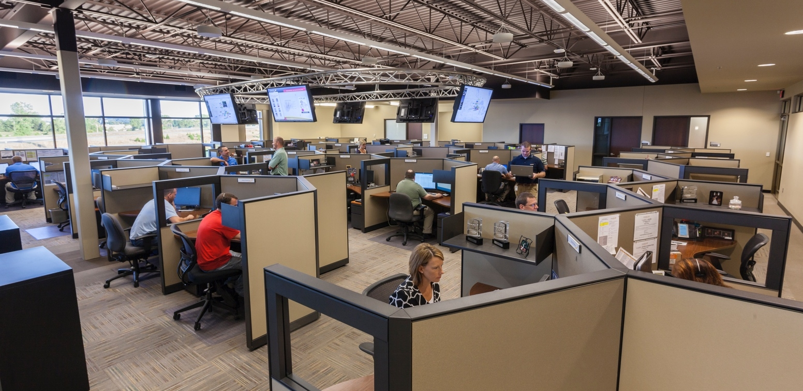
MANAGED IT SERVICES
Unlimited Support Desk
BIG COMPANY RESOURCES
Triage | 24/7 live-call answer by Marco employees
98% of calls answered within 10 seconds
Remediation | Monday - Friday 8:00 AM – 5:00 PM
98% of issues resolved remotely
24/7 remediation uplift available
Support Teams
Rapid Resolution - Front line support team to remediate issues faster
Color Care Teams - Tier 1, Tier 2, and team supervisor
Escalation - Advance Security Team, Advance Network Team, Field Services
Confidential Information

Slide 5
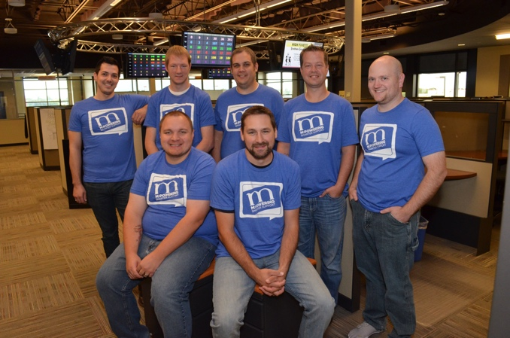
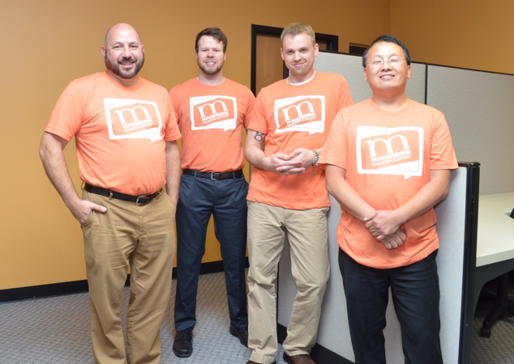
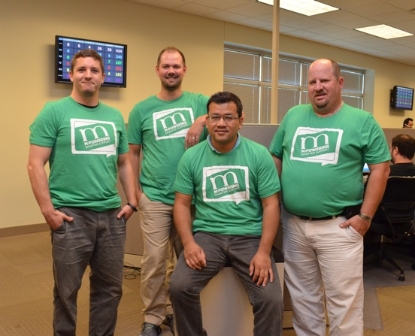
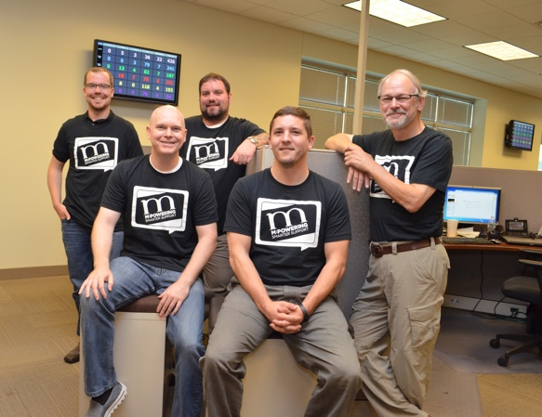
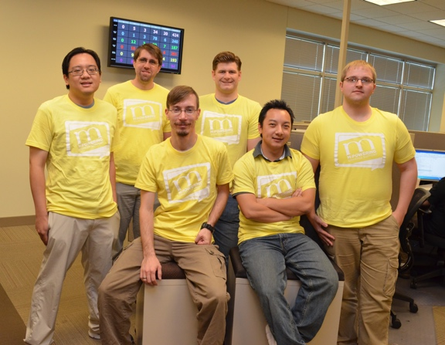
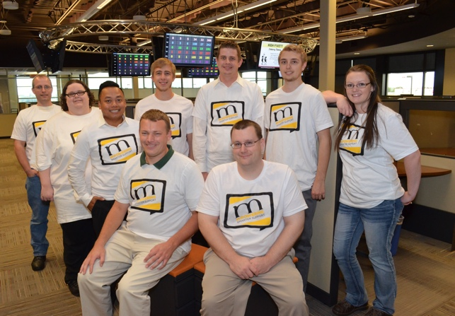
MANAGED IT SERVICES
Unlimited Support Desk
SMALL COMPANY FEEL
Triage | 24/7 live-call answer by Marco employees
98% of calls answered within 10 seconds
Remediation | Monday - Friday 8:00 AM – 5:00 PM
98% of issues resolved remotely
24/7 remediation uplift available
Support Teams
Rapid Resolution - Front line support team to remediate issues faster
Color Care Teams - Tier 1, Tier 2, and team supervisor
Escalation - Advance Security Team, Advance Network Team, Field Services
Confidential Information

Slide 6
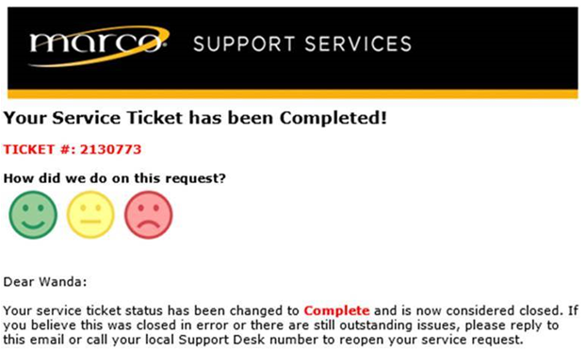
MANAGED IT SERVICES
Client Business Review Process
Immediate Client Feedback
Client Business Reviews
Service metrics
User feedback review
Confidential Information

Slide 7
MANAGED IT SERVICES
Unlimited On-Site Support
Proactive On-Site Visits
Field Services
59 Marco locations
750+ certified systems engineers and technical representatives
On-Site Visits
Regularly scheduled maintenance visits
Recurring health checks
Marco Extended Support Network
For areas we can’t reach, we are members of a national support network of “smart hands”
Third Party Software Support (Requires active support contract)
Confidential Information

Slide 8
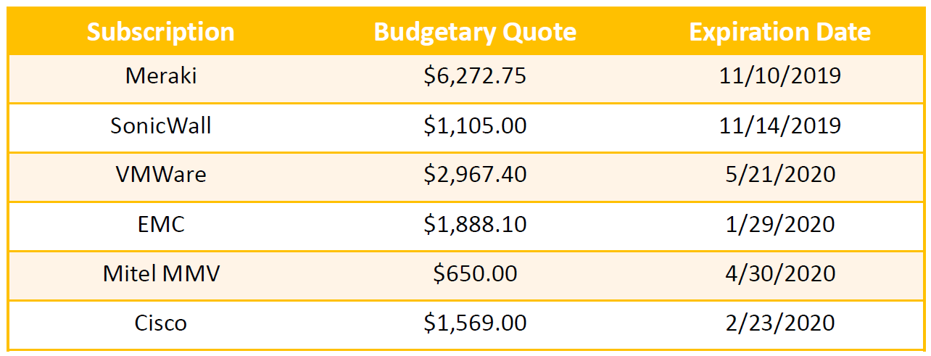
MANAGED IT SERVICES
Budgeting & Planning
Client Business Review Process
Client Business Reviews
Service metrics
User feedback review
Hardware lifecycle management
Budgeting and planning services
Confidential Information
Confidential Information

Slide 9
MANAGED IT SERVICES
Security Operations Center (SOC)
Network Operations Center (NOC)
Security Operations Center Services
Security analysts who monitor your network by leveraging an IDS (Intrusion Detection System)
24/7 network monitoring
IDS leverages multiple best-in-breed threat feeds
Network Operations Center (NOC)
Tool & software administration, proactive monitoring and alerting
Patching: operating systems (Windows / Mac) and 3rd party software
Secret Server – encrypting and securing our client data repository
Confidential Information

Slide 10
EXPERIENCE MATTERS
Geographic
Call Routing
(small company feel)
Call
Recording
(quality control)
End-User
Surveys
(immediate feedback)
Warm Call
Handoff
(no repeating yourself)
Vendor
Facilitation
(no finger pointing)
IT is never
“Out of the Office”
(increase productivity)
Over 10 Years of
MIT Experience
(mature processes)
Security
Focused
(reduce risk)
Unlimited
Support
(issues get resolved)
Rapid Resolution
Team
(1st call remediation)
Confidential Information

Slide 11
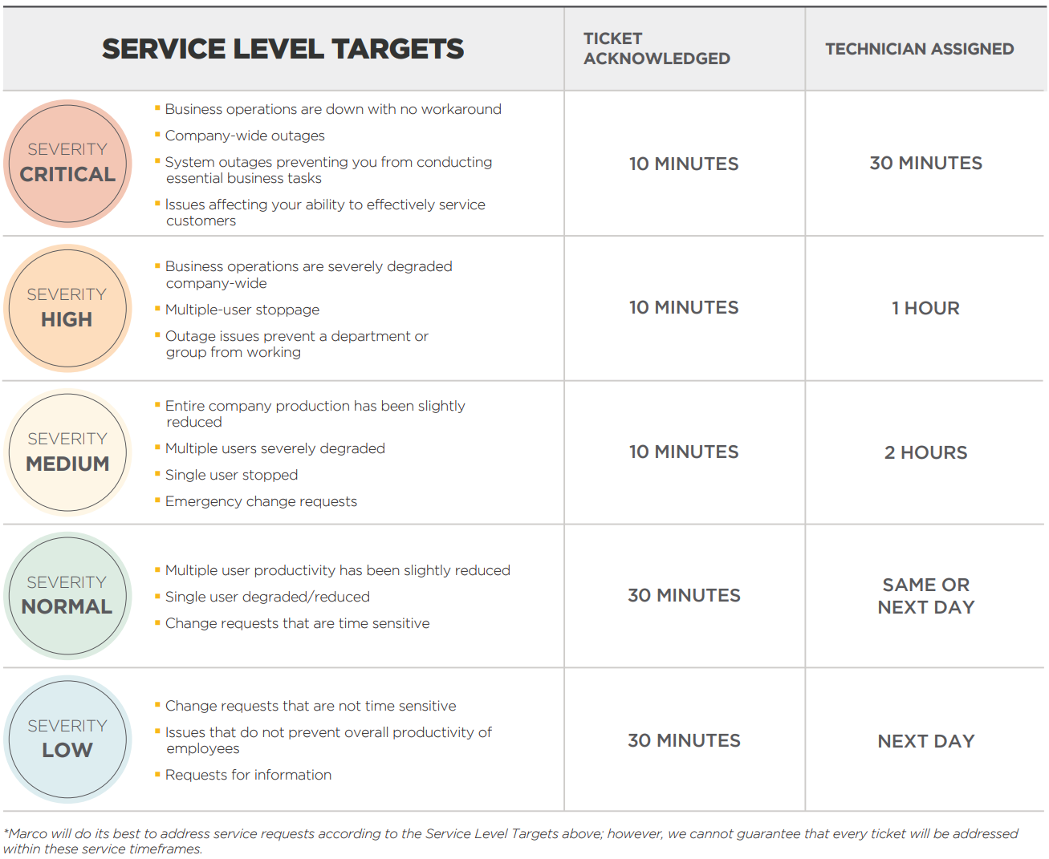
MEASUREMENTS MATTER
Confidential Information

Slide 12
SECURITY AT HOME
Human’s Monitoring
Video Surveillance
Glass Break Sensors
Lock
Alarm System
Front Door

Slide 13
SECURITY MATTERS
NIST Framework | National Institute of Standards and Technology
The NIST Cybersecurity Framework consists of standards, guidelines, and best practices to manage cybersecurity-related risk.
IDENTIFY
PROTECT
DETECT
RESPOND
RECOVER
Asset management
Business environment
Governance
Risk assessment
Risk management strategy
Access control
Awareness and training
Data security
Information protection process and procedures
Maintenance
Protective technology
Anomalies and events
Security continuous monitoring
Detection processes
Response planning
Communications
Analysis
Mitigation
Improvements
Recovery planning
Improvements
Communications
www.nist.gov/about-nist
Confidential Information

Slide 14
SECURITY AT WORK
Human’s Monitoring
Video Surveillance
Glass Break Sensors
Lock
Alarm System
Front Door

Slide 15
SECURITY AT WORK
Security Operations Center (SOC)
Monitoring and Alerting
Network Sensors
Anti-Virus / Anti-Malware
Detection and Response Platform
Firewall

Slide 16
MANAGED IT SERVICES
SUPPORT
TOOLS
Unlimited
Support Desk
Unlimited On-site Support
Proactive
On-site Visits
Threat Detection
and Response
Secure Managed Network
Remote Management
and Monitoring
Client Business
Review Process
Security Operations Center
Network
Operations Center
Security Training
and Phishing
Email and Web
Security
Anti-Malware
Protection
Confidential Information

Slide 17
SECURITY AT WORK
Security Training and Phishing Security Operations Center (SOC)
Remote Management and Monitoring Monitoring & Alerting
Secure Managed Network Network Sensors
Anti-Malware Protection Anti-Virus / Anti-Malware
Email & Web Security Detection and Response Platform
Threat Detection and Response Firewall

Slide 18
MANAGED IT SERVICES
NIST Framework | Marco Resources
The NIST Cybersecurity Framework consists of standards, guidelines, and best practices to manage cybersecurity-related risk.
IDENTIFY
PROTECT
DETECT
RESPOND
RECOVER
Client Business Review Process
Onboarding Process
Secure Managed Network
Remote Management and Monitoring
Marco Assessments
Proactive On-site Visits
Email & Web Security
Unlimited Support Desk
Secure Client Repository
Anti-Malware Protection
Patching (OS & 3rd Party)
Security Training and Phishing
Threat Detection
and Response
Security Operations Center
Anti-Malware Protection
Network Operations Center
Unlimited Support Desk
Rapid Resolution Team
Threat Detection and Response
Anti-Malware Protection
Unlimited On-site Support
Managed Backup (Optional)
Comprehensive IT Partner
Over 10 Years of MIT Experience
Unlimited On-site Support
Confidential Information
Notes:
Add NIST copy

Slide 19
MANAGED IT SERVICES
PER USER PRICING MODEL
$84/USER
Confidential Information

Slide 20
WHY MARCO?
Unlimited
Support Desk
Unlimited On-site Support
Proactive
On-site Visits
Threat Detection
and Response
Secure Managed Network
Remote Management
and Monitoring
Marco Assessments
Client Business
Review Process
Security Operations Center
Network
Operations Center
Security Training
and Phishing
Email and Web
Security
Anti-Malware
Protection
Rapid Resolution
Team
Onboarding Process
Over 10 Years of
MIT Experience
Predictable Cost
Secure Client Repository
Big Company Resources
Small Company Feel
IT is never
“Out of the Office”
Comprehensive IT Partner
Confidential Information

Slide 21
WHAT TO EXPECT
KICK-OFF MEETING
1
PROJECT PLAN
2
CREATE TIMELINE
3
AGENT LOAD
4
SITE DISCOVERIES
5
COMPLETE DOCUMENTATION
6
TRAINING
7
GO-LIVE
8
DAILY/WEEKLY
STATUS
UPDATES
9
MONTHLY SERVICE REVIEWS
SEMI-ANNUAL
BUSINESS REVIEW
Our extensive onboarding process provides a feeling on go-live day. It’s as if we've been your IT support forever!
Confidential Information

Slide 22
MARCO SOLUTIONS
IT Projects
Managed Services
Copiers & Printers
Data Center
Security
Unified Communications
Network Infrastructure
Audio Visual
Software
Document Management
Cloud Migration Services
Managed IT
Cloud Voice
Managed Print Services
Digital Printing Press
Wide Format Printers
Print Software Applications
Copiers, Printers & Multi-function Devices
Shredding Services
End-User Support Desk
Network Management
Desktop Management
Software Subscriptions
VaaS
UCaaS
Connectivity
Managed SD-WAN
Carrier Services
Cloud Solutions
Private Cloud
Public Cloud
Multi Cloud
Confidential Information

