Slide 1
Modernize Existing Apps: Continue Your Legacy in the Cloud
A Joint Project by Ocean9 and Apcera

Slide 2
Gartner is “Busting Bimodal Myths*”
Making Legacy and Traditional Applications “Cool” again
Gartner’s Mode 1 Application
Gartner’s Mode 2 Applications
Traditional
Monolithic
Tightly coupled
Slow
Cloud native
Microservices
Containers
Hybrid/multi-cloud
* http://www.gartner.com/smarterwithgartner/busting-bimodal-myths/

Slide 3
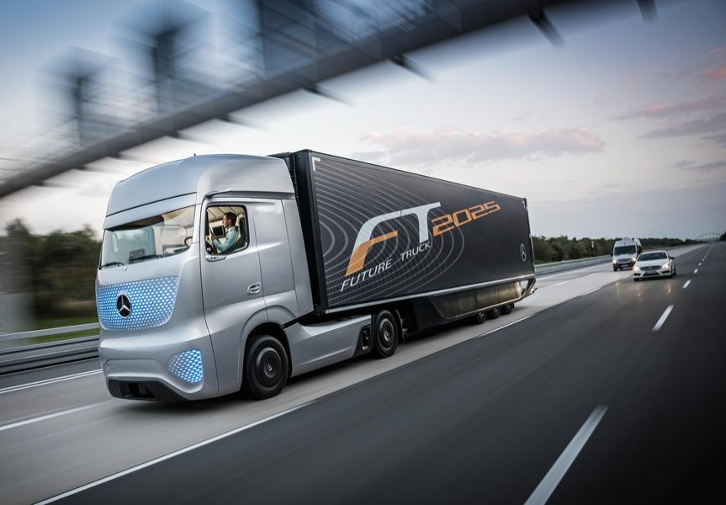
Making Business Truly Agile
All workloads need to be FAST and AGILE
FASHION & RETAIL
Smart stores
LOGISTICS
Supply chain
FINANCE
Virtual close

Slide 4
The Problem
Two Conflicting Paradigms in our Digital World
SLOW BACKEND
OPERATIONS
FAST PACED DIGITAL BUSINESS

Slide 5
The Joint Ocean9 and Apcera Solution
Born in the Cloud Containerized Applications and Databases
Database-as-a-Service
Business Apps-as-a-Service
Ocean9 + Apcera

Slide 6
About Ocean9
Cloud Native Service Characteristics for SAP Workloads
From Month to Minutes
Accelerate Innovation
Re-Inventing DevOps
Increase Uptime
Reduce Cost
Maximize
business value
$
BLACK FRIDAY
+
+

Slide 7
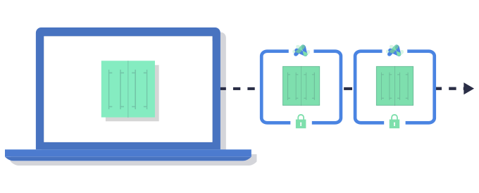
About Apcera
SOLVE REAL PROBLEMS.
MODERNIZE LEGACY APPLICATIONS
CONTAINERS IN PRODUCTION, SECURELY
MULTI AND HYBRID CLOUD PORTABILITY
Independence and agility in days, not months.
Accelerate innovation and agility without compromise.
Run across any infrastructure. No lock-in.

Slide 8
SAP Hybris on SAP HANA for Retail
A fully Containerized Architecture with Fallback to the Virtualized World
Hybris eCommerce Suite
Dev/Test
Prod
Joint Business Value
Rightsizing of retail systems driven by usage patterns and demands
Accelerated App Modernization – Traditional workloads in containers
Real time enforcement of business driven policies
Apache
Apache
Apache
Hybris
Hybris
Hybris
HANA Dev
HANA Test
HANA Prod
Fallback
option
Virtualized HANA
Prod
VPC 1 or VNET 1
VPC 2 or VNET 2
Cloud Account 1 (AWS or Azure)
Cloud Account 2 (AWS or Azure)

Slide 9
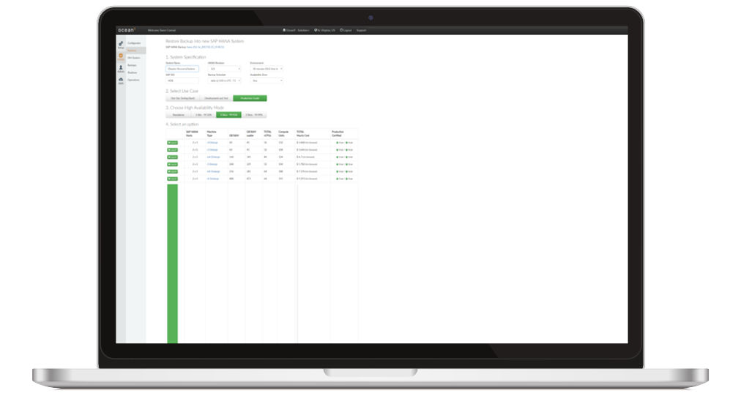
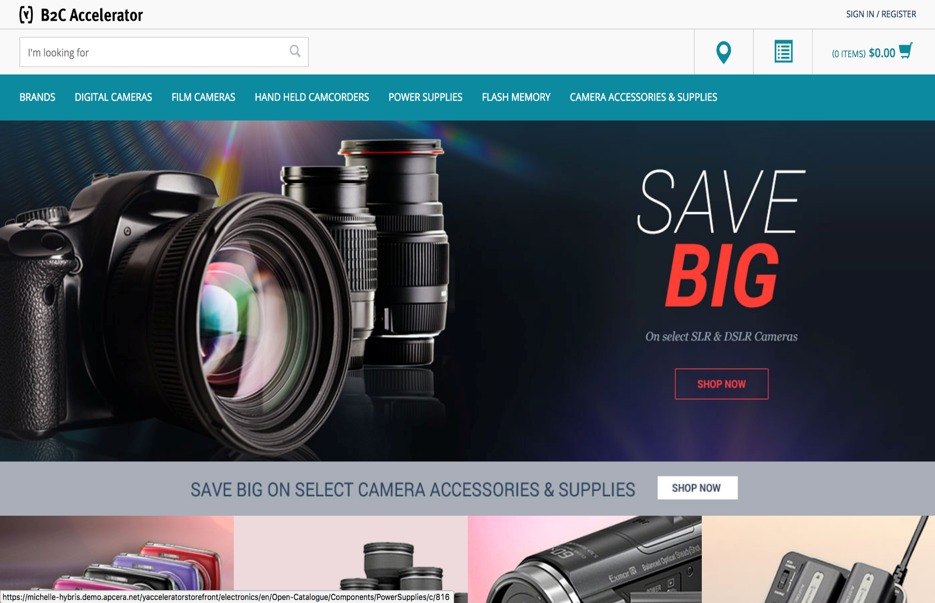
DEMO

Slide 10
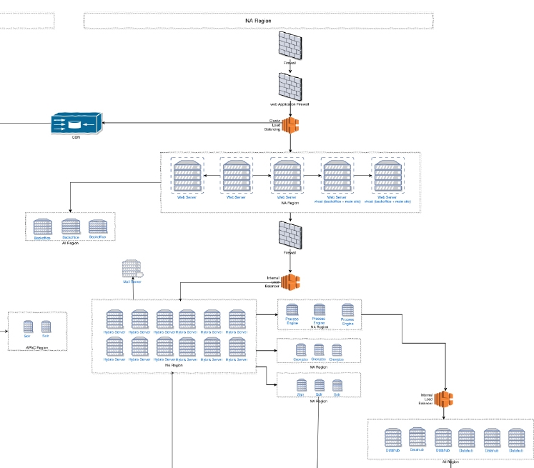
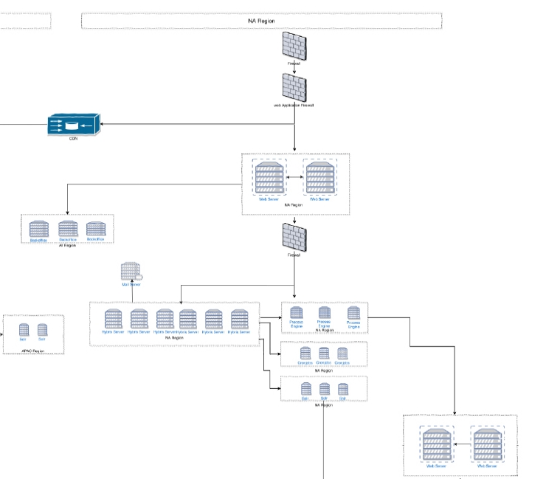
CUSTOMER STORY: Simplified on Apcera
Before
After
Apache Layer: 5x Server
SAP Hybris 6.1.0: 12x Server
F5 Load Balancers
SAP Hybris DataHub: 6x Server
Over 24 TB memory
Reduce AWS footprint by 50%: 24 to 7 servers
F5 load balancers are no longer needed: More money savings
Scalability without configuration changes
Deploy complete Stack in 10 min
Agility: move from 2 to 8 deployments per day

Slide 11
CUSTOMER STORY: Simplified on Ocean9
Flashbrand
After
“We needed an easier way to run SAP HANA, ensuring security, scalability and high availability without consuming precious engineering resources.
Now we can focus our energies on our own product innovation and customer success.”
Denis Descause, CEO at Flashbrand

Slide 12
Enabling Business Value
Containers are Making it Happen
Quick provisioning and scaling – for stateless & stateful
Higher Average Resource Utilization
Workload Mobility

Slide 13
High Value Pilot Offer
Agenda:
Analysis of Your Application Portfolio
Best Practices for Enterprise Apps in Cloud
Containerize, Deploy and Manage
Free trial of the Apcera and Ocean9 solutions
In-person or Virtual Session
See if you qualify for one of three customized pilots

Slide 14
Slide download
Click Icon
http://ocean9.io/content-download/modernizing-existing-legacy-applications

Slide 15
Thank You
LEARN MORE AT
Ocean9.io
Apcera.com

