Slide 1
December 7, 2016

Slide 2
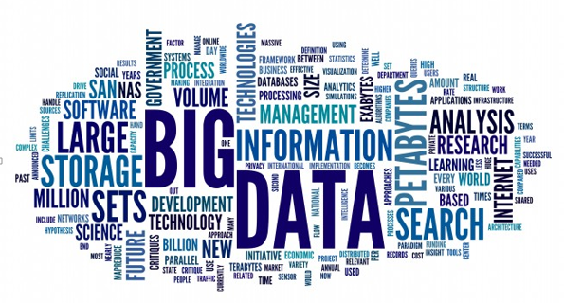

Slide 3
+ Data Lake

Slide 4
Definition of a Data Lake
James Dixon in 2010
"If you think of a datamart as a store of bottled water – cleansed and packaged and structured for easy consumption – the data lake is a large body of water in a more natural state.
The contents of the data lake stream in from a source to fill the lake, and various users of the lake can come to examine, dive in, or take samples."
Source

Slide 5
Warehouse vs Lake
Inclusive or Exclusive Solutions?
Data Warehouse | vs | Data Lake
Pre-defined business analysis | INTENTION | Ad-hoc, explorative analysis
Structured, processed | DATA | Structured / semi-structured / unstructured, raw
Expensive for large data volumes | STORAGE | Designed for low-cost storage
Schema-on-write Built-in compute | PROCESSING | Schema-on-read In cloud: Only when needed
Less agile, fixed configuration | AGILITY | Highly agile, configure and reconfigure as needed
Mature | SECURITY | Maturing
Business professionals | USERS | Data scientists and others
80% preparation – 20% analytics | EFFORT | 20% preparation – 80% analytics

Slide 6
High Level Data Lake Architecture
Business Analyst
Strong Governance is the Key Ingredient
Time Series Analysis
Data Scientist
Analyze + Transform
Metadata
Lineage
Age
Privacy
Usage history
Business Analyst
Data Scientist
Real Time Analysis
Analyze
Relational
Data
bucket
Data
bucket
Documents, Emails
Data
bucket
SAP HANA
Social
Data
bucket
Data
bucket
Data
bucket
Data
bucket
Data Warehouse
Machines and Devices
Notes:
AWS Glue virtualizes traditional datas sources like Datawarehouse and makes them appear in the lake.
Azure Datalake

Slide 7
Agenda
Key Architecture Considerations
Collecting Data
Preserving and Manipulating Data
Making Key Data easily Accessible
Compliance with Company Rules and Processes
Managing the Lifecycle of your Data
Summary

Slide 8
Collecting Relevant Data
Ingestion Workflow Mechanism
Temp/Flow/Vibration
Data sheets
Location
Personnel
Inventory/RFID
POS data
RFID
Cust loyalty
Beacon marketing
GPS
Telemetry
Video
Temperature
Maintenance
Contents
Key requirements
Easy and quick addition of configurable workflow
Automated and reliable
Traceable
Secure
icons8
Notes:
Technical examples:
- AWS CLI
- AWS Kinesis – streaming service
- AWS IoT – device based
- azure CLI
- Azure. Like Kinesis

Slide 9
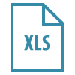
Preserving and Manipulating Data
Data Immutability and Lineage
Data Warehouse
Typical Scenario
Data Lake
Tracking of Data Lineage
Key requirements
Track origin of data
Machine ID
Medical device ID
Protect original data object
Track all transformations to establish data lineage
?
icons8
Notes:
http://www.fda.gov/MedicalDevices/DeviceRegulationandGuidance/UniqueDeviceIdentification/

Slide 10
Making Key Data easily Accessible
Search Capabilities, Data Tiering and Ageing
 | Archive | Object | Local Disk | Local SSD | SAN Disk | SAN SSD
Cents per GB/ Month* | 0.4 | 2.4 | D2 instance | I2, X1, R3 instances | 2.5 | 10
Key requirements
Managed trade-off between access speed and storage cost
Key business data with fast access – In-Memory
Consider usage over time, delete data with short lifespan
*AWS
SSD
Disk
--
SAN
Local
Delete
Archive
Object
Storage
In-Memory
COLD HOT
Cost
Optimized
Performance
Optimized
icons8
Notes:
Integrate With Existing Environments
Instead of ripping and replacing your enterprise environment, a new data lake needs to work with existing enterprise data management paradigms, tools and methods, Knowledgent recommends.

Slide 11
Comply w/ Company Rules and Processes
Data Lake Governance
Key requirements
Reporting mechanism
Consumption tracking
Security
Privacy
Chargeback models
Data Privacy Classification:
CRITICAL
RESTRICTED
HIGHLY CONFIDENTIAL
CONFIDENTIAL
PUBLIC
Notes:
Design and Roll Out An Operating Model
If working with an expert partner, make sure the operating model meets your company’s processes, organizational structure, rules and governance – including such capabilities as chargeback models, consumption tracking and reporting mechanisms, Knowledgent recommends.

Slide 12
Managing the Lifecycle of your Data
Meta Data Management
Key requirements
Comprehensive
Highly automated
Ongoing extraction and management
Foundation for self-service data discovery
Business Context
Technical Context Data Types, Machine IDs
Lineage Source, Time & Transformations
History
Age, Usage
Privacy
Notes:
“Attributes like data lineage, data quality, and usage history are vital to usability,” Knowledgent states. “Maintaining this meta data requires a highly-automated meta data extraction, capture, and tracking facility. Without a high-degree of automated and mandatory meta data management, a data lake will rapidly become a data swamp.”

Slide 13
High Level Data Lake Architecture
Business Analyst
Time Series Analysis
Data Scientist
Analyze + Transform
Metadata
Lineage
Age
Privacy
Usage history
Business Analyst
Data Scientist
Real Time Analysis
Analyze
Relational
Data
bucket
Data
bucket
Documents, Emails
Data
bucket
SAP HANA
Social
Data
bucket
Data
bucket
Data
bucket
Data
bucket
Data Warehouse
Machines and Devices
Notes:
AWS Glue virtualizes traditional datas sources like Datawarehouse and makes them appear in the lake.
Azure Datalake

Slide 14
Summary
The Power of the Data Lake
Data Lakes suited for extremely large data volumes
Open and flexible architecture
Integrate existing data assets
Future expandability
Data democratization across the business organization through holistic governance

Slide 15
Ocean9, Inc.
Platform-as-a-Service for Applications and Databases
Application-as-a-Service
+
Enterprise Class
High performance
High availability
Strict security
PLUS
Extensibility via Add-ons
Business Continuity and Disaster Recovery
S/4HANA
+
Database-as-a-Service
HANA
Platform-as-a-Service
Cloud OS
Ocean9 Intelligent Platform
+
Notes:
Ocean9 solves this problem for SAP systems and workloads with our on-demand Infrastructure SaaS solutions for SAP business apps like ERP and the SAP HANA database. We run natively on both AWS and Azure.
Our service provides the highest level of enterprise class
- performance
- availability
- security
What’s more, the Ocean9 platform takes full advantage of native cloud … and … we even have the ability to run the heavy state SAP HANA database in a Docker Container for additional agility and cost benefits.
Let’s have a closer look at the cloud native characteristics of our services.

Slide 16
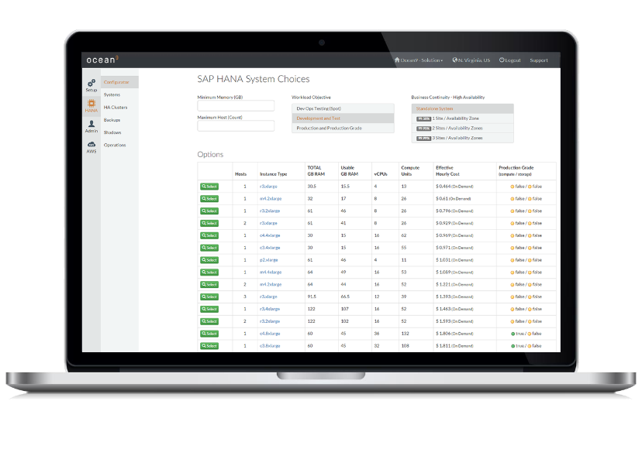

Slide 17
Thank you
Swen Conrad, CEO Ocean9
swen@ocean9.io
650 889 9876

Slide 18
Download the Slides
Download link

