Slide 1
Running Databases in Containers. How to Overcome the Challenges of Data
Frank Stienhans
CTO
Ocean9
Prepared for

Slide 2
Evolution of Enterprise IT
Subjective Perspective
More Choices
Faster Delivery
Higher Density
Increased Control
CONTAINERS
CLOUD
VIRTUALIZATION
BARE METAL

Slide 3
Containers
What is it
Standardized Application Virtualization
Application defined as Image, without the OS Kernel
CPU, RAM, Network, Mount & Process Isolation
Begin: ~ 2006 @ Google

Slide 4
Containers
Value
Enable quick provisioning and scaling
Enable Higher Resource Density
Increased Control over workload Placement and Usage

Slide 5
Adoption Phases
1.
Frontends
2.
Applications
3.
Databases
 |  | FRONTEND | APPLICATION | DATABASE
RISK | Blast Radius | Single User | Many Users | All Users
 | Recovery | Minutes | Minutes | Hours - Days
BENEFIT | Cost Savings | $ | $$ | $$$

Slide 6
Definition
Heavy Containers
“Heavy Containers”
Containers with a lot of State

Slide 7
Challenges
Heavy Containers
Local State – Focus Today
Long Life
Highest Security

Slide 8
Databases before Containers
Traditional Cloud Sizing
CPU
Available Resources in Virtual Machine Instance Type
DB Sizing: Function of …
RAM
CPU
Network
I/O
DB Utilization
5% average utilization is normal
Hence, 95% waste
DB Resources
Required
for a predicted Peek
DB Resources utilized on Average
RAM

Slide 9
Database with Container
Cloud Native Sizing
CPU
Available Resources in Virtual Machine Instance Type
Fill the DB Host with Apps (Stateless Containers)
Grow your DB container as if those do not exist.
Keep some resource reserve as a buffer
App
App
App
App
App
App
App
App
App
App
App
App
App
App
App
App
App
App
DB Resources utilized on Average
RAM

Slide 10
Cloud Native Maximum High Availability
Triple Site Database Setup in one GEO Region
Available Resources in Virtual Machine Instance Type
Available Resources in Virtual Machine Instance Type
App
App
App
App
App
App
App
App
App
App
App
App
App
App
App
App
App
App
App
App
App
App
App
App
App
App
App
App
App
App
App
App
App
App
App
App
Available Resources in Virtual Machine Instance Type
DB Site A
Sync DB
Replication
DB Site B
Sync DB
Replication
DB Site C

Slide 11
Network Filesystems for HPC Persistence
Your Apps
AWS
EBS
DB Host
::
X1.32xlarge
::
Amazon EC2
DB Replication
Max
Max
Network 20G
I/O ~ 10G
Data Integration
Network / Cluster File System for Tier 1 I/O
Ephemeral
Locally Attached
SSD

Slide 12
Amazon EC2 R4 Family
x
x
x
x
X-large
RAM : 30 GB RAM
CPU : 4 vCPUs
Network : ~ 1.25 Gbps
EBS I/O : ~ 0.60 Gbps
16 X-large
RAM : 488 GB
CPU : 64 vCPUs
Network : 20 Gbps
EBS I/O :~ 10 Gbps
x
x
x
x
x
x
x
x
x
x
x
x

Slide 13
Azure, same answer
Your Apps
Azure
Premium Disks
DB Host
::
Azure Virtual Machine
DB Replication
Max
Max
Network 25G
I/O ~ 10G
Data Integration
Network / Cluster File System for Tier 1 I/O
“Resource Disk”
Locally Attached
SSD

Slide 14
Needs
Heavy Containers
Intelligent Placement (4D : CPU, RAM, Net, I/O)
Real-time Monitoring
Data Agility and Data Performance (usually XOR)
Density

Slide 15
Demo
Heavy Containers
Running Virtual Machine
No Storage
Linux Bash
>> ray docker recover hana2/206
Example uses SUSE Linux 12 SP2 and SAP HANA SPS 12

Slide 16
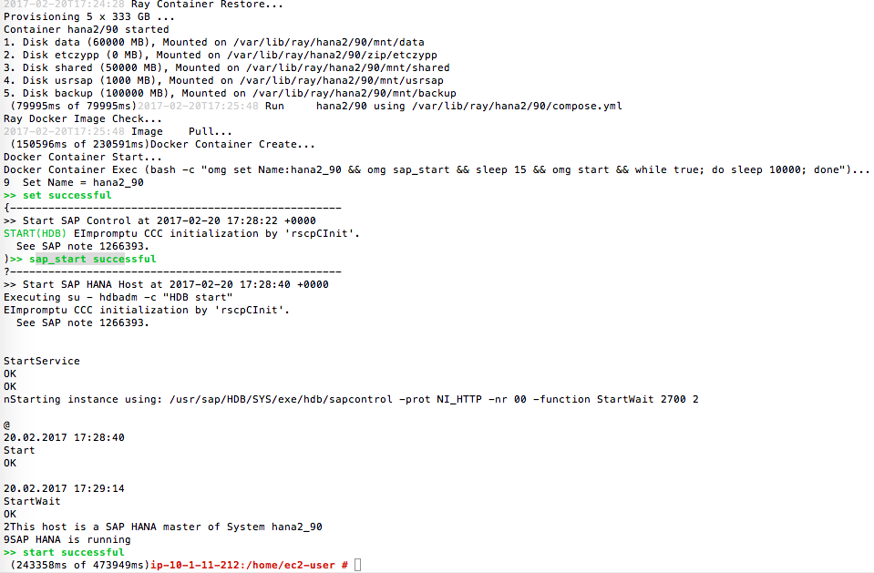
Output: SAP HANA System with 1.2 billion rows
Storage
Docker Image
Docker Container

Slide 17
Inbuilt Automated Fallback
One Click Away
Backup & Recovery
OR
Synchronous DB Replication
HANA
Production
HANA Production
Container
Virtual Machine

Slide 18
The Ocean9 Solution
Born in the Cloud SAP-as-a-Service
Database-as-a-Service
Business Apps-as-a-Service
Enterprise Class
High performance
High availability
Strict security
PLUS
Cloud native capabilities
Database containers
B1on
Ocean9 Intelligent Platform

Slide 19
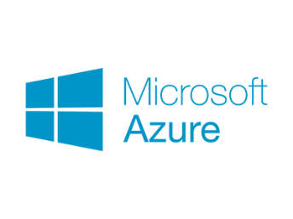
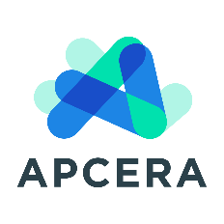
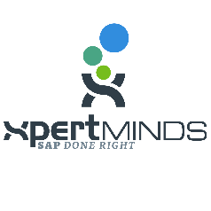
Partner Ecosystem
Constantly Growing

Slide 20
Thank You
Please Meet Us at our Booth #234
Attend our Sessions
Running Databases in Containers. How to Overcome the Challenges Frank Stienhans, CTO Ocean9 Wed, June 7th, 8:30 – 9:05 am
The “known unknown" of Big Data in IoT Swen Conrad, CEO Ocean9 Wed, June 7th, 5:00 – 5:35 am
Booth #234
Visit us!
Try Ocean9
Born-in-the-Cloud solutions for SAP

Slide 21
Thank you
Frank Stienhans
frank@ocean9.io

