Slide 1
Enterprise Cloud Adoption & Digital Trans.
The "known unknown" of Big Data in IoT: How big will your data grow and by when?
IoT is at the core or many Digital Transformation initiatives with the goal of re-inventing a company’s business model. We all agree that collecting relevant IoT data will result in massive amounts of data needing to be stored. However, with the rapid development of IoT devices and ongoing business model transformation, we are not able to predict the volume and growth of IoT data. And with the lack of IoT history, traditional methods of IT and infrastructure planning based on the past do not apply either.
Understand key cloud concepts and how they enable your successful IoT initiative providing flexibility and elasticity to your IT infrastructure in a highly secure fashion.
Join this presentation to understand how the two trends of cloud and IoT are better together."

Slide 2
The “known unknown" of Big Data in IoT: How big will your data grow and by when?
Swen Conrad, CEO Ocean9
Cloud Expo, New York, June 2017

Slide 3
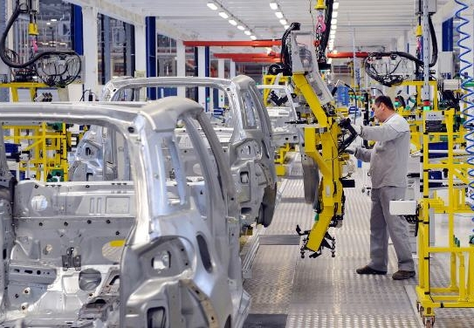
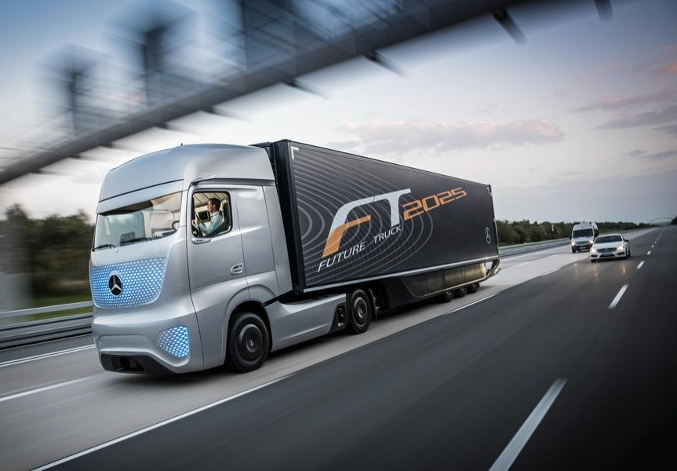
IoT for Digital Transformation
A Strategic Imperative
MANUFACTURING
Industry 4.0
LOGISTICS
Self-driving vehicles
BANKING & INSURANCE
Real time risk

Slide 4
Collecting Relevant Data
You are darned if you do, you are darned if you don’t
Temp/Flow/Vibration
Data sheets
Location
Personnel
Inventory/RFID
POS data
RFID
Cust loyalty
Beacon marketing
GPS
Telemetry
Video
Temperature
Maintenance
Contents
Key consideration
Data access
Value of data over time
Security
Traceability to source
icons8

Slide 5
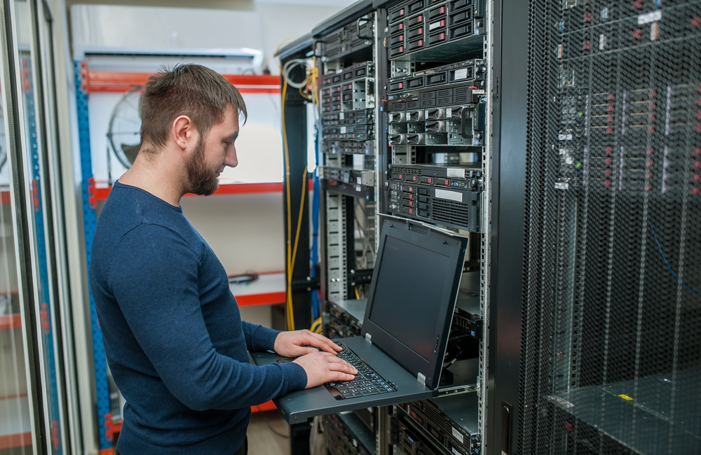
One More Problem
Two Conflicting Paradigms in our Digital World
SLOW BACKEND OPERATIONS
FAST PACED DIGITAL BUSINESS

Slide 6
Cloud for IoT and More
Key Architecture Considerations
Data Lakes
Taking your “Legacy” to the Cloud
Heavy State Containers for Database agility
Experimentation as the new Planning

Slide 7
Data Lakes – A Definition
A Cloud Architecture well suited for IoT use cases
"If you think of a datamart as a store of bottled water – cleansed and packaged and structured for easy consumption – the data lake is a large body of water in a more natural state.
The contents of the data lake stream in from a source to fill the lake, and various users of the lake can come to examine, dive in, or take samples."
Source

Slide 8
High Level Data Lake Architecture
Business Analyst
Strong Governance is the Key Ingredient
Time Series Analysis
Data Scientist
Analyze + Transform
Metadata
Lineage
Age
Privacy
Usage history
Business Analyst
Data Scientist
Real Time Analysis
Analyze
Relational
Data
bucket
Data
bucket
Documents, Emails
Data
bucket
SAP HANA
Social
Data
bucket
Data
bucket
Data
bucket
Data
bucket
Data Warehouse
Machines and Devices

Slide 9
Making Key Data easily Accessible
Search Capabilities, Data Tiering and Ageing
 | Archive | Object | Local Disk | Local SSD | SAN Disk | SAN SSD
Cents per GB/ Month* | 0.4 | 2.4 | D2 instance | I2, X1, R3 instances | 2.5 | 10
Key requirements
Managed trade-off between access speed and storage cost
Key business data with fast access – In-Memory
Consider usage over time, delete data with short lifespan
*AWS
SSD
Disk
--
SAN
Local
Delete
Archive
Object
Storage
In-Memory
COLD HOT
Cost
Optimized
Performance
Optimized
icons8

Slide 10
Cloud for IoT and More
Key Architecture Considerations
Data Lakes
Taking your “Legacy” to the Cloud
Heavy State Containers for Database agility
Experimentation is the new Planning

Slide 11
Taking your “Legacy” to the Cloud
Born in the Cloud SAP-as-a-Service
Database-as-a-Service
Business Apps-as-a-Service
Enterprise Class
High performance
High availability
Strict security
PLUS
Cloud native capabilities
Database containers
Ocean9 Intelligent Platform

Slide 12
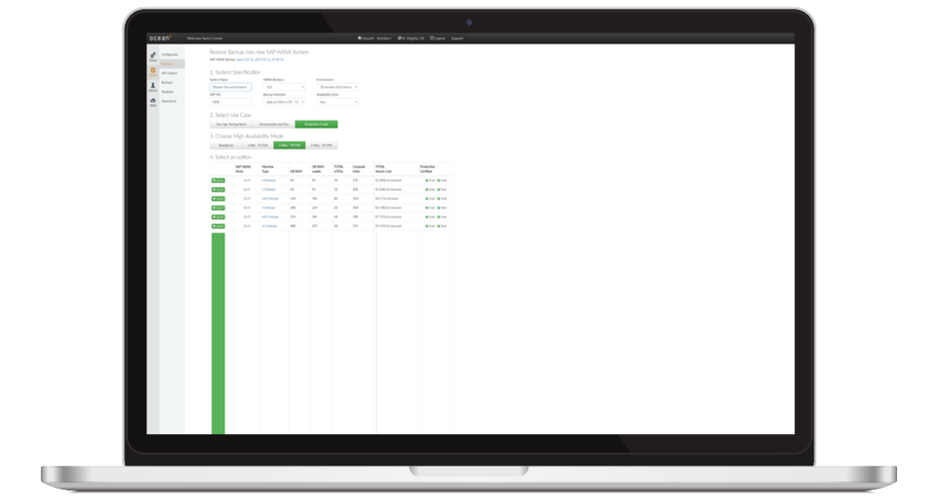
DEMO

Slide 13
Cloud for IoT and More
Key Architecture Considerations
Data Lakes
Taking your “Legacy” to the Cloud
Heavy State Containers for Database agility
Experimentation is the new Planning

Slide 14
Evolution of Enterprise IT
Trend or Fad?
More Choices
Faster Delivery
Higher Density
Increased Control
CONTAINERS
CLOUD
VIRTUALIZATION
BARE METAL

Slide 15
DB Containers – Production Ready
Further Enterprise Security with Fallback to Virtualized World
Frontends
Applications
Databases?
 |  | FRONTEND | APPLICATION | DATABASE
RISK | Blast Radius | Single User | Many Users | All Users
 | Recovery | Minutes | Minutes | Hours - Days
BENEFIT | Cost Savings | $ | $$ | $$$$$$

Slide 16
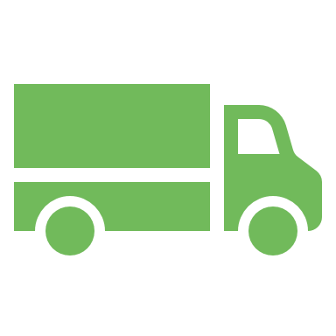
Containers
Business Value
Quick provisioning and scaling – for stateless
Higher Average Resource Utilization
Workload Mobility

Slide 17
Cloud for IoT and More
Key Architecture Considerations
Data Lakes
Taking your “Legacy” to the Cloud
Heavy State Containers for Database agility
Experimentation is the new Planning

Slide 18
“Experimentation is the new planning”
Enable Many Ideas and Projects for IoT Business Sucess
Example: SAP HANA | Experimentation for IoT Success | Enterprise IT Reality
Infrastructure cost: 256GB appliance | $1–2k | $35k*
Provisioning lead times | Hours (maximum days) | On-prem:3–6 month Most clouds: 2–6 weeks
Digital experiment succeeds Capitalize on solution ASAP De-risk with business continuity and disaster recovery (BCDR) | Days (maximum weeks) | Months
* Source: SAP HANA blog

Slide 19
Cloud: a Must in our Digital IoT World
Growing number of Companies are Taking Advantage Already
“Cloud is … part of the Digital Transformation agenda, and ... companies … digitally transforming themselves, struggle to do so without the [Cloud].
UK Cloud Industry Forum, Cloud and the Digital Imperative, 2016

Slide 20
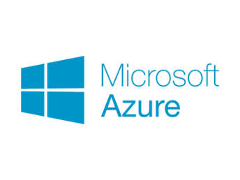
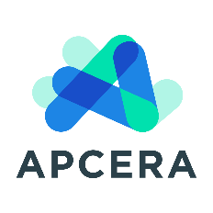
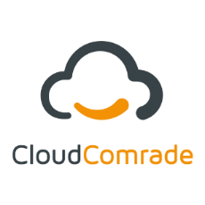
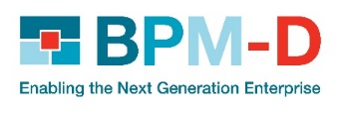
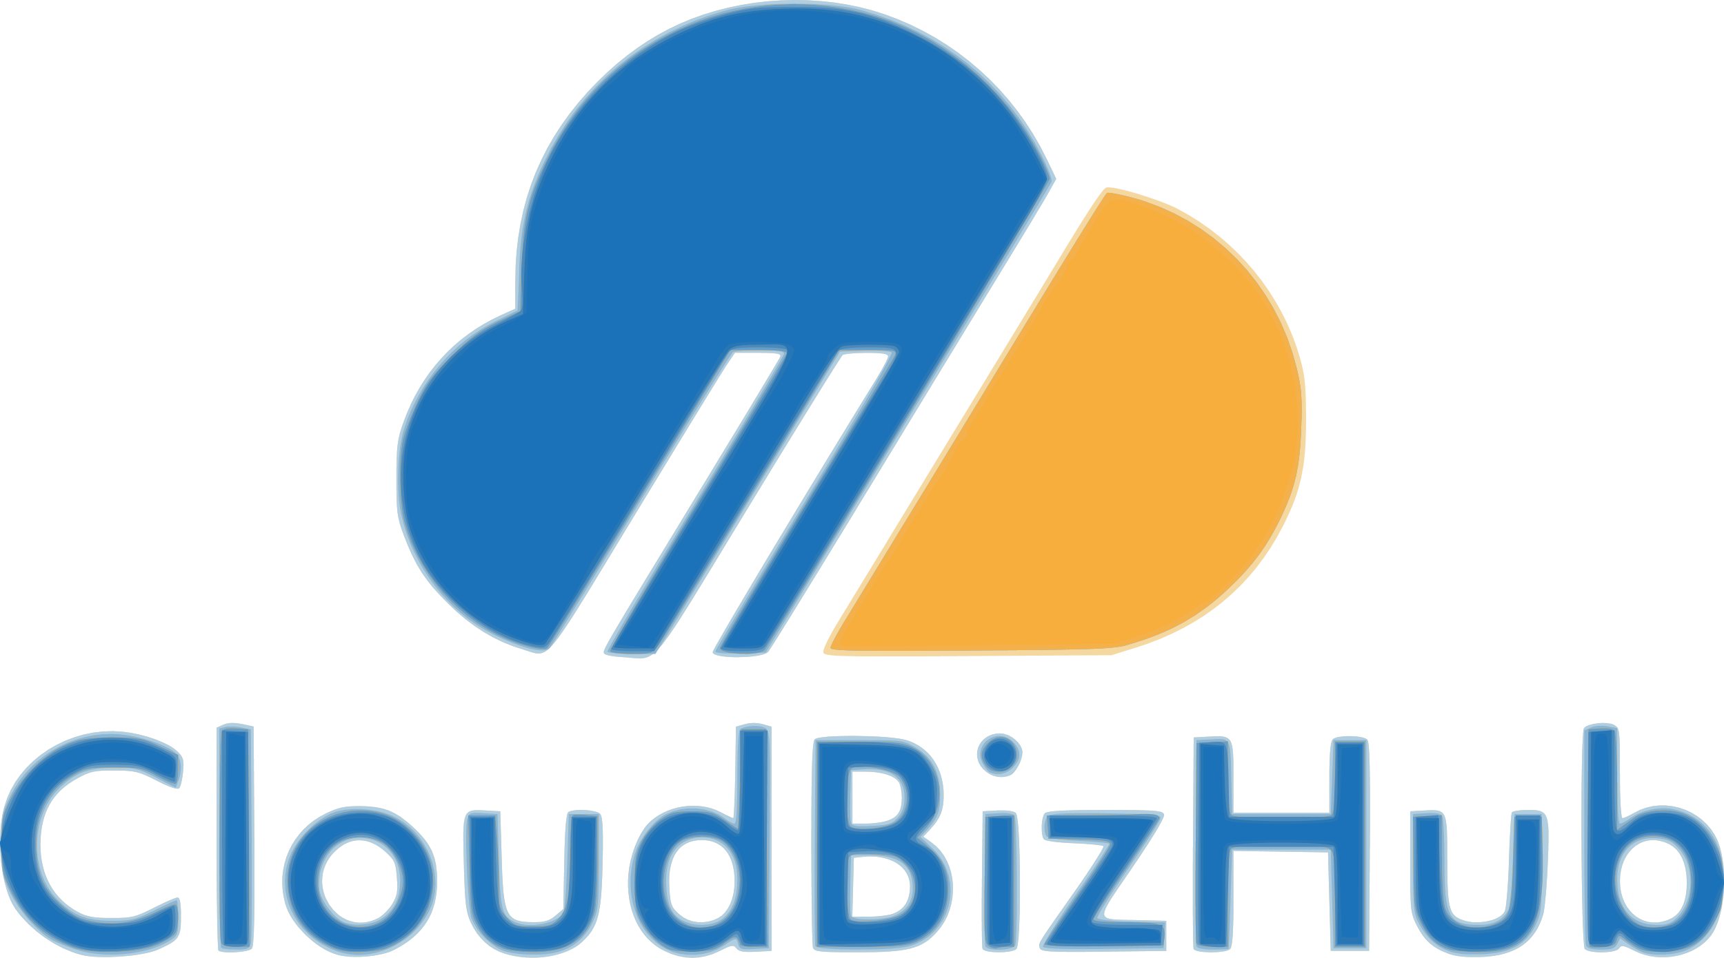
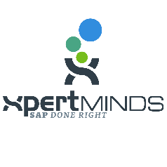
Enabling many Partners and Customers
Join our Growing Ecosystem

Slide 21
Summary
Cupcake!
X
Cloud makes IoT a Piece of cake
Solve the Chicken and Egg Problem
Turn “Legacy” Apps into Digital Engines via native cloud
Public Cloud is the True Enabler of IoT

Slide 22
Let’s Continue
Please Meet Us at our Booth #234
Attend our Sessions
Running Databases in Containers. How to Overcome the Challenges Frank Stienhans, CTO Ocean9 Wed, June 7th, 8:30 – 9:05 am
The “known unknown" of Big Data in IoT Swen Conrad, CEO Ocean9 Wed, June 7th, 5:00 – 5:35 am
Booth #234
Visit us!
Try Ocean9
Born-in-the-Cloud solutions for SAP

Slide 23
Questions?

Slide 24
Thank you
Swen Conrad, CEO
swen@ocean9.io
650 889 9876

Slide 25
Founding team – Ocean9
Swen Conrad, CEO
Frank Stienhans, CTO
Swen brings 20 years of business leadership in SAP and cloud across consulting, IT management, marketing and sales disciplines to Ocean9.
In 2002, he held IT operational responsibility for one of Hewlett Packard’s ww SAP installations with $8billion in annual transaction volume.
When at SAP he created the first unified solution for the Business of IT, earning company wide recognition. Being part of the highly successful SAP in-memory database launch (SAP HANA), and later launching related AWS and managed cloud offerings, he started shifting his full attention to cloud.
In 2014, Swen rejoined HP where he has recently held roles as SAP CTO as well as in cloud sales.
Swen has co-authored a book on IT Business Management and is a frequent presenter at events.
Frank is an early cloud innovator with key architecture and operations contributions to SAP On Demand starting in 2005.
In 2007, he was first to recognize the power of AWS for SAP use cases: His team built a self-service platform that allowed simple deployment of any kind of complex SAP solution on AWS, launching more than 10k servers per month. Gaining tremendous operational expertise, SAP’s then CTO Vishal Sikka challenged Frank to build a fully unattended SAP HANA service on AWS, which resulted in 96% cost savings.
In 2013 Frank joined AWS Professional Services. He has helped many large SAP customers to leverage the full power of the AWS platform.
Frank is considered the leading expert in his field and is the holder of 18 cloud related patents.

Slide 26
Download Slides
https://www.ocean9.io/content-download/cloudexpo-nyc-2017-database-containers

