Slide 1
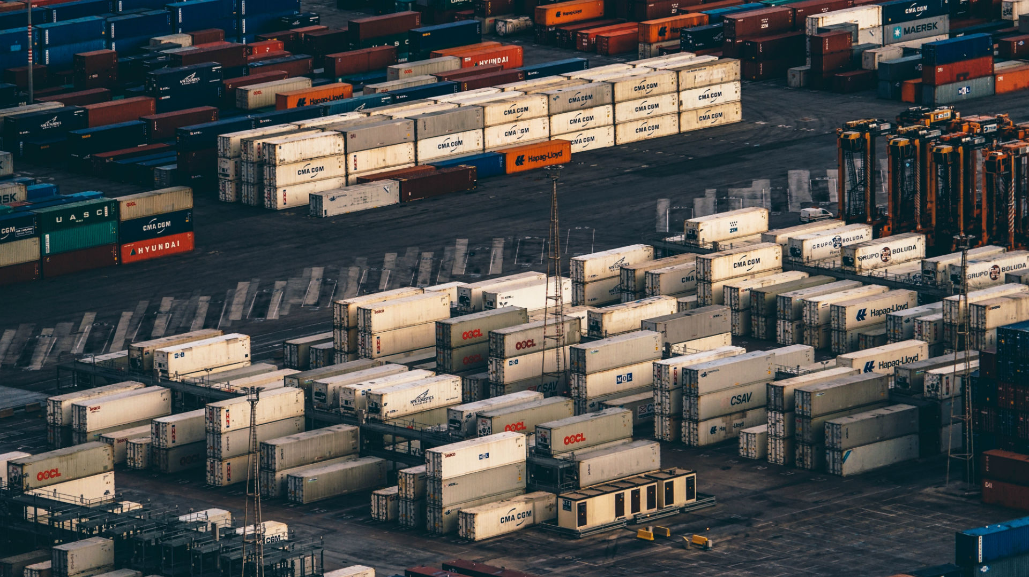
Running Databases in Containers: Overcome the challenges of Heavy Containers
Join LIVE Webinar
April 20 at 10 am Pacific

Slide 2
Containers
What is it?
Standardized Application Virtualization
Application defined as Image, without the OS Kernel
CPU, RAM, Network, Mount & Process Isolation
Available for
Linux
Windows 2016

Slide 3
Containers
Trend or Fad?
CONTAINERS
Increased Resource Utilization
Accelerated Delivery
Increased Security and Control
PUBLIC CLOUD
Resources whenever, wherever
Pay per use
Increased Security and Control
PRIVATE CLOUD
Service catalogues
Some degree of automation
VIRTUALIZATION
Increased Resource Utilization
Accelerated Delivery
Increased Security and Control
TRADITIONAL DC

Slide 4
Containers
Business Value
Quick provisioning and scaling – for stateless
Higher Average Resource Utilization
Workload Mobility

Slide 5
Container Adoption Phases
Following the adoption path of related technologies
Frontends
Applications
Databases?
 |  | FRONTEND | APPLICATION | DATABASE
RISK | Blast Radius | Single User | Many Users | All Users
 | Recovery | Minutes | Minutes | Hours - Days
BENEFIT | Cost Savings | $ | $$ | $$$$$$

Slide 6
Heavy Containers
Definition
Containers with a lot of State,
we call “Heavy Containers”

Slide 7
Challenges
Heavy State Database Containers
Need state locally – the more local the better
Require high performance I/O
Long lifespan compared to application containers

Slide 8
Amazon EC2 R4 Family
Anatomy of Cloud Compute
x
x
x
x
Green Box = R4.xlarge
RAM 30.5 GB RAM
CPU 4 vCPUs
Network Up to 10 Gbps (~ 1.25 Gbps)
EBS I/O ~ 0.60 Gbps
All Slots Combined = R4.16xlarge
RAM 488 GB
CPU 64 vCPUs
Network 20 Gbps
EBS I/O ~ 10 Gbps
x
x
x
x
x
x
x
x
x
x
x
x

Slide 9
Database without Container
Traditional Cloud Sizing
CPU
Available Resources in Virtual Machine Instance Type
DB Sizing: Function of …
RAM
CPU
Network
I/O
DB Utilization
5% average utilization is normal
Hence, 95% waste
DB Resources
Required
for a predicted Peek
DB Resources utilized on Average
RAM

Slide 10
Database with Container
Cloud Native Sizing
CPU
Available Resources in Virtual Machine Instance Type
Fill the DB Host with Apps (Stateless Containers)
Grow your DB container as if those do not exist.
Keep some resource reserve as a buffer
App
App
App
App
App
App
App
App
App
App
App
App
App
App
App
App
App
App
DB Resources utilized on Average
RAM

Slide 11
Cloud Native Maximum High Availability
Triple Site Database Setup in one GEO Region
Available Resources in Virtual Machine Instance Type
Available Resources in Virtual Machine Instance Type
App
App
App
App
App
App
App
App
App
App
App
App
App
App
App
App
App
App
App
App
App
App
App
App
App
App
App
App
App
App
App
App
App
App
App
App
Available Resources in Virtual Machine Instance Type
DB Site A
Sync DB
Replication
DB Site B
Sync DB
Replication
DB Site C

Slide 12
Why not a network/cluster file system?
On AWS: Not really an option
Your Apps
AWS
EBS
DB Host
::
X1.32xlarge
::
Amazon EC2
DB Replication
Max
Max
Network 20G
I/O ~ 10G
Data Integration
Network / Cluster File System for Tier 1 I/O
Ephemeral
Locally Attached
SSD
Earlier Example:
r4.16xlarge – 488 GB RAM – 20 Gbps Network + ~ 10 Gbps EBS
r4.xlarge – 30 GB RAM – estimate 1.25 Gbps Network + 0.6 Gbps EBS

Slide 13
How about Microsoft Azure
Same Answer
Your Apps
Azure
Premium Disks
DB Host
::
Azure Virtual Machine
DB Replication
Max
Max
Network 25G
I/O ~ 10G
Data Integration
Network / Cluster File System for Tier 1 I/O
Ephemeral
Locally Attached
SSD

Slide 14
Heavy Container - Demo
Starting Point
Running Virtual Machine
No Storage except Boot Volume
No Container
Linux Bash
>> ray docker clone hana2/80 hana2/90 SAP_INSTANCE:00
Example uses SUSE Linux 12 SP2 and SAP HANA SPS 12

Slide 15
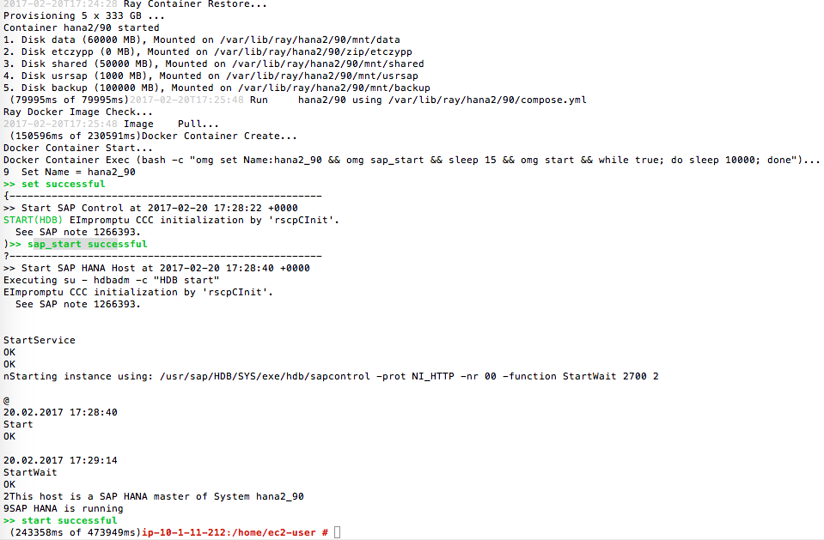
Output: SAP HANA System with 1.2 billion rows
Storage
Docker Image
Docker Container

Slide 16
SAP Hybris on SAP HANA for Retail
Containerized Architecture w/ Fallback to Virtualized World
Hybris eCommerce Suite
Dev/Test
Prod
Joint Business Value
Rightsizing of retail systems driven by usage patterns and demands
Accelerated App Modernization – Traditional workloads in containers
Real time enforcement of business driven policies
Apache
Apache
Apache
Hybris
Hybris
Hybris
HANA Dev
HANA Test
HANA Prod
Fallback
option
Virtualized HANA
Prod
VPC 1 or VNET 1
VPC 2 or VNET 2
Cloud Account 1 (AWS or Azure)
Cloud Account 2 (AWS or Azure)

Slide 17
SUMMARY: DB Containers Great Choice
Insured by a quick Failover back to Virtualized World!
Frontends
Applications
Databases?
 |  | FRONTEND | APPLICATION | DATABASE
RISK | Blast Radius | Single User | Many Users | All Users
 | Recovery | Minutes | Minutes | Hours - Days
BENEFIT | Cost Savings | $ | $$ | $$$$$$

Slide 18
Call to Action
Let us Show You in Your Own Environment
High Value Pilot offer
Virtual customer workshop
Explore virtualized and containerized SAP HANA on public cloud
See if you qualify for one of three customized pilots
Download today’s presentation slides here

Slide 19
Meet Ocean9 at Cloud Expo in New York
June 6-8, 2017 – Free Ocean9 guest passes
Go to the special registration page
Fill out the Attendee Information form
Select the VIP Gold Pass Registration Option (located on page 3 - “Registration Plan”)
Enter the Discount Code: FacultyGuest
The price will re-set to $0

Slide 20
Slide download
Click Icon
https://www.ocean9.io/content-download/ heavy-state-databases-in-containers

Slide 21
Thank you
Swen Conrad, CEO
swen@ocean9.io
650 889 9876

