Slide 1
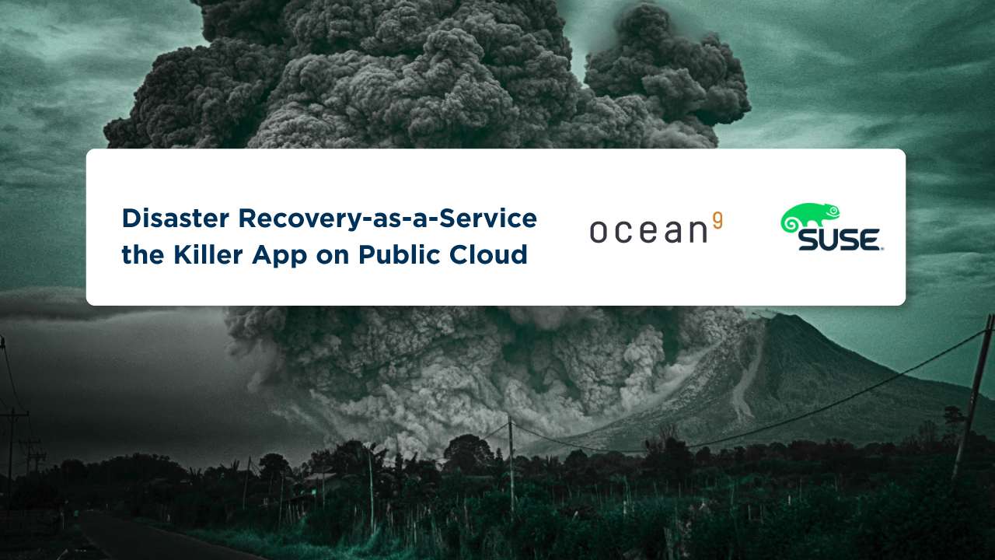
Swen Conrad
CEO, Ocean9 | swen@ocean9.io
David Torres
Partner Exec, SUSE | david.torres@suse.com

Slide 2
Where SUSE Leads
95%
70%
80%
9/10
SAP HANA on SUSE
SUSE is the leading base OS for
building SAP HANA deployments
SAP on Linux
70% of all SAP applications running on Linux run on SUSE
Linux in Large Enterprise
Over 80% of the Fortune Global 50 are active SUSE Customers
Linux in Aerospace
9 out of 10 of the largest aerospace companies rely on SUSE
15+
x10
7/10
7/10
Mainframe Linux
Over 15 years of mainframe Linux market share leadership
Linux in Telecom
10 of the largest telecommunications carriers rely on SUSE
Linux in Pharma
7 out of 10 of the largest pharmaceutical companies use SUSE Linux Enterprise
Linux in Retail
7 out of 10 of the largest retailers in the U.S. are active SUSE customers
4/5
x10
50%
7/10
Linux in Finance
4 out of 5 of the world’s largest banks use SUSE Linux Enterprise
Linux in Automotive
10 of the largest global automobile mfgs. are active SUSE customers
Linux in HPC
Half of the world’s 20 largest super computers run on SUSE
Linux in Manufacturing
7 out of 10 world’s largest manufacturers use SUSE Linux Enterprise
Notes:
Many of you are familiar with SUSE already, but for those who aren’t you will see that our mission is to deliver the best enterprise-grade open source
solutions through partnering and community innovation has led to incredible success in the market.
Whether looking at how SUSE powers 70% of the mission-critical SAP application workloads or our foothold in many notable industries and verticals you’ll find that SUSE is the underpinning Linux Operating System Platform for some of the most important Enterprise Businesses Worldwide.
That’s why it
[click]

Slide 3
Partners that Understand Cloud Readiness
Managed Cloud
Business continuity
Implementation
DevOps (CI/CD)
Consulting Services
ROI/Business case
Cloud adoption strategy
Security and risk assessment
Cloud architecture
3200
13,500+
Solution Providers & System Integrators
Certified Hardware
5000+
2500+
8500+
Certified Applications
Certified Products
Partner Ecosystem members
1800
600
Technology Partners
Training Partners
Notes:
SUSE that understands the significance of driving customer success through partners.
Over 24+ years of driving Linux adoption focused on the enterprise we have built an incredibly diverse ecosystem of partners. A subset of these are now the incredibly important and influential partners that understand how to drive cloud adoption and hold a Microsoft Cloud Service Provider (or CSP) role or an Amazon Web Services Premier Consulting Partner title.
We collaborate with industry leading cloud providers, and the partners that they trust to deliver solutions with the right mix of Open Source Solutions and innovative software. These key partners fill in the skills gap at many enterprises and SUSE is building relationships with these, making sure to prioritize and identify those which also have an SAP competency or software solution that enables SAP HANA adoption on public cloud.

Slide 4
Core Advantages and Benefits
Trade CAPEX
for OPEX
Massive Economies
of Scale
Increase Speed
and Agility
Notes:
These are the most relevant advantages and benefits of public cloud
Only pay when you consume, and only pay for how much you consume.
Achieve higher economies of scale which translates into lower pay as you go prices.
New IT resources are only ever a click away, which means you reduce the time from weeks to just minutes

Slide 5
Public Cloud Workloads
SAP
Applications
Analytics
Dev / Test
Infra Servers
Machine Learning &
High Performance
Data Analysis
Mission Critical
Notes:
A quick preview: SUSE supports these workloads in the cloud. Now let’s talk about the market trends
Dev and Test / Dev/Ops
Capacity Computing /Bursting
Web applications and edge servers
High performance and capacity computing (for simulation, research, manufacturing, fraud detection)
Modernized applications
Web and mobile applications that are built off of legacy applications
Big Data and analytics
SAP Applications
TODAY WE’RE TALKING ABOUT DISASTER RECOVERY

Slide 6
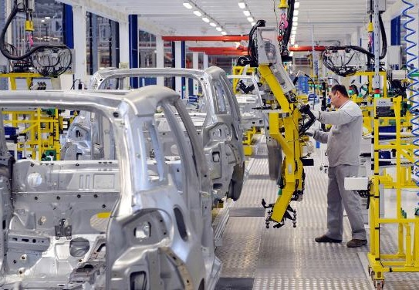
Why So Relevant Today?
Digital Business requires Always On, High Performance Computing!
RETAIL & FASHION
Smart Stores
MANUFACTURING
Industry 4.0
FINANCE
Virtual close

Slide 7
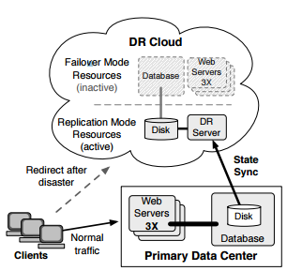
Disaster Recovery as-a-Service
Best kept Cloud Secret for 8 years and counting …
Findings from 2009
“We have compared the costs of running DR services using public cloud or privately owned resources, and shown cost reductions of up to 85% by taking advantage of cloud resources.”
Source

Slide 8
Disaster Recovery vs High Availability
What is What
Disaster Recovery Being prepared for the Worst Case
Response to a natural or human-induced disaster.
Set of policies and procedures.
Enabling recovery or continuation of vital technology infrastructure and systems.
High Availability The Right Architecture in the Cloud
Elimination of single points of failure via redundancy. Failure of a component does not mean failure of the entire system.
Reliable systems must provide for reliable crossover via redundancy.
Detection of failures as they occur. If the two principles above are observed, then a user may never see a failure.

Slide 9
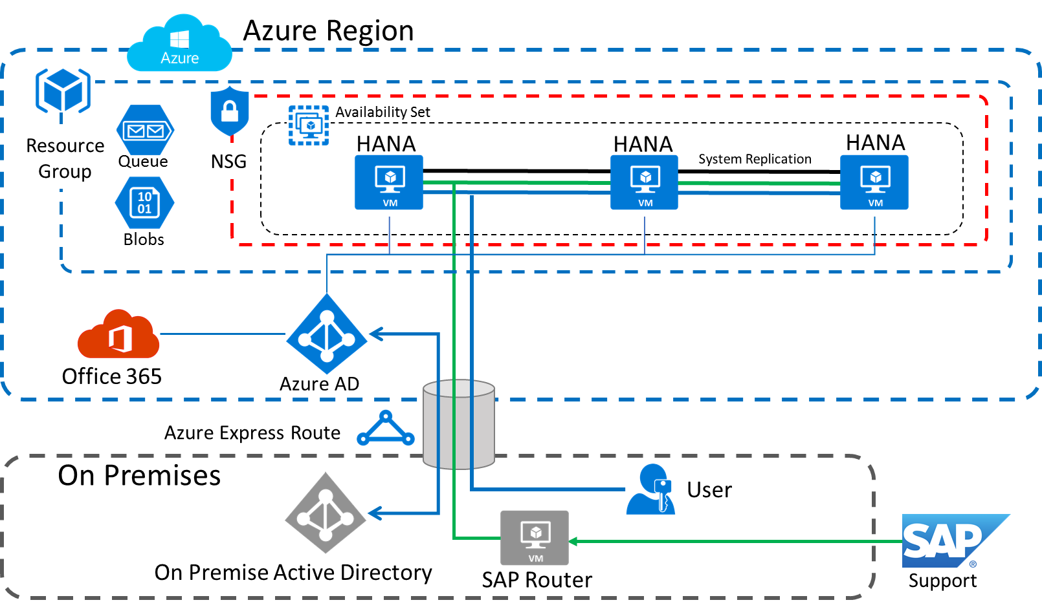
How to Architect for High Availability?
A brief detour – Microsoft Azure Example

Slide 10
How to Prepare for Disasters?
X
X

Slide 11
Disaster Recovery (DR)
Traditional DR compared to DR-as-a-Service
Traditional Disaster Recovery
Redundant infrastructure at secondary location
Hardware cost impact: + 100% or 2x!
Additional cost for setup & operations
Cost prohibitive for most companies!
Cloud DR-as-a-Service
No full redundant infrastructure
Data backup or replication into cloud
IaaS cost impact: + 5-15%
Savings: 85-95%
Available DR-as-a-Service solutions
X
X
Cloud

Slide 12
DR-as-a-Service Scenarios
Three Patterns with equal Functionality and Business Benefits
On Premise to Cloud
Cloud A to Cloud A
Cloud A to Cloud B
X
Azure
X
X
AWS
AWS
Azure
AWS
AWS
US West US East
US North US East
other

Slide 13
Disaster Recovery Process & KPIs
Recovery Point Objective (RPO) and Recovery Time Objective (RTO)
Step 1 – Provision new system infrastructure
Step 2 – Load data from backup
Primary Site – Active System
ongoing log backup
(or ongoing replication)
RPO
Actual loss of data =< than RPO
1
2
DR Site – Recovered System
“Cold” Disaster Recovery Site – System Backup
RTO
[Time Axis left to right in minutes]

Slide 14
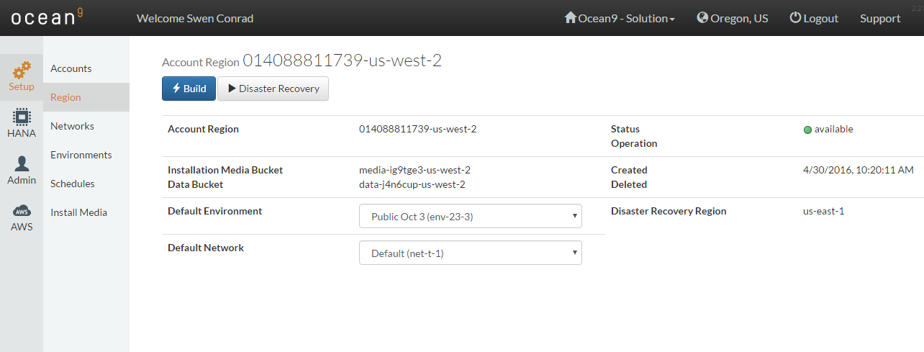
LIVE DEMO – Ocean9
DR-as-a-Service for SAP HANA

Slide 15
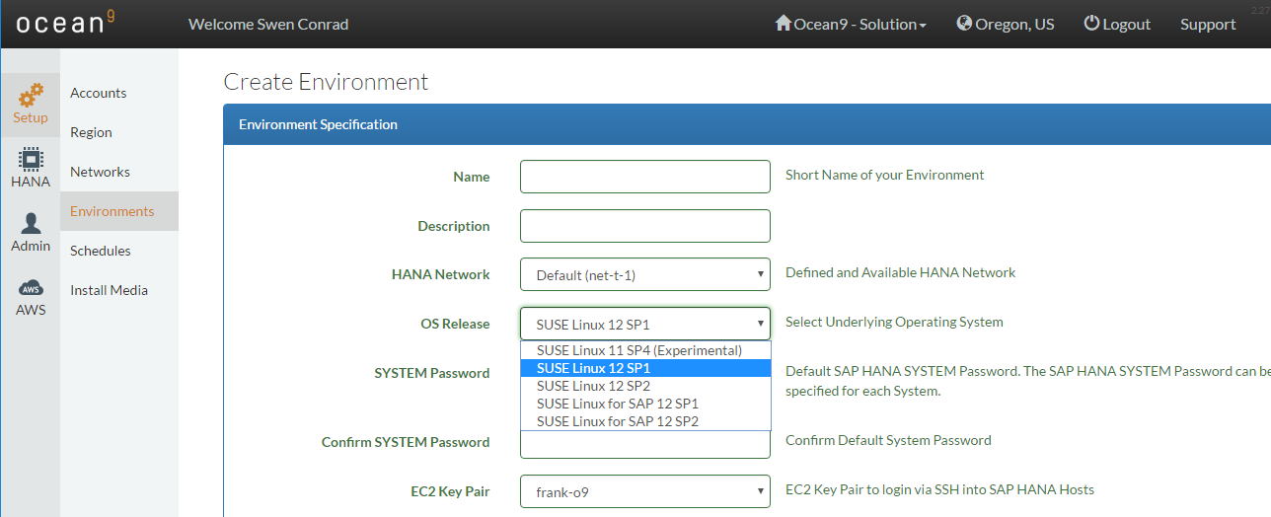
LIVE DEMO – Ocean9
Powered by SUSE, the Leading Linux Operating System

Slide 16
Cloud Platforms for DR-as-Service
Amazon Web Services and Microsoft Azure are the Leaders
AWS and Azure are the leading IaaS platform providers in the Gartner MQ
Strong list of enterprise customers
AWS
Kellogg’s
Comcast
Johnson & Johnson
Unilever
Pfizer
Qantas
Nordstrom
BMW
John Deere
Azure
GE Healthcare
NBC Universal
3M
Tyco International
The Hershey Company
Jet.com Inc.
Hollands Kroon
Crystal Group
First Tech
Source: Gartner (August 2016)

Slide 17
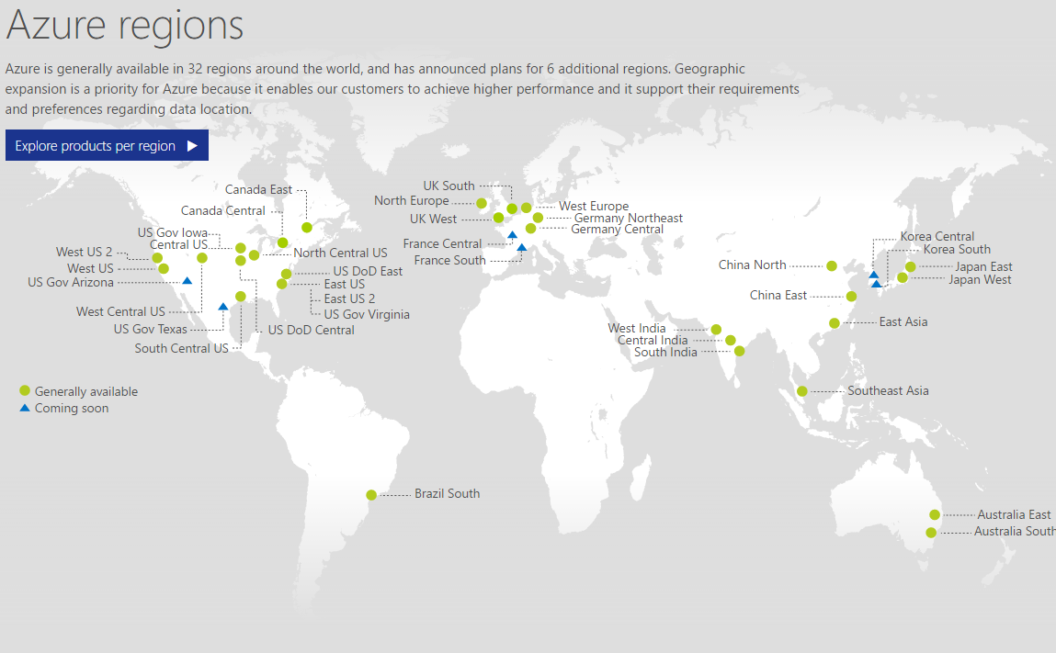
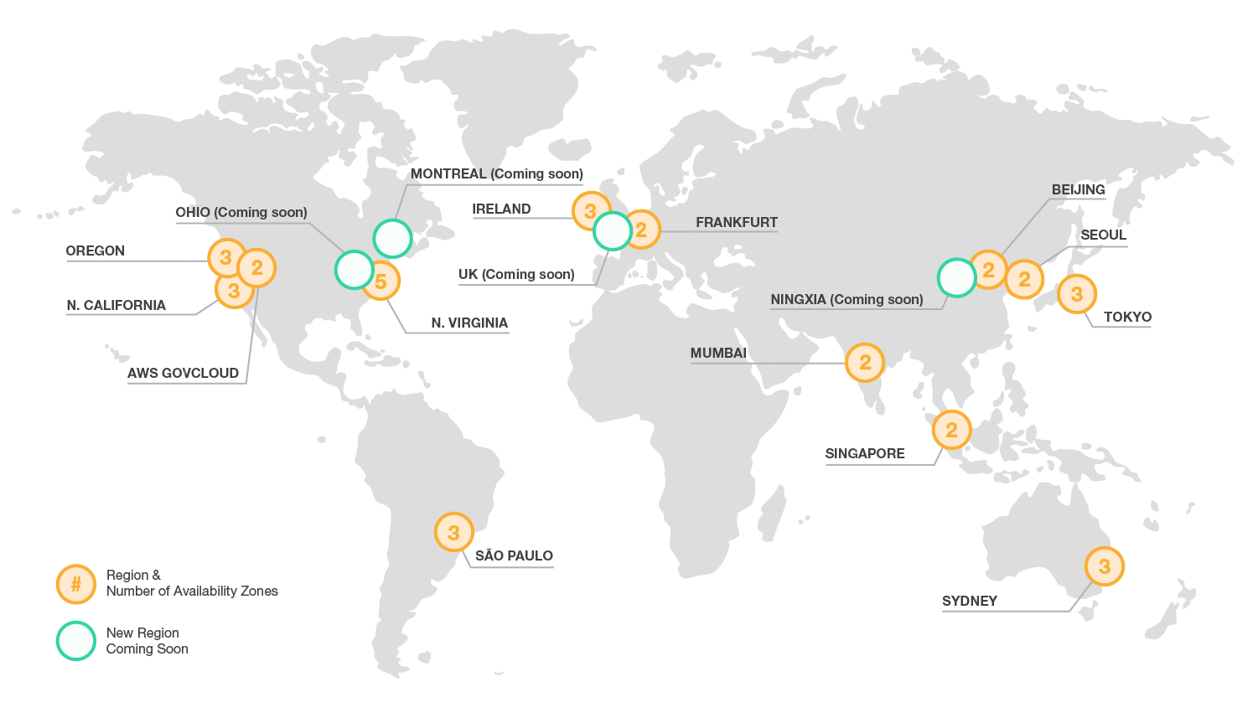
Hyper scale Infrastructure
Leading today and growing daily …
Microsoft Azure
Amazon Web Services
Latest Azure map
Latest AWS map

Slide 18
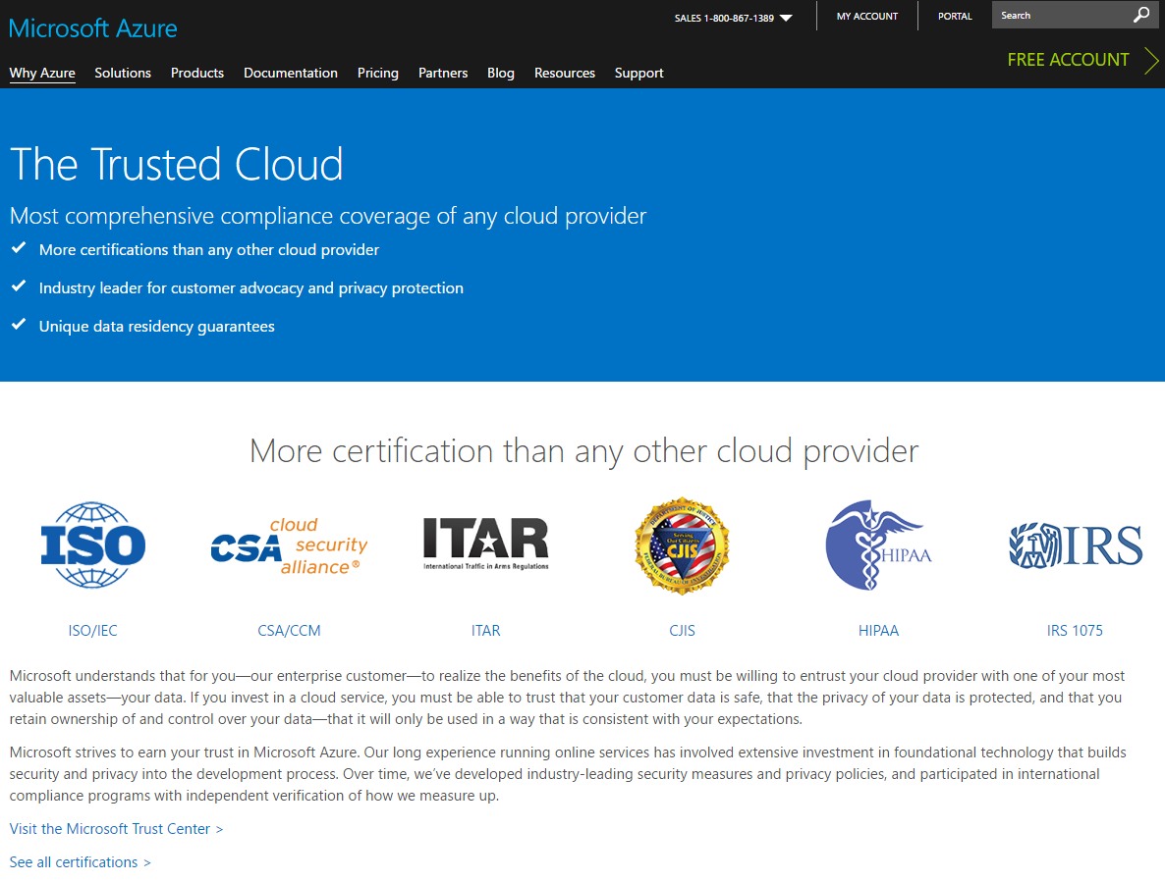
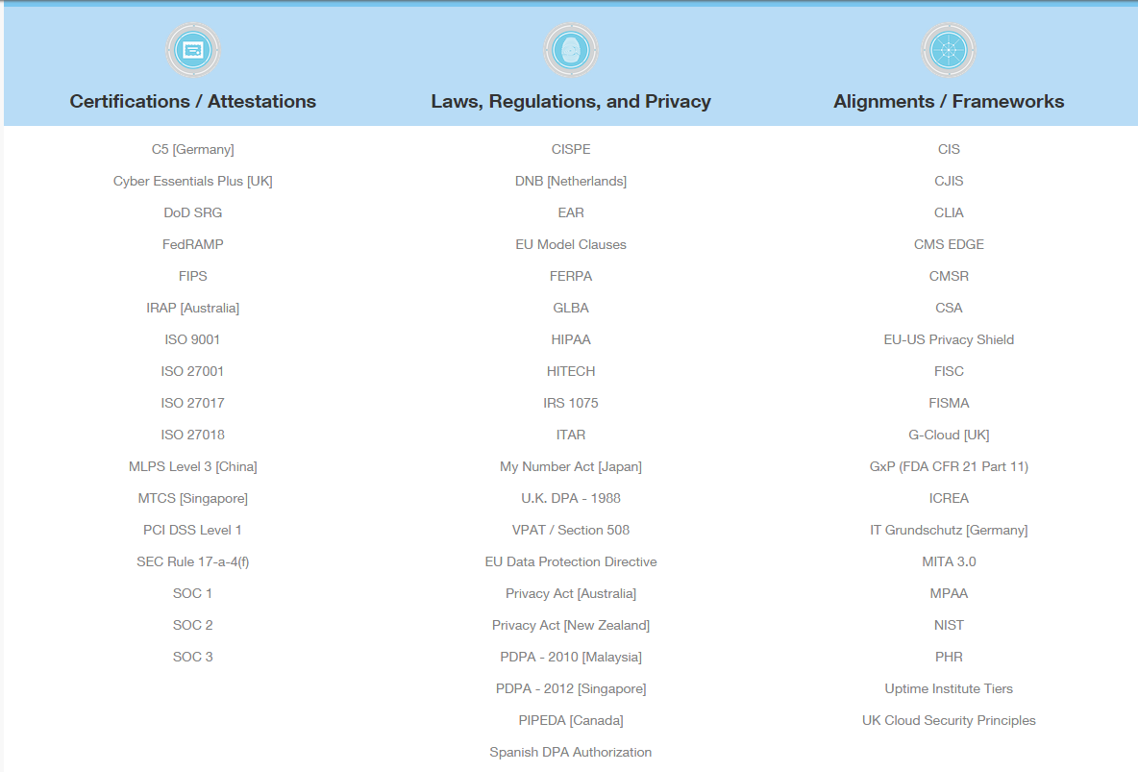
Providing the Highest Level of Security
A Top Priority for Public Cloud Providers
Link to Microsoft Trust Center
Link to AWS Cloud Compliance

Slide 19
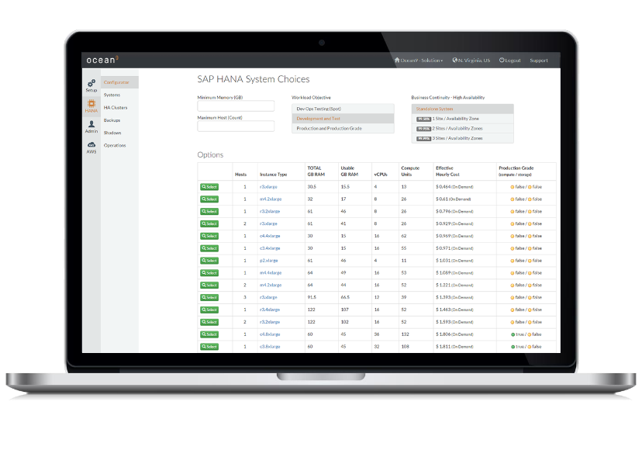
Do-it-Yourself vs Ocean9 DR-as-a-Service?
Allowing You to focus on Business Differentiation
service
service
service
service
service
service
service
service
service
service
service
service
service
service
service
service
service
service
service
service
service
service
service
service
service
service
service
service
service
service
service
service
service
service
service
service
service
service
service
service
service
service
service
service
service
service
service
service
service
service
service
service
service
service
service
service
service
service
service
service
service
service
service
service
service
service
service
service
service
service
service
service
service
service
service
service
~100 AWS and Azure Services available
New services being added frequently
Cloud native SAP HANA Using min of 12 services
Ocean9 Cloud Service for SAP Simple operations, fully automated

Slide 20
Ocean9 Use Cases for SAP
Start Projects Easily – Seamlessly Move to Production
Jumpstart SAP HANA POC
SAP HANA Dev and Test
SAP HANA Production
On-prem Backup to AWS | Azure
Automated Disaster Recovery
SAP HANA Upgrade Testing
Digital Transformation
Enable SAP Partners and ISVs
Size and Price SAP HANA
Size and Price SAP landscapes
On-demand Analytics
Hybrid Cloud Azure | AWS
Supported for all SAP HANA use cases:
S/4HANA
BW/4HANA
Suite on HANA
BW on HANA
Datamart
Custom solutions
ISV solutions
OEM solutions
Try anytime
Business Agility and Innovation
Business
Continuity and Security
Business
Transformation

Slide 21
The Ocean9 and SUSE Difference
Disaster Recovery as-a-Service for All SAP Customers
DR-as-a-Service with very high Business Benefit / Cost & Effort
Ocean9 DRaaS protects your SAP based Digital Business
15 min RPO 30-90 min RTO 95% Cost Savings
SUSE Linux Enterprise Server for SAP Applications provides High Availability for SAP deployments on AWS and Azure

Slide 22
Call to Action
Let us show You in Your Own Environment
High Value Pilot offer
On-site/virtual customer workshop
Ocean9 DR-as-a-Service and SAP HANA as-a-Service trial subscription
See if you qualify for one of three customized pilots
Download the Ocean9 DRaaS whitepaper here
Download DRaaS presentation slides here

Slide 23
Q&A
Swen Conrad - CEO, Ocean9 | swen@ocean9.io
David Torres - Partner Exec, SUSE | david.torres@suse.com
Notes:
Questions:
How long does it take to implement DRaaS for SAP HANA with Ocean9.
How do you charge for DRaaS?
Does Ocean9 offer other services than DRaaS?
What is the difference between backup and replication based DRaaS?

