Slide 2
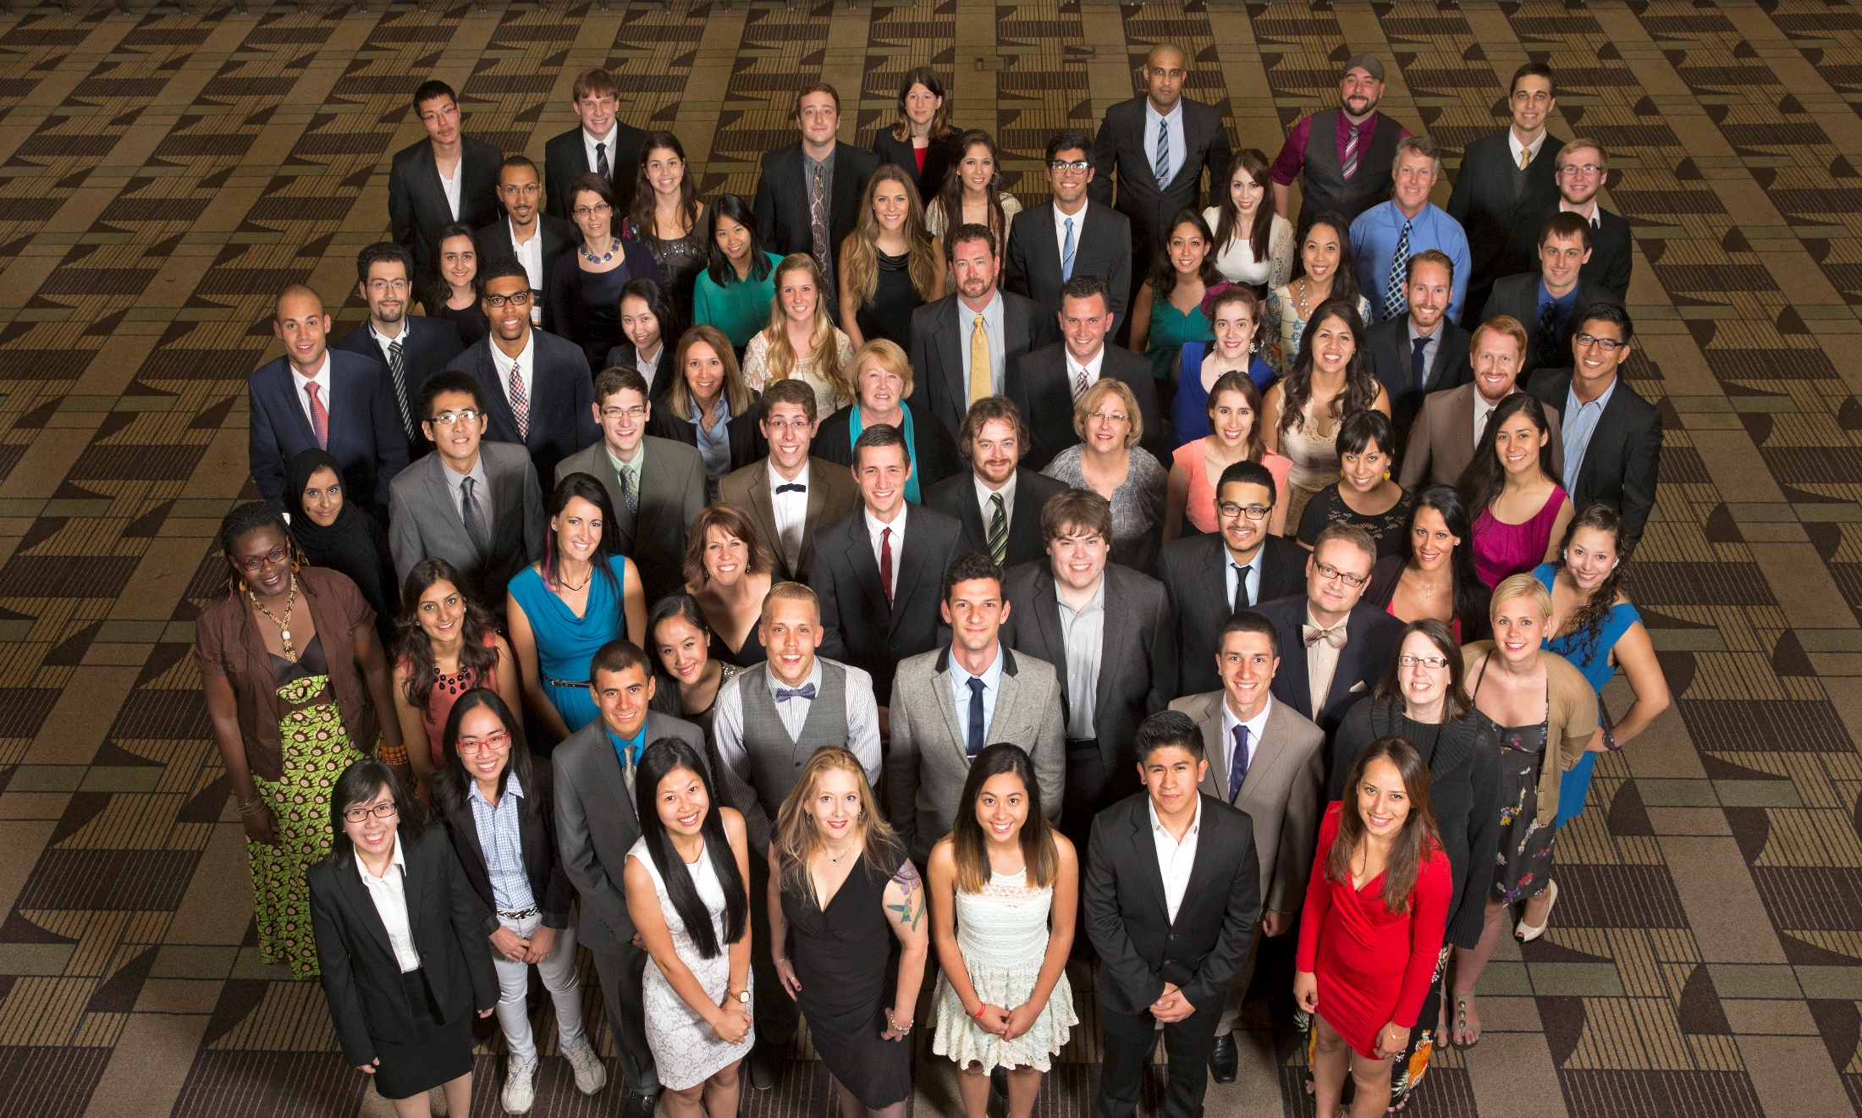

Slide 3
Today’s Agenda
Program Benefits
Application
Selection
Tips
Q&A

Slide 4
Program Benefits
Transfer to four-year colleges and universities with up to $40,000 per year in financial support
Freedom to focus on learning

Slide 5
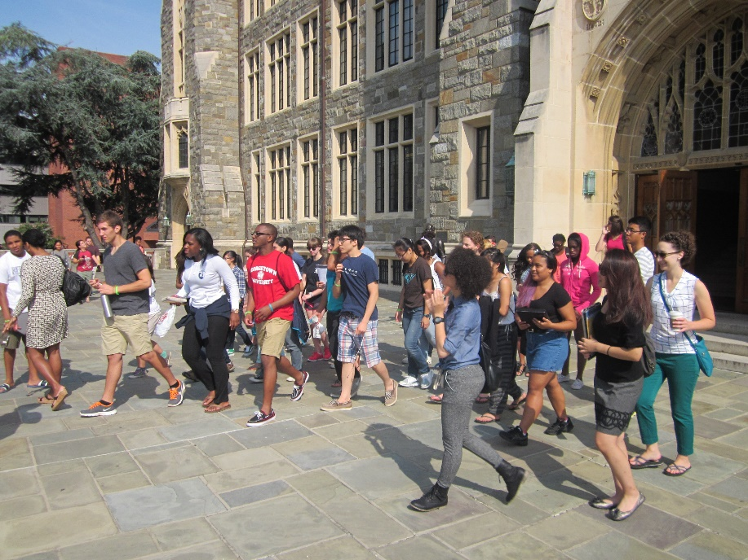
Financial Support
Receive up to $40,000 per year to transfer to a four-year accredited undergraduate institution for tuition, expenses, books, and other required fees

Slide 6
Advising Support
Have access to advising about navigating college choices, understanding financial aid, transitioning to college, and maximizing the college experience

Slide 7
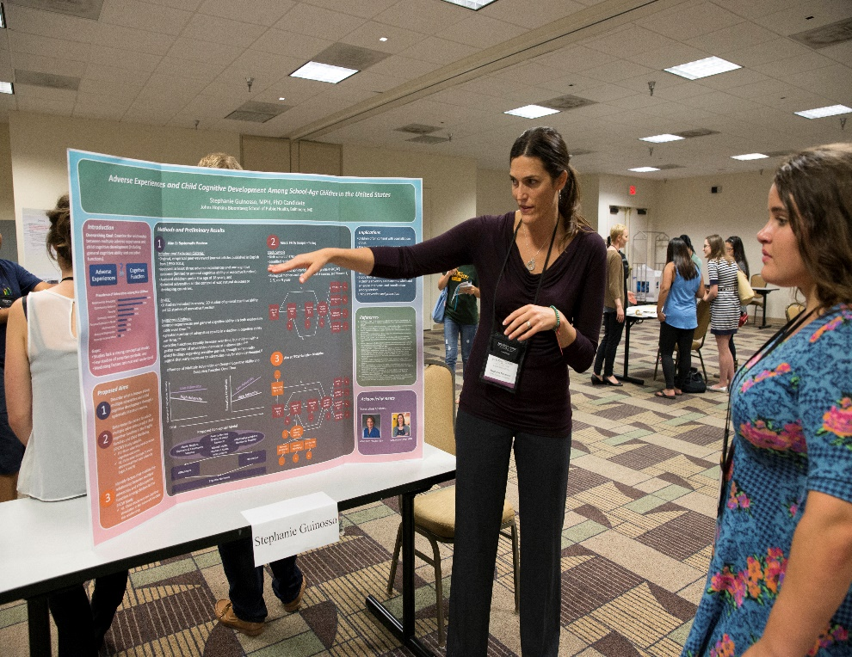
Graduate School Funding
Be automatically eligible for up to $50,000 a year of graduate school funding for up to three years after successful completion of college

Slide 8
Scholars Weekend
Attend a scholarship gathering like none other. Over 400 Cooke Scholars convene each year in August to celebrate new Cooke Scholars and share amazing leadership and service experiences
Notes:
Each August, we welcome new Cooke Scholars from all of our scholarship programs to a one-of-a-kind gathering called Scholars Weekend. The weekend gathering is all-expense paid (travel, food, lodging) and it’s an amazing experience for new and current scholars to create community and learn valuable leadership skills.

Slide 9
Scholar Community and Network
Have a community and network of scholars that spans the country and globe. Currently there are 935 Cooke alumni.
Notes:
Biennially, the foundation hosts alumni of the scholarship programs at an alumni summit. Currently, there are nearly 1000 Cooke alumni across the country and around the world.

Slide 10
Scholar Community and Network
Access to leadership and service opportunities within the scholar community and beyond
Notes:
Cooke Scholars are committed to making the world a better place. The foundation supports local and regional gatherings to give back to the community and do outreach in various ways. Scholars and alumni have volunteered at schools and community centers, conducted college counseling and awareness workshops at Title I schools, and many scholars have founded their own non-profit organizations at grassroots and national levels.

Slide 11
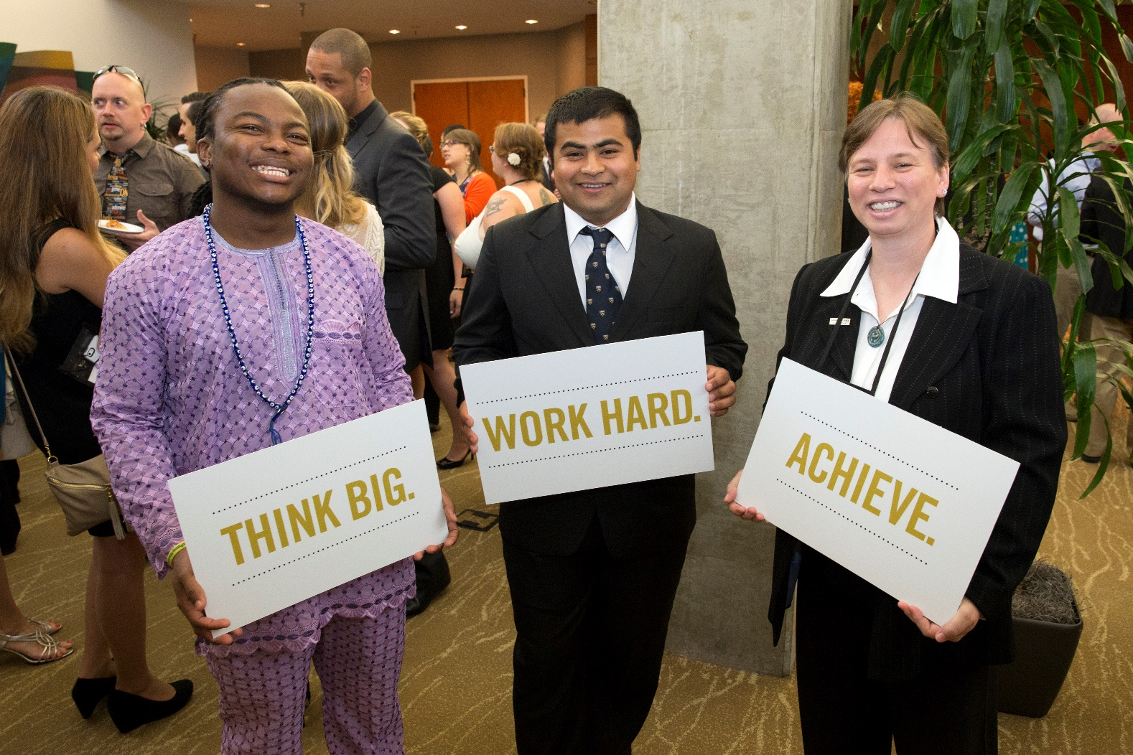
Who is the Cooke Scholar?
Notes:
Cooke Scholars are committed to making the world a better place. The foundation supports local and regional gatherings to give back to the community and do outreach in various ways. Scholars and alumni have volunteered at schools and community centers, conducted college counseling and awareness workshops at Title I schools, and many scholars have founded their own non-profit organizations at grassroots and national levels.

Slide 12
Eligibility
Be a current student at an accredited US community college or two-year institution with sophomore status
OR
a recent graduate of community college (last five years)
Notes:
The Jack Kent Cooke Foundation College Scholarship Program is the nation’s largest undergraduate scholarship program through providing up to $40,000 per year available to high-achieving high school seniors with financial need who seek to attend the nation’s best 4-year colleges and universities.

Slide 13
Eligibility
Have a minimum 3.5 GPA
on a 4.0 scale
Not have previously applied or have been nominated for the Undergraduate Transfer Scholarship
Notes:
The Jack Kent Cooke Foundation College Scholarship Program is the nation’s largest undergraduate scholarship program through providing up to $40,000 per year available to high-achieving high school seniors with financial need who seek to attend the nation’s best 4-year colleges and universities.

Slide 14
Eligibility
Plan to enroll in a full-time baccalaureate program at an accredited college or
university in the fall of 2016
Notes:
The Jack Kent Cooke Foundation College Scholarship Program is the nation’s largest undergraduate scholarship program through providing up to $40,000 per year available to high-achieving high school seniors with financial need who seek to attend the nation’s best 4-year colleges and universities.

Slide 15
Demonstrate Financial Need
Demonstrate significant unmet financial need. We will consider applicants with family income up to $95,000. However, we anticipate that a majority of scholarship recipients will be eligible to receive a Pell grant.
Notes:
The Jack Kent Cooke Foundation College Scholarship Program is the nation’s largest undergraduate scholarship program through providing up to $40,000 per year available to high-achieving community college students with financial need who seek to transfer to the nation’s best 4-year colleges and universities.

Slide 16
Selection Criteria
Achievement and academic ability
Financial need
Persistence
Leadership
Desire to help others

Slide 17
Application Components
Student Academics/Activities/Honors
Short Answer and Essay Questions
Recommendations
Financial Forms (Parent/Self)
Official transcripts

Slide 18
General Tips/Common Mistakes
Begin right away. Many students don’t allow for enough time to complete the application.
Follow up with your recommenders, parents/guardians, et al. Students often focus only on their part of the application and then forget to remind the other people to complete their parts.
Finish the application. Many students start the application and even get very far in the process but do not submit by the deadline. Set a reminder for the deadline, mid-December 2015.
Notes:
Here are some general tips. Begin right away. This way you will get important alerts and reminders in our application system. You also should enter your team names and email addresses right away so that they have plenty of time to complete their portion. The application is very logical and similar to the college application process. Students should take time to submit a strong application. Students should set a reminder for the deadline, not only for themselves but also take the lead in ensuring that the recommendations and all necessary parent forms are completed by the deadline.

Slide 19
Timeline
Early- to mid- October 2015
Application Opens
Mid-December 2015
Application Deadline
February 2016
Applications reviewed by scholarship committee
Early April 2016
Scholarship recipients notified

Slide 20
Ways to Share the Scholarship
Start identifying prospective applicants on campus
Share information about the scholarship to get students interested
Invite students to attend an application workshop featuring Cooke Scholars on October 20, 6 p.m. EST

Slide 21
Additional Help and Info
Cooke Undergraduate Transfer Scholarship application period
Early- to mid- October through Early December
Cooke Undergraduate Transfer Scholarship Application Workshop
Featuring Cooke Scholars and Cooke Foundation Staff
Tuesday, October 20 at 6 p.m. EST
www.jkcf.org/transfer
Questions?
Call toll-free: 855.509.5253
Email: scholarships@jkcf.org
Notes:
If you have questions, you can call the toll-free number that is noted here and on our materials and website: 855-509-5253 or email scholarships@jkcf.org
We will also have a followup webinar on October 8 at 7pm EST that will be hosted by the outreach team and current Cooke College Scholars. This will be geared specifically towards students who are considering applying and those who have already started the application. This is a great opportunity to learn about scholarship application tips from our very own scholars.

