Slide 1
AI Chatbots: Another Fad or the Next Customer Service Revolution?

Slide 2
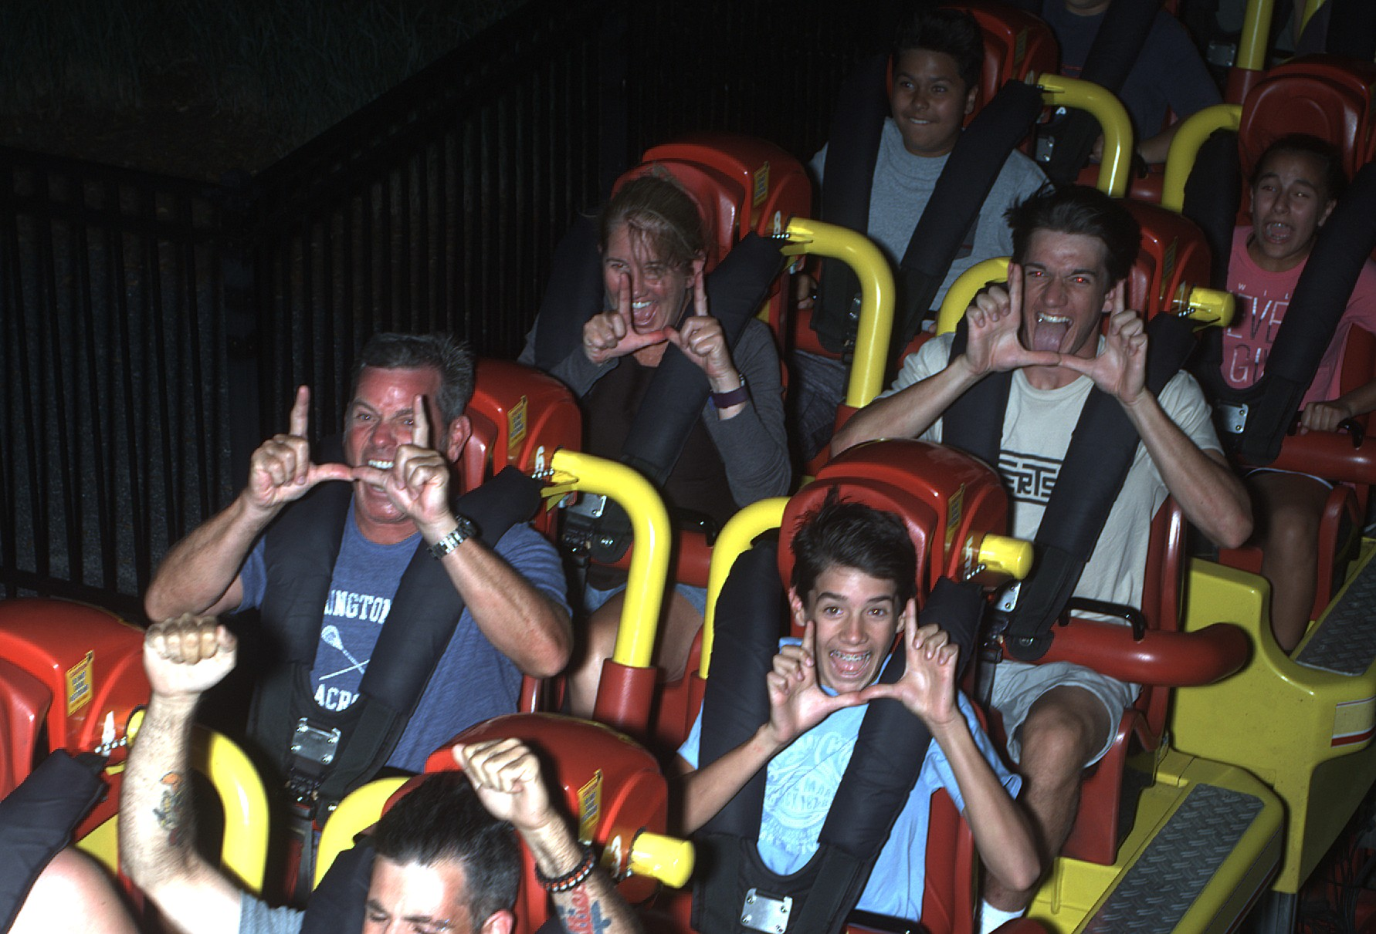
Who am I?
Bob Caldwell:
Founding Partner
EventBots

Slide 3
Understanding Fads
Fad:
an intense and widely shared enthusiasm for something, especially one that is short-lived and without basis in the object's qualities; a craze.

Slide 4
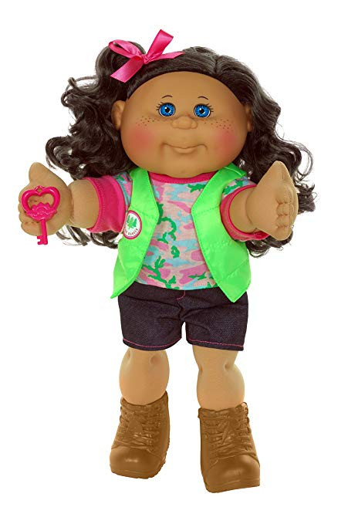
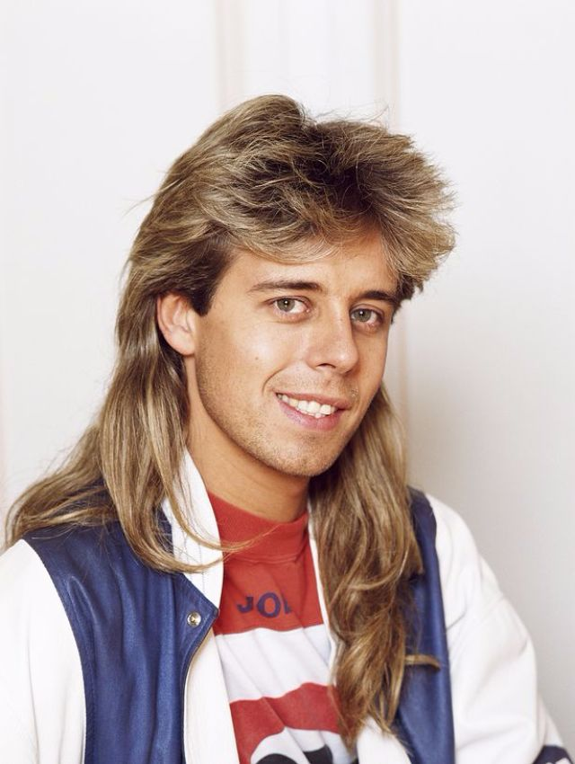
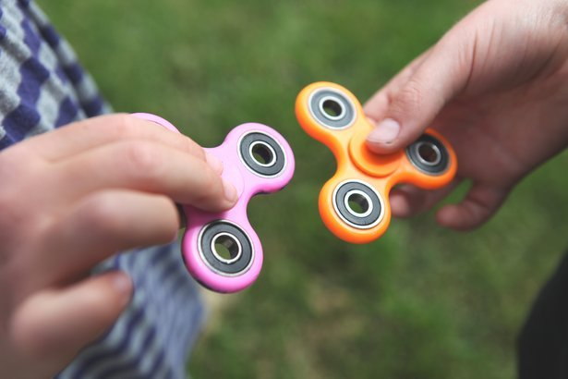
Understanding Fads

Slide 5
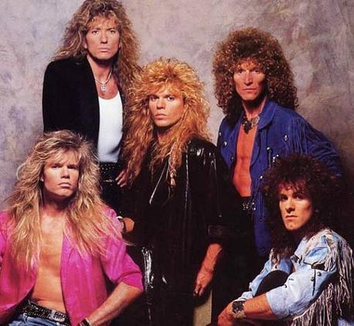
Understanding Fads

Slide 6
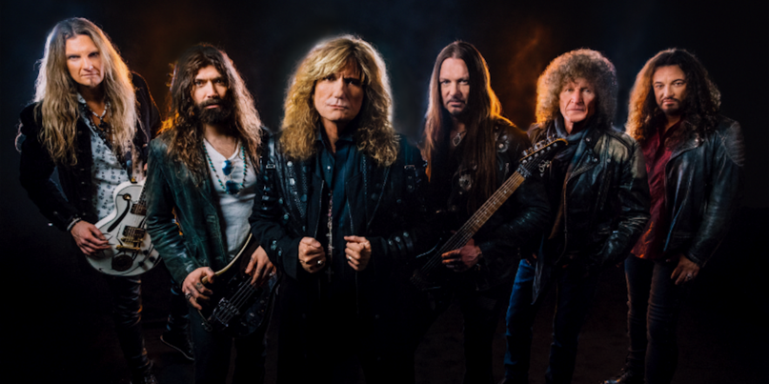
Understanding Fads

Slide 7
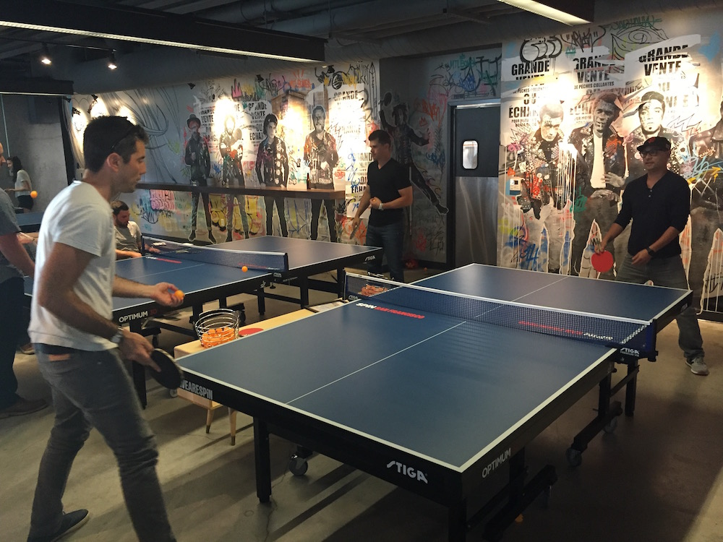
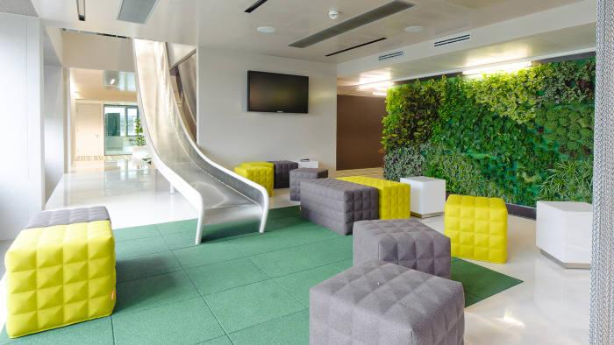
Understanding Business Fads

Slide 8
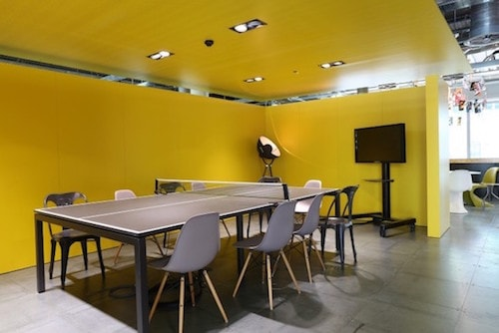
Understanding Business Fads

Slide 9
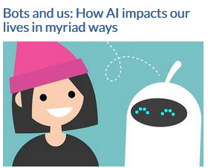
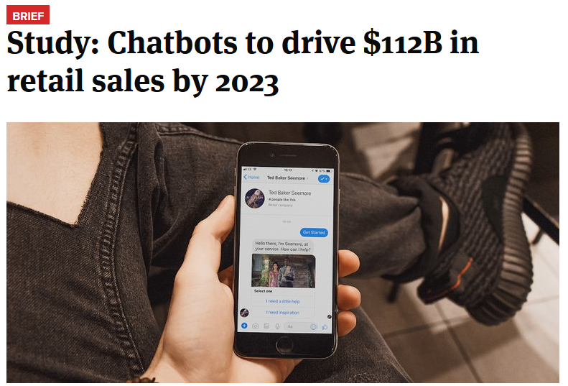
Understanding Business Fads

Slide 10
Understanding Business Fads

Slide 11
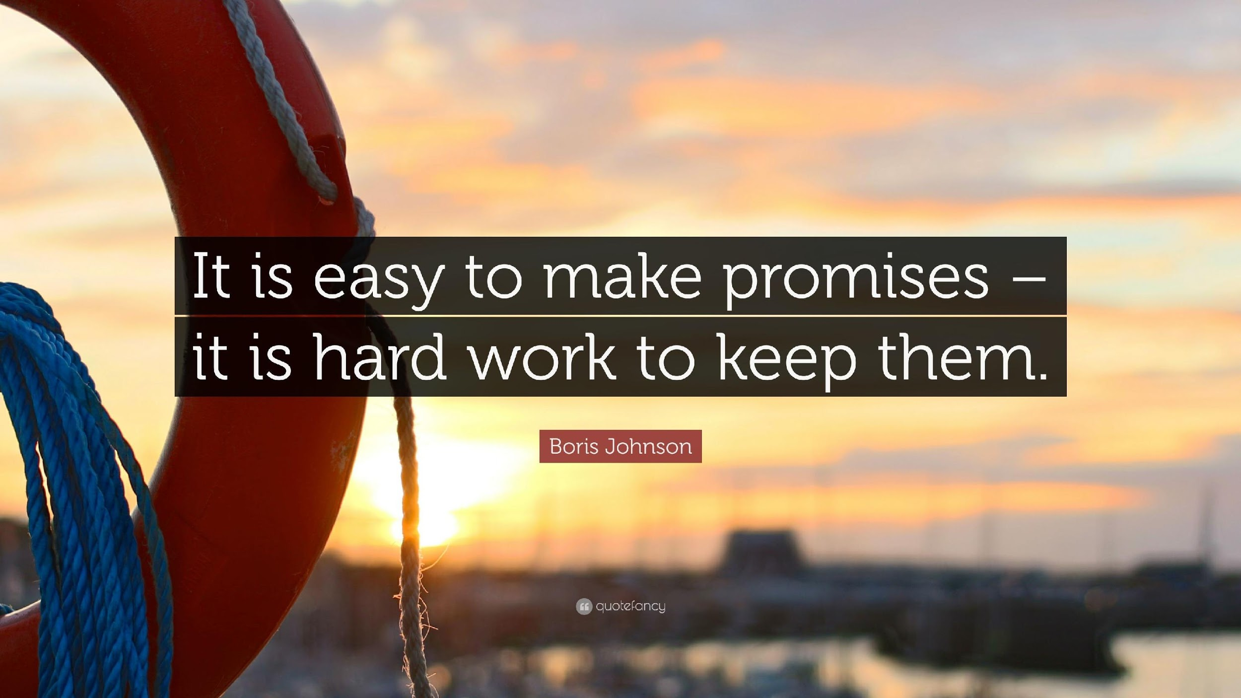
Understanding Technology

Slide 12
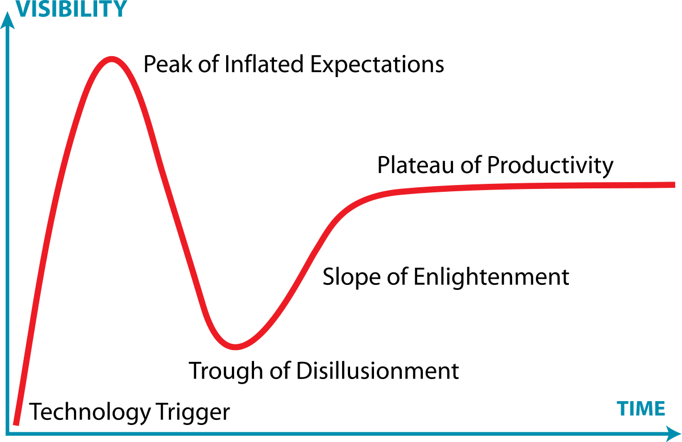
Understanding Technology

Slide 13
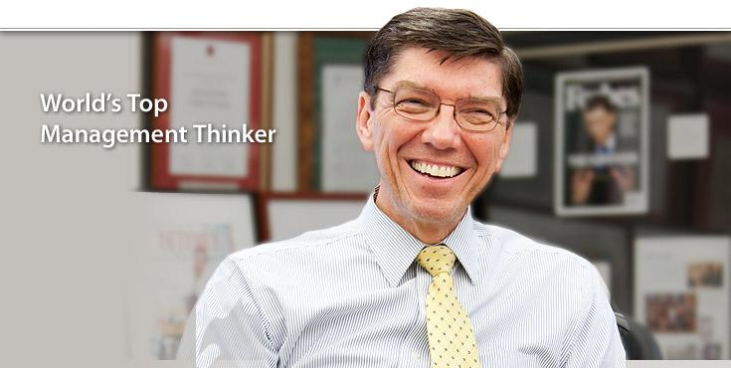
Sustaining vs. Disruptive Innovation
A sustaining innovation improves existing
products and processes
A disruptive innovation helps create a new market and value network
Clayton Christensen –
Harvard Business School Professor

Slide 14
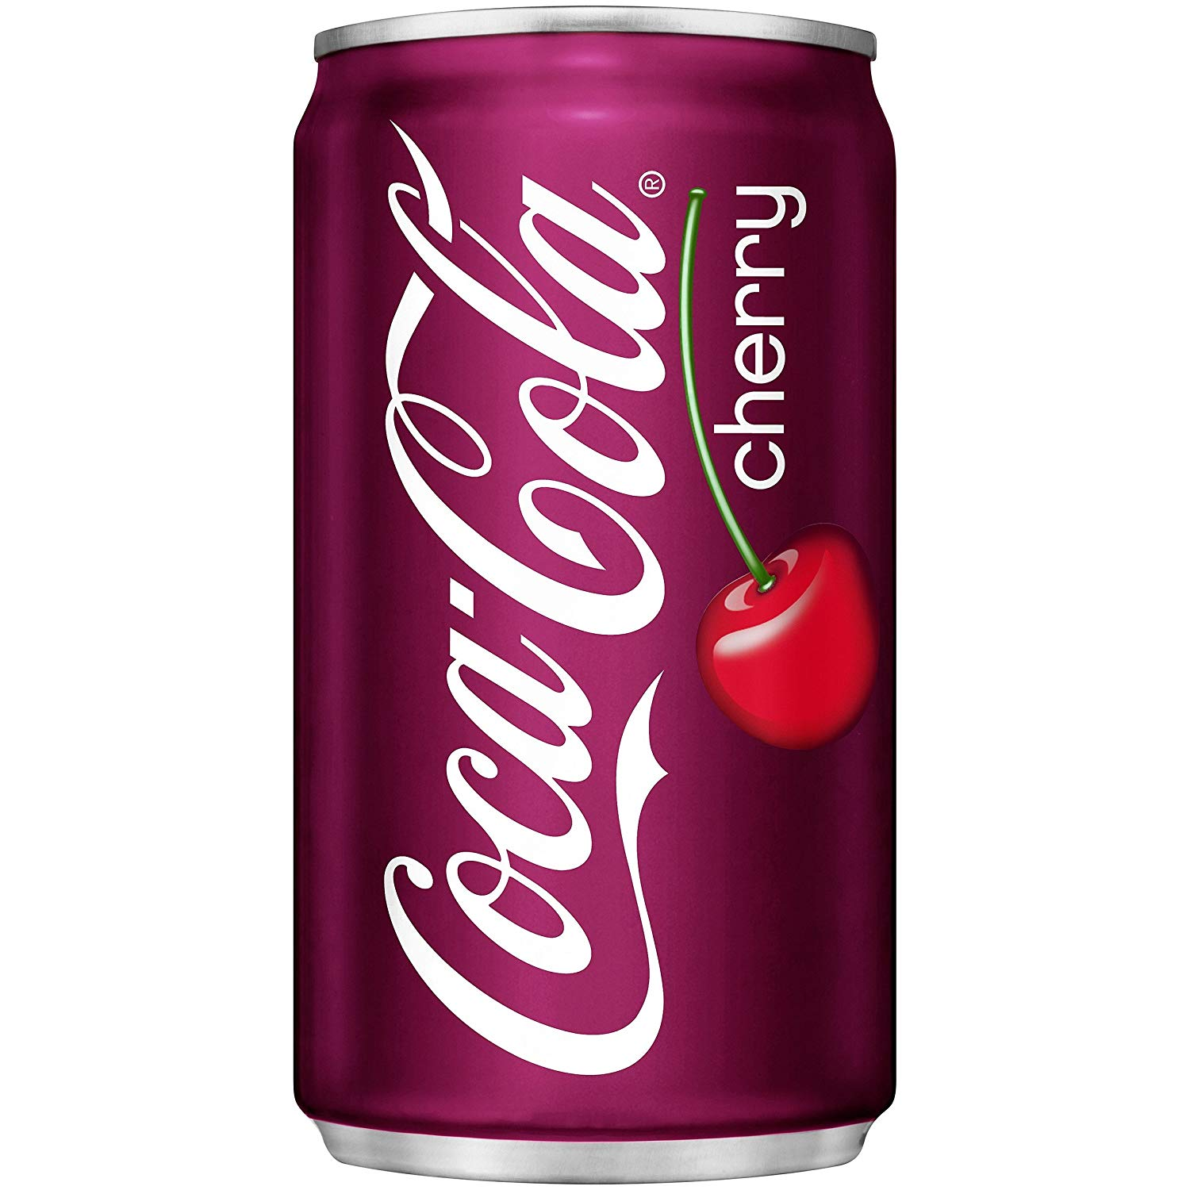
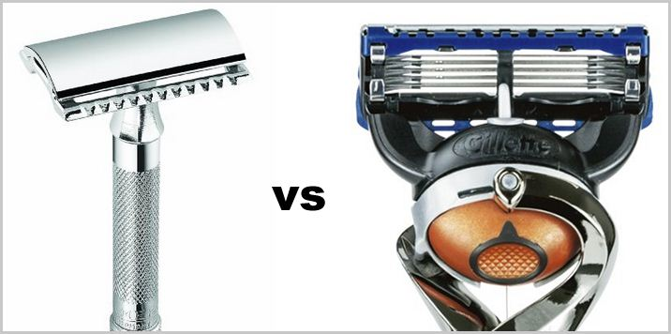
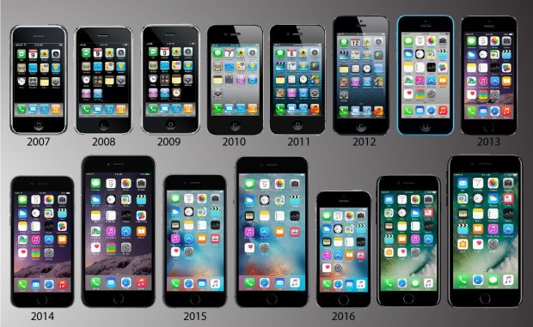
Sustaining vs. Disruptive Innovation

Slide 15
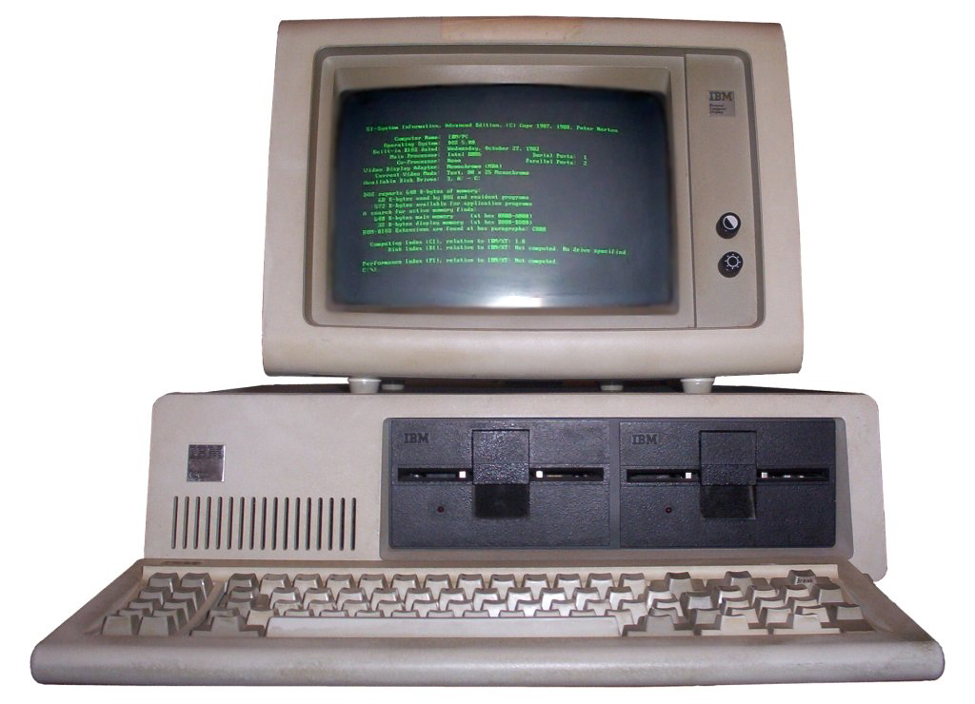
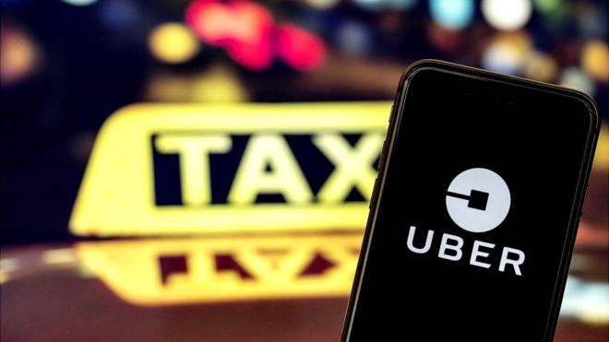
Sustaining vs. Disruptive Innovation

Slide 16
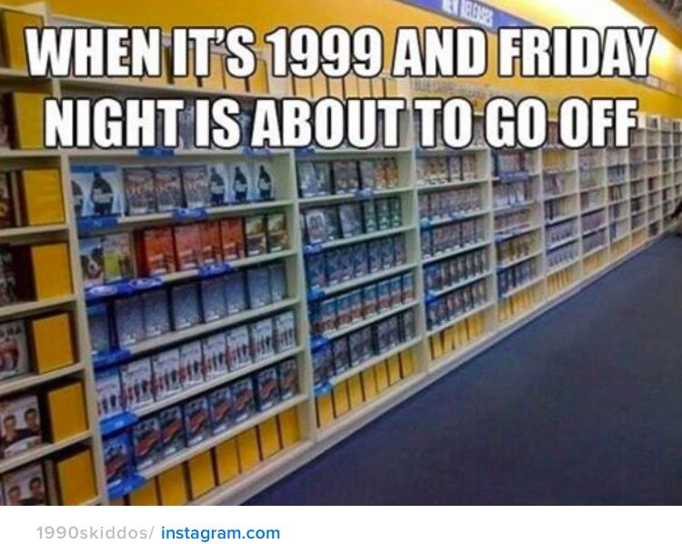
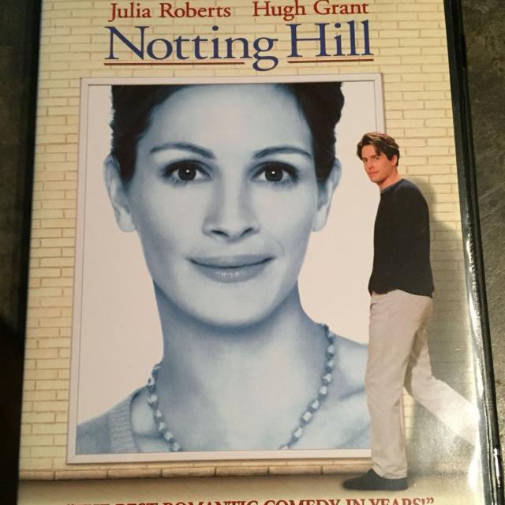
Sustaining vs. Disruptive Innovation
9,000+ Stores
$6 Billion in revenue

Slide 17
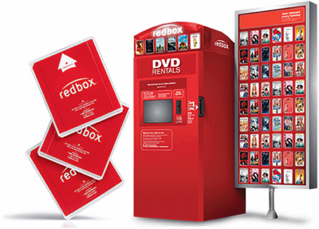
Sustaining vs. Disruptive Innovation
Easy Access
No late fees
Delivered to Home
Minimal Footprint
Low late fees
Return Anywhere

Slide 18
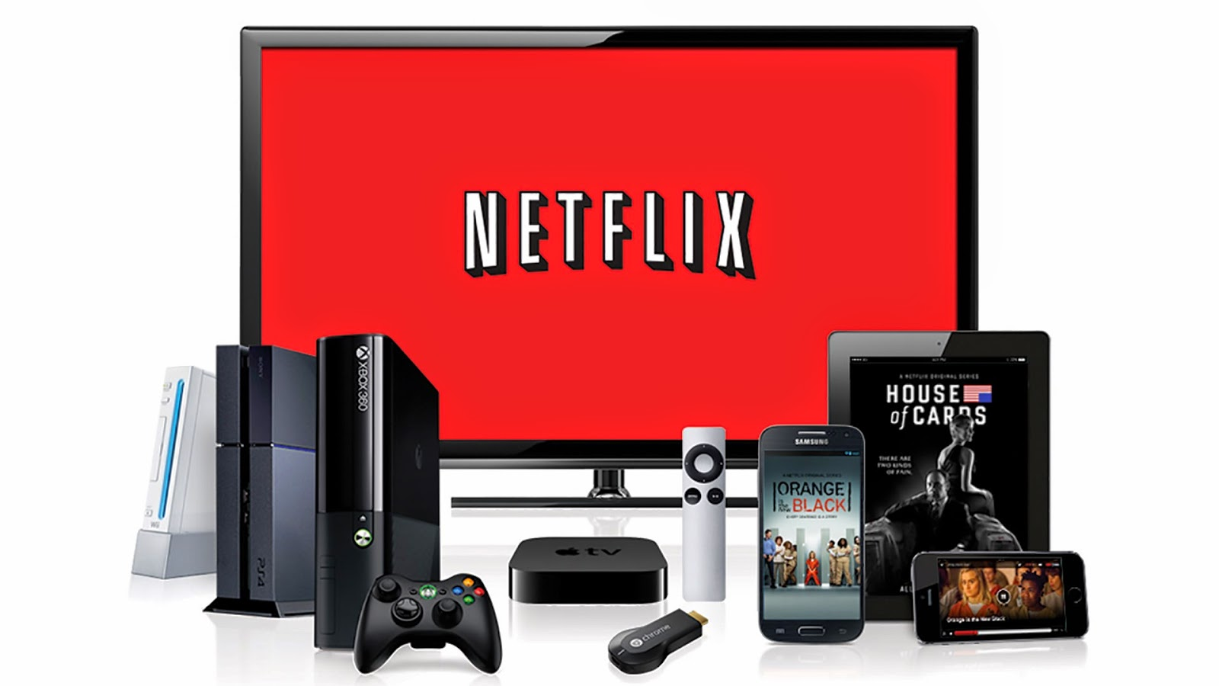
Sustaining vs. Disruptive Innovation
Instant Access
Always Available
Flat Fee
You can use the device you already have

Slide 19
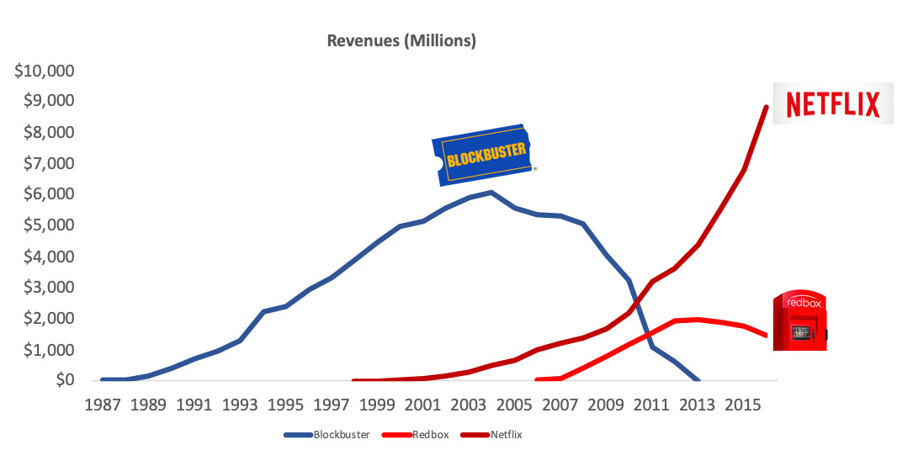
Sustaining vs. Disruptive Innovation
$17.6B
Jun 2019

Slide 20
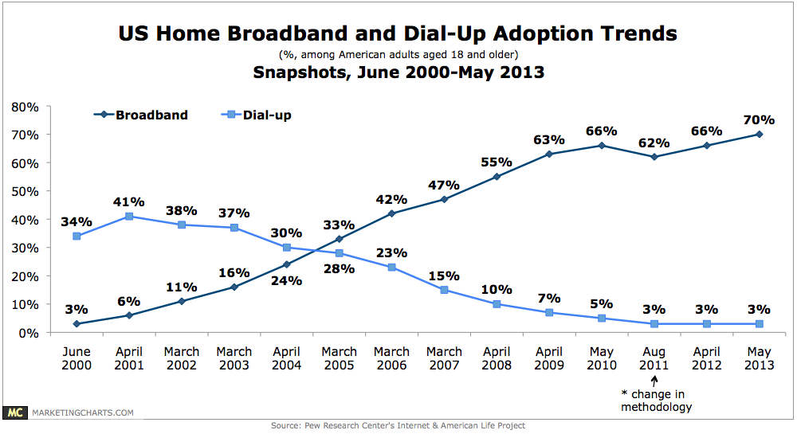
Sustaining vs. Disruptive Innovation

Slide 21
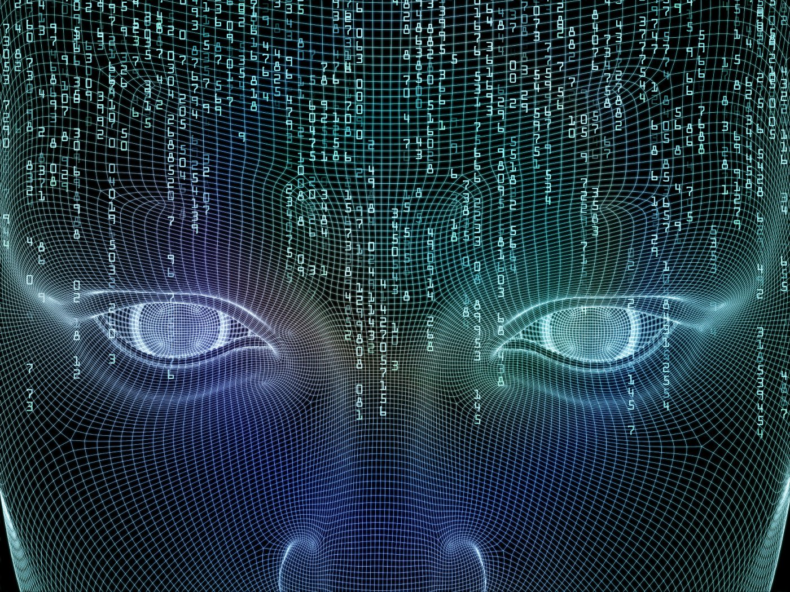
Understanding AI
Imagine a machine that is all-seeing, all-knowing, that can think for itself
….Yeah, that is the stuff of great Hollywood movies, not reality.

Slide 22
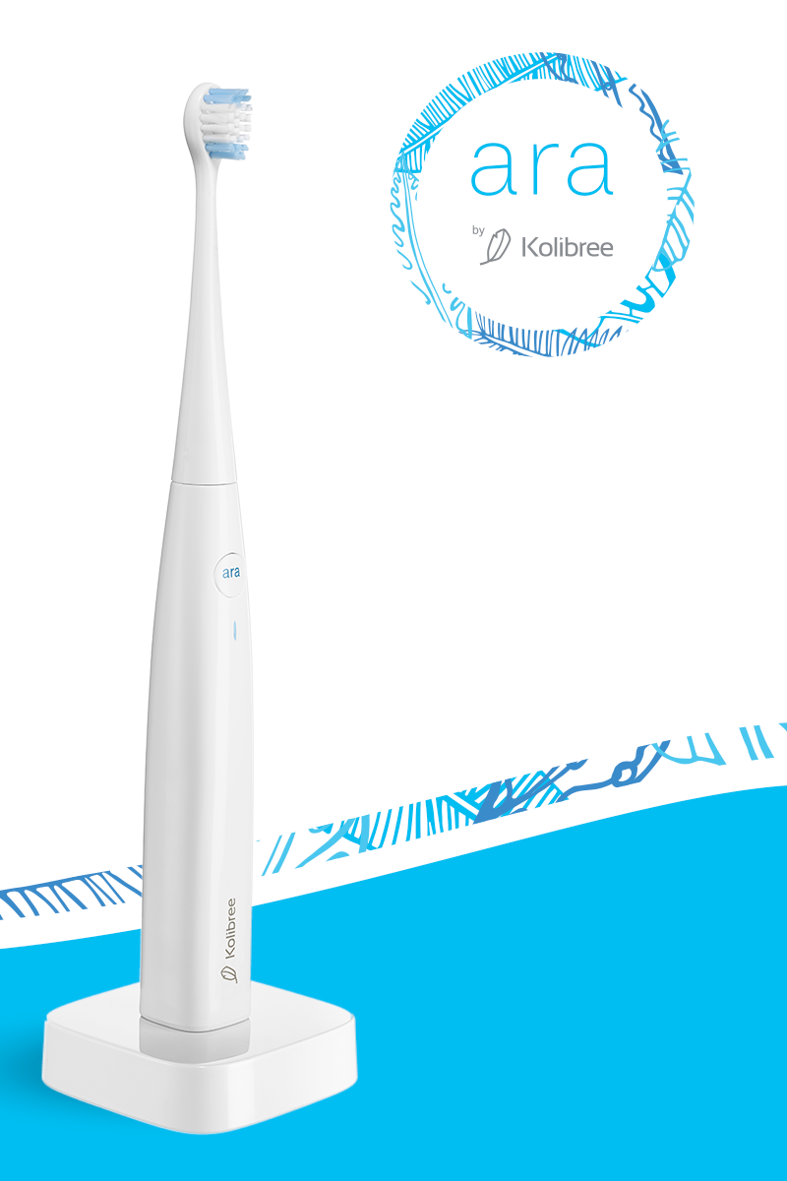
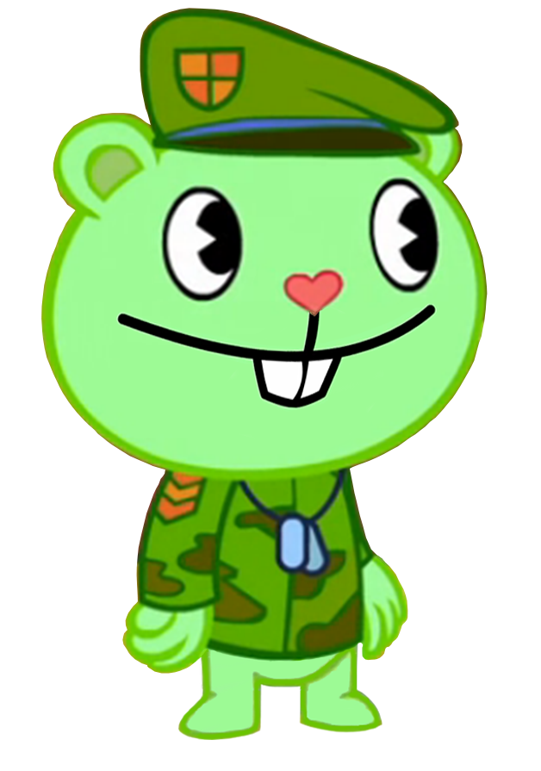
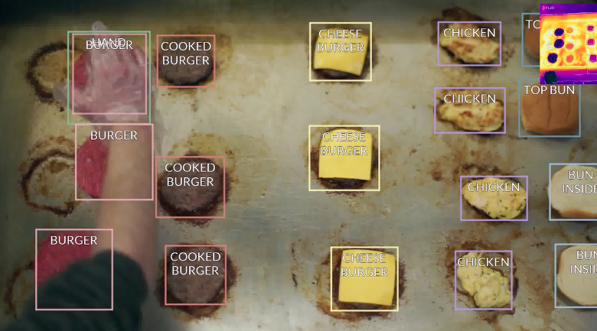
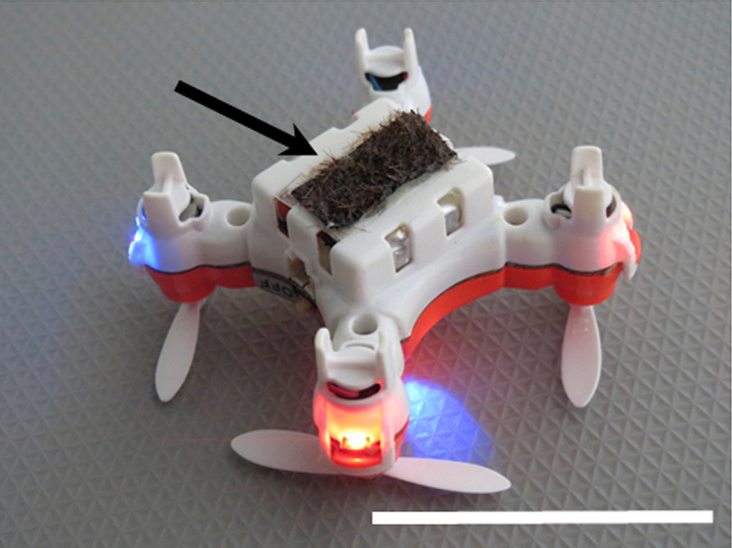
Understanding AI
“Ara”
“Flippy”
“Robot Bees”

Slide 23
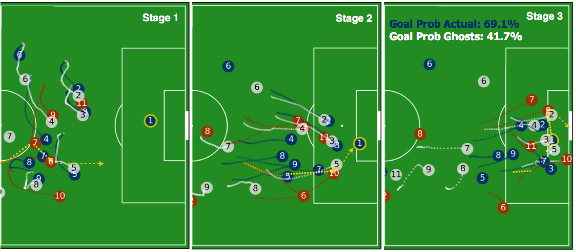
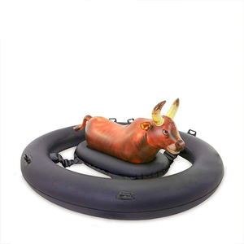
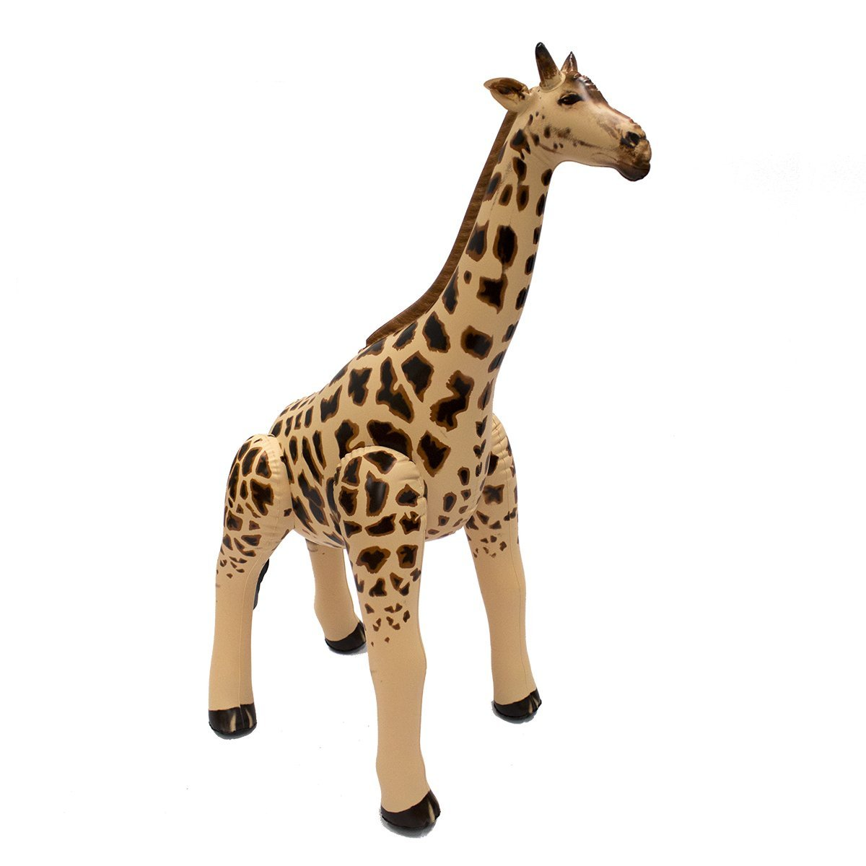
Understanding AI
“Anomalies”
“Analyzing Sports Data”
“Inflatable Giraffe”

Slide 24
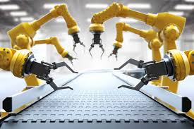
Understanding AI / Machine Learning
Today’s AI is really good at two things:
Crunching Numbers
Repetitive
Tasks

Slide 25
Understanding AI / Machine Learning
It turns out – Customer Service is an incredibly repetitive task

Slide 26
Understanding Customer Service
1. Understanding Customer Needs
2. Choosing Technology Wisely
3. Know Your Customer

Slide 27
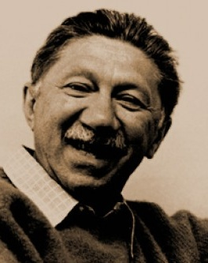
Basic Problems / Mazlow’s Hierarchy:
Abraham Maslow led a movement in 1960’s to focus on the “good” in people (vs. a “bag of symptoms”)
Developed a system of fulfilling human needs in priority – called it his hierarchy of needs.

Slide 28
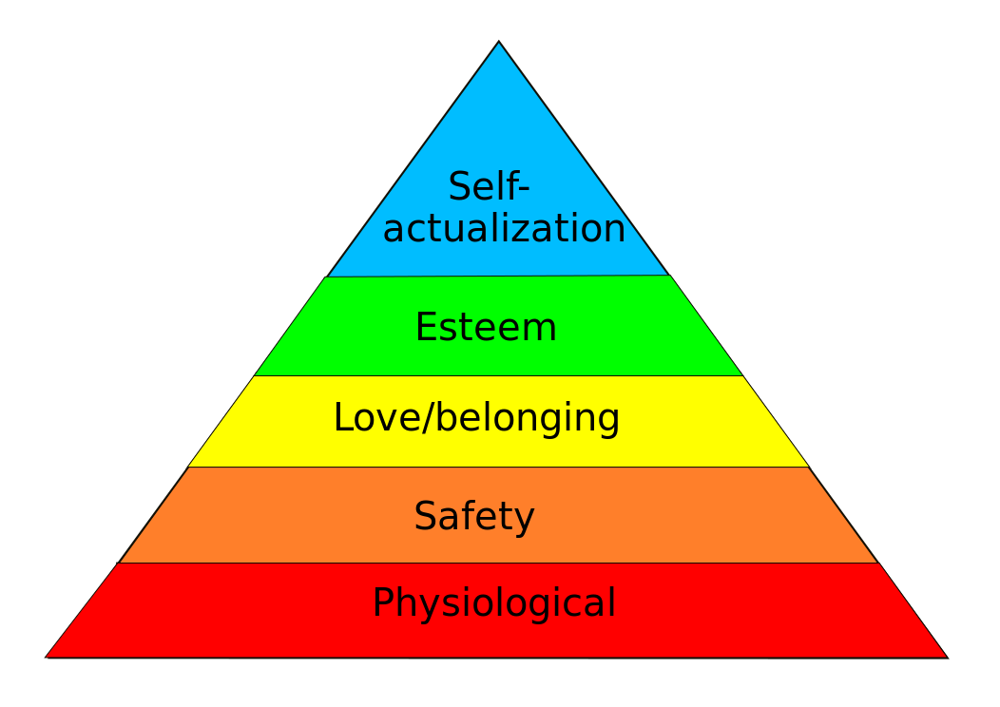
Mazlow’s Hierarchy:
Self-Fulfillment
Needs
Morality, creativity, spontaneity, problem-solving, lack of prejudice, acceptance of facts, achieving one’s full potential…
Confidence, self-esteem, achievement, respect by & for others…
Psychological Needs
Friendship, family, sexual intimacy…
Security of body, health, family, employment, resources…
Basic Needs
Breathing, food, water, warmth, sex, sleep, excretion…

Slide 29
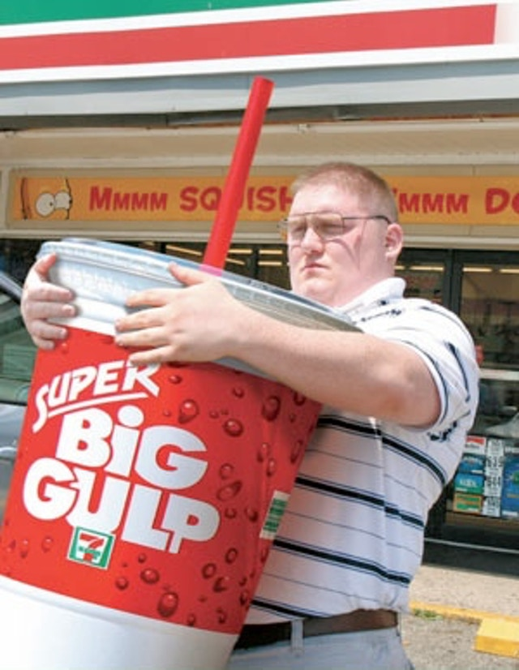
Inform / Engage / Experience
Self-Fulfillment
Needs
Can you unlock experience
Psychological Needs
Only once these needs have been met…
Basic Needs

Slide 30
Key Job / Christensen’s JTBD:
Clayton Christensen – Harvard Business School Professor
Focused on Innovation & Disruption
Posited that consumers make decisions based upon
“Job to Be Done”

Slide 31
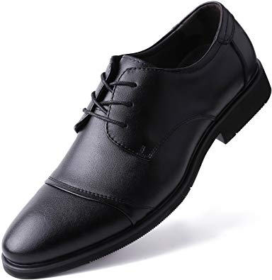
Key Job / Christensen’s JTBD:
I “hired” this coffee to deliver caffeine
I “hired” these shoes for comfort and style

Slide 32
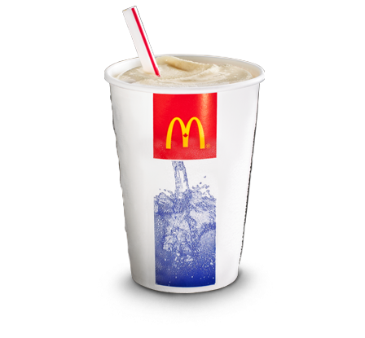
Christensen’s JTBD:
What job do you hire a milkshake for?
To deliver sweet goodness?
To provide a beverage with a meal?
To drown your sorrow in calories?
It turns out, none of these…….

Slide 33
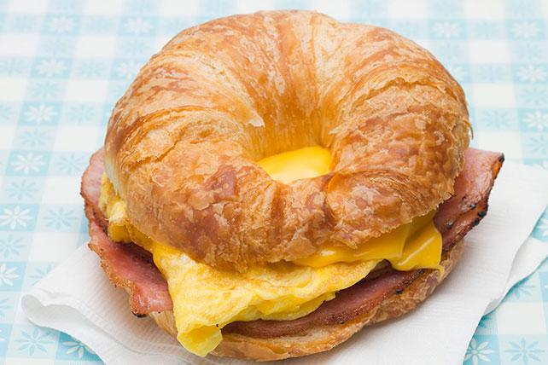
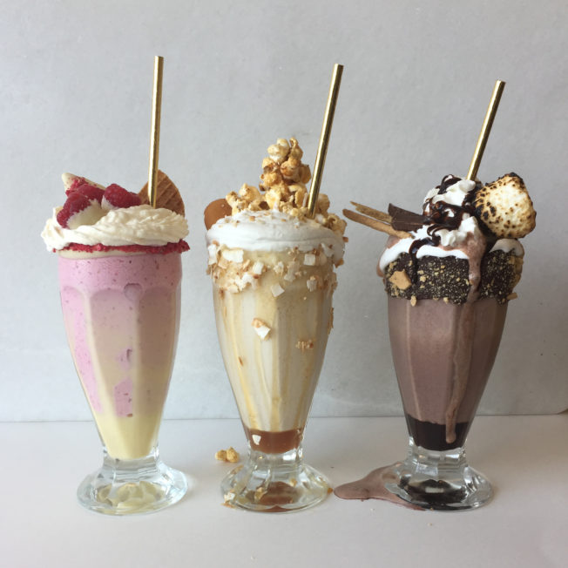
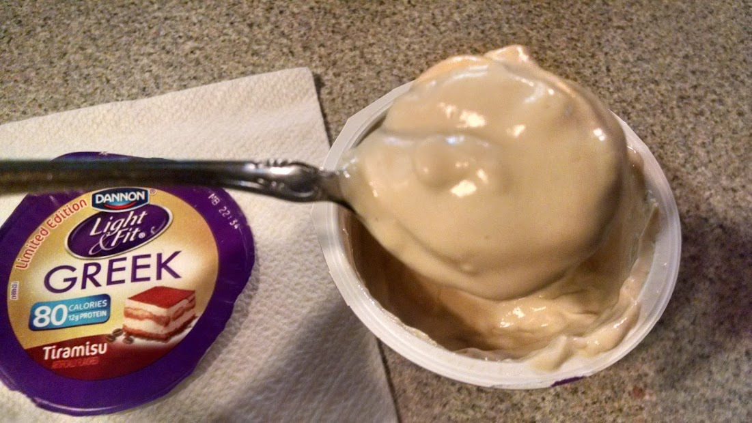
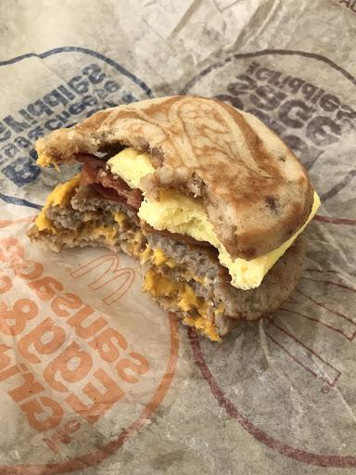
Christensen’s JTBD:
What job do you hire a milkshake for?

Slide 34
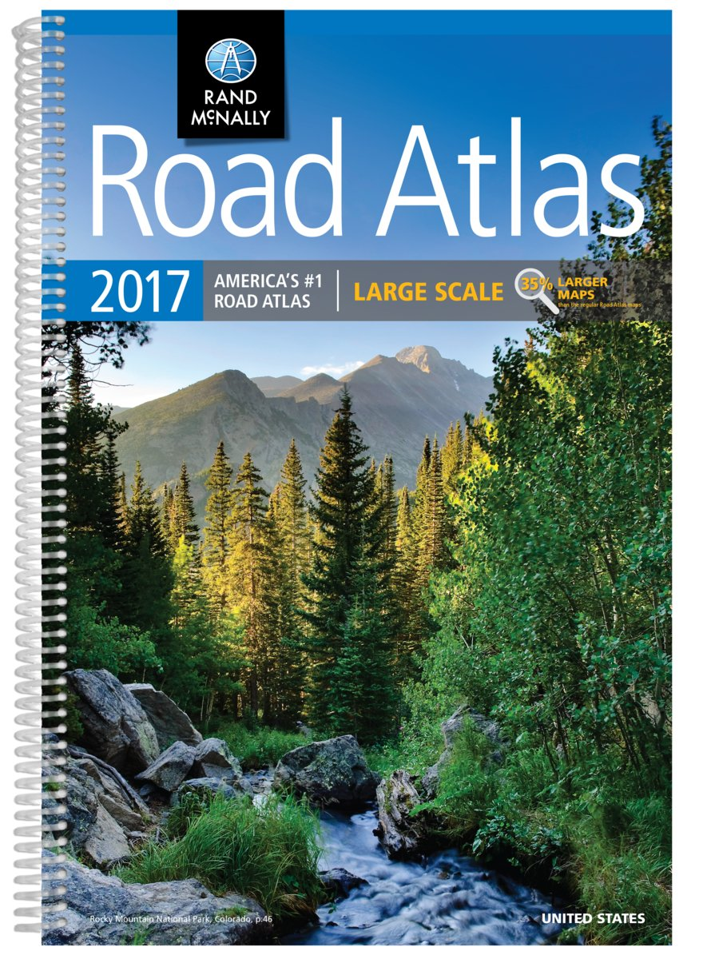
Understanding Your Customer
(technology has changed us all)
Phone Numbers
Actually coordinating schedules
Actual Maps
742-1895 (Jeff Erskine)
749-4282 (John Murphy)
749-4324 (Greg Ellis)
742-6394 (my mom)

Slide 35
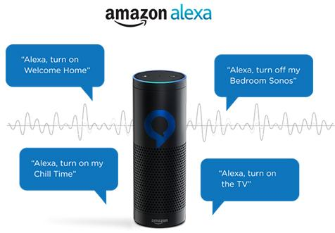
User Expectations / Alexification:
We have an entire society that has been trained to get instant answers
Weather, news, music, directions, etc
Why is your show any different?

Slide 36
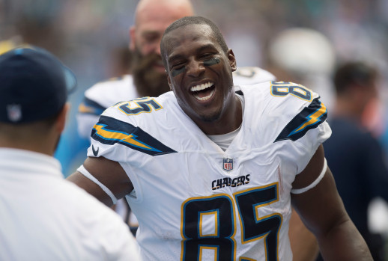
User Expectations / Alexification:
Most Touchdowns by a tight end?

Slide 37
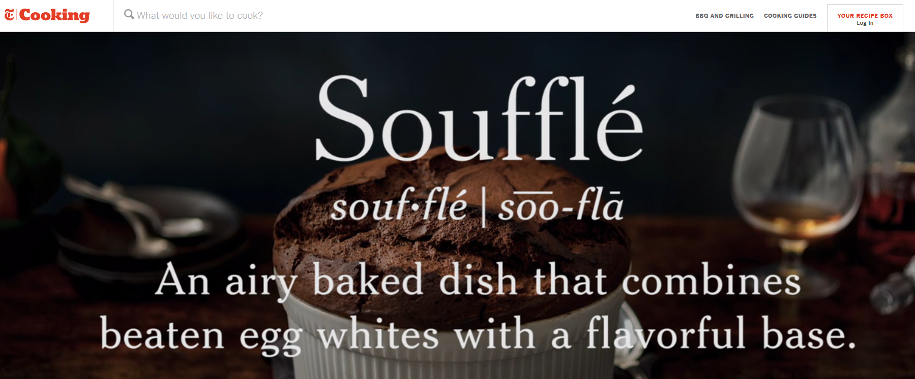
User Expectations / Alexification:
Bake a souffle?

Slide 38
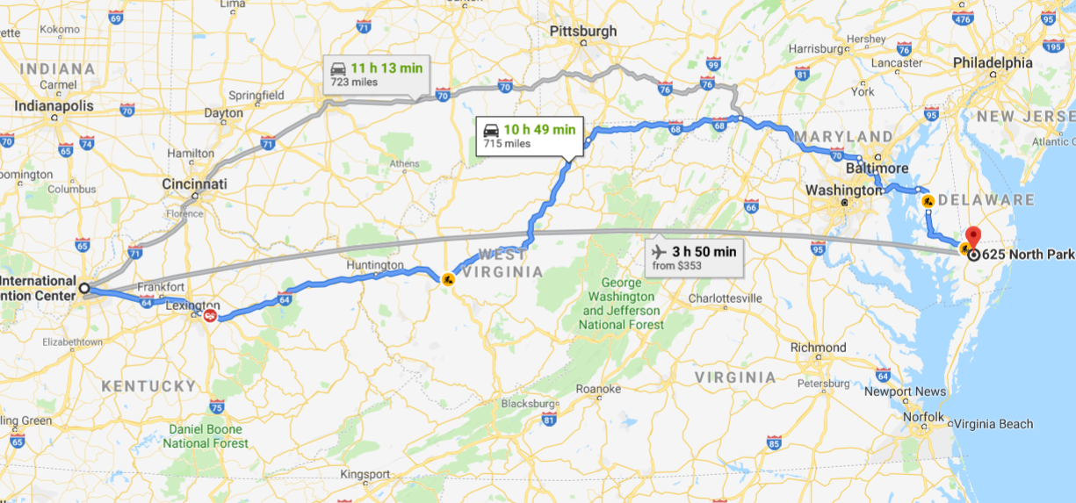
User Expectations / Alexification:
Get to grandmom’s house?

Slide 39
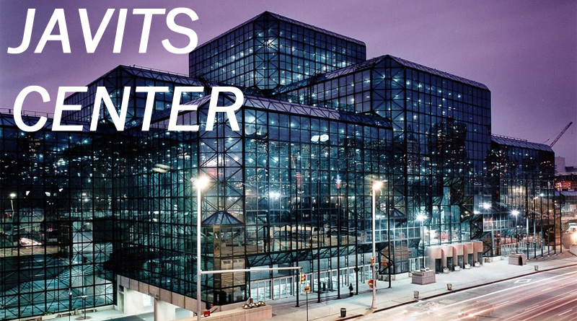
User Expectations / Alexification:
Walk in the door of your show?

Slide 40
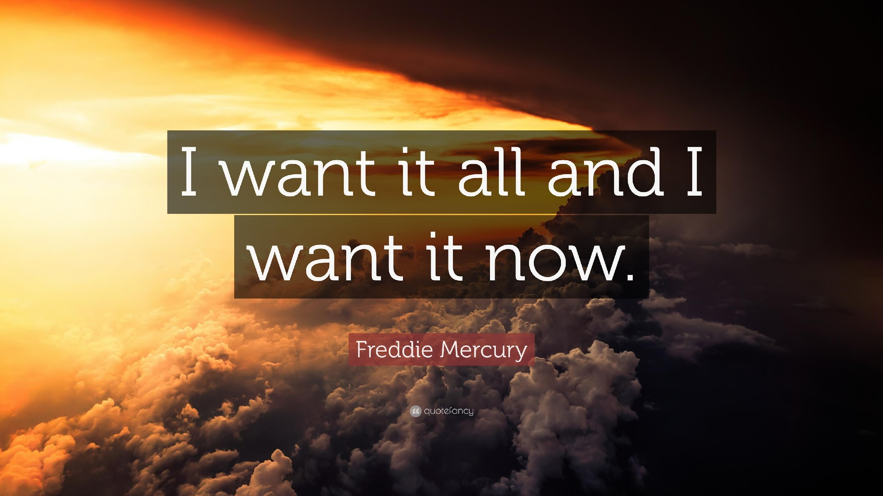
Christensen’s JTBD:

Slide 41
What if...
There were a solution with a 98% open rate AND a 95% Correct Response Rate
That solution did NOT require a download, login, and was virtually zero friction
And every single attendee already had the device to access that solution AND knew how to use it
You could use that solution to do everything from answer questions to deliver badges to networking
And set up was easy and it saved money vs. every other solution on the market

Slide 42
Understanding Technology

Slide 43
Understanding AI Chatbots
Rigid / Structured “Bots”
Deep Conversational Bots

Slide 44
Understanding
Artificial Intelligence
Natural Language
Processing
ChatBots
Bots work 24X7
Bots operate in multiple channels
Bots can deliver deep conversation

Slide 45
What does deep conversation mean?
Deep conversation means understanding and answering ALL the ways people actually ask questions. (Not just a few)
Help Me Find The
Restroom?
Where is the
Ladies Room?
Nearest
Men’s Washroom?

Slide 46
What does multi-channel mean?
Multi-channel means supporting the User In The Channel THEY Want
SMS
WebChat
FaceBook
Messenger
Twitter
Notes:
.

Slide 47
Why text?
Why on the Web?
Text messages have 98% open rate
Texts are read in under 5 seconds
Text is everywhere
Installs with 2 lines of code (easy for you)
“Alexifies” your website
Multiplies your staff

Slide 48
Your Messages Actually Get Read
Scheduled Notifications
Adhoc Notifications

Slide 49
All chatbots have two key components:
Template
Library
These are all the questions you can ask the bot.
These are all the answers AND who is allowed to see them.

Slide 50
Answers can be personalized based on Identity:
Attendee
VIP

Slide 51
Theoretically, Chatbots can answer any question,
Practically, you choose:
Scope
How much do you want the chatbot to do?
Scale
For how many? For how long?
On how many channels?
Notes:
Practically, you get to choose the scope and the scale for your event.

Slide 52
Ask a question…
Get an answer…
Ask a question…
Get an answer…
Ask a question…
Get an answer…
Ask a question…
The power of
“I Don’t Know…

Slide 53
The power of
“I Don’t Know”…
Not only do you get a written record of what your users asked…..
Oh dear... I haven't been trained on that topic.
If your chatbot is not trained on a question…..
For assistance before the event, the events team is available M-F 9am-5pm ET via phone at 649.111.1800 or at events@yourevent.com. And at the event, our onsite staff will be happy to assist.
Attendees are referred to another customer support option (Just like any other channel)

Slide 54
Leveraging Data:
What is your most valuable piece of data?

Slide 55
Bots Build Community (in a channel that works)
Other channels like apps, onsite support, or email are shut down or rarely viewed
SMS does not go away
This creates an ever-growing community to drive sales, participation, and interaction
SMS

Slide 56
Use Technology!

Slide 57
What To Look For in a Custom Chatbot:
What to ask about | Leading Providers
Available channels? | SMS, Web, FaceBook, Twitter, WhatsApp, more
Typical scope | 30-150
Correct Response Rate? (must see it!) | 95%+
How are “I Don’t Know’s” (IDKs) handled? IDK % rate? | Portal, vendor managed, <4%
How are False Positives identified? FP % rate? | Portal, vendor managed, <1%
Enhanced features (multiple libraries, polling, personalized schedules, vendor search, and more)? In SMS? | Yes, Yes, Yes, Yes, Yes…..
Full AI, deep conversation ? | Yes 4MM+
Deployment time and effort? (ask an actual customer) | 6-8 weeks (or less)
Live demo available 24/7 for you to play with? | Text “Demo” to 25525, or visit EventBots.com
Notes:
Others
Usually just Web or FaceBook
Usually >30
Usually less than 85%
Usually don’t disclose
Usually don’t disclose
No
Usually not
Months
Usually not.

Slide 58
ChatBot Process: Should Be Quick & Easy
Vendor should harvest data from your website, schedule, and systems.
Your Beta bot should be ready within 1-2 weeks of kickoff.
Entire process should take 6-8 weeks
(most of which is vendor waiting for you)

Slide 59
BizBash “Betty”
Betty joined the BizBash team for BizBash Live Florida in May 2017
96%+ Correct Response Rate and 70% Engagement rate
Now she can respond to 100+ user needs asked over 8 million different ways
“Hi”
Notes:
Bots can be branded and have their own voice

Slide 60
ChatBots are the Perfect Technology
Team Member
They deliver a 95.4% (+) Correct Response Rate
Chatbots don’t take breaks, show up hungover, or ask to leave early...
They are constantly learning and handle hundreds of concurrent interactions
Chatbots capture a clear written record of what attendees really ask for

Slide 62
Pelotonia “Tonia”
Largest Cancer Ride in America
Nearly 70% of 30K riders register within 3-hour window
Answered over 21K questions and delivered nearly 8,000 badges
(saving about 6,000 minutes of rider time)
Notes:
Bots can be branded and have their own voice

Slide 63
Premier Lacrosse League “Slash”
Newest Professional Sports League
Travel to different city every week
(a trade show every week for 12 weeks straight)
Delivered 45% click through on transactional messages
(you read that right)
Notes:
Bots can be branded and have their own voice

Slide 64
Sustaining vs. Disruptive Innovation
Event Apps
Crappy Wifi
Replaced Paper Guides
Quicker Download
Quick Availability
Personal & Searchable
Limited Mobile Data

Slide 65
Sustaining vs. Disruptive Innovation

Slide 66
The Age of Bots is Upon Us
Sustaining vs. Disruptive Innovation
Instant Access in SMS Channel
95%+ Correct Response Rate
70%+ Engagement Rates
Less than 1% Opt-out Rates
Click throughs 30%+

Slide 68
Do our EventBots Work?
We are proud to have won 17 awards in the last 24 months

Slide 69
The Connect Concierge EventBot!
Need directions, parking information, agenda, reception details, Wi-Fi access or anything else for Connect? Just ask Connie!
To get started, text “Connect” to 25525.

Slide 70
‘Connect’ to 25525
‘profile’
‘participant list’
‘my badge’
‘exhibitors’
‘poll’
‘notifications’

Slide 71
#ConnectMP
Bob Caldwell
+1-801-971-4952
robert.caldwell@sciensio.com

