Slide 1
Copyright Compliance in Multinational Business
Developments in Enterprise Compliance Solutions
Content Workflow 2015

Slide 2
Copyright Compliance in Multinational Business
About CLA
About Copyright
CLA Licence Solutions
CLA Licence Plus
Workflow Tools

Slide 3
About CLA
Who we are and what we do
CLA is a not for profit company owned by publishers and authors, primarily in the UK but with an increasingly global membership
CLA helps people and organisations to use content the way they want, when they want
CLA services simplify copyright and streamline the permissions process
We offer blanket licences which give permission to copy and re-use content from copyright publications including digital or print

Slide 4
About CLA
Blanket licensing
Blanket licences from organisations such as CLA, CCC, CAL cover millions of copyright works
Permit reproduction or copying of an extract of a copyright work
‘Copying’ includes digital-to-digital; photocopy; scan; print; display; digital storage
CLA licences also provide an indemnity against copyright infringement claims from any rightsholder

Slide 5
About Copyright
What is copyright?
UK: CDPA 1988 and other legislation
EU: Copyright Directive
Copyright is a property right that protects literary, musical, artistic and dramatic works
- No official registration system; protection is automatic
- Lasts 70 years after author’s death
- No copyright in ideas, names, titles
Copyright owner has economic and moral rights or ‘restricted acts’ including the right to copy
Permission must be sought to do one of those ‘restricted acts’

Slide 6
About Copyright
What are the risks?
Infringement of copyright risks legal action
Potential financial and legal costs
- Remedial actions
- Civil offence, damages may be awarded
- Companies can be guilty by enabling infringement
- Officers can be found personally liable by aiding infringement
Reputation damage
Lost business
Infringement denies creators income

Slide 7
About Copyright
Exceptions and Exemptions
Exceptions where copying is permitted
- In certain circumstances, e.g. for judicial proceedings
- For certain categories of people, e.g. visually impaired people
Exemptions under ‘Fair Dealing’
- Copying for non-commercial research or private study
- Copying for criticism or review
- Copying for news reporting

Slide 8
About Copyright
Access and Permissions
Creative works have automatic protection
Permissions are determined by copyright owner
Default state is ‘All Rights Reserved’
Open Access – full or hybrid
Creative Commons –standardised licences offering varying degrees of Open Access:
CC-BY
CC-BY-NC

Slide 9
CLA licensing solutions
CLA Corporate Licences
Sector-specific licences developed for and with sector customers over two decades
Designed to provide the broadest possible solutions to copyright issues and risks in the global corporate environment
Covers copying and digital storage by global employees
Hard copy publications from over 36 countries and digital publications from 16 countries
Include digital magazines and journals, selected free-to-view and subscription websites, material received via document delivery, and via media monitoring services

Slide 10
CLA licensing solutions
CLA Corporate Licences: Options
Domestic Business and Pharmaceutical Licences – for any sector
Extended Multinational Business Licence – for UK HQs with global subsidiaries
Multinational Business Licence – for companies in any territory with global subsidiaries
Joint CCC-CLA Multinational Copyright Licence

Slide 11
CLA licensing solutions
Joint CCC-CLA Multinational Copyright Licence
Available from January 2016
New licence administered by CCC
Available as an option to companies in the UK who operate in R&D intensive industries
Similar permissions to CLA pharmaceutical licences
More details available for interested customers from December 2015

Slide 12
CLA licensing solutions
CLA Corporate Licences
What can I do with copies?
Copy one article (two with Pharma licence) from a journal, one chapter of a book, or up to 5% of any book or journal issue, whichever is the greater
Storage on a secure network
Mark up / annotation of digital copies
Employees of overseas affiliates may receive, access and print single copies

Slide 13
CLA licensing solutions
CLA Pharmaceutical Licences
What else do the Pharma licences permit?
External delivery of licensed digital and print copies in response to incoming medical information requests relating to a licensee’s products
External delivery of licensed digital and print copies for regulatory submissions in any jurisdiction
External delivery of licensed digital and print copies for patent applications or legal proceedings in any jurisdiction

Slide 14
CLA licensing solutions
CLA Corporate Licences
What about collaborative workflow tools?
Zinc MAPS etc
Collaboration Licence
Facilitates sharing between licence holders
Supports collaborative projects and partnering opportunities
Permits sharing via e-delivery or shared network locations

Slide 15
CLA licensing solutions
CLA Corporate Licences
What about Open Access and Repositories?
Publisher’s version of record
Rights-reserved articles in hybrid open access journals
CC-BY-NC licensed articles
Preprints or author manuscripts

Slide 16
CLA Licence Plus
Licensing + Content
New licensing option, includes supply of content via document delivery suppliers within overall cost of licence
CLA working with the British Library and other providers to enhance licensed content supply – removes the need for encryption
Benefits include:
Streamlined service – enhancing established relationships with reduced administration
Cost efficient – delivering quality assured content at fixed and upfront cost
User friendly – access to vast breadth of material with no DRM

Slide 17
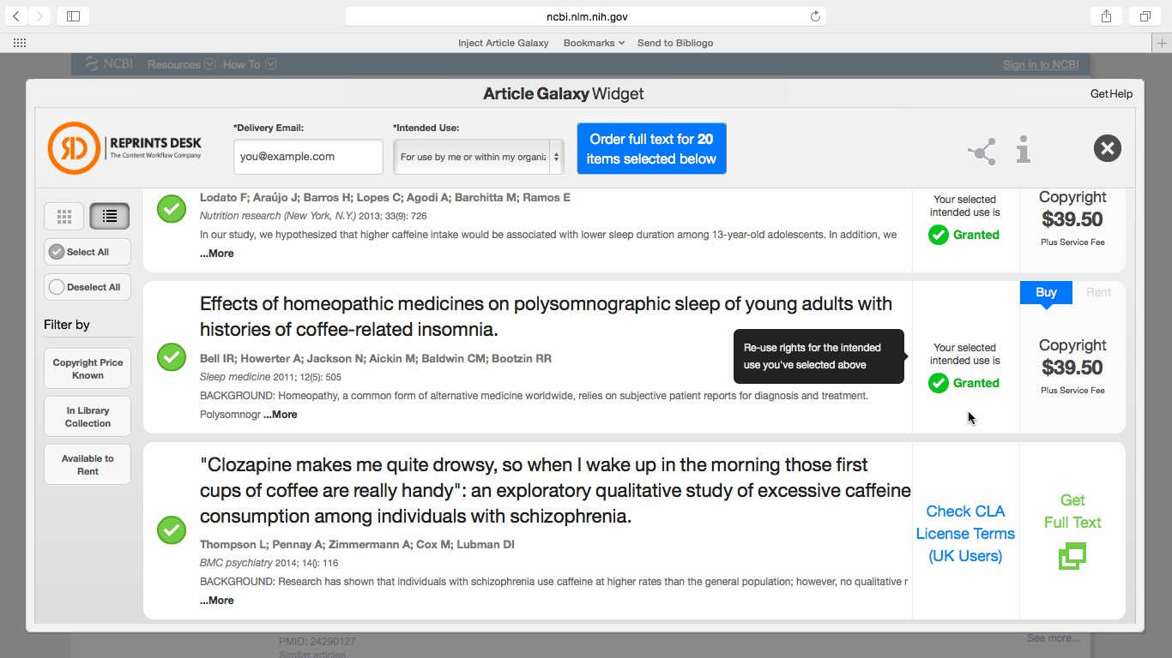
Workflow Tools
Article Galaxy Widget with CLA Rights

Slide 18
Workflow Tools
Check Permissions Tool
Tool for customers which identifies user permissions by licence
Designed to replace or complement existing website support for included and excluded licence material
Can be used with ISSN / ISBN or title & publisher details, Mobile App and API facility available
Aims to simplify process of confirming whether titles are included and what can be copied
Available at http://permissions.cla.co.uk/titlesearch.html

