Slide 1
Literature Monitoring in Drug Safety Tessa Heffernan Product Specialist, Pi2

Slide 2
Drug Safety Regulations and Guidelines: A Practical Interpretation
Notes:
US and Europe

Slide 3
Individual Case Safety Reports (ICSRs)
Ascertain whether the article contains the minimum information needed for a valid ICSR
One Adverse Reaction/Event
One Identifiable Patient
One Suspect Drug
One Identifiable Reporter

Slide 4
Aggregate Reports
Safety Study
Lack of Efficacy
Overdose/abuse/misuse
Off Label Use
Pregnancy cases
Pharmacokinetics
Drug interactions
Developmental Safety Update Reports (DSUR)
Periodic Safety Update Reports (PSUR)
Class effects/issues
Pharmacogenomics
Benefit Risk
Spec Population - Elderly
Spec Population - Children
Other AR Criteria

Slide 5
Signal Detection
A new causal association between a drug and an adverse event
OR
A new aspect of a known causal association between a drug and an adverse event

Slide 6
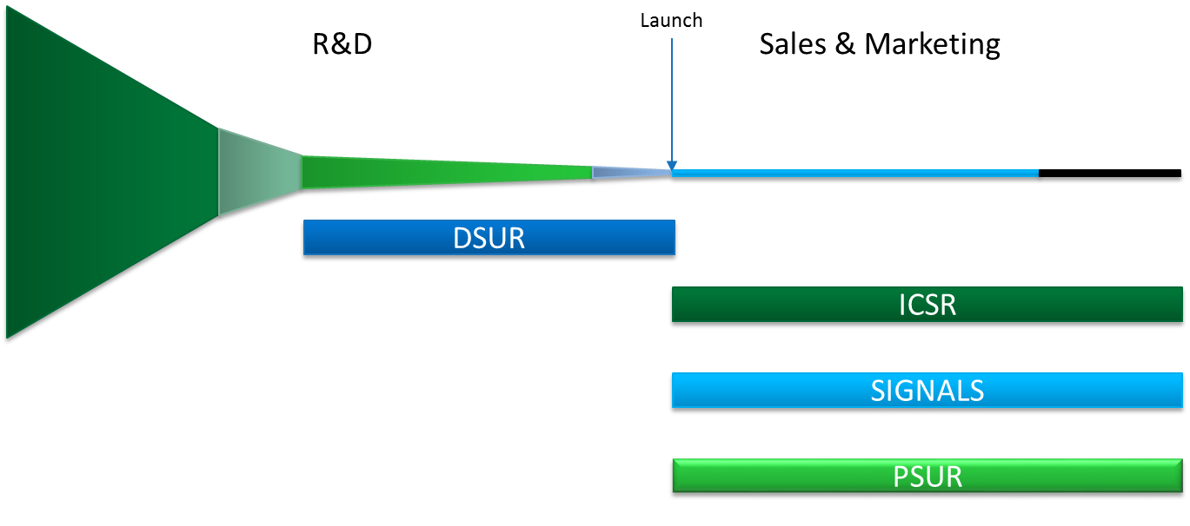
When is it required?

Slide 7
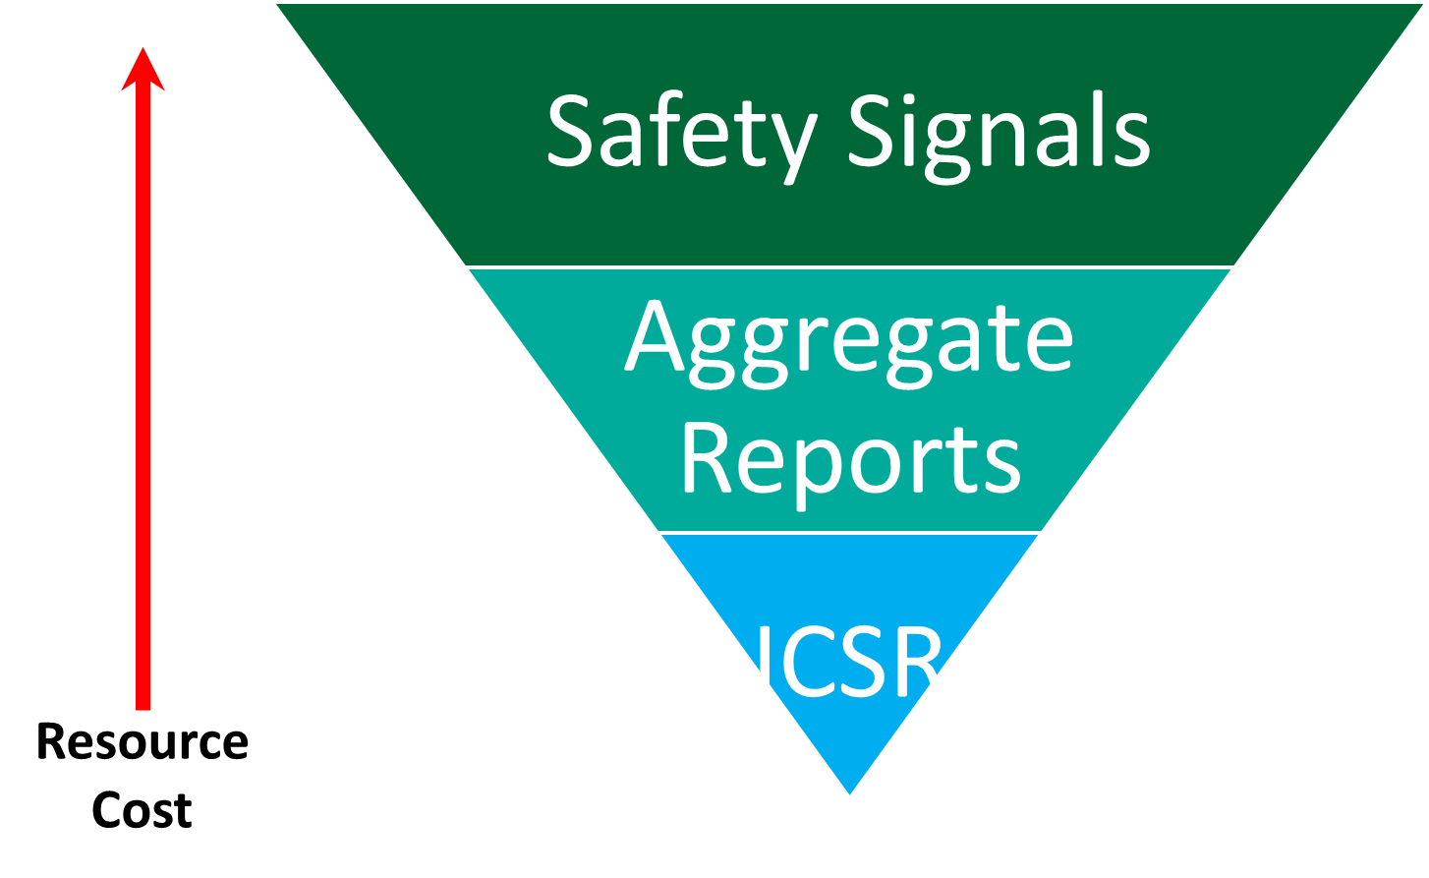
Cost and Complexity

Slide 8
Day Zero
ICSRs identified from references
Day Zero is the day that the search was conducted
Full Text
4 points of data cannot be identified from the reference alone
Day Zero is the day that the full text was obtained
Articles must be routinely obtained without delay

Slide 9
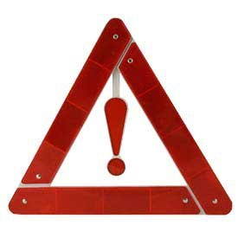
Assessment for Safety Signals
Previously
Preformed retrospectively
Typically with the assessment of literature for aggregate reports (after the reporting interval)
Now
Systematically performed in real time
Typically within 30 days after the assessment for ICSR

Slide 10
Speed of Review
ICSR
Typically within 2 days of Day Zero
Safety signals
Typically within 30 days after ICSR Review

Slide 11
MLM – Medical Literature Monitoring Service
Not widely viewed as something that will reduce the overall workload for Drug Safety departments
Organizations continue to formulate the optimal approach to dove-tail with the MLM service
Most appear to be continuing to perform literature review for products on the MLM list
But are suppressing submission of references with criteria

Slide 12
The Risk of Missing Information

Slide 13
Screening Statistics
References screened = >1.5 million
% of references with safety criteria
ICSR | Aggregate reports | Safety signals
4.12% | 5.47% | 0.12%
Up to 95% of references screened are not relevant to drug safety!
Notes:
The volume of references to screen still remains a tremendous burden on R&D companies and the process can be very error-prone.

Slide 14
Literature Screening
Published Literature
Key resource for the identification of patient safety issues
Proper screening is crucial
Consequence of poor quality screening
Risk of drawing wrong or delayed conclusions
Could lead to patients being harmed unnecessarily
Risk of damage to the organisation

Slide 15
Literature: What Could You Be Missing?

Slide 16
Pharmacovigilance Databases
Standard
MEDLINE®
Embase®
What you’re missing
BIOSIS Previews®
Derwent Drug File
International Pharmaceutical Abstracts
SciSearch®: a Cited Reference Science Database
News and Other non-traditional sources
Notes:
Need information not available in primary databases

Slide 17
Are You Getting Everything?
Records retrieved from recent safety searches

Slide 18
Does Your Report Include…
Excessive use of <drug name >: A case report
Physical dependence following <drug name> usage: A case report
<drug name> abuse in South Wales: Three case reports
<drug name> and delirium: a case report
Not in Embase or MEDLINE

Slide 19
Streamlining the Literature Review

Slide 20
Capturing Articles is Only the First Step
Literature Review Challenges
Literature Review Needs
Need to be sure all articles are captured and reviewed
Existing in-house systems are becoming outdated and maintenance and replacement costs are high
A coordinated workflow to manage the article pipeline
Capture metrics behind article reviews in case of audits
Some outsourced systems are unable to meet the rigid regulatory demands

Slide 21
Ideal Literature Review Process
Streamlined reference review workflow
Standardised annotations
Apply safety review criteria to the reference
Reference history for audit trail
Automatic acquisition of full text
Translations when needed
Allows reviewer to focus on patient safety
No burden of the inefficient processes

Slide 22
Duplicate References
Duplicates are a major source of issues
Reference from multiple databases
Searches for different drugs
Many references contain >1 drug
ICSRs identified when screening for Signals & Aggregate Reports

Slide 23
Issues Caused by Duplicates
Compliance Issues
Obfuscate the Regulatory Clock Date / Day Zero
Same reference can be screened differently by different reviewers
Time Management
Complexity wastes significant time and resources

Slide 24
Effective Deployment of Resources
Safety Signals
Aggregate Reports
ICSR
Product Safety Physicians
Step 2
More complex
Product Safety Literature Reviewers
Step 1
Less complex

Slide 25
Benefits of Streamlined Literature Review
Companies with inspection findings are able to quickly report an audit trail
Increased confidence to face inspections from internal QA departments and the regulators
Management can more easily track key performance indicators
Granular reports can be generated to provide performance overview

Slide 26
But How?
Significant gains are made by streamlining the process
Screening quality can be improved if the screeners / reviewers are able to focus on the content
Process Waste - process administration often takes up more time than the identification of safety issues
Better handling of duplicates references
Simplify - complicated processes are more likely to be a source of inspection findings

Slide 27
Time savings
Estimates from clients varies between:
2 minutes per reference to
10 minutes+ per reference

Slide 28
Potential Time Savings
References screened to save a FTE year
42,000 references @ 2 mins per reference
21,000 references @ 4 mins per reference
14,000 references @ 6 mins per reference
10,500 references @ 8 mins per reference
8,400 references @ 10 mins per reference

Slide 29
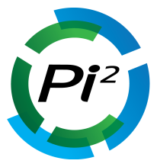
ICSRs
Online hosts
Auto Importer
Auto Output
Signals
Conference material
PSURs
Internal information
PBRERs
Drug Safety Triager
Ad-hoc
Compliance
Reports
Ad-Hoc Reports
Minimize alerts management | Automate data entry | Streamline & automate the literature review process | Automate PDF acquisition | Standardize and automate the audit trail | Reporting | Integrate seamlessly

Slide 30
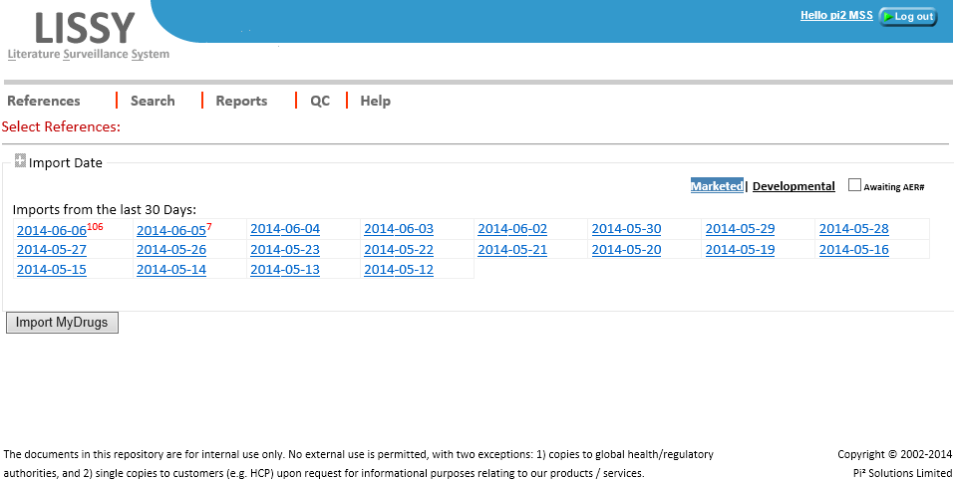

Slide 31
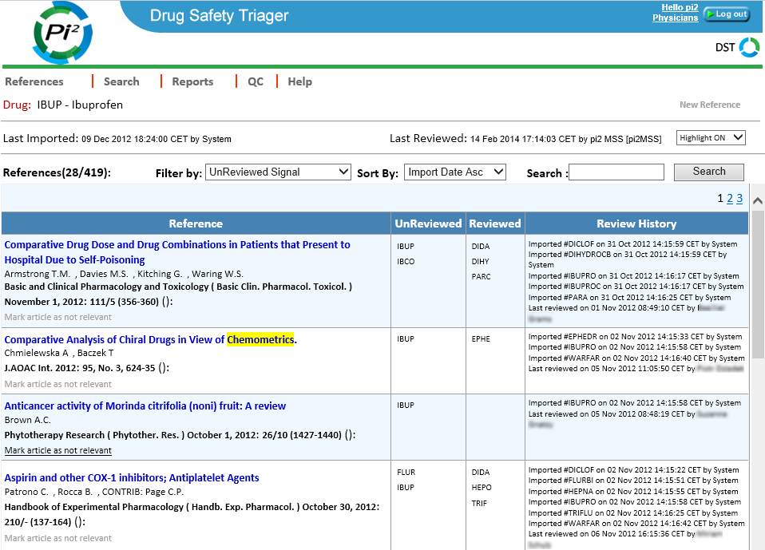

Slide 33
The Bermuda Triangle of Drug Safety
Cost
Risk
Drug safety
Legal needs
Key issues for drug safety
Inefficient processes
Duplicated reference review
Ineffective deployment of resources
Management oversight
Inspection findings/compliance

Slide 34
Feedback
Increased confidence to face inspections from internal QA departments and the regulators
Less frustration supporting the workflow
Motivated team
Able to focus on safety
“Compared to what we had before it’s like going from a horse-drawn carriage to a space rocket”
Safety Operations Scientist, Literature Screening team, top ten pharma

Slide 35
Summary
Is your compliance and patient safety at risk?
Inefficient literature review
Missing literature references
Lack of management oversight
Optimize Literature Review
Provide the most complete set of documents for review
Save time and duplicated efforts with a streamlined review process

Slide 36
Questions?

Slide 37
Tessa Heffernan, Product Specialist tessa.heffernan@proquest.com

