Slide 1
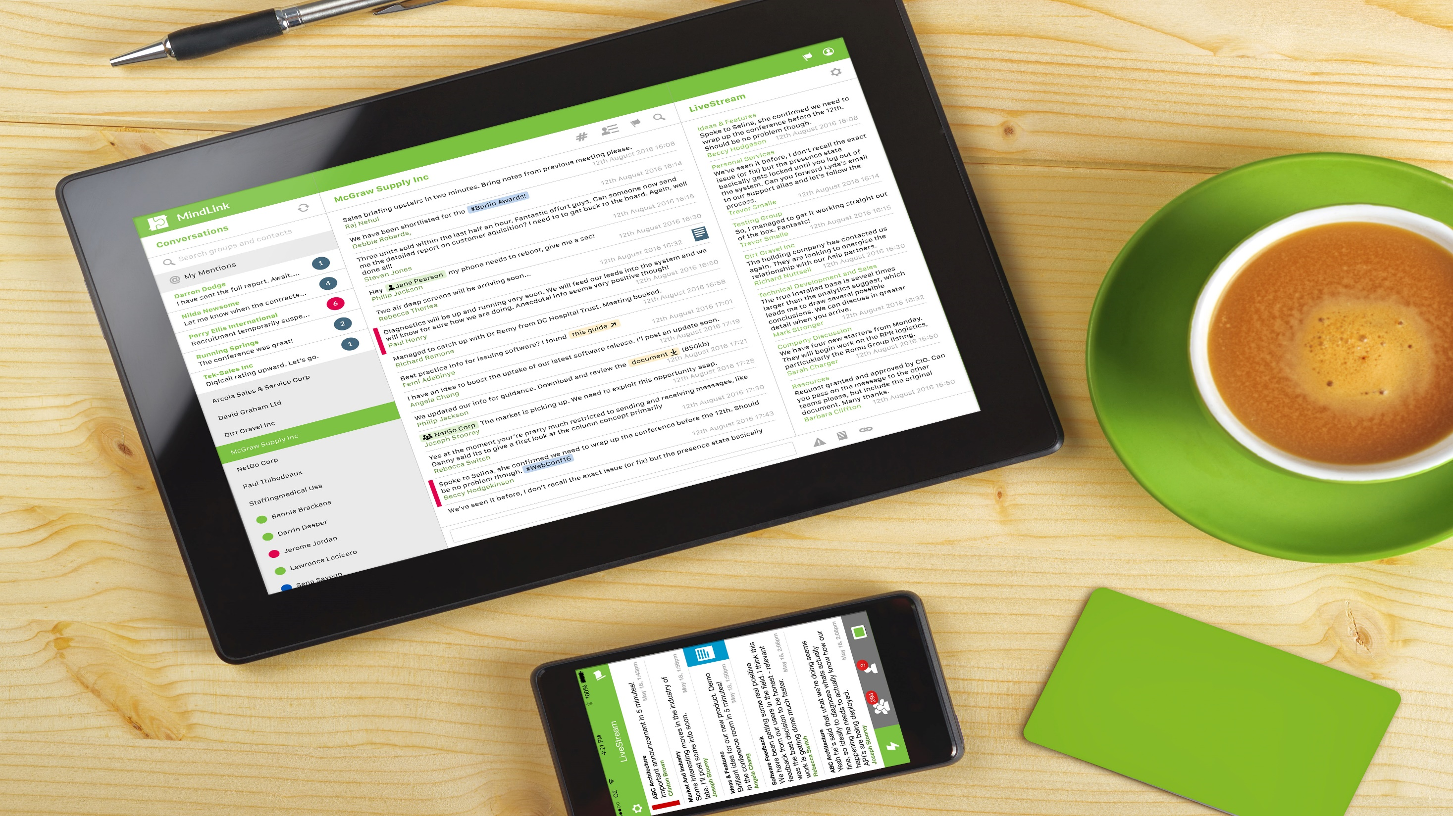
TIMING

Slide 2
TIMING
A DAY
IN THE LIFE OF
…
JOHN
WORKS FOR A LARGE CORPORATE
2000 EMPLOYEES
MULTIPLE PROJECTS
CLIENT ACCOUNTS
MANAGES SMALL TEAM
USING EMAIL!
Notes:
A Day in the Life of…
This is John:
John works for a large company, 2k employees and 20 regional offices. He is in the European HQ working on multiple projects, client accounts and manages a small but dispersed team.
Here is a day in the life of John:

Slide 3
TIMING
Getting Ready for the Day
HERE WE GO AGAIN!
EMAIL:
80%: SYSTEM GENERATED
38%: ONLY DEEMED IMPORTANT
28%: OF TIME SPENT READING/
RESPONDING TO EMAILS
INBOX (40)
RE: OUT OF OFFICE
RE: RE: RE SUBJECT
EMAIL IS:
NOT REAL-TIME
ASYNCHRONOUS
A BROADCASTING TOOL
WHAT’S IMPORTANT?
FW: SUBJECT
LAST CHANCE
SOURCES: SANEBOX
Notes:
Bright n Early:
John wakes up to 40 unread Emails that came in over night
He doesn’t know which one is the most important so he reads them all, newest to oldest, and sorts them chronologically. He also is on cc, bcc and FW of emails that may or may not be important but he still needs to read them all as colleagues tend to assign tasks even to ppl in cc. There is a big culture of people just sending emails to everyone to be on the ‘safe side’. Emails, that’s about 1h every morning just to know what is going on
What is important? 80% of Emails are system generated + the average inbox contains only 38% of important messages (SaneBox’s)
Same Email with cc and bcc? When to cc someone?
What the latest version of the project document?
Email is asynchronous
No way to quickly view what is important and what isn’t SOURCES:
SaneBox’s,
blog.sanebox.com/2016/02/18/email-overload-research-statistics-sanebox/

Slide 4
TIMING
The Daily Commute
EMAIL HAS BECOME A PROBLEM
AN AVERAGE OF 122 EMAILS RECEIVED EACH DAY
ESTIMATED 20% OF EMAIL IS SPAM
INBOX (40)
50
FW: RE: RE: RE: RE::RE:RE
RE: RE: RE: RE SUBJECT
RE: RE: RE: RE: RE:RE: RE:
RE: RE: RE SUBJECT
FW: RE: RE: RE: RE: RE:
RE: RE SUBJECT
RE: RE: RE: RE: RE:
RE SUBJECT
SOURCES: RADICATI, PHILLIPS & COMPANY
Notes:
Ready for the day ahead:
John commutes into the office during which time another 10 Emails have accumulated
This is just for the story to be told verbally
SOURCE:
http://www.radicati.com/wp/wp-content/uploads/2015/02/Email-Statistics-Report-2015-2019-Executive-Summary.pdf
http://y98.cbslocal.com/2016/04/22/work-emails-that-waste-time/

Slide 5
TIMING
Managing Projects & Team Work
CC’s, BCC’s and FWD’s DON’T ADD ANY VALUE
PROJECT
X
John pls action
NO MECHANISM OF ASSIGNING #TASKS TO @PEOPLE
INABILITY TO FILTER, SEARCH OR ALERT
Notes:
John gives an update about Project X by sending an Email to the team as well as putting into cc. all stakeholders that might be interested (that’s 8 ppl btw). Someone replies with a comment with everyone in cc., then a side conversation emerges between two team members, John still has to read all dozen Emails that go back and forth as they may contain nuggets of information he needs and sure enough in Email No 10 there is an action for him which he would have missed otherwise
CC and FWs flood Emails without adding value
No mechanism of alerting people to #tasks or @mentions

Slide 6
TIMING
Knowledge Management
NEED TO GET
BACK TO MY CLIENT! BUT WHERE IS THE FILE?
HAVE TO EMAIL SOMEONE ELSE WHO MAY BE ABLE TO HELP
KNOWLEDGE IS KEPT IN SILOS / PEOPLE’S INBOXES OR HEADS
WELL MY
COLLEAGUE WASN’T HAPPY WHEN I CALLED LAST NIGHT
URGENT!
EXECUTIVES WASTE 150H/ YEAR SEARCHING FOR LOST INFORMATION
NO VISIBILTY, EMAIL BLACK HOLE
KNOWLEDGE ISN’T AN ORGANISATIONAL ASSET
SOURCES: FORBES
Notes:
John needs an urgent answer for his biggest client. His colleague would know but he is on vacation. He called him yesterday and could tell he wasn’t happy. He also sent an Email last night to another team, no answer, Email is asynchronous, not real time. He sends another Email. He doesn’t even know whether the team he asked is the right one. The client is still waiting for a reply
If people are not available, knowledge isn’t available and stick in the Email black hole, it isn’t available as a company asset
No visibility on who is the expert
If several ppl are on the Email no one may take action or ownership
John is in cc of several projects where he is only marginally involved and only occasionally checks in. He needs to scroll through entire Email streams to get up to speed in case anyone asks a question. He is worried he maybe missing anything otherwise
No mechanism of alerting people to #tasks or @mentions
No ability to customise how he wants to consume data
No way to prioritise or structure how information comes in
SOURCE: http://simplyorderly.com/surprising-statistics/

Slide 7
TIMING
Document Management
ASIA HAS
ALREADY DONE IT,
THAT’S 2 HRS WASTED!
CLIENT
PPT
Asia Team – Client PPT
SENT
EMAIL LACKS ACCESS & TRANSPARENCY ACROSS SILOS
DUPLICATION OF WORK
ISSUE WITH VERSION CONTROL
LOSS OF PRODUCTIVITY
Notes:
John submits a slide deck for Client A for global use. Seems like the Asia team has already done the exact same thing last month and creates a slide deck for Client A – Asia division. That’s 4h work duplicated and wasted.
Email lacks transparency across silos
The Email ‘black hole’

Slide 8
TIMING
Meeting in Town
AVERAGE COST OF DATA BREACH: $3.8 - $4MILLION
59% OF RESPONDENTS EXPERIENCED INCREASE IN MOBILE THREATS OVER PAST YEAR
SO FRUSTRATING,
I CAN’T CONNECT TO ALL MY CONTACTS!
I KNOW USING WHATSAPP MAY BE RISKY BUT I HAVE NO ALTERNATIVE
SOURCES: IBM, GLOBAL NETIQ
Notes:
John heads to a meeting in town – He wants to prep on the go but he can’t connect to all his systems. He uses WhatsApp to share a confidential document and chat to his colleague in real time. He knows using WhatsApp may be risky and against policy but then again his firm hasn’t banned it and in any case, there is no alternative.
WhatsApp breaches corporate security policy and corporate governance
The list of WhatsApp data breaches is long: xxxx
Need to add examples
SOURCES: http://www-03.ibm.com/security/data-breach/
http://globalworkplaceanalytics.com/resources/costs-benefits
https://www.netiq.com/communities/cool-solutions/netiq-views/84-fascinating-it-security-statistics/

Slide 9
TIMING
And So to Bed!
INADEQUATE WORK PRACTICES
BURN OUT!
EMPLOYEE CHURN
LOSING A VALUED EMPLOYEE CAN COST AN EMPLOYER $10,000 TO $30,000
INBOX (50)
60
FW: RE: RE: RE: RE::RE:RE
CC: RE: RE: RE SUBJECT
RE: RE: RE: RE: RE:RE: RE:
RE: RE: RE SUBJECT
FW: RE: RE: RE: RE: RE:
FWD: RE SUBJECT
CC: RE: RE: RE: RE: RE:
RE SUBJECT
Notes:
Emails are coming in throughout the evening and as John can’t filter as to what is important he reads each and every one of them. He is frustrated and sometimes thinks of just changing jobs
Work/Life balance and job satisfaction are impacted by Email overload
Inadequate work practises and systems can increase churn
Email overload increases stress levels and burn out
Before drifting off, John makes sure to have read all Emails, ready for the next day

Slide 10
TIMING
Email Drains Productivity
WORKERS CHECK EMAIL 74x PER DAY
WE GET DISTRACTED FOR 90 SECONDS WITH EVERY EMAIL
WE SPEND 28% OF OUR WORKTIME ON EMAIL
SOURCES: MCKINSEY REPORT, SANEBOX
Notes:
SOURCES:
https://blog.sanebox.com/2016/02/18/email-overload-research-statistics-sanebox/ http://mashable.com/2012/08/01/email-workers-time/#Sm0FX1eiGGqA, http://www.huffingtonpost.com/2012/08/01/email-workday_n_1725728.html

Slide 11
TIMING
A DAY
IN THE LIFE OF
…
JOHN
WITH

Slide 12
TIMING
Getting Ready for the Day
I CAN LOOK AT
THINGS THAT MATTER & PRIORITIZE
CHAT ROOM
GREAT,
ALL RELEVANT DOCS ARE HERE!
MESSAGES (80)
TEAM: (5)
CLIENT A: (2)
BENEFIT: PRODUCTIVITY
CHAT CUTS DOWN EMAIL BY UP TO 50%
CHAT LETS YOU FILTER EASILY
ONLY RECEIVE & READ WHATS IMPORTANT
CLIENT B: (1)
CLIENT C: (5)
PROJECT A: (3)
CLIENT D: (8)
CLIENT E: (2)
SOURCES: Client Survey
Notes:
Bright n Early:
John wakes up to 80 unread Messages that came in over night
8 are relating to his client accounts, 5 from his team and the rest split between company updates, engineering, support etc.
He is only interest in his core channels so reads them first, the rest can wait till later
The latest info and documents are at the bottom of the chat room, so no need to sift through unnecessary clutter
That’s about 15min every morning and John is up to speed
Chat lets you filter and prioritise what you want to look at
You can customise your interface to make sure you receive only what matter to you

Slide 13
TIMING
Managing Projects & Team Work
#ACTION
@ANNE
PROJECT X UPDATE
BENEFIT: PRODUCTIVITY
CHAT ROOMS SHOW PRESENCE OF TEAM MEMBERS FOR REAL-TIME 1-1 CHAT
ONLY RELEVANT PEOPLE RECEIVE INFORMATION
@MENTIONS LET YOU ASSIGN TASK TO TEAM MEMBERS AND ALERT THEM
#TAGS LET YOU THREAD CONVERSATION AND CREATE ACTIONS
# ACTION
@ANNE
!
# ACTION
@ANNE
Notes:
John gives an update about Project X by posting a message into the dedicated chat channel set up for Project X with all relevant team members having access to the chat room. He can see the Central European team is already online and he decides to have a quick IM conversation with the project lead out there. He decides to assign an #Action to team member @Anne. As @Anne has been mentioned she will get an automatic notification to get her attention so she can look at the chat room
Chat rooms show presence of team members in case you want to have a real-time 1-1 chat – no need to flood the chat room and distract team members with unnecessary, irrelevant messages
Only relevant people receive information and have access to select channels #Security for sensitive topics
@Mentions let you assign task to team members and alert them that they are needed without the person having had to follow previous conversation chains
#Tags let you thread conversation and create actions and subtopics e.g. #Reporting #Presentation #Meeting regarding a certain project

Slide 14
TIMING
Knowledge Management
NEED TO GET
BACK TO MY CLIENT BUT WHERE IS THAT FILE?
MY COLLEAGUE IS
ON HOLIDAY BUT NO PROBLEM! I CAN CHECK
THE CHANNEL OR
ASK JACK
PROJECT
CHAT CHANNEL
URGENT!
BENEFIT: KNOWLEDGE MANAGEMENT
PREVIOUS CONVERSATIONS/ FILES/ FINDINGS ARE STORED AND SEARCHABLE BY ANYONE
GLOBAL SEARCH LETS YOU FIND EXPERTS EASILY
KNOWLEDGE IS RETAINED AS AN ORGANISATIONAL ASSET
CHAT IS REAL-TIME
Notes:
John needs an urgent answer for his biggest Client Y. His previous colleague who knew the answer is on vacation. However, his notes and previous findings are stored in the chat channel for Client Y, searchable and accessible to John. To ensure everything is in order he also sends a note out to another project team channel which he found by searching the chat tool. He can see that team is online and he receives confirmation nearly imminently.
Global search lets you find experts easily no matter what location
Previous conversations and findings are stored and searchable by anyone
Knowledge is retained as an organisation asset
Chat is real-time or close to real-time speeding up decision making

Slide 15
TIMING
Document Management
I NEED A SLIDE
DECK FOR MY CLIENT.
QUICK GLOBAL
SEARCH
BINGO!
THE ASIA TEAM
HAVE COMPLETED ONE.
THAT’S PROBABLY
SAVED 2HRS!
CLIENT
PPT
BENEFIT: KNOWLEDGE MANAGEMENT
a
SAVE 30-60 MINUTES DAILY FINDING THE RIGHT INFORMATION
CHAT OFFERS TRANSPARENCY ACROSS TEAMS & GEOGRAPHIES
AVOID WORK DUPLICATION
SHARE DATA, INFO AND KNOWLEDGE
Notes:
John needs a slide deck for Client A. Before building it himself he does another search. Bingo, the Asia team has already done one last month.
Chat offers transparency across silos/locations and avoids work duplication
Achievements, documents and data isn’t lost in a ‘black hole’

Slide 16
TIMING
Out and About
THAT WAS EASY!
CHAT CAN BE SECURED VIA: a
COMPLETE ENCRYPTION
MDM/EMM
AUTHENTICATION
USER & ACCESS CONTROLS
AND MORE
NEED TO CONTACT A COLLEAGUE AND QUICKLY
SEND A CONFIDENTIAL DOCUMENT
DONE, SENT AND SAVED!
BENEFIT: COST CUTTING / PRODUCTIVITY
a
MEET SECURITY & COMPLIANCE NEEDS
NO RISK OF DATA LEAKS OR FINES
CONTINUITY: 75% OF REMOTE-WORKERS CONTINUE WORK DURING A DISRUPTION COMPARED TO 28% OF NON REMOTE-WORKERS
SOURCES: CORNERSTONE, GLOBALWORKPLACEANALYTICS
Notes:
John heads to a meeting in town – He shares a confidential document on-the-go on the chat channels and messages real-time with a colleague doing some prep work. As all his systems are integrated he can also access CRM data when mobile via chat. John uses an MDM to protect his Mobile so all data is save at all times
Chat can be secured via Encryption, MDM support etc.

Slide 17
TIMING
And So to Bed!
WORK / LIFE BALANCE
REDUCED STRESS / BURN OUT
78% EMPLOYEES FEEL MORE FLEXIBLE WITH DIGITAL TOOLS
MESSAGES (20)
TEAM: (2)
CLIENT A: (8)
CLIENT B: (1)
PROJECT A: (4)
CLIENT C: (3)
CLIENT D: (1)
PROJECT B: (2)
SOURCES: EREMEDIA
Notes:
Wait, the day isn’t over yet:
Chat messages are still coming in throughout the evening. But John filters and only reads a handful
Digital tools reduce stress levels and burn out
Before drifting off, John looks at chat one more time – reads one more messages and drifts off
SOURCES: https://www.eremedia.com/tlnt/a-love-hate-relationship-how-technology-impacts-work-life-balance/

Slide 18
TIMING
Why MindLink?
With MindLink you win:
PRODUCTIVITY GAINS
Approx. 10% Productivity Increase leading to improved P&L
RISK MITIGATION
Security & Compliance requirements met with reduced data leakage risk
COST REDUCTION
Reduction in travel, meeting & telco costs. A typical business saves £8963 per person per year allowing remote-working.
KNOWLEDGE RETENTION
Improved access, retention and reuse of existing corporate knowledge base
Reduce knowledge loss
COMPETITIVE ADVANTAGE
Lead the field with improved productivity & knowledge management
2017
JAN
FEB
MAR
APR
MAY
JUN
JUL
AUG
SEP
OCT
NOV
DEC
Digital tools allow a saving of 20 eight-hour workdays each year! That’s roughly 1 full working month of gained productivity
SOURCES: SANEBOX, GLOBAL WORKPLACE ANALYTICS
Notes:
SOURCES:
https://blog.sanebox.com/2016/02/18/email-overload-research-statistics-sanebox/ http://mashable.com/2012/08/01/email-workers-time/#Sm0FX1eiGGqA
http://globalworkplaceanalytics.com/telecommuting-statistics

