Slide 1
JTECH PRODUCT TRAINING
2018

Slide 2
Agenda
JTECH Intro
Marketing and Support review
Product Overview
  Pagers / Chargers
  Transmitters
Product Programming
  PC
  OTA
  Charger

Slide 3
JTECH Introduction

Slide 4
ABOUT JTECH AN HME COMPANY
HM ELECTRONICS
JTECH AN HME COMPANY OVERVIEW
PRODUCT CHANGES

Slide 5
ABOUT HM ELECTRONICS
Founded in 1971
A group of diverse companies serving the Hospitality, QSR, professional audio, medical, sports & retail industries
Privately-held company based in Carlsbad, California
Acquired NTN Communications in 2007 (HME Wireless)
Acquired JTECH Communications in 2015
Acquired Host Concepts in 2016

Slide 6
HME WIRELESS TO JTECH AN HME COMPANY
Three main Paging Companies
  HME WIRELESS
  JTECH Communications
  Long Range Systems
HMEW’s acquisition of JTECH Communications consolidated to two main players
Closed Boca Raton office and consolidated staff and products

Slide 7
JTECH AN HME Company
Why did we keep the name JTECH?
Who founded the On-site paging industry?
Who has the best name recognition?
Who gets more internet searches?
JTECH
JTECH
JTECH
JTECH An HME Company is now the world’s largest paging company with over 65% market share!

Slide 8







LEADERSHIP TEAM
Paul Meggers
President
Sal Veni
VP of Operations
Gina DiPerna
Director of Sales
Christine Banks-Senkiewicz
Marketing Director
Laura Myers
Service & Support Manager
Jolene Smith
Channel Manager
Mel Canlas
Production Manager

Slide 9
PRODUCT CHANGES
Expanded to include core JTECH Communication products
Remodeled and revamped core HME Wireless & JTECH products
Move all manufacturing to South Korea
Consolidated Spinnaker & Host Concepts into one offering

Slide 10
Marketing & Support

Slide 11


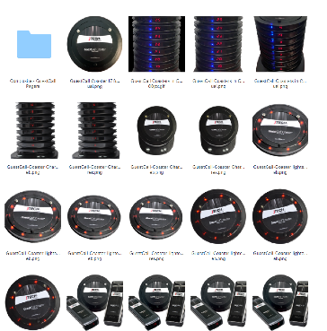
Global Dealer Support www.jtech.com/dealer-portal
News & Promotions
  Dealer News
Image Library
  JTECH Logo
  Product Images
  Brand Guidelines
Product Resources
  Quick Start Guides
  User Manuals
  Software Drivers
  Product Training
  Label Templates
Sales / Data Sheets
Password: international

Slide 12
JTECH Support
JTECH now offers 24hr Technical Support!
  Immediate service required
    Call into +1-800-321-6221 or 1-770-925-8630
    Response time is within 30 mins
  Non emergency assistance
    Send an email to wecare@jtech.com
    Response time is the next business day
All purchase orders, pricing & quote inquires should be sent to: distributororders@jtech.com

Slide 13




Technical Support Escalation
JTECH offers 24/7 technical support!
Support Ticket
Lvl 1
Technician
Lvl 2 Technician
Manager
Call or email
1-800-321-6221
1-770-925-8630
wecare@jtech.com
A Certified Level I technician will contact you within
1 hour.
Normal business hours:
M-F 8am-6pm EST
If the Lvl I technician is unable to assist they will escalate your inquiry to a Lvl 2 technician.
If the Lvl 2 technician cannot assist, your inquiry will be escalated to a manager.

Slide 14
Product Overview

Slide 15
JTECH’s New Part Number Scheme
WWXXXYZ
WW = Equipment Type
PG = Pager
TX = Transmitter
CH = Charger
AC = Accessories
XXX = Product Name
CP = Commpass pager
CST = Coaster pager
RG = Rugged pager
IQ = IQ pager
Y = Display Type
D = Digital (applies to pagers only)
Z = Version # / Accessories
1 = Version #
M=Metal Clip
S = Spring Loaded Clip
Example: PGRGDM = Digital Rugged pager with Metal Clip
CHCP = Charger for Commpass pager
PGCPD1 = Digital Commpass Pager Version 1

Slide 16
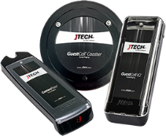

Pagers and Chargers
JTECH’s “Core Four” pagers & chargers have been updated to have:
Pagers:
Digital display - eliminates the need for number decals. Pagers can be renumbered in seconds on site.
Low battery (LO) and Out of Range indicator
Multiple Pager Alert Options - Flash, vibrate, tone & voice* options for personalization
Blue Charging Light Indicator
Take Half Battery (HLFBAT)
Programmed either by over the air, charger** or PC software
Chargers:
“Smart Charging” avoids over-charging the battery and charges quickly in 4 hours.
New Power Supply – Power supply can be used with a charging base AND transmitter
*Only available with the CommPass pager
**Rugged and IQ chargers only

Slide 17
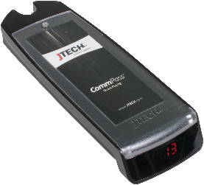



CommPass Pager - Features
Considered “Entry Level” option
Replaceable Custom insert (Insert size : 3.32”x1.28”)
Multiple Pager Alert Options - Flash, vibrate, tone and voice alert options for personalization.
Selectable Voice Alert - Four options to choose from
  Custom voice options available for a set up fee & MOQ
Voice 1: “Thank You for waiting. Please return to the host for seating”
Voice 2: “Your order is ready. Please return to the counter”
Voice 3: “Your order is ready. Please return at your convenience”
Voice 4: “Please come to the reception desk”
Replaceable Insert for advertisement
Part#: PGCPD1
LED Pager Number Display
Low Battery Indicator

Slide 18
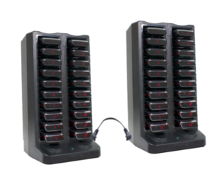
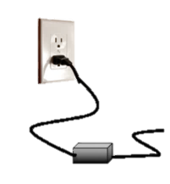
CommPass Charger Base – Features
Part#: CHCP
Green power light power indicator
Backwards Compatible – can charge the old Legacy CommPass pager
Maximum of 3 chargers can be connected with one power supply.
Jumper
Wire
Power Indicator

Slide 19
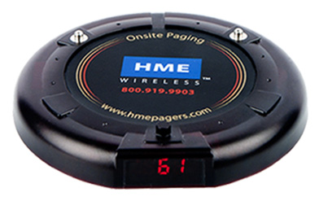
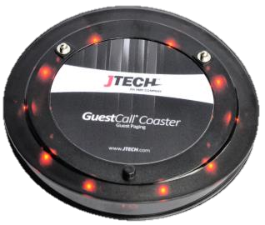
Digital Coaster Pager
The digital coaster pager has an updated, sleek modern look & design. Perfect for a mid-tier guest paging system.
OLD
NEW
Part#: LT2008D
Part#: PGCSTDIG

Slide 20
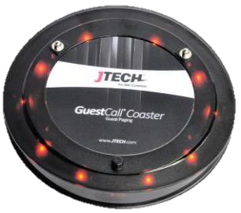
Coaster Pager Features
Considered “MID” level option
Four Digit Pager Number LED Display - can now support up to 9999 pagers.
Customizable top membrane: 2.75 in
Backwards compatible with classic (LT2008D) & premium (LT2012E) coasters
No More Battery Door - Removing the battery door has made the pager sturdier
Part#: PGCSTDIG

Slide 21
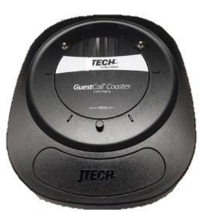
Coaster Charger Base Features
New Updated Design and Sleek Modern Look
Charger is backwards compatible with the old legacy coaster charger
Maximum of 4 chargers can be connected with one power supply.
OLD
NEW
Part#: CHAR
Part#: CHCSTB

Slide 22
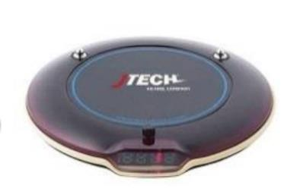
Digital Premium Euro Pager
Four Digit Pager Number LED Display - can support up to 9999 pagers.
Customizable top membrane: 2.75 in
Backwards compatible with classic & new coaster (LT2008D/PGCSTDIG)
Rubber bumper for added protection
Available in cranberry and white cases (has MOQ)
Part#: LT2012E

Slide 23
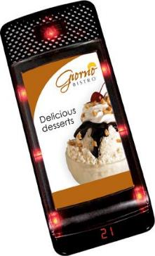
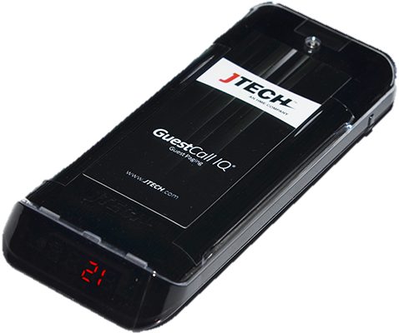
IQ Pager
The IQ pager has an updated, sleek modern look, design & feel to it. Its ergonomic shape fits nicely in your hand and is perfect for a high-tier guest paging system.
OLD
NEW
Part#: IQ2008
Part#: PGIQD

Slide 24
IQ Pager Features
Considered the “HIGH” end option
Four Digit Pager Number LED Display - can now support up to 9999 pagers.
New Replaceable Custom insert (Insert size : 3.32”x1.28”). Insert size is different from IQ2008.
Backwards compatible with legacy IQ2008 pagers
Can receive a numeric four digit message
Part#: PGIQD

Slide 25
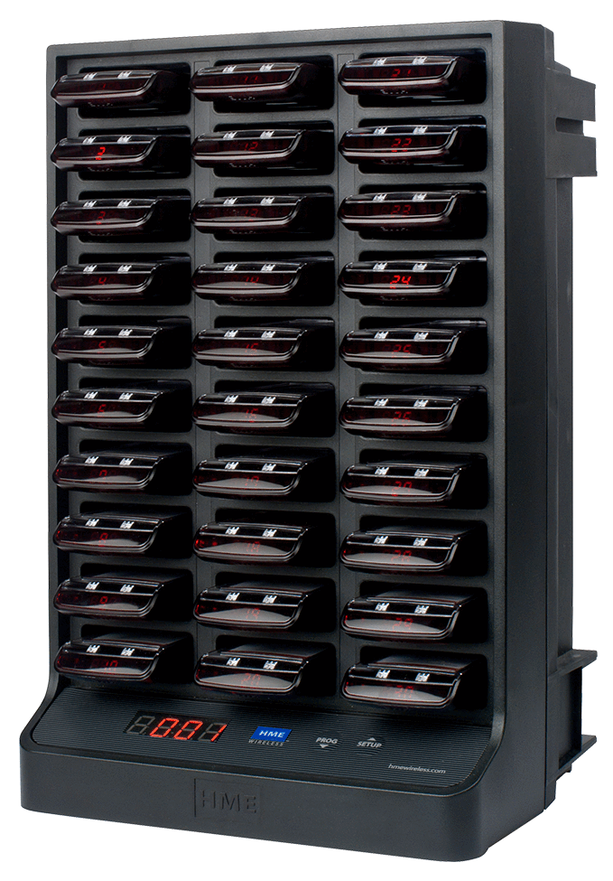
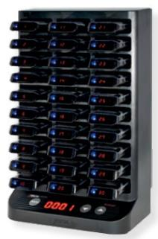
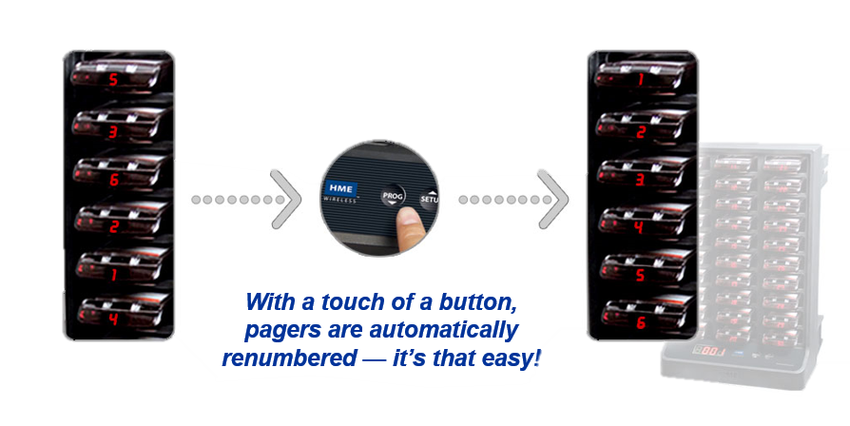
IQ Pager Charger Base Features
Renumber pagers in seconds with a touch of a button.
Charger will save and store all programmable information for a location.
Backwards compatible with the old legacy IQ pager & charging base
Maximum of 2 chargers can be connected with one power supply
Part#: IQCHAR
Part#: CHIQ

Slide 26
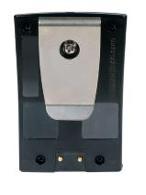
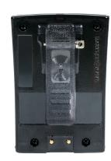
Rugged Pager Features
New form factor - sleek modern look
Backwards compatible with legacy JTECH rugged and ServerPass pager
Auto Renumbering - No more duplicate pagers or missing number decals.
2 clip options – Metal and Plastic
6 capcodes (4 groups/1 individual)
Will receive a numeric three digit message
User Replaceable Clip
Metal Clip
Spring Loaded
Part#: PGRGDM
Part#: PGRGDS

Slide 27
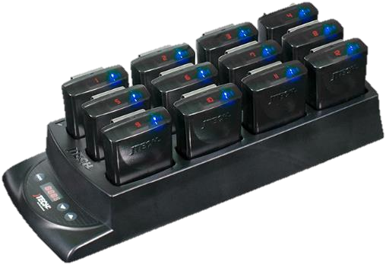
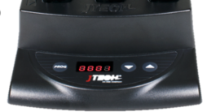
Rugged Charger Base Features
First in the paging industry! Renumber belt pagers in seconds with a touch of a button.
Backwards compatible with the old legacy rugged pager.
Will save and store all programmable information for a location
Maximum of 5 chargers can be connected with one power supply
Part#: CHRG

Slide 28
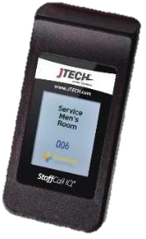
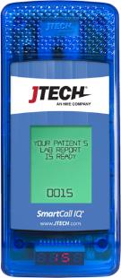
StaffCall & SmartCall IQ Pager Features
4 digit pager number capability
Full color TFT display - 16 characters/line x 7 lines
Customizable power up and stand by message – text, logo or image
10 programmable canned messages available (text or graphics)
  128 x 64 bmp image size can be uploaded for canned messages
8 cap code storage
Uses Lithium Ion Batteries
Part#: STFIQ
StaffCall IQ Features
Single pager charging via Micro USB cable
Holster or lanyard option
Magnetic charging pins
Scrolling side button
SmartCall IQ Features
  Lanyard option
Part#: BSMTIQ

Slide 29
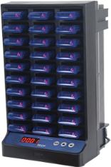
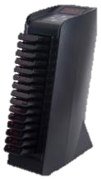
StaffCall & SmartCall IQ Pager Charger
Allows for the ability to perform programming functions in bulk
Ability to read and program Base ID, Frequency, Alert type and alert time on the pagers via the charging base
Part#: SMTCHAR
StaffCall IQ Charger
15 Position with option to daisy chain up
to 4 chargers
Programming via Mini USB Cable
SmartCall IQ Charger
30 position only – cannot be daisy chained
Programming via Type A USB cable
Part#: STFCHAR

Slide 30
TRANSMITTERS

Slide 31
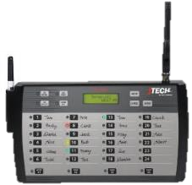
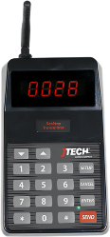
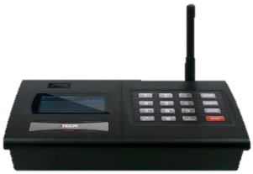
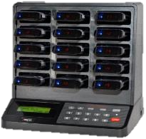
Transmitters
All JTECH transmitter features:
Handle up to 9999 pagers*
Backlit LED Display and keypad**
Menu Driven programming for ease of use
Numerous mounting options
UHF bandwidth
*All In One & ServerCall transmitters do not accept 9999 pagers
**ServerCall transmitters do not feature a backlit keypad

Slide 32
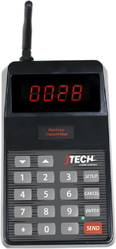
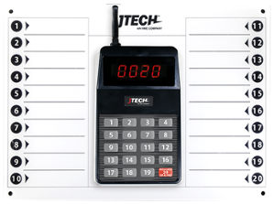
NEO Guest Transmitter
“Entry level” – basic transmitter
Great for small footprint locations
NEO ServerCall Transmitter
Part#: NEO10
Direct Press with 20 buttons
Handles up to 20 pagers.
Great for small footprint locations
Optional Detachable dry erase board
Part#: NEODP20

Slide 33

GuestCall IQ ® Base Station
Standard Desktop Transmitter.
Duty alerts for quick reminders and communication
Connects to any RS232 serial port of PC for Software paging
Durable membrane (keypad), limits intrusion of liquids
Part # TXGCIQ

Slide 34
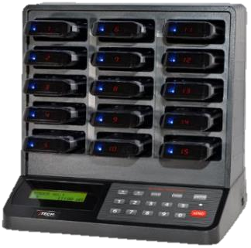
IQAIO - All in One Transmitter
Small footprint / Sleek design unique to JTECH
Unique design includes transmitter, charger and pagers All-In-One unit.
Holds up to 15 IQ pagers
Patented automatic pager renumbering system allows all IQ pagers to be renumbered at the touch of a button.
Duty alerts for quick reminders and communication
Part # - IQAIO

Slide 35
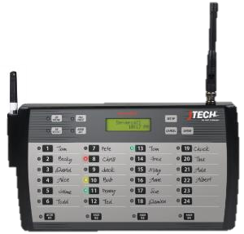
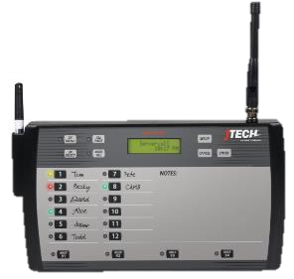
ServerCall ® Paging System
All page feature allows manager to send a message to entire staff
Handles up to 24 servers & 4 managers (per panel) – max of 72
Auto server recall for prompt customer service w/ manager notification
1x, 2x or 3x vibrations for flexibility
Duty alerts for quick reminders & communication
Vesa 100 Compatible for easier mounting option
Kitchen tough design
Fully programmable at the store level
Cancel Panel ready within same transmitter unit
12 position also available
Part # - LTKSC
Part # - LTKSC12

Slide 36
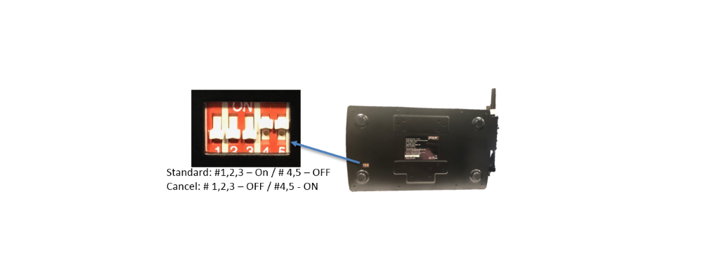
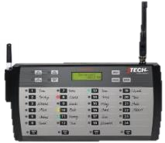


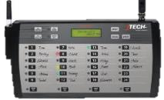
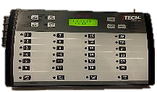
ServerCall ® Cancel Panel
Standard ServerCall transmitter now doubles as the Cancel Panel
Connected via an Ethernet Cable
No secondary power supply required – power to second unit comes from main unit
Page and cancel from either panel
ETHERNET
CABLE
KITCHEN TRANSMITTER
CANCEL PANEL

Slide 37
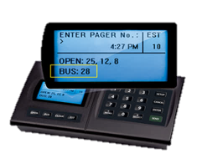
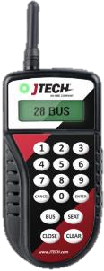
TableScout Transmitter Features
Used to communicate with table management software solutions.
Stand-alone version works as a simple table management system.
Press the table number followed by the appropriate function key. The messages sent can show open, sat and bussed tables.
The message will be sent through the JTECH Integration Station to the table management system.
Handheld is small & lightweight.
Can double as a standalone mini handheld transmitter
Rechargeable transmitter will last days on a single charge.
Integrates with table management solutions including: Aloha GuestManager, ProHost, QSR Automations, OpenTable & Reserve Interactive.
TS3 - TABLESCOUT

Slide 38
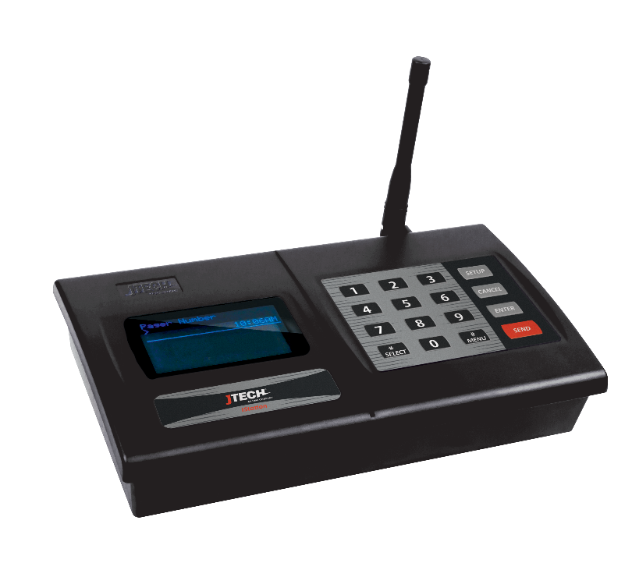
Istation
One Device for Every Need

Slide 39
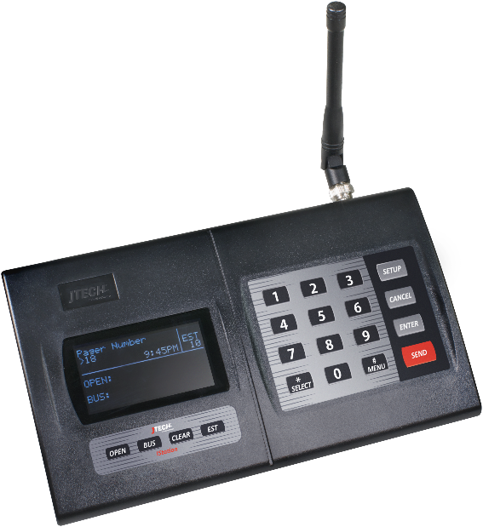

Did You Know?
1)
2)

Slide 40
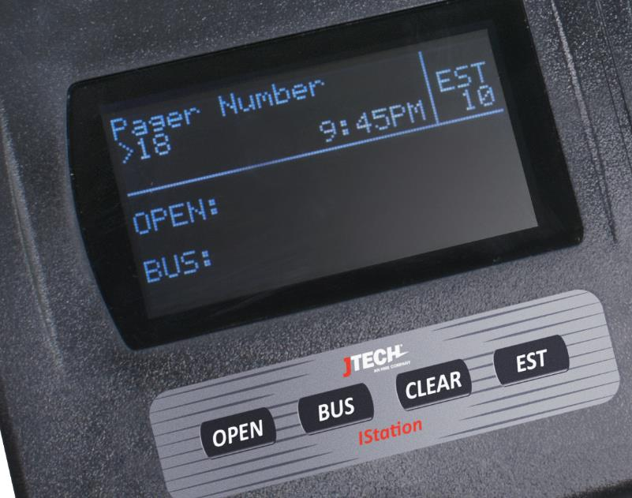
IStation with Hospitality Display
Basic Paging w/ALL Pagers
Lite Table Management
Four buttons under the display
    Open, Bus, Clear, Estimate
  EST adds time to estimated wait with each press; removes with each sent page
  Works with TableScout

Slide 41
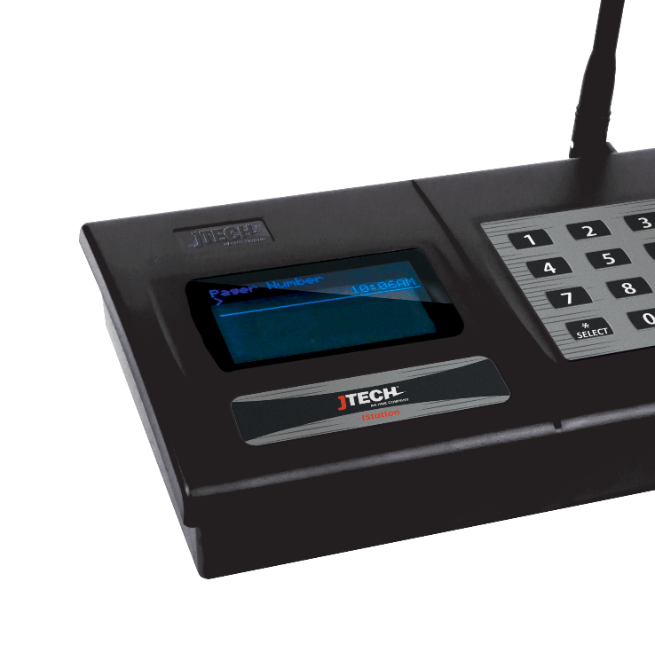
IStation with Standard Display
For ALL other applications
  Works with ALL Pagers
  Host Concepts, SmartCall Messenger
  ES Buttons w/Receiver
  MultiCast Network Paging
  Over the Air Repeater
  Teleconnect
  Alpha Messaging with Keyboard

Slide 42
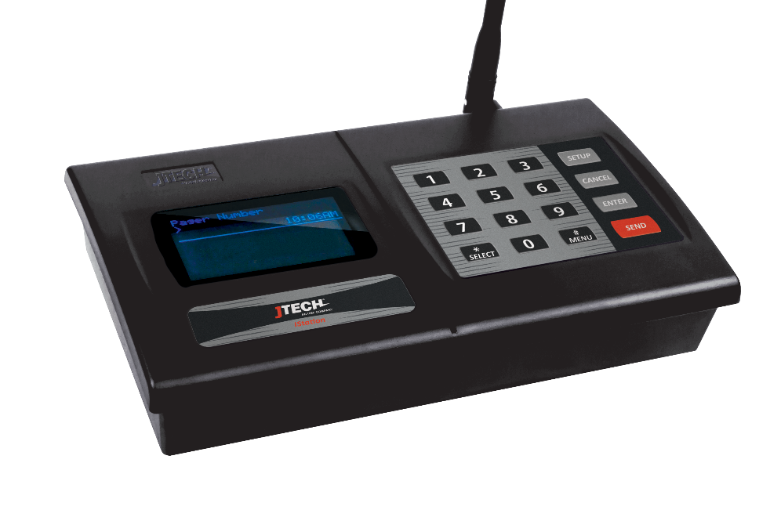
Do You Know Everything IStation Can Do?
Standalone | Page JTECH legacy pagers. Page HMEW legacy pagers. Accept a USB Keyboard for alpha messaging. Send numeric or pre-canned messages by default. Be a repeater for Paging & Push Buttons Curbside or Restroom Alert | Mount on a wall. Connect to a High Gain Antenna. Be a Lite Table Management System. Be a wait time estimator. Receive updates from a TableScout. Manage ranges for alpha and non-alpha pagers separately. Send a Duty Alert to a pager at a pre-set interval. | Give a visual indicator when it receives a message over the air. Give a visual indicator when it sends a page. Receive and send on different frequencies. Tune to any licensed frequency between 420 ~ 470 MHZ for international use. That’s 2,000 possible combinations.
Connected | Via a Serial Cable: Kitchen Systems Table Management POS Systems Cruise line Systems Healthcare Systems ES Push for Service Buttons Display message strings to HyperTerminal or Putty Send TableScout updates to Aloha Guest Manager, QSR ConnectSmart Hostess, ESP System ProHost Dry Contact Modules to trigger paging | Via a Phone Line: Page by dialing an extension Via Ethernet: Host Concepts SmartCall Messenger Custom built paging solutions Send SMS standalone and through Aloha Send TableScout updates to OpenTable Create a chain of transmitters via a wired network with MultiCast. Give you a visual indicator when that chain is broken.
And there is more on the way

Slide 43
MultiCast
MultiCast is the ability for JTECH transmitters to send cascading pages to a series of transmitters over an IT network. This cascade allows the user to cover areas within the facility(ies) without the need for radio repeaters or large-scale broadcast antennas. Using this form of MultiCast permits for the expansion of signal to a specific area regardless of distance.
Each ISTATION contains two IP Addresses, its own and the next ISTATION it will be transmitting to
The display on each ISTATION should show a consistent “Y” to denote it is in the MultiCast chain.
  If it shows an “N” in the top right corner instead there is an error in the loop.
When paging through MultiCast, each ISTATION will flash an “R” if receiving a signal Over the Air or “T” next to the “Y” to confirm transmitting of the page.
Suggested 1 ISTATION per 3 floors.
Every additional ISTATION will increase the number of times a pager is paged
  EX: A multicast system with 5 ISTATIONS will page 5 times.

Slide 44
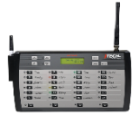


MultiCast
Optional Transmitter
1ST IST, 9th floor
2nd IST,
6th floor
Local Network
3rd IST,
3rd floor
4th IST,
1st floor

Slide 45
PROGRAMMING

Slide 46
Programming
Three ways to program a JTECH pager
Using the PC programming software
  There are two new software versions
    Core Programming Software (ID Writer)
    IQ Alpha Programming Software (New Alpha 2.1)
Using the charger (Available only for IQ & Rugged chargers)
Over the air programming

Slide 47
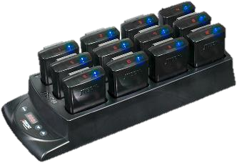
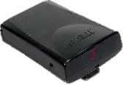

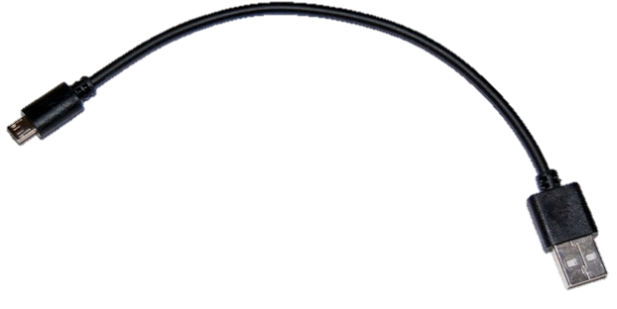
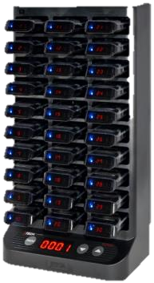
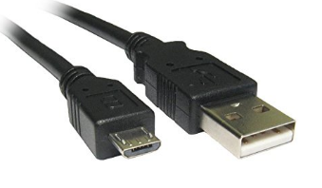

Pager Programming
Programming via Software – Setup
(Rugged & IQ pagers)
Rugged Charger
Micro USB to Standard USB cable
IQ Charger
Micro USB to USB A

Slide 48
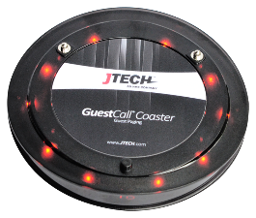




Pager Programming
Programming via Software – Setup
(Commpass & Coaster Pager)
COASTER
USB Programming
Adaptor
Commpass Rear side
Programming
Probe
COMMPASS

Slide 49





Pager Programming
Programming via Software – Setup
(Staffcall Pager)
Staff Pager Charger
USB port
Mini USB to USB A Cable

Slide 50

Pager Programming
Programming Software - Overview
Features
Windows 7 & 10 Compatible
7 Capcodes
Embedded End User ID Number to easily track where pagers came from.
Easy and Simple User Interface
Can program 30 pagers in less than a minute

Slide 51

IQ Alpha Pager Programming
PC Programming Software - Overview
Features
Windows 7 & 10 Compatible
8 Capcodes
  1 Individual Capcode
  7 Groups
Easy and Simple User Interface
Can program 30 pagers in less than a minute
Programmable canned messages…
  Alpha Text
  Images
Use your own logo or image on the pager display when it’s on standby mode.

Slide 52


Pager Programming
Programming Using a Charger
Accessing the programming menu (admin)
Unplug the power cord.
Press and hold the “PROG" and "▲" keys and plug in the power cord into the charger simultaneously.
Display will show “PROG” then will change to “Freq”.
Press "▲" to scroll to different menus.
Press “PROG” to select and edit.
Press "▼" to cancel or exit the programming mode.

Slide 53

Pager Programming via Charger

Slide 54

Pager Programming via Charger

Slide 55

Pager Programming
Over The Air (OTA) Programming using a Desktop Transmitter
Sample OTA Commands
Flash & Vibe – 9696
Flash, Vibe & Beep – 9898
60 seconds Alert Time – 9093
Continuous Alert - 9099
Pager Off - 99
Out of range OFF – 9393
Out of Range ON – 9494
Pager Number Change - *XXX (XXX =New Number)
Change Base ID – 9*7*8YYY (YYY=New base ID)
Procedure
Remove pagers from the charging base.
Using a desktop transmitter, enter the group ID (911 for belt pagers & 1248 for Guest pagers) followed by the “Enter” key.
Enter the 4 digit OTA command then press “Send” key.
Pagers will flash to indicate pagers receive the new code.

Slide 56
Transmitter Programming
To enter Programming Mode
1. Press the “SETUP” button.
2. Enter the password followed by “Enter” key.
3. Use the following buttons to configure your transmitter.
“*/ Menu or 2X ” key to scroll through the different menu options.
“#/Select” key to toggle between
“Enter” to edit the menu and save the new settings.
“Cancel” to cancel or exit the system

Slide 57
Transmitter Menus

Slide 58
Transmitter Menus (continuation)

Slide 59
Transmitter Menus (continuation)

Slide 60
Vuze

Slide 61



VUZE® Table Location System
The Vuze Table Location System provides users the ability to quickly identify where a party is located in a restaurant in order to deliver food in a timely and efficient manner.
JTECH uses an active RFID technology that allows users to create Delivery Zones or, by adding additional tags, have a tag per Table. Delivery Zones allow food runners to eliminate a majority of the restaurants floor space when locating a guest.

Slide 62





VUZE® Components
Reference Tag
Part #: VUTBL
Guest Tag
Part #: VUGSTV
Gateway (reader)
Part #: TLREAD
Software with PC*
Part #: TLPC / TLSW
*PC is not sold outside of the USA
62

Slide 63


VUZE® Software
The Vuze Management software handles all of the back end setup for the Vuze system. In the Management screen, you will be able to add or make adjustments to the different tags, as well as pull reports showing the latest activity of each of the tags in the system for troubleshooting
Vuze Waitlist allows users to quickly identify the location of a Guest Tag (customer) based on information received by the Reader
Vuze Management
Vuze Waitlist

Slide 64






How Vuze System Works
VUZE PC
GATEWAY
TABLE 5
TABLE 4
DEACTIVATOR BASKET
TABLE 6
GUEST TAGS
DEACTIVATOR TAG
HOST/COUNTER
ACTIVATOR TAG

Slide 65



How Vuze System Works
Guest Tag 10 - TABLE 4
TABLE 5
TABLE 4
DEACTIVATOR BASKET
TABLE 6
GUEST TAGS
DEACTIVATOR TAG
ACTIVATOR TAG
HOST/COUNTER

Slide 66
BAR 7
55B
BAR 6
55A
BAR 5
BAR 4
BAR 3
54
56
BAR 2
53
57
BAR 1
37
52
58
36
32
34
51
59
35
31
33
50
22
24
48
21
23
41
43
47
46
40B
42
A
45
A
40A
44
11
12
13
14
15

Slide 67
Easy Vu

Slide 68

EasyVu
JTECH’s new and exciting entry – level table location system! EasyVu locates guests and tables on demand for faster food delivery. With the built in feature of being a standard paging system, self-installation and the use of NFC (Near Field Communication) proving 100% accuracy, EasyVu provides our customers freedom to grow their business!

Slide 69

EasyVu
Uses passive RFID tags (NFC).
Custom RFID Tags available
Tablet based software running on Windows 7/8/10.
Hand the guest a coaster style “Guest Tag”
Guest places coaster on a NFC tag that sits on a table.
Tag/Table ID information is sent back to the tablet over the air.
No incorrect readings as long as the guest touches the tag.
Coaster confirms the reading with lights before sending to tablet.
Easy installation, place and go.

Slide 70



EasyVu Components
-Length: 54 mm
-Width: 85 mm
-Weight: 5g
-Durable Plastic (adhesive)
Part #: PGEVTT
Diameter: 105 mm
Thickness: 15 mm
Weight: 102g
Battery: Lithium / 12-14 hours off charge
Out of Range Notification
Alert Type: Vibe / Flash / LED / Find
Part #: PGEVGT
Diameter: 105 mm
Thickness: 20 mm
Weight: 90g
Part #: CHEVB
**Different charging base from a standard coaster charger**

Slide 71


EasyVu Components
Length: 4.5 inches (116mm)
Width: 5.5 inches (140mm)
Height: 1.4 inches (37mm)
Weight: 185g
Carrier Frequency: 420-470 MHZ
Range: Up to 250 meters
Part #: TXEVGW
Table Tag Writer
All table tags will be programmed in production during system set up
Part #: ACEVPRG

Slide 72

How EasyVu works
EasyVu

Slide 73


Slide 74



Slide 75



