Slide 1
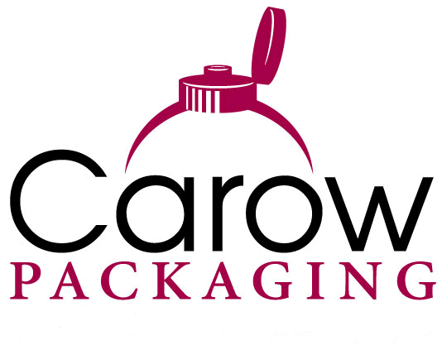
Product and service overview

Slide 2
Published May 2018

Slide 3

Company Overview
Carow Packaging
  Providing dispensing solutions since 1987
  Market leader with innovative products, including
    EuroDrop ®
    Dropper Pipettes
    Adaptor Caps
    SnapPET Caps
  Manufactures core products and distributes additional packaging alternatives
  Applies 30+ years of knowledge and experience to continually expand existing and develop new solutions to meet customer needs
Carow Packaging provides industry expertise
that can only come from years of focus.

Slide 5
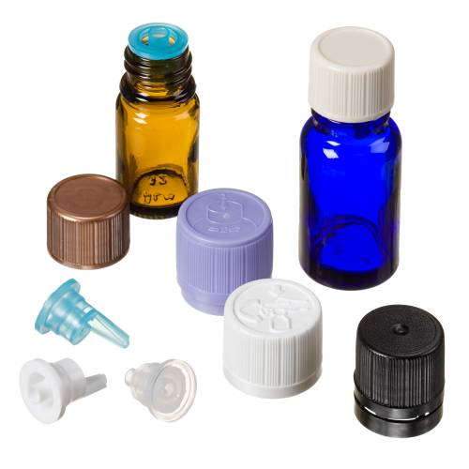

EuroDrop ®
An all-in-one drop measuring and dispensing solution
Pair a vertical or horizontal insert with one of four cap styles to create a complete dispensing system
An alternative to a standard eye dropper pipette
Economical, safe, convenient and reliable
Ideal for essential oils, tinctures, herbal extracts and aromatherapy products

Slide 6
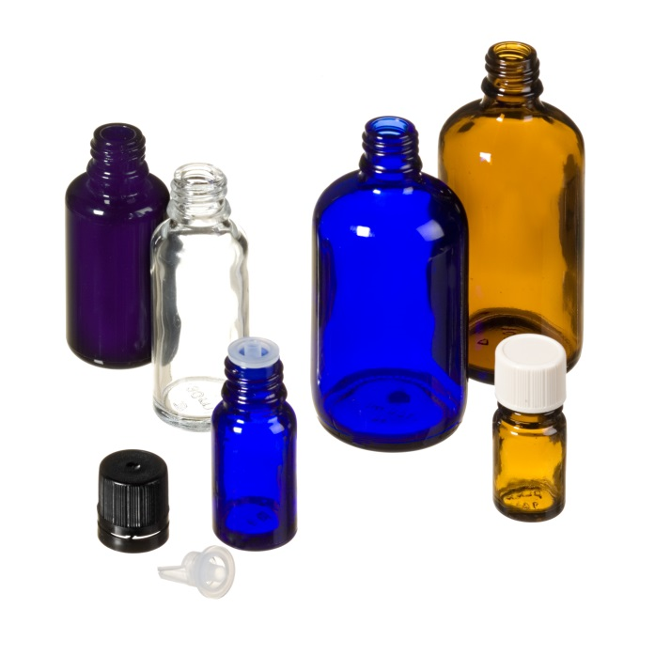
Dropper Bottles
The perfect match for EuroDrop Caps and Inserts
All glass and PET dropper bottles have an 18 DIN neck designed to fit EuroDrop closures
Amber, cobalt, flint, green and violet color options
Capacities starting at 5ml with many in stock
Improve product integrity and enhance brand image

Slide 7
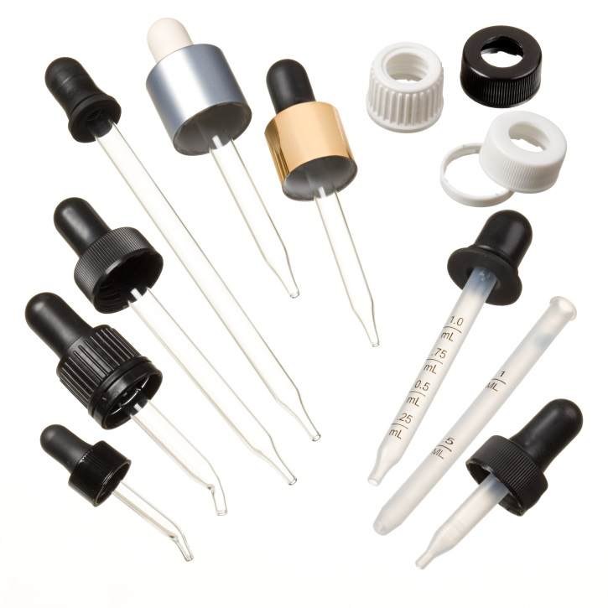
Dropper Pipettes
Dispense in a controlled fashion
Wide user acceptance makes this a practical dispensing choice
Huge selection of bulb and pipette materials, cap styles and deco options
Low minimum order quantities
Pair with Carow glass or rigid plastic bottles

Slide 8
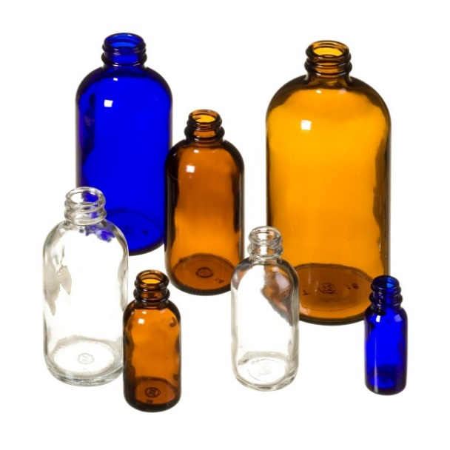
Boston Rounds
The reliable, glass container for almost any liquid
The rounded shoulder profile is recognized in the beauty, health and chemical markets
Choose from light-sensitive amber, cobalt blue or clear flint at capacities ranging from 0.5-32oz
USA quality or economical Asian souring options

Slide 9
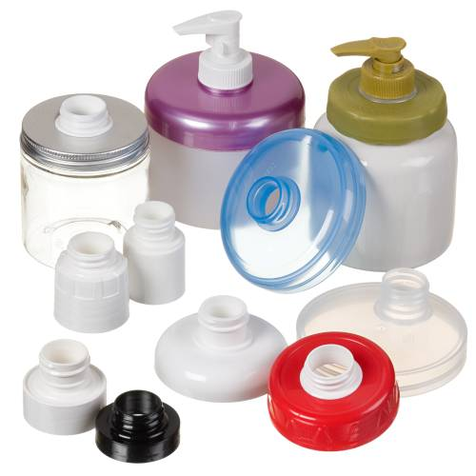
Adaptor Caps
Fit any pump to any jar
The versatility of the Adaptor Cap allows for unlimited choices of closure, size, shape and finish
Add a pump from Carow’s vast product line to complete the package
Faster lead times than traditional jar pump options
Ideal for retail, testers, salon and economy size

Slide 10
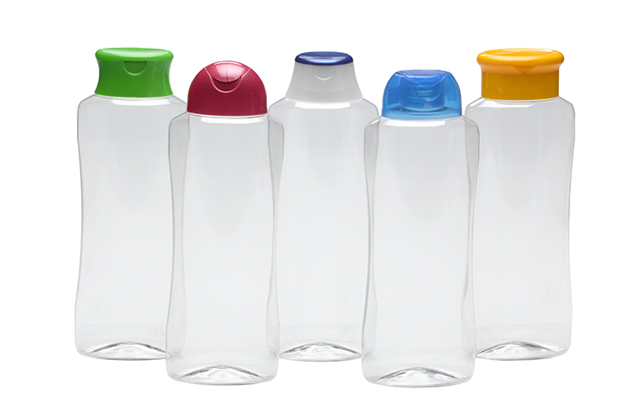
SnapPET Caps
Create a custom package without the custom cost
Designed to snap on to the neck of industry standard 28-PCO and 28-410 preforms
Eliminate time and expense of custom tooling, bottle neck design and developmental trials
Extend brand or product line by alternating 5 different caps on 1 shoulder profile

Slide 11
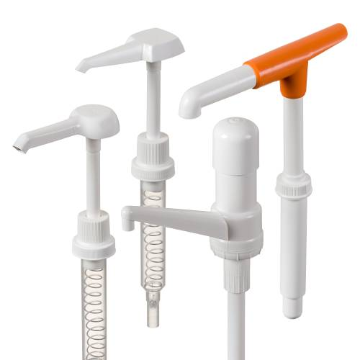
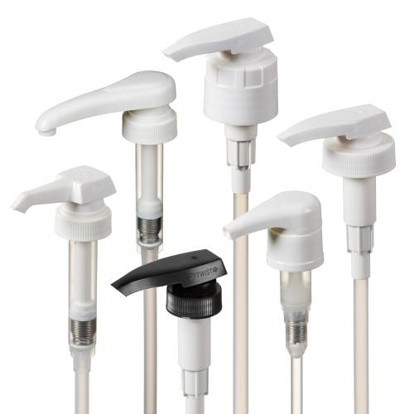
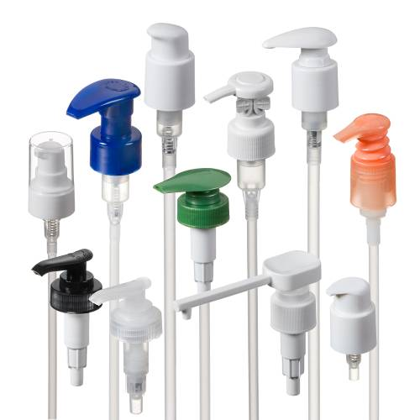
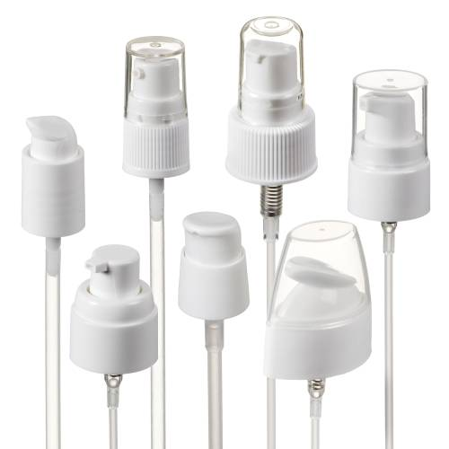
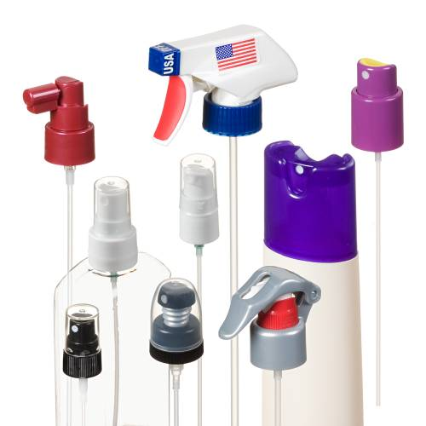
Pumps
Large Pumps
Medium Pumps
Lotion Pumps
Treatment Pumps
Sprayers

Slide 12
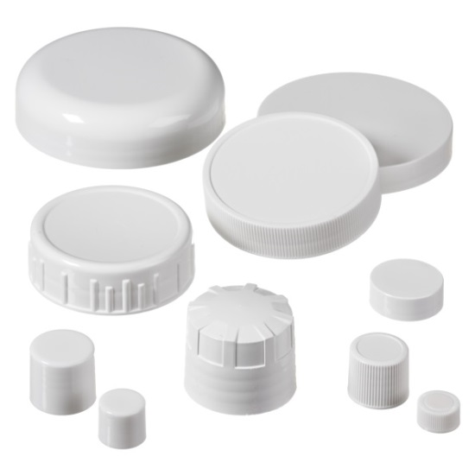
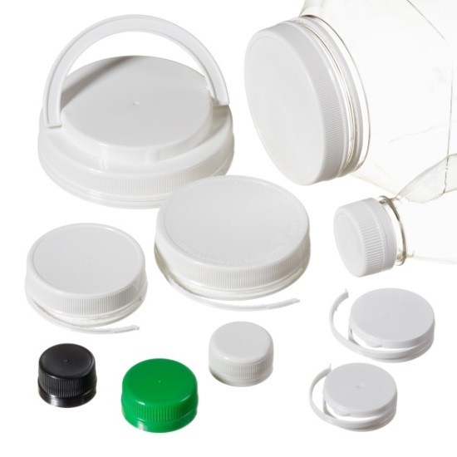
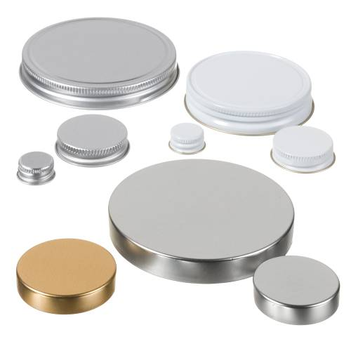
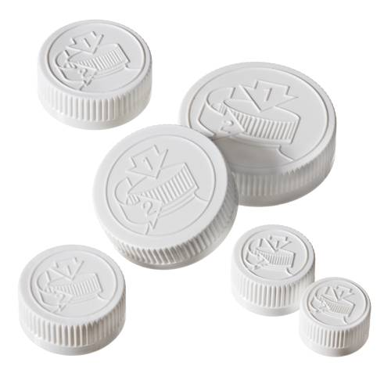
Caps
Continuous Thread
Tamper Evident
Metal
Child Resistant

Slide 13
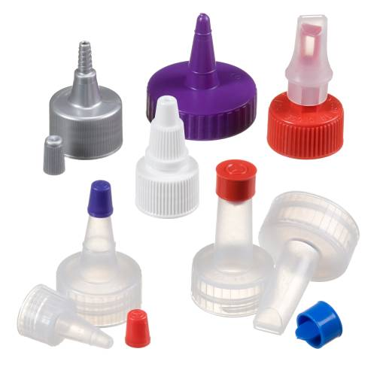
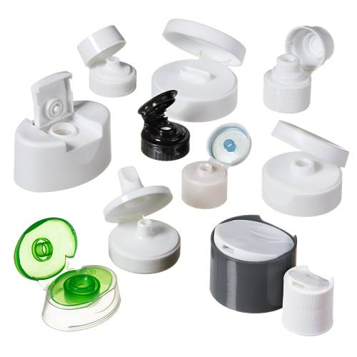
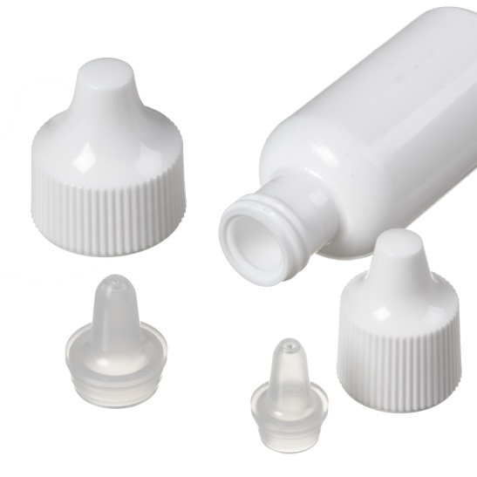
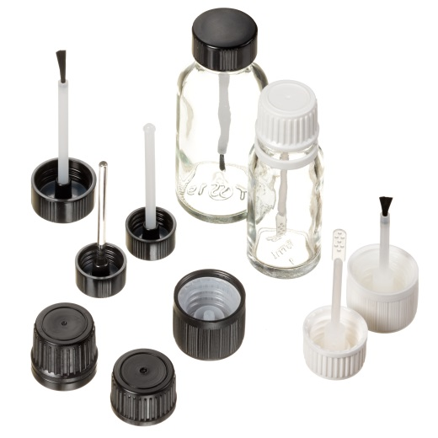
Caps
Spout
Flip, Disc, Valve, Bi-Injection
Squeeze Dropper
Applicator

Slide 14
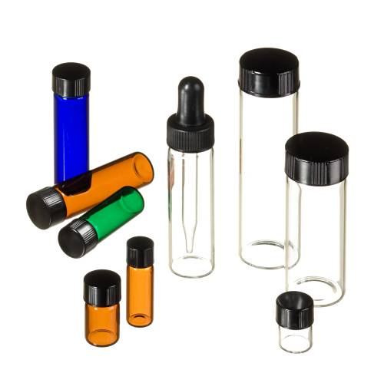
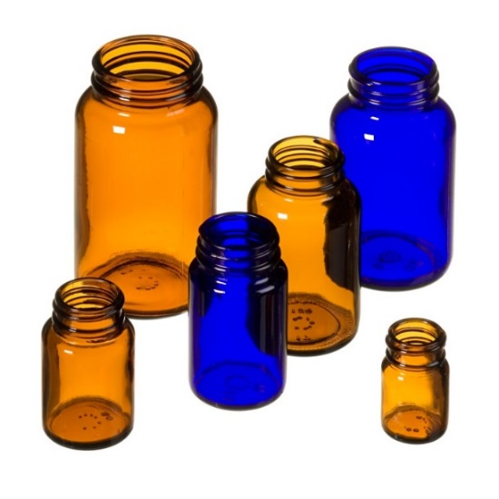
Bottles & Dispensing
Glass Vials
Glass Packers
E-liquid Packaging
Pharmaceutical Packaging

Slide 15

Additional Services
USA, European and Asian sourcing options
Inventoried international and domestic products
Regional warehousing
Forecasted stocking program
Data driven technical support and quality process
Custom closure and dispensing solutions
Mold design
Component assembly
Cap punching
Kitting
Re-work / sorting

Slide 16
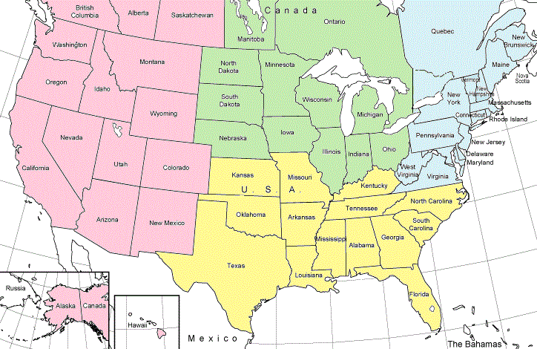
Sales Team
Steve Carow, ext. 15
steve@carowpackaging.com
Midwestern US and Central Canada
Sheryl Stier, ext. 16
sheryl@carowpackaging.com
Western US and Western Canada
Jeff Washbourne, ext. 18
jeff@carowpackaging.com
Eastern US and Eastern Canada
Dean Gavney, ext. 17
dean@carowpackaging.com
Southern US
Corporate
Office
Elgin
Warehouse
Salt Lake City
Warehouse
Philadelphia
Warehouse
Atlanta
Warehouse

Slide 17








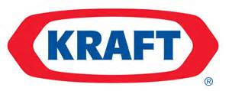


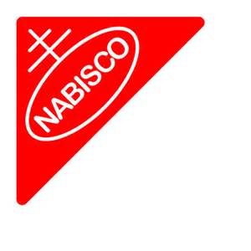






Customers Served

