Slide 1


Clare Controls
Builder Program

Slide 2
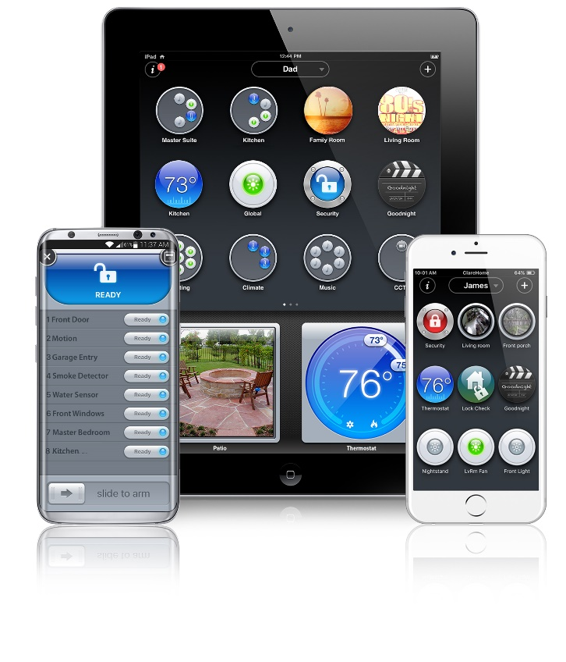
Agenda
About Clare Controls
ClareHome App
How it Works
For Homeowners
For Builders

Slide 3

About Clare Controls
An all-inclusive smart home solution
OUR FUTURE IS NOW!
The Clare platform supports climate controls, lighting, door locks, garage doors, cameras, sensors, security, music throughout the home, and home theatres
Control everything from one App
Best in class support structure

Slide 4
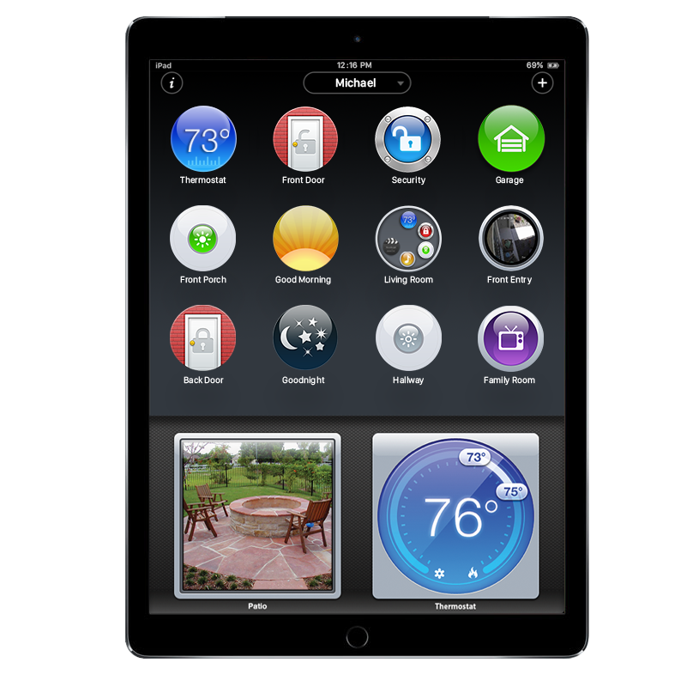
A Familiar Methodology
Personal
Organized by the individual, not the installer
Add profiles for every occupant and guests
Simple
Add, delete, group, and rearrange controls on the fly
Train in five minutes
Useful
Control every system or only a few
Smart icons preview dynamic information
Robust full-screen interfaces where needed
Pin cameras and other functions for always- available monitoring and control

Slide 5
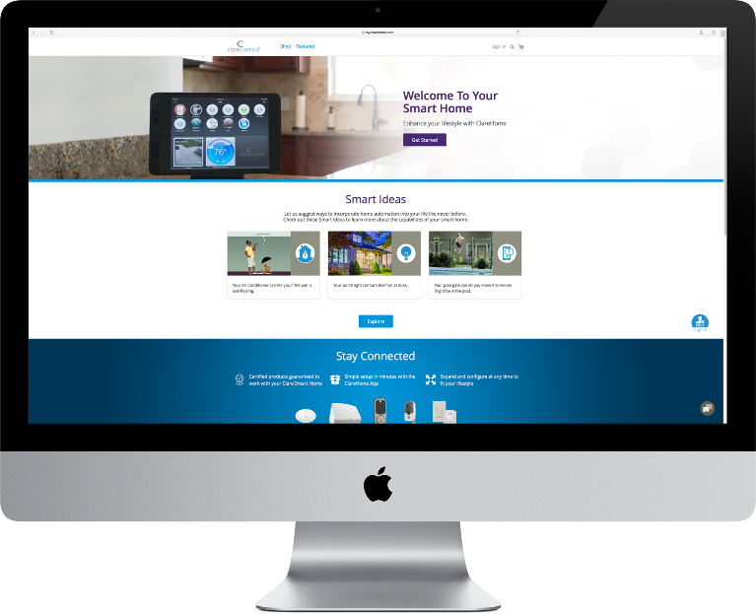
myClareHome
myClareHome homeowner portal:
Configuration (scenes, schedules, notifications)
Learn about home technology from Clare
and its partners
Assist – gain access to chat support,
telephone support, forums, tips and tricks
Reward – receive coupons and rewards
(coming soon)
Expand the Clare system through online purchases

Slide 6

Clare Care
ClareCare Homeowner Support
We want Clare system owners to have a great experience.
US: 941.315.2273
Canada: 844.360.4816
help@clarecontrols.com
Monday through Friday – 8 am to 10 pm EST
Saturday – 10 am to 7 pm EST

Slide 7
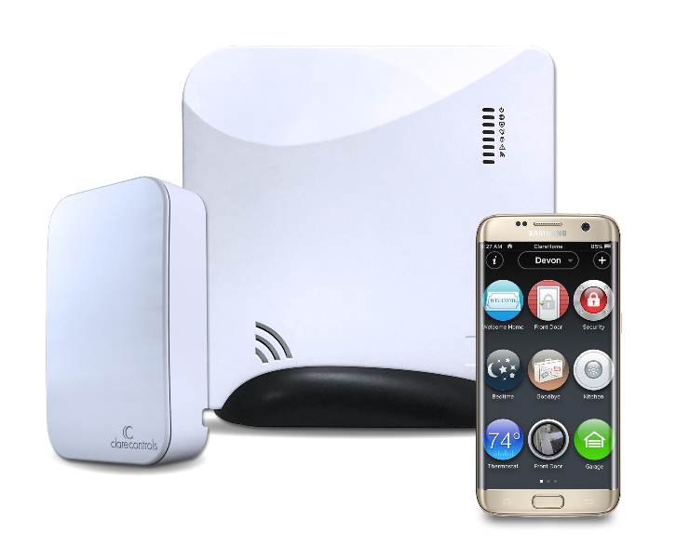
How it Works
Start with the “Brain”
Add a “Base Package”
Make your inventory “Smart”
Smart and Secure Brain

Slide 8




How it Works
Start with the “Brain”
  Provides smart home and security backbone in one
  Integrates with most popular brands of smart products
  Flexible mounting options
  One wire drop
  Highly secure, 256bit encrypted device
  Configuration is stored in the cloud so your customer’s system is always backed up
  Over air updates, Always have the latest software!

Slide 9
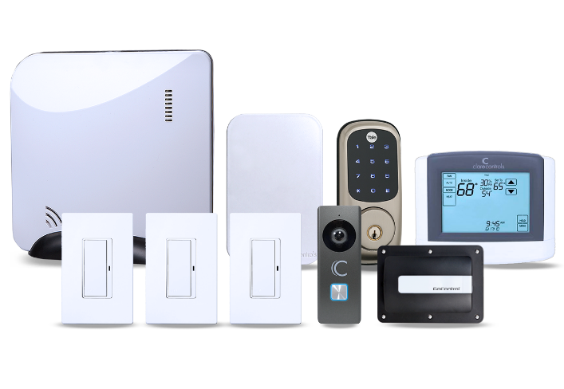
How it Works
Add a “Base Package”
  Improve security by adding programable dimmers and switches. Never walk into a dark house again!
  Take advantage of market trends with a highly visible front door camera!
  Integrate a smart door lock and wi-fi thermostat from brands you know and trust.
  Scale to match any and all price points.

Slide 10
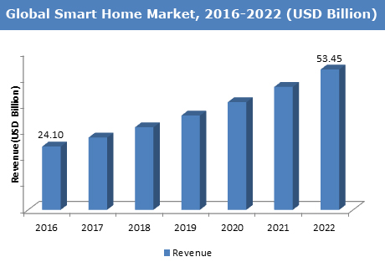
How it Works
Make your spec inventory “Smart”
  Market differentiator, for now
  Over 50% of new home buyers believe a new homes should be smart home
  Most flexible and scalable solution on the market
  “If you don’t offer smart home technology options, you’re really late. Figure out what you’re going to do for smart home options and get on the train because it is too late from a consumer perspective. You should have been there years ago. If you aren’t there, you need to get on that train.” Tim Costello, CEO BDX Marketing.

Slide 11
How it Works
Your Integration Partner sells the Technology Upgrades and onboards the customer.
  Design and bid packages that fit your home price points and business model.
  Meet with every homeowner to present options and answer technical questions.
  Install and configure base packages, options, and complete an initial homeowner orientation after close.
  Clare Care is a phone call away for any additional questions.
Clare "Brain"
Package more value
All inventory is “smart”
Sell more homes

Slide 12
What Homeowners Need to Know
Why Clare over something else?
  Includes all major smart categories – even home entertainment
  Voice control enabled (“Alexa turn on Foyer light”)
  First in class customer support.
  Controls everything from a single app
  Access inside the home or anywhere in the world – free
  Built-in security infrastructure
  Homeowner customizable, so they are in control
  Updated from the cloud so you never miss out on new features
  Add to the base package with individual devices or packages
  DIY or professional expansion

Slide 13
What Builders Need to Know
Why Clare over something else?
  Low Cost of Entry – One controller can enable the automated lifestyle in any home in your product portfolio - from starter to luxury homes
  Systems That Scale – Lights, locks, thermostats, entertainment system integration, water features, shades, and more
  Brands People Trust – Support for over 1,800 devices; including: Amazon, Honeywell, Eaton, Denon, Resolution Products, Interlogix, Lutron, DSC, Yale, Kwikset, Schlage, Sony, DirectTV, Dish, LG, Samsung, and hundreds more
  Complete Business Solution – We provide a complete business solution along with digital marketing to prepare you for the growing demand for Smart home.
  ClareCare Support – Clare is here to support you with the design, sales process, and after the homeowner moves in
  Simple to Get Started – Let’s talk about what should be in your bid

Slide 14

Thank you

