Slide 1
Smart. Secure. Simple.
Smart. Secure. Simple.
Notes:
The tag line is important.
We lead with smart – it’s what the market wants to buy, we differentiate on Smart vs. alarm systems.
Secure – is the category most requested in automation and it differentiates us from Control4 etc.
Simple – simple to install, simple to use, simple to expand, simple to own

Slide 2
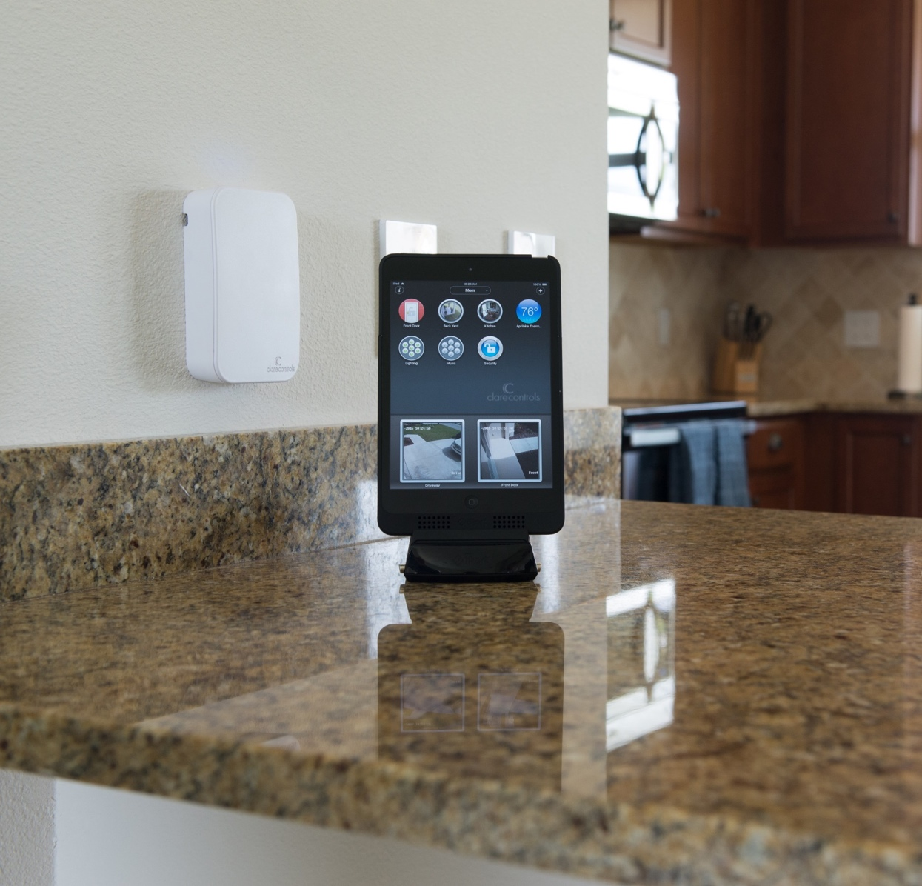
Overview
The Market
The Problem
Strategic Focus
The Plan
The Pitch
Builder Program
The Products
The Results
The Solution
Questions
Notes:
The story goes as follows – let me explain the enormity of the market, the problem the market is experiencing, what and where do we fit in the market.
How did we get here – and what do we have today.
Examples of our market successes and upcoming revolutionary products that will futher expand Clare’s potentital.
Summary
The ask.

Slide 3
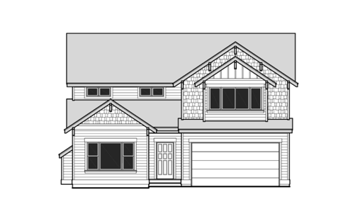
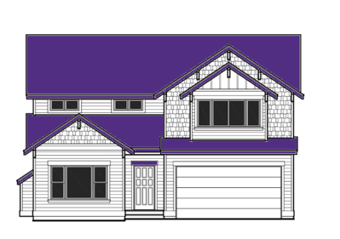
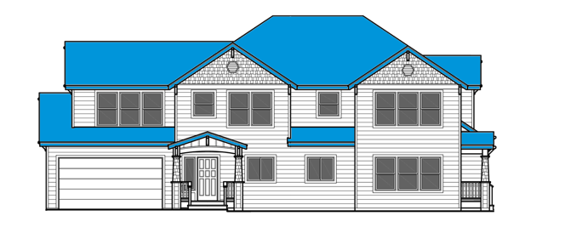
The Market
The Market
2016
2025
Industry Value
Industry Growth
Home Control:
$23bb
$61bb
Households (HH) with Security:
26mm
63mm
HH Fee-based security systems:
16.8mm
41mm
Recurring Monthly Revenue:
$875mm
$2.4bb
What will drive this?
Turning professionally installed monitoring into true smart home control and personal monitoring.
Source: Imperial Capital, “Premises Control and Automation Outlook for 2016-2017”, December 2016
Notes:
This is the home control and security market.
Big picture: home control is going to grow from $23bb to $61bb in 8 years – and surprise surprise , security could drive that. (HH with security almost triple in those 8 years as does RMR).
Achilles heal for security – TRUE smart home control is going to drive security / smart home growth, not intrusion detection. In fact, intrusion detection has been a flat line business for years.
SO…..lets make the security system smart and call it day?

Slide 4
The Problem
The Problem
The professionally installed solutions in the security market today are essentially centered around intrusion detection at the expense of smart home capabilities.
Mandatory intrusion monitoring monthly fees hamper adoption and growth.
Notes:
But here’s the problem with that – every security based home control platform from Honeywell, to Interlogix, to Alarm.com, the core feature set remains security. Perhaps they didn’t get the memo that smart home is sell, security follows?
Example: Alarm.com – does not integrate with a single popular thermostat: Honeywell, Nest, Ecobee. Zero audio video, zero shades and so on.
Example: Honeywell – integrates to Honeywell. That’s it. NO third party thermostats, cameras are terrible, no doorbell, no third party lighting, no garage doors, no shades, no a/v
Example: Interlogix – integrates to Carrier Cor thermostat (made by Ecobee). That’s it. No lighting systems, no support for most garage doors, no shades, no a/v etc.
Further – there is no market model for these systems to offer smart home without month monitoring in place. In other words, you have want burglar alarm in order to get smart home. It’s backwards.

Slide 5
The Gap
The Industry Gap
Security & Automation Solution Platforms
Clare fills the enormous gap between current security platforms and luxury automation systems
Highly Complex Solutions
(Crestron, Savant, Control4)
No Security
No RMR
Highly Integrated
High Cost to Purchase
High Cost to Own
Limited “Cloud”
The Gap
Integrated Security
(Clare Controls)
Smart Home Centric
Security Included
Optional RMR
Broad Integration
Cost Effective
Security Centric Solutions (Honeywell, Alarm.com, Interlogix)
RMR Required
Limited Integration support
Do it Yourself
(NEST, Ring)
Point Solutions
Limited RMR
Notes:
IMPORTANT SLIDE:
The retail, DIY products such as Ring and Nest do not have broad ecosystems and cause you to ‘app hop’. How many logins and passwords do you want for your home.
Further (until recently) very few offer professional monitoring – a critical piece of the puzzle.
So – we really should focus on the pro-install segments. Retail self install is not going to mow down pro install in the next 10 years by any study I have read.
You have a two side chasm. On one side , the security platforms (listed prior), on the other, the full on home automation systems (Control4, Crestron).
If you accept the premise that security (burglar, cameras, locks, garage doors) are central to automation, if only to create a ‘virtual presence’ home, understand C4 and Crestron do virtually NONE of that. They are really audio video integration platforms that have to have a security system installed to deliver security features.
Then we look at the security platforms – they integrate to almost none of the popular products (e.g. Nest, Ecobee, Lutron etc). But wait, smart is driving security, right?
Bottom line, luxurty is too expensive and off the market, security platforms are too limited and focus on burglar = > hence the massive opening for clare.

Slide 6
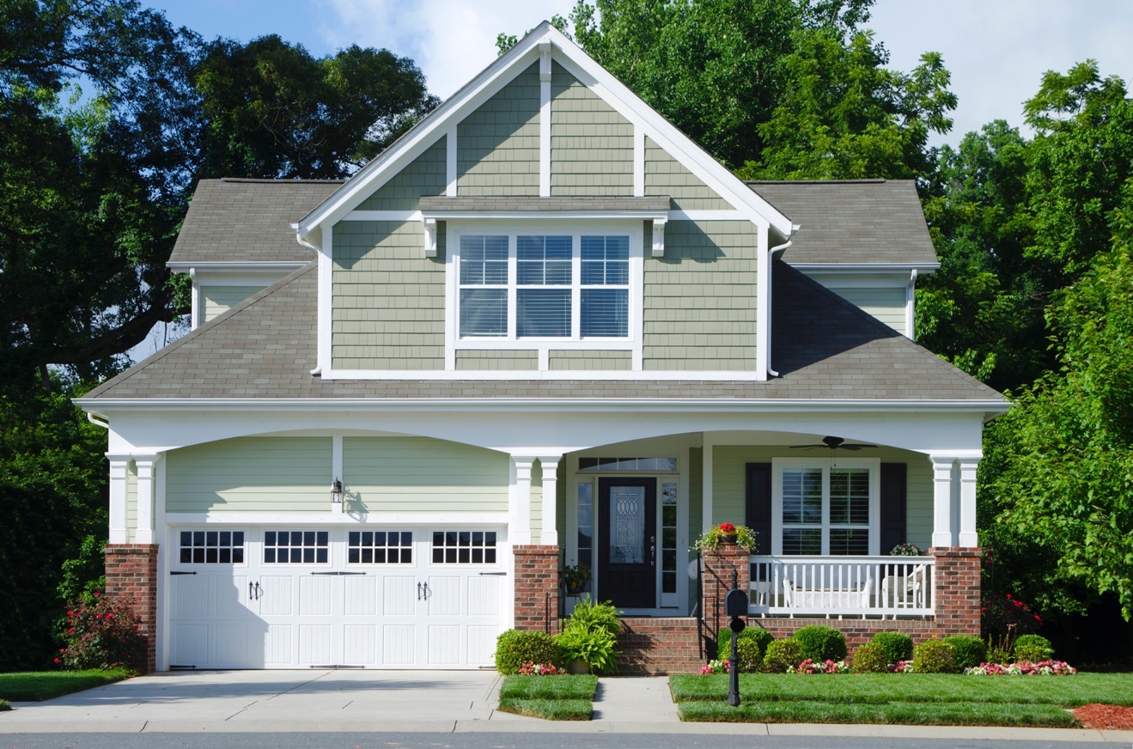
Strategic Focus
The Strategic Focus
Reduce customer acquisition costs – drive programs (e.g. builder) to shift costs away from our partner
Provide our dealers with marketable differentiating advantages (e.g. broad integration portfolio, user experience, products) to increase close rates
Increase customer satisfaction – reduce attrition, increase RMR
Reduce cost of operations for our dealers
Notes:
But here’s the problem with that – every security based home control platform from Honeywell, to Interlogix, to Alarm.com, the core feature set remains security. Perhaps they didn’t get the memo that smart home is sell, security follows?
Example: Alarm.com – does not integrate with a single popular thermostat: Honeywell, Nest, Ecobee. Zero audio video, zero shades and so on.
Example: Honeywell – integrates to Honeywell. That’s it. NO third party thermostats, cameras are terrible, no doorbell, no third party lighting, no garage doors, no shades, no a/v
Example: Interlogix – integrates to Carrier Cor thermostat (made by Ecobee). That’s it. No lighting systems, no support for most garage doors, no shades, no a/v etc.
Further – there is no market model for these systems to offer smart home without month monitoring in place. In other words, you have want burglar alarm in order to get smart home. It’s backwards.

Slide 7
The Plan
The Plan
Lead with Smart and follow with Security.
Allow every builder an opportunity to offer Smart Home.
Reduce cost of operations for our dealers through labor reduction.
Increase revenue through RMR attach rate.
Notes:
But here’s the problem with that – every security based home control platform from Honeywell, to Interlogix, to Alarm.com, the core feature set remains security. Perhaps they didn’t get the memo that smart home is sell, security follows?
Example: Alarm.com – does not integrate with a single popular thermostat: Honeywell, Nest, Ecobee. Zero audio video, zero shades and so on.
Example: Honeywell – integrates to Honeywell. That’s it. NO third party thermostats, cameras are terrible, no doorbell, no third party lighting, no garage doors, no shades, no a/v
Example: Interlogix – integrates to Carrier Cor thermostat (made by Ecobee). That’s it. No lighting systems, no support for most garage doors, no shades, no a/v etc.
Further – there is no market model for these systems to offer smart home without month monitoring in place. In other words, you have want burglar alarm in order to get smart home. It’s backwards.

Slide 8
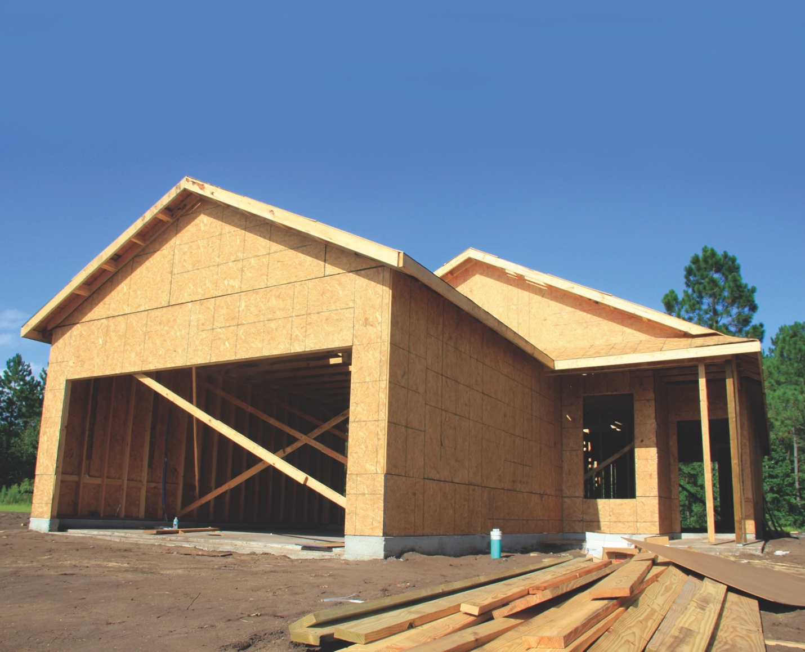
The Pitch
The Pitch
Provide the Builder a Smart Home through the absorption of existing prewire costs.
Decrease build time
Reduce trips
Increase value to the homebuilder.
Beat the “Door-Knockers” to the RMR sale.
Take advantage of market trends.
Notes:
But here’s the problem with that – every security based home control platform from Honeywell, to Interlogix, to Alarm.com, the core feature set remains security. Perhaps they didn’t get the memo that smart home is sell, security follows?
Example: Alarm.com – does not integrate with a single popular thermostat: Honeywell, Nest, Ecobee. Zero audio video, zero shades and so on.
Example: Honeywell – integrates to Honeywell. That’s it. NO third party thermostats, cameras are terrible, no doorbell, no third party lighting, no garage doors, no shades, no a/v
Example: Interlogix – integrates to Carrier Cor thermostat (made by Ecobee). That’s it. No lighting systems, no support for most garage doors, no shades, no a/v etc.
Further – there is no market model for these systems to offer smart home without month monitoring in place. In other words, you have want burglar alarm in order to get smart home. It’s backwards.

Slide 9
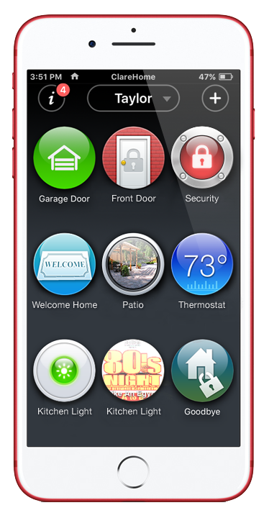
Introducing the Clare Builder Program
Clare Builder Program
Is not a series of products, but rather a complete solution tailored toward builders looking for a complete smart home program
Low cost of entry: Clare’s products and solutions are easy to install and offer a low cost alternative to only a security pre-wire
Systems that scale: Clare systems scale from entry level all the way to luxury homes
Brands people trust: With support for over 1,800 devices, Clare supports today’s top brands
No hidden fees: ClareHome is a “freemium service”.
Homeowner support: Clare’s factory direct call support
Learn more by visiting www.clarecontrols.com

Slide 10
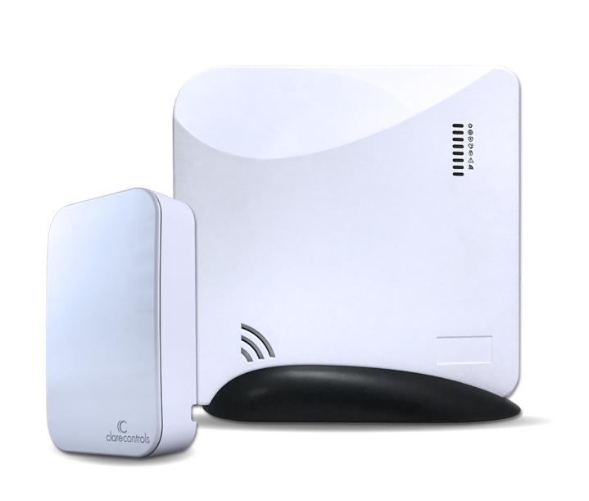
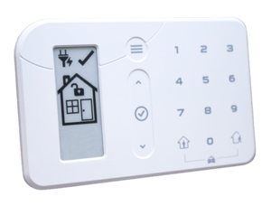
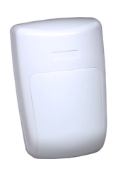
Security System Cost Comparison
Clare Secure Kits include: smart home controller, security panel, keypad, 3 door/window sensors, & 1 motion sensor
System | Dealer Cost | Labor | Total Cost
DSC Kit | $150 | $600-$900 (prewire + install) | $750-$1050
Clare Secure | Less than $400 | $120 (2 hrs) | $600

Slide 11
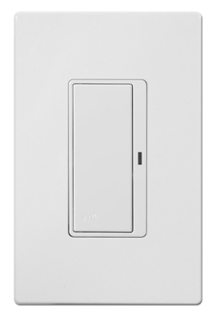
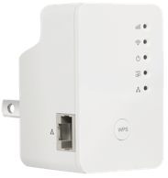
Builder Base Package Proposal
Product Description | PN | Qty
CLIQ.Mini and Helix | CLIQ.SECURE-10 | 1
Z-Wave light switches | CL-MNS-W-10 | 3
Clare Video Doorbell | CVP-B2DB50-ODIW | 1
Wi-Fi access point | EW-7438RPn Mini | 1

Slide 12
Strategic Focus – Conversion Rates with Security
The Results
CASE Study: DR Horton
Notes:
But here’s the problem with that – every security based home control platform from Honeywell, to Interlogix, to Alarm.com, the core feature set remains security. Perhaps they didn’t get the memo that smart home is sell, security follows?
Example: Alarm.com – does not integrate with a single popular thermostat: Honeywell, Nest, Ecobee. Zero audio video, zero shades and so on.
Example: Honeywell – integrates to Honeywell. That’s it. NO third party thermostats, cameras are terrible, no doorbell, no third party lighting, no garage doors, no shades, no a/v
Example: Interlogix – integrates to Carrier Cor thermostat (made by Ecobee). That’s it. No lighting systems, no support for most garage doors, no shades, no a/v etc.
Further – there is no market model for these systems to offer smart home without month monitoring in place. In other words, you have want burglar alarm in order to get smart home. It’s backwards.

Slide 13
Clare Overview
The Results…
A SMART platform that is reliable and scalable
Broad Device Support
Installs in minutes
Remotely managed
Mobile Access via Clare Cloud
Working with over 1800+ products from the brands people trust.
A security system that redefines SECURE
Cellular Reporting
Wireless Security
Alarm Reporting
A Security System that is locked to your cloud account,
preventing system and device takeovers.
A SIMPLE system that empowers the Homeowner
Call Support
DIY Device Adds
Learn in Minutes
Scenes, Schedules, Automations
Notes:
Smart – brands from Sony to Lutron, Sonos to Denon, we support them all. And we do so in a way that our partners can take our products and go from zero to installing 50 a week quickly.
Secure – embedded in the platform is wireless security. Broad call center support. Cell backup. Installs in minutes.
Simple – we make the user’s experience a dream.

Slide 14
What to expect in Q1
Recap
Exponential smart home and security growth over the next 7 years
Clare ”fills the gap” between DIY, security focused, and highly complex smart home solutions
Strategic focus and plan to make our dealer partners successful
Complete builder program focuses on a program, not a series of parts
The results prove that Clare is the smart, secure, and simple solution that increases RMR and customer retention, while reducing acquisition costs and unwanted truck rolls
THE FUTURE IS NOW!

Slide 15
Thank You

