Slide 1

AGILE PORTFOLIO MANAGEMENT IN ACTION
Grow your Agile maturity with KeyedIn

Slide 2
Housekeeping Items
45-minute webinar
w/ Q & A
All phone lines will be placed on mute
Please enter questions into the chat box
The slides and recording will be available after the presentation
This webinar is being recorded

Slide 3

Today’s Agenda
Need for Agile Portfolio Management
Agile Portfolio Principles
Four Key Areas to operate with agility
Product Review
Cautions and Considerations
Key Takeaways / Q&A
Notes:
We’ll talk about why resource execution is important – once you have a plan in place you’re not done. Keeping aligned with the strategic plan can be just as difficult
Assessing your execution strategy – do you have a plan that can withstand the inevitable changes that will come your way (and what to do about them)
Agility is a big part of resource execution – remaining agile doesn’t mean losing your strategic direction
Navigating resource execution using the key components, information, communication and visibility
Then we’ll wrap up with key takeaways from today’s presentation and a q/a portion

Slide 4
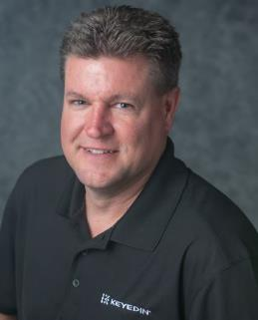
TODAY’S PRESENTER
Director of Solutions, Customer Experience @ KeyedIn
Leads KeyedIn product solutions to help PMO leaders and project teams on identify and solve business problems with innovative solutions
Spent eleven years at Changepoint working with the Changepoint and Daptiv Solutions in Field Enablement, Product Management, and Customer Success
Owner in technical consulting firm for thirteen years covering project accounting systems, infrastructure, and custom development efforts tied to those solutions.
Tom Raper

Slide 5


THE NEED FOR AGILE
PORTFOLIO MANAGEMENT
The high cost of making the wrong investments
Which way to go?
The need to deliver faster
Keeping up or staying ahead?
The urgency to create business value
What are we working on vs.
why are we working on it?
Notes:
This approach addresses three problem areas most PMOs are dealing with…
Portfolio management being driven from the top of the organization
But not fully integrated into how the organization operates
Still primarily a reporting function, not a management and delivery function
Organizational agility concepts being accepted
Adjusted to changing circumstances
Building an organization that can adapt and adjust
But change focused at tactical levels instead of strategic
Shifting work to deliver against stable goals
Not shifting goals to deliver against changing needs

Slide 6

Isn’t this just glorified
Agile Project Management?
Agile Project Management delivers projects better and faster.
Agile Portfolio Management delivers the best projects.
Agile Project Management focuses on the right people for the right projects.
Agile Portfolio Management focuses on the right TEAMS and provides resource agility.
Agile Project Management reduces risk and prioritizes stakeholder satisfaction.
Agile Portfolio Management ensures a prioritized backlog and accounts for all project types.
Notes:
An allocation plan is necessary for assessing resource demands and ensuring you have the capacity to meet those demands. But you’re not done yet – iteration will be essential in delivering against that plan.

Slide 7
Agile Portfolio Principles
1.
Deliver products, not projects.
2.
Embrace change
3.
Be customer-obsessed.
4.
Be a strategic partner, not a shared resource.
5.
Make decisions quicker, deliver faster.
6.
Focus on continuous improvement.
7.
Not everything should be agile.

Slide 8


Four Key Areas
to operate with agility
Agile Team Resourcing
Kanban & Workflow
Prioritized Backlog
Dashboards & Reports

Slide 9

AGILE TEAM RESOURCING
Managing resources in an Agile method ensures all parties are deployed to the right work. This includes assigning and monitoring a team the same as an individual, regardless of time spent
What is it? Why is it important?
Assign teams rather than individuals
Increase accountability
Reduce reliance on hourly tracking

Slide 10

PORTFOLIO
KANBAN & WORKFLOW
It’s less about how you get things done and more about what you get done – but having the right tools to help you manage it all will make a big difference. Workflow models and Portfolio-level Kanban ensure workflows are succinct and streamlined.
What does your workflow look like?
Only as much process as necessary
Don’t lose governance when increasing agility
Visualize and manage the impact of change

Slide 11

THE BACKLOG
Keeping a log of all requests and intake, understanding constraints and focusing effort to the areas that make the biggest impact while not neglecting the work that needs to get done
We all have backlog. Now let’s make it useful.
Always be working on the right projects
Have resources delivering the highest value work
Confidently answer ”what’s the status”

Slide 12
DASHBOARDS & REPORTING
Track milestones and progress. Communicate information to leadership. 100+ out-of-the-box widgets and pre-built reports allow for any level of reporting your business requires.
Transparency is critical.
Keep stakeholders and customers informed
Reduce risk
Identify red flags early and often

Slide 13
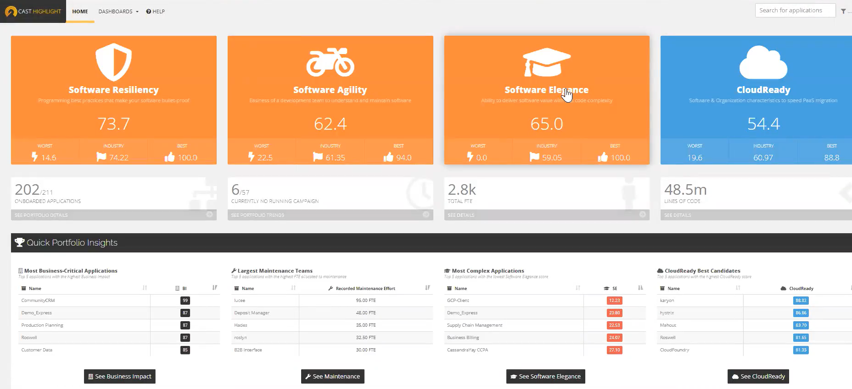

Slide 14
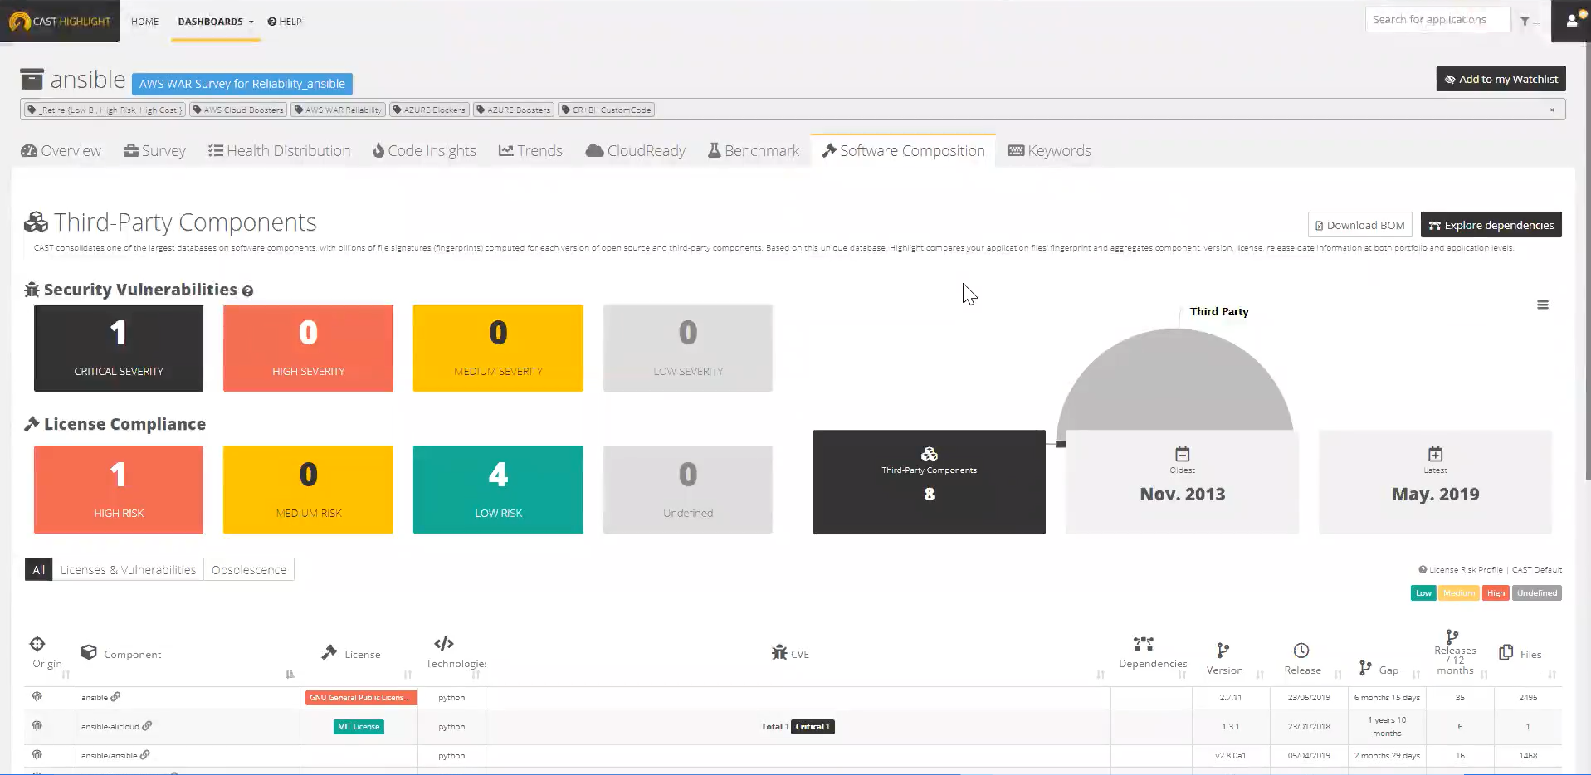

Slide 15


Agile Features for the PMO
The benefits are clear
Place the Right Bets
Turn Quickly
Deliver Faster
Product Focused PPM that emphasizes managing projects as products
Portfolio Analysis to ensure you are investing in the right areas
Capacity Planning to ensure you can deliver
Native Reporting within the product to ensure everyone has the same info
Reporting API to include data from other systems and centralize information
Software Intelligence with CAST
Resource Visibility & Assignments to ensure most valuable assets are deployed effectively
Integrated Resource Lifecycle Management
Advanced Kanban & Workflow Management
Benefits Tracking
Notes:
You’ve been asking ”how” we do this. Here is how KeyedIn approaches the shift to Agile

Slide 16
How do I know I’m ready?
Indicators Agile is the next step for your organization
Our team is starting to prioritize projects based on value-based scoring
We are moving to an ePMO model and want to increase our organizational agility
We are undergoing a digital transformation initiative and need to keep pace with change
We approach solution design with a deep understanding of the end customer’s needs
We continually improve solutions based on usage data analytics
https://go.keyedin.com/projects/report/forrester/agile-organizations-need-modern-governance-structures

Slide 17
A Word of Caution / Common Sense
Considerations when proceeding
X
Agile Portfolio Management is not an excuse not to plan.
X
Agile Portfolio Management will not replace traditional governance.
X
Without a business driver, Agile Portfolio Management is likely a bigger transition than benefit.
X
Agile Portfolio Management is not the same as Agile Project Management
X
Adopting Agile as a practice is a continuum, not an end state

Slide 18

Key Takeaways
Agile Portfolio Management in KeyedIn
Agile Portfolio Management means you will be empowered to
1) place the right bets 2) turn quickly and 3) deliver faster
KeyedIn is committed to helping our customers achieve Agile Portfolio Management in order to realize these 3 key benefits
There are four areas of our product that support these outcomes today; with more being developed everyday
This methodology and practice isn’t for everyone – and it is not our only solution. But we believe this is where the future of the PMO is going

Slide 19
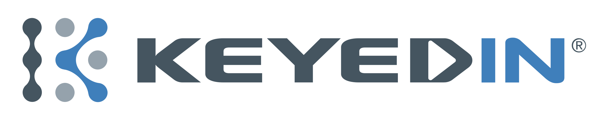


Founded in 2011
HQ is in Minneapolis, MN; offices in Manchester, UK, San Francisco, CA
Serving 500+ global customers; 1 million users; NPS score: 9/10
2019 Gartner Peer Insight Customer Choice
CEO - LAURI KLAUS
50%
60%
50%
IMPROVEMENT
INCREASE
SAVINGS
Speed of Reporting
Forecast Accuracy
Project Management Cost

Slide 20
?
Contact KeyedIn
QUESTIONS?
E-mail – info@keyedin.com
Phone – 877.932.4402
https://www.keyedin.com/contact-us

Slide 21

THANK YOU

