Slide 1
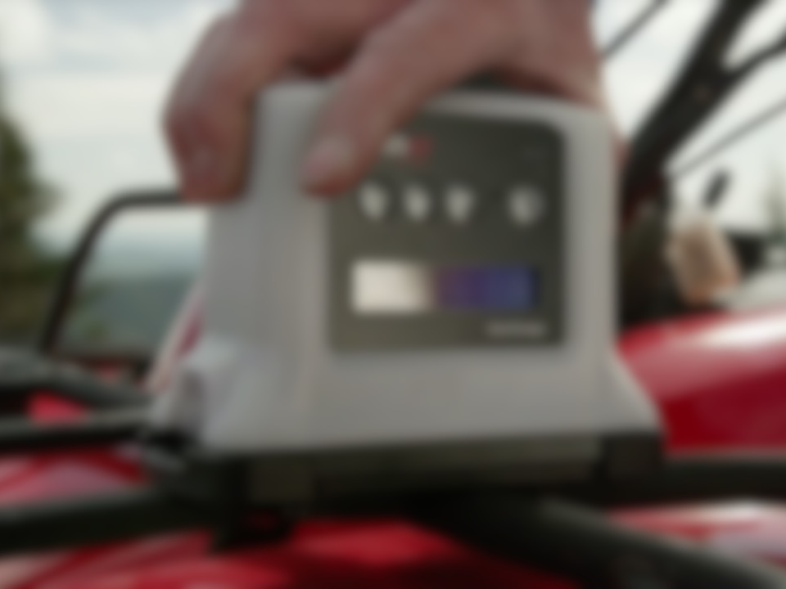
The Loner Bridge System

Slide 2
CONTENTS
About the devices
Starting your shift
During your shift
Generating Manual Alerts
Ending your shift
Questions?

Slide 3
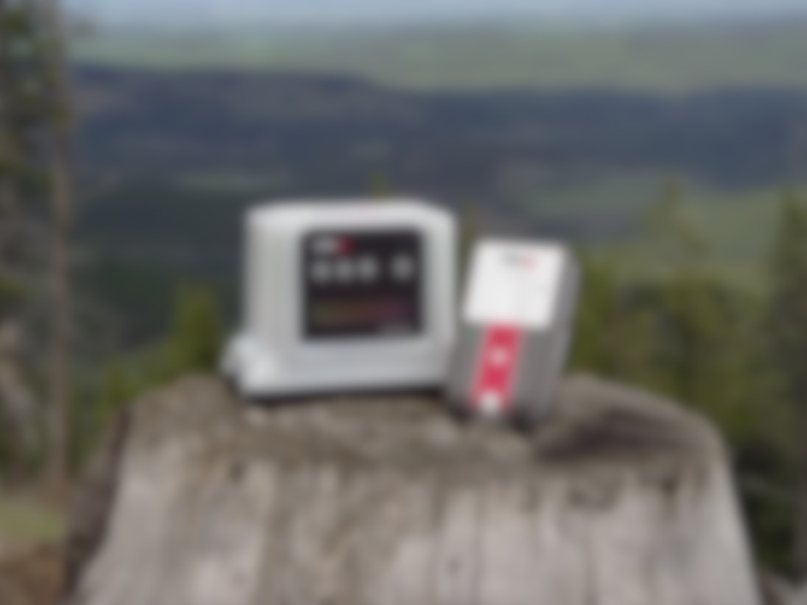
ABOUT THE DEVICES
Notes:
Is there any questions so far?
So now we’re going to talk about the physical components on each of the device so you can get familiar with the parts you’ll be interacting with while using it.

Slide 4

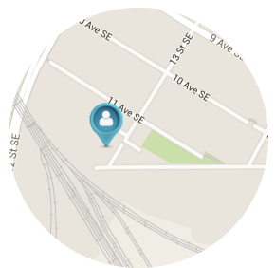
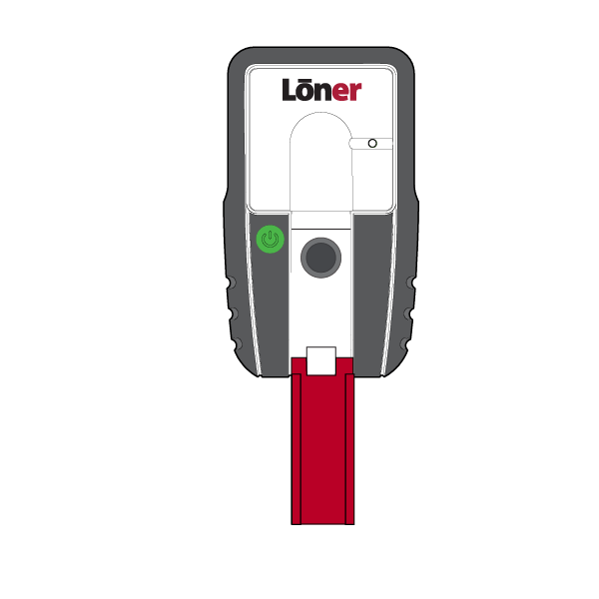
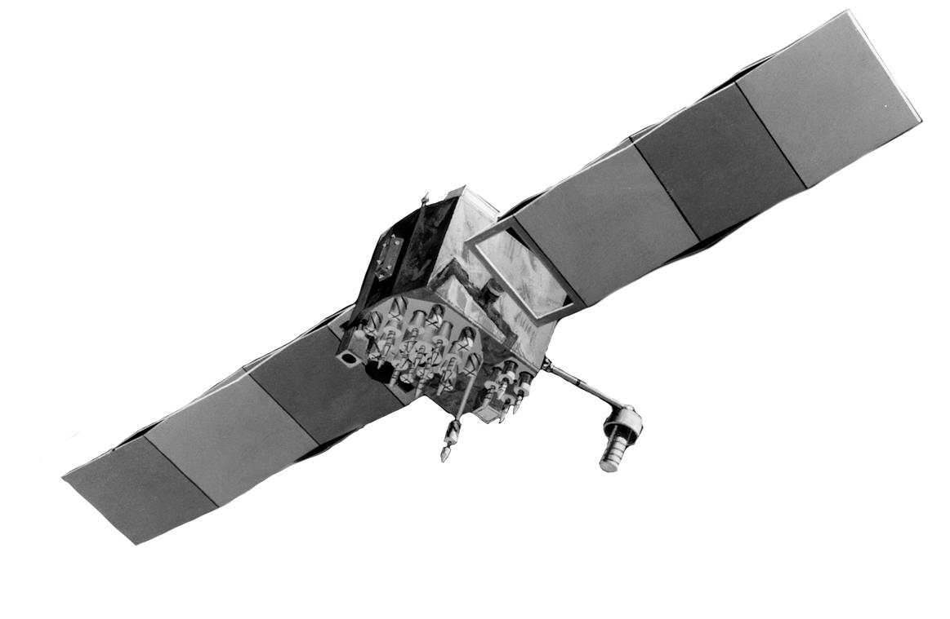

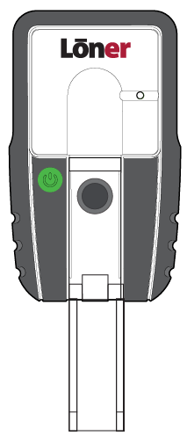
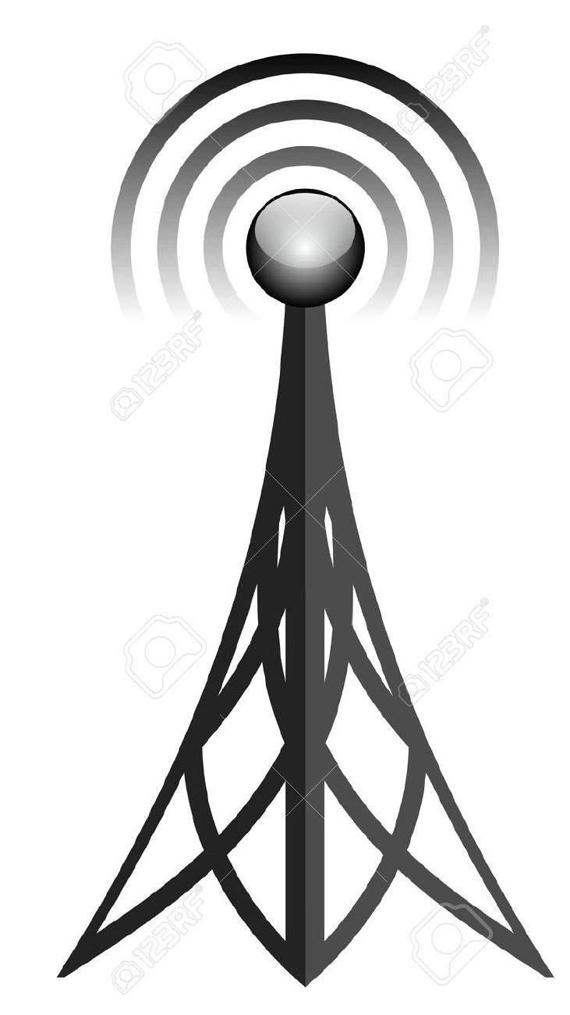
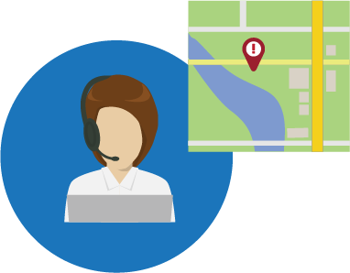
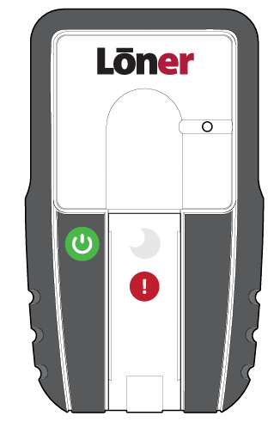


ABOUT THE DEVICE – Loner Bridge & 900
HOW DO LONER BRIDGE & LONER 900 WORK TOGETHER?
Loner 900
Loner Bridge
Cell & Satellite
Blackline Safety Network
Response
Service
The Loner Device is the monitor and the Bridge is the communicator.

Slide 5
ABOUT THE DEVICE – Loner Bridge
LONER BRIDGE COMPONENTS
Battery indicator & charging light
SureSafe™ indicator light
Menu navigation buttons
Power button
LCD Display

Slide 6
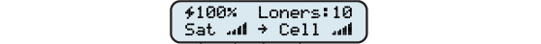
ABOUT THE DEVICE – Loner Bridge
LCD EXPLAINED
Battery level percentage
Number of connected Loner 900 Devices
Charger connected
Satellite network connection
Cell network signal strength
Satellite network
signal strength
Cell network connection
Communication service indicator

Slide 7
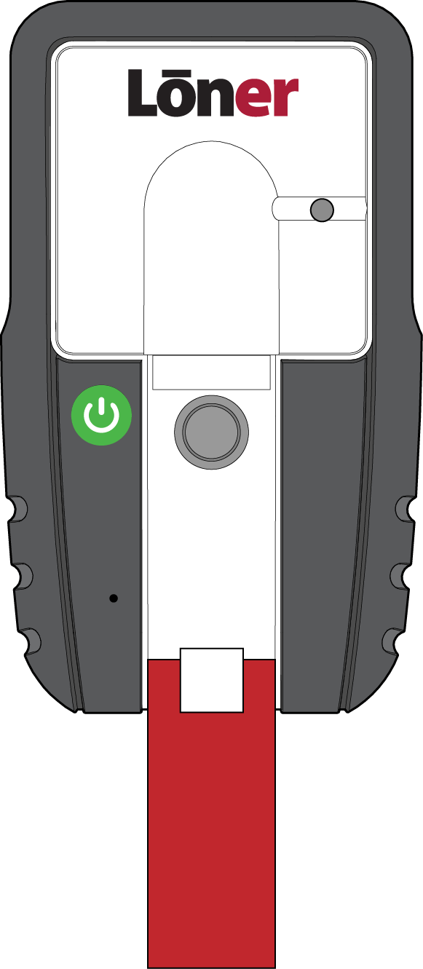
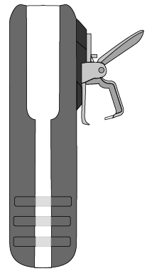

ABOUT THE DEVICE – Loner 900
LONER 900 COMPONENTS
Belt Clip
SureSafe monitoring light
and power button
Latch
Notes:
The Loner device has three primary components. The power, the belt clip, and the latch. We’ll talk more about how you’ll interact with these in the next section.

Slide 8
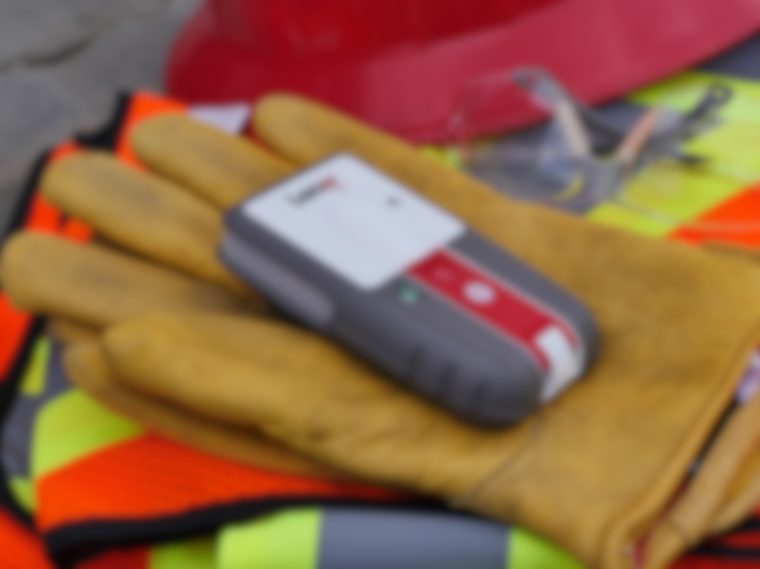
STARTING YOUR SHIFT
Notes:
Questions?
So now we’re going to talk about what you’re going to do when starting your shift and discuss how to properly set up and turn on your devices for proper use.

Slide 9
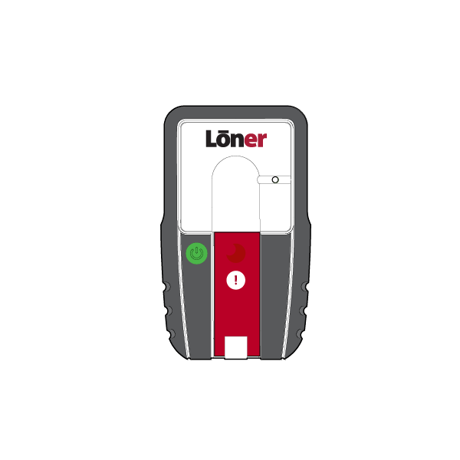
ENDING YOUR SHIFT
ALWAYS turn Loner Bridge on BEFORE turning on Loner 900
1
2

Slide 10


STARTING YOUR SHIFT
TURNING ON YOUR LONER BRIDGE
Press the power button
The green SureSafe indicator light will flash while Loner Bridge connects to a network and the LCD will say “Searching…”
Once connected, the SureSafe monitoring light will be SOLID GREEN

Slide 11

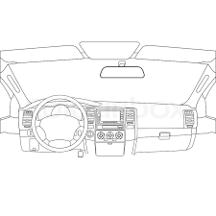

STARTING YOUR SHIFT
Ensure the top of Loner Bridge has a clear view of the sky, especially if you are outside of cell coverage
If the SureSafe indicator light on Loner Bridge is flashing, the device is not connected to the Blackline Safety Network and your safety is not monitored

Slide 12
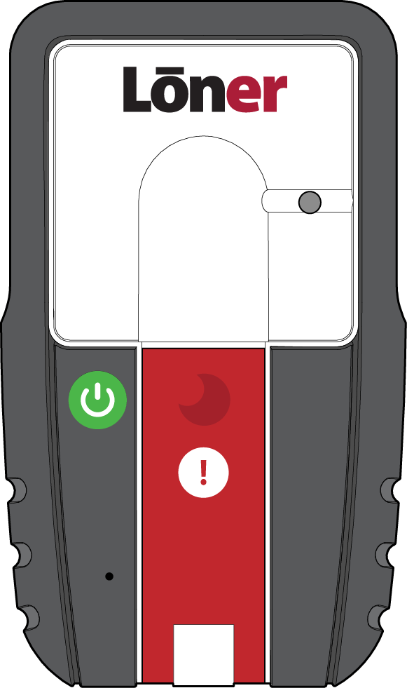
STARTING YOUR SHIFT
TURNING ON YOUR LONER 900
Press the power button
The green SureSafe light will blink until it is connected to the Blackline Safety Network.
Once connected, the light will be SOLID GREEN.
This means your safety is
now monitored.

Slide 13
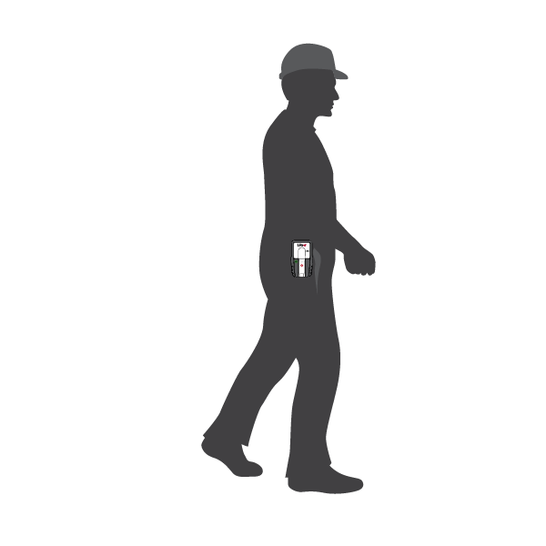
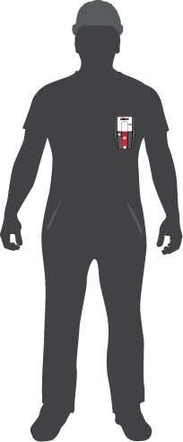
STARTING YOUR SHIFT
WEARING YOUR LONER
Clip the device to the side of your hip or to your chest pocket
Notes:
Once you have turned the device on all that’s left to do is clip the device to your hip pocket, which is the recommended placement of the device.

Slide 14
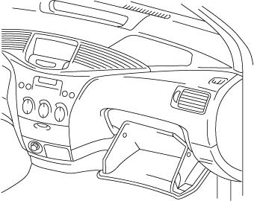
STARTING YOUR SHIFT
Do not leave Loner unattended when powered on
This can lead to false alerts
Notes:
Wearing the device is an important part of the Loner device’s functionality. While Loner device is on, NEVER leave unattended. The automatic alerts on the device (such as No Motion) can be activated and cause false alerts.

Slide 15
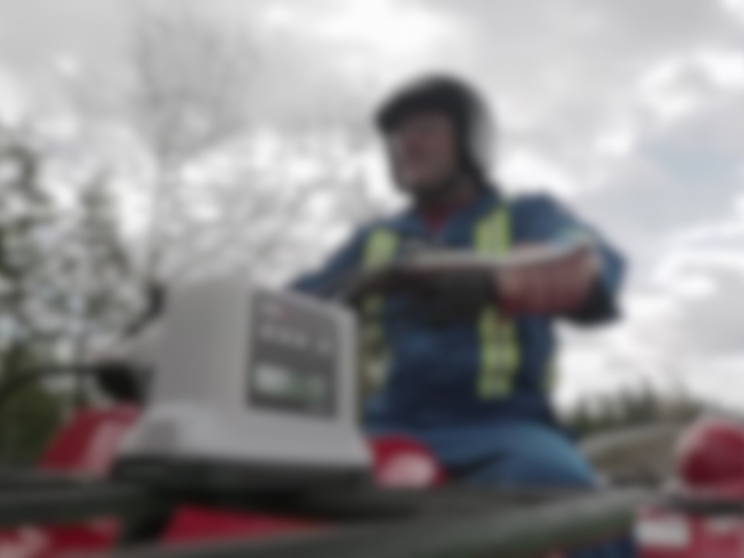
DURING YOUR SHIFT
Notes:
.

Slide 16
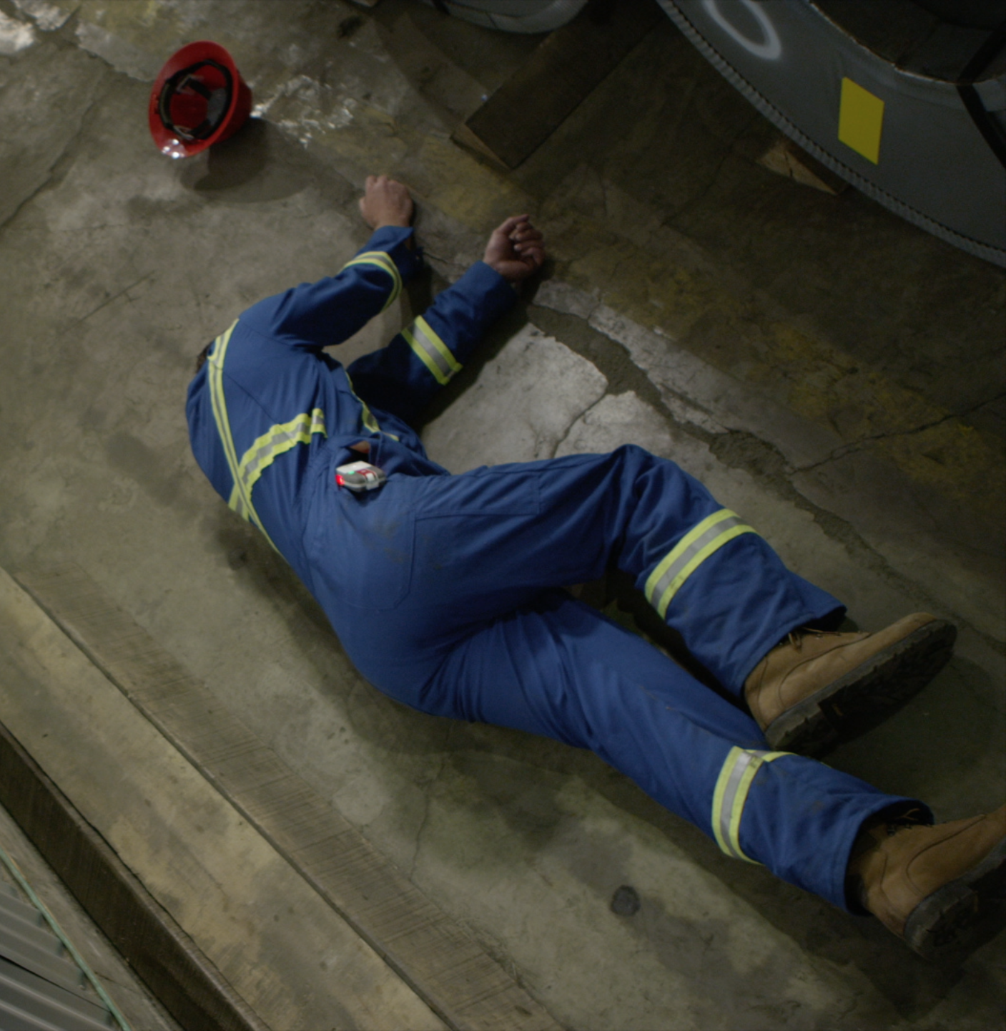
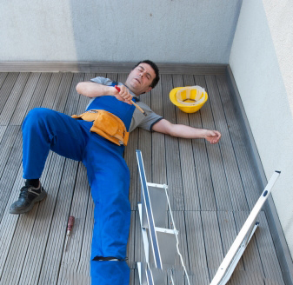
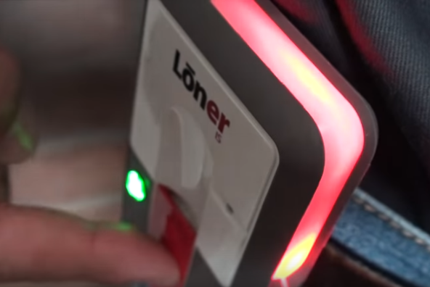

DURING YOUR SHIFT
AUTOMATIC FEATURES
During your shift, the device may ask you to confirm that you are OK when it detects one of the following:
No-motion
Fall detection
Check-in

Slide 17
DURING YOUR SHIFT
PRE CHECK-IN
Before pre-check in
Check-in timer reset
00:54:34
2:00:00
To do this, press and hold the latch for two vibrations. This will reset the check-in timer before the automatic alarm sounds.
Your device will automatically check you in if you are driving over 35 km/h.

Slide 18
DURING YOUR SHIFT
AUTOMATIC FEATURES – IF YOU’RE OK
No-motion
Fall Detection
Check-in
Pending Alarm
If you’re OK press the confirm button on the latch
This returns Loner to normal function.
No notification is sent.

Slide 19

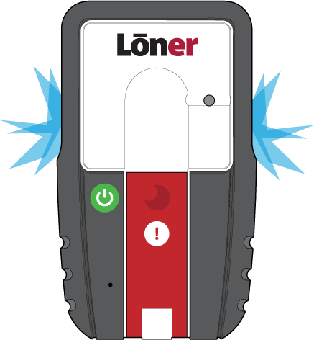

DURING YOUR SHIFT
AUTOMATIC FEATURES – IF YOU CAN’T CONFIRM
No-motion
Fall Detection
Check-in
Pending Alarm
If you can’t press the confirm button after a certain period of time, the device will go into high alarm
Once an alert is acknowledged by monitoring personnel, the loner will display a blue light
The high alarm can be silenced by pressing and holding the button. The alert notification still remains active.
This sends an alert notification

Slide 20
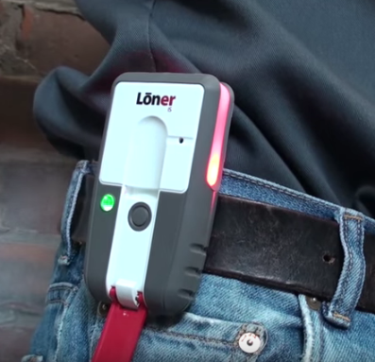
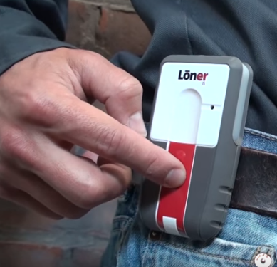
DURING YOUR SHIFT
MANUAL FEATURES
During your shift, you may need to request help using one of the manual features:
Emergency alert
(Audible)
Silent alert

Slide 21
DURING YOUR SHIFT
Emergency alert
Request help by pulling down the latch
An alert notification will be sent to monitoring personnel
The high alarm can be silenced by pressing and holding the button. The alert notification still remains active.
Once an alert is acknowledged by monitoring personnel, the loner will display a blue light

Slide 22

DURING YOUR SHIFT
Silent Alert
(No audible or visual alarm is generated on the Loner device)
Press the confirm button until the vibration stops
(two full vibration pulses ~5 sec.)
An alert notification will be sent to monitoring personnel
No alert acknowledged blue light
will be displayed on the device during a silent alert even if monitoring personnel have acknowledged the incident

Slide 23

BRIDGE MESSAGING

Slide 24


BRIDGE MESSAGING
BRIDGE MESSAGING
The purpose of Bridge Text Messaging is for the device user to communicate to the monitoring personnel via their Bridge in areas where there is no cell service or cell phones are prohibited.

Slide 25
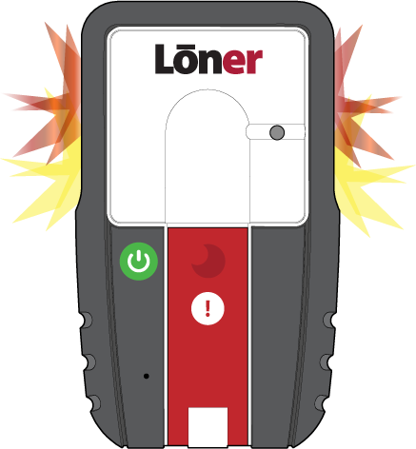
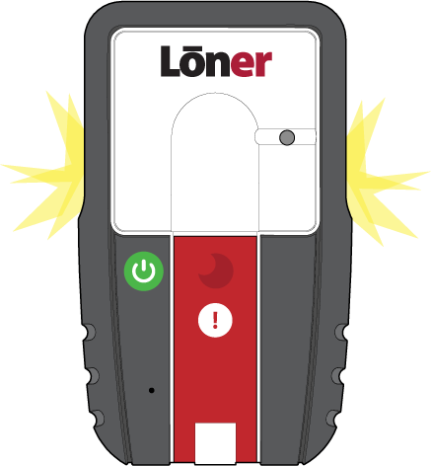
BRIDGE MESSAGING
WHAT HAPPENS WHEN YOU RECEIVE A MESSAGE
When Bridge receives a message your Loner 900 will muster
To silence your muster alarm press down on the latch for 3 seconds
Return back to your Loner Bridge and check the LCD display for a message from Monitoring Personnel
Ensure you read the message before moving to the next step
Silence your Bridge by pressing the OK button three times.

Slide 26
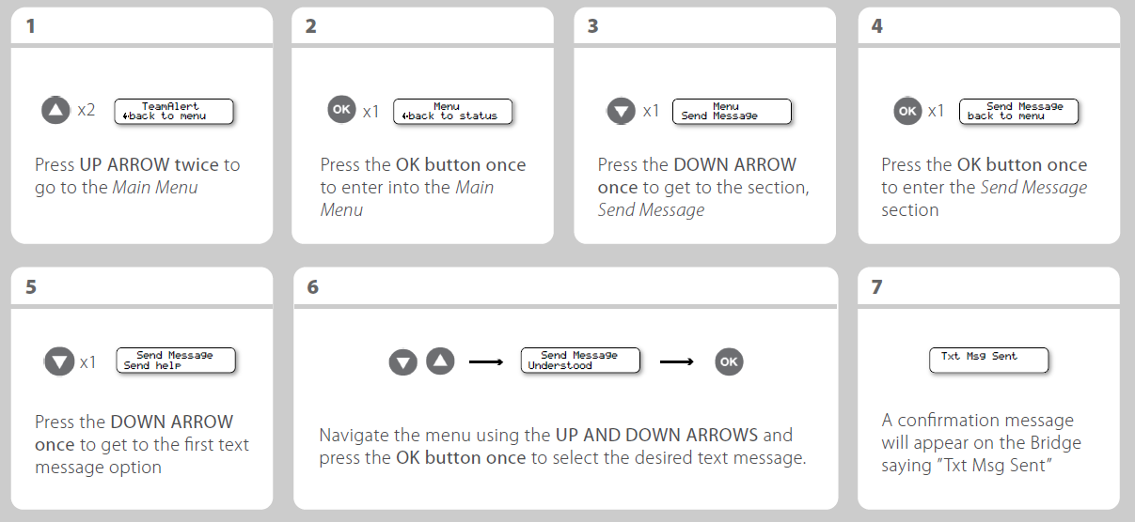
BRIDGE MESSAGING
REPLYING TO A TEXT MESSAGE

Slide 27
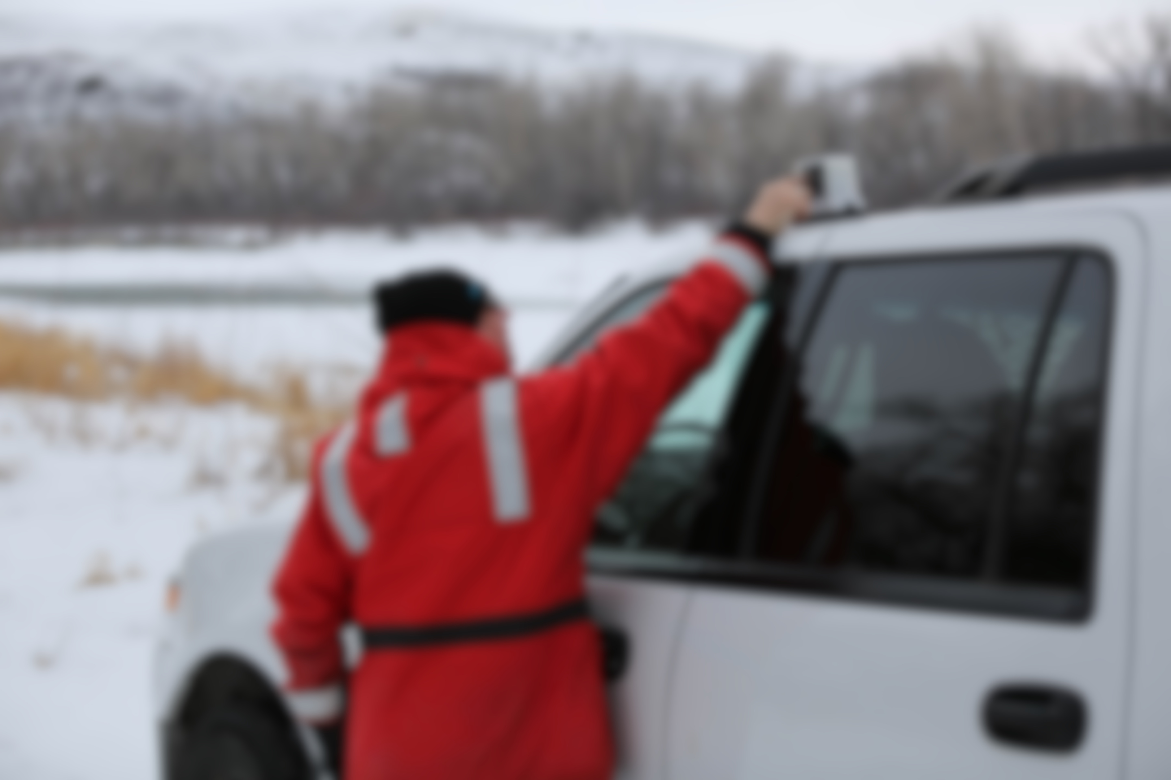
BRIDGE MUSTERING

Slide 28
BRIDGE MUSTERING
STARTING A MUSTER FROM A BRIDGE
The purpose of the Muster is to call employees back to the Bridge
Press the down button 4 times until you see TeamAlert Muster
Press OK
Press the down button until you see start
This will start a team muster and the Bridge will go into alarm
Press OK

Slide 29
BRIDGE MUSTERING
RECEIVING A MUSTER ON THE LONER 900
When a muster is generated, your Loner 900 will display the muster alarm
To silence your device, press and hold the latch for 3 seconds. Once silenced the device will display only the solid yellow light.
Return back to your bridge

Slide 30
BRIDGE MUSTERING
ENDING A MUSTER FROM A BRIDGE
Press OK
Press the down button until you see stop
Press OK
This will end the muster alarm

Slide 31
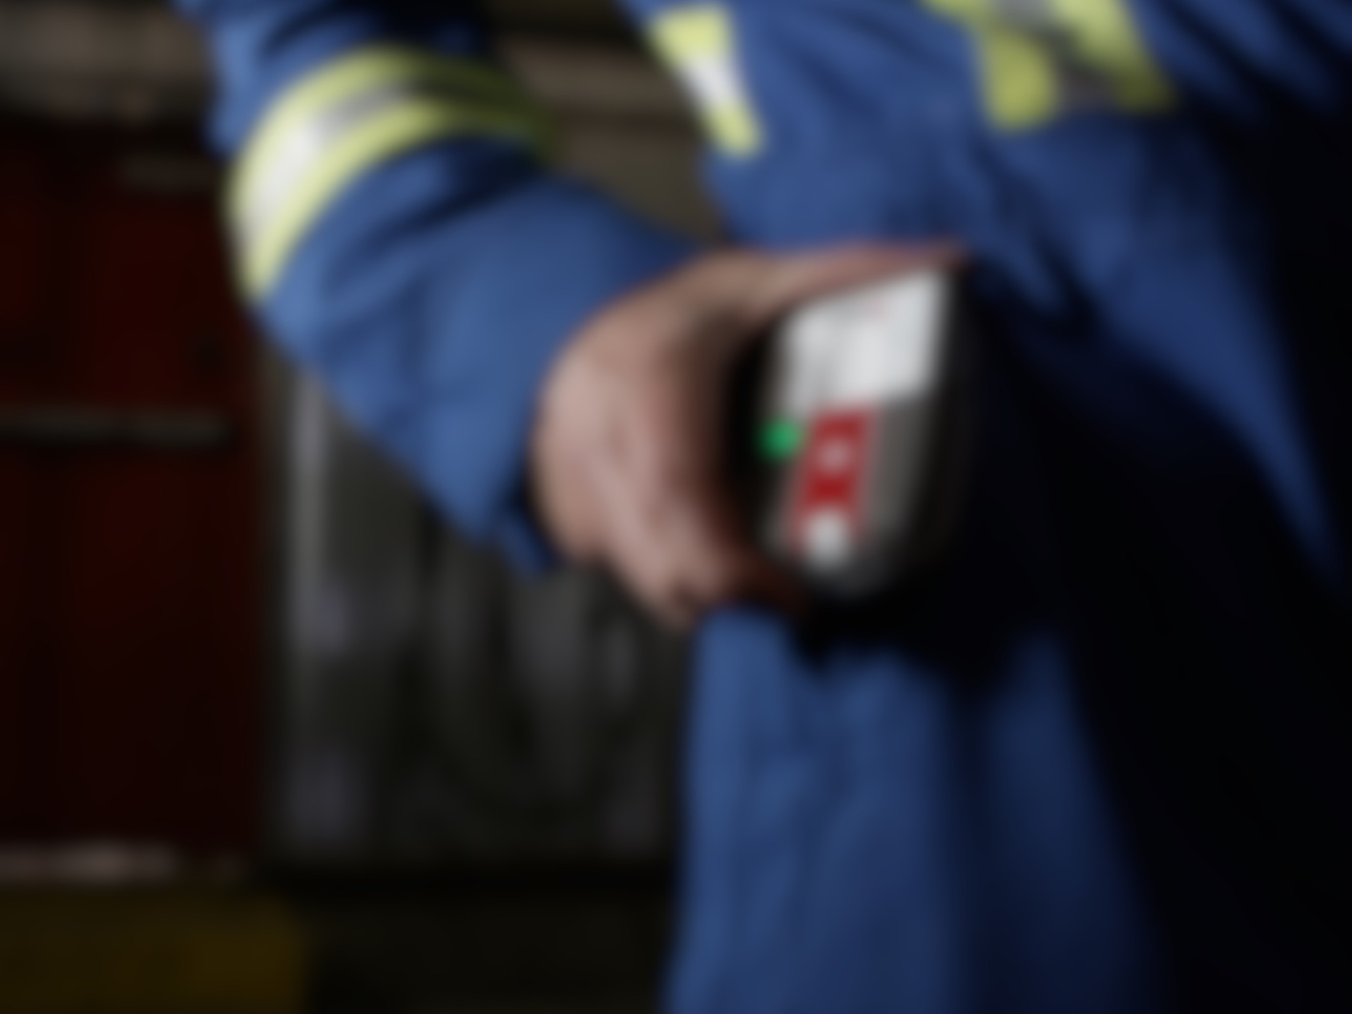
NOTIFICATIONS

Slide 32

NOTIFICATIONS
Link lost alarm
Low battery alarm
Your Loner 900 may be configured to notify you if it loses connection with Loner Bridge.
Your Loner device is configured to signal to you when the battery falls below a certain configured percentage
Loner 900
Loner Bridge
If configured, the device may initiate a LINK LOST ALARM, which is a characterized by a chirp every 5 minutes. If you hear this, head back to your Bridge.
Your Loner 900 SureSafe light will begin blinking to confirm that your safety is NOT being monitored
Low battery alarm is characterized by a short beep and a quick flash every 5 minutes. Charge your device as soon as possible.

Slide 33

ENDING YOUR SHIFT

Slide 34

ENDING YOUR SHIFT
TURNING OFF YOUR LONER DEVICE
Press the power button until beeping and vibration stops (usually 3 seconds)
The device will begin its shutdown sequence and the SureSafe light will flash and then turn off once your Loner logs off from the Blackline Safety Network.
Your safety is no longer being monitored
Notes:
At the end of your shift, remove the loner from your hip and press and hold the power button for about 3 seconds. The device will go into shutdown sequence. The green light on the Loner device may flash for up to 10 minutes while it disconnects.

Slide 35
ENDING YOUR SHIFT
TURNING OFF YOUR LONER BRIDGE
Press the power button and hold for 3 seconds
The device will begin its shutdown sequence and the SureSafe light will flash and then turn off once your Loner logs off from the Blackline Safety Network.

Slide 36
ENDING YOUR SHIFT
Always turn Loner 900 off Before turning off Loner Bridge
1
2
Loner Bridge cannot be powered down until the SureSafe light on the Loner 900 has stopped flashing

Slide 37


ENDING YOUR SHIFT
CHARGING YOUR LONER 900
Full charge takes approx 3 hours
Battery Life is 24 hours
Insert the charger into the bottom of the device and connect to power source
While the device is charging the red lights on the base will flash
When Loner is charged, the red lights will turn on continuously.
Notes:
It is recommended that you charge your Loner device after every use. Simply plug the charger into the bottom of device, while it’s charging red lights will flash at the base of the device and once it’s fully charged, these lights will be solid red. Charging Loner device from fully dead takes approximately 4 hours.

Slide 38
ENDING YOUR SHIFT
CHARGING YOUR LONER BRIDGE
Full charge takes approximately 10 hours
Battery life is 50 hours
Insert the CHARGER into the bottom of the device and connect to power source
While the device is CHARGING the top indicator light will flash RED
When Loner Bridge is charged, the RED light will turn on continuously

Slide 39
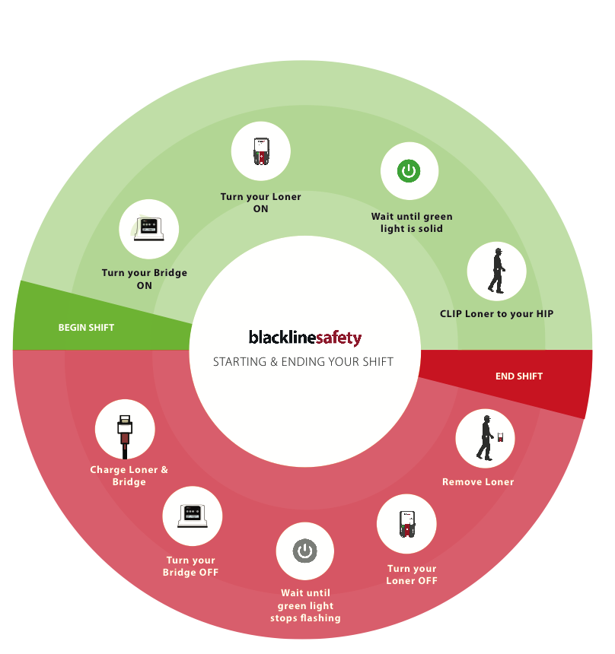

SUMMARY
SUMMARY

Slide 40

QUESTIONS?

Slide 41

For more support materials,
Please visit support.blacklinesafety.com
Customer Care: 1-877-869-7212
0049/R1/2016-06-06

