Slide 6
The way buyers discover & research products has fundamentally changed

Slide 7
Understand the Inbound Methodology

Slide 8
Understand the Inbound Methodology

Slide 9
Understand the Inbound Sales Methodology

Slide 10
Understand the Inbound Methodology

Slide 11
Understand the Inbound Methodology

Slide 13
SLAs Go Both Ways

Slide 14
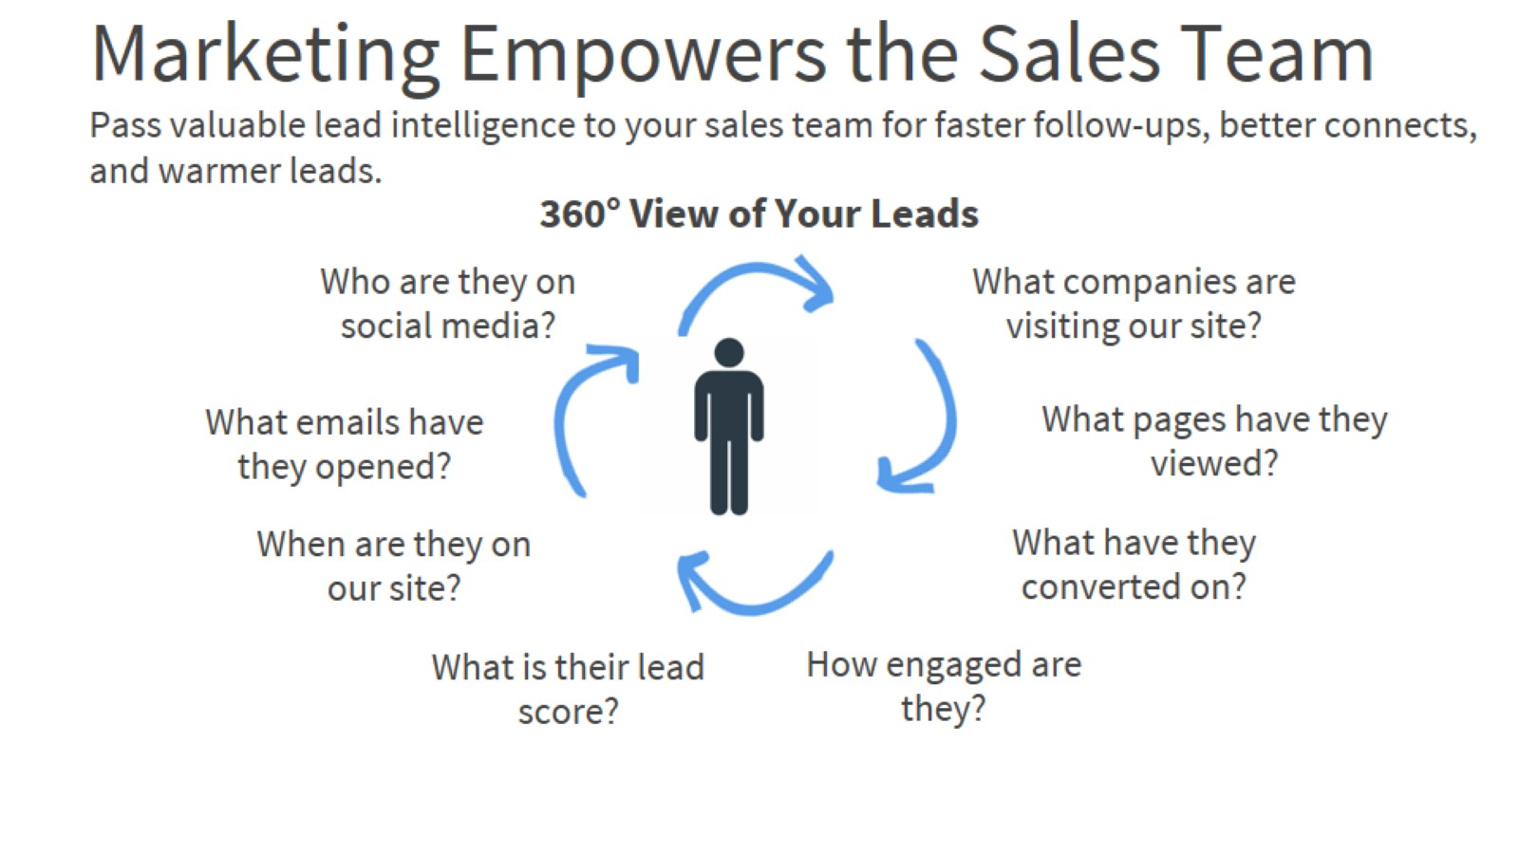
Marketing Empowers the Sales Team Pass valuable lead intelligence to your sales team for faster follow-ups, better connects, and warmer leads.

Slide 16
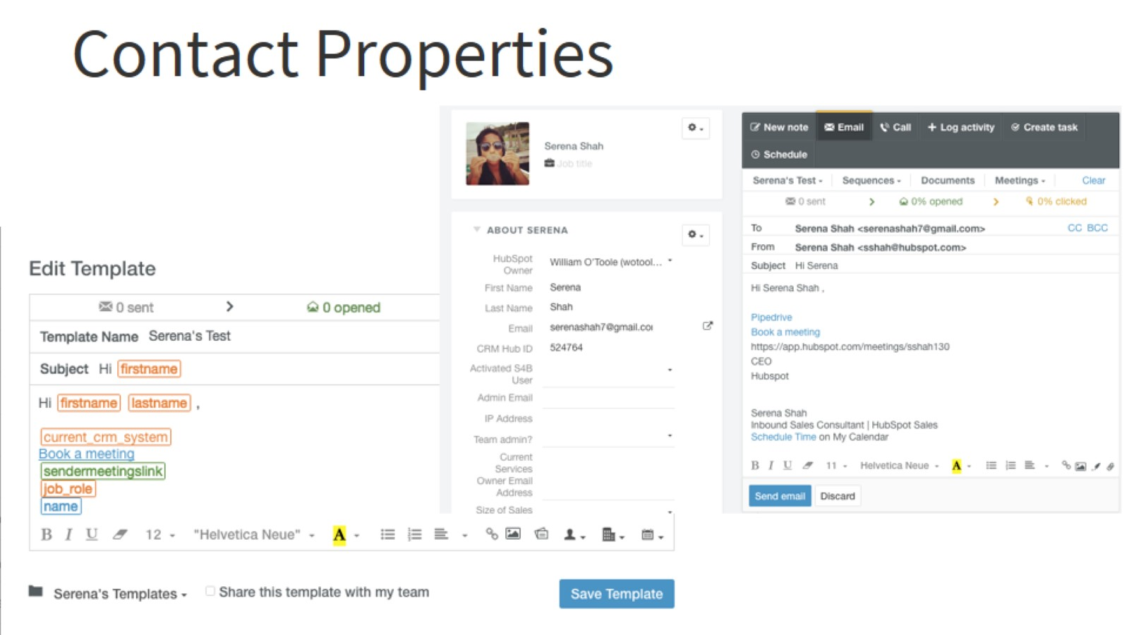
Contact Properties

Slide 17
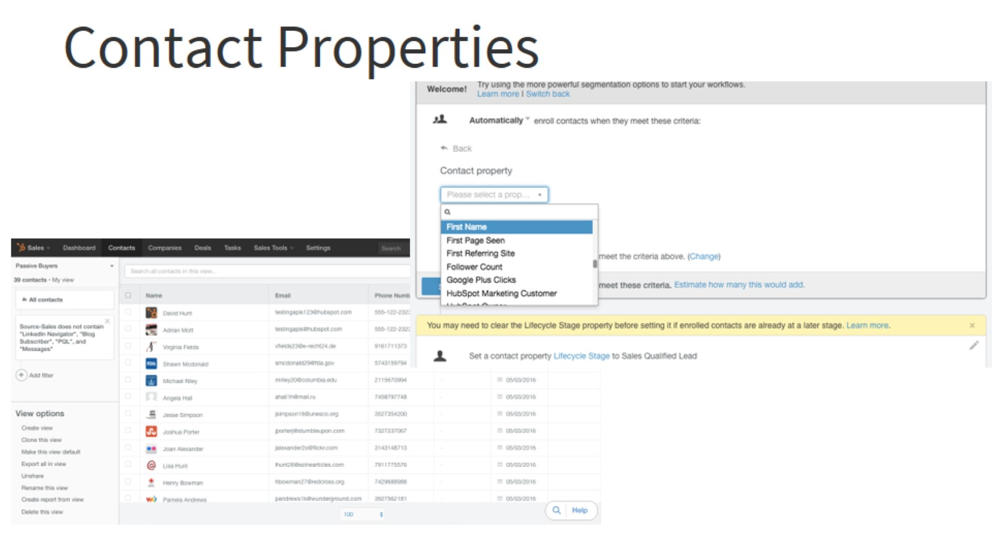
Contact Properties

Slide 19
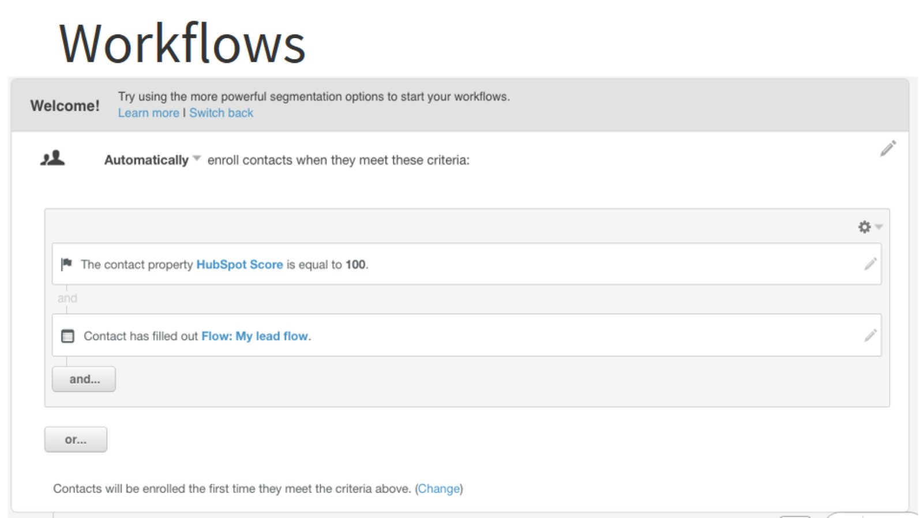
Workflows

Slide 20
Send Automated Emails from a Sales Rep

Slide 21
Use Meeting Links in Automated Emails

Slide 22
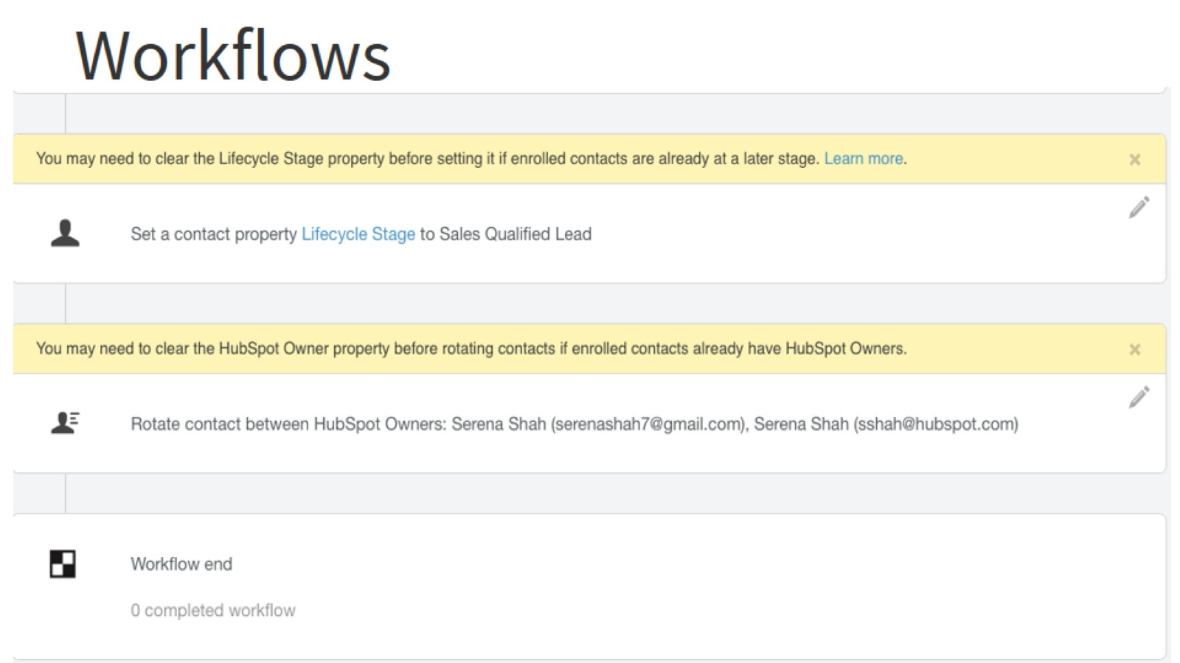
Workflows

Slide 23
Auto Prospecting with Sales

Slide 24
Review and Sequence

Slide 25
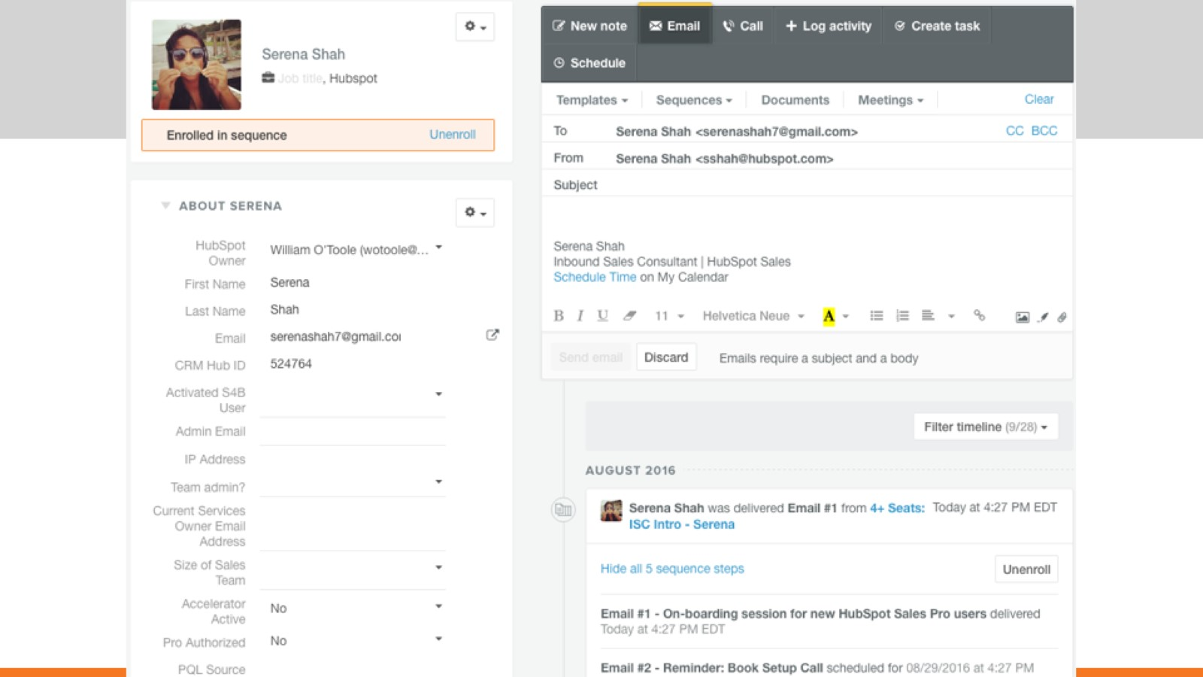

Slide 26
Sequence Dashboard

Slide 27
Auto Prospecting with Sales Email Templates

Slide 28
Use Meeting Links in Automated Emails

Slide 29
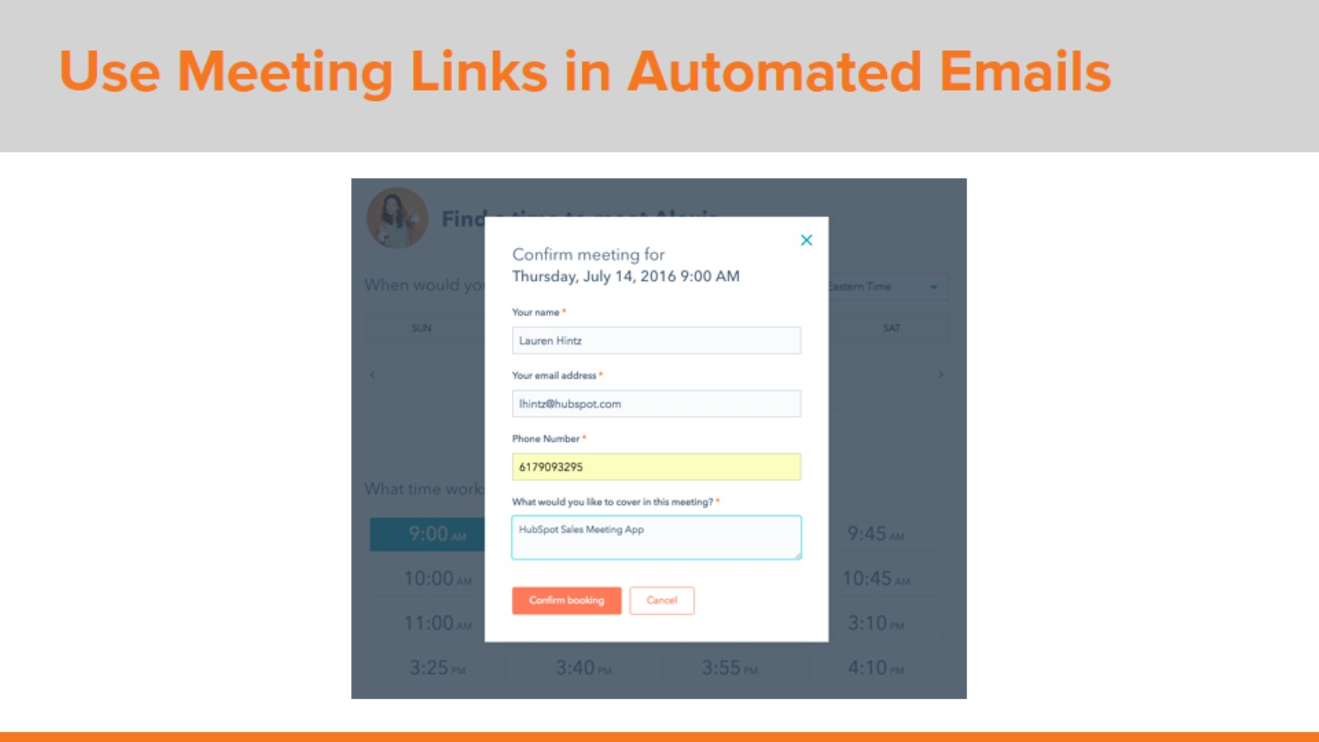
Use Meeting Links in Automated Emails

Slide 30
Use Meeting Links in Automated Emails

Slide 31
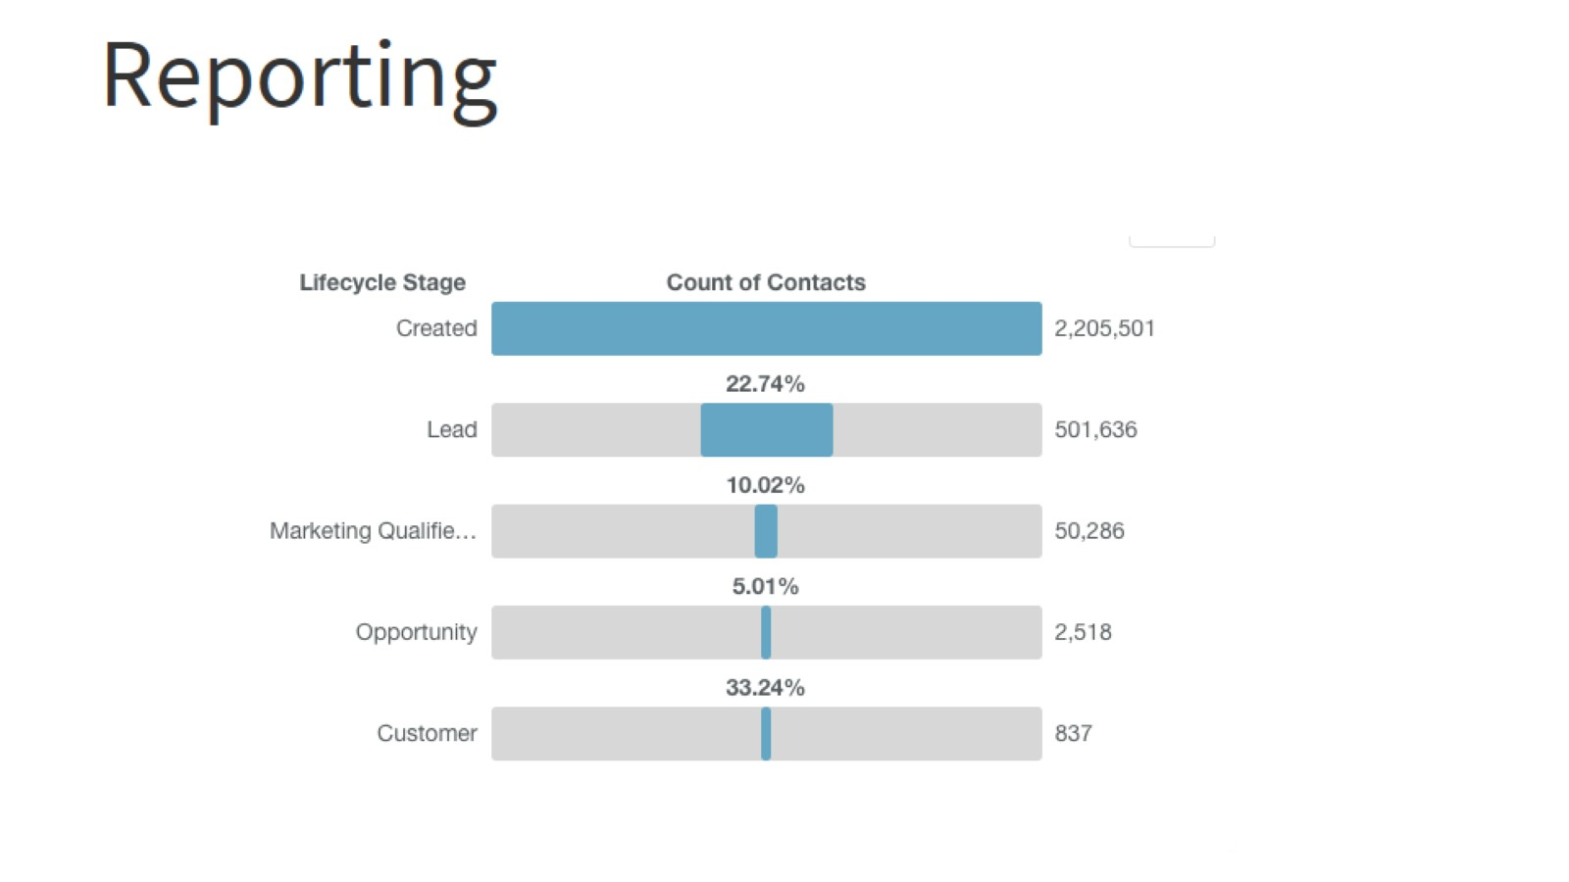
Reporting

Slide 32
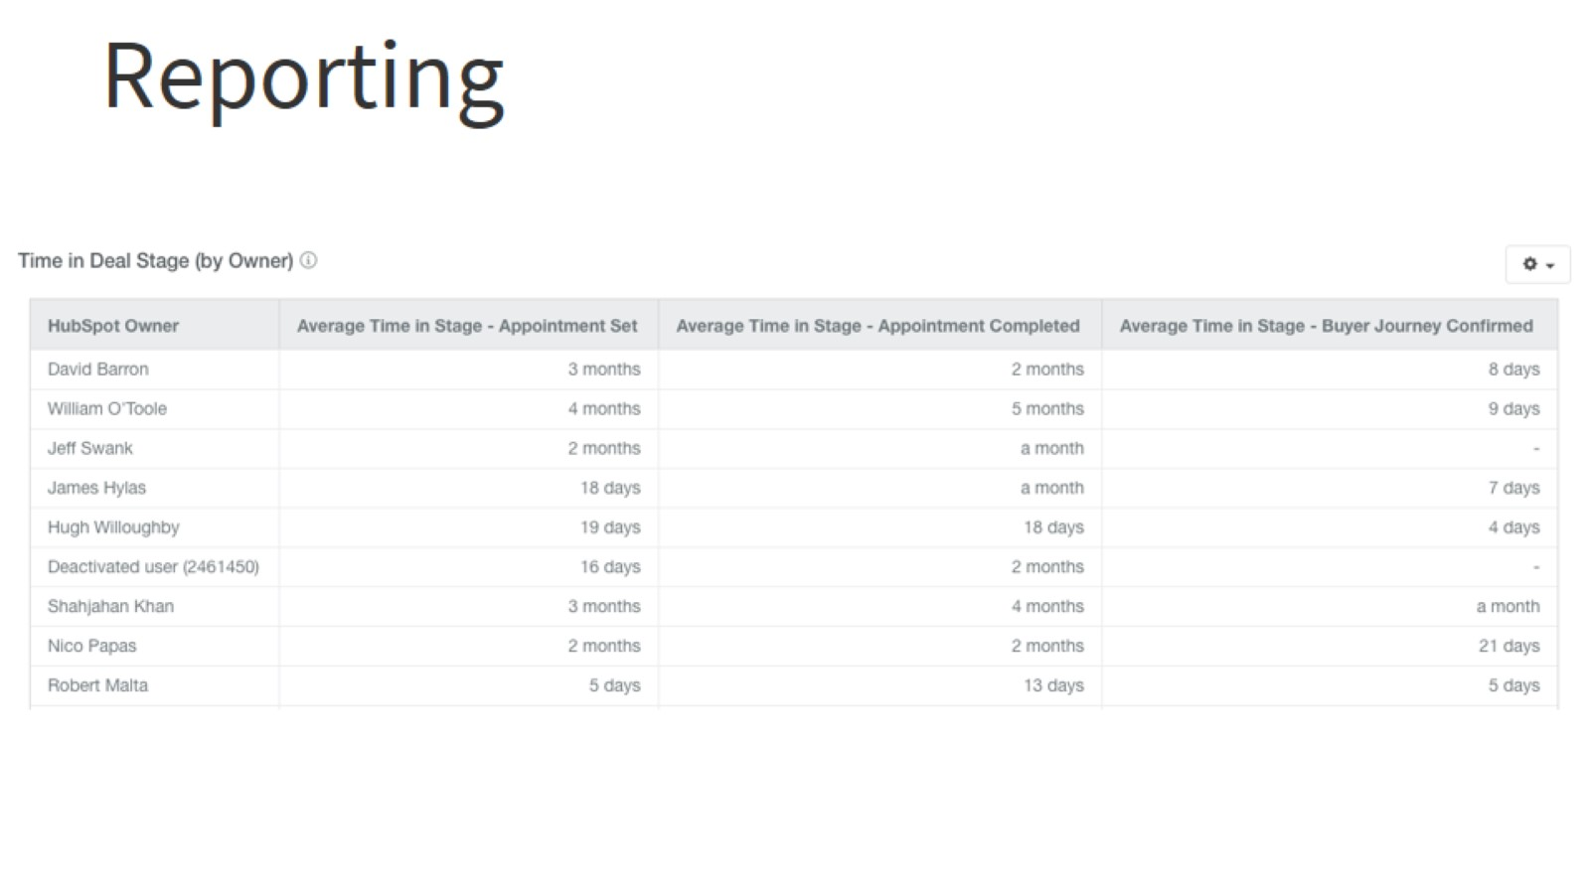
Reporting

Slide 33
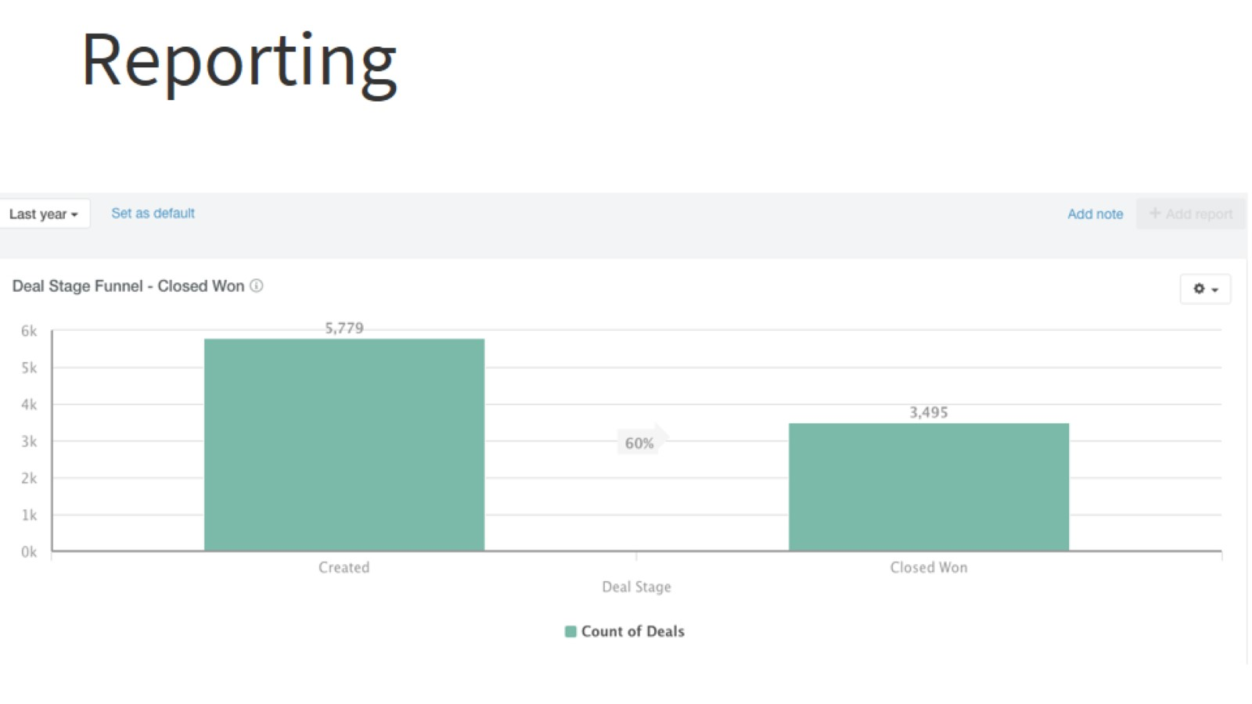
Reporting

