Slide 1





Conversations to Optimize Employee
Performance and Potential
Manager’s Program
COACHING-FORWARD
Program Facilitator
Jamie Resker
Practice Leader

Slide 2

What’s one thing you want to learn or do as a result of today’s workshop?
Record your answer on a sticky note

Slide 3

1
Employee Performance Continuum
Use a visual model to identify and describe the performance levels

Slide 4
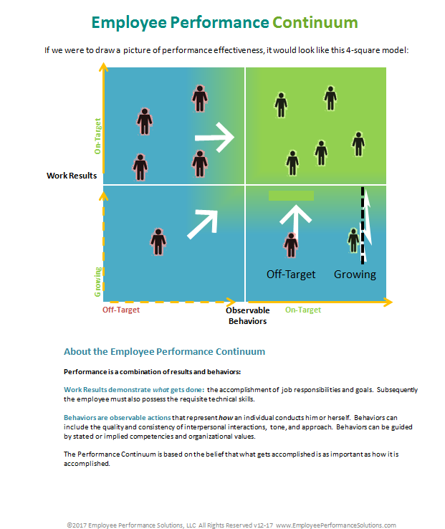
Employee Performance Continuum
On-Target
On-Target Work Results and Behaviors
Work
Results
Job Responsibilities
Goals
Skills
Growing or
Off-Target
pg8
Off-Target
On-Target
Observable Behaviors

Slide 5
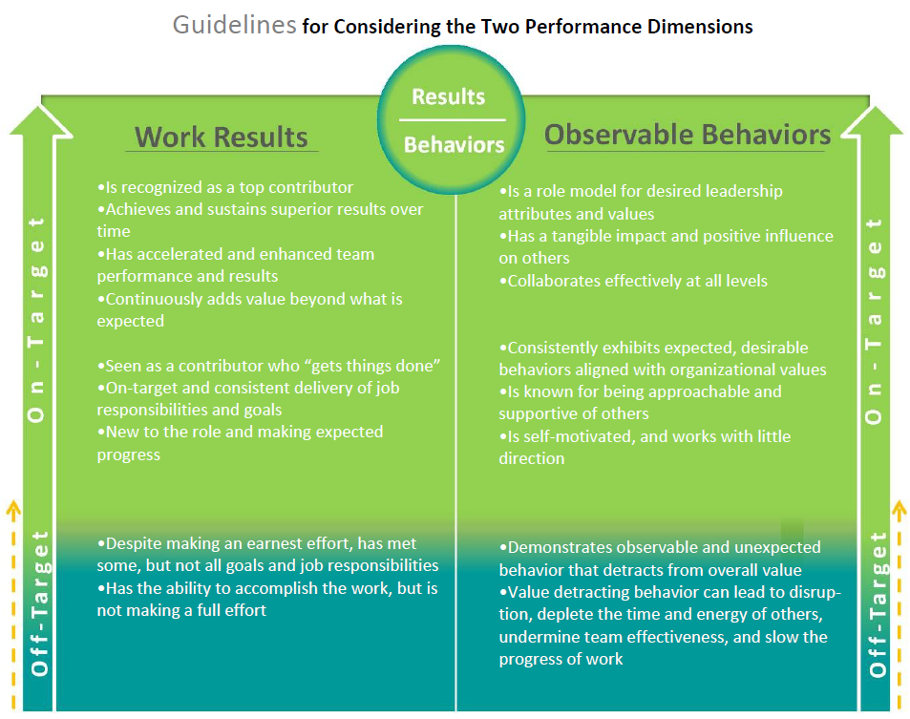

Guidelines for
Considering the Two Performance Dimensions
Instructions
Review the descriptions for On-Target and Off-Target Work Results and Behaviors
2-Minutes
See Card
Notes:
Facilitated Activity
Participants think about as many people as they possibly can , people they’ve worked with (now and in the past) and plot them, using a dot, on the Continuum. This will take approximately 5 minutes.
Have participants pair up and discuss their Continuums to explain their thinking behind where they plotted people.

Slide 6


Employee Performance Continuum
On-Target
Work
Results
Job Responsibilities
Goals
Skills
Grow
Low
Growing
pg8
Off-Target
On-Target
Observable Behaviors

Slide 7
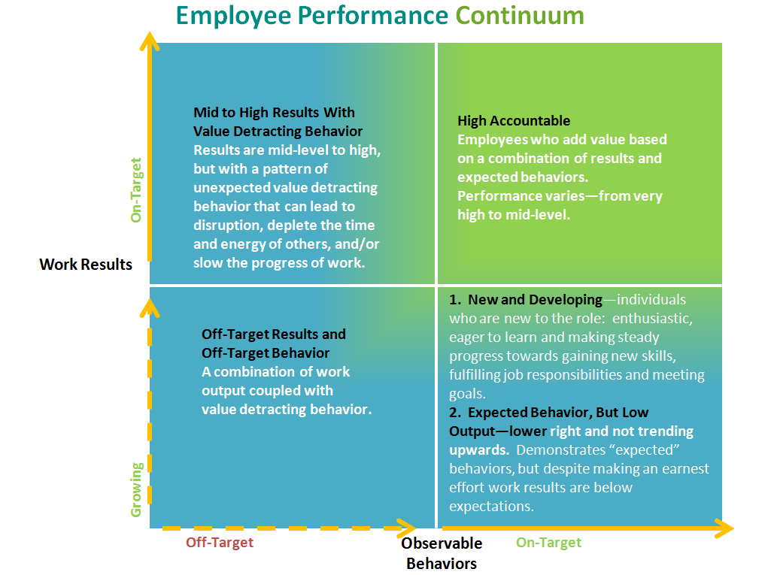
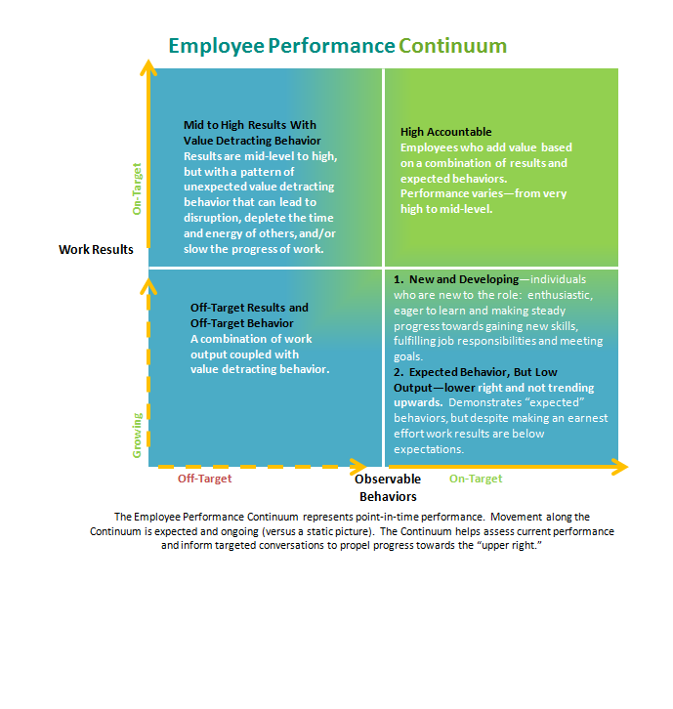
Review the Performance Types
Instructions
Review the descriptions for each quadrant
2-Minutes
Page 10
Notes:
Facilitated Activity
Participants think about as many people as they possibly can , people they’ve worked with (now and in the past) and plot them, using a dot, on the Continuum. This will take approximately 5 minutes.
Have participants pair up and discuss their Continuums to explain their thinking behind where they plotted people.

Slide 8
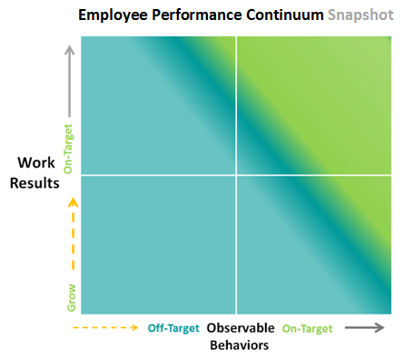
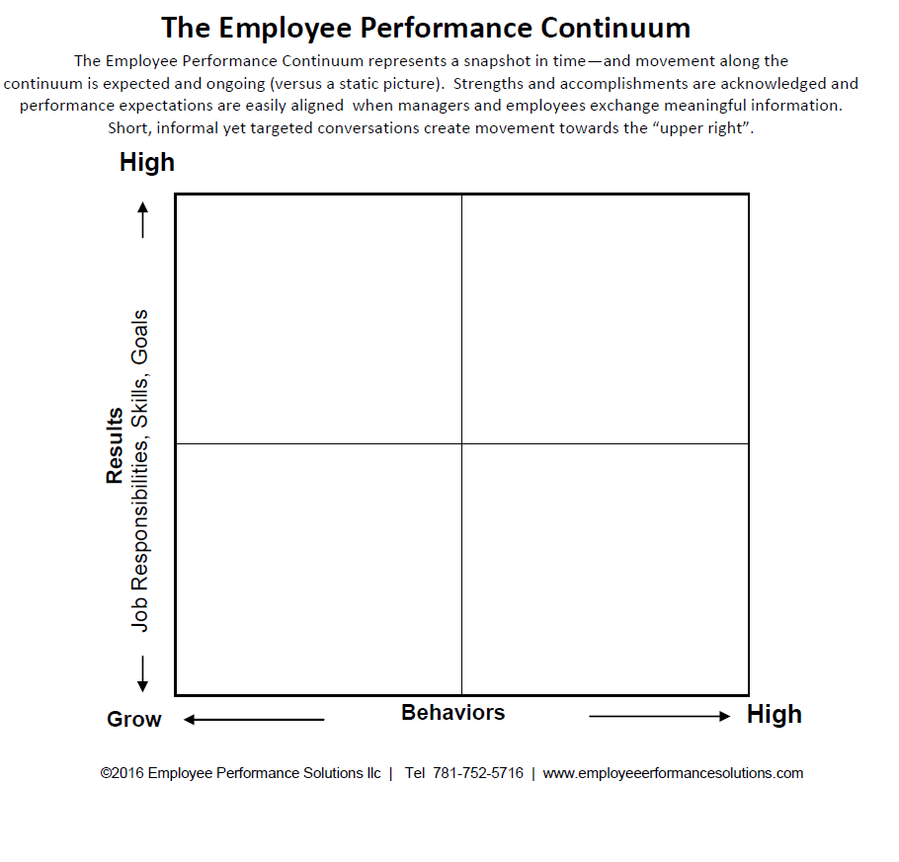

Where I see others:
Applying your experience to the Continuum
Instructions
Plot as many people as you can think of: past and present
5-Minutes
©2017 Employee Performance Solutions, LLC All Rights Reserved | Licensing for Use Within Pact
Card
Notes:
Facilitated Activity
Participants think about as many people as they possibly can , people they’ve worked with (now and in the past) and plot them, using a dot, on the Continuum. This will take approximately 5 minutes.
Have participants pair up and discuss their Continuums to explain their thinking behind where they plotted people.

Slide 9
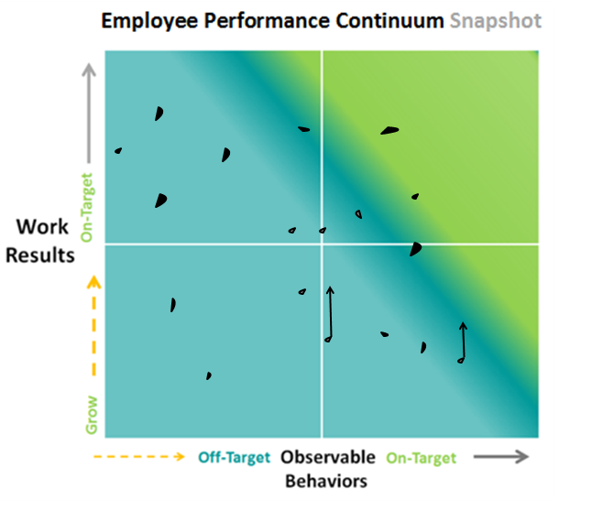
Connect with another workshop participant and explain your thinking…
Instructions
Pair up with another participant and take turns explaining your thinking behind your plotting (choose 2 -3 plots per person to explain)
10-Minutes
©2017 Employee Performance Solutions, LLC All Rights Reserved | Licensing for Use Within Pact
Card
Notes:
Facilitated Activity
Participants think about as many people as they possibly can , people they’ve worked with (now and in the past) and plot them, using a dot, on the Continuum. This will take approximately 5 minutes.
Have participants pair up and discuss their Continuums to explain their thinking behind where they plotted people.

Slide 10
Employee Performance Continuum
On-Target
Coach for Growth
Coach for Behavior
Work Results
Job Responsibilities
Goals
Skills
Grow
Coach Up or Out
Coach for Skills
Off-Target
On-Target
Observable Behaviors

Slide 11


Program Purpose
 | All of the concepts and tools in this program are designed to drive employee performance towards the “upper-right” corner of the Employee Performance Continuum
©2017 Employee Performance Solutions, LLC All Rights Reserved | Licensing for Use Within Pact

Slide 12
2
Perceptions/Opinions
Identify performance strengths and potential gaps

Slide 13
positive
Uncensored
Perceptions

Slide 14
Makes order out of chaos
Is the master of her domain
The backbone of the department
Every time I work with him I learn something new
Everyone wants to be on her team no matter the assignment
Leads the team through tough times
Takes on the difficult projects
Does things to make the process better
Finds solutions when none are evident
Gets the work done despite obstacles
No task is too big or too small

Slide 15
Not so
positive
Uncensored
Perceptions

Slide 16
Complains about things that can’t be changed
Over explains things and confuses people
Never takes things to the next level
Can’t say yes and can’t say no
Puts the “I” in team
Isn’t delegating, takes on too much and misses deadlines
Complains and acts exasperated when assigned new work
Doesn’t give credit for the work of others
Sends aggressive emails and copies everyone
Reinvents everything; won’t build off of the work of others
Doesn’t share his expertise with the team

Slide 17
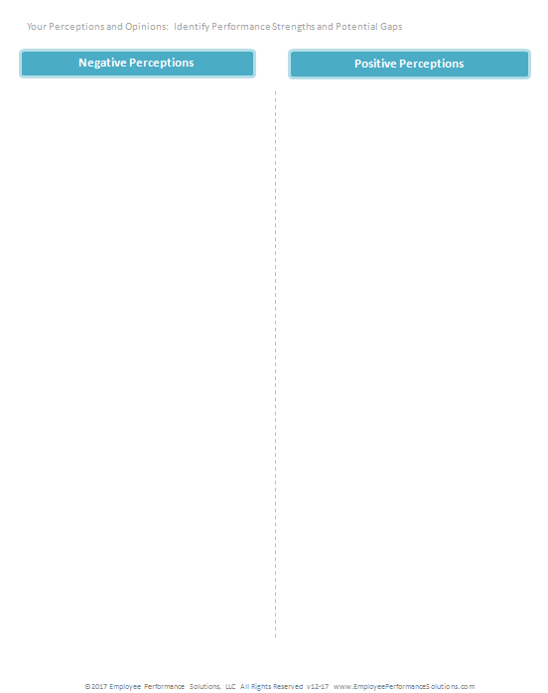
Your Perceptions and Opinions
Think about as many people as you can, people you work with now and in the past, and record your thoughts and opinions
5-Minutes
pg12
Notes:
Facilitated Activity
Participants write their uncensored perceptions, negative and positive.
5 minutes

Slide 18

Share Examples
10-Minutes
Notes:
Facilitated Activity
Debrief: Have participants share their examples at the table. Optional: participants share the positive insight example with the individual it was written for (if that person is in the room).
Connect this with the 10-Minute Questions
See “notes view” for facilitator activity

Slide 19
3
Positive Feedback
Create meaningful feedback to recognize strengths and contributions

Slide 20
4
Performance Continuum Insight Method
Analyze and improve performance

Slide 21

At-Risk Performance
On-Target
Work Results
Job Responsibilities
Goals
Skills
Grow
Growing
Off-Target
On-Target
Observable Behaviors

Slide 22
Intervention Timing
No
Change
Level 4: Disciplinary Intervention
Pattern Persists
Level 3: Formal Intervention
Level 2: Awareness Intervention
Apparent Pattern
Level 1: Informal Intervention
Single Incident
Positive Reinforcing Feedback
Source: Vanderbilt University Medical Center

Slide 23
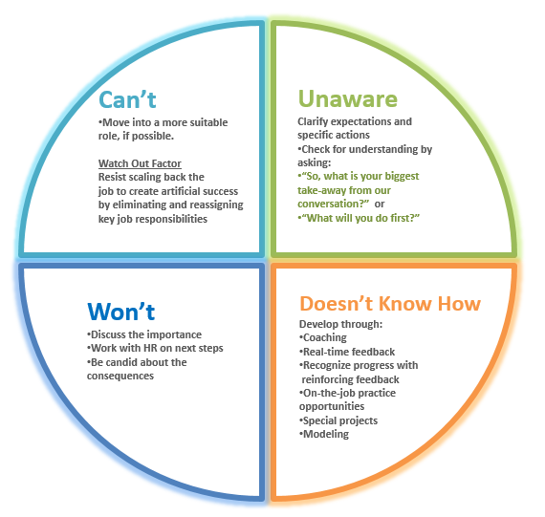
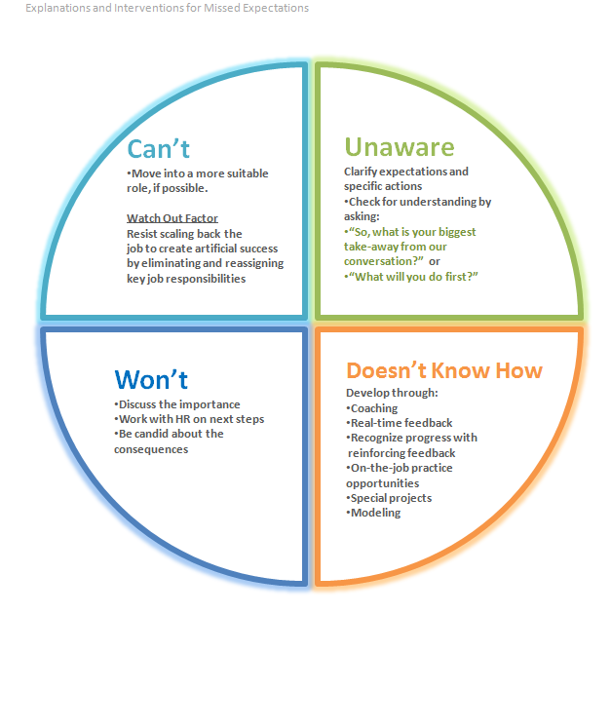
Explanations for Missed Expectations
pg 17

Slide 24
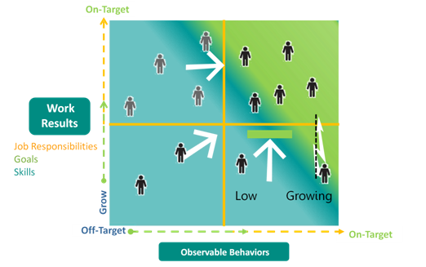
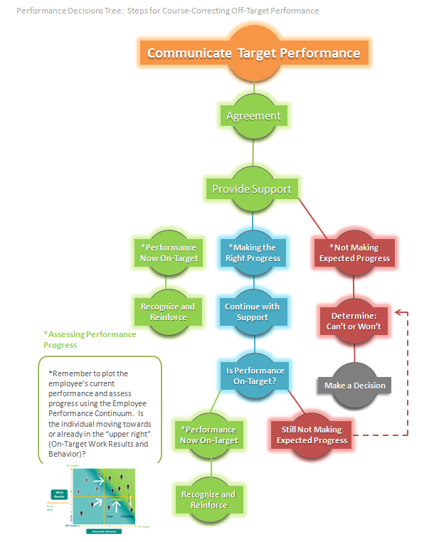
Performance Decisions Tree
Communicate Target Performance
Agreement
Provide Support
*Performance
Now On-Target
Making the
Right Progress
*Not Making
Expected Progress
Can’t or Won’t
Recognize and
Reinforce
Continue with
Support
Make a Decision
Is Performance
On-Target?
pg 18
Yes
Not Making
Expected Progress
Make a Decision
Recognize and
Reinforce

Slide 25
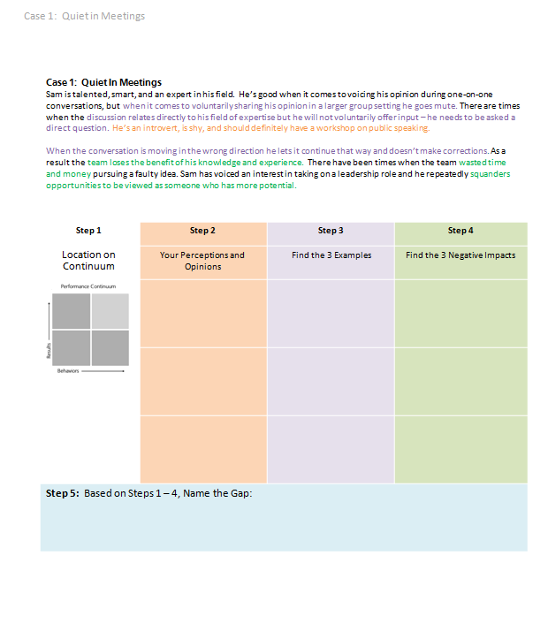
Analyze Performance
Quiet in Meetings
Instructions
Read Case
Answer Questions
1 – 5
5-Minutes
pg 19
Notes:
Facilitated Activity
Participants pick an individual (employee) to apply steps 1 – 4.

Slide 26
Analyze Performance
Case 1: Quiet In Meetings
Sam is talented, smart, and an expert in his field. He’s good when it comes to voicing his opinion during one-on-one conversations, but when it comes to voluntarily sharing his opinion in a larger group setting he goes mute. There are times when the discussion relates directly to his field of expertise but he will not voluntarily offer input – he needs to be asked a direct question. He’s an introvert, is shy, and should definitely have a workshop on public speaking.
When the conversation is moving in the wrong direction he lets it continue that way and doesn’t make corrections. As a result the team loses the benefit of his knowledge and experience. There have been times when the team wasted time and money pursuing a faulty idea. Sam has voiced an interest in taking on a leadership role and he repeatedly squanders opportunities to be viewed as someone who has more potential.
©2017 Employee Performance Solutions, LLC All Rights Reserved | Licensing for Use Within Pact
Notes:
Facilitated Activity
Participants pick an individual (employee) to apply steps 1 – 4.

Slide 27
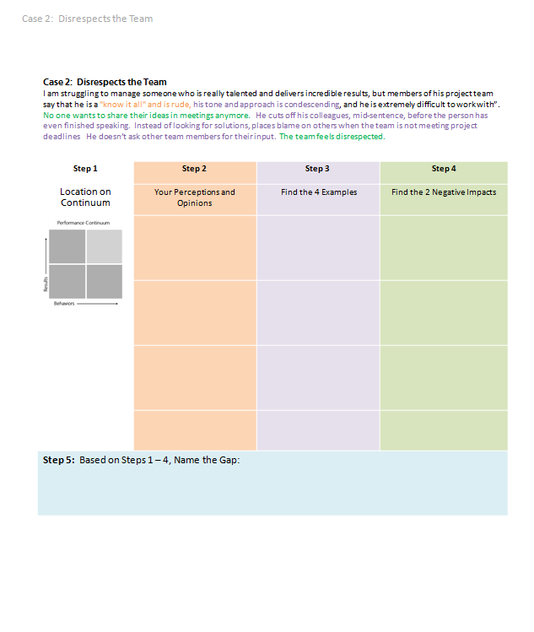
Analyze Performance
Disrespects the Team Case
Instructions
Read Case
Answer Questions
1 – 5
5-Minutes
pg 20
Notes:
Facilitated Activity
Participants pick an individual (employee) to apply steps 1 – 4.

Slide 28
Analyze Performance
Case 2: Disrespects the Team
I am struggling to manage someone who is really talented and delivers incredible results, but members of his project team say that he is a "know it all" and is rude, his tone and approach is condescending, and he is extremely difficult to work with”.
No one wants to share their ideas in meetings anymore. He cuts off his colleagues, mid-sentence, before the person has even finished speaking. Instead of looking for solutions, places blame on others when the team is not meeting project deadlines He doesn’t ask other team members for their input. The team feels disrespected.

Slide 29
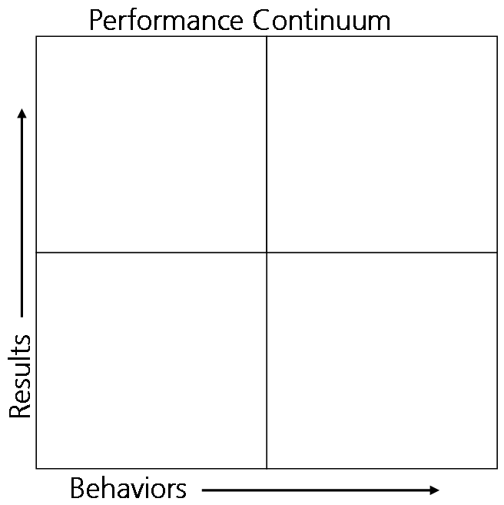

7. Reframe the supporting examples to describe the specific actions that will demonstrate the
on-target performance:
1. Indicate Current and Planned Position
3. Supporting examples:
2. Your uncensored perceptions/opinions:
Steps 1-5
Analyze Performance
Steps 6-8
Talking Points
6. Reframe the gap to the “turnaround”
(describe the on-target performance):
8. Reframe the negative impact to
what the positive impact will be:
5. Name the gap:
4. Negative impact(s):

Slide 30
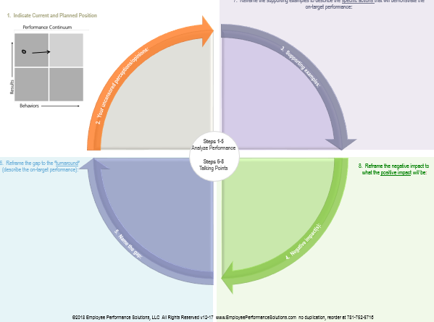
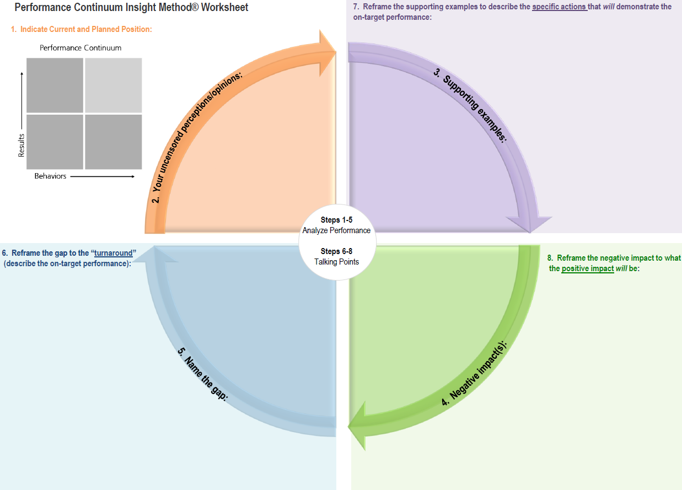
Analyze Performance
Steps 1 – 5
Instructions
Find a partner
Share your scenario while your partner records the information on the worksheet
Complete only steps 1 - 4
start here
2
3
*The issue, not the turnaround
12-Minutes
Total Time for both examples
4
5
Name the
* issue here
stop here
Worksheet
Worksheet Pad
Notes:
Facilitated Activity
Participants pick an individual (employee) to apply steps 1 – 4.

Slide 31

Performance Continuum Insight Method® Worksheet
7. Reframe the supporting examples to describe the specific actions that will demonstrate the
on-target performance:
1. Indicate Current and Planned Position
Can I get into the specifics?
1. Volunteer to contribute whenever the topic relates to your area of expertise.
There are times when the team is taking the conversation in the wrong direction . This is the time for you to jump in and expand the team’s thinking.
7
3. Supporting examples:
2. Your uncensored perceptions/opinions:
-Doesn’t share his expertise with the group
-He’s probably shy , an introvert, has low confidence
-Needs a workshop on public speaking
-Not a team player, but he’s good 1-to-1
1. Won’t speak up when the topic relates to his area of expertise.
2. Needs to be asked a direct question before contributing.
3. When conversation is moving in the wrong direction he lets it continue that way.
Steps 1-5
Analyze Performance
Steps 6-8
Talking Points
6. Reframe the gap to the “turnaround”
(describe the on-target performance):
Isn’t proactively sharing his ideas and expertise at team meetings.
8
6
8. Reframe the negative impact to
what the positive impact will be:
1. Team loses the benefit of his knowledge and experience.
2. Team wasted time and money pursuing faulty ideas.
3. He’s squandering opportunities to be seen as a leader
1&2. The team will have the benefit of your knowledge and experience and will pursue just the best ideas.
3. We’ve talked about your interest in taking on more of a leadership role; this is one way to demonstrate this capability.
You’re really effective sharing your expertise one-on-one. What’s just as important is proactively sharing your ideas and expertise at team meetings.
5. Name the gap:
4. Negative impact(s):
Quiet in Meetings
pg 21
©2018 Employee Performance Solutions, LLC All Rights Reserved v12-17 www.EmployeePerformanceSolutions.com no duplication, reorder at 781-752-5716

Slide 32
Performance Continuum Insight Method® Worksheet
7. Reframe the supporting examples to describe the specific actions that will demonstrate the
on-target performance:
1. Indicate Current and Planned Position
Can I get into the specifics?
1. When anyone on the team is explaining an idea let him/her finish and give others a chance to weigh in.
2. When we’re missing deadlines put your energy into looking for solution (forgo placing blame).
3. When you have an idea ask others for their input.
4. Last, be aware of your tone so that it comes across as helpful and respectful.
7
3. Supporting examples:
2. Your uncensored perceptions/opinions:
"know it all" and is rude, condescending and extremely difficult to work with”.
1-to-1
1. Shoots down team member ideas before the person has even finished their explanation.
2. Instead of looking for solutions, places blame on others when the team is not meeting project deadlines
He doesn’t ask other team members for their input
Condescending tone
Steps 1-5
Analyze Performance
Steps 6-8
Talking Points
6. Reframe the gap to the “turnaround”
(describe the on-target performance):
8
6
8. Reframe the negative impact to
what the positive impact will be:
Is non supportive of the value of his colleagues; (his team).
People feel disrespected and have stopped contributing at meetings. Losing the value of the team!
This will go a long way in helping people feel respected, keep them contributing at meetings and tap into the value of having a team in the first place.
Work in a way that respects and values the team
5. Name the gap:
4. Negative impact(s):
Disrespects the Team
©2018 Employee Performance Solutions, LLC All Rights Reserved v12-17 www.EmployeePerformanceSolutions.com no duplication, reorder at 781-752-5716

Slide 33
5
Reframe/Turnaround
Translate off-target performance into language describing on-target performance

Slide 34
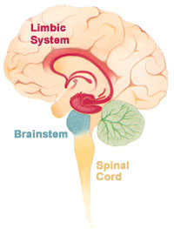
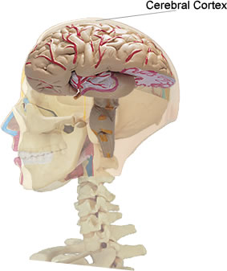
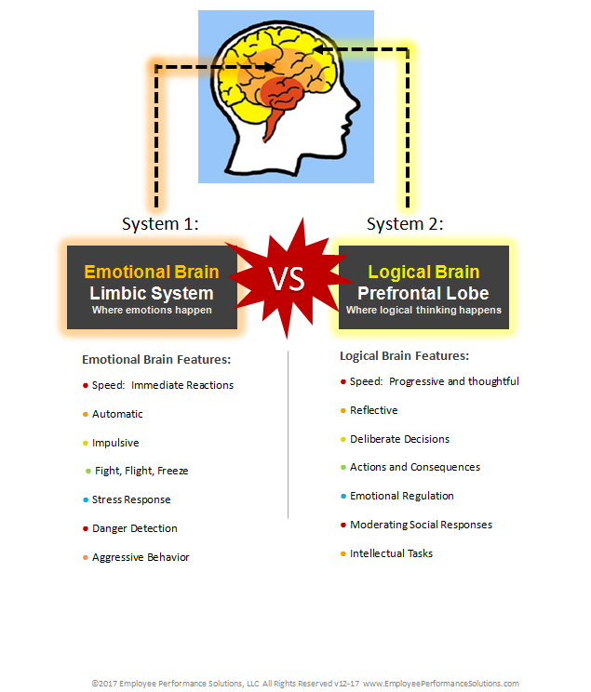
Reactions to “Feedback”
Under Attack
  Thinking brain
  shuts down
  Emotions crank up
  Self-esteem threat
  Judgment = recoil response
OVERDRIVE
pg23
pg 23
Notes:
Show Brain Fight or Flight Overhead
Say, “When our brain is in overdrive, it’s like telling someone when you get embarrassed—don’t let your face turn red. It’s a physiological reaction to threatening information that causes negative responses to feedback. Today we are going to look at how to provide information in a way that doesn’t push the emotional buttons of the person on the receiving end.”
We want to provide feedback in a way where we engage the cortex/the thinking part of the brain.

Slide 35
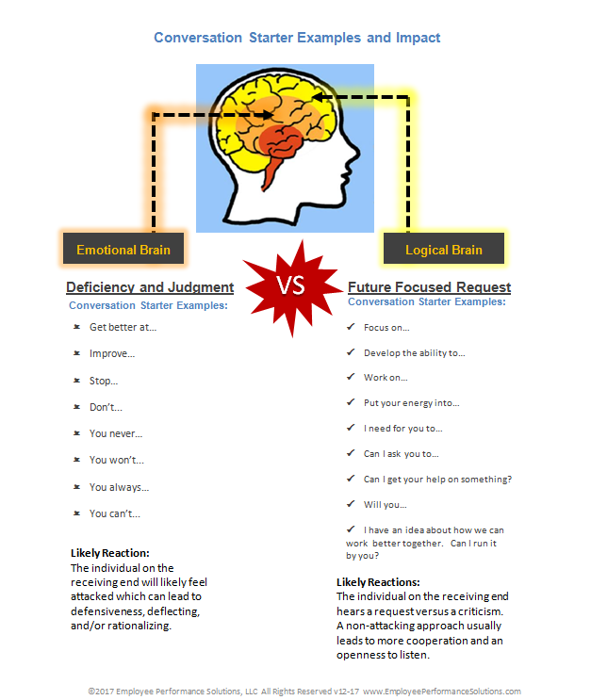

Conversation Starters
Improve…
Get better…
Stop doing…
Weakness…
You never…
Don’t…
You shouldn’t…
YOU’RE
DEFICIENT
pg23
pg 24
Notes:
Pull up text on the left side of the slide. Ask, “When I’m using these words what am I implying about the person?” Last pull up the You’re Deficient wording and picture.
Say, “How we start the conversation can mean the difference between an automatic defensive reaction (the emotional buttons are being pushed) and having the person on the receiving end feel like we’re giving helpful/coaching type information.”
Say, “Some words imply that there is something wrong with the individual. Other conversation starts convey future possibilities.”
Reference the words on the right side: This future focused wording helps the brain think forward and describe what you want people to do.

Slide 36
Conversation Starters
Improve…
Get better…
Stop doing…
Weakness…
You never…
Don’t…
You shouldn’t…
Weakness…
Develop the ability to…
Work on…
Focus on…
Put your energy into…
I need for you to…
FUTURE FOCUSED…
Possibilities
YOU’RE
DEFICIENT
pg23
pg 24
Notes:
Pull up text on the left side of the slide. Ask, “When I’m using these words what am I implying about the person?” Last pull up the You’re Deficient wording and picture.
Say, “How we start the conversation can mean the difference between an automatic defensive reaction (the emotional buttons are being pushed) and having the person on the receiving end feel like we’re giving helpful/coaching type information.”
Say, “Some words imply that there is something wrong with the individual. Other conversation starts convey future possibilities.”
Reference the words on the right side: This future focused wording helps the brain think forward and describe what you want people to do.

Slide 37
develop more accuracy
  Makes mistakes
  Stop making so many mistakes
Notes:
Walk through each slide and let participants work to turn a frustration into a request. In this example mention that we feel like saying “stop” but this still doesn’t describe what we want.
Note: Become familiar with the animation on these and other slides.

Slide 38
on time
late

Slide 39
Make
conclusions
based on facts
Makes assumptions
makes assumptions

Slide 40
  Helpfully and patiently mentor those with less experience
Condescending to those with less experience
>

Slide 41
  Make more realistic commitments for what really can be delivered
overpromises

Slide 42
proactive
reactive

Slide 43
  Take the initiative to go beyond what you already know
no desire to learn on own…

Slide 44
Complete experiments in about half the amount of time
experiments take twice the amount of time they should

Slide 45
Keeps interrupting me
  Let me finish what I have to say

Slide 46
Passes off incomplete work
  Hand off the work to me once it’s been…

Slide 47
Turn Arounds
Does not engage in the difficult client conversations
Doesn’t take responsibility for…
Takes no ownership for…
Can’t let others finish their thoughts…
g…
Notes:
The last point is that taking away the “don’t’, “can’t” etc. won’t always work! But sometimes just taking away the negative starter word describes the target performance.

Slide 48
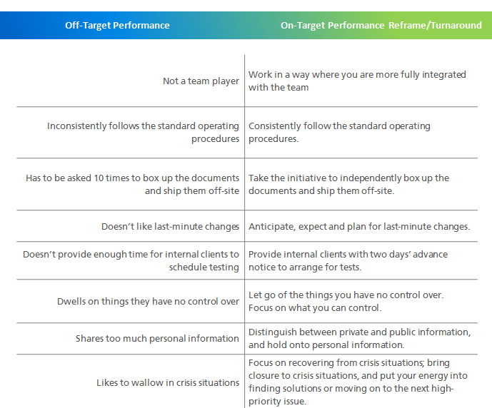
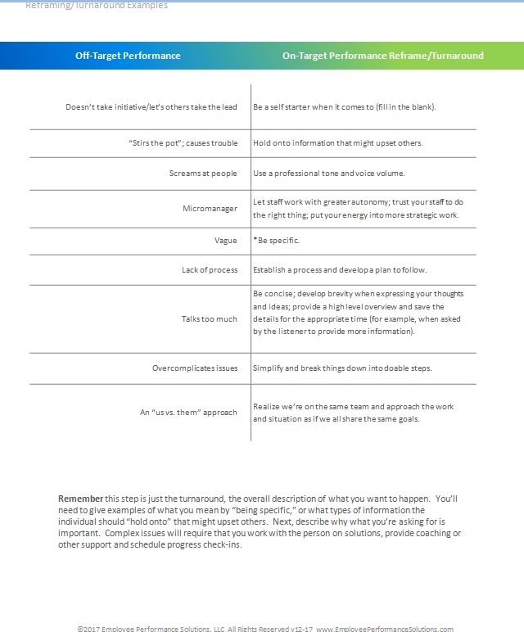
Instructions
Scan the Turnaround Examples in Your Workbook
pg23
pgs 25-34
Notes:
Follow instructions on this slide

Slide 49
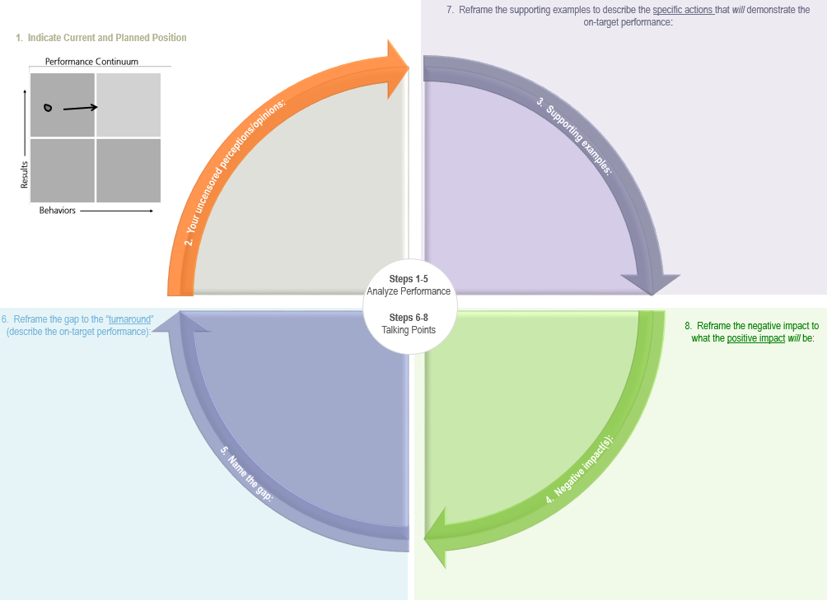
Craft the Message
Steps 6-8
Instructions
Working with your partner, reframe the
Off-Target Performance into the On-Target Performance Message
Complete only steps 1 - 4
7
10-Minutes
Total Time for both examples
6
8
Worksheet
Worksheet Pad
Notes:
Facilitated Activity
Participants pick an individual (employee) to apply steps 1 – 4.

Slide 50
6
10-Minute Conversation Framework

Slide 51
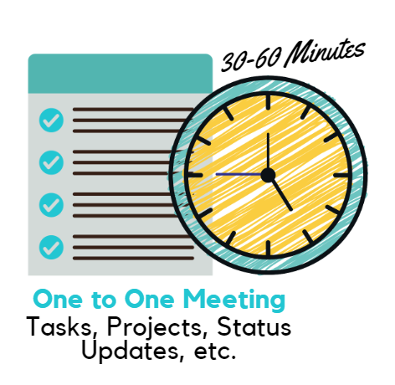
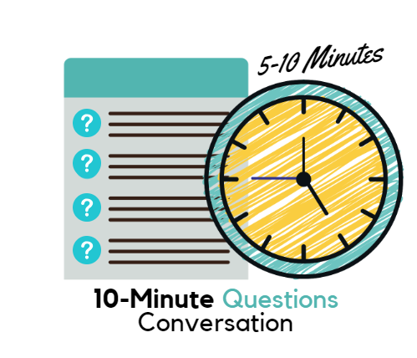
Conversation Types

Slide 52
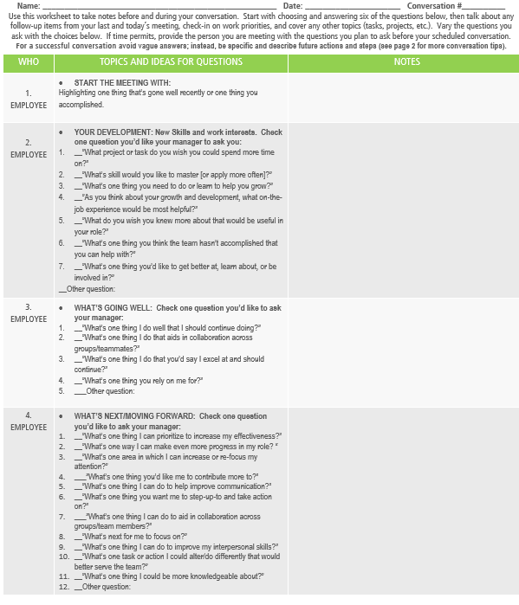

Slide 53
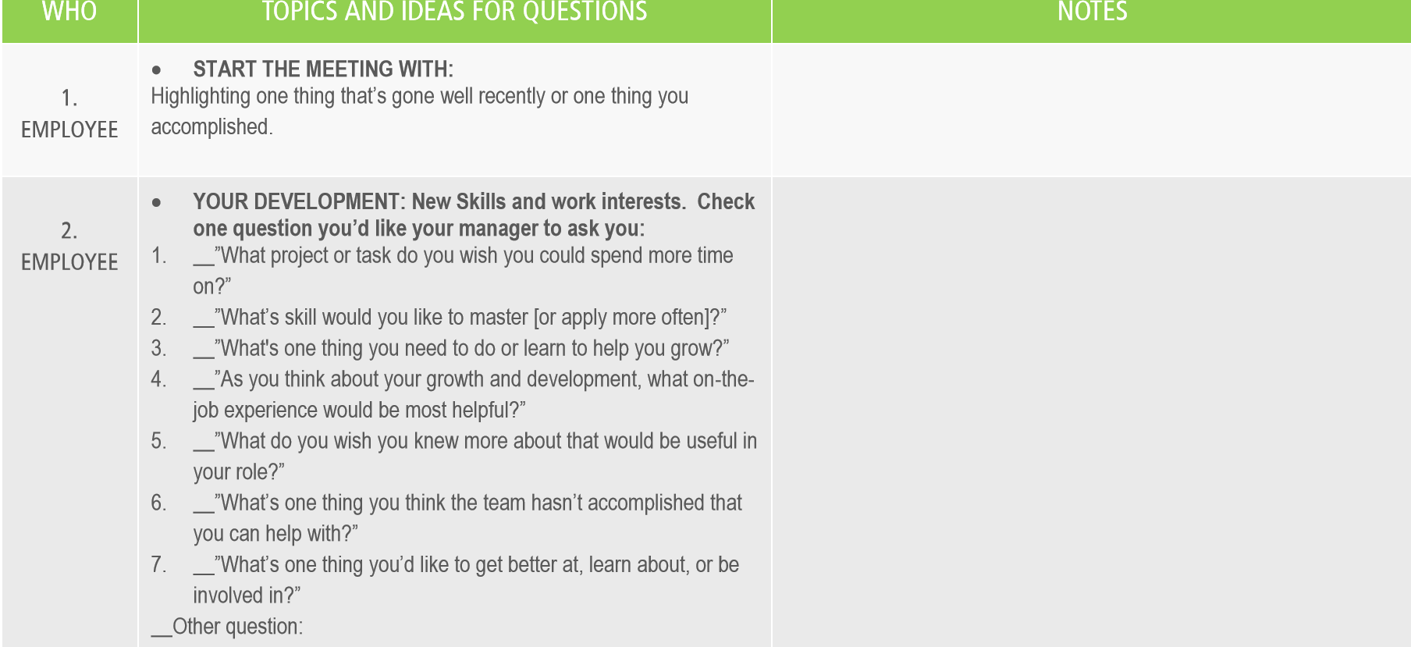

Slide 54
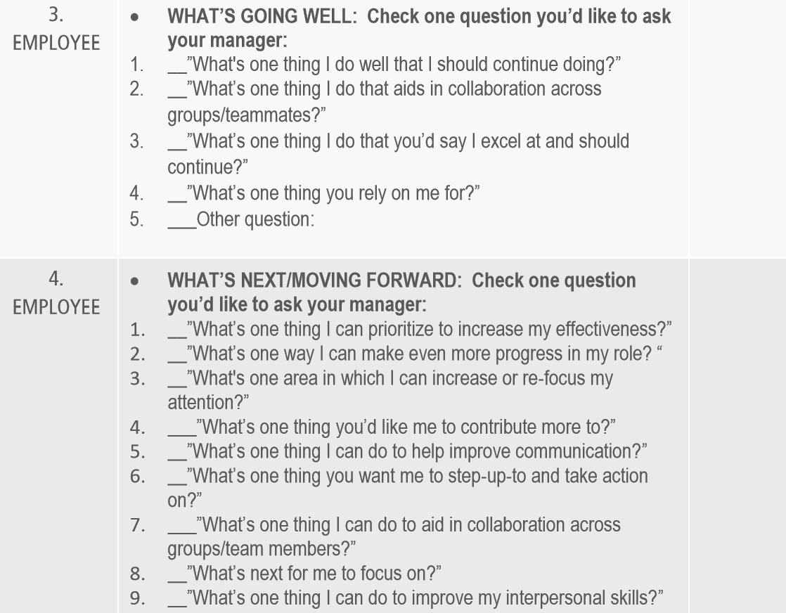

Slide 55
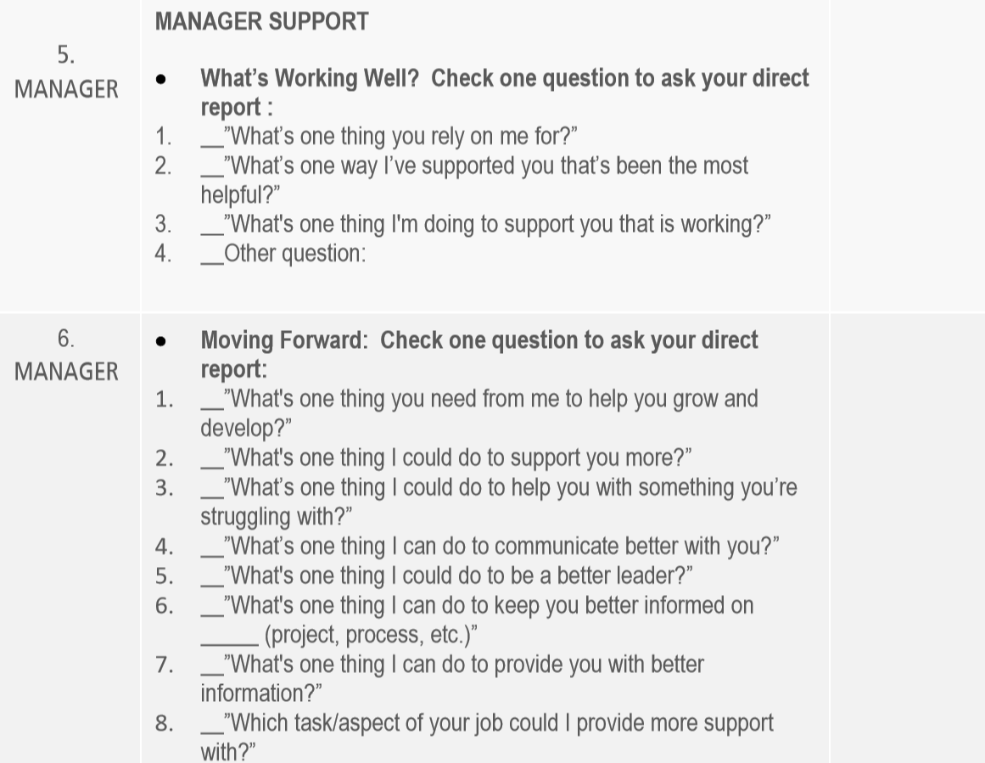

Slide 56
7
Conversation Practice
Practice a performance conversation with your partner

Slide 57
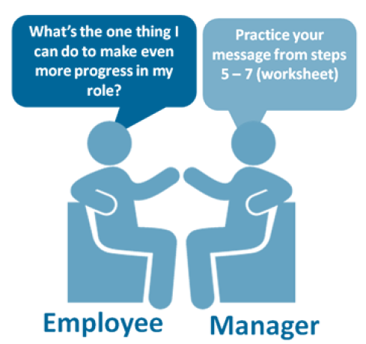
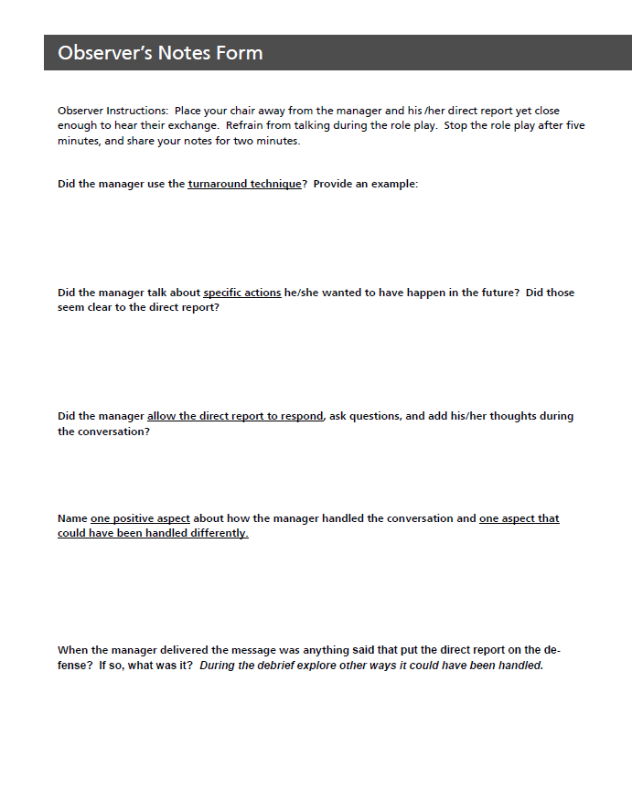

Conversation Practice
Steps 6-8
Manager Practices the Delivery
Employee Gives Feedback
*Using Observer’s Notes Form
Switch Roles
5-minutes
2-minutes

Slide 58
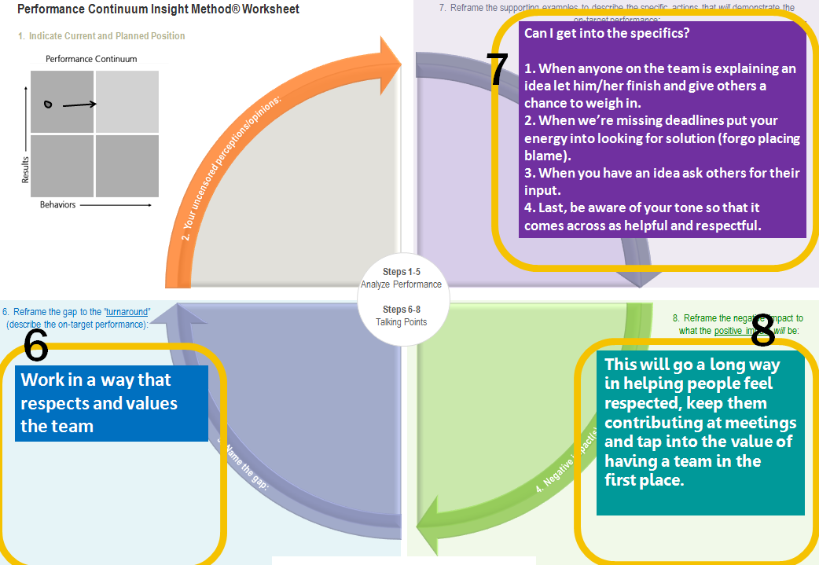
Setting
10-Minute Questions Conversation
Roles
◆ Purpose
Practice Your Message: Steps 6-8
Employee Asks: “What’s the one thing I can do to make even more progress in my role?”
Manager Practices:
Steps 6, 7, and 8
Worksheet
Worksheet Pad

Slide 59
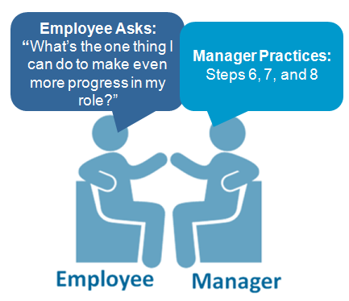
Your Goals When Practicing Your Conversation:
1. Reframe: describe the performance you want to see (versus past problems)
2. Describe the specific actions (avoid being vague)
3. Allow the employee the opportunity to respond, ask questions, and add his/her thoughts during the conversation.
Be aware of talking too much

Slide 60
Did the Manager...
1. Use the turnaround technique?
2. Describe the specific actions he/she wants to have happen in the future?
3. Allow the employee the opportunity to respond, ask questions, and add his/her thoughts during the conversation?
4.) Name one positive aspect about how the manager handled the conversation and one aspect that could have been handled differently.
5.) When the manager delivered the message was anything said that put the direct report on the defense? If so, what was it? What’s another way it could have been stated?
Observer’s Role and the Notes Form
pg41

Slide 61
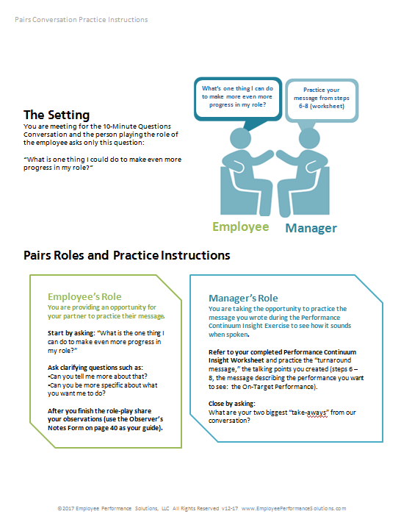
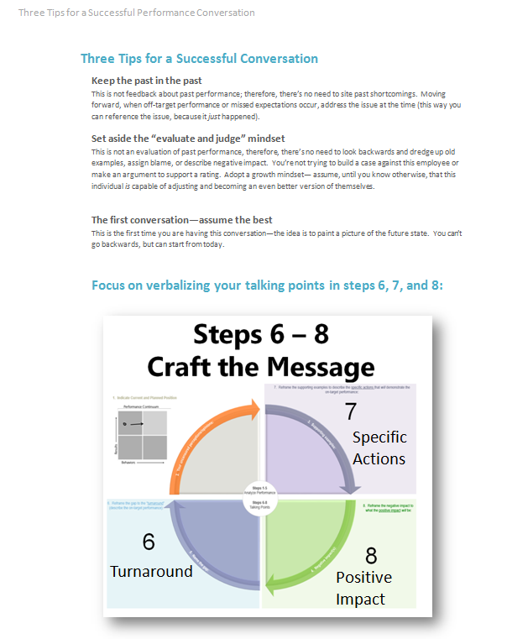
Before you begin, read the practice instructions
pgs 40-41

Slide 62
Skills and Tools Recap
Notes:
Answer the question of how often the 10 minute conversation should occur

Slide 63
Recap
PERFORMANCE CONTINUUM | Use the Performance Continuum to gain a snapshot of the employee’s current performance in terms of Results and Behaviors. The intent is to use this tool to help people grow and move forward.
PERFORMANCE CONTINUUM INSIGHT METHOD: ANALYZE PERFORMANCE | Analyze current performance to determine what the employee can do to make even more progress. The focus is on moving forward versus reviewing past performance.
TURNAROUND AND REFRAME GAPS | Translate performance gaps, large and small, into language describing the “on-target” performance.
10-MINUTE QUESTIONS CONVERSATION | These tools and approaches help inform the 10-Minute Questions Framework when the employee asks: 1. What’s one thing I’m doing well and should continue with? 2. What’s one thing I can make even more progress in my role?

Slide 64
Please Thoughts About the Program
What’s one thing you learned and will use?
What’s one thing you have a question or comment about?
Record your answers on sticky notes

