Slide 1
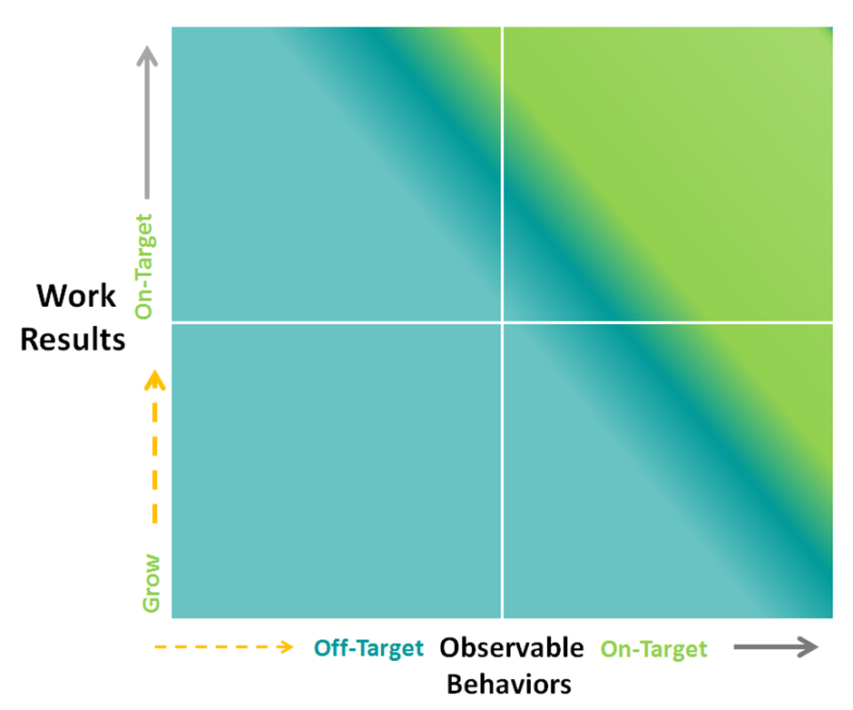
Team Plotting:
Manager: Department: Date:
Current Location | Employee
Upper right | Example Employee
Employee Performance Continuum Snapshot
EE
Use the yellow “dot” for employees who are new to role and making expected progress

Slide 2
Team Plotting:
Manager: Department: Date:
Current Location | Employee
Employee Performance Continuum Snapshot
Use the yellow “dot” for employees who are new to role and making expected progress

Slide 3
Team Plotting:
Manager: Department: Date: February 2018
Current Location | Employee
Employee Performance Continuum Snapshot
Use the yellow “dot” for employees who are new to role and making expected progress

Slide 4
Team Plotting: Web,
Manager: Department: Date:
Current Location | Employee
Employee Performance Continuum Snapshot
Use the yellow “dot” for employees who are new to role and making expected progress

Slide 5
Team Plotting:
Manager: Department: Date:
Current Location | Employee
Employee Performance Continuum Snapshot
Use the yellow “dot” for employees who are new to role and making expected progress

