Slide 1
One thing you learned or were reminded of?
Questions or comments?
Team Plotting

Slide 2
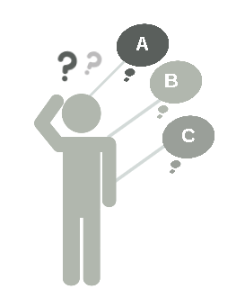
#1
Define
Defining Performance
Notes:
Let’s start by clarifying what we mean when we talk about employee performance

Slide 3
Employee Performance Continuum
On-Target
On-Target Work Results and Behaviors
Work Results
Job Responsibilities
Goals
Skills
Grow
Off-Target Results
Growing
Off-Target
On-Target
Observable Behaviors
©2017 Employee Performance Solutions, LLC All Rights Reserved
Notes:
This is an animated slide that describes performance as a continuum of Work Results and Observed Behaviors:
The Employee Performance Continuum (EPC) is a visual model that describes and measures:
Work Results:
Above the mid-level line Work Results are On-Target
Below the mid-level line Work Results are Off-Target or an individual is new to the role and developing/growing
Observed Behaviors are an individuals actions, interactions with others, interpersonal skills, etc.:
Right of center are On-Target Behaviors
Left of center Off-Target Behaviors
See next page for more details description of Work Results and Behaviors

Slide 4
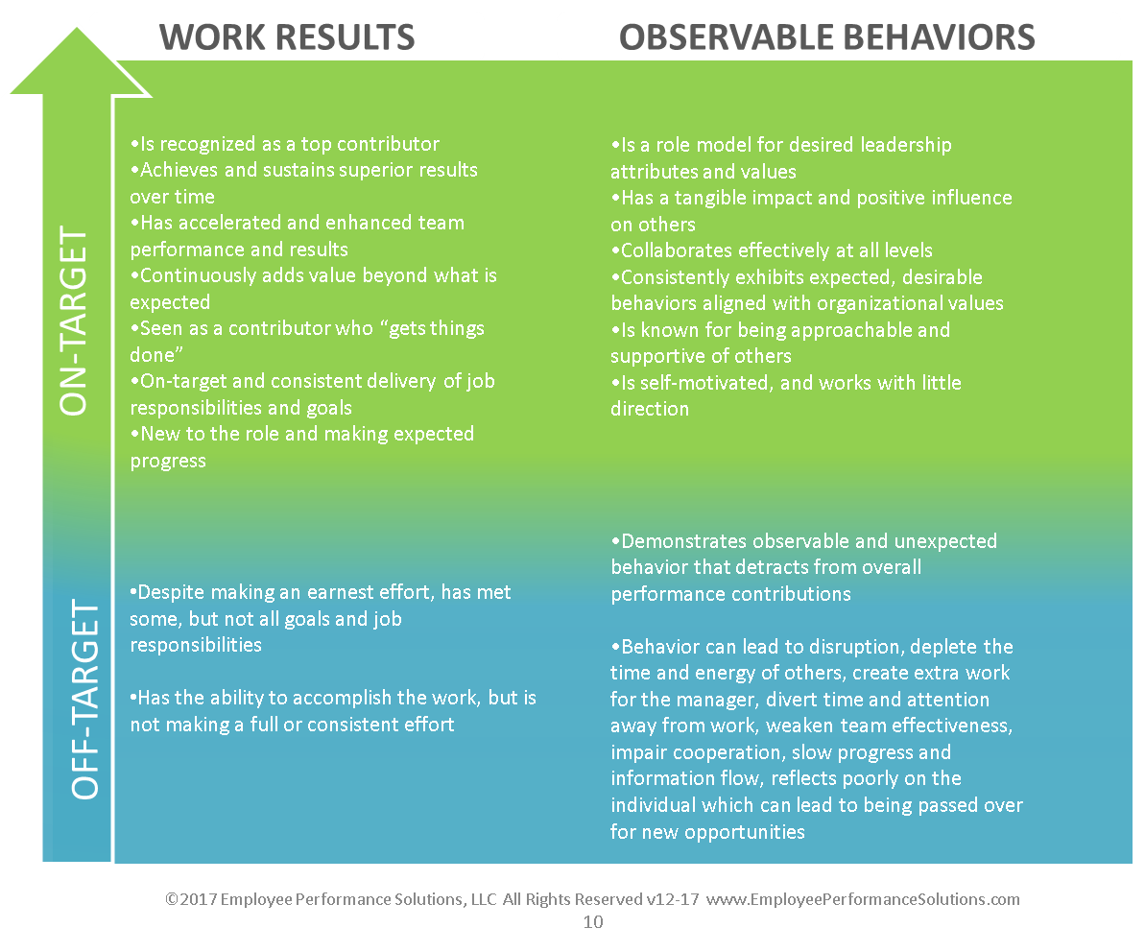
Guidelines for Considering the Two Performance Dimensions
Notes:
Review the guidelines for Work Results and Observable Behaviors
Point to Mention: the important thing is to describe the Work Results and Behaviors with examples, observations and most importantly, the impact on others, the work, operations, efficiency, and more.

Slide 5
At-Risk Performance
On-Target
Work Results
Job Responsibilities
Goals
Skills
Grow
Growing
Off-Target
On-Target
Observable Behaviors
Notes:
Consider the people whose performance is currently outside of the “upper-right”, at-risk
Remind people of the tools from training, the 7-step Performance Continuum Insight Method, to help define the problem and translate off-target performance into language and coaching to help the employee move forward .
Remind managers that you, HR, are there to help support managers with this process.
While an individual’s performance is currently off-target, don’t despair or give up. Think:
What is this person capable of
Can the be a better version of themselves if they get the right feedback, coaching, and support?
How can I help get them back on track?

Slide 6
The Important Thing…
Notes:
Keep in mind that the reason for the Team Plotting work is to…

Slide 7
Employee Performance Continuum
On-Target
Coach for Growth
Coach for Behavior
Work Results
Job Responsibilities
Goals
Skills
Grow
Coach Up or Out
Coach for Skills
Off-Target
On-Target
Observable Behaviors

Slide 8
#2 10-Minute
Question Conversations
Focus on Coaching Forward
Notes:
Here’s our process for ensuring that managers and employees connect regularly to discuss performance.

Slide 9
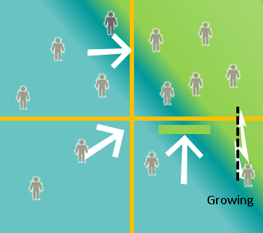
10MQ’s
Ongoing Conversations
Right now, what should I do now to be even more effective in my role?
Notes:
Remember, during the 10-Minute Questions Conversation the employee will ask a question about moving forward such as, “What’s one way I can support the team more, or “What’s one thing I should prioritize”, etc. All managers and employees have a built-in opportunity to ensure that better information is exchanged.
If an employee’s performance is Off-Target in some way, then the answer to this question is the opposite of the problem; it’s a description of the target performance, with specific actions, and a description of what the positive impact will be.

Slide 10
#3 Measure and Track Performance
Using the Employee Performance Continuum
Notes:
Let’s revisit how we measure and track performance with the EPC.

Slide 11
Performance Continuum Plotting Process
Notes:
Let’s begin by reviewing the Plotting Process steps.

Slide 12
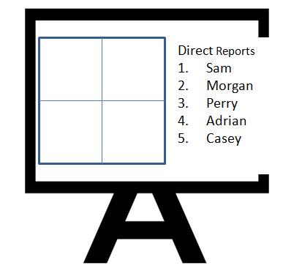
Employee Performance Continuum Team Plotting Steps
Team Lead Plotting Approach Manager Plots Last
Step 1:
Manager lists all direct reports on white board
Step 3:
Non-direct managers plot “Sam” at the white board (1 person per time is plotted)
Step 4
Manager plots “Sam”
2-minute “executive overview” describing the plotting rationale
Non-Direct Managers:
3-5-minutes for questions/discussion
Step 5
Agreement on final plotting coordinate
Now return to Step 3 to plot the next employee
Step 2:
Non-direct managers (team) plot *all employees on their personal Employee Performance Continuum grids
When:
*refrain from plotting employees you are unfamiliar with
© Employee Performance Solutions 2017
Notes:
Walk through each step on this slide.

Slide 13
Two measurements applied independently of on another Emphasis on accurate placement of Work Results and Observable Behaviors
Notes:
Read slide

Slide 14
Staying True to the Performance Continuum De-emphasize “quadrant” plotting focus on Continuum
✓
Notes:
Become familiar with this animated slide.
“The point is that we are plotting on a EPC (not so much in a box-model).
Animation Part #1: “Here’s where this individual’s Work Results fall
Animation Part #2: “Here’s the Observed Behavior.
Final Animation: So, here’s the proper plotting.

Slide 15
#4 Watch-Out-Factor
Fair and Consistent Application
Notes:
Read slide

Slide 16
Watch-out-factor
Over-valuing Work Results in a way that creates inaccurate plotting by:
Discounting, justifying, or overlooking behavior that adversely impacts work relationships, creates delays, impedes efficiency, diverts people’s time and energy away from the work-at-hand, creates more work for the manager, etc.
Here’s how that works….
Notes:
Read slide and add any anecdotal information and ask participants to share (“Have you seen this before?”, “Why does this happen?”, etc.)

Slide 17
Staying True to the Performance Continuum De-emphasize “quadrant” plotting focus on Continuum
✓
✗
Notes:
Become familiar with this animated slide.
The first part is the same as the slide you’ve already shared:
“The point is that we are plotting on a EPC (not so much in a box-model).
Animation Part #1: “Here’s where this individual’s Work Results fall
Animation Part #2: “Here’s the Observed Behavior.
Final Animation: So, here’s the proper plotting.
NOW SHOW THE ‘WHAT NOT TO DO” ANIMATION:
Animation: Behavior is “swept under the carpet/fudged, etc. to off-set the positive Results. This is an improper application of the EPC.

Slide 18
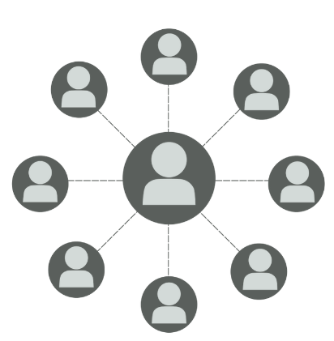
#5 Team Plotting
An Opportunity to
Demonstrate Leadership
Competence
Notes:
What do we expect from people who are participating in the plotting sessions?

Slide 19
Expectations and the Opportunity to Demonstrate Leadership Skills
What We Look For
Taking a balanced/open to new points of view
Sharing relevant information:
Concrete examples of an individual’s work accomplishments and observed behaviors (their actions).
Descriptions of an individual’s impact: Positive and or adverse effect on work relationships, team cohesiveness, work flow, productivity, etc.
Accurate Plotting
Applying what you heard to the proper plotting
Proper application of Off-Target and On-Target Work Results and Observed Behavior principles
Two Measurements Applied Independently of One Another
Watch-out-factor: Over-valuing Results in a way that creates an inflated plotting of the Observed Behavior.
Sweeping behavior under the rug that is causing less effectiveness, impeding collaboration, etc. under the carpet
Expectation: Be Accountable and Hold Each Other Accountable
If you see something, say something. Speak up when the plotting doesn’t align with what you’re hearing.
Don’t let compensation decisions sway honest and accurate plotting. Performance is just one factor in making pay decisions (Massachusetts Fair Equity Pay Act, Market Pay, Budget, and more).
Notes:
Review this information

Slide 20
#6 Purpose
Accelerating Employee
Potential
Aligning Performance to
Drive Our Business
Notes:
Let’s not lose sight of the purpose of this work and tool:
Accelerating employee potential and aligning performance to drive our business.

