Slide 1

Program Facilitator:
Engaging in Conversations to Optimize Employee
Performance and Potential
Manager’s Program
Cover Slide
©2017 copyright Employee Performance Solutions, LLC All Rights Reserved | For Use Within Client Organization

Slide 2

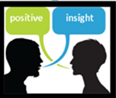


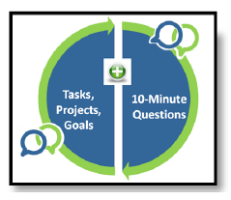

Learning Objectives
 | Use the Performance Continuum to gain a snapshot of the employee’s current performance in terms of Results and Behaviors. The intent is to use this tool to help people grow and move forward.
 | Give better quality feedback with concrete examples and the positive impact.
 | Analyze current performance to determine what the employee can do to make even more progress. The focus is on moving forward versus reviewing past performance.
 | Translate performance gaps, large and small, into language describing the “on-target” performance.
 | Practice the Conversation using the 10-Minute Conversation Framework

Slide 3
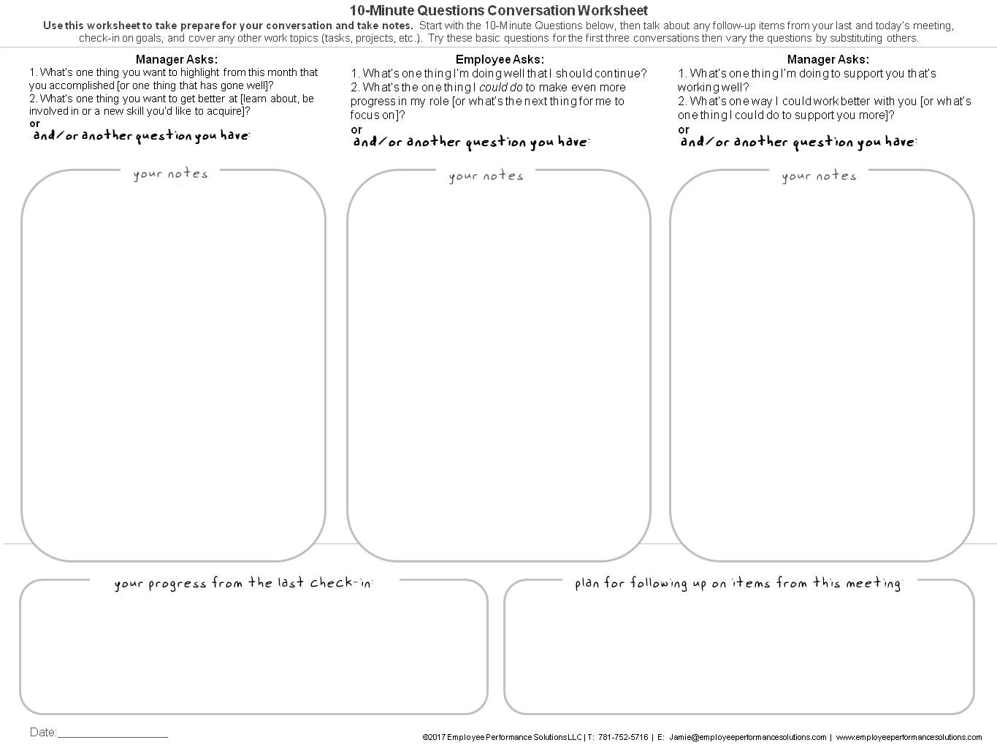
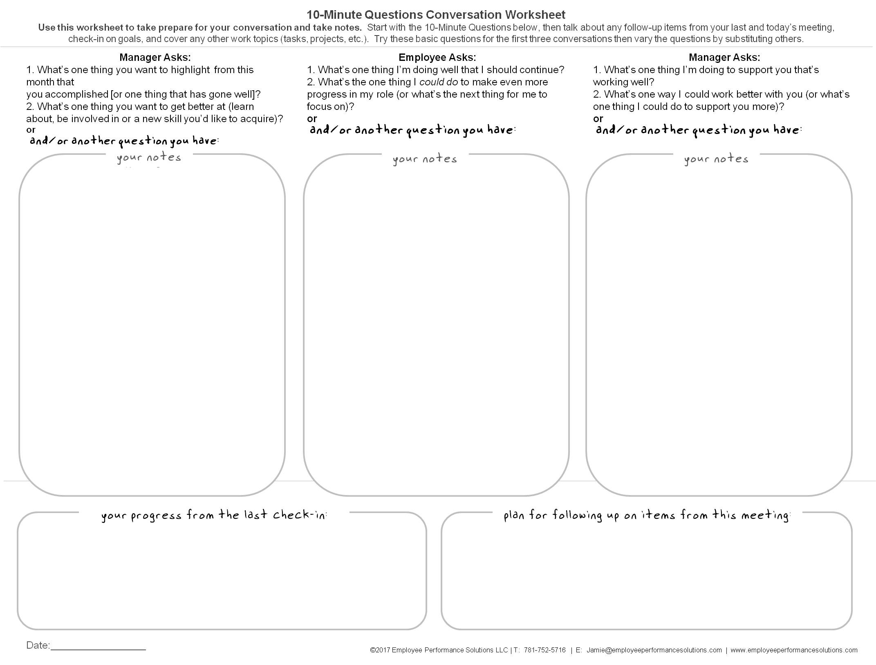
worksheet

Slide 4
Your 10-Minute Questions Conversation Video Demonstration

Slide 5


One Thing…
E a
What’s one thing you want to learn from today’s session?
Notes:
Facilitated Activity
Ask participants to answer the two questions. Via paper or typing into the chat box.
See “notes view” for facilitator activity

Slide 6
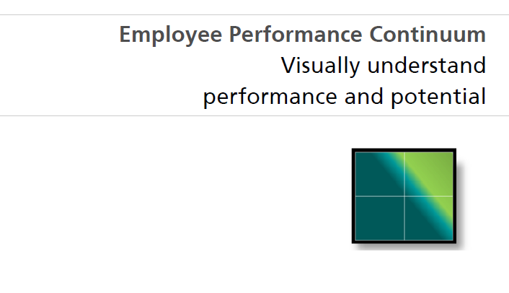
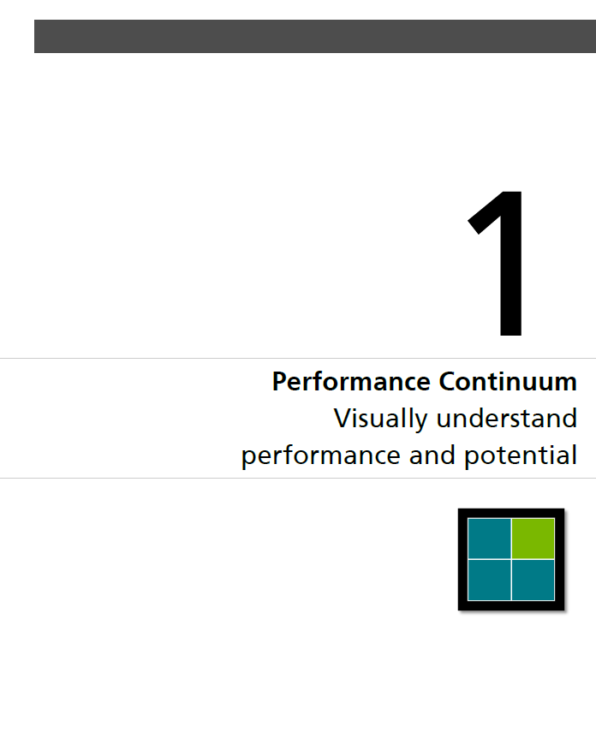
1
1
1
1
2
pg5
copyright2013© Employee Performance Solutions LLC
©2017 copyright Employee Performance Solutions, LLC All Rights Reserved | For Use Within Client Organization

Slide 7


Employee Performance Continuum
On-Target
Work
Results
Job Responsibilities
Goals
Skills
Grow
Low
Growing
pg6
Off-Target
On-Target
Observable Behaviors

Slide 8
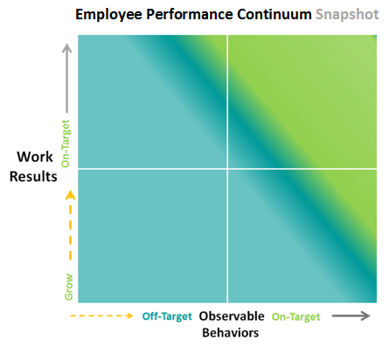

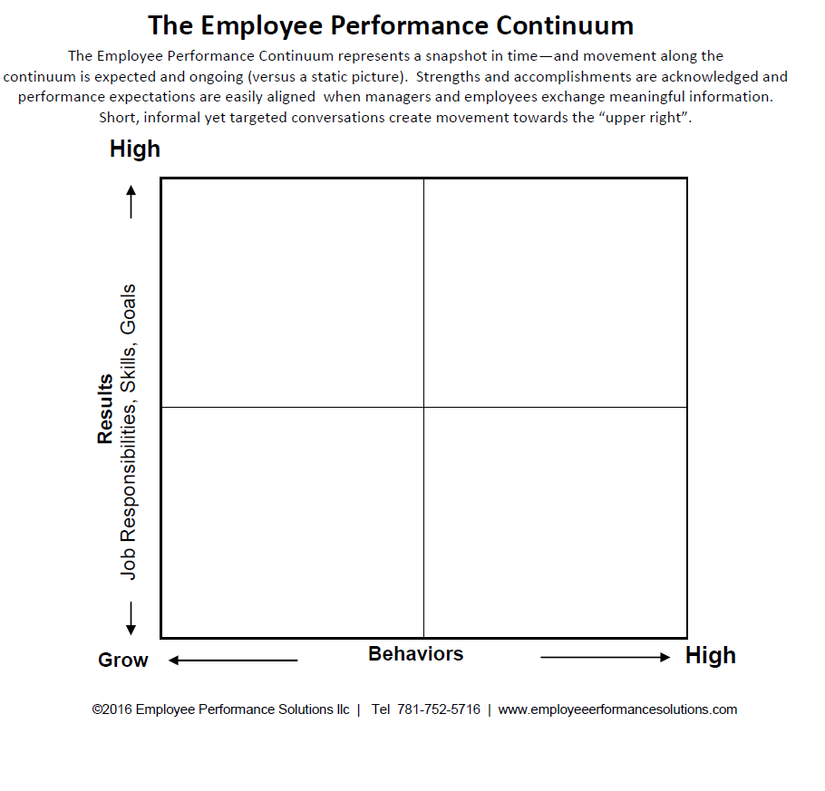

Where I see others:
Applying your experience to the Continuum
Instructions
Plot as many people as you can think of: past and present
5-Minutes
Card
Notes:
Facilitated Activity
Participants think about as many people as they possibly can , people they’ve worked with (now and in the past) and plot them, using a dot, on the Continuum. This will take approximately 5 minutes.
Have participants pair up and discuss their Continuums to explain their thinking behind where they plotted people.

Slide 9
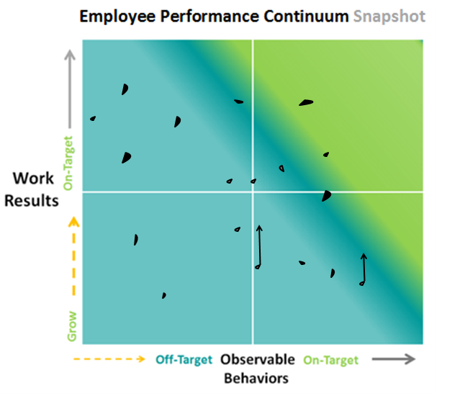
Connect with another workshop participant and explain your thinking…
Instructions
Pair up with another participant and take turns explaining your thinking behind your plotting (choose 2 -3 plots per person to explain)
10-Minutes
Card
Notes:
Facilitated Activity
Participants think about as many people as they possibly can , people they’ve worked with (now and in the past) and plot them, using a dot, on the Continuum. This will take approximately 5 minutes.
Have participants pair up and discuss their Continuums to explain their thinking behind where they plotted people.

Slide 10
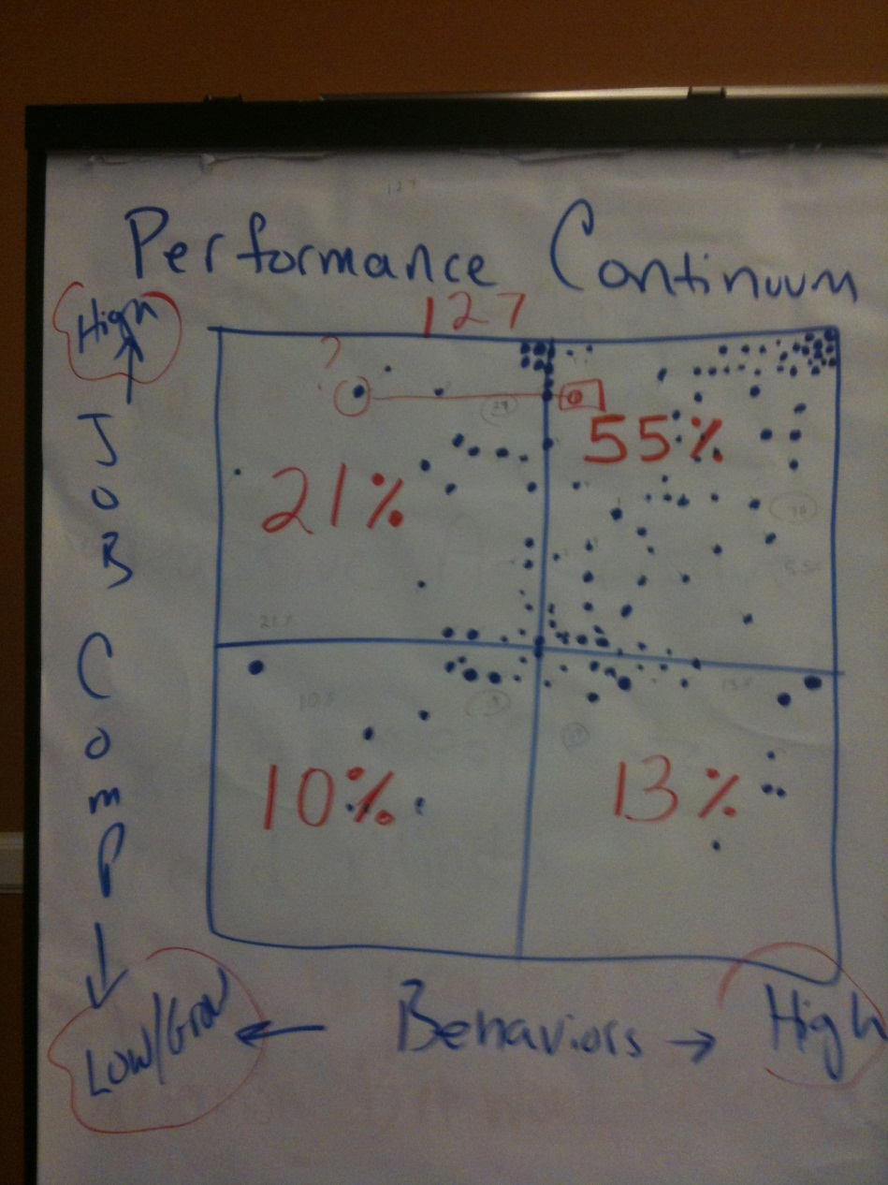
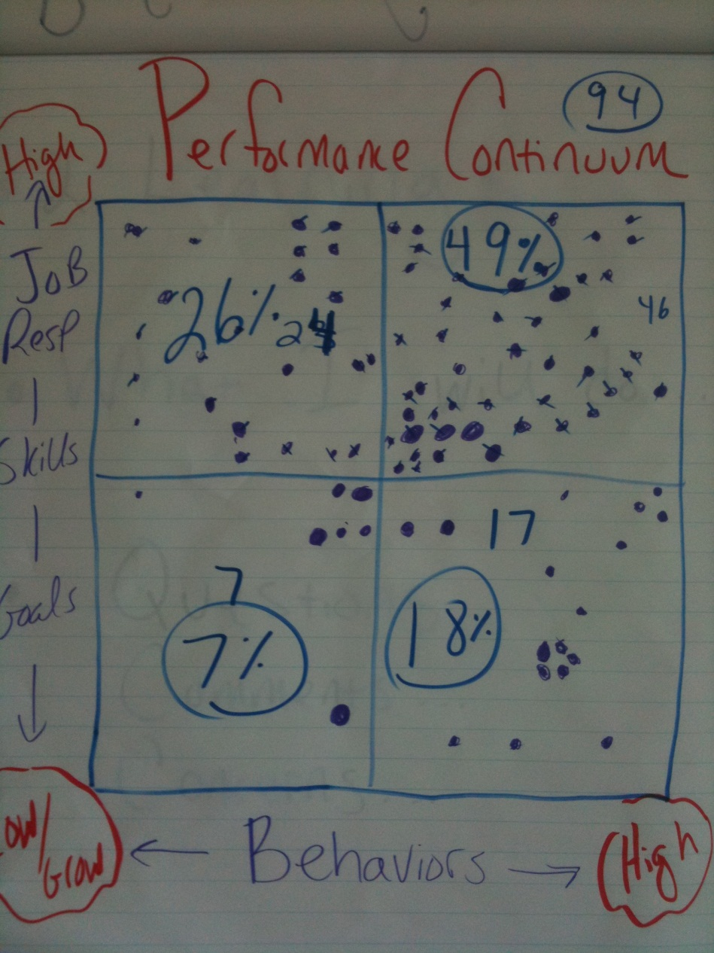

Slide 11
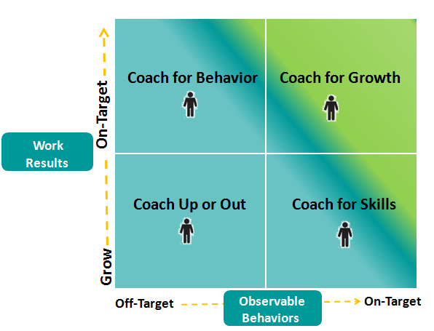
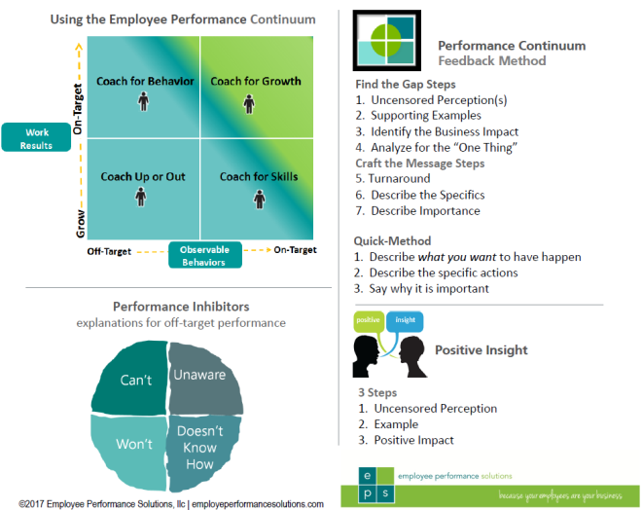
Use the Employee Performance Continuum to:
C
Card

Slide 12

Program Purpose
 | All of the concepts and tools in this program are designed to drive employee performance towards the “upper-right” corner of the Employee Performance Continuum

Slide 13
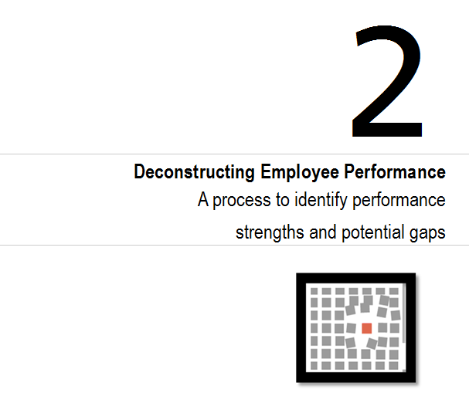
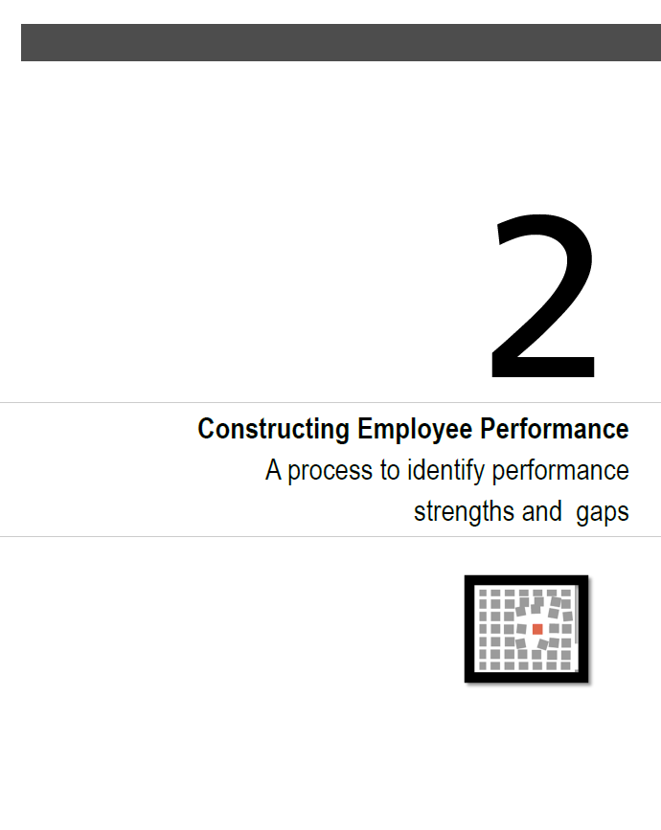
pg8
©2017 copyright Employee Performance Solutions, LLC All Rights Reserved | For Use Within Client Organization

Slide 14
positive
Uncensored
Perceptions

Slide 15
Makes order out of chaos
Is the master of her domain
The backbone of the department
Every time I work with him I learn something new
Everyone wants to be on his team no matter the assignment
Leads the team through tough times
Takes on the difficult projects
Does things to make the process better
Finds solutions when none are evident
Gets the work done despite obstacles
No task is too big or too small

Slide 16
Not so
positive
Uncensored
Perceptions

Slide 17
Complains about things that can’t be changed
Over explains things and confuses people
Never takes things to the next level
Can’t say yes and can’t say no
Puts the “I” in team
Isn’t delegating, takes on too much and misses deadlines
Passes off incomplete work
Looks good by making others look bad
Shames people via email
Reinvents everything; won’t build off of the work of others
Doesn’t share his expertise with the team

Slide 18
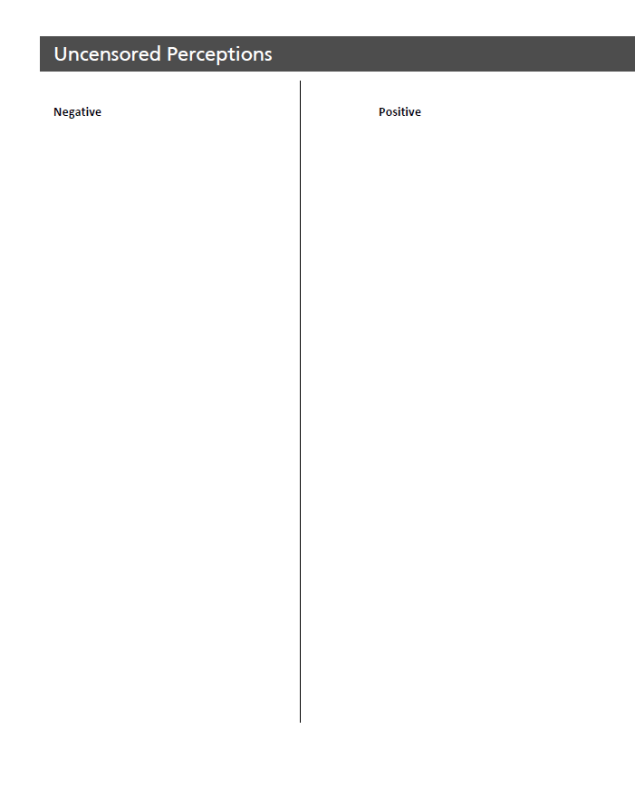
Your Uncensored Perceptions
5-Minutes
pg9
Notes:
Facilitated Activity
Participants write their uncensored perceptions, negative and positive.
5 minutes

Slide 19

Share Examples
10-Minutes
Notes:
Facilitated Activity
Debrief: Have participants share their examples at the table. Optional: participants share the positive insight example with the individual it was written for (if that person is in the room).
Connect this with the 10-Minute Questions
See “notes view” for facilitator activity

Slide 20
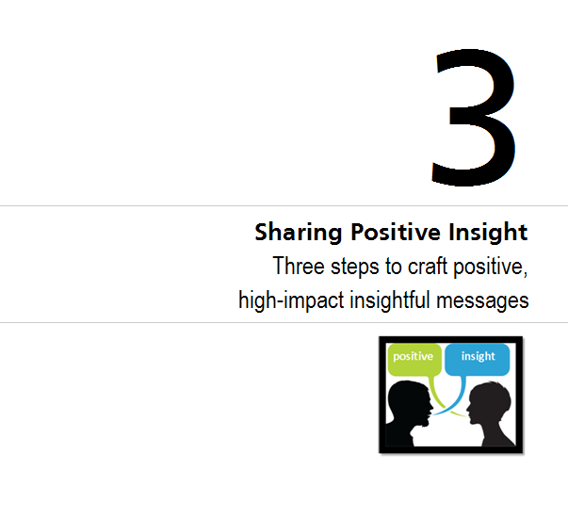
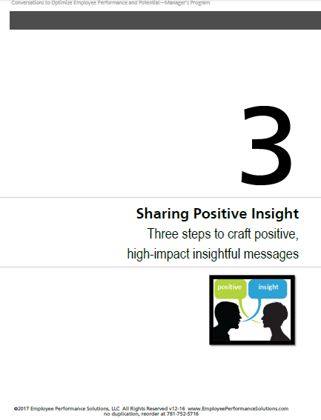
1
1
1
1
2
pg10
copyright2013© Employee Performance Solutions LLC
©2017 copyright Employee Performance Solutions, LLC All Rights Reserved | For Use Within Client Organization

Slide 21

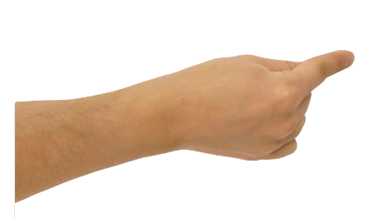

3 Steps for Positive Feedback
uncensored
perception
specific
example
positive impact
©2014 Jamie Resker, Employée Performance Solutions, LLC www.EmployeePerformanceSolutions.com
Notes:
Walk through the 3 “bubbles” sets of questions.
Animated Slide

Slide 22
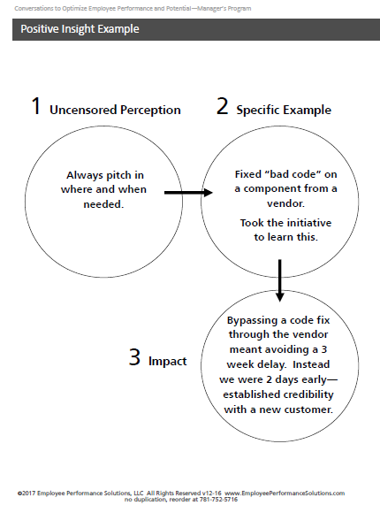
Positive Feedback
Returning the component would have created a 2 week delay. 2 days early!
Readily pitches in where and
when needed.
Fixed “bad code” on a software component from a vendor.
Took the initiative to learn this.
specific
example
uncensored
perception
positive
impact
pg11
Notes:
Walk through the 3 sets of questions.

Slide 23
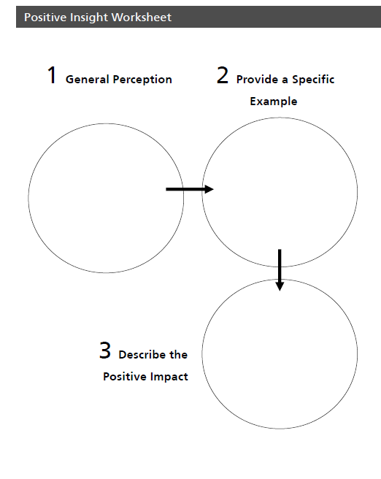
Steps
1. Find a partner to work with.
2. Think of someone you work with (peer, internal customer, your manager, etc.)
3. Interview your partner by asking the three sets of questions:
4. Record your partner’s answers in their workbook (not yours)
5. Switch roles
6. Return your partner’s workbook
Positive Feedback
Pairs Exercise
1.) What is a positive perception you have about the individual you have in mind (example: Great team player)?
2.) Describe a specific example.
3.) What is the impact? Why does this matter?
6-Minutes Total
pg12
Notes:
Facilitated Activity
Participants pick an individual (employee) to apply steps 1 – 4.

Slide 24
Share Examples
5-Minutes
pg12
Notes:
Facilitated Activity
Debrief: Have participants share their examples at the table. Optional: participants share the positive insight example with the individual it was written for (if that person is in the room).
Connect this with the 10-Minute Questions
See “notes view” for facilitator activity

Slide 25
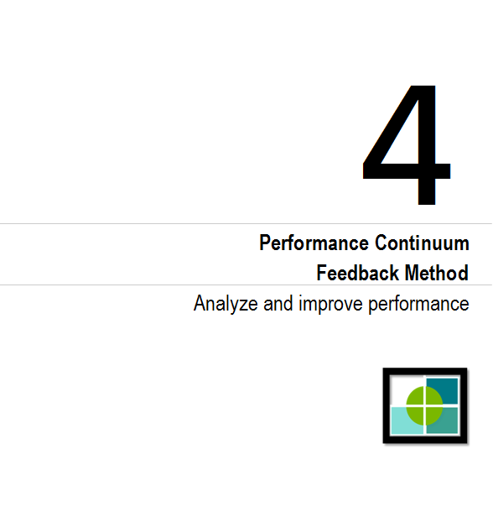
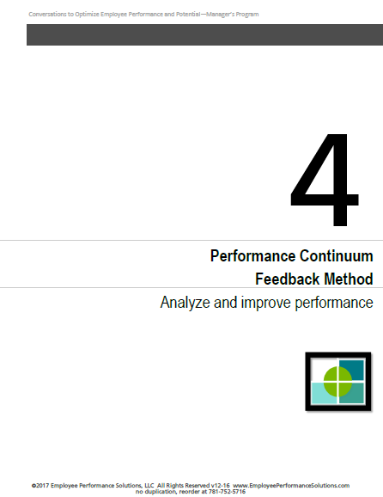
1
1
1
1
2
pg13
copyright2013© Employee Performance Solutions LLC
©2017 copyright Employee Performance Solutions, LLC All Rights Reserved | For Use Within Client Organization

Slide 26




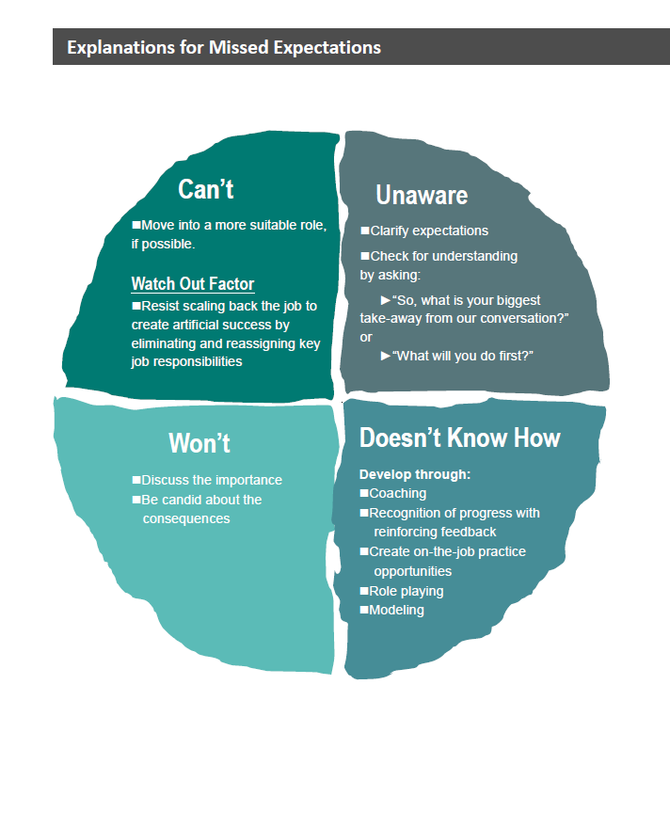
Explanations for Missed Expectations
Unaware
Can’t
Inhibitors
Doesn’t Know
How
Won’t
pg14
Notes:
Why isn’t the employee meeting expectations?
Identify what might be happening for this employee.
It’s usually the first quadrant: the employee doesn’t know. There’s never been a conversation.

Slide 27
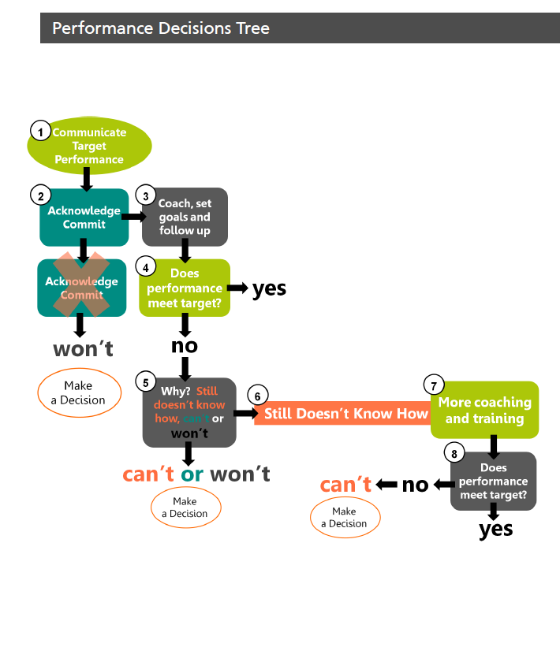
communicate expected performance
1
start here
2
☺
coach, set goals and follow up
pg10
acknowledge
commitment
Pg15
😐
?
does performance meet target?
great!
☺
2
yes
no
agreement
no
3
4
☹
determine why: still doesn’t know how, can’t or won’t
more support
still doesn’t know how
won’t
3
☹
?
5
Make a Decision
now does performance meet target?
great!
no
☺
Make
a Decision
yes
can’t
Notes:
Walk through the slide animation to describe the performance management steps/decisions. Point: many managers haven’t communicated target performance and go right to the ready to fire stage.
Underperforming employees often have no idea they aren’t meeting target performance expectations. Why would they if the manager hasn’t provided full information? Is no news good news?

Slide 28
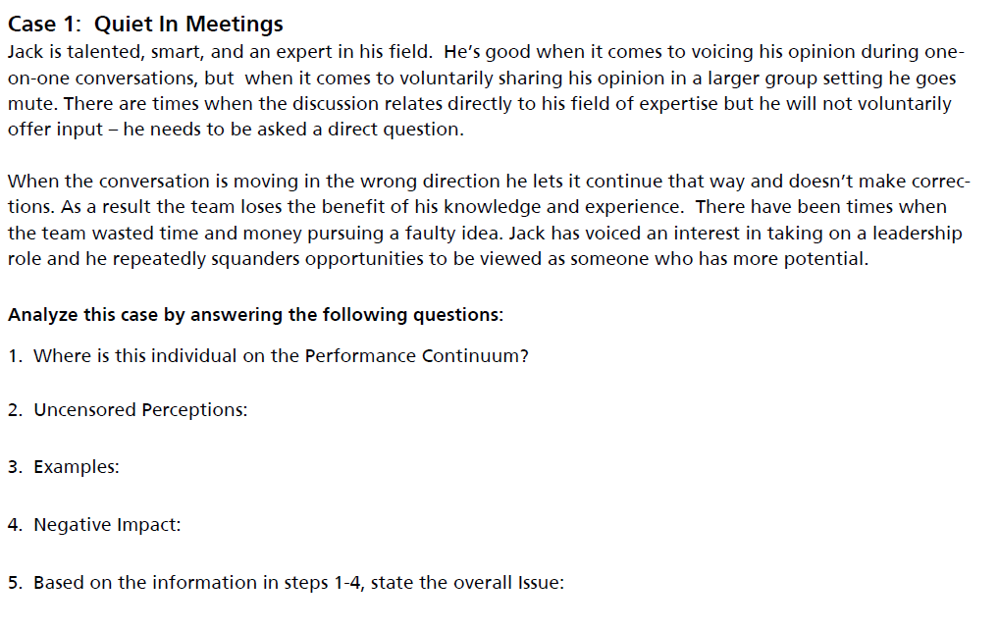
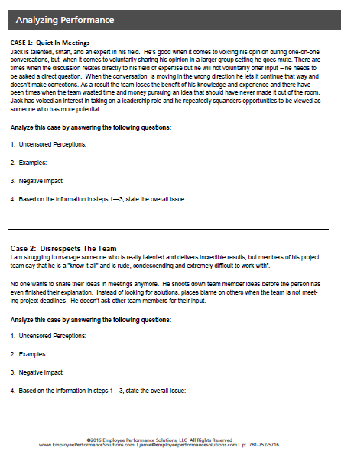
Steps 1-5
Analyze Performance
Instructions
Read Case 1
Answer Questions
1-5
5-Minutes
pg16
Notes:
Facilitated Activity
Participants pick an individual (employee) to apply steps 1 – 4.

Slide 29
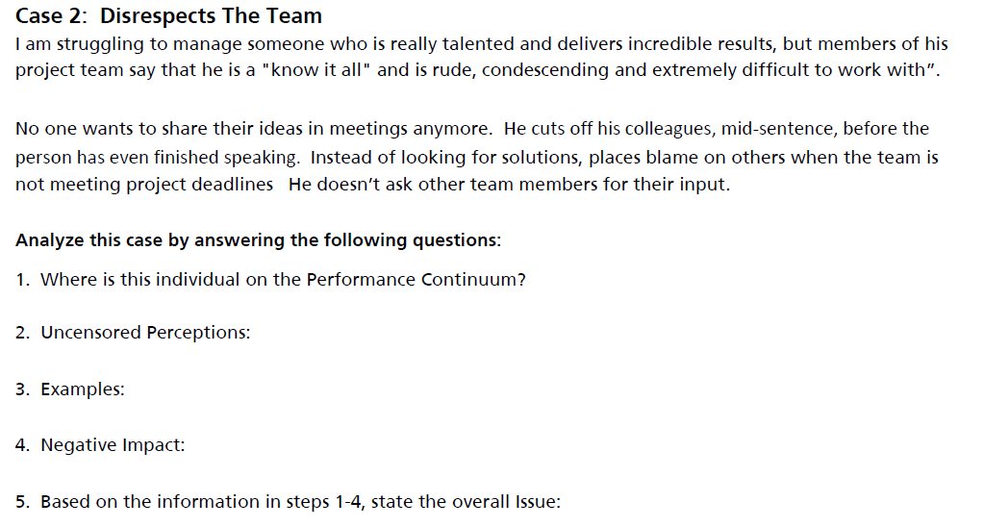
Steps 1 – 5
Analyze Performance
Instructions
Read Case 2
Answer Questions
1 – 5
5-Minutes
pg16
Notes:
Facilitated Activity
Participants pick an individual (employee) to apply steps 1 – 4.

Slide 30
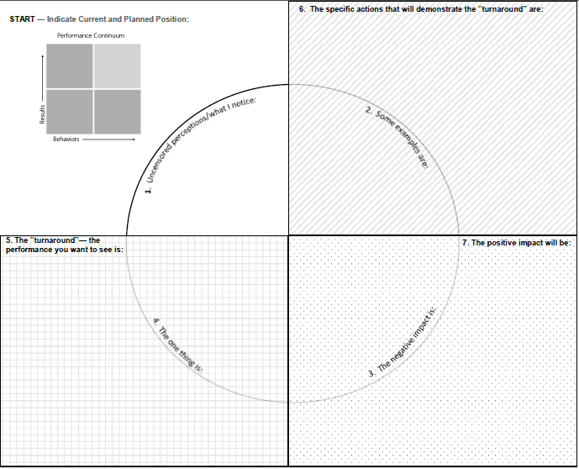
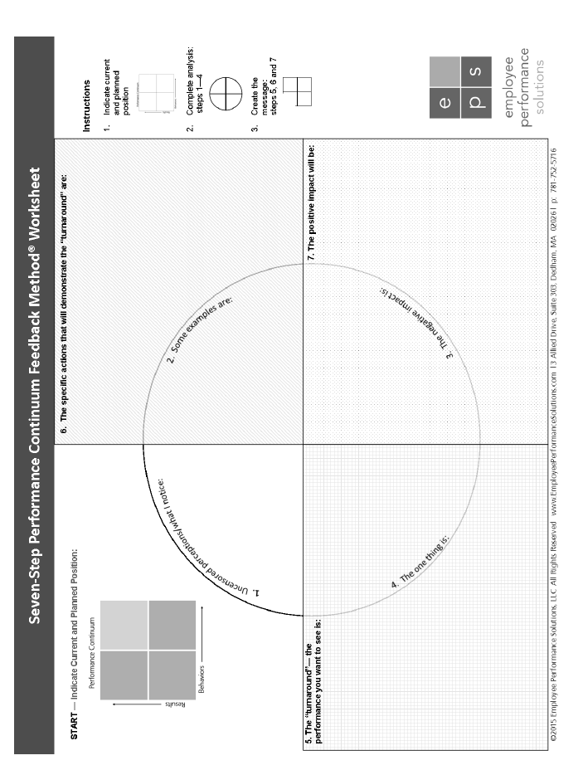
Seven Step Performance Continuum Feedback Method
worksheet

Slide 31
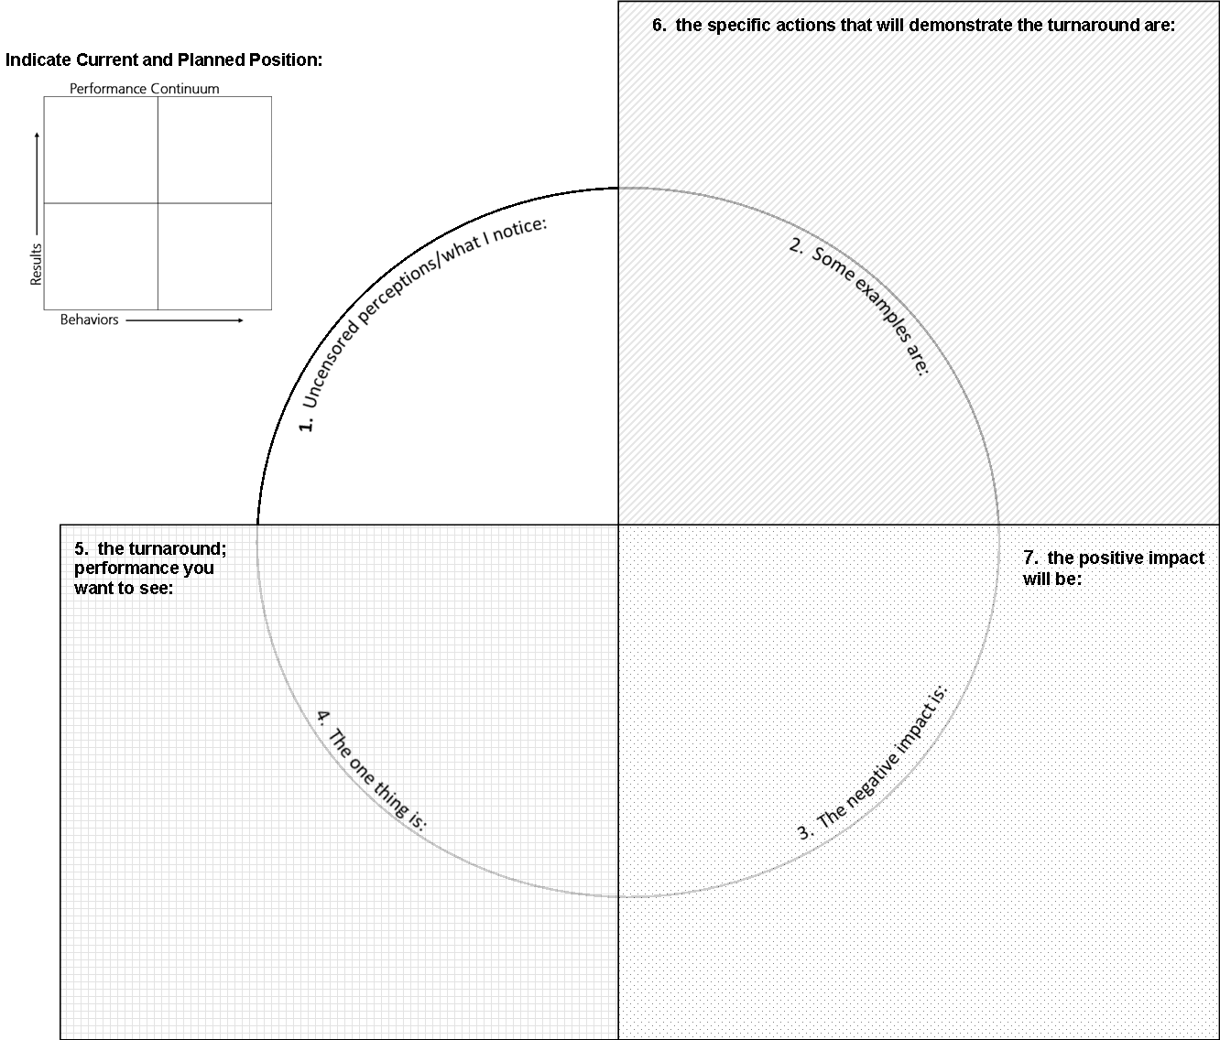

6
Can I get into the specifics?
1. When anyone on the team is explaining an idea let him/her finish and give others a chance to weigh in.
2. When we’re missing deadlines put your energy into looking for solution (forgo placing blame).
3. When you have an idea ask others for their input.
4. Last, be aware of your tone so that it comes across as helpful and respectful...
Follow-along on pg17
1. shoots down team member ideas before the person has even finished their explanation.
2. Instead of looking for solutions, places blame on others when the team is not meeting project deadlines
He doesn’t ask other team members for their input
Condescending tone
"know it all" and is rude, condescending and extremely difficult to work with”.
Is non supportive of the value of his colleagues; (his team).
People feel disrespected and have stopped contributing at meetings. Losing the value of the team!
7
5
This will go a long way in helping people feel respected, keep them contributing at meetings and tap into the value of having a team in the first place.
I need for you to work in a way that includes and supports the value of your team.
Disrespects the Team
Follow Along on Page 17

Slide 32
Can I get into the specifics?
1. Volunteer to contribute whenever the topic relates to your area of expertise.
There are times when the team is taking the conversation in the wrong direction . This is the time for you to jump in and expand the team’s thinking.
6
-Doesn’t share his expertise with the group
-He’s probably shy , an introvert, has low confidence
-Needs a workshop on public speaking
-Not a team player, but he’s good 1-to-1
1. Won’t speak up when the topic relates to his area of expertise.
2. Needs to be asked a direct question before contributing.
3. When conversation is moving in the wrong direction he lets it continue that way.
Isn’t proactively sharing his ideas and expertise at team meetings.
1. Team loses the benefit of his knowledge and experience.
2. Team wasted time and money pursuing faulty ideas.
3. He’s squandering opportunities to be seen as a leader
7
5
1&2. The team will have the benefit of your knowledge and experience and will pursue just the best ideas.
3. We’ve talked about your interest in taking on more of a leadership role; this is one way to demonstrate this capability.
You’re really effective sharing your expertise one-on-one. What’s just as important is proactively sharing your ideas and expertise at team meetings.
Quiet in Meetings

Slide 33
Steps 1 – 4
Analyze Performance
Instructions
Find a partner
Share your scenario while your partner records the information on the worksheet
Complete only steps 1 - 4
start here
❶
❷
*The issue, not the turnaround
12-Minutes
Total Time for both examples
❹
Name the
* issue here
stop here
❸
Worksheet
Worksheet Pad
Notes:
Facilitated Activity
Participants pick an individual (employee) to apply steps 1 – 4.

Slide 34
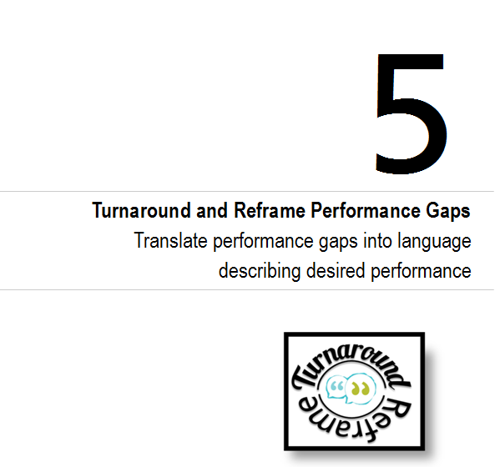
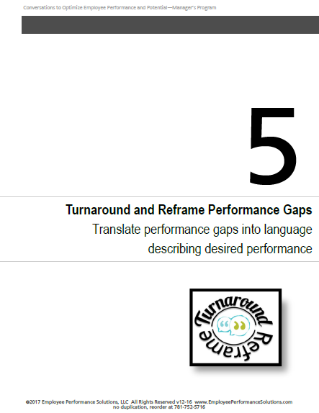
1
2
pg
pg20
copyright2013© Employee Performance Solutions LLC
©2017 copyright Employee Performance Solutions, LLC All Rights Reserved | For Use Within Client Organization

Slide 35
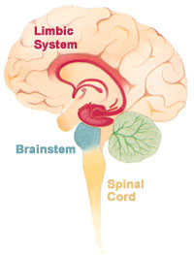
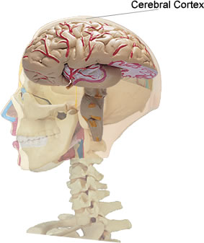
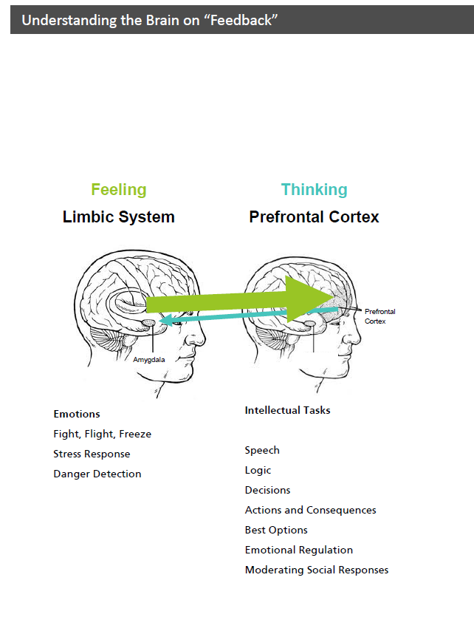
Reactions to “Feedback”
Under Attack
  Thinking brain
  shuts down
  Emotions crank up
  Self-esteem threat
  Judgment = recoil response
OVERDRIVE
pg21
Notes:
Show Brain Fight or Flight Overhead
Say, “When our brain is in overdrive, it’s like telling someone when you get embarrassed—don’t let your face turn red. It’s a physiological reaction to threatening information that causes negative responses to feedback. Today we are going to look at how to provide information in a way that doesn’t push the emotional buttons of the person on the receiving end.”
We want to provide feedback in a way where we engage the cortex/the thinking part of the brain.

Slide 36
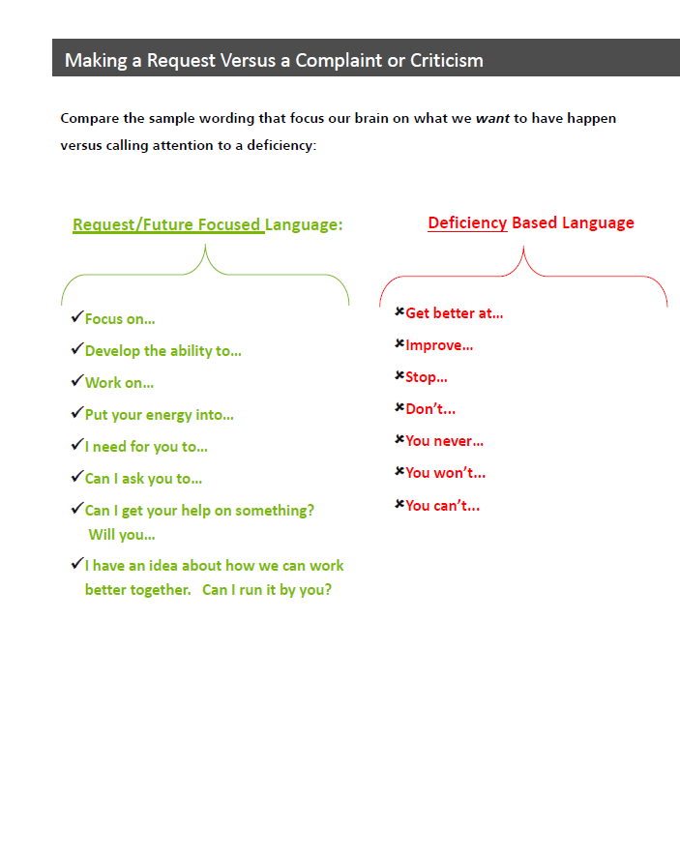

Conversation Starters
Improve…
Get better…
Stop doing…
Weakness…
You never…
Don’t…
You shouldn’t…
Weakness…
Develop the ability to…
Work on…
Focus on…
Put your energy into…
I need for you to…
FUTURE FOCUSED…
Possibilities
YOU’RE
DEFICIENT
pg23
pg22
Notes:
Pull up text on the left side of the slide. Ask, “When I’m using these words what am I implying about the person?” Last pull up the You’re Deficient wording and picture.
Say, “How we start the conversation can mean the difference between an automatic defensive reaction (the emotional buttons are being pushed) and having the person on the receiving end feel like we’re giving helpful/coaching type information.”
Say, “Some words imply that there is something wrong with the individual. Other conversation starts convey future possibilities.”
Reference the words on the right side: This future focused wording helps the brain think forward and describe what you want people to do.

Slide 37
develop more accuracy
  Makes mistakes
  Stop making so many mistakes
Notes:
Walk through each slide and let participants work to turn a frustration into a request. In this example mention that we feel like saying “stop” but this still doesn’t describe what we want.
Note: Become familiar with the animation on these and other slides.

Slide 38
on time
late

Slide 39
Make
conclusions
based on facts
Makes assumptions
makes assumptions

Slide 40
  Helpfully and patiently mentor those with less experience
Condescending to those with less experience
>

Slide 41
  Make more realistic commitments for what really can be delivered
overpromises

Slide 42
proactive
reactive

Slide 43
  Take the initiative to go beyond what you already know
no desire to learn on own…

Slide 44
Complete experiments in about half the amount of time
experiments take twice the amount of time they should

Slide 45
Keeps interrupting me
  Let me finish what I have to say

Slide 46
Passes off incomplete work
  Hand off the work to me once it’s been…

Slide 47
Turn Arounds
Does not engage in the difficult client conversations
Doesn’t take responsibility for…
Takes no ownership for…
Can’t let others finish their thoughts…
g…
Notes:
The last point is that taking away the “don’t’, “can’t” etc. won’t always work! But sometimes just taking away the negative starter word describes the target performance.

Slide 48
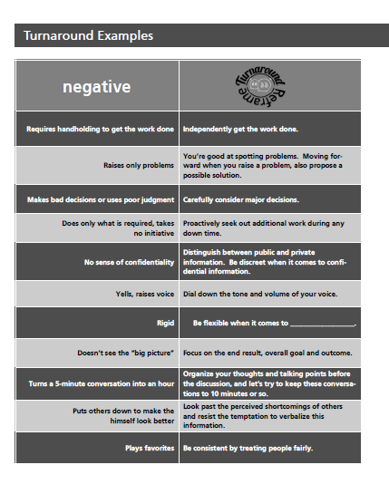
Instructions
Scan the examples
pg23
pgs23-32
Notes:
Follow instructions on this slide

Slide 49
Steps 5 – 7
Craft the Message
Instructions
Complete remaining steps 5 - 7
❻
❺
➐
worksheet
Notes:
Facilitated Activity
Participants pick an individual (employee) to apply steps 1 – 4.

Slide 50
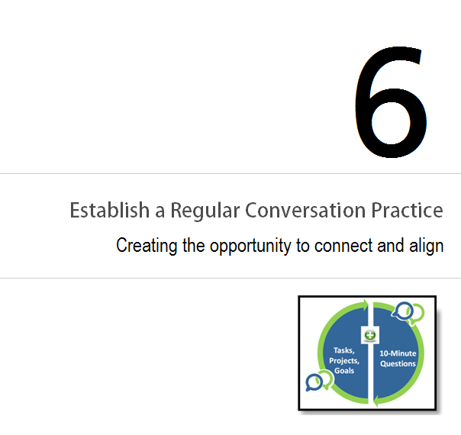
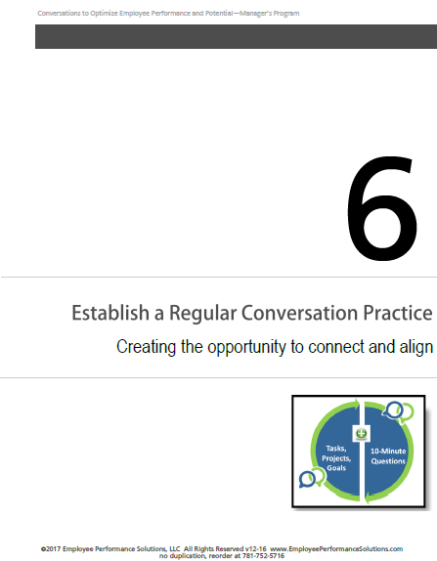
1
1
1
1
pg23
pg33
©2017 copyright Employee Performance Solutions, LLC All Rights Reserved | For Use Within Client Organization

Slide 51
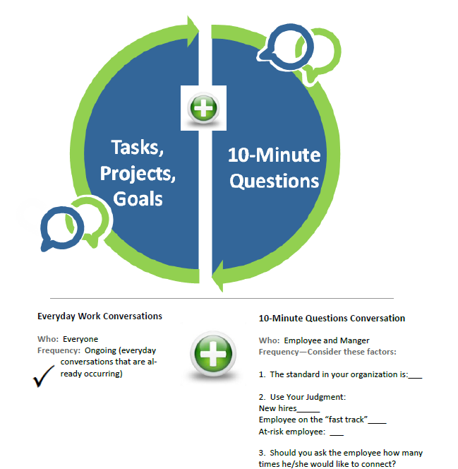
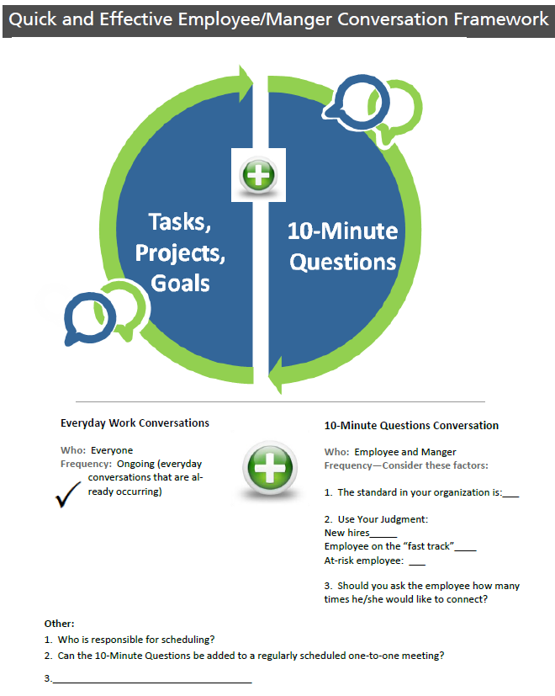
Who schedules this meeting?
◆ Can it be added to an existing meeting?
◆ Other thoughts or questions:
1
1
1
1
pg34
pg23
copyright2013© Employee Performance Solutions LLC

Slide 52
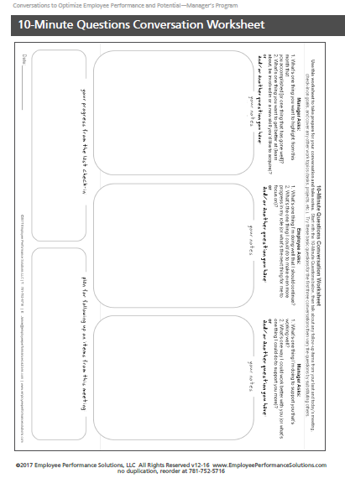
pg35

Slide 53
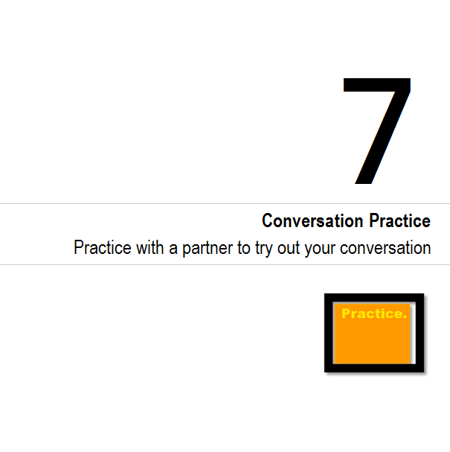
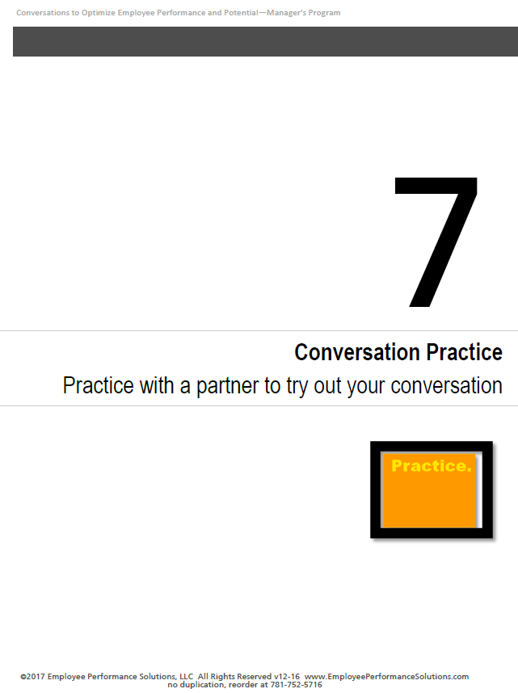
1
1
1
1
pg23
pg36
pg23
copyright2013© Employee Performance Solutions LLC

Slide 54
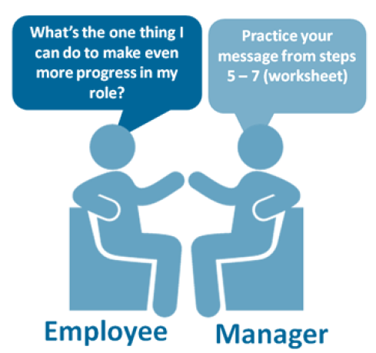
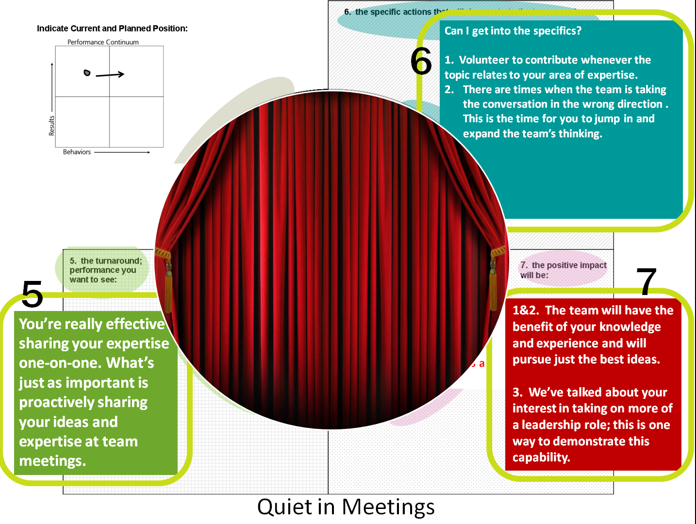
Setting
10-Minute Questions Conversation
Roles
◆ Purpose
Practice Your Message: Steps 5 - 7
©2015 Employee Performance Solutions, LLC All Rights Reserved

Slide 55
Your Goals When Practicing Your Conversation:
1. Reframe: describe the performance you want to see (versus past problems)
2. Describe the specific actions (avoid being vague)
3. Allow the employee the opportunity to respond, ask questions, and add his/her thoughts during the conversation.
Be aware of talking too much

Slide 56
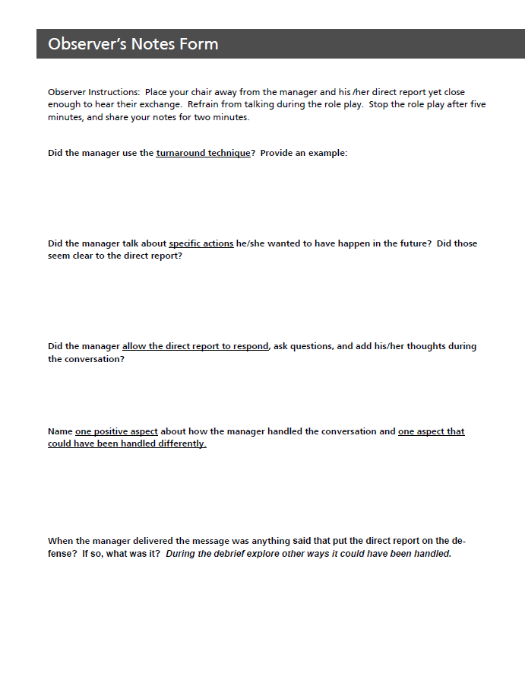
Did the manager...
1. Use the turnaround technique?
2. Describe the specific actions he/she wants to have happen in the future?
3. Allow the employee the opportunity to respond, ask questions, and add his/her thoughts during the conversation?
4.) Name one positive aspect about how the manager handled the conversation and one aspect that could have been handled differently.
5.) When the manager delivered the message was anything said that put the direct report on the defense? If so, what was it? What’s another way it could have been stated?
Observer’s Role and the Notes Form
pg39

Slide 57
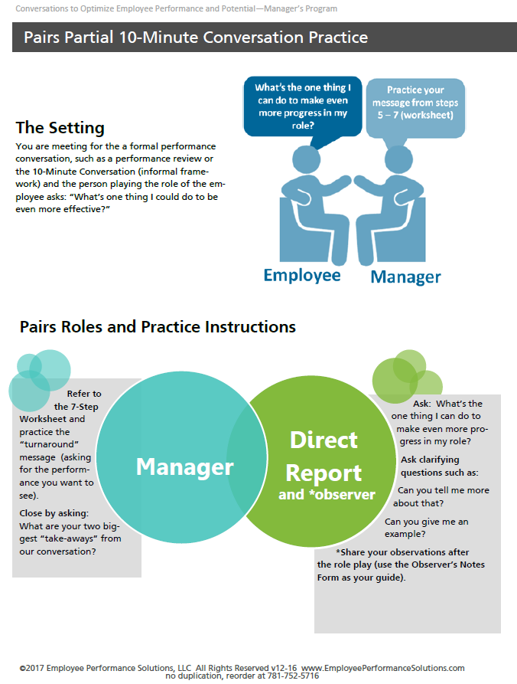
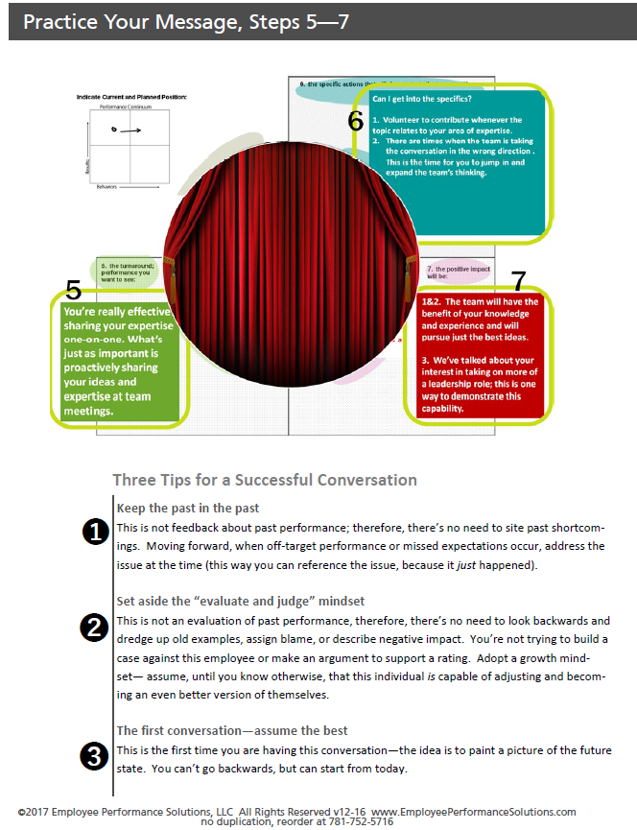
Read the Practice Instructions on pages
37 and 38
Pg37-38

Slide 58

Manager Practices the Delivery
Employee Gives Feedback
*Using Observer’s Notes Form
Switch Roles
5-minutes
2-minutes

Slide 59
Recap
 | Use the Performance Continuum to gain a snapshot of the employee’s current performance in terms of Results and Behaviors. The intent is to use this tool to help people grow and move forward.
 | Give better quality feedback with concrete examples and the positive impact.
 | Analyze current performance to determine what the employee can do to make even more progress. The focus is on moving forward versus reviewing past performance.
 | Translate performance gaps, large and small, into language describing the “on-target” performance.
 | These tools and approaches help inform the 10-Minute Questions Framework when the employee asks: 1. What’s one thing I’m doing well and should continue with? 2. What’s one thing I can make even more progress in my role?

Slide 60
Please Share Your Insight …
E a
What’s one thing you learned and will use?
What’s one thing you have a question or comment about?
Notes:
Facilitated Activity
Ask participants to answer the two questions. Via paper or typing into the chat box.
See “notes view” for facilitator activity

