Slide 1
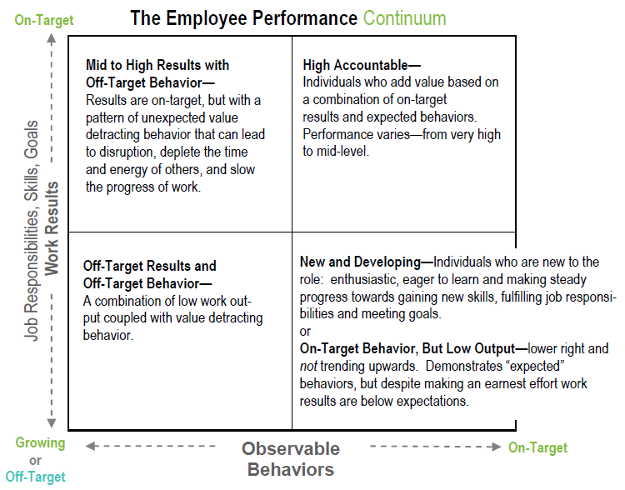
Part 2: Deconstructing/Analyzing Employee Performance: A process to identify performance strengths and potential gaps
Part 3: Sharing Positive Feedback:
Three steps to craft positive high-impact insightful messages
Part 4: Analyze Off-Target Performance: Recognize the difference between opinions/judgments and methodically evaluate and "name“ performance gaps
Part 6: Performance Conversation Framework: Learn how to use the 10-Minute Questions Conversation Framework to facilitate two-way dialogue between the manager and employee to drive and align performance expectations (the opportunity to use and apply Parts 1 - 5 of the skills-training; translating the workshop into direct action and immediate practice)
Part 5: Turnaround and Reframe Performance Gaps:
Translate Off-Target performance into language describing the On-Target Performance (whether related to Behavior or Work Results)
©2017 Employee Performance Solutions LLC www.employeeperformancesolutions.com 781-752-5716

