Slide 1
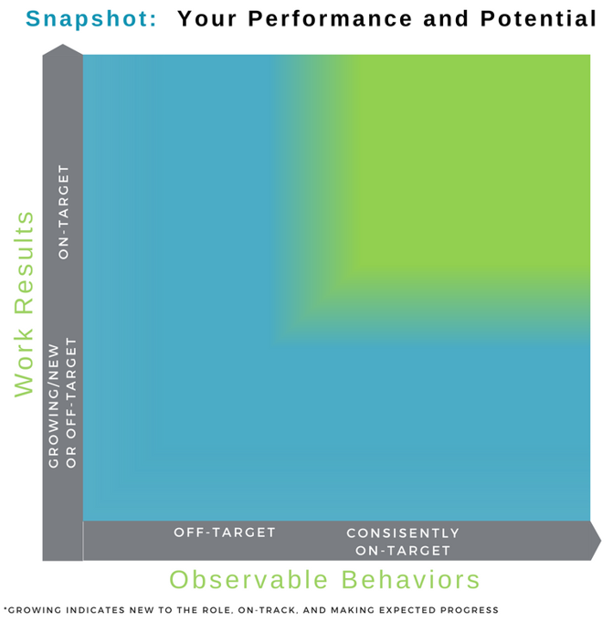
Performance and Potential Snapshot: Visualize and Reflect on Your Performance and Potential
Guidelines for Using This Worksheet Use this worksheet and exercise to explain to your manger how you see your performance and potential. Then listen to your manager’s perspective. Work to ensure you are aligned and work towards future goals. The visual model and questions below are designed to facilitate dialogue about current expectations and ideas for future growth, your interests and potential.
Step 1: Start by Describing Your Perspective About Your Performance and Potential | 1. The Present Snapshot: Reflect on your current performance Where do you see yourself now? Would you put yourself in different places depending upon the various aspects of your job? 2. The Future Snapshot: Your Potential Where do you have the potential and desire to move? What is one thing you can do to make progress?
Step 2: Your Manager Shares His or Her Perspective | Reflect on the Present: Where on the Continuum the employee’s current performance? Explain your thinking. 2. Plans for Future Growth/Moving Ahead Describe how this individual can continue moving forward. Be specific and by discussing ideas for specific actions and steps: Discuss and explore ideas about developing new skills, leveraging strengths, shifting or adopting a new behavior or work style. Together, identify at least one action and agree on next steps.

