Slide 1
Presentation by
Ask Me Anything:
Recognition, Rankings, and Awards
Professor Gurpreet Jagpal
Director of the Institute for Enterprise and Entrepreneurship
12th December 2019

Slide 2
Key Areas
Importance of organisational strategy/vision and senior leadership support
Establishing a benchmark and set of KPIs to be measured year-on-year
Role of awards and (external) recognition in driving your centre’s reputation
Building internal relationships between the centre and academic faculties.

Slide 3
About Me
September 2006 – Birmingham City University supporting Staff and Student Enterprise and university-business collaboration.
September 2010 –University of Birmingham designing and delivering postgraduate and graduate enterprise programmes and operational responsibility for the enterprise team.
September 2012 – Deputy Director UCL Advances, University College, London (UCL). Strategic oversight of enterprise and small business engagement activities.
September 2014 – Director of Research, Enterprise and Innovation, and CEO South Bank University Enterprises Ltd. Responsibility for the strategic and day-to-day operations for London South Bank University’s (LSBU) research and enterprise activities.
  At LSBU, and in a relatively short period of time (approximately 18-months), established an award-winning research and enterprise centre.
July 2018 – Professor and Director of the Institute for Enterprise and Entrepreneurship at UWE Bristol
Common thread is establishing and fostering the growth of a number of enterprise and business outreach centres strengthening their links with local industry.

Slide 4


Organisational Strategy
Importance of organisational strategy/vision and senior leadership support
>>>>>

Slide 5
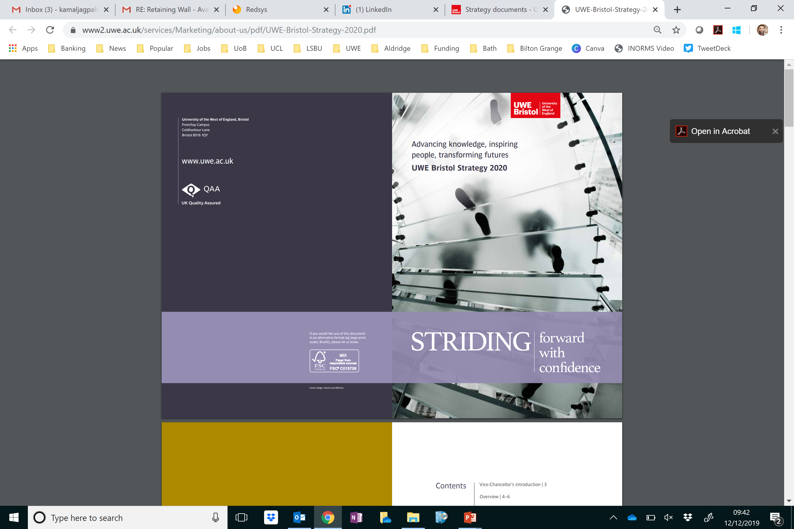
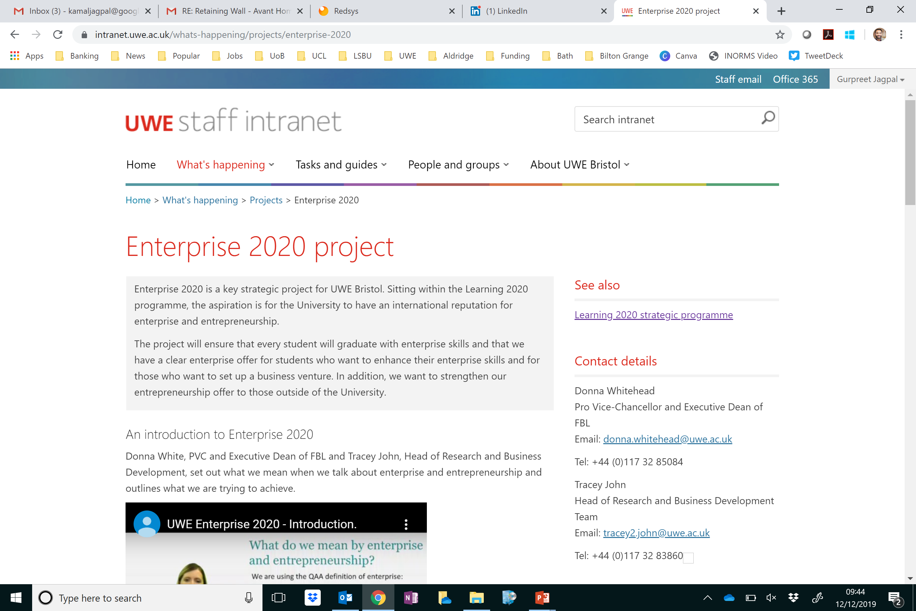
Organisational Strategy
Importance of organisational strategy/vision and senior leadership support
>>>>>

Slide 6
KPIs (1)
Establishing a benchmark and set of KPIs to be measured year-on-year
Research Income
Enterprise Income
Student/Graduate Start Ups

Slide 7
KPIs (2)
Number of Graduate Start Ups
Number of student/graduate learner hours
Number of students/graduates with business ideas advised 1-2-1
Number of supported student/graduate businesses
Amount of income raised by student/graduate ventures
Number of new staff start-ups supported
Number of external businesses supported
Incubation Occupation Rates
Number of Business operating in Incubators
Total turnover of businesses in Incubators
Number of enterprise related training participants

Slide 8

KPIs
Establishing a benchmark and set of KPIs to be measured year-on-year
Research Income
Enterprise Income
Student/Graduate Start Ups

Slide 9
Recognition and Awards
Role of awards and (external) recognition in driving your centre’s reputation
Times Higher Awards
  Business School of the Year
  Knowledge Exchange/Transfer Initiative of the Year
  Outstanding Contribution to the Local Community
  Outstanding Entrepreneurial University
  Outstanding Support for Students
Guardian Awards
  Business Collaboration
  Employability and Entrepreneurship
  Social and Community
Global Consortium of Entrepreneurship Centres
  Outstanding Emerging Entrepreneurship Centre
UBI Global
  Ranking for Innovation Centre
IOEE
  Accredited/recognised enterprise and entrepreneurship provision

Slide 10
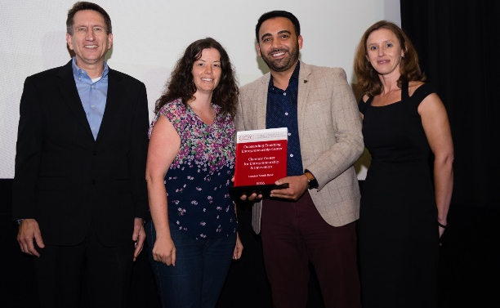

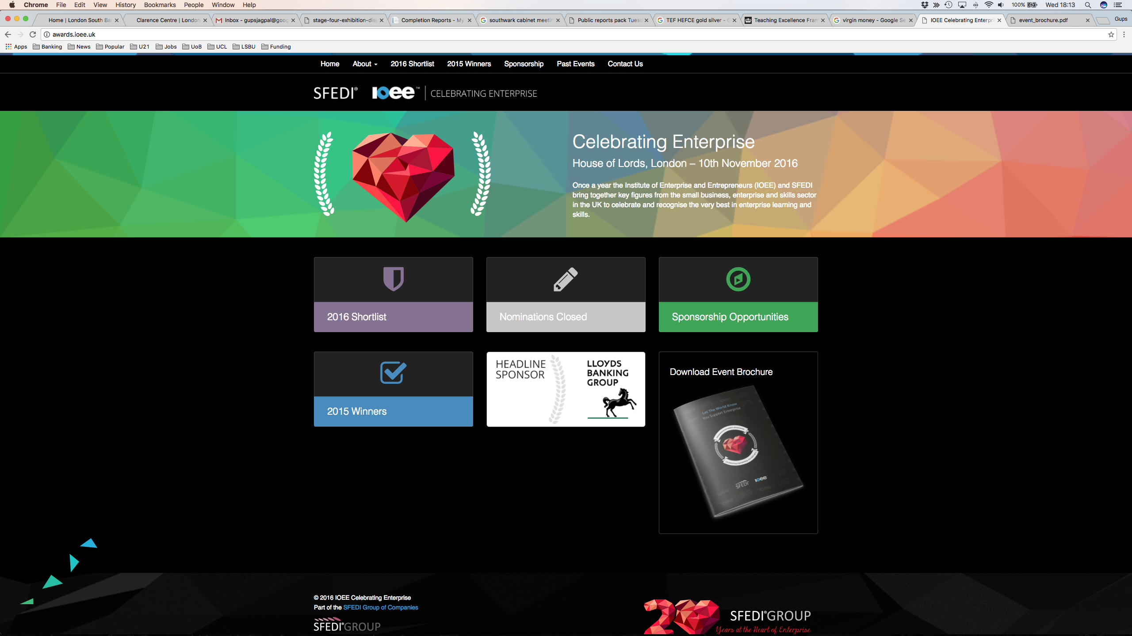
2016/17 Awards
Our Incubation space
  Outstanding Emerging Entrepreneurship Centre
Our Learning Provision
  Highly Commended
Entrepreneurial University

Slide 11
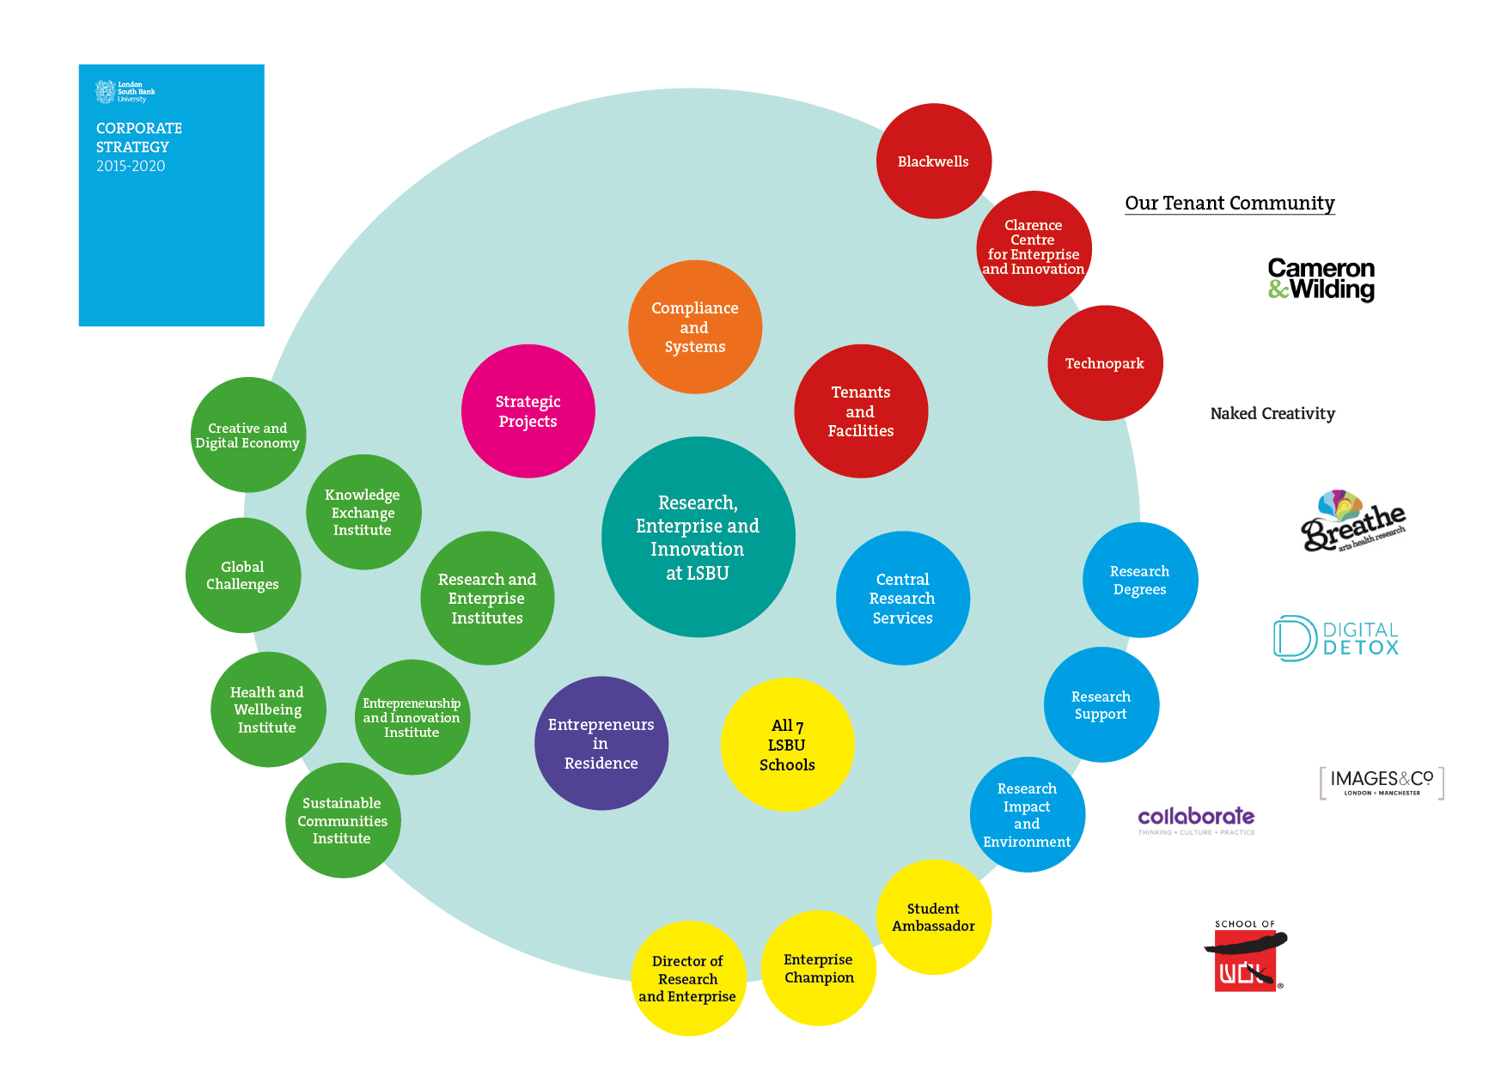
Eco-System
Building internal relationships between the centre and academic faculties.

Slide 12
Ask me anything……..
Gurpreet.Jagpal@uwe.ac.uk
@gupsjagpal
https://www.linkedin.com/in/gurpreetjagpal
+44(0) 7958 568 211

