Slide 1
HYPE Innovation Company and Product Overview
Who we are and what we do
March 2016

Slide 2
HYPE’s Mission
Once organizations have reached a certain size, there is a significant distance between those who have ideas and insights and those who have the power and resources to act upon them.
HYPE Innovation provides technology and processes that bring idea contributors and decision makers closer together, helping organizations to generate additional revenue, to become more efficient, and to empower people.

Slide 3
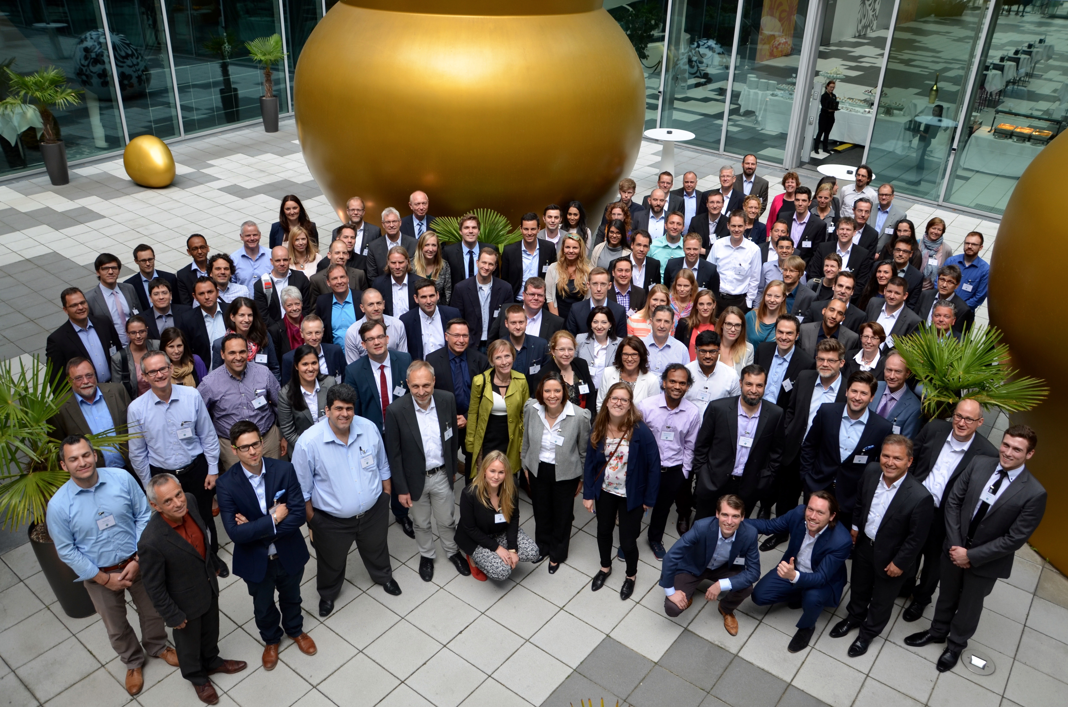
About HYPE Innovation
HYPE Innovation
Founded 2001: Daimler spin-off
Specialized in Idea and Innovation Management
Headquartered in Bonn, Germany
Additional offices in Brunswick, Berlin, Boston, Southampton, Lyon and Abu-Dhabi.
Product
200+ active clients around the globe
Supports Full Lifecycle of Innovation
Off-the-shelf, Experience-Based Tools
100% Configurable: Evolves with You
Cloud or On-Premise

Slide 4
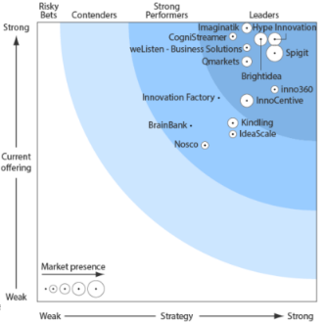
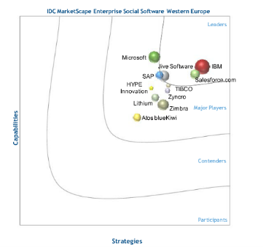
Recognized in All 3 Spaces
Top Ranks in the Innovation Space …
… only Idea Management Vendor in the Social Space …
HYPE
HYPE
… and leader in the Suggestion Scheme Space …

Slide 5
Solution Architecture
HYPE Innovation / Portfolio App for IBM Connections
HYPE Innovation App for Jive
HYPE Enterprise Xpress
HYPE Improve
HYPE Enterprise
HYPE PLATFORM

Slide 6
Your Contact @ HYPE Innovation
Dietmar Breyer
Anne Knipp
VP ALLIANCES
PARTNER ECOSYSTEM
Mobile: +49 171 8173 – 733
E-Mail: dietmar.breyer@hype.de
Phone: +49 228 2276 – 260 Mobile: +49 159 0442 1784 E-Mail: anne.knipp@hype.de

