Slide 1
ABCD Leadership
in Edmonton

Slide 2
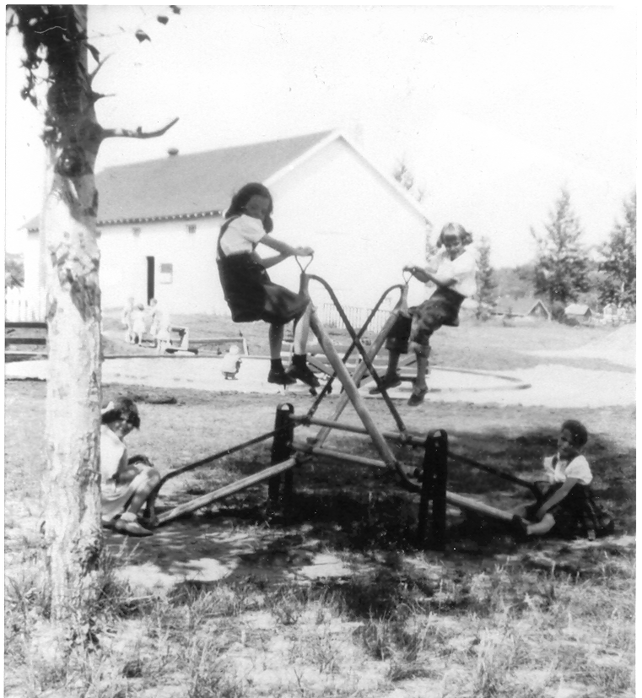
“No city provides as much Public Park Land, facilities or financial assistance to autonomous organizations and no city depends as much as we do on the local initiative and citizen participation in recreational facility planning and progress planning”
Mayor Elmer E. Roper [1959-1963]

Slide 3
Welcome & Agenda
History of Leagues
Bernice Neufeld
Community Leagues Today
Laura Cunningham-Shpeley
Small Group Work
Abundant Community Edmonton
Debra Jakubec
Neighbourhood Connector – Bridging Leagues and Blocks
Karen Wilk

Slide 4
Introduction
How the community league/association movement began
Role of the leagues
Formation of the Edmonton Federation of Community Leagues
How the City supported the leagues

Slide 5
How it all began
England: The Settlement Movement, 1600’s
Informal movement, poverty in parish's
United States: City Clubs, 1870’s
Rev. S. H. Gurteen moved to Buffalo N.Y.
Education and use of public lands
Edmonton: Community League, 1917
George Hall, Edmonton Industrial Commission in 1912 from Providence, Rhode Island

Slide 6
Edmonton 1917
Annexation of surrounding towns
World War I
Immigration and High Unemployment
Low tax base
Poor infrastructure
Scarce resources
Prohibition
Women’s Rights Movement

Slide 7
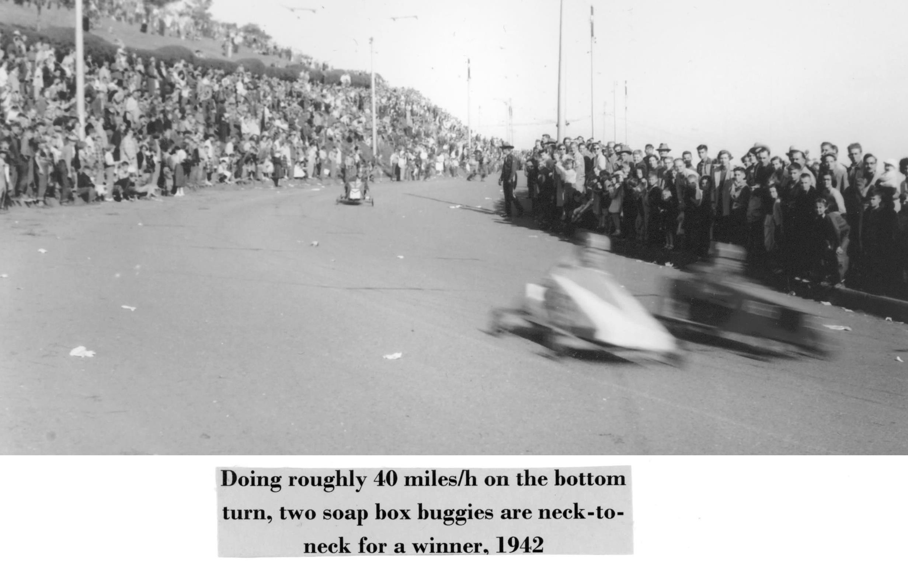
Citizens Respond
The first league (Crestwood Community League)
Jasper Place Literary Society and rate payers association under the leadership of George Hall
Concerns with:
Use of Public School facilities
Improvements for the district
Community Activities like Adult Education
Social and sports events

Slide 8
Guiding Principles
Membership open to all residents regardless of class, ethnicity, or gender.
Non-partisan
No religious affiliation
Incorporated Society
Objective: “…the development of intelligent public spirit through the holding of public meetings for open presentations and discussion of public questions, and for such other civic, social and recreational activities as give promise of common benefit.”

Slide 9
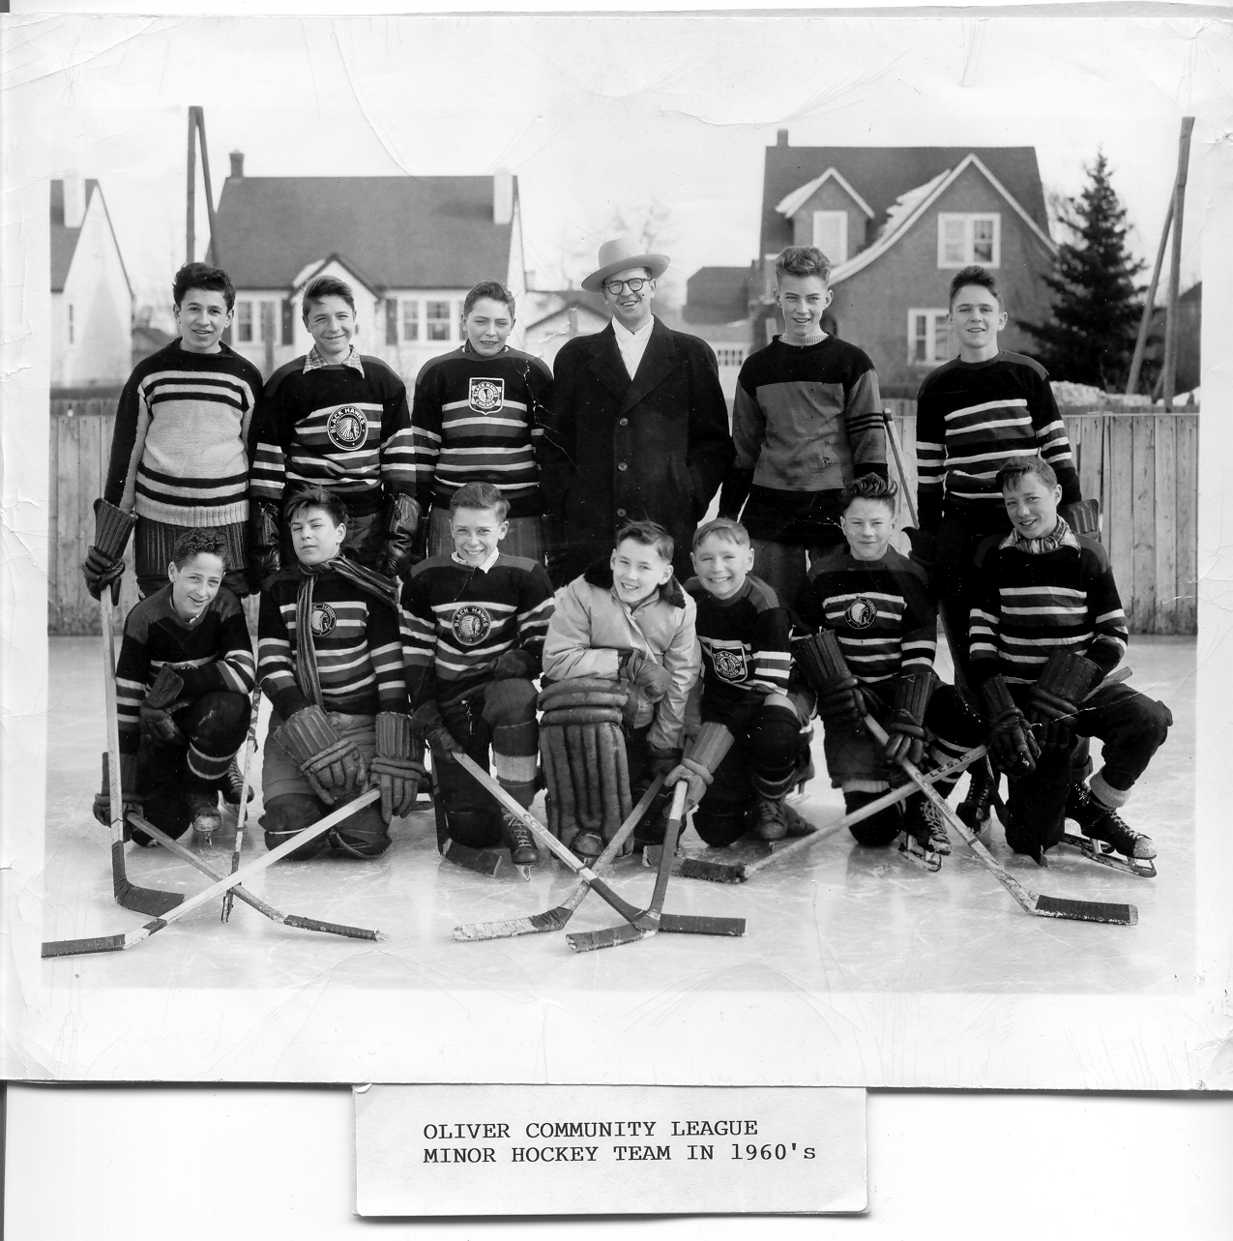
The Federation
1921 saw 9 Leagues with very different agendas vying for attention and resources from the City
A central body was determined to be needed to strengthen the movement and present common issues to decision makers
Early achievements:
Allocation of land for development of recreational facilities [1922]
Annual grants from the City and School Board for operation of skating rinks

Slide 10
The Federation
Objectives:
To facilitate the distribution of information between the member units
To promote suitable educational and recreational programs, and to provide a clearing house for same
To take united action in matters of common interest and in the interest of the city as a whole
To come to the support and assistance of individual leagues as deemed advisable, or when requested to do so.

Slide 11
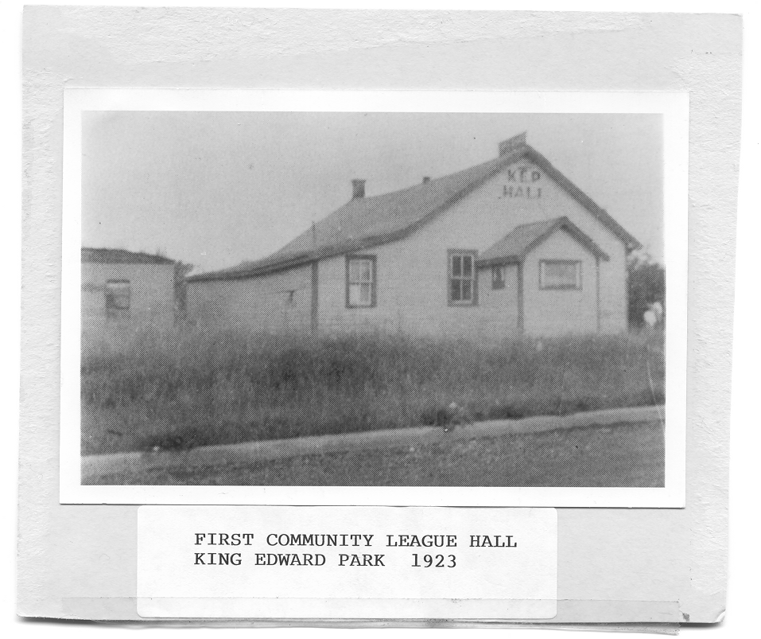
Conclusion
Symbiotic relationship for a livable city
City | Leagues
Land Grants | Community Halls
Financial assistance | Playgrounds
Professional guidance | Outdoor Skating Rinks
Opportunities to consult | Recreational Opportunities
Use of public facilities | Playschools
 | Crime Prevention (Neighbourhood Watch)
 | Social activities

Slide 12
EFCL Moving Forward
The EFCL is committed to increasing it’s support to the health and vibrancy of the 159 Community Leagues in Edmonton
Community Inclusion Committee
Abundant Communities- CoE
Housing for Health Partnership
Indigenous, LGBTQ, Youth engagement initiatives
Affordable Housing focus groups
Live Active Strategy Partner

Slide 14
More than half a billion dollars of community infrastructure has been built by Community Leagues across the City using Licensed Land

Slide 15
Outdoor community ice rinks: 119
Community league halls: 126
Water spray parks: 55
Outdoor tennis court facilities: 24
BMX/skateboard tracks: 10
Playgrounds: 250
Community gardens: 25
Basketball court facilities: 46
The Tri-Partite Agreement between the CoE and the EFCL supports the building and operation of amenities on Licensed Land (Municipal Reserve Land)

Slide 16
Resources for Leagues
weekly online workshops with EFCL staff
monthly workshops on wide range of topics
yearly Leagues Alive conference
EFCL as the organization that raises the profile of the Leagues City wide
9 full time staff to support Leagues
Downloadable Guides Available
Notes:
Weekly Online workshops- topics include:
Monthly workshops- “Let’s talk about Governance”, Making Gsuite work for you, Strategic Planning:What, Why and How, Urban Spaces and Community Leagues, Yearly Leagues Alive all day Conference

Slide 17
Social Media
142 Leagues have presence on Facebook
EFCL Social media stats:
3,029 Facebook Page likes
3,480 Facebook Page followers
7,311 Twitter followers
1,087 Instagram followers
1,558 subscribers to Living Local: EFCL E-News

Slide 18
“At 157 leagues and growing, Edmonton’s network of community leagues is the strongest in Canada and that’s something we should all be proud of. The leagues all play a major role in being the community voice on city issues and events, and in keeping families active, healthy and engaged in their community.
– Mayor Don Iveson, 2016

Slide 19
Pair Work
Does neighbourhood leadership exist where you live?
Are their groups in your neighbourhood who organize things?
What does it look like? Share with your partner.
Notes:
DJ – 10 minutes

Slide 20
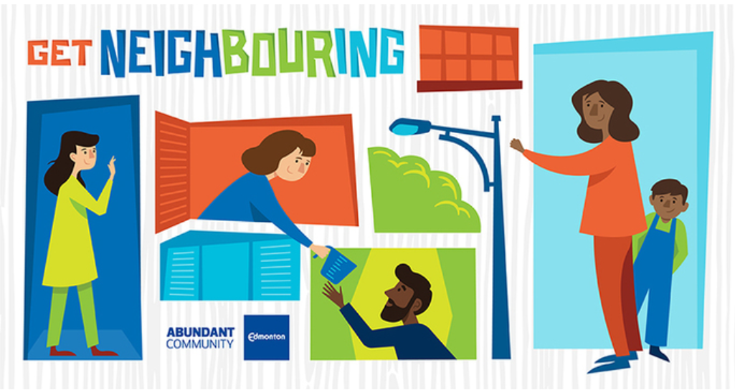
Abundant Community Edmonton
Abundant Community Edmonton (ACE) is…

Slide 21
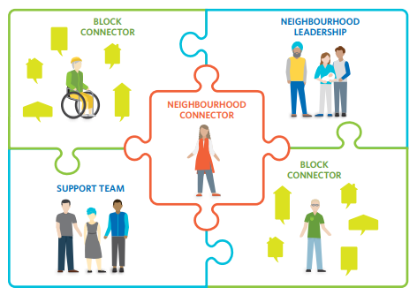

Slide 22
Abundant Community Edmonton
The Block Connector / Neighbourhood Animator
Point Person
Party Person
Listener

Slide 23
Abundant Community Edmonton
The importance of neighbourhood leadership
Benefits of Neighbouring!

Slide 24
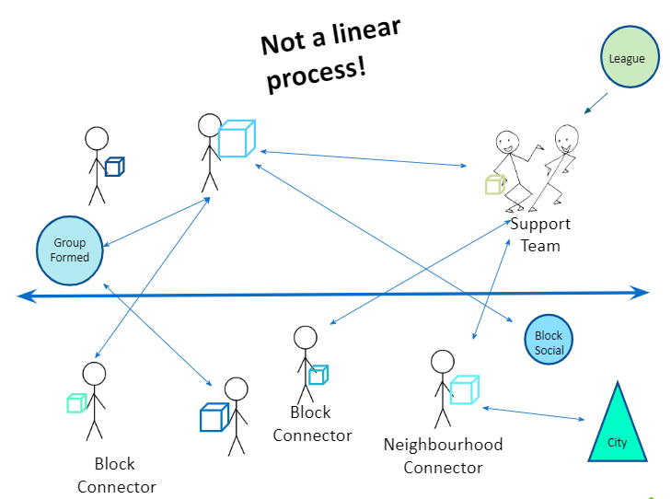

Slide 25
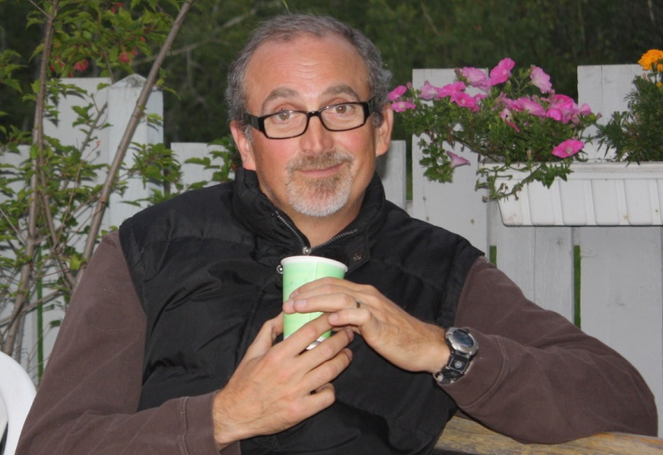
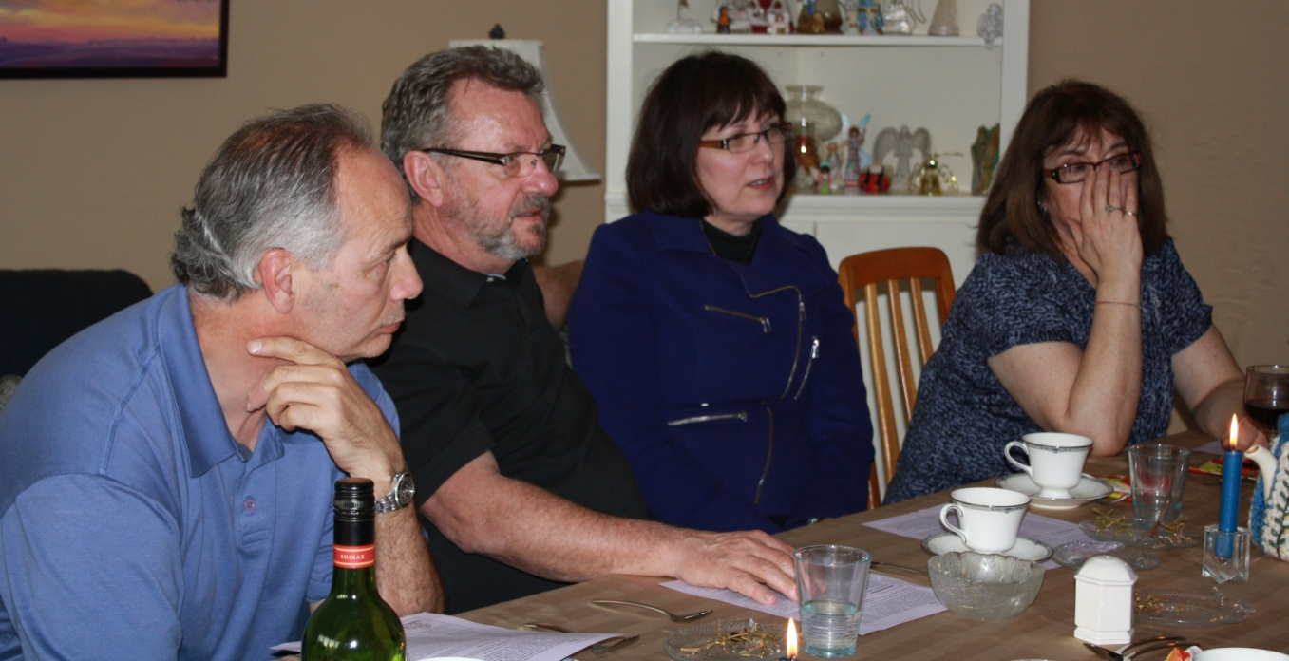
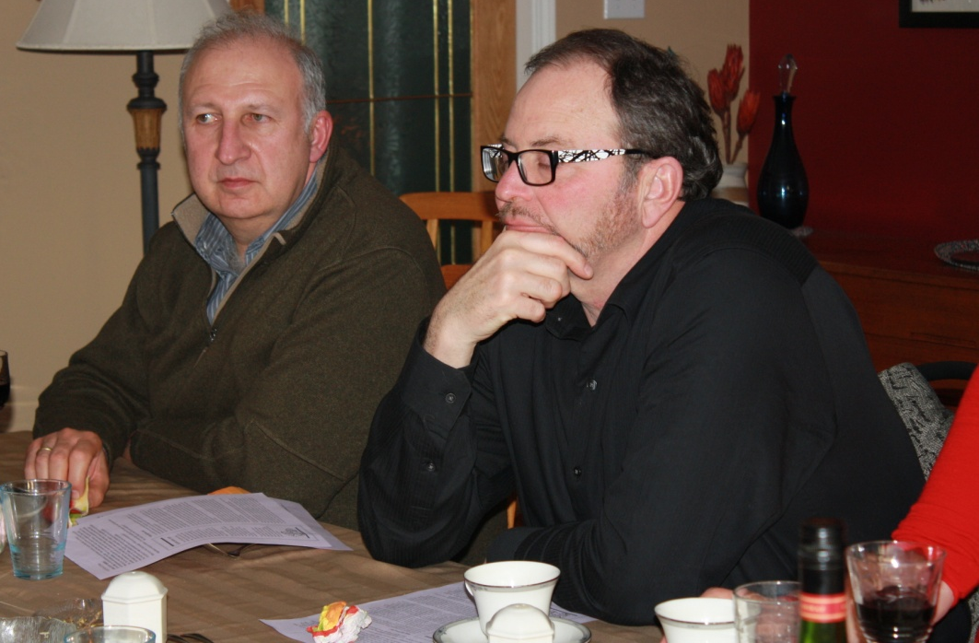
Laurier Heights
Neighbourhood Engagement Team
...engaging neighbours in being community and sharing our gifts and assets to make our neighbourhood an even better place to live.

Slide 26
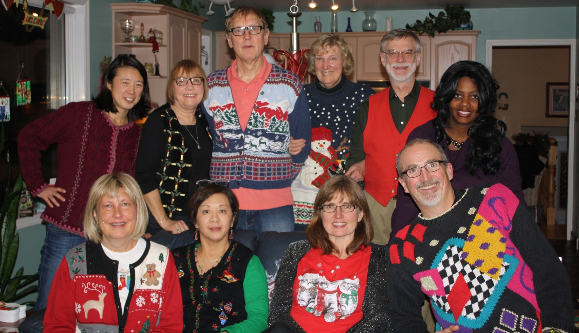
From strangers to acquaintances to relationships
“I now know my home is bigger than my house.”

Slide 27
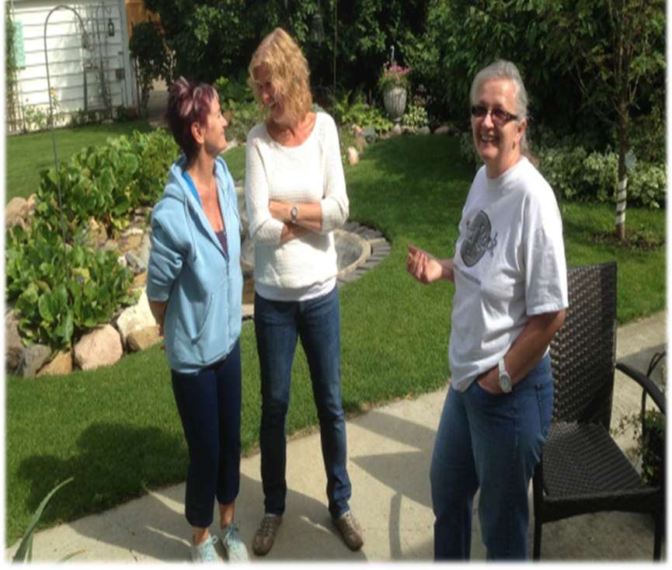
Human Scale:
Neighbour to neighbour

Slide 28
GIFTS
GIFTS

Slide 29
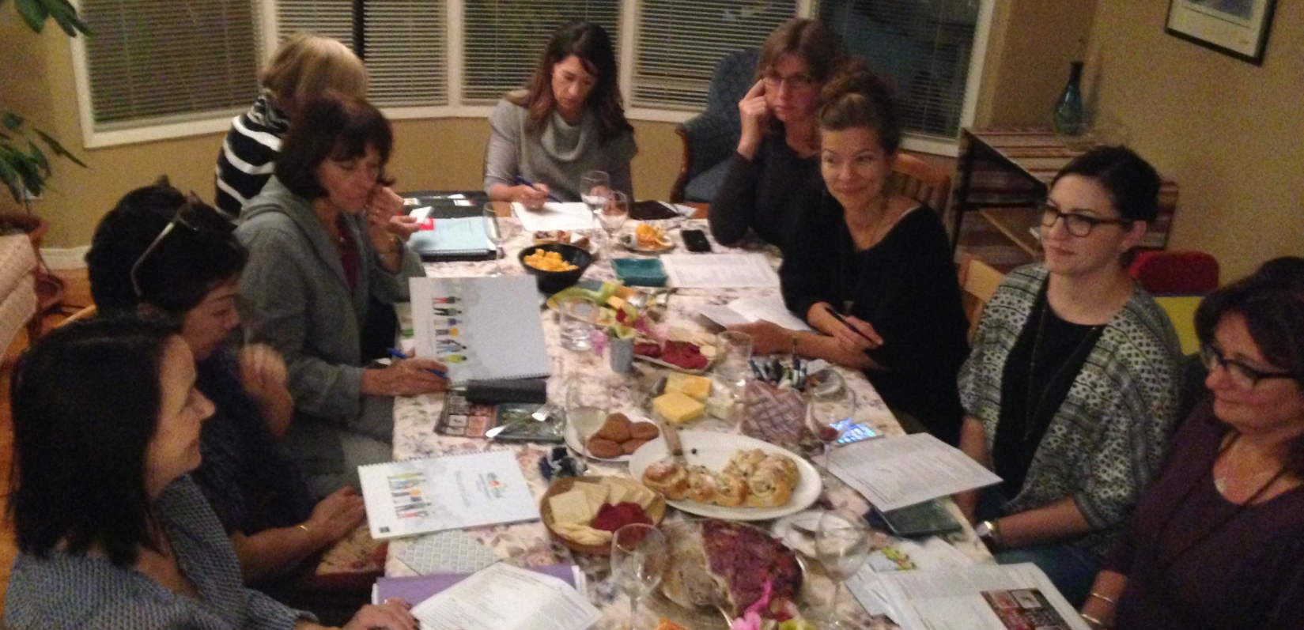
A Block Connector is the Point Person, Party Person and Listener on their ‘block’

Slide 30
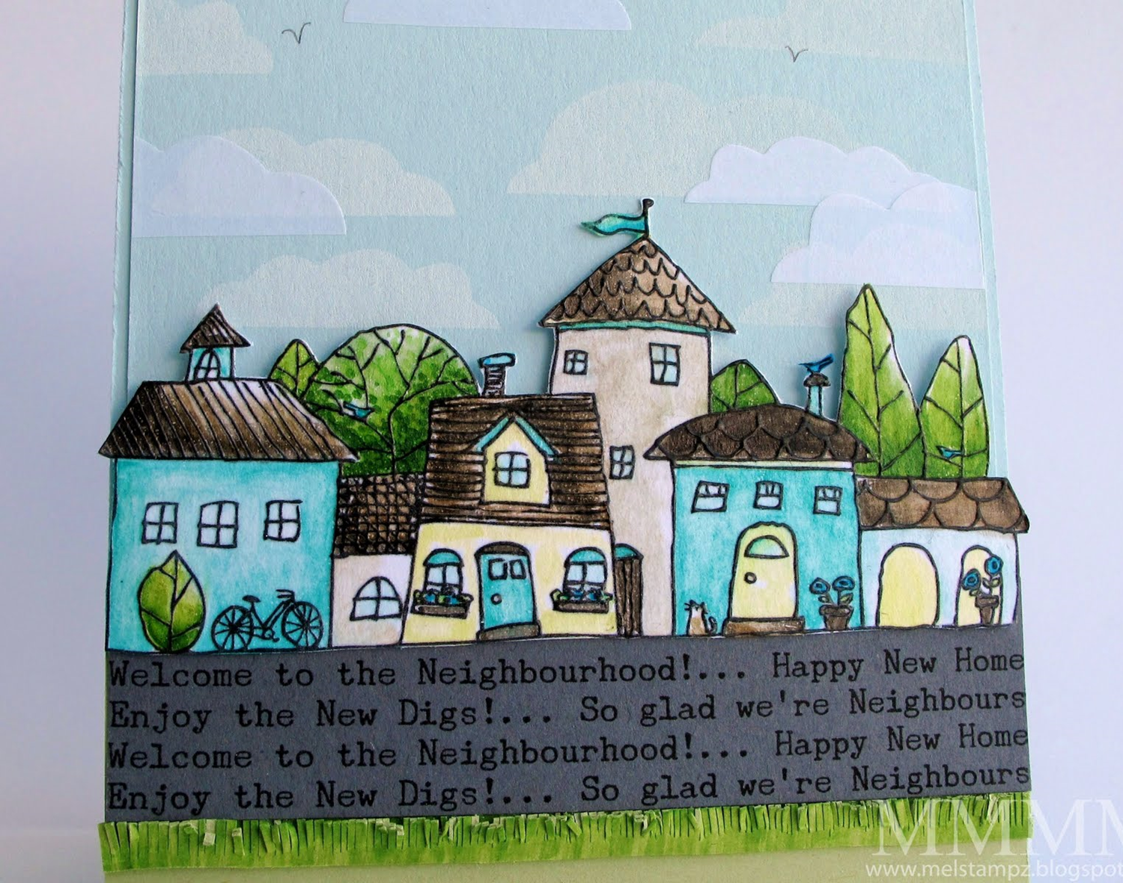
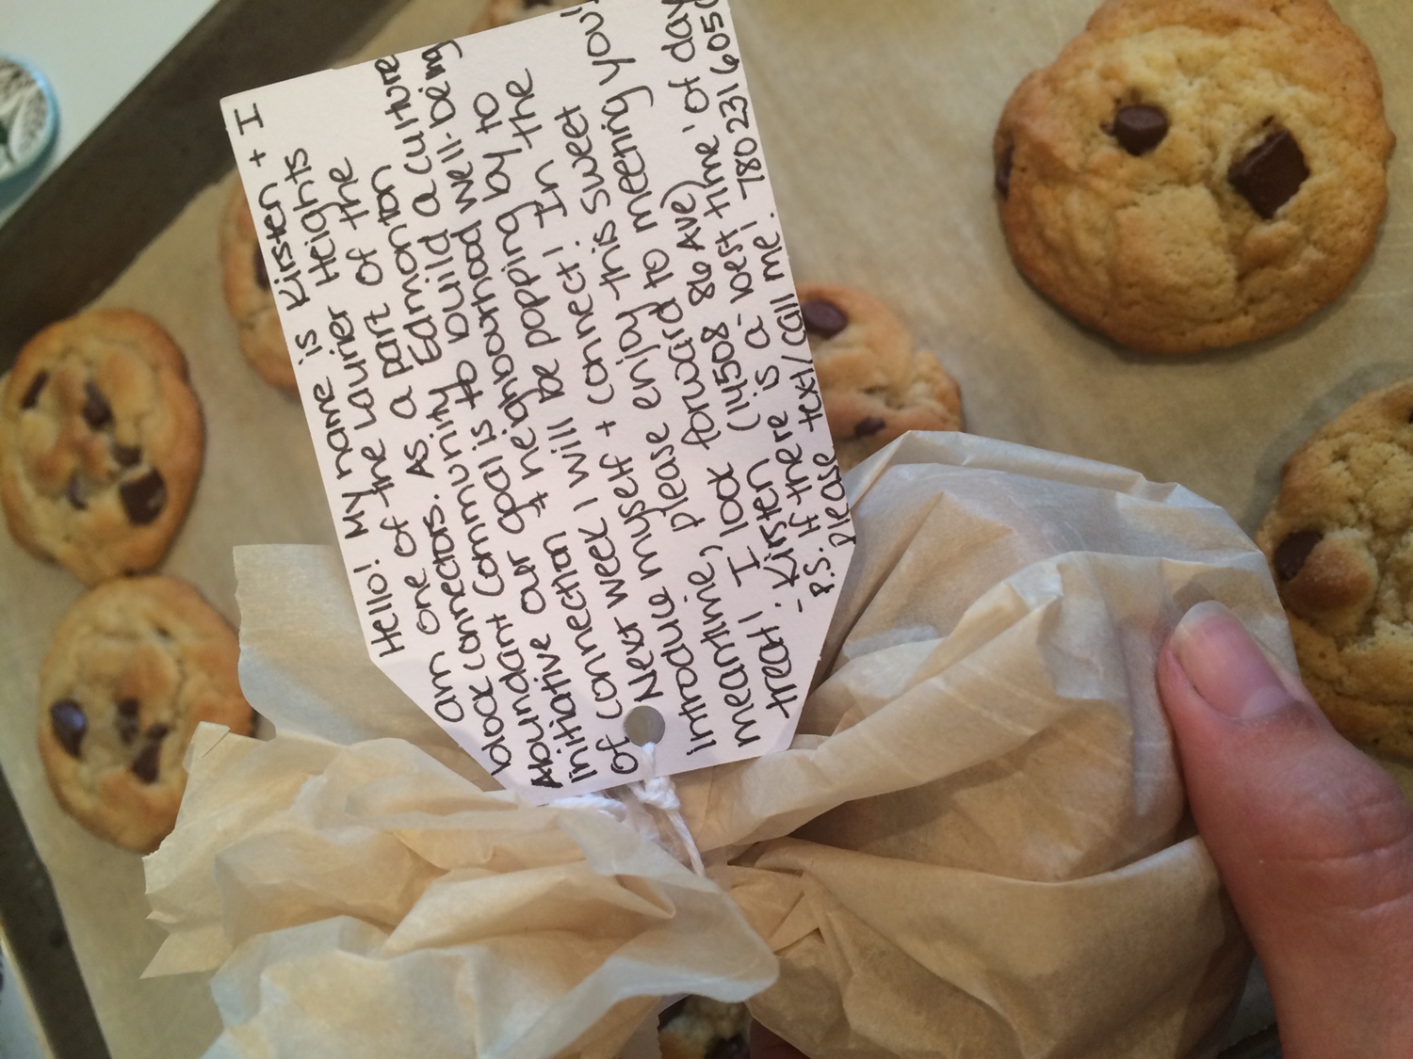

Slide 31
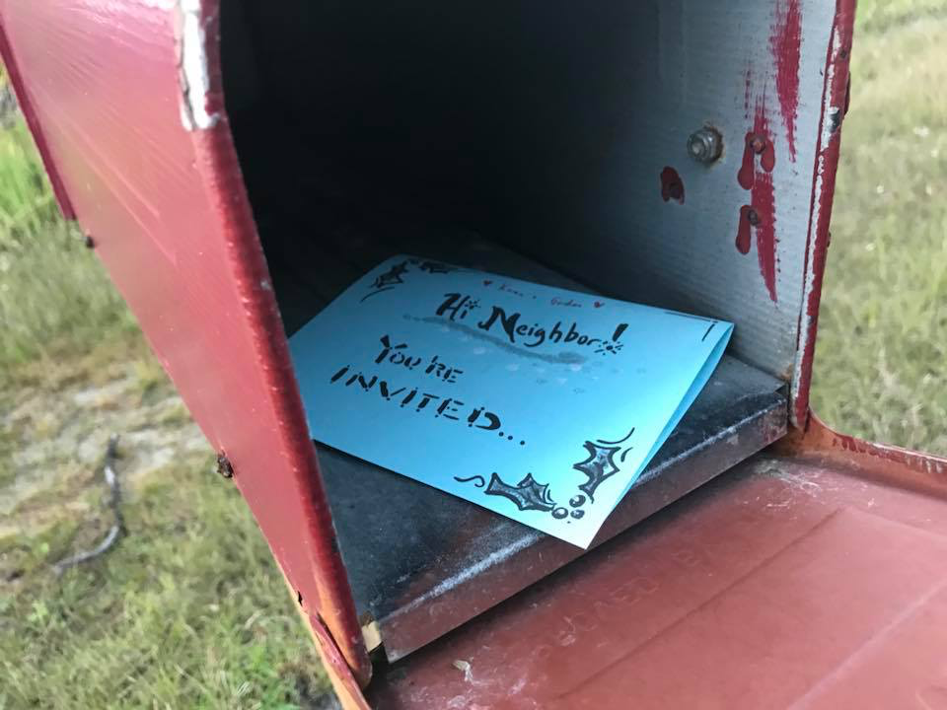
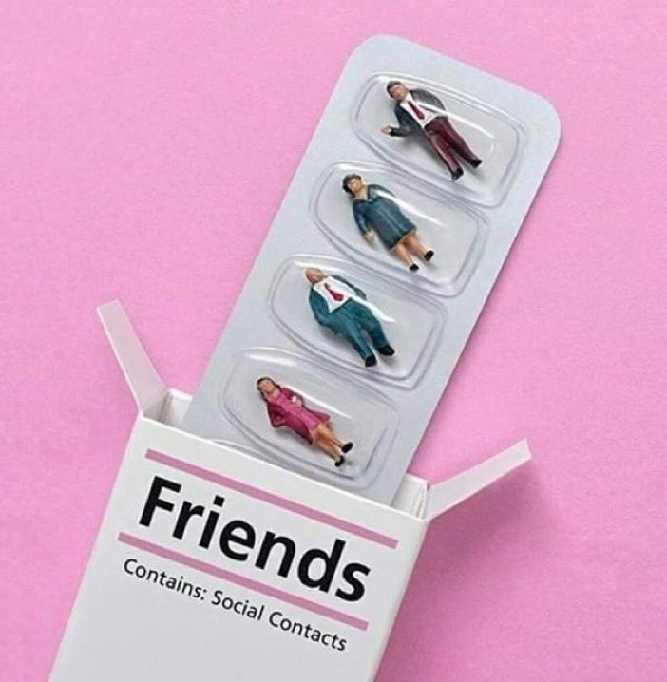

Slide 32
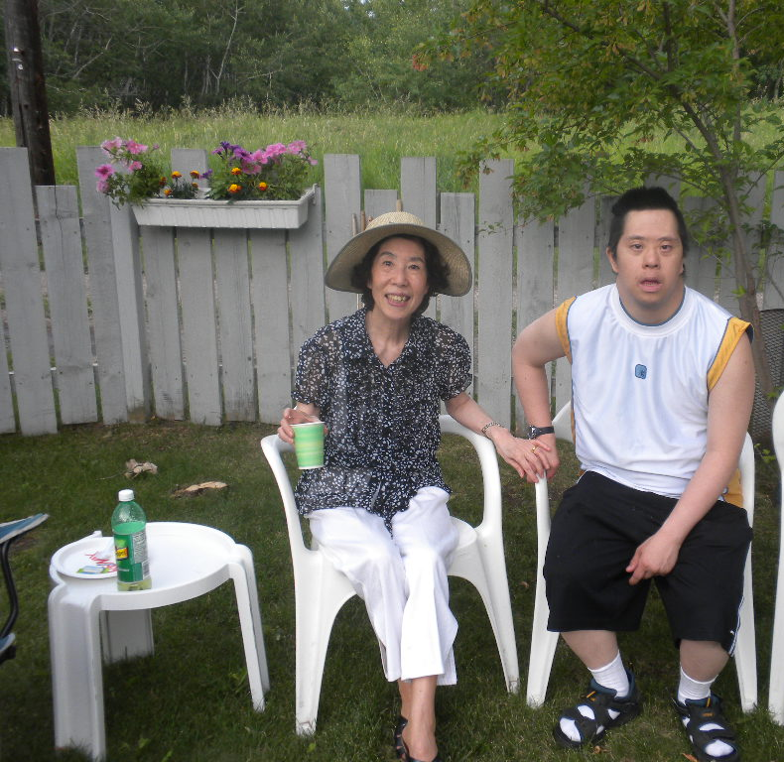
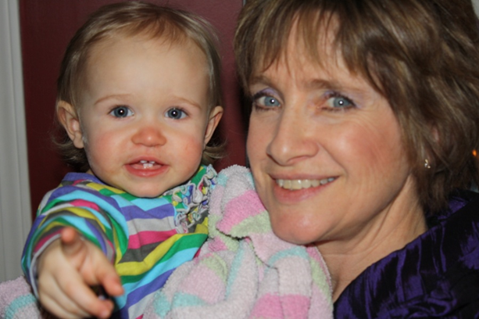
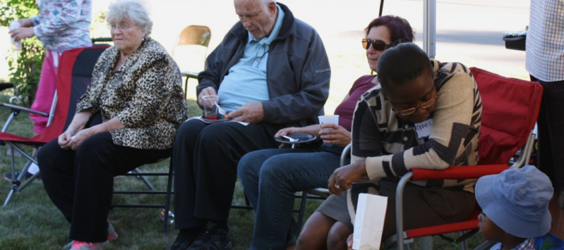
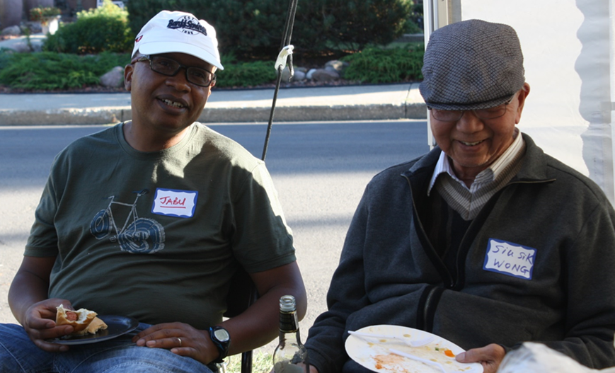

Slide 33
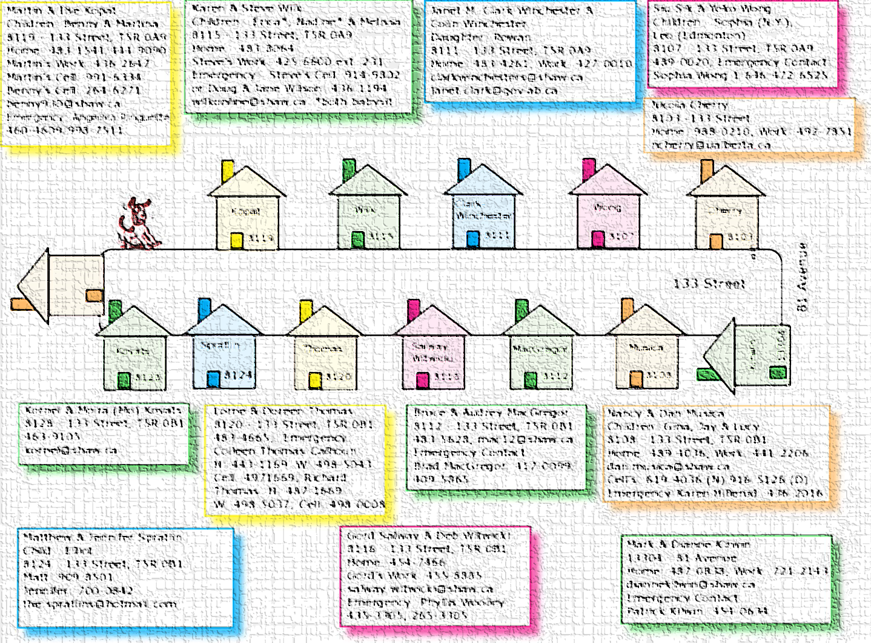
Making connections

Slide 34
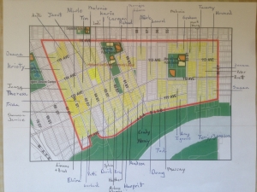
Block Connectors: Initiate Conversation

Slide 35
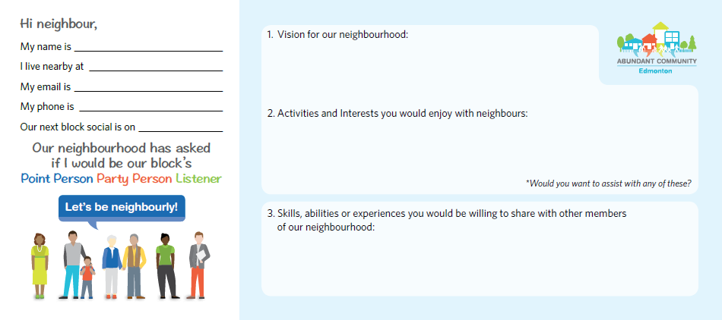

Slide 36
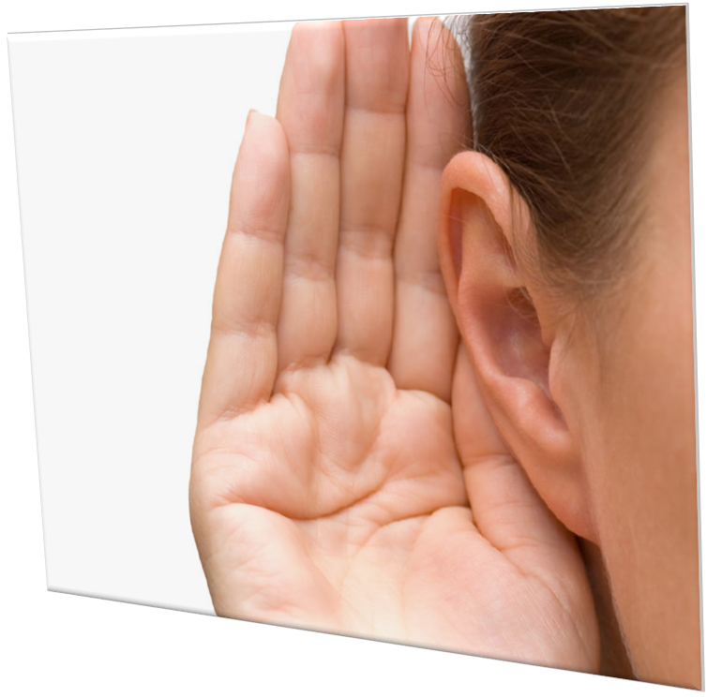
These Asset Based Conversations...
Vision | Inform neighbourhood leadership in their decision making regarding projects, programs and services Later on...could inform municipality on civic matters
Activities & Interests | Share opportunities to join existing groups/activities in the neighbourhood Form new groups of shared interest
Skills, Abilities & Experience | Discover and engage untapped human assets (skills, abilities and experiences of neighbours) Neighbours helping neighbours; More neighbours contributing to making the neighbourhood a better palce to live for all.

Slide 37
Notes:
Discoverables vs. deliverables

Slide 38
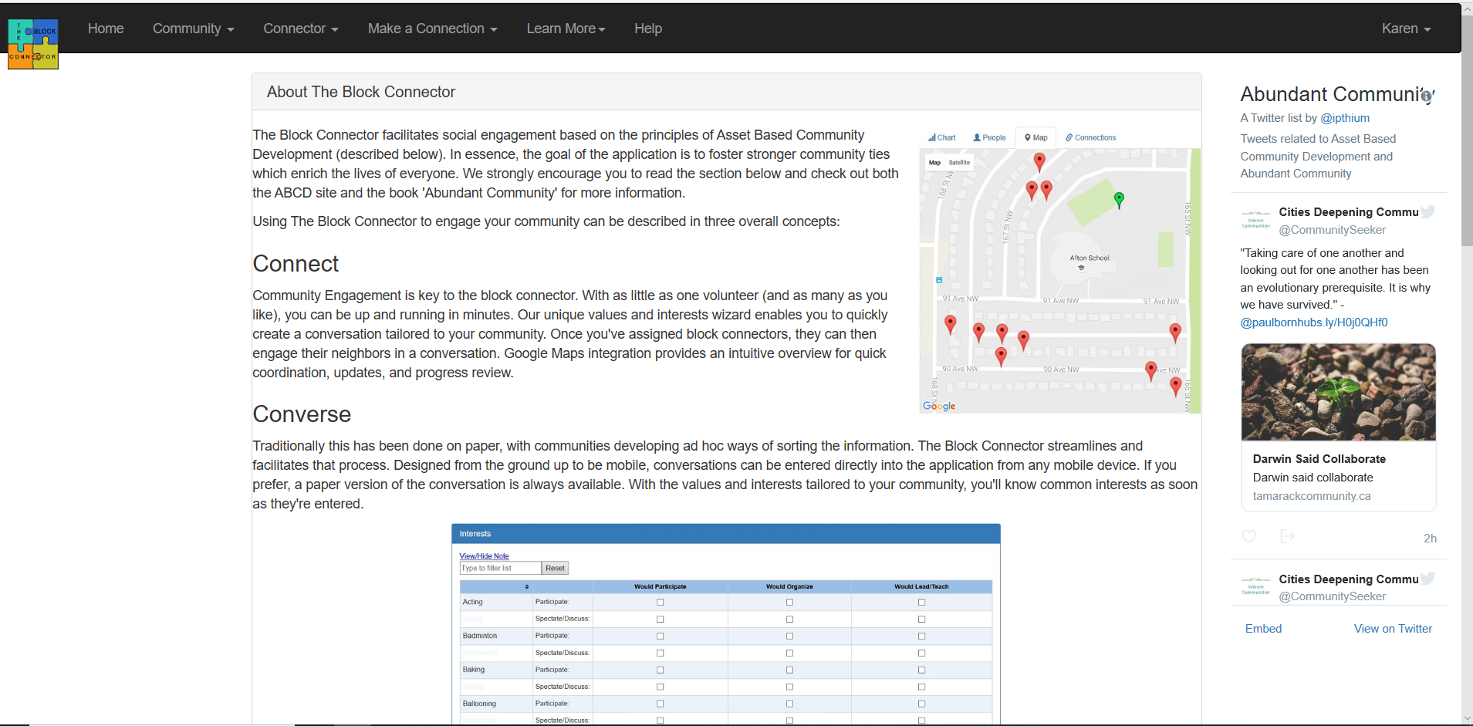
https://www.theblockconnector.com

Slide 39
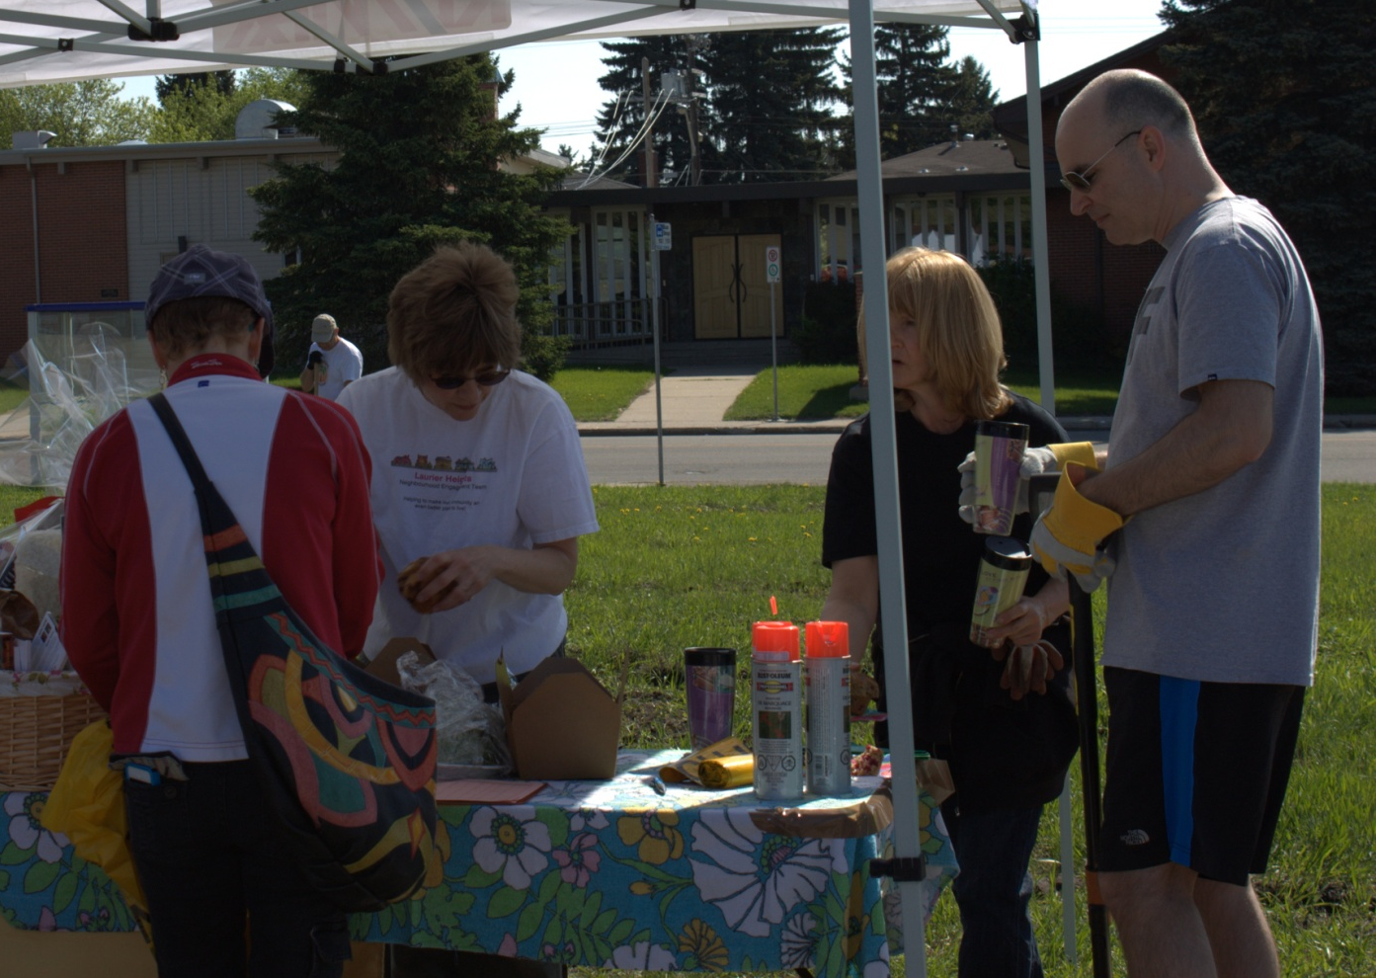
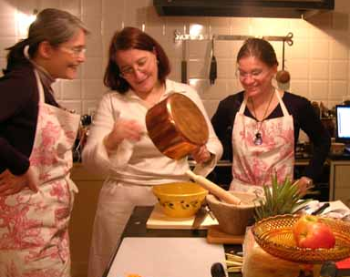
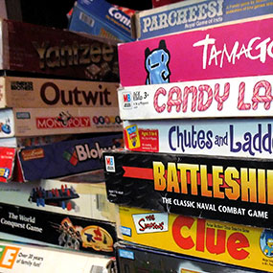
Groups form through conversations that identify shared interests, gifts & skills
Notes:
Community wellness

Slide 40
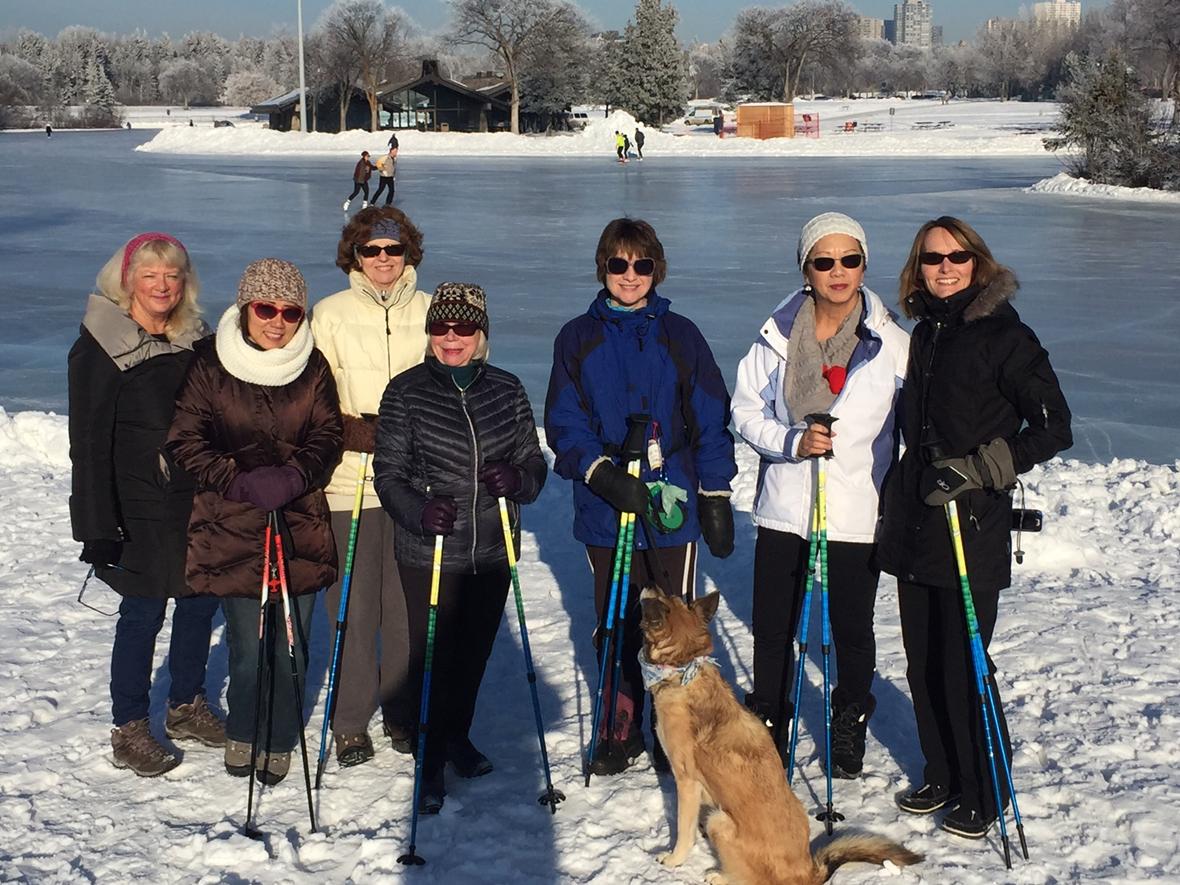
Nordic Walking Group

Slide 41
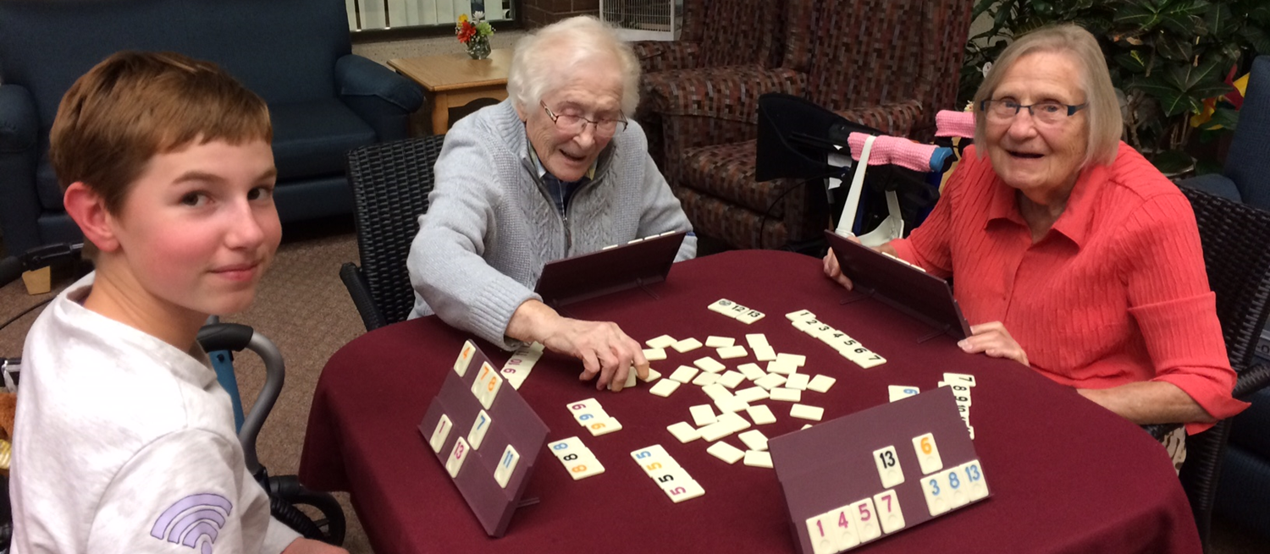
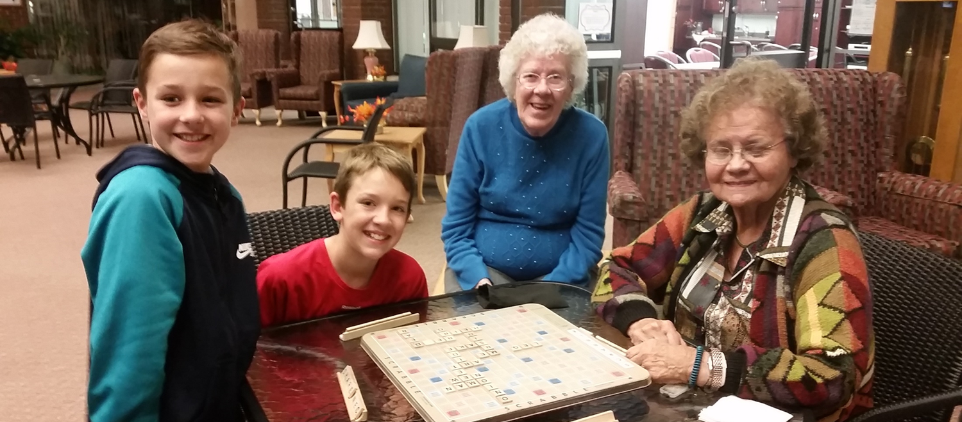
Canterbury Games

Slide 42
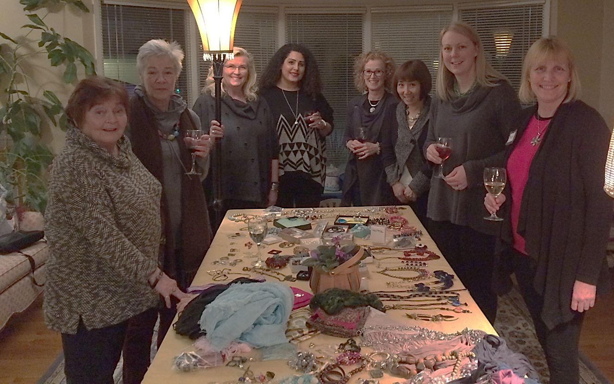
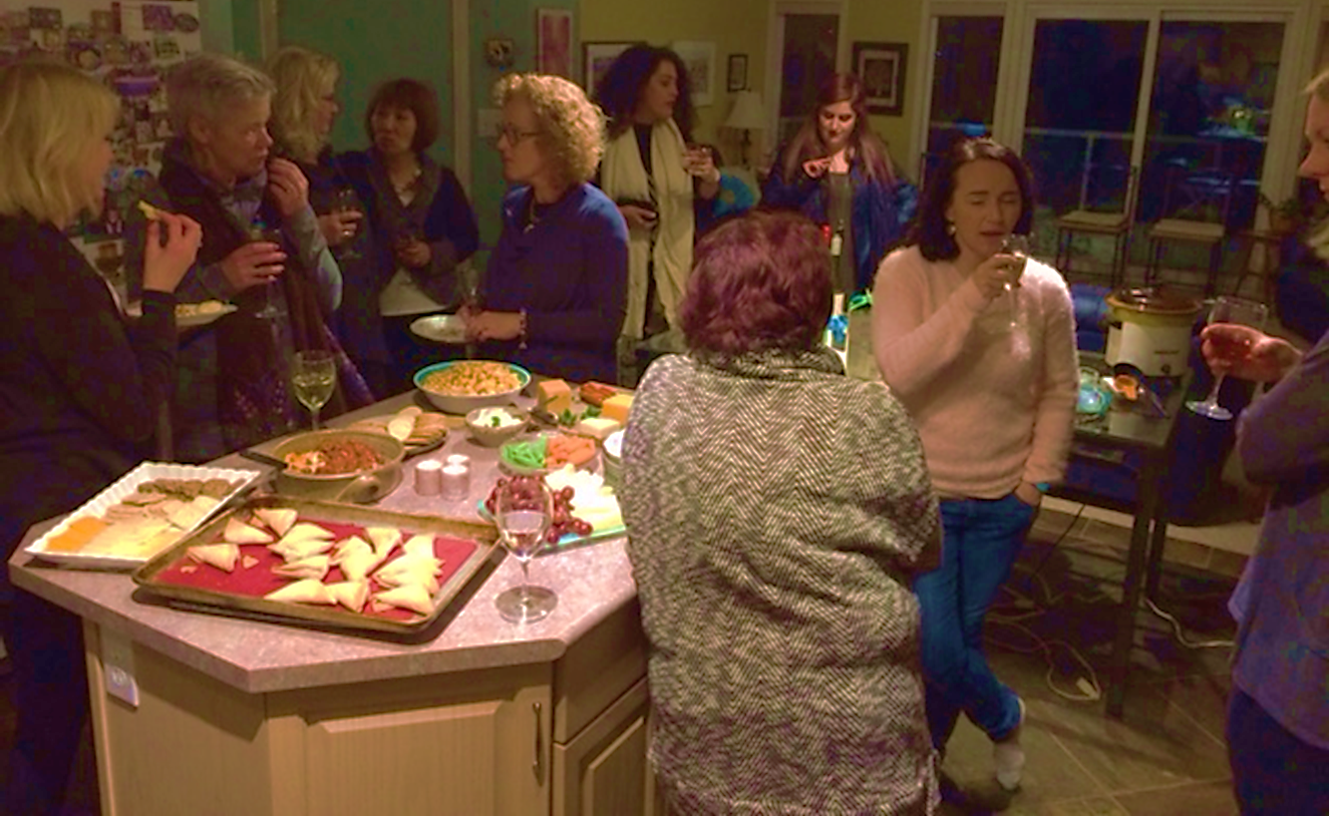
WWW- Women ‘n Wine on Wed.’s

Slide 43
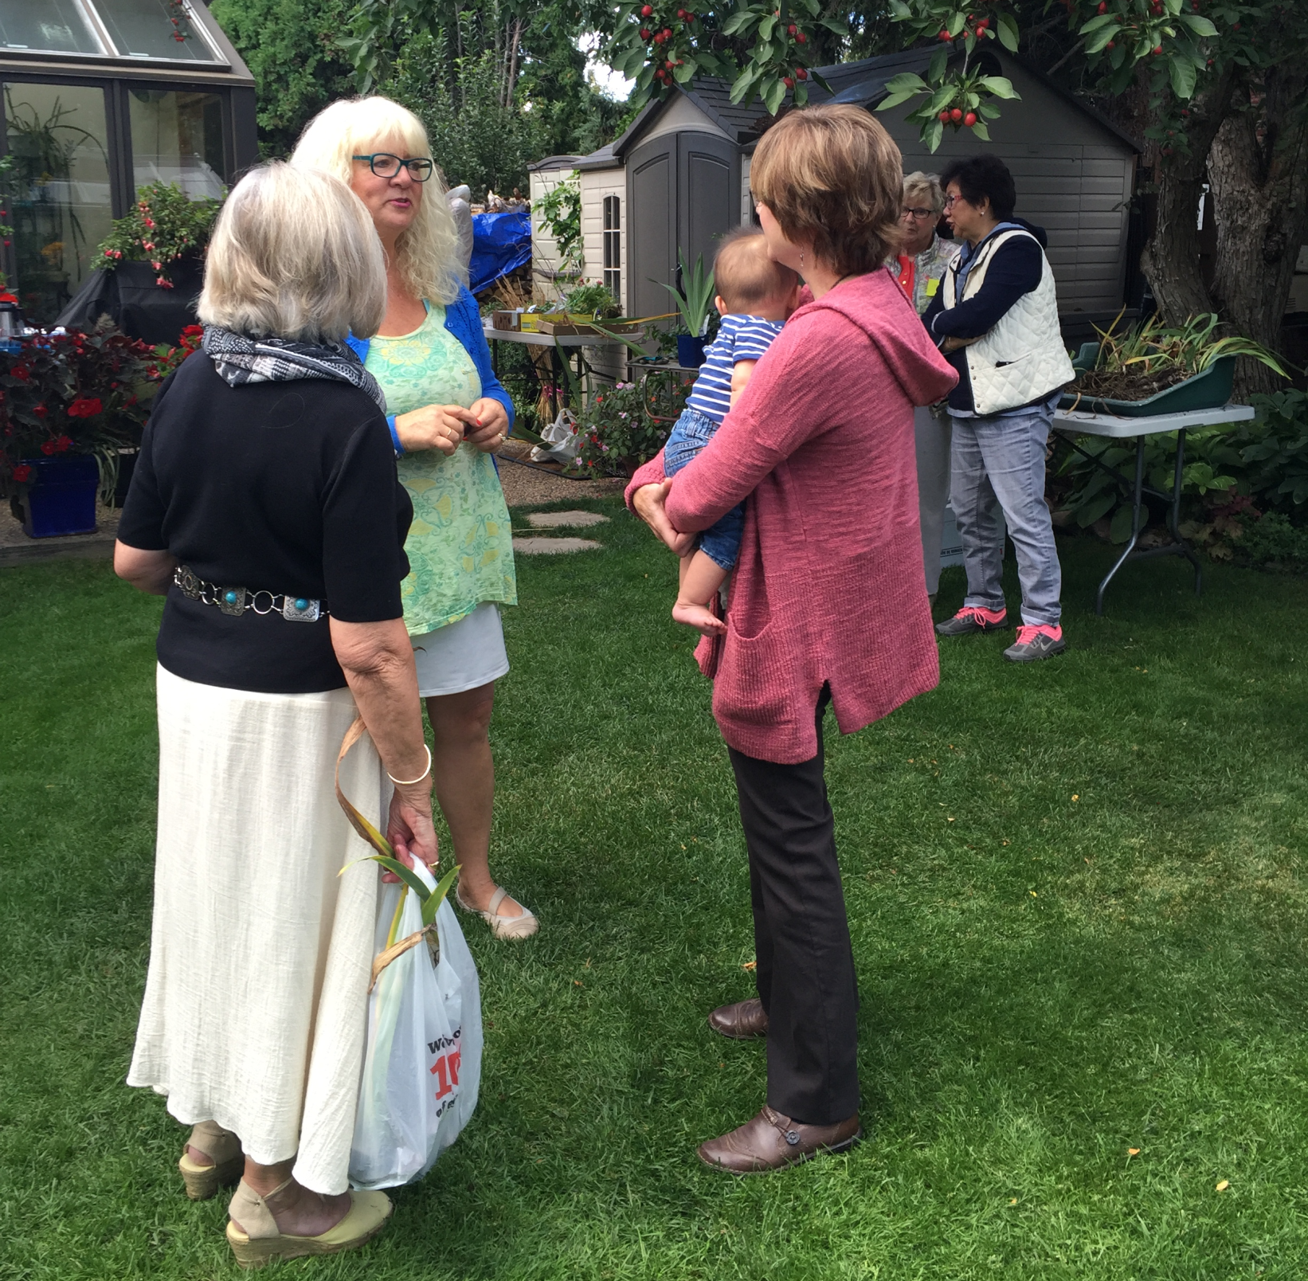
Talking Gardens

Slide 44
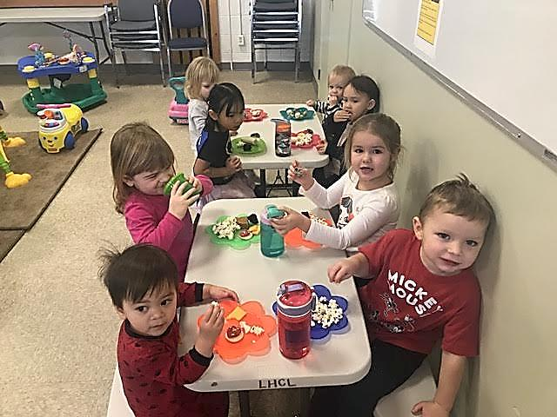
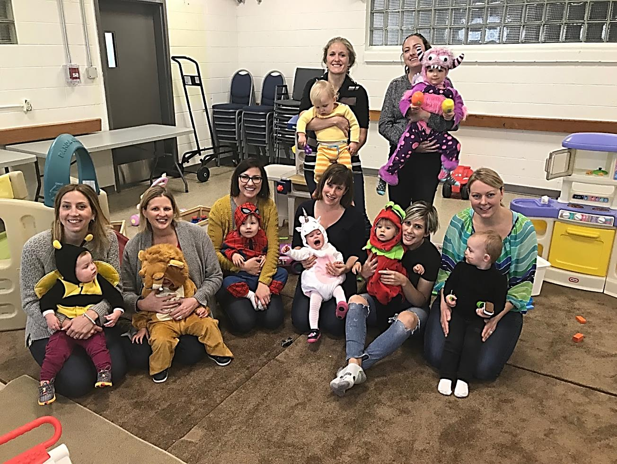
Play Group

Slide 45
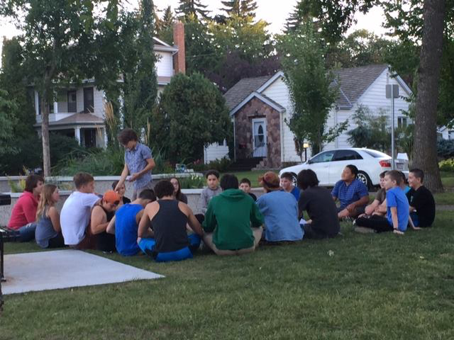
Youth Group
Notes:
Run by the Neighbourhood teens
Mentored by the 20 Something's
Supported by the Parents
Endorsed by Community Leadership
Anticipated by the Grade 6’s
Celebrated by the Neighbourhood!

Slide 46
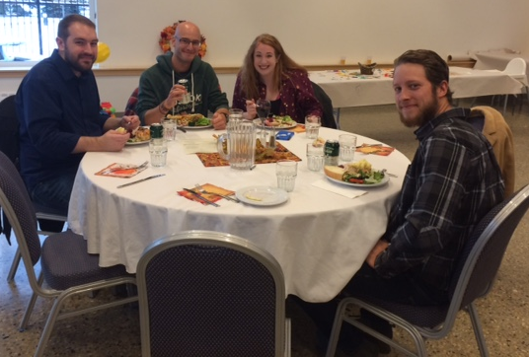
Monthly Community Potlucks
Crappy Dinners
Progressive Dinners
Sips & Tips

Slide 47
Digital Story
My House is Bigger than My Home
By Karen Wilk
Video link to be added

Slide 48
World Café (30 min)
Questions
How could your community leverage:
A similar neighbourhood leadership model?
A similar ABCD model?
What will you do differently now that you have heard about these experiences?
What could a partnership like this look like in your city? Where would you start?

Slide 49
Homework!
What does neighbouring mean to you?
Send a sentence and a photo
Email Debra.Jakubec@edmonton.ca

