Slide 1
Together we’re connected, building Strong Neighbourhoods
Notes:
Introduce myself

Slide 2
Why Deepen Community?
“It was a windstorm that collapsed our neighbourhood fence that actually brought the whole neighbourhood together. Before this incident some of us knew each other, but after we came together to rebuild the fence with the help of the 'Strong Neighbourhood' grant program we now all know each other, and have committed to continue to arrange gatherings to stay connected…Truly knowing your neighbours is what makes a neighbourhood worth living in.”
- Paul M., Neighbourhood Grant Recipient
Notes:
… We have found that the neighbours we had only glimpsed occasionally are all wonderful folks.
This act of coming together and getting to know one’s neighbours can seem trivial; and yet, as an ever increasing number of municipalities are discovering, the simple act of connecting and engaging with those in close proximity can dramatically enhance quality of life.
Increased safety

Slide 3
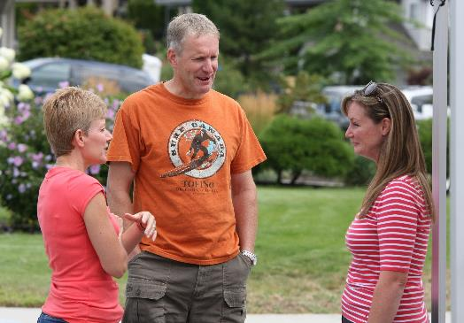
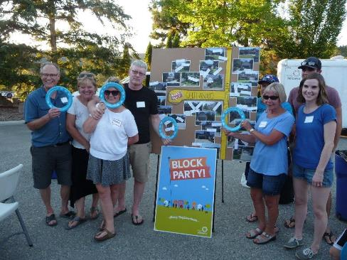
The Start of Strong Neighbourhoods
Work undertaken was guided by:
City Council’s priorities
Corporate framework
Divisional drivers
Notes:
Work undertaken by the City of Kelowna is guided by City Council’s priorities, the corporate framework, and divisional drivers. The current Council has articulated six focus areas and priority projects for their term; one of the identified focus areas is: “ensuring a healthy, safe, active and inclusive community”. Within this area, Council has identified the Strong Neighbourhoods Program as a priority project. Similarly, the corporate framework identifies “an active, inclusive city” as a focus area and lists “strengthening our neighbourhoods” as a key component. Within Active Living & Culture, two of the four divisional drivers are: “working to build effective partnerships, strong neighbourhoods and connected community; [and,] building healthy, active individuals and families”.
As the City of Kelowna strives to be the best mid-sized city in North America, fostering engaged and connected neighbourhoods has become a priority.
In 2014, the Community and Neighbourhood Services branch of the City of Kelowna’s Active Living & Culture Division, undertook a large scale community engagement effort in order to understand what residents of Kelowna valued in their neighbourhoods. They used this information to create a series of pilot initiatives aimed at enhancing neighbourhood life. The pilot phase has concluded, evaluation of the programs demonstrated positive results, and the initiatives have continued. These innovative programs tend to focus on fostering feelings of connection, engagement and attachment within neighbourhoods.
The Strong Neighbourhood Project was established as an eighteen month pilot project, during which time project staff conducted community engagement conversations and invited Kelowna residents to complete a survey regarding citizen attachment to the community online or in-person. With this information, staff developed, launched, implemented and evaluated a suite of pilot projects.

Slide 4
Strong Neighbourhoods
Neighbourhood Grant
Neighbourhood Events
YDEG
Grant
Park & Play
Active Living & Culture
Notes:
Good neighbour toolkit
SN toolkit
Neighbourhood Events
Neighbourhood Grant
Webpage
Park & Play
Based on the information obtained during the engagement and research, five pilot projects were developed and implemented in 2015. The intention was to foster neighbourliness, inspire leaders, and empower residents. In addition to the pilot projects, the existing Park & Play program was enhanced so that it also supported these focus areas.
Grant
It’s an opportunity for residents to lead, develop and implement projects that make their neighbourhoods even better places to live with a matching grant of up to $1,500.
Focus areas: Leadership, Relationships, Social Offerings, Safety, Aesthetics
Inspire residents to connect with their neighbours
Stimulate resident initiated neighbourhood enhancement projects
Encourage resident involvement in making their neighbourhoods even better places to live
Programs to support connection and engagement of residents

Slide 5
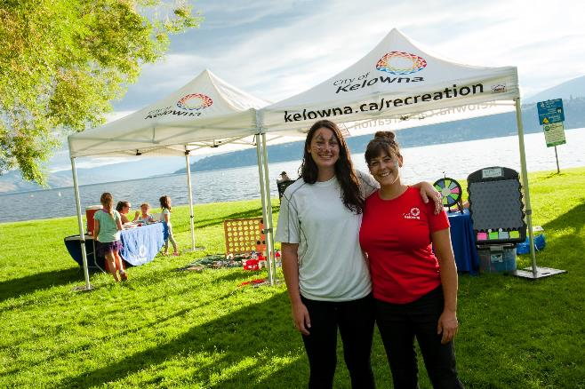
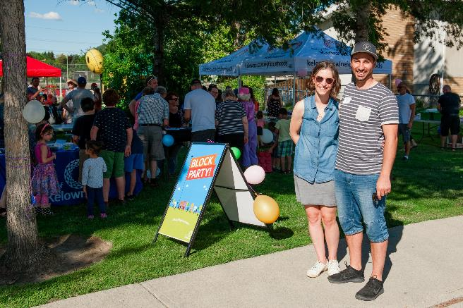
Who leads the work?
Supporting residents to lead the way
Notes:
City has programs/initiatives to help residents
Tools and resources for residents to lead the way
How this is done
Resident led, City supported

Slide 6
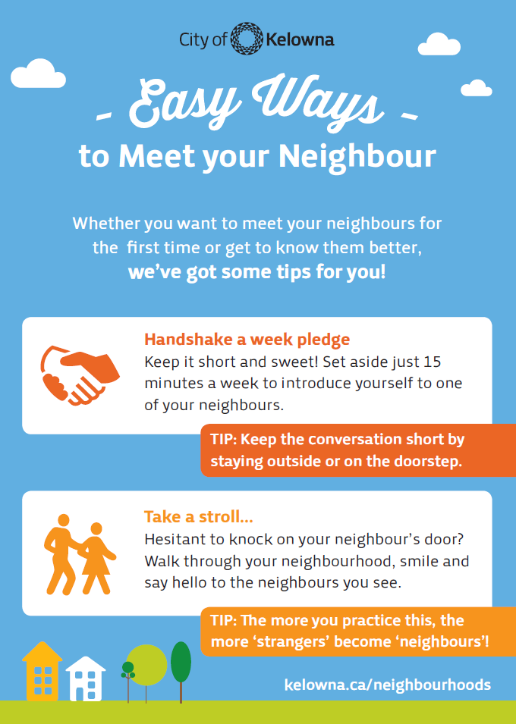
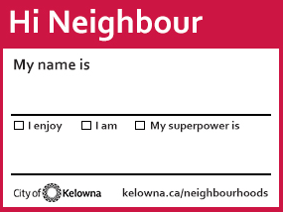
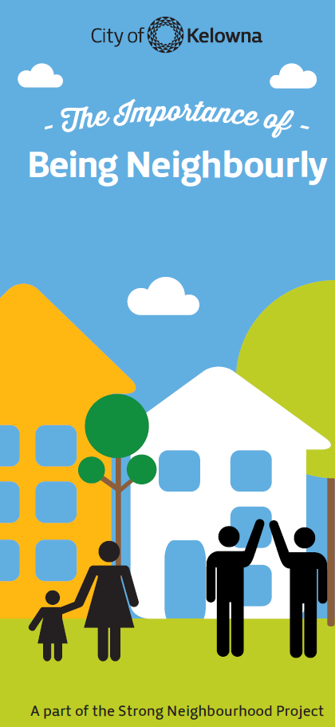
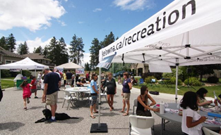
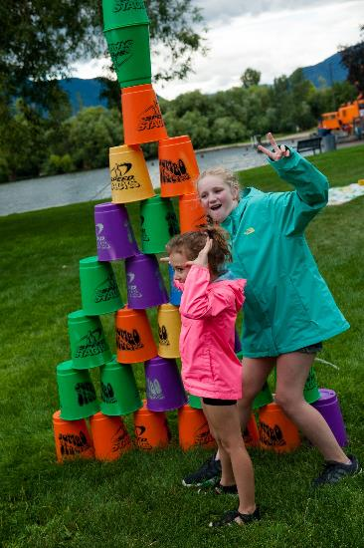
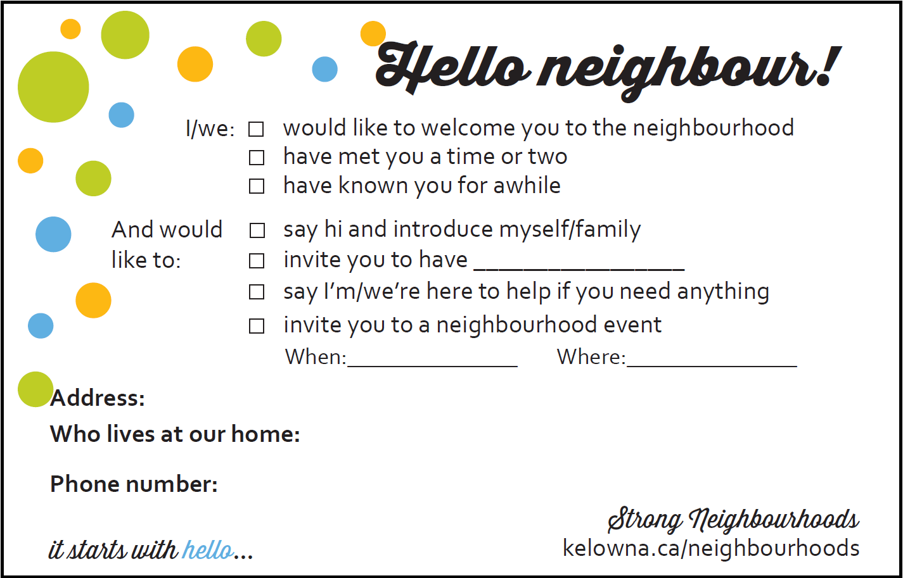
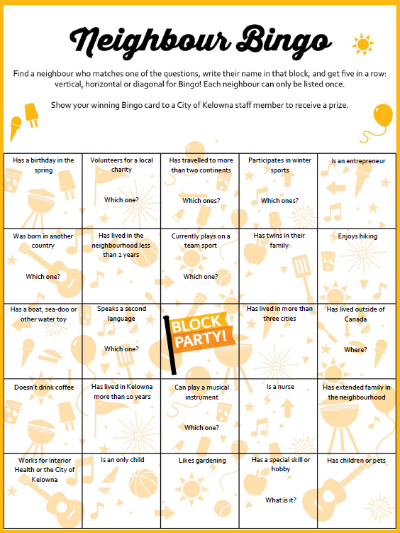
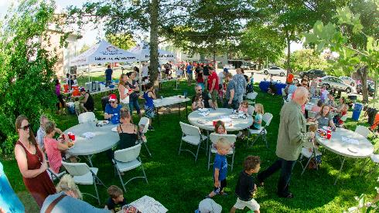
Building on Momentum
Progressing Neighbourhood Events
Notes:
block parties to mini event toolkit
Benefits
Residents still receive support, $100 gift card
Can support more different neighbourhoods

Slide 7
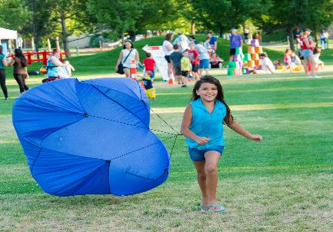
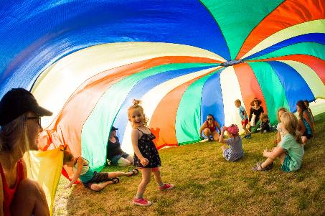
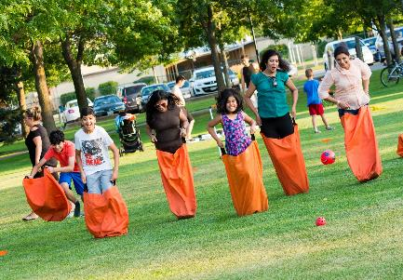
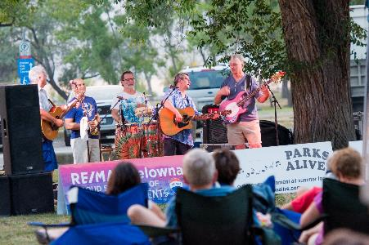
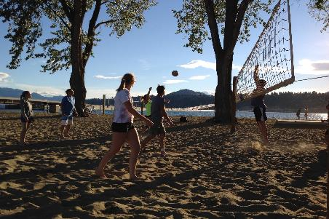
Building on Momentum
Progressing Park & Play
Notes:
Bouncy castle, Zorbs, Adult Zone, Festivals Kelowna (Youth / lower SES populations)

Slide 8
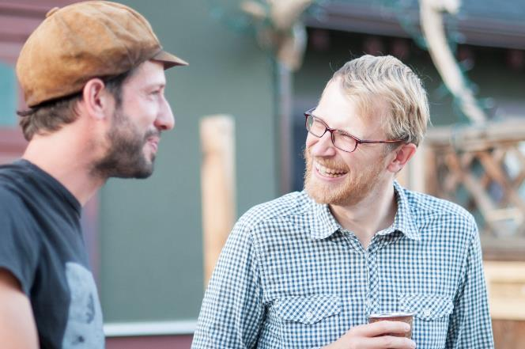
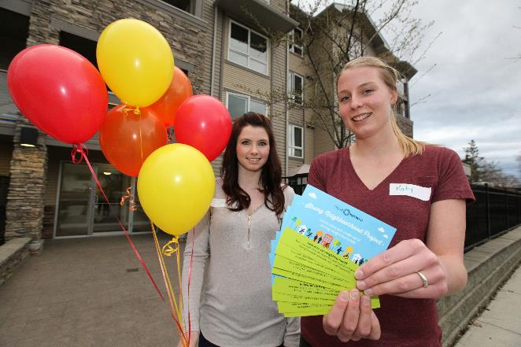
Future Plans
Establishing block and neighbourhood connectors
Neighbourhood strategy
Notes:
Building on momentum

Slide 9
3 Lessons Learned
Building relationships is important
Engage early and often
Engagement process should be flexible and responsive
Notes:
1. Importance of connecting neighbours and how residents give back to the City reducing City time/budget from implementing. What residents can do when they come together.
2. Meet them in the neighbourhood. Invite neighbours to all share ideas as we don’t have a connector program yet. Build trust, ownership and relationships
3. Thoughtful process design and different tools needed to match interests and assets of neighbourhoods.
Plan with different SE barriers and background in mind

Slide 10
Thank you!
Tanya Sletten, MSc Community Development Coordinator | City of Kelowna 250-469-8723 | tsletten@kelowna.ca
kelowna.ca/neighbourhoods

