Slide 1
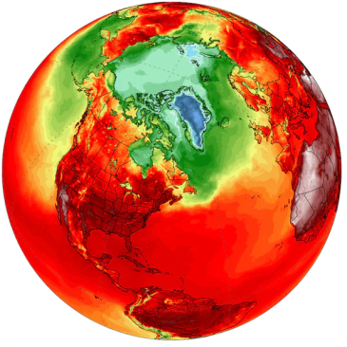
ABCD
Healthy Neighbourhoods, Healthy Cities Conference
May 28-30 | Edmonton, Alberta
Emergency Preparedness Builds Social Capital
Facilitated Panel Discussion
Notes:
Thank you for attending today’s session that will provide a bit of insight-- from those who have walked these paths before --about the role of citizens in disaster preparedness, and how, through those preparations and planning, a sense of community can emerge.
And speaking about walking these paths before… I wish to remind everyone we are gathering on Treaty Number Six territory. For centuries, footsteps from a diversity of Indigenous people, such as the Cree, Saulteaux [Sole-toe], Blackfoot, Dene and Nakota Sioux have marked –and continue to mark– this land. We also acknowledge this as the Métis’ homeland, and the home of the largest concentration of Inuit south of the 60th parallel.
We have planned, what I you will find to be, an enlightening and engaging session for the next hour and a half. That time will likely go by quickly, so I am going to get us started. Let me begin with this to set the stage: It has been said that in an emergency situation, a first responder is not the first responder. Rather, the first responder is your neighbour.

Slide 2
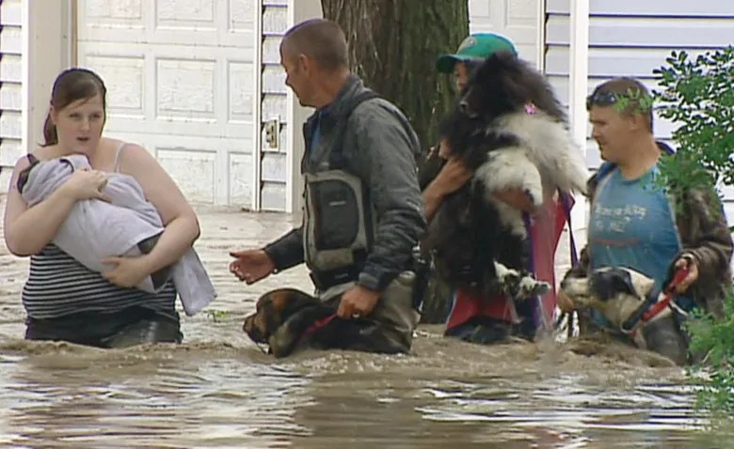
Photo credit: cbc.ca/news
Notes:
https://www.cbc.ca/news/canada/calgary/high-river-flood-alberta-uncertain-future-1.4710837
The people in these photos are probably neighbours.
~PAUSE~
Just imagine if they actually knew each other BEFORE disaster hit…

Slide 3
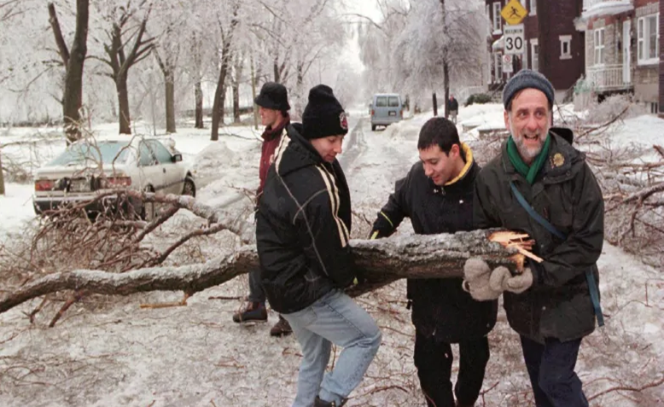
Photo Credit:
Ryan Remiorz/Canadian Press
Notes:
https://www.cbc.ca/news/canada/montreal/ice-storm-1998-1.4469977

Slide 4
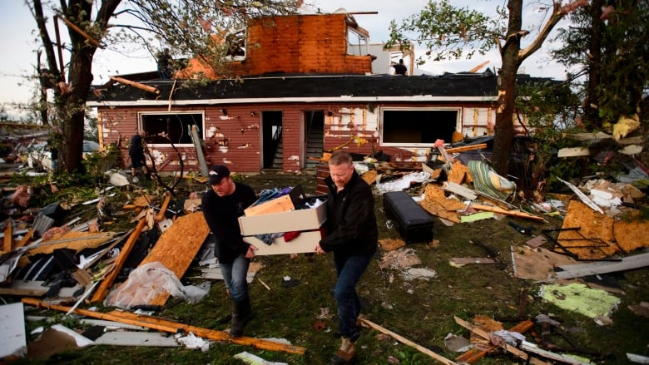
Photo Credit: Sean Kilpatrick/Canadian Press
Notes:
https://www.cbc.ca/news/canada/ottawa/what-you-should-know-after-tornado-1.4834605
(Photo Credit: Sean Kilpatrick/Canadian Press)

Slide 5
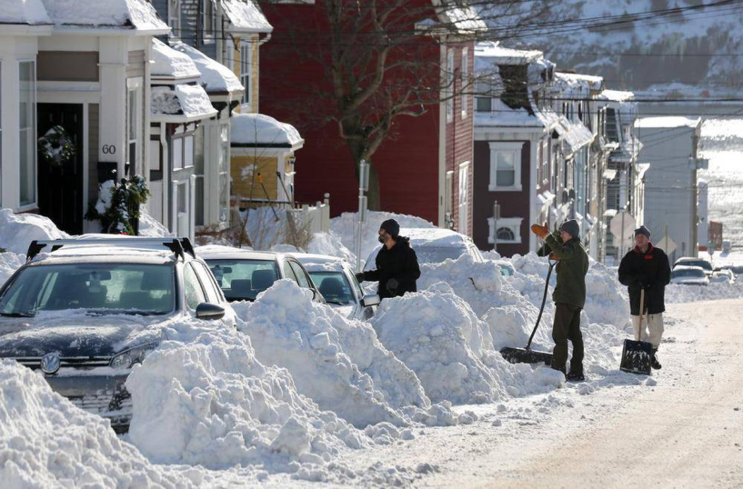
Photo Credit: Paul Daly/The Canadian Press

Slide 6
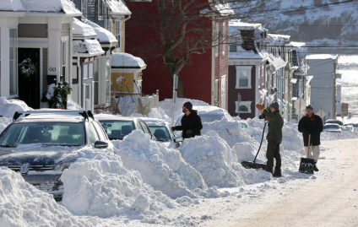
Photo credit: cbc.ca/news
Photo Credit:
Ryan Remiorz/Canadian Press
Photo Credit: Sean Kilpatrick/Canadian Press
Photo Credit: Paul Daly/The Canadian Press
Notes:
The people in these photos are probably neighbours.
~PAUSE~
Just imagine if they actually knew each other BEFORE disaster hit…

Slide 7
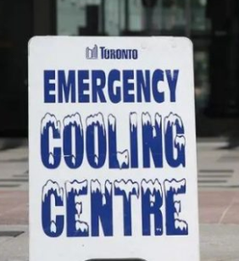
PANEL DISCUSSION SESSION STRUCTURE
Meet the Panel
Presentations
Table Talk
Q & As
2018
(Timothy Neesam/CBC)
2
Notes:
This afternoon’s session is about how preparing for emergency situations is a good way to build a sense of community. We are told that we should always have enough food, water and so on hand to get us through at least 72 hours, in case of an emergency. I have also been told that emergencies only occur when we are not prepared. If we are well prepared for impacts, the emergency bells don’t play quite so loud.
This 90-minute sessions will include brief presentations on different types of emergencies and the role of community planning. Presentations will be followed by an opportunity for you, at your table, to have brief discussions, ending with a suite of questions that you --or I-- pose to our panelists.

Slide 8
MEET THE PANEL
Eva Bogdan, PhD Candidate, UofA
Sarah Hunn, City of Victoria
Adam Conway , University of Alberta
Heather Wheeliker, City of Edmonton
Panelist
Panelist
2018
Panelist
Facilitator
2
Notes:
So first, let’s meet our panelists.
Eva Bogdan…
Sarah Hunn…
Adam Conway...the Team Lead of Emergency Management at the University of Alberta since 2010, and the team lead for Safety Implementation and Collaboration since 2015.
He is responsible for the University's readiness for a major emergency, including readiness, response and recovery, and the integration of safety tools into workplaces.
He has been an emergency manager since 1999, first with the Canadian Red Cross Society for 6 years, then with the provincial EMO in Alberta, the Alberta Emergency Management Agency, for 4 years.
He has responded, in a variety of roles, to floods, fires, tornadoes, chemical releases, shootings and humanitarian crises.
In his spare time, he is a father and husband, and an enthusiastic member of the performing arts in Edmonton
And I’m Heather Wheeliker; I’ll be facilitating today’s sessions. I work for the City of Edmonton in the Policy and Environmental Management Unit, which is part of the Economic and Environmental Sustainability Branch. I provide community and staff engagement and programming in support of the City’s Environmental Management System, and Climate Adaptation and Resilience.

Slide 9
PRESENTATIONS
Heather: Climate Resilient Neighbourhoods
Eva: High River Case Study
Sarah: VictoriaReady
Adam: UofA Emergency Management
Presentations
2018
2
Notes:
Here is our outline for this morning.
I will present on Edmonton’s plan for developing Climate Resilient Neighhbourhoods.
Eva will provide a case study of her community experience at the High River AB flood of 2013
Sarah will speak to emergency preparedness and climate resilience in Victoria BC.
Adam will share about Emergency preparedness at the UofA

Slide 10
CLIMATE RESILIENT EDMONTON Adaptation Strategy and Action Plan
Climate Resilient Neighbourhoods
ABCD, MAY 28-30 2019
EDMONTON ALBERTA
Heather Wheeliker

Slide 11
BACKGROUND & CONTEXT
Council’s Strategic Plan - ConnectEdmonton (2019-2028)
Goal: Climate Resilience
The Way Ahead Implementation Plan
2015/2016
2017
2018
Council Initiative
Nov. 2018 - climate adaptation strategy
Edmonton Declaration
CitiesIPCC Science and Climate Change conference
Impacts and risk management ⧫ Cities are directly vulnerable ⧫ Investment reduces exposure
3
Notes:
-To provide a bit of context, the City’s climate plans -- both mitigation and adaptation -- were identified in the City’s environment Plan called, The Way We Green - in 2011, as being key strategies that our City would need to develop in great depth, and again in The Way Ahead in 2016, and a specific Council Initiative. -
Last March, Edmonton hosted the world for the inaugural Cities IPCC Science and Climate Change conference where the Edmonton Declaration was put forward; to date, over 4,500 cities are committing to science-based climate action.
I’ll start with some context for the Climate Resilient Edmonton Startegy.
Id like to draw your attention to the right side of this image….
Climate mitigation and adaptation are part of Council’s most current strategy called ConnectEdmonton, where Climate Resilience is identified as one of Council’s four strategic goals.
-Last November, Climate Resilient Edmonton: Adaptation Strategy and Action Plan was presented at City Hall.
Bear with me as I tell you a little about the strategy.

Slide 12
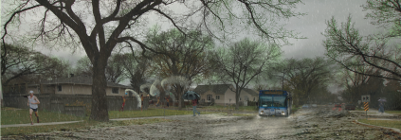
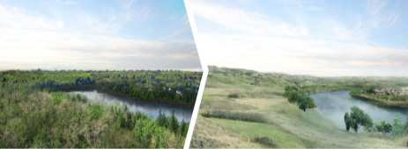
WEATHER or CLIMATE?
Weather
short-term, limited area, changes rapidly… happening outside now
Climate
long-term, wide area, changes gradually… average of weather over many years
4
Notes:
First, lets review some terminology.
Weather is short term phenomenon, it covers a limited area and changes rapidly. A good way to think about weather is that it is what’s happening outside now.
Climate on the other hand is long term, typically talked about at a wider spatial scale, and it changes gradually. Climate is the average of weather over many years, assessed at 30 year intervals.

Slide 13
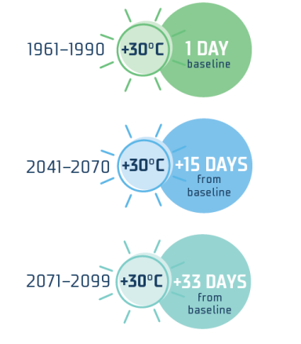
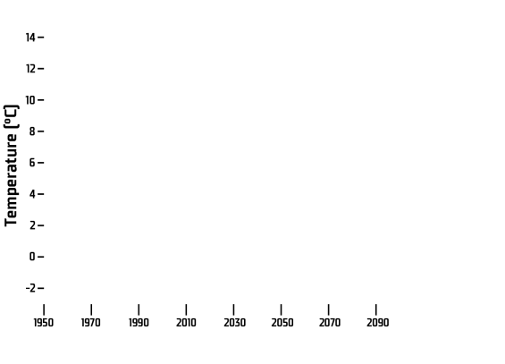
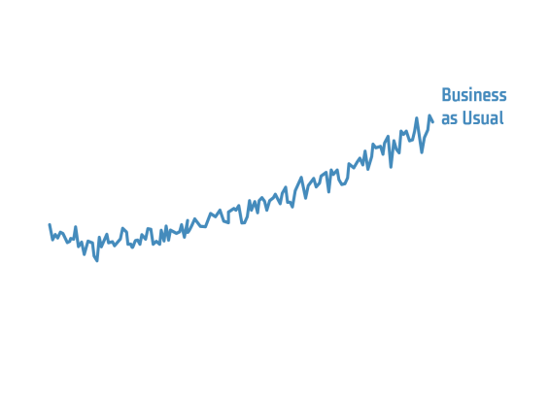
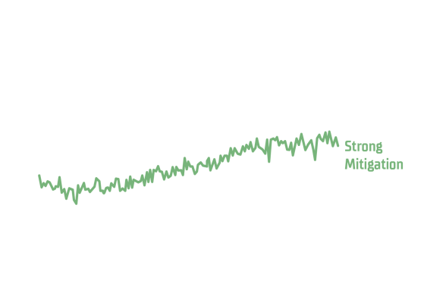
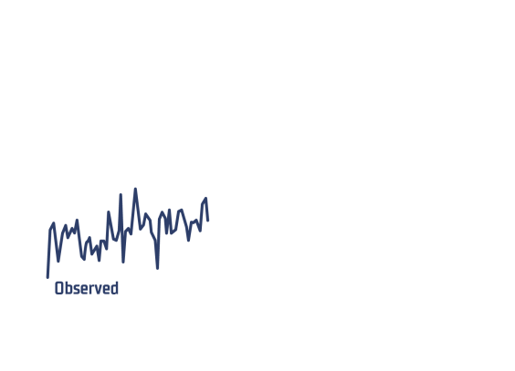
IT’S GETTING HOT OUT THERE!
5
Notes:
So… what is in store for Edmonton this is what the models tells us:
Temperature highs rarely seen before
Chance of multi-year drought is more than doubling
And while not depicted on this slide, Precipitation risks are also something we need to be aware of
Risk of River Flooding will remains low
Risk of Urban Flooding will almost double - which is a bigger concern for Edmonton.
It seems a bit counter-intuitive to talk about flooding if we’re heading into increased droughts along with higher temperatures. The heavy precipitation is thought to be coming at us in short, but severe bursts, unlike gentle rains of the past that had time to soak into the soil. This precipitation will be the likely cause of overland flooding as the water races to lower points of land.

Slide 14
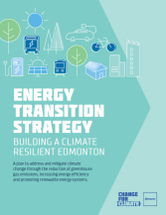
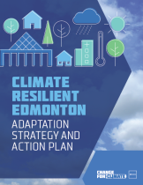
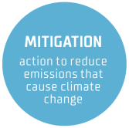
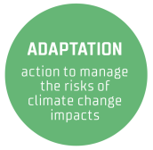
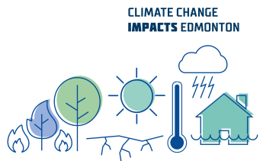
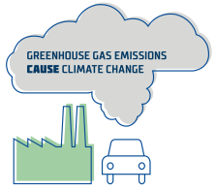
MITIGATION or ADAPTATION?
6
Notes:
My work focuses on climate change adaptation, supporting our community to be able to withstand and bounce back from climate change impacts.
Another part of our office focuses on climate mitigation, finding ways to reduce emissions so that we might keep the temperature from continuing to rise. At the City, we refer to this as energy transition…

Slide 15
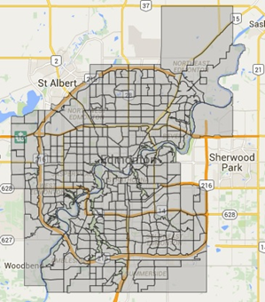
SCOPE - CLIMATE ADAPTATION
Community and civic operations
Edmonton city boundary
Assets and services
Infrastructure
Energy and utilities
Transportation
People
Emergency management
Economy
Environment
4
Notes:
Adapting to climate change is important from a risk management perspective. When the strategy was being considered, we needed to set boundaries for this work. We know that our transportation network moves well beyond Edmonton, and a glitch on any major highway entering Edmonton certainly impacts our City, just as an ice storm in Florida impacts our supply of oranges, and drought in California impacts our supply of almonds and fire in the Okanagan can impact our wine supply.
But, the effort required to develop a strategy for Edmonton was a large enough undertaking without so we landed on Edmonton City Limits PLUS the International Airport, given the important role it plays in moving goods… and people.

Slide 16
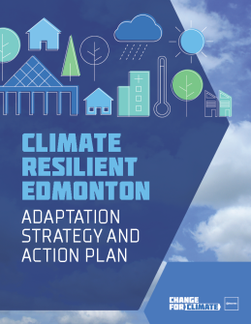
TAKING ACTION
Climate Resilient Edmonton: Adaptation Strategy and Action Plan
Received by Executive Committee of City Council on Nov.13, 2018
Science and Evidence Based Decisions
Preparing for Changing Temperatures
Preparing for Changing Precipitation
Preparing for Changing Weather Extremes
Preparing for Changing Ecosystems
10
Notes:
The forecasts, modeling and considerations was many years of work by scientists, experts and community stakeholders and our team continually monitors for new information.
When I bring this to citizens, I always tell them that this information is meant to inform, not shock. If we don’t have any idea of what to expect, then it’s very difficult to figure out what we should prepare for.
The strategy is online, for those interested.

Slide 17
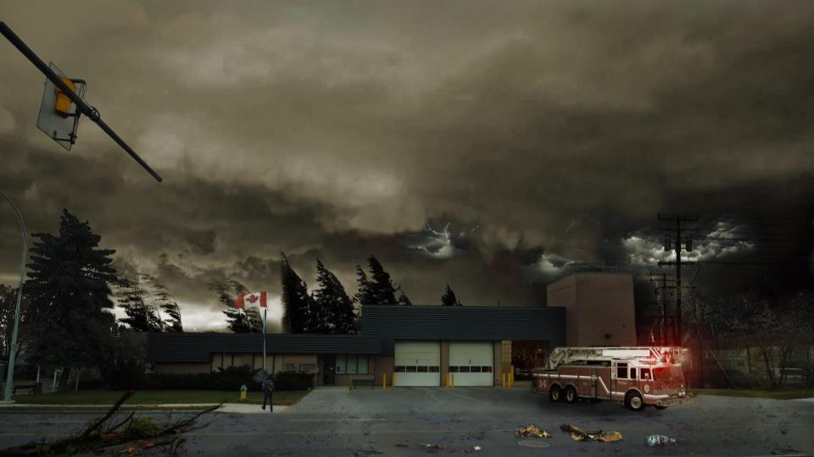
Climate Change - Acute Shocks
Notes:
With climate change we are looking at two things - one of them being acute, short term shocks. These are sometimes referred to as climate hazards, and they are events that already occur, but climate change may be changing their frequency and intensity. Examples of this includes
-extreme rainfall events that lead to flash flooding,
-hail events,
-freezing rain, that sort of thing
It is the climate shocks that give us most concern when it comes to helping citizens prepare for climate change and climate-related emergencies.

Slide 18
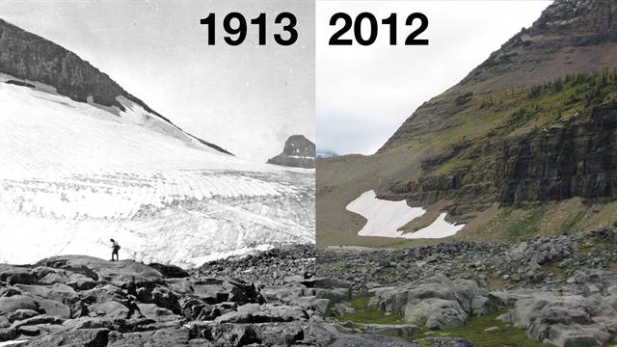
Climate Change - Chronic Stresses
Climate Change – Chronic Stresses
Photo Credit: https://video.nationalgeographic.com/video/news/151021-glacier-national-park-melting-vin
Photo Credit: https://commons.wikimedia.org/wiki/File:F5_tornado_Elie_Manitoba_2007.jpg
Notes:
The other thing that we take into consideration when assessing climate change impacts are long term, slow onset climate stresses. These stresses occur only because of climate change. This includes such things as glacial retreat, ecosystem shift, overall increased temperature, overall drying conditions,....occurrences that happen over long periods of time that we may not really notice until the change is in place.

Slide 19
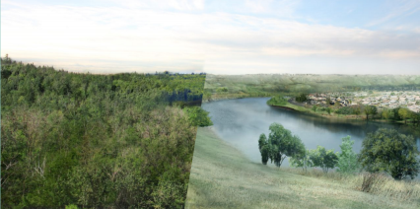
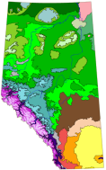
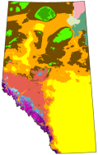
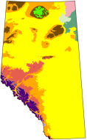
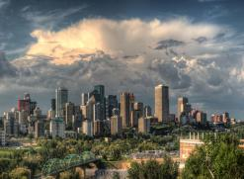
Shocks and Stresses
Transformational ecosystem shift (Chronic Stress)
Extreme weather (Acute Shock)
Climate hazards will be more frequent and extreme/severe
Historical
2050s
2080s
Source: Alberta Biodiversity Monitoring Institute
7
Notes:
So to put the acute shocks and stresses in perspective…. One of the chronic stresses we expect is that our river valley will transform from a boreal-parkland ecosystem to one that more closely resembles the prairies. In essence, Edmonton’s climate will become much more like the lands surrounding Calgary, or southern Alberta, generally. And some of us think, hey, maybe we will oneday be able to grow enough grapes or apples or other heat-loving fruits and vegetables. But with that change comes a lack of water, and we know that most plants don’t grow without a steady supply.
We also need to be prepared for more extreme and severe weather. Sure, we’re used to cold, but the extreme heat in summer over an extended period is not the Edmonton I know, and something most of us here are not well prepared for. Those of you living in this area may have noticed how gusty the wind has become in recent years. Sustained, high wind speeds have been modeled for Edmonton, with great certainty. It is these climate hazards, or acute shocks that will create the most grief for us if we do not prepare -- individually, in communities, and the City’s infrastructure and services.

Slide 20
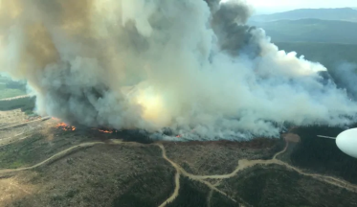
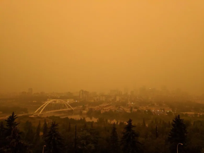
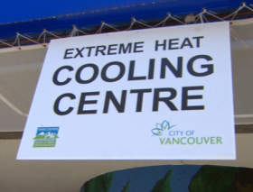
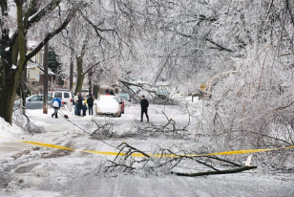
SEASONAL IMPACTS
(@Raptor_Chick/Twitter)
SUMMER
hotter, drier
AVG TEMPS
historic: 15.1ºC
2050s: 17.2-19.5ºC
(B.C. Wildfire Service)
WINTER
warmer, wetter
AVG TEMPS
historic: -13ºC
2050s: -10.1 to -7.5ºC
(CTV Vancouver)
(Aaron Vincent Elkaim/Canadian Press)
9
Notes:
It’s important to remember that events occurring outside of Edmonton, such as the fires in BC last summer, also have the potential to impact Edmonton. This makes breathing very difficult, especially for those whose respiratory systems are already compromised. Last August, we experienced two weeks of very poor air quality.
And while we didn’t experience an ice storm per se last winter, two warming trends led to pretty treacherous sidewalks and a reported increase of slips and falls by medical staff at local hospitals.
It sounds doom and gloom, but it only becomes an emergency is we are unprepared.
So just how do we prepare? Let’s look...

Slide 21
Notes:
Part of being prepared is tapping into local news and social media channels that will tells us in advance of what to expect. For this reason, Communications was considered in the Climate Resilient Edmonton strategy, because if the communications systems goes down, it becomes very difficult to reach people. It’s also another reason why it’s a good idea to build climate preparedness plans at a community level -- not just at the individual homeowner level. That way, word can spread from neighbour to neighbour…. If neighbours know each other!

Slide 22
HOMEOWNER ACTIONS
 | Changing Temperatures | insulation ■ awnings ■ window shades ■ he furnace ■ access to water & air conditioned spaces ■ know your neighbours
 | Changing Precipitation | Sump pumps ■ sewage backwater valves ■ lot grading ■ eaves troughs ■ know your neighbours
 | Changing Weather Extremes | Sand / ice cleats for traction ■ prune weak trees ■ secure outdoor furniture ■ neighbours ■ emergency prepared
 | Changing Ecosystems | ■ Rainbarrels ■ native grasses / plants ■ drought-tolerant species
9
Notes:
There are a number of ways that homeowners can respond to climate change. Some actions are individualized, but some broaden out to the community level. Imagine all of the neighbours walking around the nighbourhood and identifying the trees that are showing signs of stress and weakness. One large windstorm could take them out, and severely damage private property with them. What if the neighbourhood could all agree on which ones need to be removed or trimmed, and could call upon the City to help out, without having to deal with a “save the trees” petition from disgruntled neighbours?
Your home emergency kit might contain phone and text numbers for your neighbours or others to call upon for assistance. Who in the neighbourhood is able to shut off the power and gas in your home? If you don’t bother to get to know your neighbours before disaster strikes, then bad weather can easily escalate into an emergency. But if you have all of these things figured out beforehand and know who to call, then it becomes much more manageable. This is asset-based community development, yes?

Slide 23
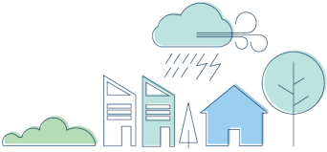
ACTION PLAN: Involve Citizens
Climate Resilient Neighbourhoods
Climate Resilient Homes
Climate Resilient People
Climate Resilient Schools
Climate Resilient Community Leagues
Climate Resilient Buildings
Climate Resilient Businesses
Community Climate Resilience Hubs
14
Notes:
This year, we are working on developing materials and programs that will, eventually, support a variety of audiences in their understanding of climate change and how to adapt to Edmonton’s changing climate. Different audiences mean different approaches, and one that I am very excited about is helping citizens to develop climate resilient neighbourhoods.

Slide 24
Climate Resilient Neighbourhoods
Information Sessions @ Community Buildings (Leagues)
Community Workshops
3-4 sessions
Build initial sessions with community
Link climate resilience with emergency preparedness
Create neighbourhood networks
Notes:
Neighbourhood networks… and support and invite them to network with other neighbourhoods so they can broaden their understanding and capacity.
This proposed approach is based on a fair bit of research but it still sits in the planning stages. Conversations I’ve had with with the “doers” out there-- including experienced community staff at the City; locally; provincially nationally national, locally, and beyond our borders, have confirmed for me that this approach is sound and we are on the right track.

Slide 25
Notes:
So now I am looking forward to hearing from our panelists so I can add to my knowledge and gain new perspectives for my work. And what I find very impressive about each panelist is that they will be sharing their first hand experience, compared to my planned approach. So let’s now hear from a “doer” Eva Bogdan will share her experience that emerged from the High River Floods of 2013.

Slide 26
SESSION STRUCTURE
Heather: Climate Resilient Neighbourhoods
Eva: High River Case Study
Sarah: VictoriaReady
Adam: UofA Emergency Prepared
Presentations
2018
2

Slide 27
SESSION STRUCTURE
Heather: Climate Resilient Neighbourhoods
Eva: High River Case Study
Sarah: VictoriaReady
Adam: UofA Emergency Prepared
Presentations
2018
2
Notes:
The next “doer” will will hear from is Sarah Hunn, the Emergency Management Community Liaison Officer with the City of Victoria Fire Department.

Slide 28
SESSION STRUCTURE
Heather: Climate Resilient Neighbourhoods
Eva: High River Case Study
Sarah: VictoriaReady
Adam: UofA Emergency Management
Presentations
2018
2
Notes:
Our final panelist is also a “doer”, please welcome Adam Conway with Emergency Management at the University of Alberta here in Edmonton.

Slide 29
PANEL DISCUSSION
Meet the Panel
Presentations
Table Talk
Q & As
2018
(Timothy Neesam/CBC)
2
Notes:
Thank you to all of our panel presenters! You have given me lots to think about, and I have a few questions. But before we venture down that path, I’d like to turn it to our audience who has been sitting quietly for the past (45) minutes. I’d like to give you a bit of time to talk.

Slide 30
TABLE TALK
Engage in a short discussion:
Share your experiences in community capacity building for emergency preparedness
What questions do you have?
What challenges do you face?
Table Talk
2018
QUESTIONS for the panel: two from each table
2
Notes:
I ask that, over the next 10 minutes, for you to share at your table any highlights from your experiences in this space that you think your table mates may find interesting. Or, some of the challenges you face with this work.
Some of you may have something to share, while some may just want to take it all in - that’s your call. Then, as a table, come up with a couple of questions for our panelists. If you can also identify which panelist you would like to answer the question, that’s good too! We’ll reconvene in about 10 minutes, which doesn’t give you much time...

Slide 31
PANEL DISCUSSION
Meet the Panel
Presentations
Table Talk
Q & As
2018
(Timothy Neesam/CBC)
2

Slide 32
Questions and Answers for the Panel
Round ONE:
Tables ask one question each.
Direct to a panelist, optional
Round TWO:
Repeat, time permitting
Q&As
2018
QUESTIONS for the panel: two from each table
2

Slide 33
THANK YOU, PANEL!
Eva Bogdan, PhD Candidate, UofA
Sarah Hunn, City of Victoria
Adam Conway , University of Alberta
Glenda Cooper, Tamarack
Panelist
Panelist
2018
Panelist
Convenor
2

Slide 34
For more info:
Heather Wheeliker
Policy and Environmental Management Unit
e: heather.wheeliker@edmonton.ca
w: edmonton.ca/resilientedmonton

