Slide 1
Emergency Preparedness to Build Social Capital
Sarah Hunn, City of Victoria

Slide 2
OVERVIEW
Hazards and Preparedness
VictoriaReady
Connect and Prepare
Results
Plans for the Future

Slide 3
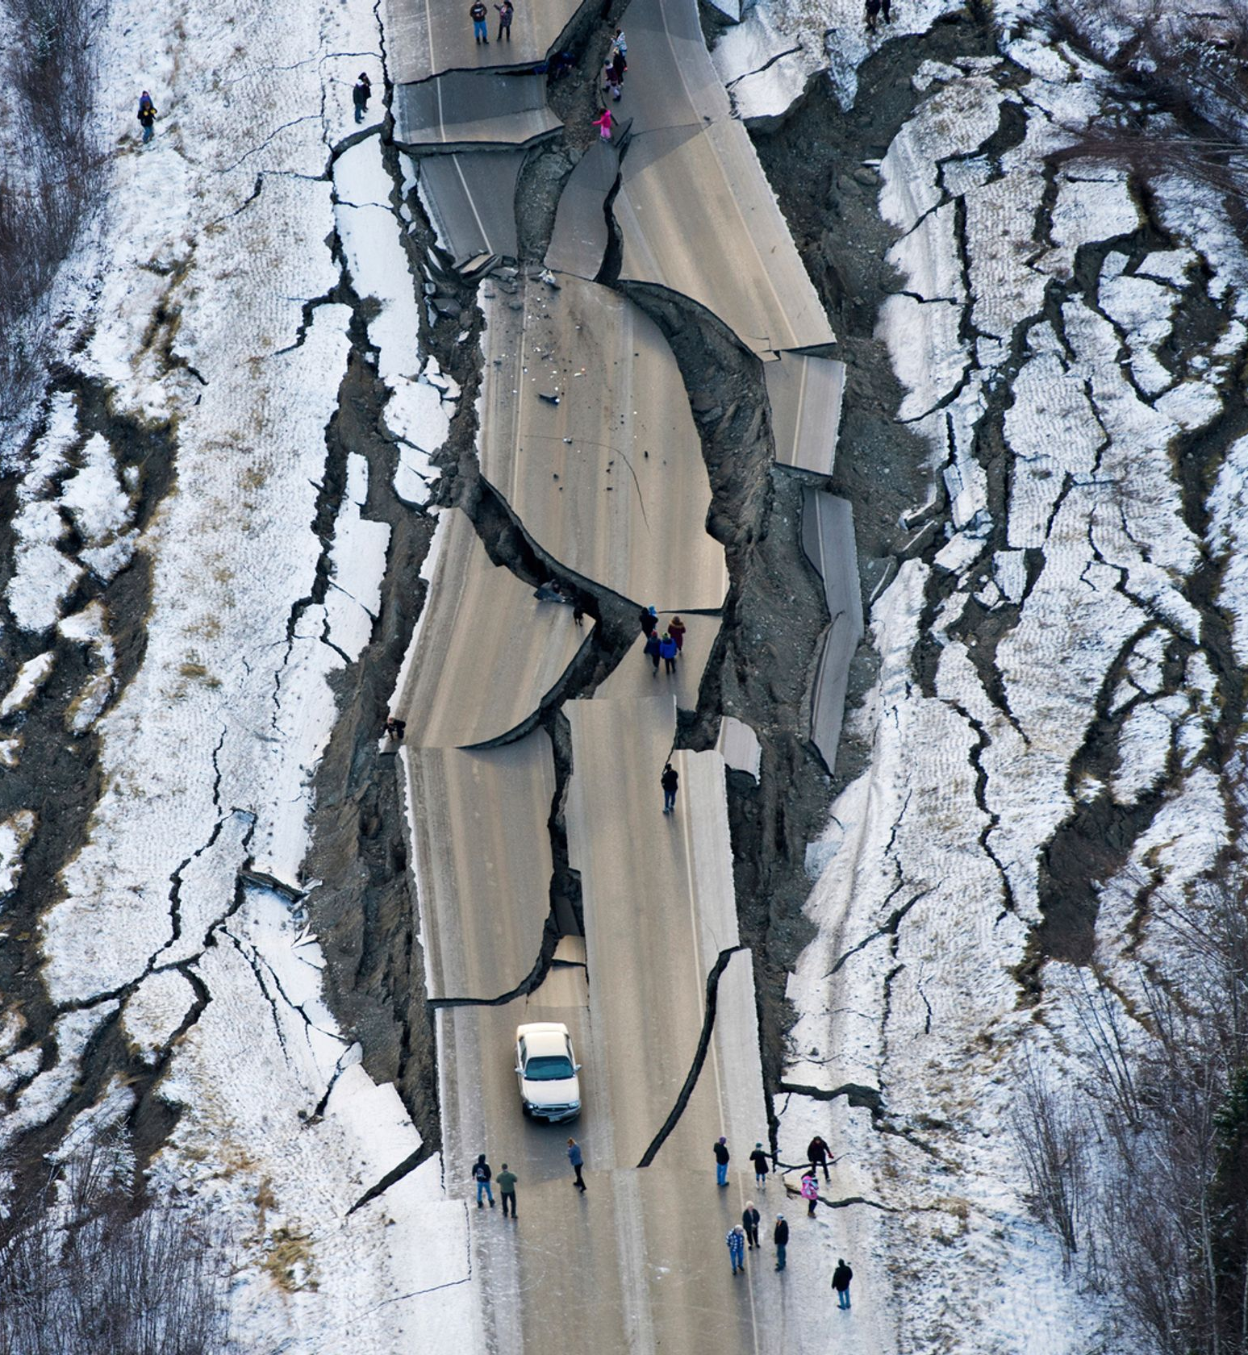
Hazards
Earthquake
Severe weather
Structure fire
Climate change
Everyday emergencies
We recommend everyone to have at least 7 days of supplies
Anchorage Alaska earthquake - November 30, 2018
Notes:
https://windsorstar.com/pmn/news-pmn/alaska-putting-together-pieces-after-massive-earthquake/wcm/a2ec9f47-57ef-4bce-a88a-f788d1acf6a3
There is a 1 in 3 probability of a damaging earthquake in the next 50 years, this may not seem like it will be a concern but the ground is shaking every day and it’s just a matter of time. About 1,000 earthquakes are recorded each year in the Lower Mainland and on Vancouver island. The province’s estimates are that 14,000 people will be displaced from their home in the Capital Regional District
----------------
There are 3 types of earthquakes that affect our region, without going into the science of the differences, they are:
----------------
A shallow crustal earthquake, which lasts between a few seconds up to a minute, we often get small versions of this type each year. Shallow crustal earthquakes can still have aftershocks.
----------------
A deep earthquake can be a few seconds or up to about 30 seconds and they don’t usually have aftershocks
----------------
A subduction earthquake, often called the Cascadia Subduction Zone earthquake, can be between 1 and 4 minutes in duration. These are the earthquakes that will cause tsunamis, the other two types won’t cause a tsunami. Aftershocks for subduction earthquakes can last for months afterwards
It’s important to recognize that we are continuously learning new things about earthquake science as new technologies develop that give us more insight into the ground beneath our feet

Slide 4
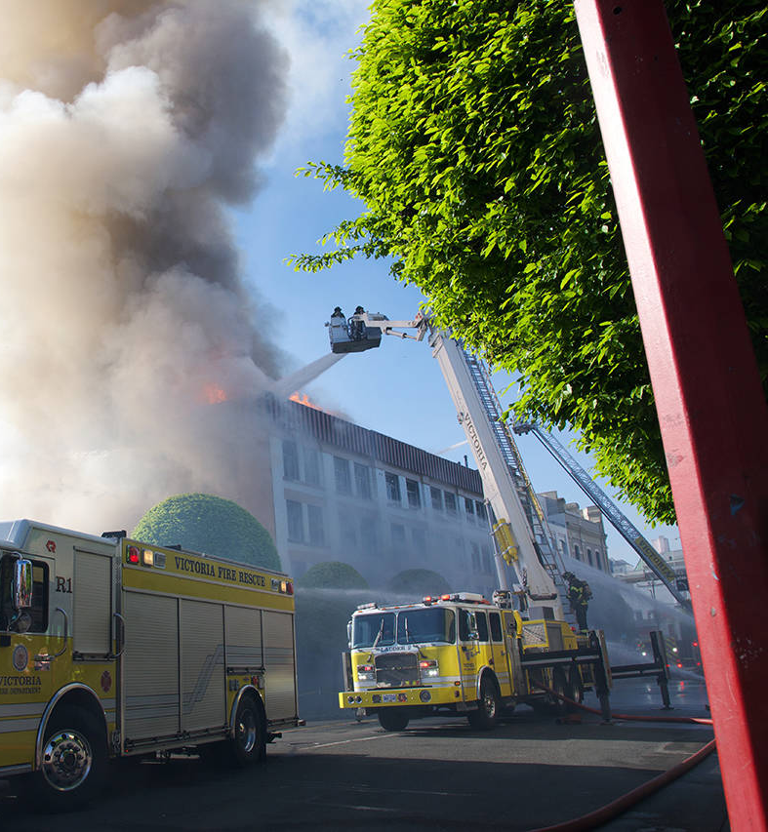
Personal Preparedness
Only 54% of British Columbians say their households have any emergency plans
Only 13% feel their emergency plans are reasonably complete
Only 20% have any contacts and plan with neighbours to help each other
Source: BC Government Personal Preparedness Survey Report, 2018
Plaza Hotel Fire, downtown Victoria – May 6, 2019
Notes:
https://www.vicnews.com/news/one-man-missing-in-relation-to-downtown-victoria-fire/

Slide 5
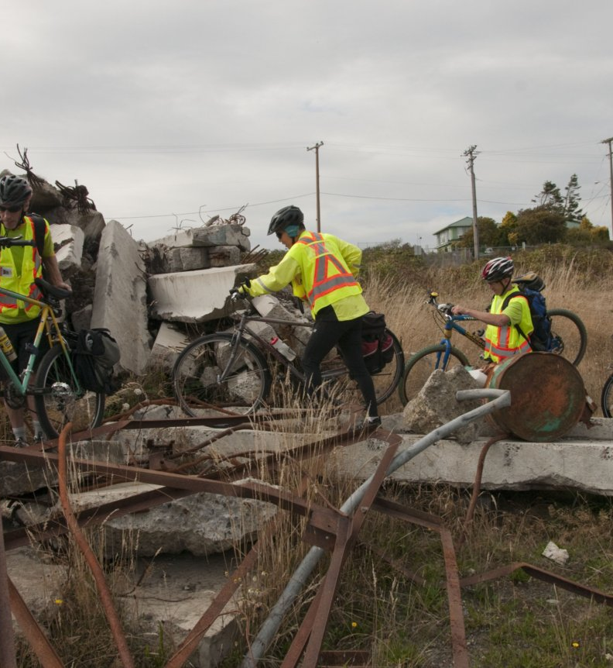
VictoriaReady
3 staff
Over 50 volunteers
Emergency Preparedness Workshops
Website, resources and materials
Outreach events, exercises

Slide 6
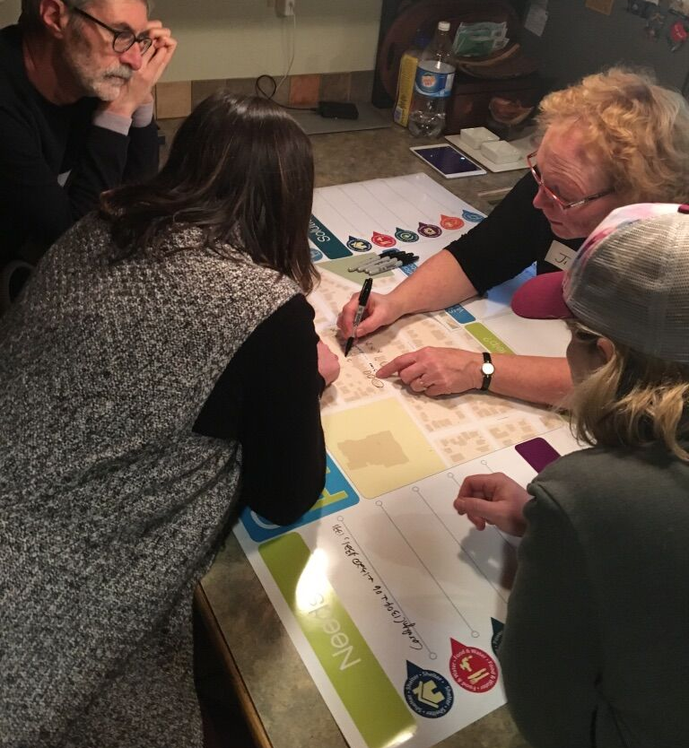
Connect and Prepare
Partnership with SHIFT Collaborative’s Building Resilient Neighbourhoods initiative
Strengthen social connections between neighbours
Help them become better prepared and resilient together
Started in 2018, piloted at 3 Victoria locations
Currently delivering the program to an additional 3 sites

Slide 7
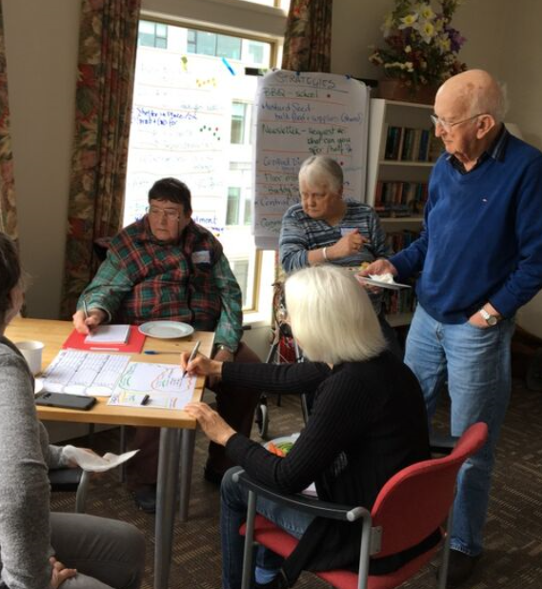
Program Design
Neighbour champions, orientation
3 facilitated workshops (on location)
Resources, funding, support to access grants
Leave the program more connected and working on projects that will contribute to emergency preparedness

Slide 8
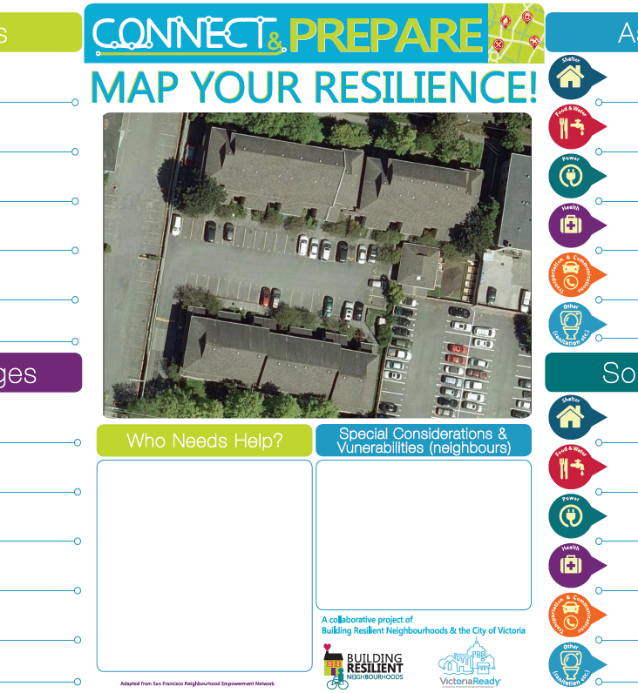
Workshop 1
Social time
Introductions and overview
Short presentation from BRN and VictoriaReady
Tabletop exercise – needs, challenges, assets and solutions
Thinking about ‘small’ vs ‘large’ emergencies and everyday readiness

Slide 9
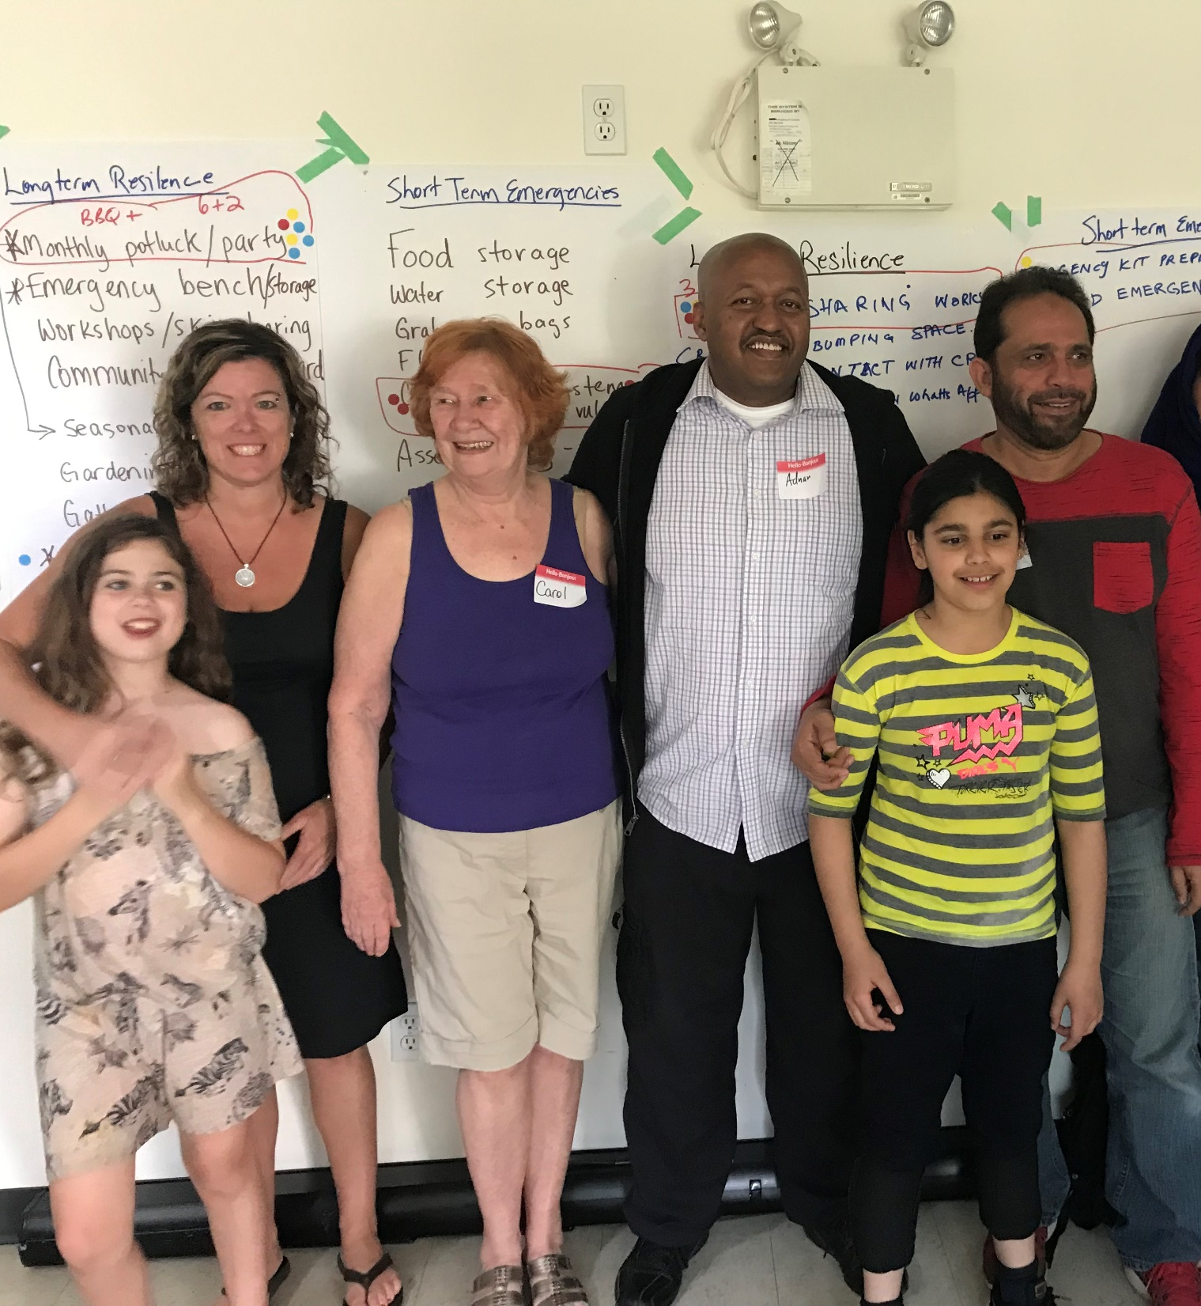
Workshop 2
Social time
Human barometer
Recap last session
Review strengths/weaknesses
Short presentation from BRN and VictoriaReady
Brainstorm projects to build resilience and social connection for both long and short term

Slide 10
Workshop 3
Social time
Recap last session
Transition to neighbour-lead projects
Leave session 3 with clear plan of what to do, by who, when, what resources are needed, next steps, etc
$500 for shared supplies from VictoriaReady
$200 for projects from BRN

Slide 11
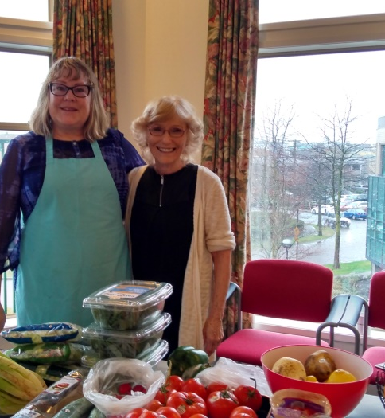
Results From Pilot
94% of neighbours got to know each other better
100% of neighbours became more connected with each other
100% of neighbours achieved better understanding of their collective strengths, assets and vulnerabilities
100% of neighbours took action to be better prepared for emergencies

Slide 12
Moving Forward
Currently delivering Connect and Prepare to 3 sites – all CRHC
Plans to deliver an additional 3 sites in the fall
VictoriaReady is creating a ‘workshop in a box’ to reach more sites

Slide 13
Sarah Hunn Emergency Management Community Liaison City of Victoria
250.920.3373 shunn@victoria.ca victoriaready.ca

