Slide 1
Niagara Prosperity Initiative
The Role of Municipalities in Poverty Reduction:
The Ontario Experience
September 2018

Slide 2

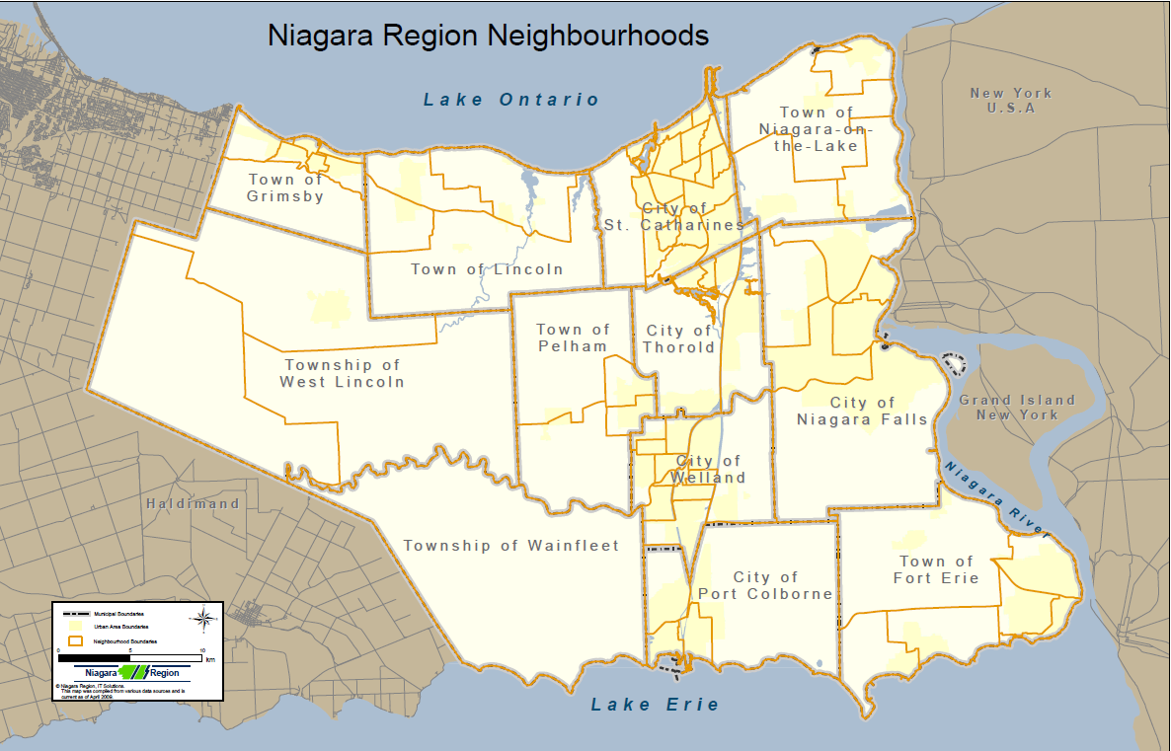
Notes:
The Regional Municipality of Niagara lies on the west side of the Niagara River, between lakes Ontario and Erie. We are the southern end of what’s called the “Golden Horseshoe”. There are 12 municipalities with a 2 tier (Regional & Municipal) government structure. We have a population of approximately 449,000 people in an area of approximately 1,800 km²

Slide 3



Step 1: Tools
Mapping tool; Data; Research; Communication tools;
Financial investments; Evaluation
Step 2: Techniques
Review committee; Reports to council; Legacy reports (strategy); Secretariat; Convener; Community conversations
Step 3: Mechanisms
RFP process for investing funding; Community based issue development; Other networks at the neighbourhood level; Niagara Poverty Reduction Network (NRPN)
Notes:
I want to talk about how the Niagara Region went about developing and implementing our local poverty reduction strategy – what Tools, Techniques, and Mechanisms we put in place to get to where we are.
I won’t be able to get through everything so I’m going to go through this very quickly…

Slide 4
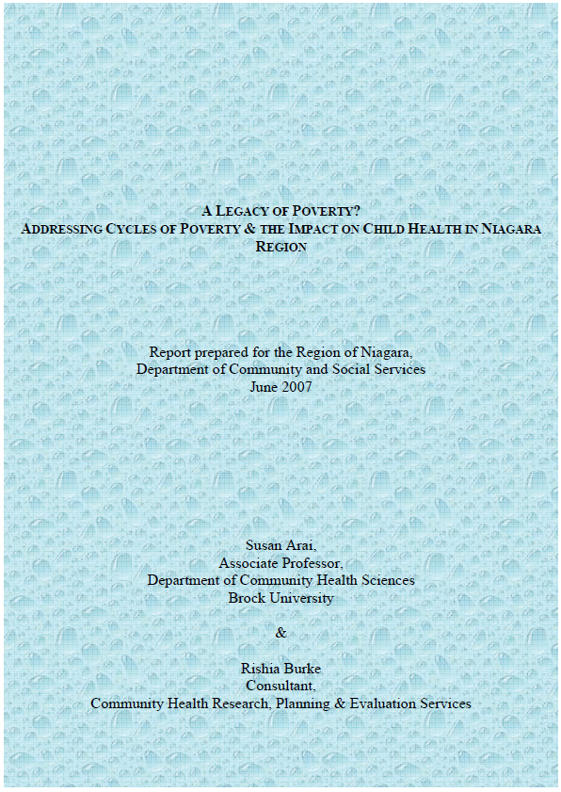
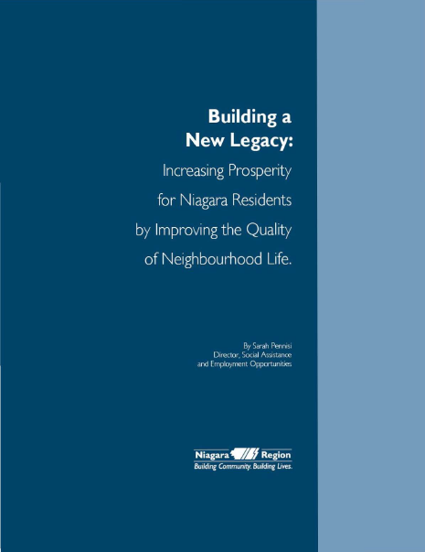
Developing and Implementing Local Poverty Reduction Strategies
The Niagara Prosperity Initiative (NPI) began in 2008, when Niagara Regional Council approved $1.5 million in yearly investments to address poverty reduction initiatives in Niagara
Notes:
TOOL
Where to begin? Funding was made available with the upload of Social Assistance costs for children in 2008. However the report from Brock came out in 2017.
NPI follows the recommendations made in the report: “Legacy of Poverty? Addressing Cycles of Poverty & The Impact on Child Health in Niagara Region” released in 2007; and in 2011, the report was updated with “Building a New Legacy: Increasing Prosperity for Niagara Residents by Improving the Quality of Neighbourhood Life”, renewing the framework for annual NPI investment
The broad recommendations in these reports sets the context for funding initiatives. Projects must demonstrate how they address at least one of the following:
Reduce poverty through advocacy – Proposals to create opportunities for communities of practice to occur (such as community development activities; multi-sectoral agency collaborations, etc.) in order to improve service delivery.
Appropriate supports which address the broader determinants of health for adults – Proposals to offer meaningful engagement opportunities to enhance opportunities for social inclusion.
Mitigate the negative effects of low income on children and youth through programs and services – Proposals to show how projects will meaningfully engage people in poverty to address isolation and stigma.
Monitor our progress – Proposals to develop increased capacity and foster sustainable commitment from the community.

Slide 5
Niagara Prosperity Initiative
Place-Based Strategy
Goals:
  Create stronger and more prosperous neighbourhoods
  Improve engagement of people living in poverty
  Improve health for people living in poverty, and
  Create greater economic prosperity for individuals and their communities
Notes:
TECHNIQUE
Research and experience shows that families do better when they live in strong and supportive communities. In short, place matters. NPI is based on data and analysis and issues funding in a calculated manner in order to ensure that funding is appropriately distributed to the areas of need.

Slide 6
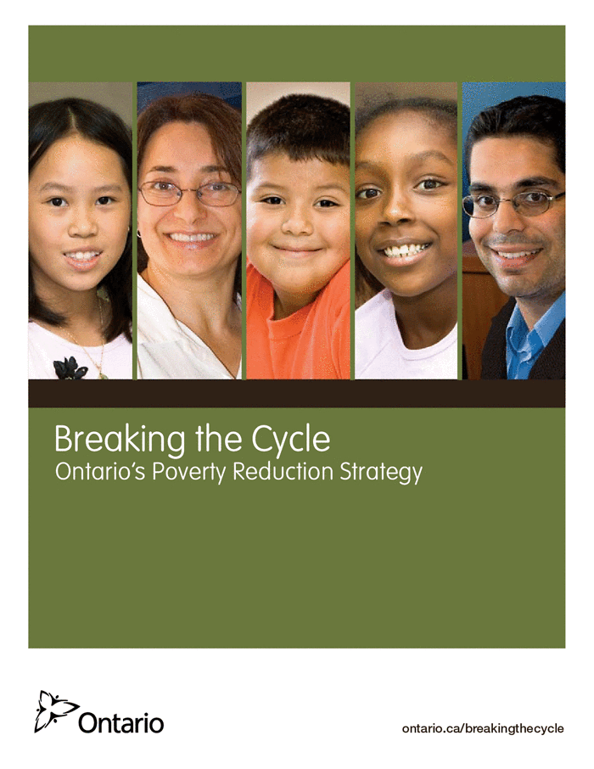
Breaking the Cycle:
Ontario’s Poverty Reduction Strategy
On May 6, 2008 the Ontario legislature unanimously passed The Poverty Reduction Act, which commits successive provincial governments to act on poverty
and provides measures to track progress
over time. And in December 2008, the
Government of Ontario introduced the
plan Breaking the Cycle: Ontario’s
Poverty Reduction Strategy.
Notes:
Also in 2008. By the time the Provincial plan came out – we had already started funding projects in Niagara.

Slide 7
NPI Approach
Use available data (poverty reports; mapping tool data)
Listen to the community and use expert advice on how to address poverty; use the recommendations from the poverty reports
Place the recommendations in a Request For Proposal (RFP) for the community to respond on how poverty will be addressed given funding
Funding is allocated through a place-based approach – addressing poverty at the community/neighbourhood level
Has an independent review committee decide on who receives funding
Contracts a secretariat to manage the NPI contracts
Employs a Convener to assist in collaboration efforts in the community
Complete Short-term Project evaluation to provide outcome data for ongoing investment
Notes:
How it works
I’ll get back to ‘Short-term’ project evaluation at the end.

Slide 8
Niagara Region Investments in Poverty Reduction
Notes:
So what have we done in the past 10 years. Funding has been given for all kinds of programs:
362 projects contracted out to 85 different agencies

Slide 9
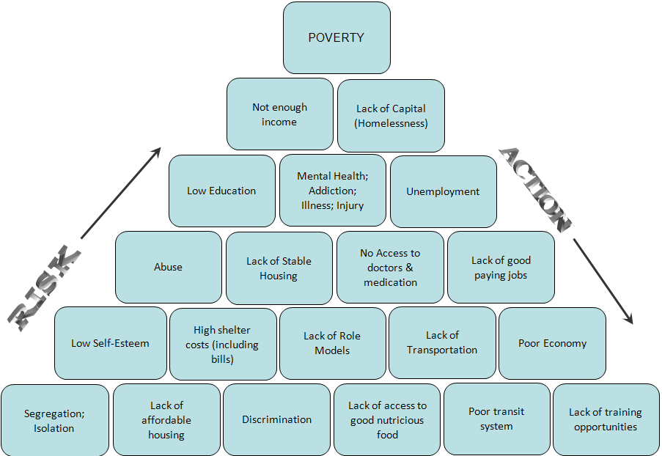
Notes:
The thinking about funding projects to address poverty…
Actions in Poverty Reduction/Elimination
There is no magic bullet for Poverty Reduction – would be great to give everyone a million dollars but that would still not solve all the issues.
Mostly systemic issues listed here – solutions are systemic as well although assistance with these issues can be provided on an individual basis (i.e. Lack of Transportation/Poor transit system means dealing with the system of transportation however providing people with bus passes until the larger issue is resolved will assist individuals with their immediate need)

Slide 10
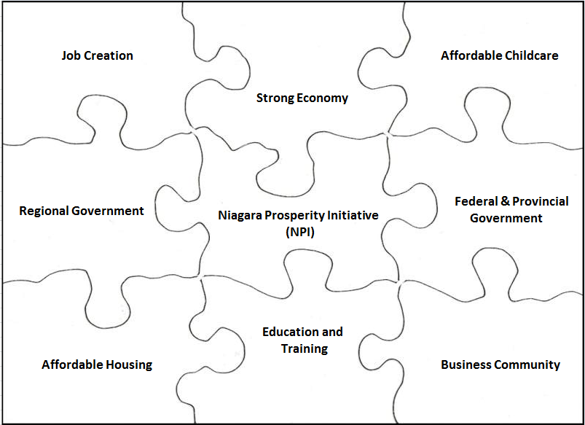
NPI is one piece of the puzzle
Notes:
Some of the barriers of measuring NPI effectiveness is that NPI is only one piece of the puzzle when it comes to poverty issues. If one of the puzzle pieces isn’t working well then all of the other pieces also suffer in what they can achieve. E.g. If the economy is poor this can affect the business community – if the business community isn’t doing well that can affect the taxes paid to government which affects availability of funding for programs such as NPI or affordable housing, childcare, education and training. Every piece has a role to play in the bigger picture and each has an impact on the other.

Slide 11
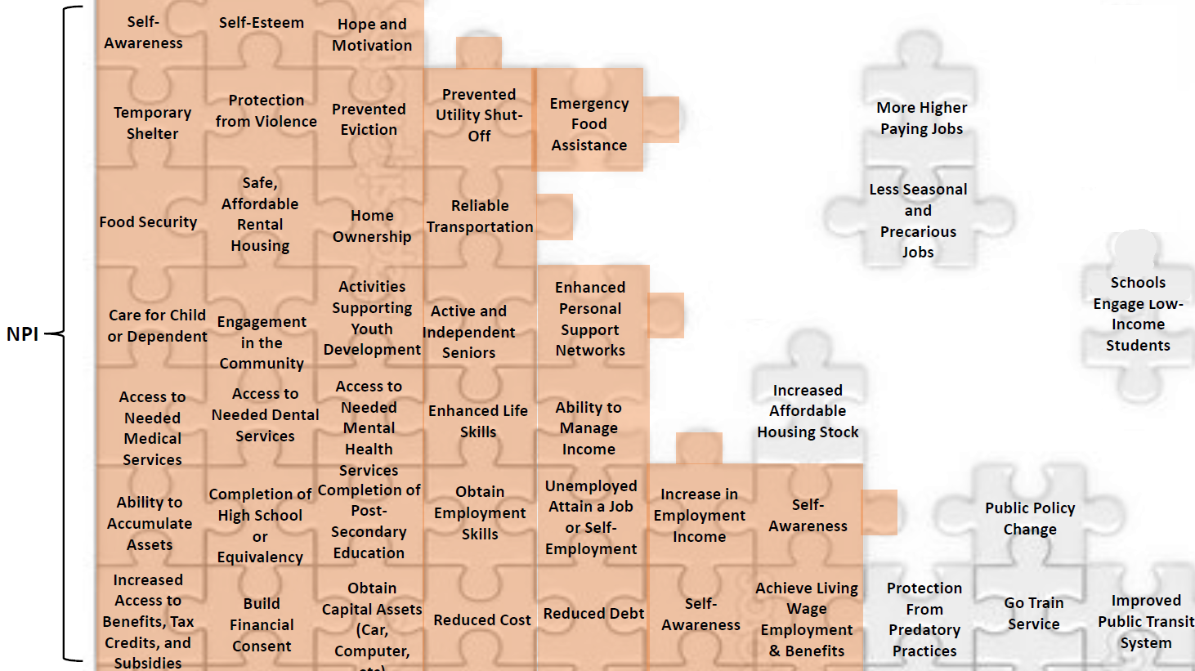
Tackling Poverty
Notes:
When looking at the impacts of NPI – we see that there are limitations to what the funding can do and that other factors are also needed in order to tackle poverty – including changes to funding formulas for Housing needs in Niagara, increased social assistance rates, higher paying jobs, improved transportation such as Go Train service. These are items beyond NPI’s means to address and requires advocacy. That is why it’s important to have advocacy groups such as NPRN.
However funding is necessary to make changes – what’s important is that we can show to the people making decisions on funding the impact that the work is doing in the community.

Slide 12

Putting the Pieces Together
Advocacy
Funding
Citizen Involvement
Community Development
Notes:
Putting the pieces together is more than just funding projects – its about advocacy for the things that funding can’t fix. By working together we can not only alleviate the effects of poverty but eliminate poverty.

Slide 13
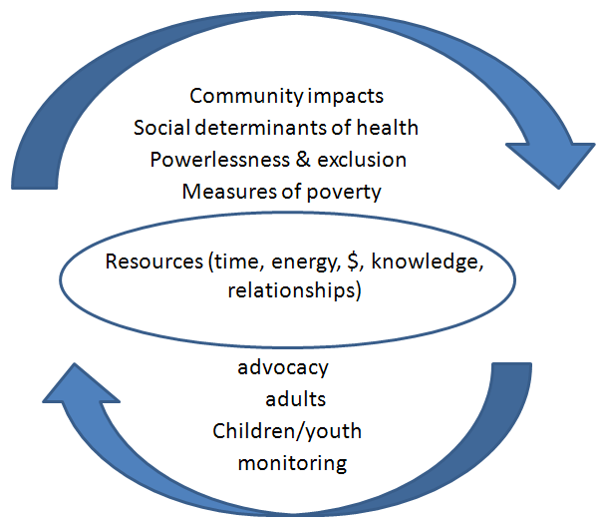
Theory of Change
Notes:
With NPI the resources are – the financials ($1.5M); the time, the people, the agencies, the political will from Regional Council, also – Municipal, Provincial, and Federal government have the resources.
The frameworks used to examine the issues of poverty and make corresponding recommendations for poverty reduction strategies in Niagara are:
Measures of poverty; Impact on the Social Determinants of Health; Experiences of Powerlessness and Social Exclusion; Community Impact
Recommendations for Action are - Decrease poverty through advocacy; Appropriate and flexible supports which address the broader determinants of health for adults living in poverty; Mitigate the negative effects of low income on children and youth through programs and services; Monitor our progress
Vision: Work to increase prosperity by investing resources to support ideas that respond to the recommendations for action in neighbourhoods in need of attention.

Slide 14

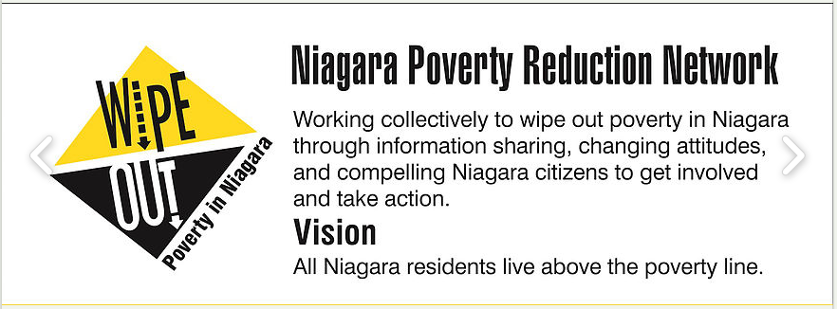
Balancing Government & Community Ownership
Niagara Poverty Reduction Network
The Niagara Poverty Reduction Network is working collectively to wipe out poverty through education, collaboration and advocacy to address poverty's root causes.
Notes:
MECHANISM
Because we know that investing in projects alone will not eliminate poverty we also created the Niagara Poverty Reduction Network. Originally an advisory committee to NPI, it was seen early on that it needed to expand and become an advocacy group for the issues of poverty. NPRN is working collectively to reduce poverty in Niagara through information sharing, changing attitudes, and compelling Niagara citizens to get involved and take action.
NPRN provides leadership in informing and changing attitudes about poverty, sharing ideas, resources and information services to leverage, collaborate and maximize the opportunities for community engagement.

Slide 15
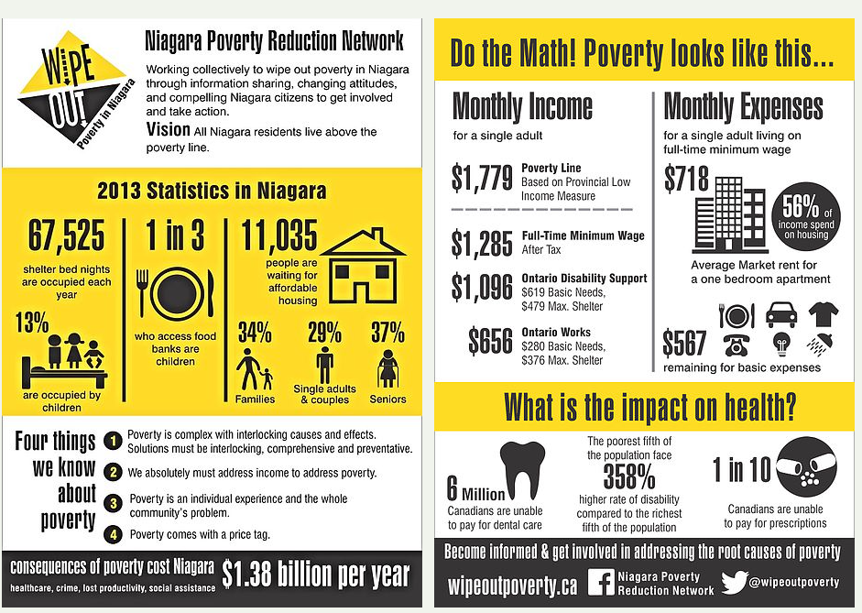
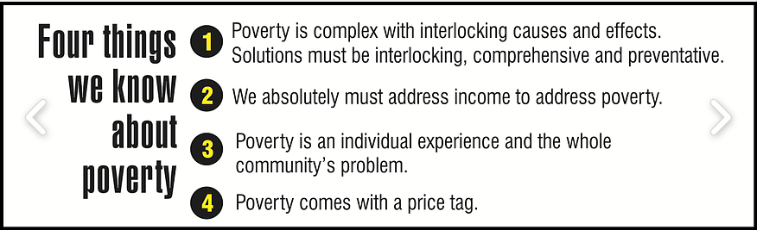
Niagara Poverty Reduction Network

Slide 16
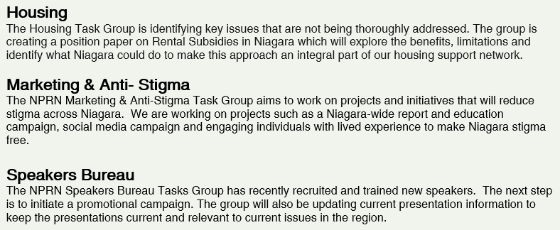
Niagara Poverty Reduction Network
The NPRN has several associated working groups. These groups have representation from a wide-range of community organizations and meet regularly to work on relevant, poverty-related initiatives.

Slide 17
“To be a jazz freedom fighter is to attempt to galvanize and energize world-weary people into forms of organization with accountable leadership that promote critical exchange and broad reflection. The interplay of individuality and unity is not one of uniformity and unanimity imposed from above but rather of conflict among diverse groupings that reach a dynamic consensus subject to questioning and criticism. As with a soloist in a jazz quartet, quintet or band, individuality is promoted in order to sustain and increase the creative tension with the group--a tension that yields higher levels of performance to achieve the aim of the collective project.”
― Cornel West,
Notes:
Love this quote – I introduced at one of our meetings…
Dr. Cornel Ronald West is an American philosopher, political activist, social critic, author, and public intellectual who also loves jazz.

Slide 18
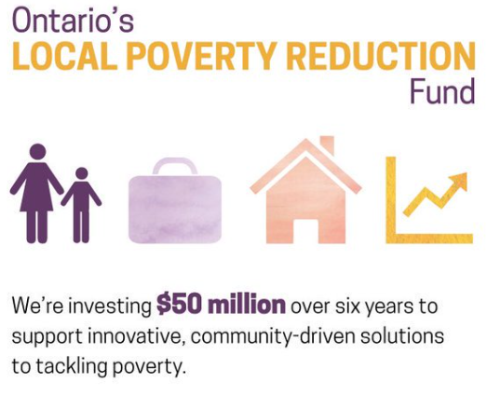
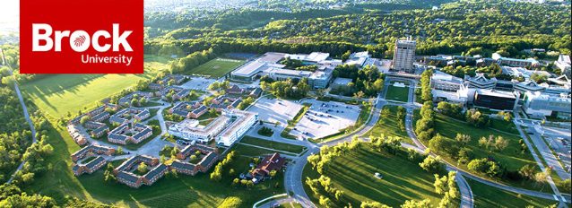
Notes:
TOOL
Community Services was awarded $476,763 as a successful applicant to the Province’s Local Poverty Reduction Fund (LPRF).
Which will result in a report outlining the state of poverty in Niagara using data from the 2016 census, an analysis on the impacts, outcomes, and value of Niagara Region’s poverty reduction strategy (NPI) and offer recommendations on best practices moving forward.

Slide 19
