Slide 1
Poverty Reduction Strategy Engagement: What We Heard So Far

Slide 2
Context
The Government is committed to developing a Canadian Poverty Reduction Strategy that sets targets to reduce poverty, includes a plan to measure and publicly report on progress and that aligns with and supports existing provincial/territorial/municipal strategies.
Public engagement commenced February 2017 and the What We Heard report was released on February 20, 2018.

Slide 3
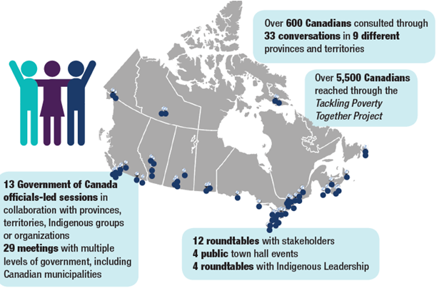
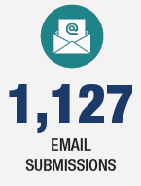
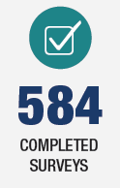
National Poverty Conference (September 27-28, 2018)
Release of What We Heard Report (February 20, 2018)

Slide 4
Tamarack Institute was a key partner
Partnered with ESDC as part of PRS consultations
Leveraged their Vibrant Communities network of partner organizations to deliver 33 community conversations (in-person engagement events)
Tamarack’s organizational reach made them an ideal partner to connect the PRS engagement process with a wide range of views and experiences from Canadians across the country

Slide 5
Other Consultation Activities
In keeping with our multi-dimensional approach on poverty, we paid close attention to consultation activities across the GoC, including:
Renewal of the Aboriginal Skills and Employment Training Strategy – led by ESDC
National Housing Strategy – led by Canada Mortgage and Housing Corporation
New accessibility legislation – led by ESDC
The Standing Committee on Human Resources, Skills and Social Development and the Status of Persons with Disabilities’ study of poverty reduction (“Breaking the Cycle: Study on Poverty Reduction”)
…among others

Slide 6
What We Heard from Canadians
Three Basic Themes:
Inability to Meet Basic Needs
Challenges with Joining the Middle Class
Risks of Slipping into Poverty
We also heard about:
Uniques Experiences of First Nations, Inuit and Métis
Service Delivery Issues
Advice on Targets and Indicators

Slide 7
Theme 1: Inability to Meet Basic Needs
Struggling to afford basic necessities
Vital importance of providing for children’s basic needs
Insufficient affordable and suitable housing, and homelessness
Food insecurity – a particular concern for First Nations, Inuit and Métis communities
Links between illness, disability and poverty
The relationship between mental illness and/or addiction and poverty

Slide 8
Theme 2: Challenges with Joining the Middle Class
Difficulties finding stable jobs and concerns about the changing nature of work
Discrimination limiting career prospects and income for many
Some youth are taking longer to join the workforce than in the past
Costs of education, training and child care
People living with disabilities do not always have enough access to education, training and support to participate fully in the workforce.
Lack of Canadian credentials and language barriers can limit prospects of some newcomers.

Slide 9
Theme 3: Risks of Slipping into Poverty
Job loss often a trigger for Canadians to fall into poverty and some youth feel insecure in precarious low-wage employment
Reductions in benefits and/or social assistance seen as a disincentive to find and maintain employment.
Some seniors need more support during retirement years
Canadians from marginalized groups tend to have more unstable, low-wage work.
Unpaid caregiving responsibilities falling disproportionately on women
Women fleeing domestic violence
Losing a partner can have devastating emotional and financial impacts which can lead to poverty.

Slide 10
Unique Experiences of Indigenous People
We heard that certain barriers/challenges are unique to or greater for Indigenous people, and may be even more pronounced for those in northern or remote communities, women, LGBTQ and Two-Spirit people, and those with disabilities.
Examples of barriers/challenges we heard about:
Colonialism and racism;
not enough recognition of First Nations, Inuit and Métis governments;
Culturally-biased government funding;
lack of training and job opportunities in communities;
loss of traditional economies;
high cost of living in remote communities (in particular the high cost of food);
over‑representation in the child welfare system, criminal justice system and homeless population;
lack of basic infrastructure in certain communities; and,
moving from a reserve or remote community to an urban setting.

Slide 11
Service Delivery Issues
There is a lack of knowledge about federal programs and services, particularly among rural and remote First Nations, Inuit and Métis communities
Applying for help can be difficult for people who are in need
Information about programs and services should be more accessible and easy to understand.
Multiple layers of administration and bureaucratic complexity.
When accessing services in person, some Canadians feel judged and discriminated against

Slide 12
Advice on Targets and Indicators
a Strategy focused on achieving real results that can be measured in precise, innovative ways.
Government should be accountable for the Strategy’s goals (e.g., through legislation)
Current approaches to measuring poverty present challenges
Existing low income measures rely on different methods and produce different results.
consider multiple indicators when measuring poverty (e.g., health, housing, access to quality food)
Targets should be ambitious and inspire long-term poverty reduction
Short-term targets to encourage more immediate action to help those who are struggling in poverty today.

Slide 13
A foundation has already been laid for the Poverty Reduction Strategy
Infrastructure Investments
New Investments for
Indigenous People
More flexible
access to EI benefits
ELCC Frameworks and agreements
New EI benefit for caregivers
GIS
enhancements
Canada
Child
Benefit
Enhanced Student Grants/ Loans
Canada Workers Benefit
CPP
New Indigenous Skills and Emp. Training Program
Enhancement
National
Housing Strategy
$$$ for home care and mental health
Skills Boost
New Canada Labour
Code
flexibilities
(EI flexibilities)
13

Slide 14
Conclusion
Conversation with Canadians on poverty reduction is not over.
Substantial recent progress in adressing poverty in Canada, but this is a persistent problem: roughly 1 in 10 continue to struggle to make ends meet each year.
As such, reaching goals likely to require brand new ideas on top of existing programs/policies - we took stock of many innovative proposals during engagement.
Setting targets and publicly measuring/reporting on progress will be key to understanding where/how GoC needs to think “outside of the box”.
The Poverty Reduction Strategy is in development and will be released in 2018. Stay tuned!

