Slide 1
What can a Social Innovation Approach Contribute to Poverty Elimination?

Slide 2
What is Social Innovation?
Changing the system dynamics, rules and routines that created the problem in the first place
A social innovation is any initiative, product, process, program or design that challenges and, over time, changes, the defining routines, resource and authority flows or beliefs of the broader social system in which it is introduced. Successful social innovations have durability, scale and transformative impact.
- Dr. Frances Westley

Slide 4
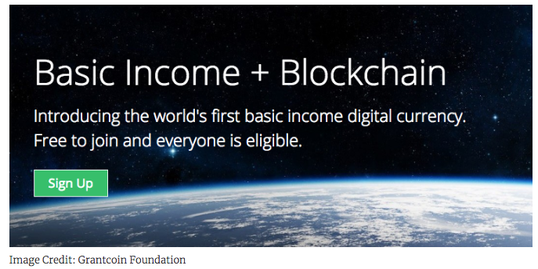

Slide 5
1) Methods for Experimentation and Systems Design
Service Journeys, Innovation Units, Social Labs, Futures and Scenarios, Systems Mapping, Strategic Design, Containers for Risk & Iteration

Slide 6
2) Raise our Gaze: Unleash Agency, Relationships & Collaboration across Boundaries

Slide 7
3) Financial innovation and market-based tools
New forms of capital
Stacking to reduce risk
Outcomes based finance
Social Procurement
Integration with social enterprise
Changing regulatory regime for charities

Slide 8
4) Advance Big Cultural Ideas
We aim to create a reconciliation economy. In a reconciliation economy, wealth and resources are equitably shared and sustainably managed.

Slide 9
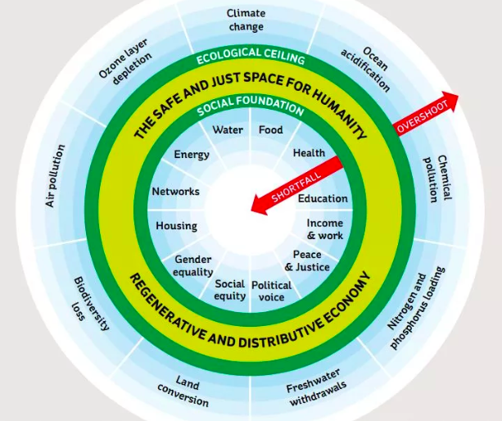

Slide 10
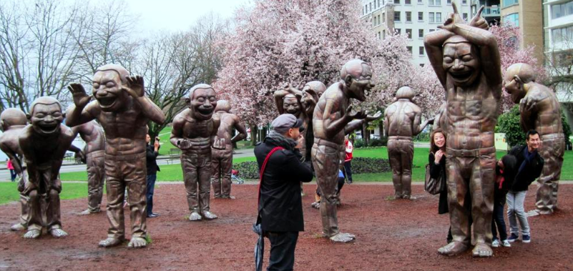
5) Work Across Levels and Systems
Scaling Out, Up and Deep, Role of the System Entrepreneur

Slide 11
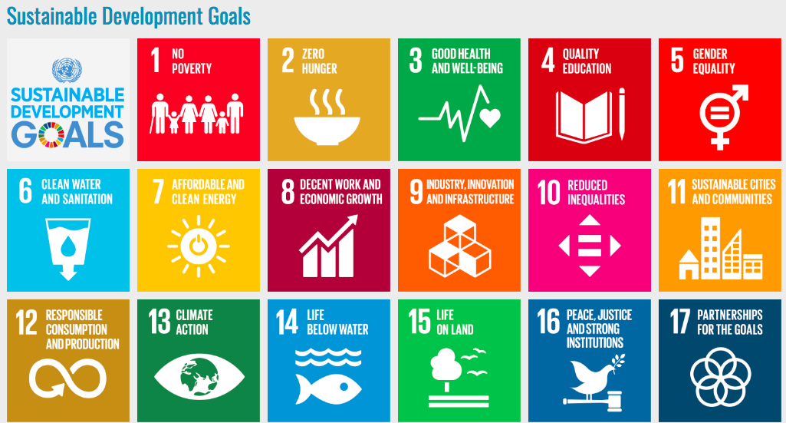
6) Evaluate Patiently, Learn Vigorously
Open Data
Trans-disciplinarity
Traditional knowledge
Developmental Evaluation
Strategic Learning
Emergent Strategy

