Slide 1
Human Rights in the City: Working towards recognition, institutionalization, and accountability of human rights
June 12, 2018
Tamarack Innovation Summit Vancouver
Kate Butler, Lead, Human Rights and Learning

Slide 2
Introductions & Outline
Intros & icebreaker
Social and economic rights
RIA framework
Exercises
Conclusions

Slide 3
What are social and economic rights?
“Overcoming poverty is not a gesture of charity. It is an act of justice. It is the protection of a fundamental human right, the right to dignity and a decent life.” Nelson Mandela
the right to an adequate standard of living, including housing
the right to work
the right to the highest attainable standards of physical and mental health
the right to education
the right to an adequate standard of living, including adequate food

Slide 4
Status of economic & social rights
Some international successes (Optional Protocol on the International Covenant on Economic Social and Cultural Rights has been adopted)
Federal:
National Housing Strategy – right to housing built in
Best Interests of the Child in Family Law reform – best interest of the child as a core component of the Convention on the Rights of the Child
Federal, provincial, territorial meeting in December 2017 for ministers responsible for human rights (includes a commitment to econ & social rights)

Slide 5
Status of economic & social rights (cont’d)
Provincial:
Ontario: Private Members bill attempting to get social condition as part of the Ontario Human Rights Code introduced in fall 2017
B.C.: Legislation for the Poverty Reduction plan will be released this fall. There is some hope that social and economic rights will be mentioned
However, courts still have mostly resisted recognizing social and economic rights

Slide 6
New RIA framework
Legal recognition
Institutionalization
Accountability
Proposed by Philip Alston, the UN Special Rapporteur on extreme poverty and human rights

Slide 7
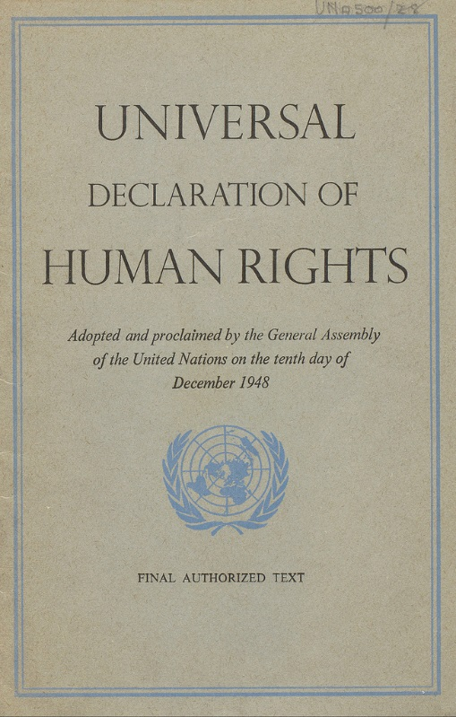
Legal recognition
States should ensure that their domestic law is consistent with their international legal obligations by incorporating norms of international human rights law into their domestic law

Slide 8
Examples
Winnipeg is billing itself as the Human Rights Capital of Canada
Montreal has engaged in a number of activities over the last year to frame itself as a human rights city (Rights City/Montréal, ville des droits humains)

Slide 9
Exercise #1
What would recognition of the human right on your table look like in your community?
Think about how the right might be phrased, where it would be (city charter? Bylaws?), and why this would make a difference.

Slide 10
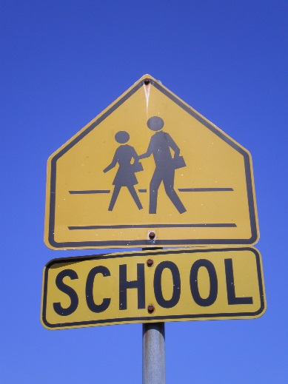
Establish institutions
The assumptions underpinning rights are that institutions will be created and will help to develop the content of this right, promote its implementation, and facilitate its realization
If these institutions are not created, it’s unlikely that a particular right will be realized by people

Slide 11
Exercise #2
Look at the social and economic right at your table.
What kinds of institutions might be created at the municipal or regional level that might let people realize this right?
Think outside the box. What about a human rights court, run by an ombudsperson? Or a new power for an existing body?

Slide 12
Promote accountability
Ensuring the governments are accountable to their citizens and other rights holders
“Appropriate means of redress, or remedies, must be available to any aggrieved individual or group, and appropriate means of ensuring governmental accountability must be put in place”

Slide 13
Exercise #3
If the courts are not recognizing social and economic rights at this moment, what other kinds of accountability mechanisms might be in place for your social and economic right?
Think about landlords, schools and/or school boards, workplaces, etc

Slide 14
Conclusions
We can still work towards a greater inclusion of social and economic rights at various levels of government and by the courts
In the meantime, however, the RIA framework (recognition, institutions & accountability) may help us build a culture of rights in our communities

