Slide 1
The Role of Cities in Poverty Reduction: The Edmonton Approach
Notes:
Thank you for the opportunity to speak today on the work to end poverty in Edmonton. And thanks to Cities Reducing Poverty and Tamarack and Paul Born, for creating a space for this kind of sharing across our country.
Together with my EndPovertyEdmonton colleagues, I am happy to share some highlights of and learnings from our journey in Edmonton about the role of cities in addressing poverty.
I work for the City of Edmonton in its Citizen Services Department. A couple of years ago, I was asked to support a new Task Force being formed with the aim of ending poverty. That was the beginning of the remarkable journey Edmonton has been a part of …and my team and I were honoured to be part of it!

Slide 2
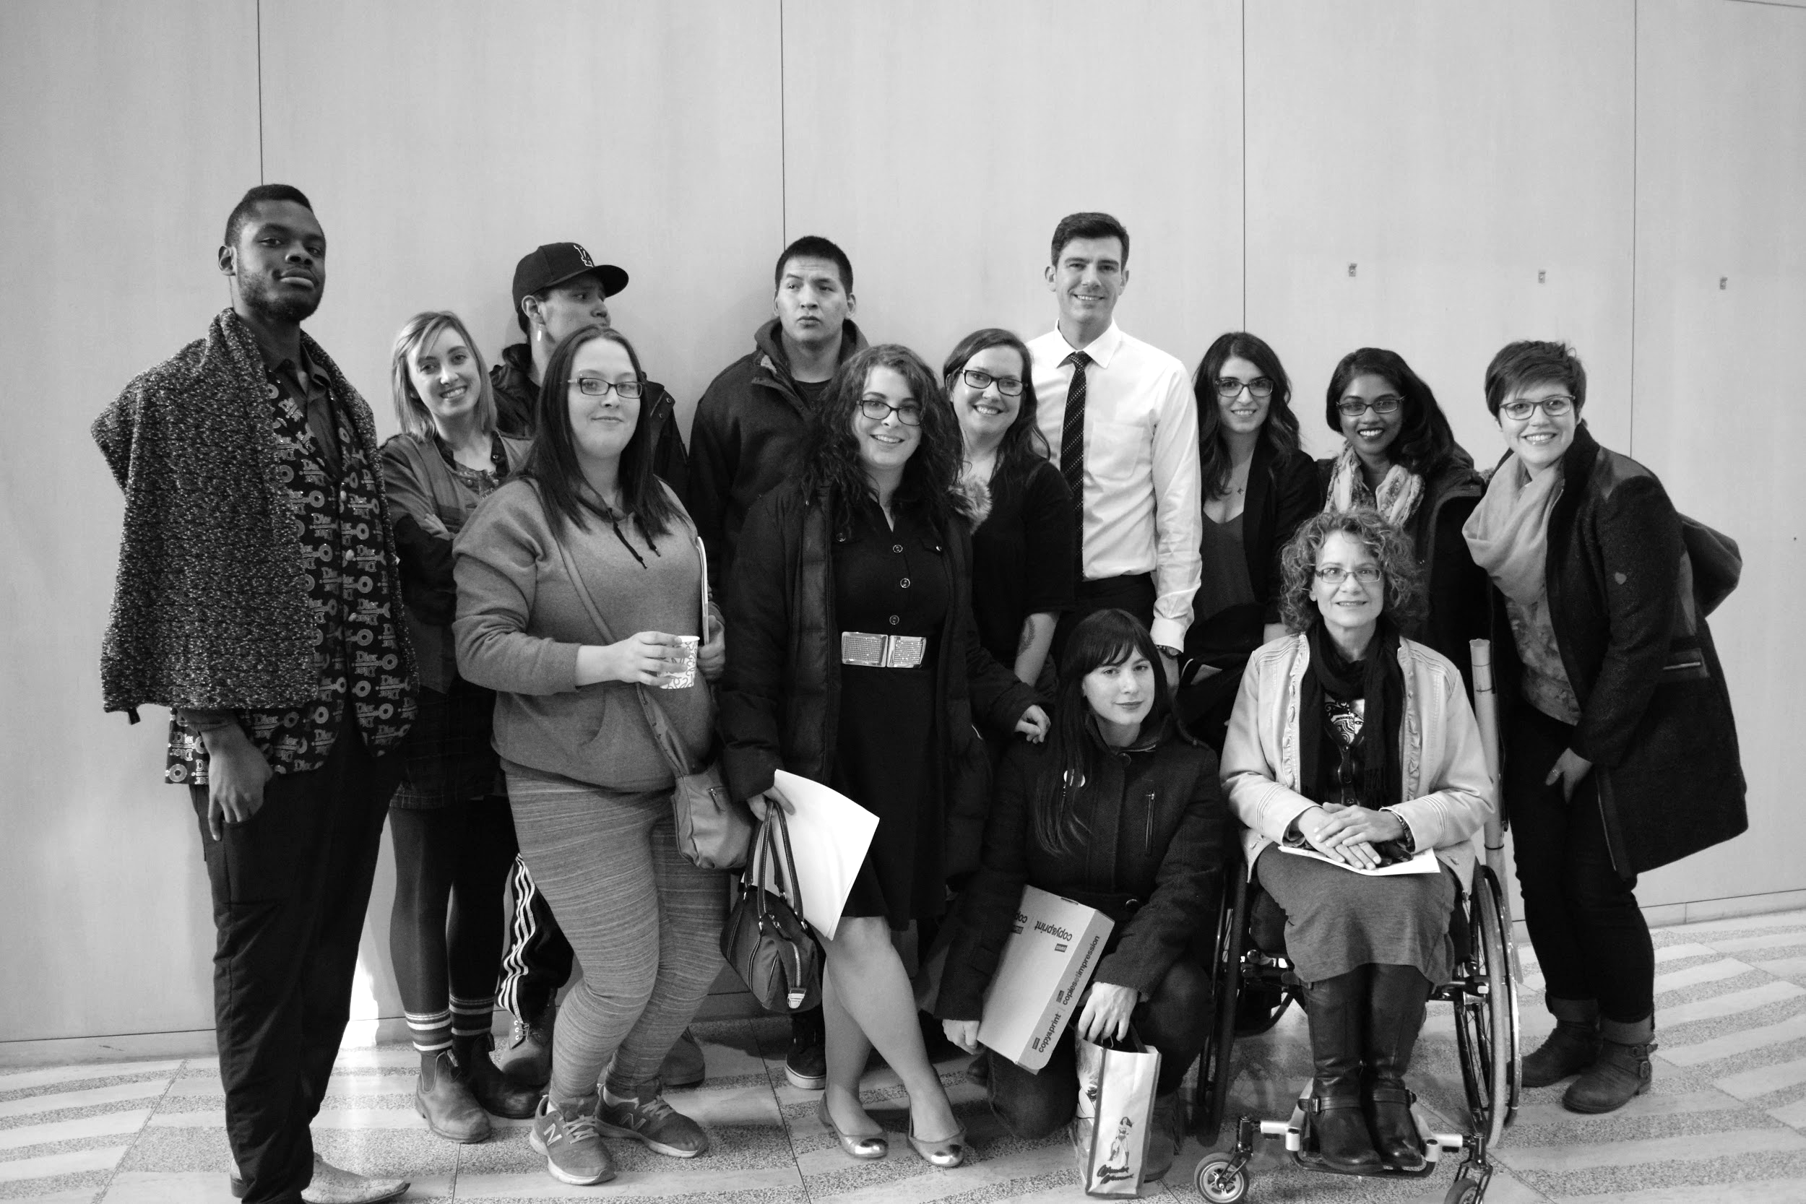
Change and Cities:
“Cities are the crossroads where resources and creativity intersect - the labs where ideas reach their tipping point and become reality.” ~ Mayor Don Iveson
Notes:
For me, these words of our Mayor Don Iveson capture the exciting sense of possibility and influence that a municipality has at its fingertips. The capacity to work differently , to engage citizens and to mobilize a community to achieve a bold goal.
This framing of the city as a lab where ideas can be explored, shared, improved on and implemented, is an exciting one.
From 2014 to 2018, Edmonton’s anti-poverty approach, involving grassroots community mobilization, high level political leadership and municipal heft, has attracted national attention for its focus on human rights, Reconciliation and on catalyzing a movement for change.
Today, I’d like to touch on the work in Edmonton to end poverty from the City’s point of view. What role the City played, how it worked and evolved and what our learnings have been.

Slide 3
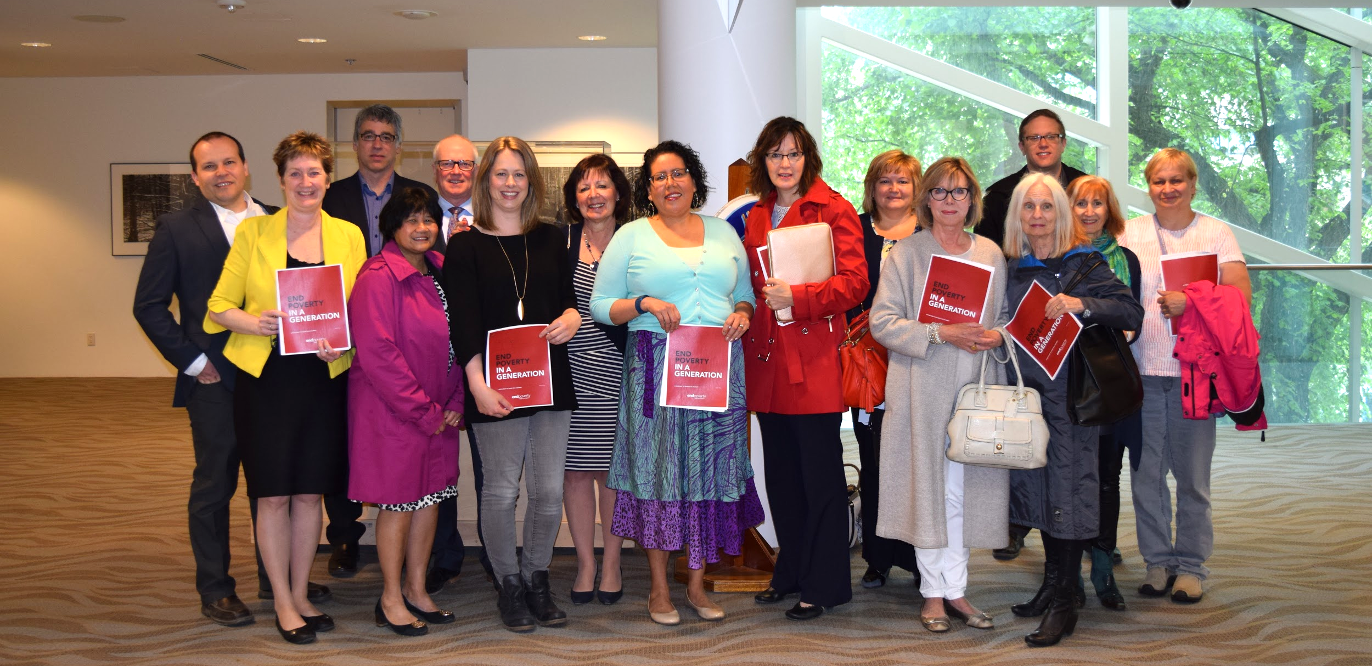
Evolve and Adapt: The Roles of the City
Convenor and Catalyst
Stakeholder and Investor
Incubator and Advocate
Notes:
Evolve and Adapt. As municipalities take on a role in addressing a complex issue like ending or reducing poverty, the city needs to be resilient, open and adaptive , evolving its role over time as the need requires. I’d like to walk you through the 3 phases of the City’s role in this work.
Phase 1-CONVENOR The initial phase of our work in Edmonton saw the municipality launch a high profile TaskForce in 2014. It began a year long process to develop a Vision and Strategy. This included: formation of Task Force tables, evidence based leading practice research and an initial snap shot of poverty in Edmonton 2015, formation of 8 working groups for ideation. A city wide attitudinal survey on ending poverty was conducted as a benchmark, prioritization of recommendations for a draft Strategy, extensive community engagement and consultation, finalization of the Strategy and approval by Council in December 2015. The City role was to convene the players, support the Task Force with resource dollars- for engagement, for meetings, for communications and research- and with a City staff team, and most importantly, with the leadership of Mayor Don Iveson as the Co Chair with Bishop Jane Alexander.
Phase 2- STAKEHOLDER AND INVESTOR The next year long Phase, 2015-2016, included development of a ROAD MAP, a 5 year community implementation plan. In this work the City continued to convene and support the Task Force, its subcommittees and Round Tables. This included the Aboriginal Round table that played such a key role in framing the work to end poverty with an Indigenous World View and grounding the entire strategy in reconciliation. In this phase the City emerged as a STAKEHOLDER or implementer of 18 of the 35 Road Map Actions designated as City Led. The Road Map is often referred to as a Community plan, reflecting the fact that many players – including the City -were designated as leads for the actions.
The Road Map was approved by City Council in May 2016. This phase concluded later that year with unanimous Council support for a significant multi million dollar 5 year investment in the work to end poverty in so the role of INVESTOR. Funds from the City went to the operations of the new EPE, to actions other stakeholders would implement and to actions the City itself would lead on. More on that later
Phase 3- INCUBATOR and ADVOCATE The third phase in 2017, once funding was approved, saw the establishment of the new arms length community collective, EndPovertyEdmonton, with strong municipal support and investment. A new role of INCUBATOR emerged as myteam of 4 -who had supported the Task Force in its two years - now shifted to support the transition to a new community driven entity, called EndPovertyEdmonton and set it up for success. Basic building blocks included recruitment of the ED ( Andrea!), formalizing funding agreements for Road Map actions, continuing the partnership and social media momentum of the Task Force era. Although not too sexy, this behind the scenes role of helping launch the new coalition was definitely an important stage and one the municipality didn’t hesitate to commit to.
And what about PARTNER? The City also is a Partner who who sits on the Stewardship Round Table and Investment Collective of the new community collective. In addition, Two Councilors and I sit on the governance table, to ensure connection and communication are seamless and robust!
And finally, the City is a powerful ADVOCATE for all things related to poverty and the EPE Road Map. Whether its affordable housing, transit, anti racism work –the City takes this role seriously , is at the tables through our Mayor and City Council, as well as Administration. As chair of FCM’s Big City Mayor’s Forum, our Mayor plays the role of ADVOCATE nationally and also provincially for systems change, sustainable funding and new approaches to address poverty and homelessness.
In Alberta, provincially, many initiatives have been implemented in the past 3 years that support people struggling with poverty- the AB Child Benefit (200K kids), Seniors Benefit, 25$ per day child care pilot sites, Minimum Wage going up to $15 per hour in 2018., as well as affordable housing and housing first. The Big City Charter discussions, involving the GOA, Calgary and Edmonton, explore new approaches to many of these key priority issues.
Mayor Iveson also continues to be a visionary CHAMPION- most recently with his frame and focus on building a Health City, creating a family friendly City and relentlessly pursing an agenda of innovation- both technological and data driven and deep social innovation.
So you can see that the roles played by the City have been driven by timing, by the phase and need of the work. The roles are not siloed or exclusive, in fact the City plays multiple roles at any one time. This flexibility and ability to respond are key to our success.
Edmonton is in the fortunate situation of having a strongly committed and invested municipal leadership as well as a new collective entity that brings together diverse voices , partners and players around the goal of ending poverty in a generation. This bodes well for a sustainable , long view generational effort to end poverty and brings the potential for continued City – community co-creation !

Slide 4
City Led Road Map Actions
Indigenous Culture & Wellness Centre
Intercultural Workshop Pilot
City Living Wage Policy
Low Income Transit Pass
Free Transit for Children 12 and under
Suicide Prevention Implementation Plan
Notes:
Within the City itself, a cross corporation Poverty Elimination Steering Committee was formed in 2017 to lead and coordinate the City’s massive commitment to advance these 18 City led anti poverty actions in the Road Map. So although the Task Force wrapped up, and the new EndPovertyEdmonton formed, the City maintains a strong involvement ,investment and commitment to the success of this work, to the implementation of the Road Map.
Some City Led actions are listed here on the slide: ( add a sentence about each KATE)
ICWC
Intercultural Workshop Pilot
City Living Wage
Low Income Transit Pass
Free Transit for Kids 12 and under
Suicide Implementation Plan
Beside City led actions, 17 actions are led by other players and organizations in Edmonton, but collectives and by front line agencies. The City , through its investment in the Road Map, funds these actions that include: City Community Bridge on Tenant Eviction Prevention, Creation of ECDC, Financial Empowerment, Mental Health Action Plan, Early Learning and Care Strategy for Edmonton.

Slide 5
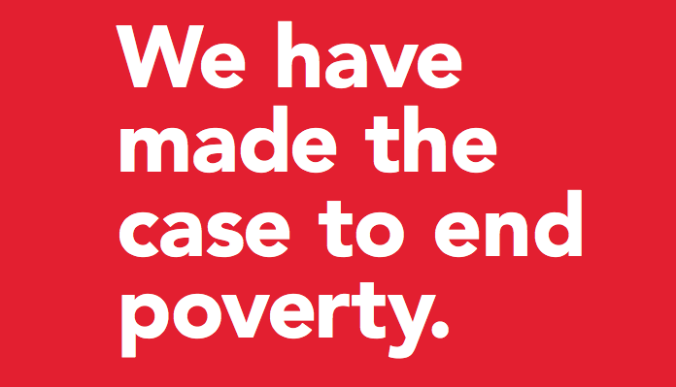
YEG Council Initiatives: Profile and Priority
Prioritized leadership for change
A sustainable platform for long term action
A model to engage diverse community leadership
A platform for innovation
Notes:
The City of Edmonton and its Council have a model that has proved extremely successful this past decade , one that was used for our work on poverty. It is called Council Initiatives, and this approach offers a powerful model for prioritized leadership on social issues.
1. Each 4 year term, Edmonton’s City Council identifies key portfolio priorities for the city and for City Administration called Council Initiatives for that term. This 4 year term we have over 20 Council Initiatives. Initiatives are priority areas that are then sponsored by City Councilors , giving them an opportunity champion and support issues of important to them, but that are city wide in scope and importance. It offers an effective and robust model for municipalities to use in intentionally addressing complex social and community issues like poverty elimination, homelessness, gender equity, anti- racism and mental health and social isolation – and more.
How does it work?
Each Council Initiative is sponsored by one or two City Councilors, who liaise, link , advise and advocate for that area of interest. City staff support the day to day work and progress of the Initiative.
In the case of EndPovertyEdmonton, the Mayor elevated the Poverty Elimination Council Initiative to that of a Mayor’s Task Force, personally bringing the power of the Mayor’s leadership to this work for 2 years as he co chaired the Task Force with Bishop Jane Alexander. In addition he had 2 Councilors, Ben Henderson and Amarjeet Sohi- who left for Ottawa in 2015- on the Task Force with him.
When City work is designated as a Council priority or initiative, it brings with it high level political champions, access to needed resources and enables the City to leverage this profile to convene a diverse cross section of players to the table- from Government of Alberta and Canada, to grassroots community leaders and social agencies at the table. It is a model that can be considered and adapted by other cities, large or small, who are tackling complex issues, and tailored to local conditions, challenges and governance.
2. It offers a sustainable platform to support the long term effort needed to address complex issues
By identifying the Elimination of Poverty as a key City Council Initiative in 2014, and then making it a time limited Task Force, Mayor Don Iveson and Edmonton City Council shone a powerful spotlight on the issue of ending poverty. The 2014-2017 term saw the creation and launch in this Initiative mandated to seek out best practices, engage lived experience and community input and leverage new approaches and partnerships.
The Task Force came to an end when it completed its work, the Strategy and Road Map, in late 2016. But , as you have heard, the City is still at the table, playing key roles in this work. Following the fall municipal election in 2017, Edmonton City Council renewed this powerful Council Initiative to end Poverty, for another 4 year term- 2017-2012. Designation as a Council Initiative provides for City Council advice and guidance and ensures, through regular reports to City Council, a consistent and sustained spotlight on progress to end poverty. This sustained commitment at the highest political level is a very good thing!
3. It offers a model of how municipalities can engage community leadership for change
The Council Initiative approach – and the convening of time limited task forces- is a tool the municipality of Edmonton has used this model of Council Initiatives, and high profile task forces, for some years now.
The City has used this approach to convene a cross section of community leaders to spotlight key issues – around arts and heritage, crime prevention and safety and now around ending poverty. In a number of instances thishas led successfully to the creation of a new community driven collectives or organizations. These new entities have a special relationship with the City, with funding, they act as agents of the municipality- taking on the leadership of key community issues. Examples include : the Edmonton Arts Council, the Edmonton Heritage Council, REACH Edmonton Council for Safe Communities… to EndPovertyEdmonton.
Underlying this approach is a key belief in the power and expertise of community leadership – a recognition that the municipality is not always the best lead on these issues but that community driven leadership will yield the greatest change.
4. It employs innovative approaches, tools and methods
The Council Initiative approach in Edmonton has seen doors opened to bold thinking , to creative approaches and to innovation. In most cases, the resulting strategies and organizations that have emerged are not merely business as usual, but reflect a deeply engaged and focused effort to seek innovative solutions to old problems.
With the EndPovertyEdmonton Task Force, for example, the members were encouraged to match the bold vision to end poverty in our city in a generation with equally bold actions and approaches. The direction for the Task Force was encouraged to think big, to take risks and to engage diverse perspectives. Over the two years, the City engaged its Analytic Centre of Excellence, used a Human-Centred Design Action Lab approach and Social Innovation Techniques, employed Complex Issue Prioritization Techniques and looked to adapt the Collective Impact governance model for change. Not business as usual.

Slide 6
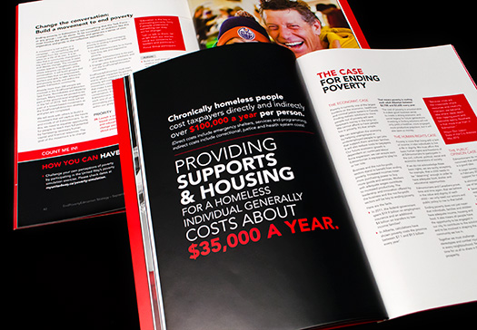
The Benefit to the Municipality
It’s already clear that the EndPovertyEdmonton Strategy and Road Map are emerging as a touchstone for the City’s work to address many complex social issues.
GBA+
FCSS funding alignment
RECOVER
Family Friendly Platform
Notes:
How has the Municipality benefited?
it’s very clear that the powerful EndPovertyEdmonton Strategy and its five year Road Map, this community plan in which the City plays a key role, is increasingly used as a foundational touch stone by the municipality in its work to end poverty.
The value of the EndPovertyEdmonton Road Map lies in its ability to provide an integrated and common vision for change and a platform for a large municipality to ground its work to address the complex social and equity challenges facing Canadian communities today. Some key elements of the work to End Poverty that have cascaded into City work include: the collective impact framework, language and principles around human rights , equity and reconciliation, the value of a social innovation approach , prioritizing human centred design and the voices of those impacted by poverty.
The breadth and boldness of the Plan to end poverty ensure that the entire Corporation is touched, in some way, by these actions, and has the potential to advance some and support others. From low cost transit to living wage, from mental health and anti racism to financial empowerment, community hubs and literacy, there are few City reports or strategies underway today in the municipality that don’t reference or align with the EndPovertyEdmonton plan.
In its deep understanding of the root causes of poverty, the EndPovertyEdmonton plan provides an overarching priority and substantive touchstone for a range of corporate initiatives now at the City of Edmonton. In the past few months, we have seen long standing programs align with the EndPoverty goals, and a number of City reports ground their work in those outcomes. They include ( as listed on the slide) :
GBA+- at the end of May City Council approved plans to implement use of a GBA+ lens in our city. Beginning with Training of City leadership, and City Council last fall and this spring, there is momentum to use and learn from this internationally recognized analytical tool to examine how the diverse needs of citizens are served by policies, programs and services. As a city we aspire to policies and programs that meet the needs of all, but we understand power dynamics, institutional bias and historical legacies of oppression exist and are prevalent in our work. Ultimately GBA+, including in the + socio economic factors , will help us make better decisions that reflect the diverse city we serve.
FCSS- Family and Community Support Services is a unique City –Province partnership in Alberta, a $22 M cost shared grant program for Edmonton that was first launched in 1966! Its mission in to develop local community preventive social services to enhance the wellbeing and inclusion, resilience, of individuals, families and communities. In 2018 Edmonton FCSS funds 70 agencies for 100 programs- $16 M annually. FCSS provided significant funds to support the Road Map : 5 actions in all- youth, families, mental health, financial empowerment and early learning and care. But more that this, FCSS has embedded the vision of ending poverty in its grants:
Since the Road Map was approved, FCSS asks on all applications : How does your program align with City of Edmonton Initiatives such as EndPovertyEdmonton?
When monitoring program, FCSS liaison workers ask agencies: How is the program aligned with or contributing to EndPovertyEdmonton?
A new initiative, RECOVER: Edmonton’s Urban Wellness Plan, just underway this year, is building on the value of co creation with communities and neighbourhoods. Using a social innovation lens, and conducting deep ethnographic research in 5 of Edmonton’s Core communities, RECOVER has mobilized citizens to work together in a new way, identifying and testing new solutions or prototypes , all with a view to enhancing urban wellness- a goal and outcome very much aligned with ending poverty!
Family Friendly Platform- In the fall election, under the leadership of Mayor Iveson, a family friendly platform emerged, that is quite tied to the EPE work. As Canada’s youngest city, this calls for Edmonton to recognize and develop a city that is family friendly, addressing the needs and aspirations of modern, diverse families . This platform speaks strongly to the spirit and actions of the EndPoverty Road Map including actions such as: Free transit for youth 12 and under ( an EPE action), development of schools as community or neighborhood hubs, a priority on easing regulations for locating child care spaces and making sure they are in our City facilities and addressing issues of racism and Reconciliation.

Slide 7
Five Key Learnings
Build on your community legacy
Mobilize municipal expertise
Leverage community investment
Co-create and innovate
Be bold
Notes:
We have learned that the work of a city is iterative. It’s influenced by the changing landscape, political agendas, yes, by timing, by readiness… and by what has come before. From a municipal lens, I’d like to share 5 powerful lessons learned with you that are now shaping, as we speak, new initiatives and directions at the City of Edmonton.
1.Build on and Honour the Community Legacy
The City set out to leverage and build on- not ignore- the local legacy of effort which included a two year Poverty Elimination Committee. In its work , the municipality and its task force made a clear effort to recognize, showcase and acknowledge the decades of work and leadership by local community organizations, committed to ending poverty and to helping all Edmontonians thrive.
2.Mobilize Municipal Expertise
The EndPovertyEdmonton Task Force model illustrates the power of not only convening a broad diversity of community leadership and sectors, but of looking inward and drawing on the heft and expertise of the whole municipality in an integrated and creative way. Besides the high level political support, mobilization of city staff from Transportation, City Clerks’ office, Human Resources, Edmonton Police Services, Urban Planning has occurred as different departments lead various Road Map actions.
3. Leverage Community Investment
Collective leveraged investment is vital to ending poverty. Investment by Edmonton’s United Way Capital Region and the Edmonton Community Foundation were also leveraged in addition to City funds. The United Way houses and provides office infrastructure to the new organization. And the Edmonton Community Foundation is a providing $10 M in financing and is incubating the new Edmonton Community Development Company, an investment complemented by a commitment of $10 M of City land to create value , through affordable housing , jobs and economic development, in key vulnerable neighbourhoods.
4. The Power of Co Creation and Innovation
Through the EndPovertyEdmonton mobilization , the City of Edmonton has learned clearly that innovation and creativity come from those whose lives are impacted by poverty. This belief anchors the work of EndPoverty Edmonton and its collective impact model. It ensures the authentic participation, grassroots leadership and the voices and involvement of those struggling with poverty. Through this Task Force process, the City wanted to make this the journey of the many, not of the few, to engage Edmontonians of all walks of life and perspectives to build a plan for robust and lasting change. This learning is now shaping much of the work of the City of Edmonton as it tackles complex social issues for change.
5.Be bold
Through the EndPovertyEdmonton model, the municipality has learned that people rally around an aspirational vision. While some see stretch goals, like ending in a generation, as naïve or daunting, we have found the opposite. Our experience is that broad, holistic and bold goals attract interest, offer citizens and sectors an opportunity to see themselves in the solutions and inspire involvement and ownership. Authentic and robust engagement, evidence based foundations, an inclusive approach are keys to achieving this and a focus on innovative methods as are early quick wins, small tangible successes along the journey.

Slide 8
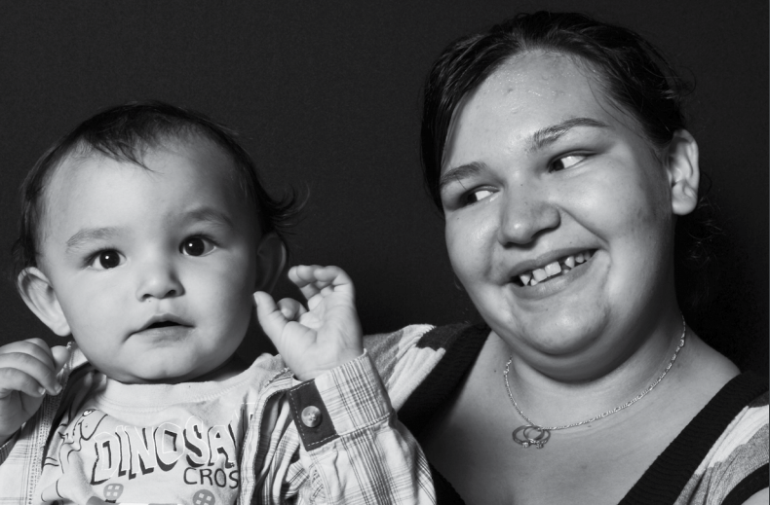
“Another world is not only possible, she is on her way. On a quiet day, I can hear her breathing.” ~ Arundhati Roy
Notes:
I hope I have given you a sense of the journey that the City of Edmonton has been on to end poverty in a generation. My focus has been the municipality, and its role in change, but I want to stress that our journey has been one made stronger by the many Edmontonians who have been leading the way alongside us. The leadership of the new EndPovertyEdmonton is a huge asset to our city.
We live in a time of great change, as organizations and governments and systems struggle to reshape themselves to the year 2018 and be able to respond to new challenges and new opportunities.
We also live in a nation of city dwellers with over 80% of us spending our lives in urban centres. These new, messy, rich and diverse centres hold the possibilities for real change.
Add to that, we also know that Municipal Governments are the order of government closest to the citizen.
Every day , in cities across this country, without the formal levers or resources, cities are stepping up to the plate to convene diverse perspectives, seek solutions and build communities that lift all citizens up. And they are doing it in new ways, propelled by new visions and ideas and doing it with Canadians.
Many of us here today are in the vanguard of that change in our communities. As Arundhati Roy has said so evocatively: Another world is not only possible, she is on her way. On a quiet day, I can hear her breathing..
Thank you.

