Slide 1
Notes:
Introductions. Who we are, a bit about our lives, and how we got into this work. Wh

Slide 2
Learning Objectives
Define the key concepts of GBA+
Recognize how sex, gender, intersectionality and root causes can influence the outcomes of policies, programs, and legislation
Apply some basic GBA+ concepts and processes
See how GBA+ is complementary to ABCD
2
Notes:
KEY MESSAGES
Welcome Remarks:
Introduce Facilitators
Participant Introductions:
Include their name, who they represent, have they taken the online training, their desired outcomes for the training
2

Slide 3
Notes:
Current WAVE cohort. Using an asset based lens is how the WAVE committee is formed and how the group are skilled in GBA+ When recruting the group we use an intersectional lens (we will go more indepth with this further in the presentation) and look at the assets, connections, gifts, skills, and life experiences as we recruit. These different women bring different lenses that allow us to implement a GBA+ lens in everything we do.

Slide 4
Women’s Advocacy Voice of Edmonton (WAVE)
Women’s Council Initiative
Sponsor: Councillor Bev Esslinger and Mayor Don Iveson
Supported by Community Inclusion & Investment Citizen Services
Programs and events
Notes:
SPEAKING NOTES:
Kaylin to provide a verbal summary of women’s initiative presentation slides from Women’s Initiative presentation- Internal
Elyssa to speak to WAVE experience.

Slide 5
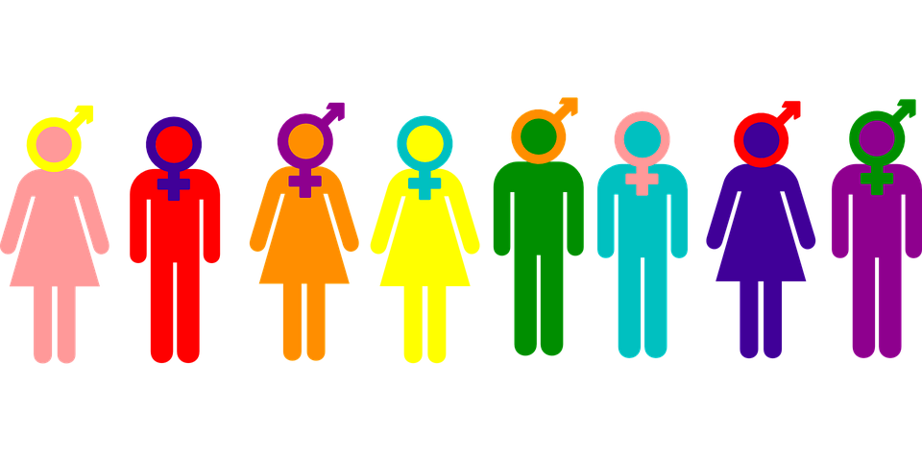
Gender-Based Analysis Plus (GBA+)
A tool of analysis that assesses the effects of policies, programs and services, and legislation on diverse groups of women, gender non-conforming, and men.
Raises awareness about differences among the genders through intersectional analysis.
Identifies ways to reduce and prevent inequality.
5

Slide 6
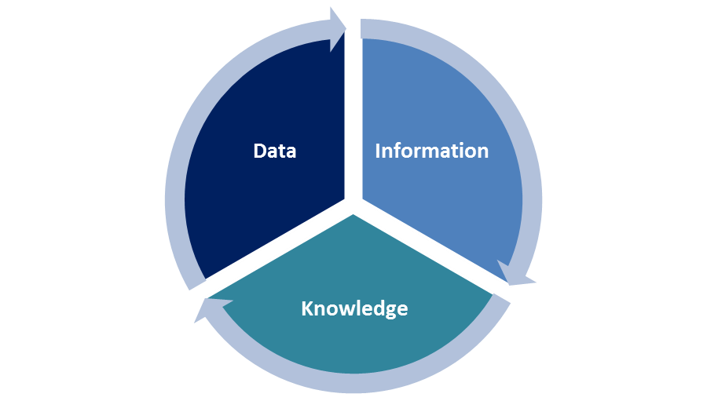
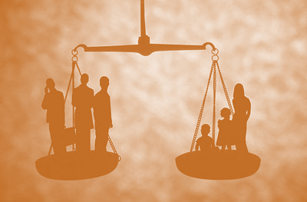
Benefits for GBA+
Enhanced decision-making
Improved data and information
Improved effectiveness
Equality of outcomes
6

Slide 7
Everyone has gifts: Each person in a community has something to contribute.
Looks at the diversity of contributions of people of intersecting identities.
Relationships build a community: People must be connected in order for sustainable community development to take place.
GBA+ looks at how people exist in the world and connects their lived experiences
Citizens at the center: Citizens should be viewed as actors—not recipients—in development.
All work done is with Citizens in mind.
Leaders involve others: Community development is strongest when it involves a broad base of community action.
Broad community action and broad representation
People care: Challenge notions of "apathy" by listening to people's interests.
GBA+ works with people where they are.
Listen: Decisions should come from conversations where people are heard.
GBA+ is about listening to and hearing people’s lived experiences and needs
Ask: Asking for ideas is more sustainable than giving solutions.
Solutions are best found when we hear from diverse people
Inside-out organization: Local community members are in control.
Institutions serve the community: Institutional leaders should create opportunities for community-member involvement, then "step back.
GBA+ works within Asset Based Community Development. They are complementary.
Notes:
Connect these core values throughout the presentation

Slide 8
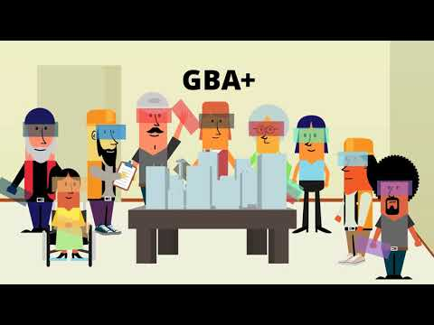

Slide 9
Our vision: Gender Equality
GBA+
Community
Capacity & Outreach
Research & Analytics
Gender Budgeting
Gender
Mainstreaming
9

Slide 10
Sex and Gender
Sex
Biological
Genetics, physiology, hormones, anatomy
Sex also isn’t binary and up to 1% of the population is born intersex.
Gender
Social construction with real life impacts
Informed by society, culture, norms, history, responsibilities, expectations, roles
10
Notes:
Neither sex or gender is a binary! People exist outside of the binary.

Slide 11
Notes:
Hersharon, there is a better version of this. I can’t find it, do you happen to know about it?

Slide 12
Sex and Gender in GBA+
Both sex and gender influence the experience of policies, programs, and initiatives.
Importantly, differential effects of an initiative will most often reflect gender differences such as:
Socially constructed roles;
Differential power relationships; and
Gender norms, expectations, and stereotypes.
These differences are the result of the gender socialization process.
12

Slide 13
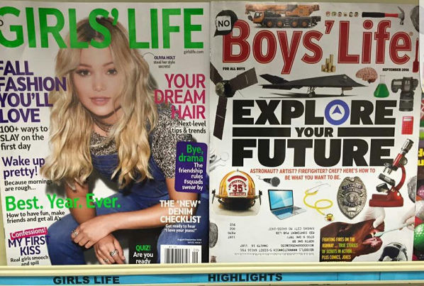
13
Notes:
Gender socialization. And consider the children that don’t identify as either reading these magazines. Where do they fit?

Slide 14
= Intersectionality
Promotes the understanding that human beings are shaped by multiple identity factors.
(e.g., ethnicity/ “race”, Indigeneity, gender, class, sexuality, geography, age, disability/ability, migration, status, religion).
Adapted from the work of Kimberlé Crenshaw
14

Slide 15
Notes:
Intersectionaity- Show the snail video

Slide 16
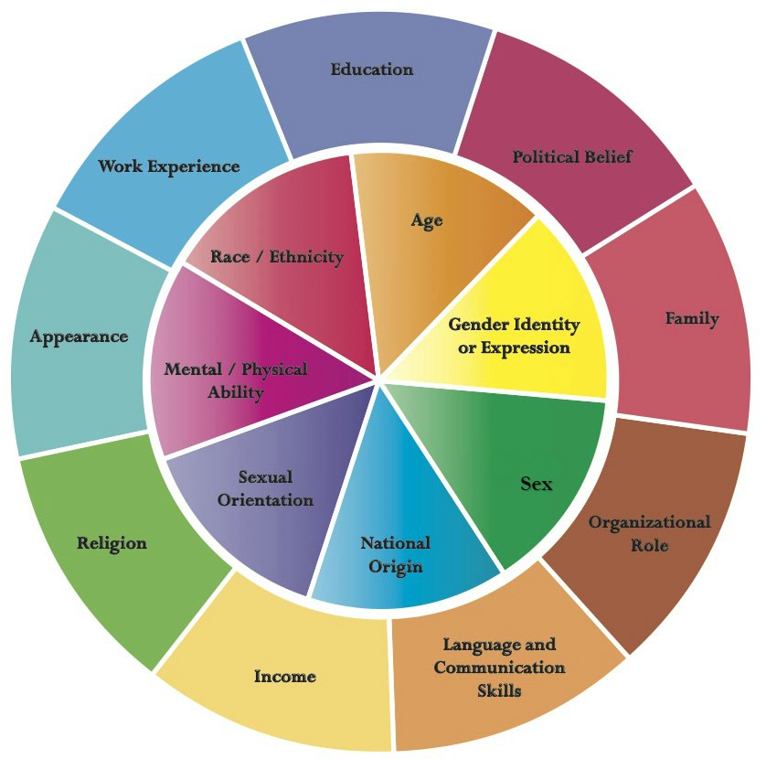
= Intersectionality
Promotes the understanding that human beings are shaped by multiple identity factors.
Adapted from the work of Kimberlé Crenshaw
Johns Hopkins University – Diversity Wheel
16

Slide 17
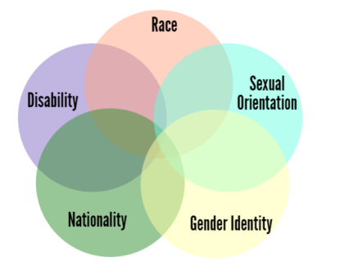
Notes:
More information on diversity/intersectionality

Slide 18
= Intersectionality
Helps us understand how different factors affect access to rights and opportunities.
These factors interact to form systems of inequality and structures of power, privilege, and oppression.
e.g.: laws, policies, state governments and other political and economic institutions, media.
Inequities are the result of intersections of different:
social locations, power relations and experiences.
18

Slide 19
What does this mean?
Visible minorities, women and gender non-conforming people (to name a few) are often excluded in:
Decision-making and leadership;
Access and control over resources;
Labour market participation and economic security; and
Health, safety, and social resources.
Exclusions are amplified by ethnicity, ability, socioeconomic status, gender identity, sexual orientation, etc.
19

Slide 20
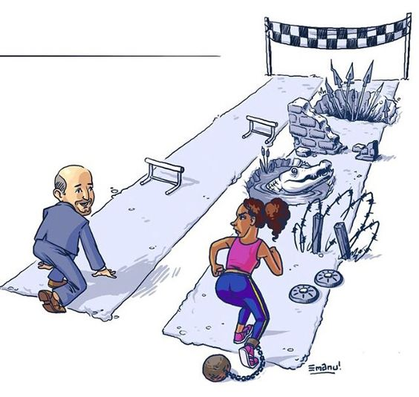
It’s the same distance!
20
Notes:
Inner city school kids

Slide 21
EQUITY
EQUALITY
Achieved when everyone enjoys the same rights and all people benefit equally in all aspects of society;
Factors such as gender, race, sexual orientation, socioeconomic status, etc. do not limit those rights and benefits; and
The different behaviours, aspirations and needs of people are equally valued.
Means treatment according to people’s respective needs.
May require different treatment or compensation for historical or social disadvantages.
Ensures people have appropriate measures to achieve their desires, needs, and aspirations.
21

Slide 22
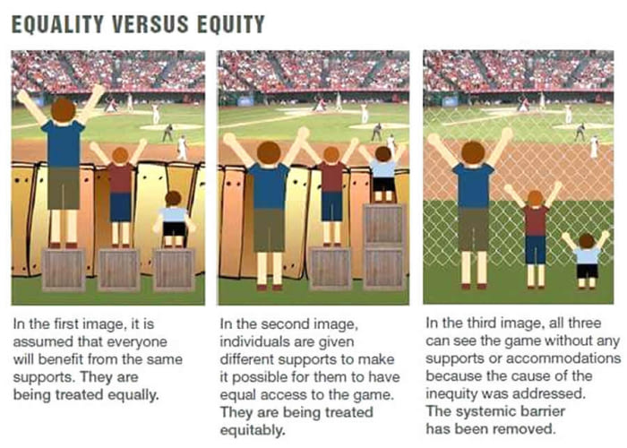
EQUITY and EQUALITY
22

Slide 23
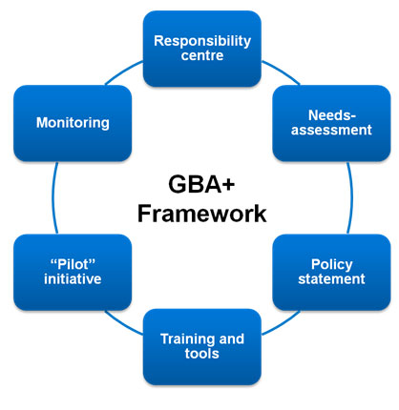
Notes:
ABCD and GBA+ Both approaches involve a look at the exsisting resources, strengths and abilities of the group of people or project being undertake. GBA+ aims to design things in a way that will strengthen and involve people

Slide 24
Root Causes
Colonialism
Islamophobia
Classism
Patriarchy
Individual
& Community
Racism
Homophobia
Sexism
24

Slide 25
“Race”, Racism and Ethnicity
stereotypes
Race: a group of people identified as distinct from other groups because of supposed physical or genetic traits shared by the group.
Racism: the belief that race accounts for differences in human character or ability and that a particular race is superior to others. Often exhibited through comments and behaviours that are meant to offend and oppress a specific group of people while privileging another.
prejudice
Ethnicity: A shared culture and way of life. This can be reflected in language, religion, material culture such as clothing and food, and cultural products such as music and art. Ethnicity is often a major source of social cohesion and social conflict.
discrimination
25

Slide 26
Gender-Based Analysis Plus (GBA+) in Practice
26

Slide 27
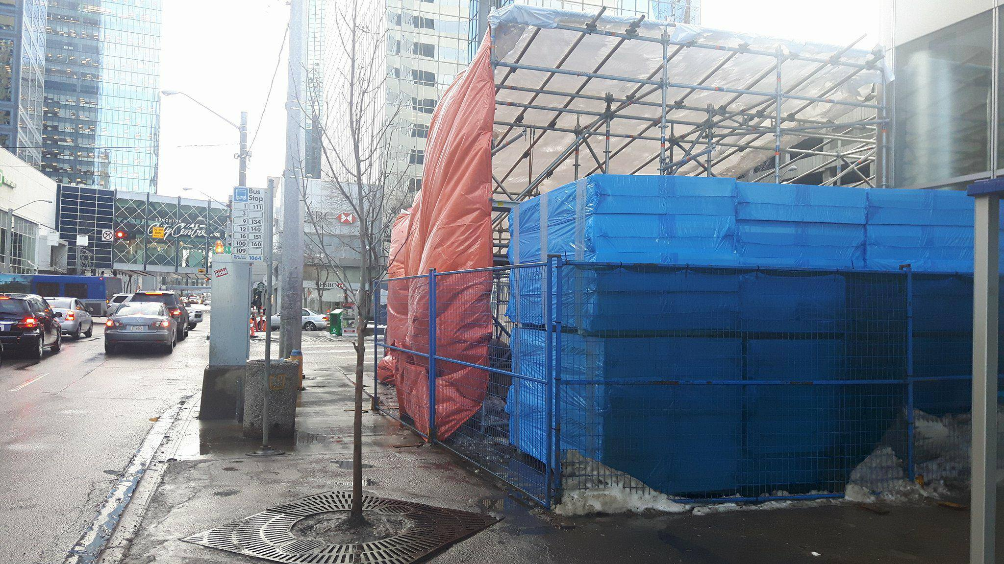
Application of GBA+
27

Slide 28
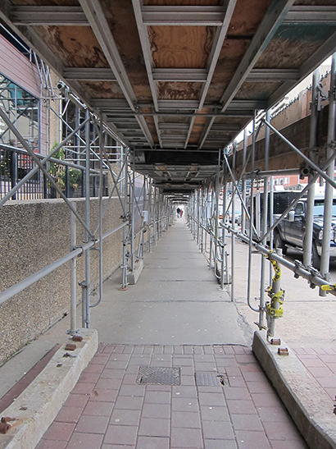
Notes:
Use the diversity lenses. Who is going to be impacted by this work

Slide 29
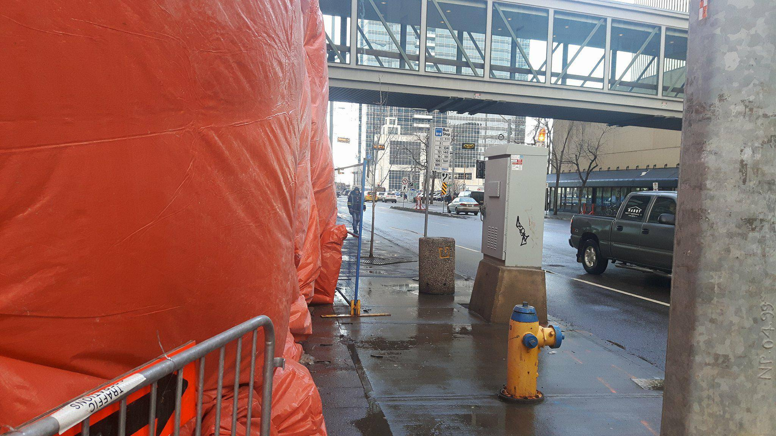
Notes:
Walkability
Liveability
These slides are about a policy issue in the city that are making sidewalks unsafe. The women’s initiative is looking at the policy “Sidewalk hoarding” to see what can be done to leave more sidewalk accessible and with better visability.

Slide 30
Application of GBA+
The use of GBA+ leads to intersectional and gender responsive policies, programs and legislation when:
root causes, gender norms, roles, and inequalities have been considered;
AND
measures have been taken to actively address inequalities.
30

Slide 31
Application of GBA+
What | Assumptions are you making?
Who could be left | Behind?
Who did you | Consult?
What | Data did you look at?
How are you ensuring | Equality of outcomes?
31

Slide 32
Exercise #2 Case Study
Public Consultation Processes
32
Notes:
Public Consultation Processes to Ensure you are Inclusive
What area of work do you think is important to focus on? City Planners? City Policy? City Leadership? Why?
Discuss Council Orientation Policy
Council Parental Leave Policy
Programs at Recreation facilites

Slide 33
Resources
Status of Women – What is GBA+
Five GBA+ Templates
Inclusive Language and Communication Guide
Gender Mainstreaming Video
https://www.youtube.com/watch?v=udSjBbGwJEg
Online GBA+ course developed by Status of Women Canada:
http://www.swc-cfc.gc.ca/gba-acs/gbacourse-coursacs-eng.html
33

Slide 35
Questions?
marian.bruin@edmonton.ca
35

