Slide 1
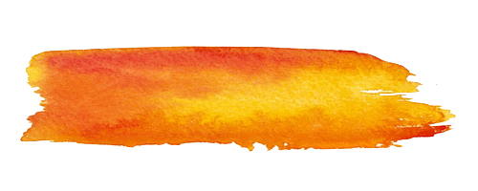
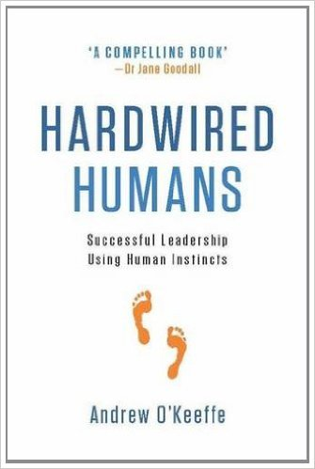
A CULTURE OF COLLABORATION: LESSONS FROM HARDWIRED HUMANS
A Tamarack Webinar Event with
Andrew O’Keeffe & Lisa Attygalle

Slide 2
Welcome to the Webinar!
Audio Options:
VoIP: You may choose to connect your audio using your computer’s speakers. A headset is recommended.
Phone: You may choose to call in using your telephone by calling : +1 (647) 497-9389 in Canada and +1 (213) 493-0005 in the United States and enter access code 475-372-371
Enter the unique audio pin you see in the audio tab of your GoToWebinar control panel to connect to audio.
Tech Support: Use Question Box in your GoTo Webinar control panel or email megan@tamarackcommunity.ca
Twitter: For those of you who like to tweet your thoughts as you learn use #TamarackConnect
Questions? Please use the Question Box to ask your questions.

Slide 3
Share Your Thoughts Online!
@Tamarack_Inst
@lisaattygalle
#TamarackConnect

Slide 4
A CULTURE OF COLLABORATION: LESSONS FROM HARDWIRED HUMANS
A Tamarack Webinar Event with
Andrew O’Keeffe & Lisa Attygalle

Slide 5
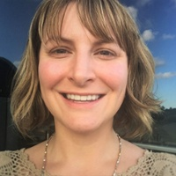
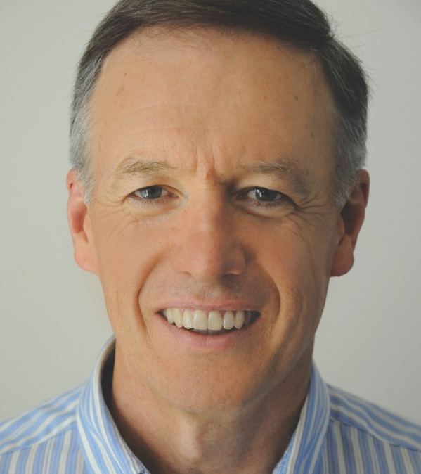
Your Webinar Hosts
Lisa Attygalle Director of Engagement Tamarack Institute
Andrew O’Keeffe
Director
Hardwired Humans

Slide 6
Questions?

Slide 7
Stay Engaged | Continue your journey
Subscribe to monthly newsletter
Read Hardwired Humans
Leadership development workshops
Change team development and accreditation
www.hardwiredhumans.com
andrewo@hardwiredhumans.com

Slide 8
Stay Engaged | Upcoming Events
Community Engagement: The Next Generation
http://events.tamarackcommunity.ca/ce
Community Engagement: Technologies for Change
http://events.tamarackcommunity.ca/ce-london

Slide 9
Stay Engaged | Subscribe
Stay up to date with the latest in community change.
Visit www.tamarackcommunity.ca to subscribe.

Slide 10
Thank You!
Please share your feedback with us at tamarack@tamarackcommunity.ca

