Slide 1
Information
March-April 2020

Slide 2
Take everyday precautions
Avoid touching your face
Hand washing
Social distancing
Personal Protective Equipment (PPE)

Slide 3
Take everyday precautions
Eating one person per table
Clean your place before and after eating
Regularly clean their workstations
Undress take a shower once you get home.

Slide 4
Take everyday precautions

Slide 5
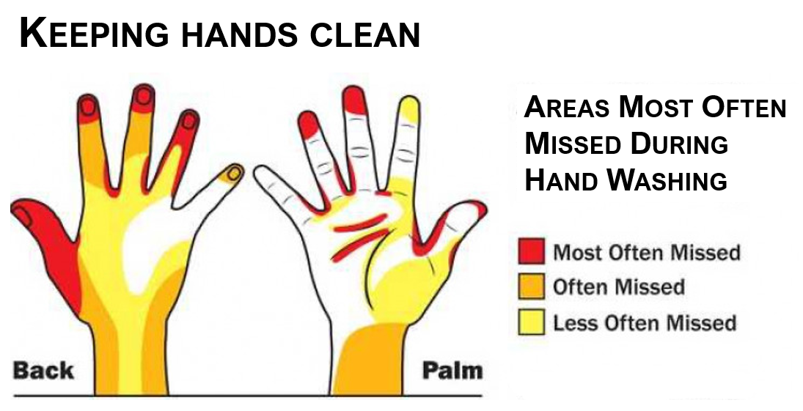
Take everyday precautions

Slide 6
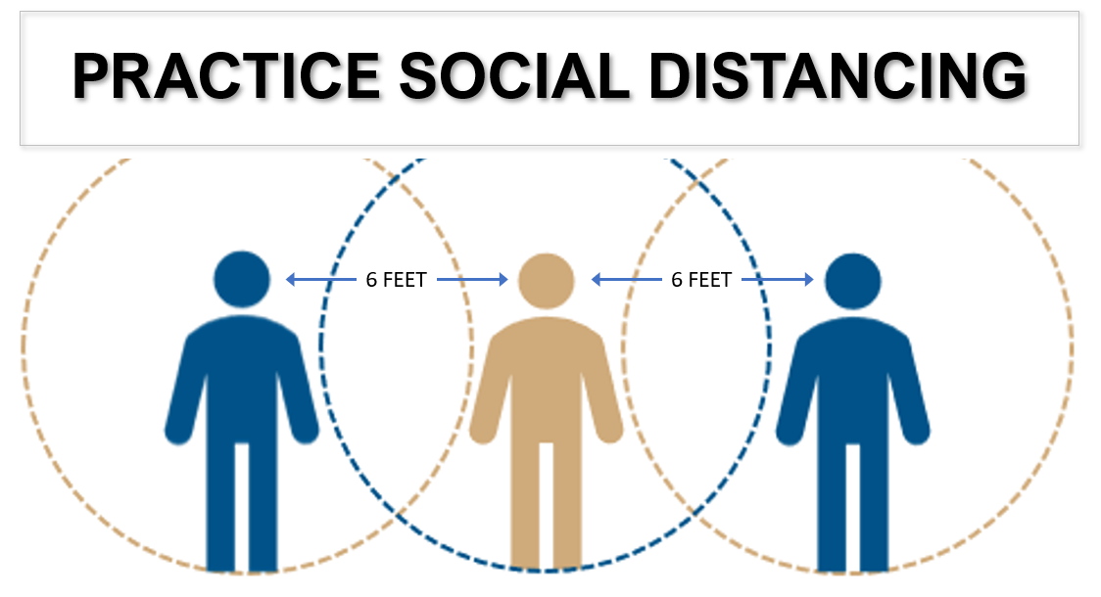
Take everyday precautions

Slide 7
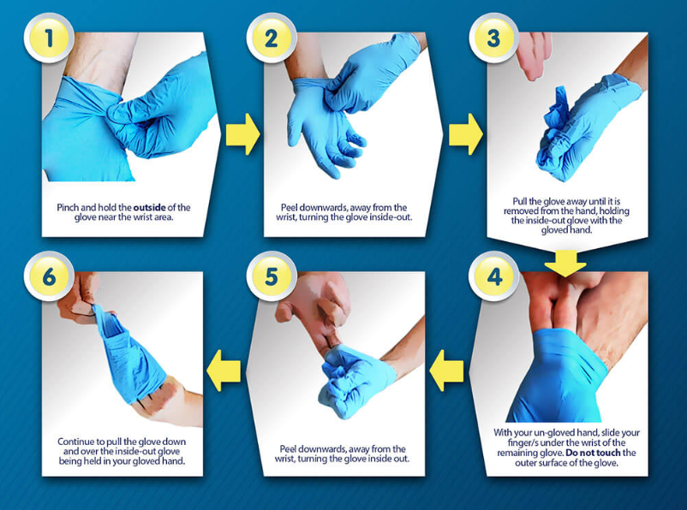
How to safely remove disposable gloves
Clean to clean
A clean bare hand touches only
clean areas inside the other glove
Dirty to dirty
Contaminated surfaces only touch other contaminated surfaces
Do not touch your face or adjust PPE with contaminated gloves
Do not touch environmental surfaces – eg: door handles - with contaminated gloves
Never wash or reuse disposable gloves

Slide 8
Take everyday precautions

Slide 9
You have doubts about the health of a colleague?
Notify your supervisor immediately
or
contact hr@techo-bloc.com

Slide 10
Measures in place to ensure your protection
All employees who are able to work remotely are asked to stay at home and telework.
All face-to-face meetings were discontinued and replaced by remote conferencing.
We have significantly increased health measures such as regularly disinfecting frequently touched objects and surfaces (door handles, light switches, tables, desks, toilets, taps, sinks and other sensitive surfaces).
We put up dozens of safety signs in every building about the responsibility to take to following actions:
Wash hands for 20 seconds with soap and water;
Physical distancing;
Not touch their face;
Identifying the symptoms of COVID-19, etc.
We asked all employees who had recently traveled or were experiencing flu-like symptoms to place themselves in voluntary isolation for two weeks.

Slide 11
Measures in place to ensure your protection
We have suspended the use of biometric punches.
We have implemented preventative operating procedures to limit the number of employees on site during shift changes.
We have prohibited access to all our buildings by visitors, suppliers and outside contractors.
We have restricted access to common areas.
We have installed partitions to limit direct interaction between people.
We have stopped all business travel.

