Slide 1
HR Challenges of International Expansion
Facts & Figures from the latest Economist Research
ADP Executive Briefing Series | 17th March 2020

Slide 2
The Research
“Growing pains: The HR challenges of international expansion” is an Economist Intelligence Unit report, sponsored by ADP.
It identifies the chief HR challenges of managing a growing international workforce and the executive leadership skills, technologies and strategies that are important for overcoming them.
1,000 HR executives in internationally expanding companies share their views
A third of respondents are from companies with 5,000+ employees
Global survey conducted Oct–Nov 2019
Executive Summary
Although global trade growth is on the decline, according to predictions by the World Trade Organization (WTO), it has not stopped companies from extending their reach abroad.1 The opportunity to diversify markets and supply chains and increase access to specialist skills and capabilities is too tempting.

Slide 3
5 Key findings

Slide 4
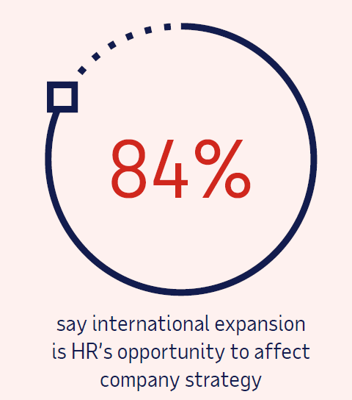
1 |
International expansion is poised to accelerate
Notes:
International businesses are setting themselves aggressive growth targets:
31% of businesses expect to grow by 11–25%
28% expect to grow by 26–50%
25% expect to grow by 51–100%
Ambitious companies are looking to expand beyond their home market to access new market opportunities and specialist talent. The majority of survey respondents say their firm increased their overseas headcount by over 25% in the past five years, and that growth is expected to accelerate in the next year.
For 75%, access to new market opportunities is the primary driver of expansion. As expected, the pursuit of growth is the main reason a company might take the effort to expand beyond their home markets.

Slide 5
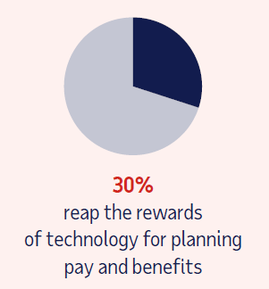
2 |
Technology and data analytics have greatly helped companies to expand their global functions.
Notes:
From designing HR services and systems to recruitment strategy, analytics have played an overwhelming role in supporting and driving change, according to survey respondents. This is particularly helpful as companies try to design global services that factor in the ever-growing, ever-changing legal and cultural requirements of foreign offices.
Let technology lead the way in process integration
HR process integration 46%
Employee training 42%
Managing HR operations cost 38%
Employee engagement 34%
Recruitment 30%
Planning pay and benefits 30%
Commutating across languages and cultures 29%
Diversity and inclusion 26%

Slide 6
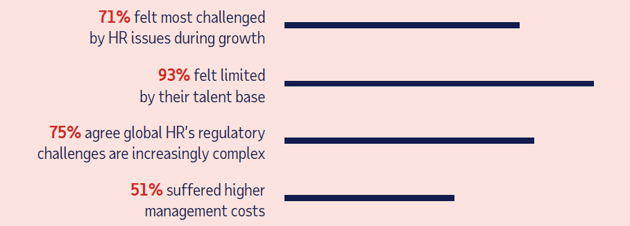
3 |
The most widely felt HR challenges to international expansion are compliance and recruitment
Notes:
Recruiting suitably skilled employees and managers, and remaining compliant with employment law across multiple jurisdictions, are the most common HR-related issues that survey respondents encounter. These challenges and others have limited the pace of international expansion for a majority of respondents.

Slide 7
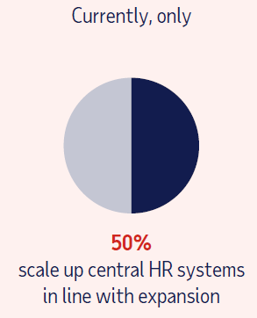
4 |
Large companies are more likely to expand through mergers and acquisitions, and encounter cultural challenges as they do so.
Notes:
Companies with over 5,000 employees are more likely to have expanded internationally through mergers and acquisitions than those with fewer, although opening regional offices is the most common approach for both groups. Meanwhile, the most common HR challenge among these larger companies is understanding cultural differences.

Slide 8
5 |
International expansion is an opportunity to make a strategic contribution.
The experience of interviewees and insights from the survey provide some guidance on how this can be achieved:
Equip your company with specialist skills & experience
Assert the strategic role of HR in expansion
Let technology lead the way in process integration
Build a culture of diversity
Notes:
Most respondents (84%) agree that international expansion trends are an opportunity for HR to help drive company strategy. But, as interviewees advise, HR leaders must be assertive to ensure that workforce-related issues are acknowledged and addressed in their organisation’s expansion strategy.

Slide 9
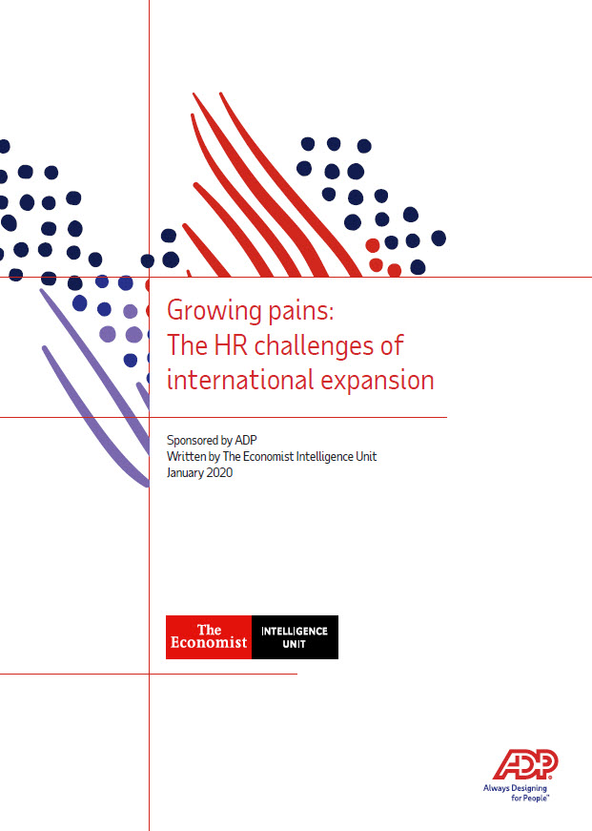
ADP and Economist Report
Learn more:
de-adp.com
Get a copy of the report at:
www.adpinfo.com/EIU-report-2020

