Slide 1
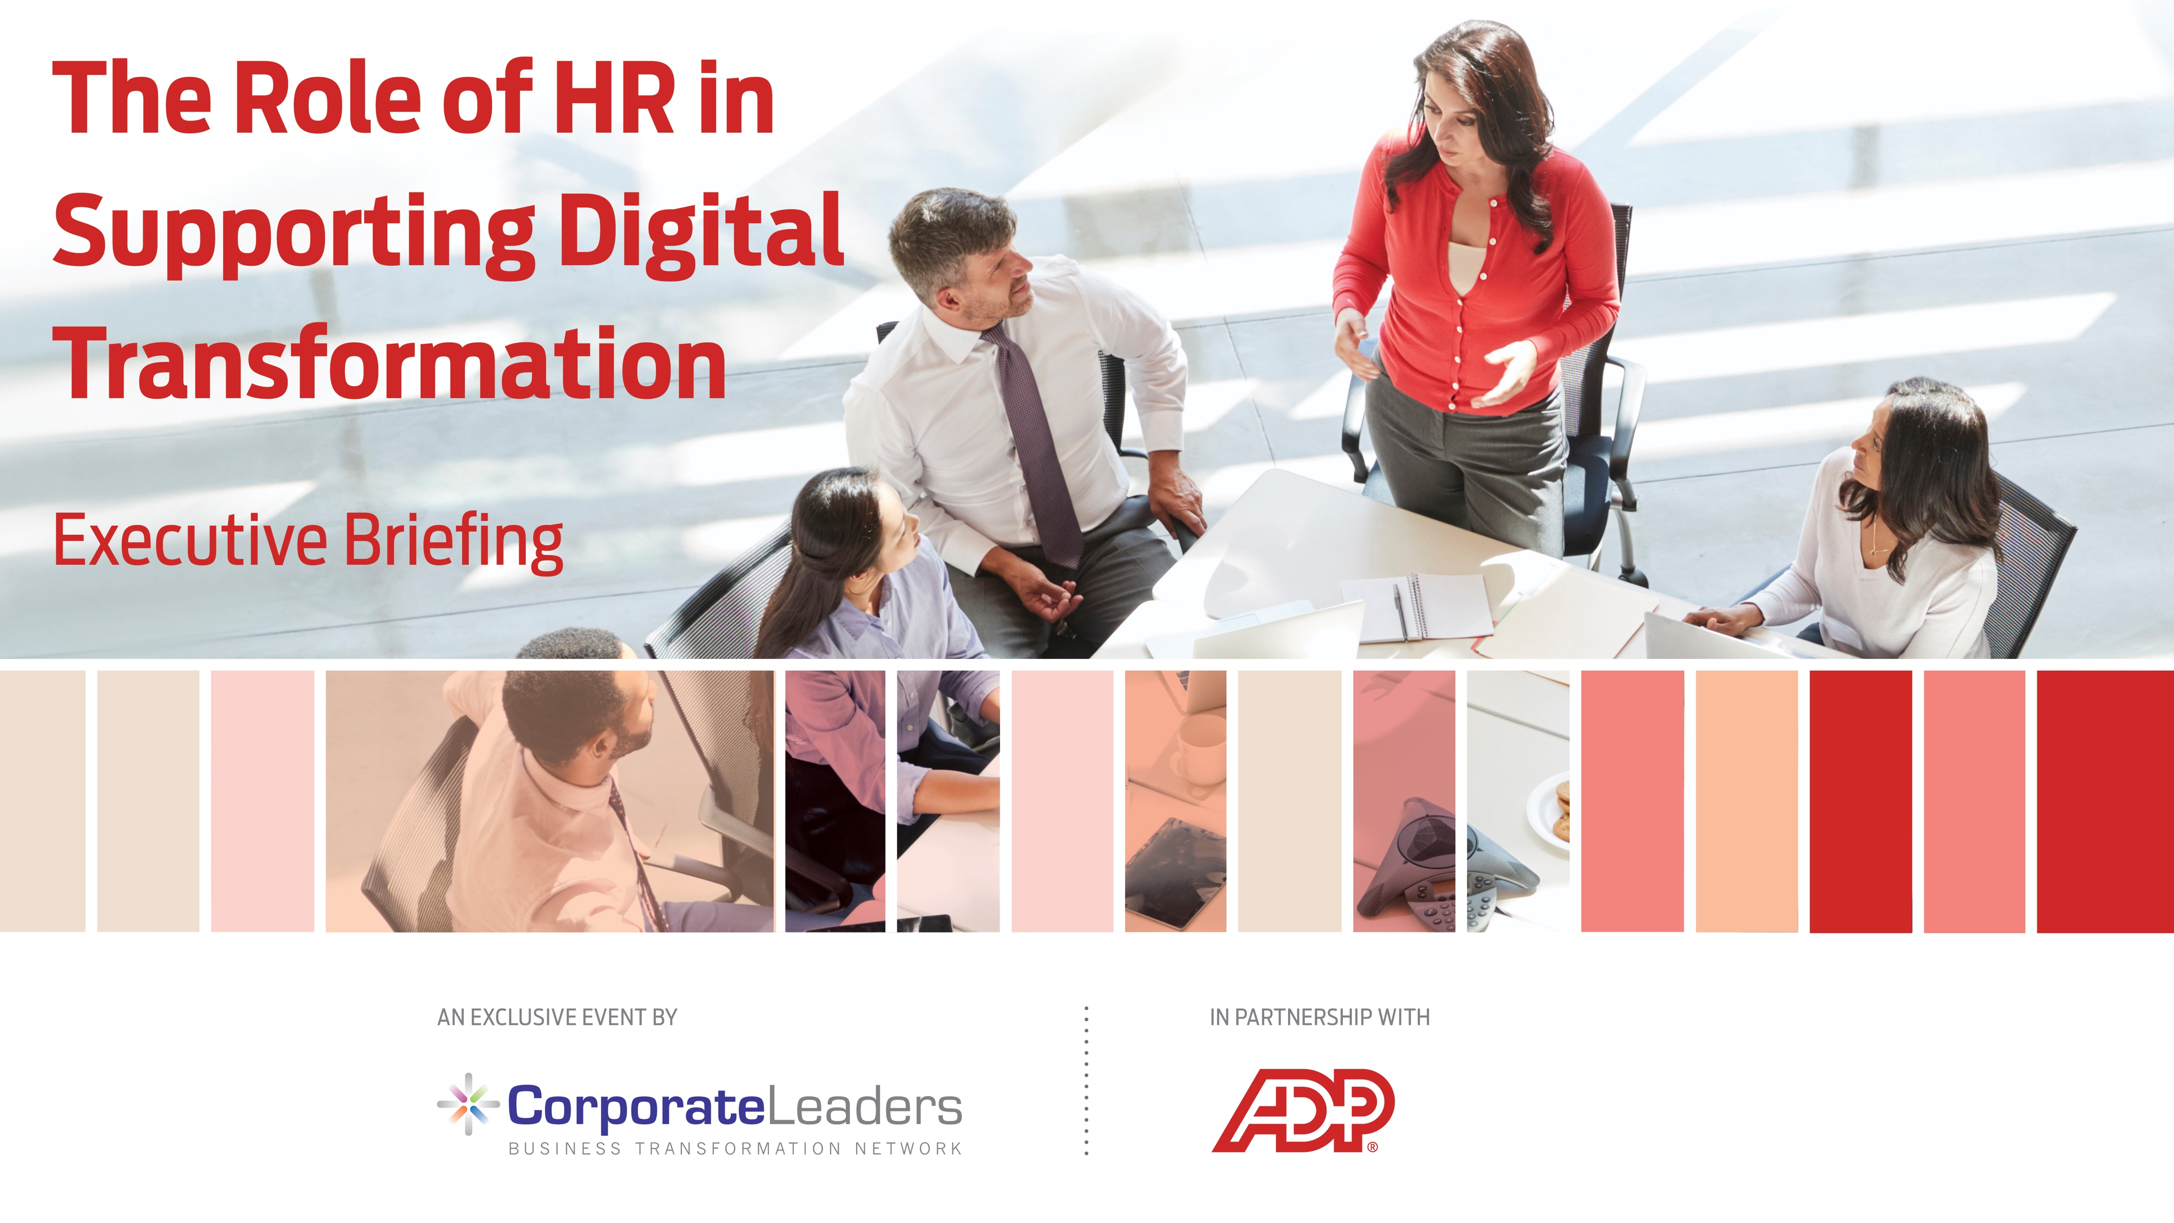

Slide 2
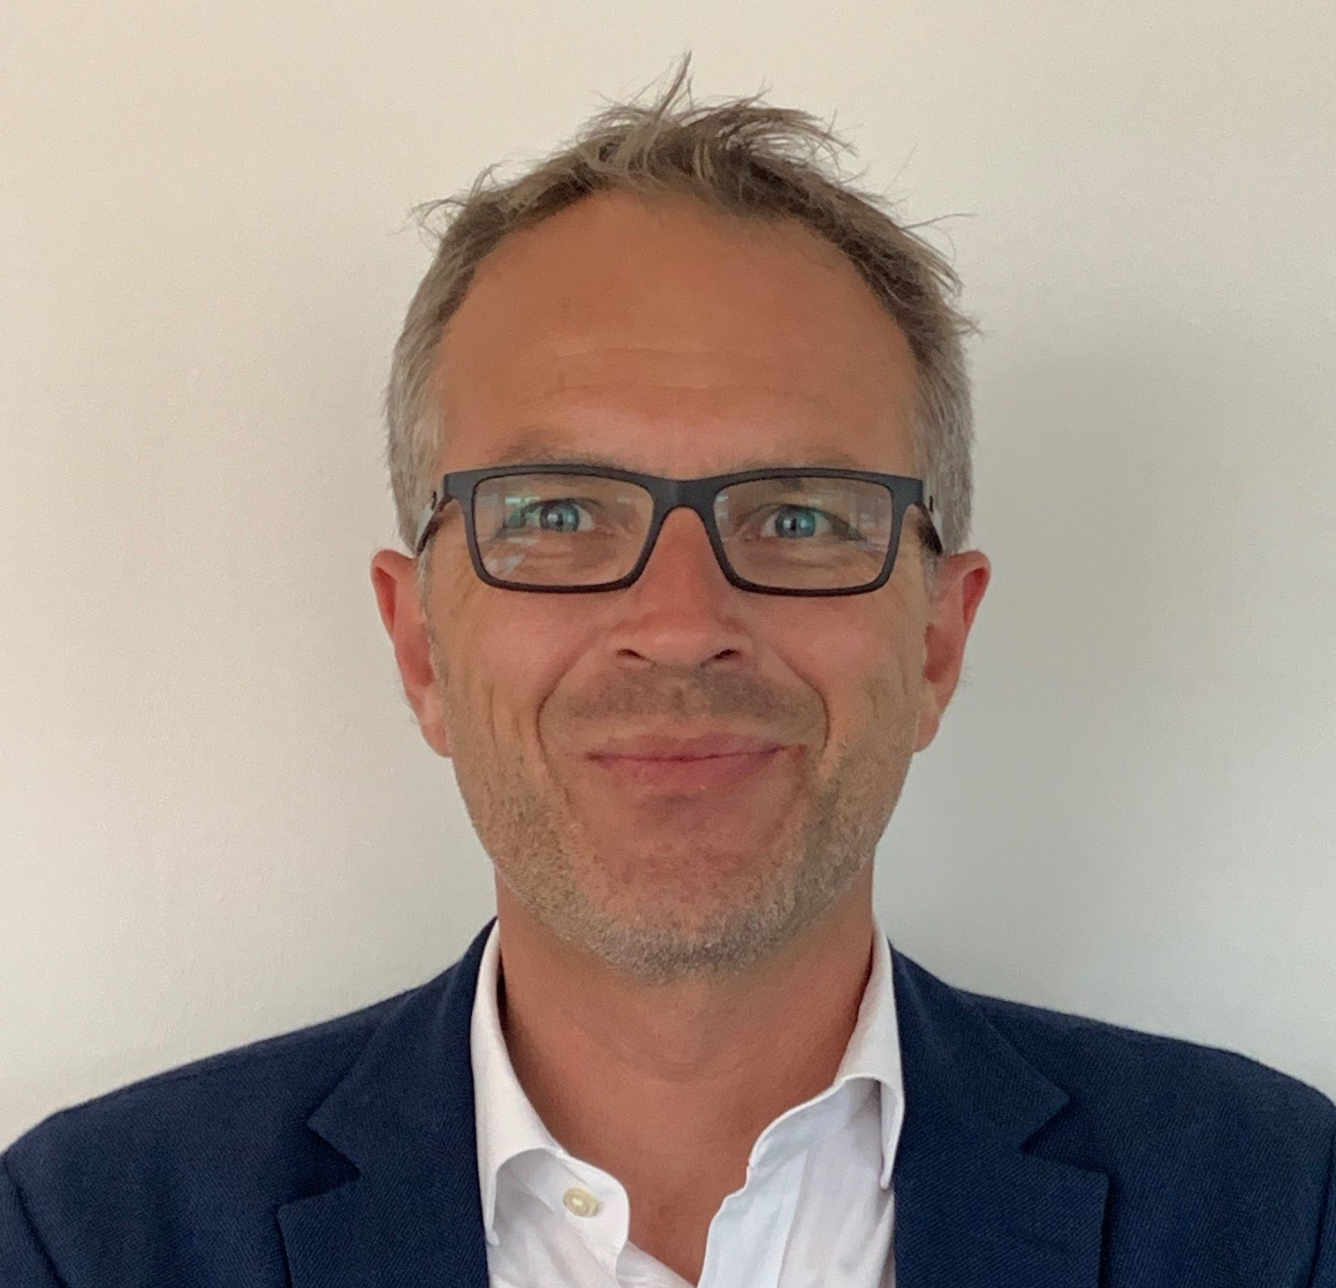
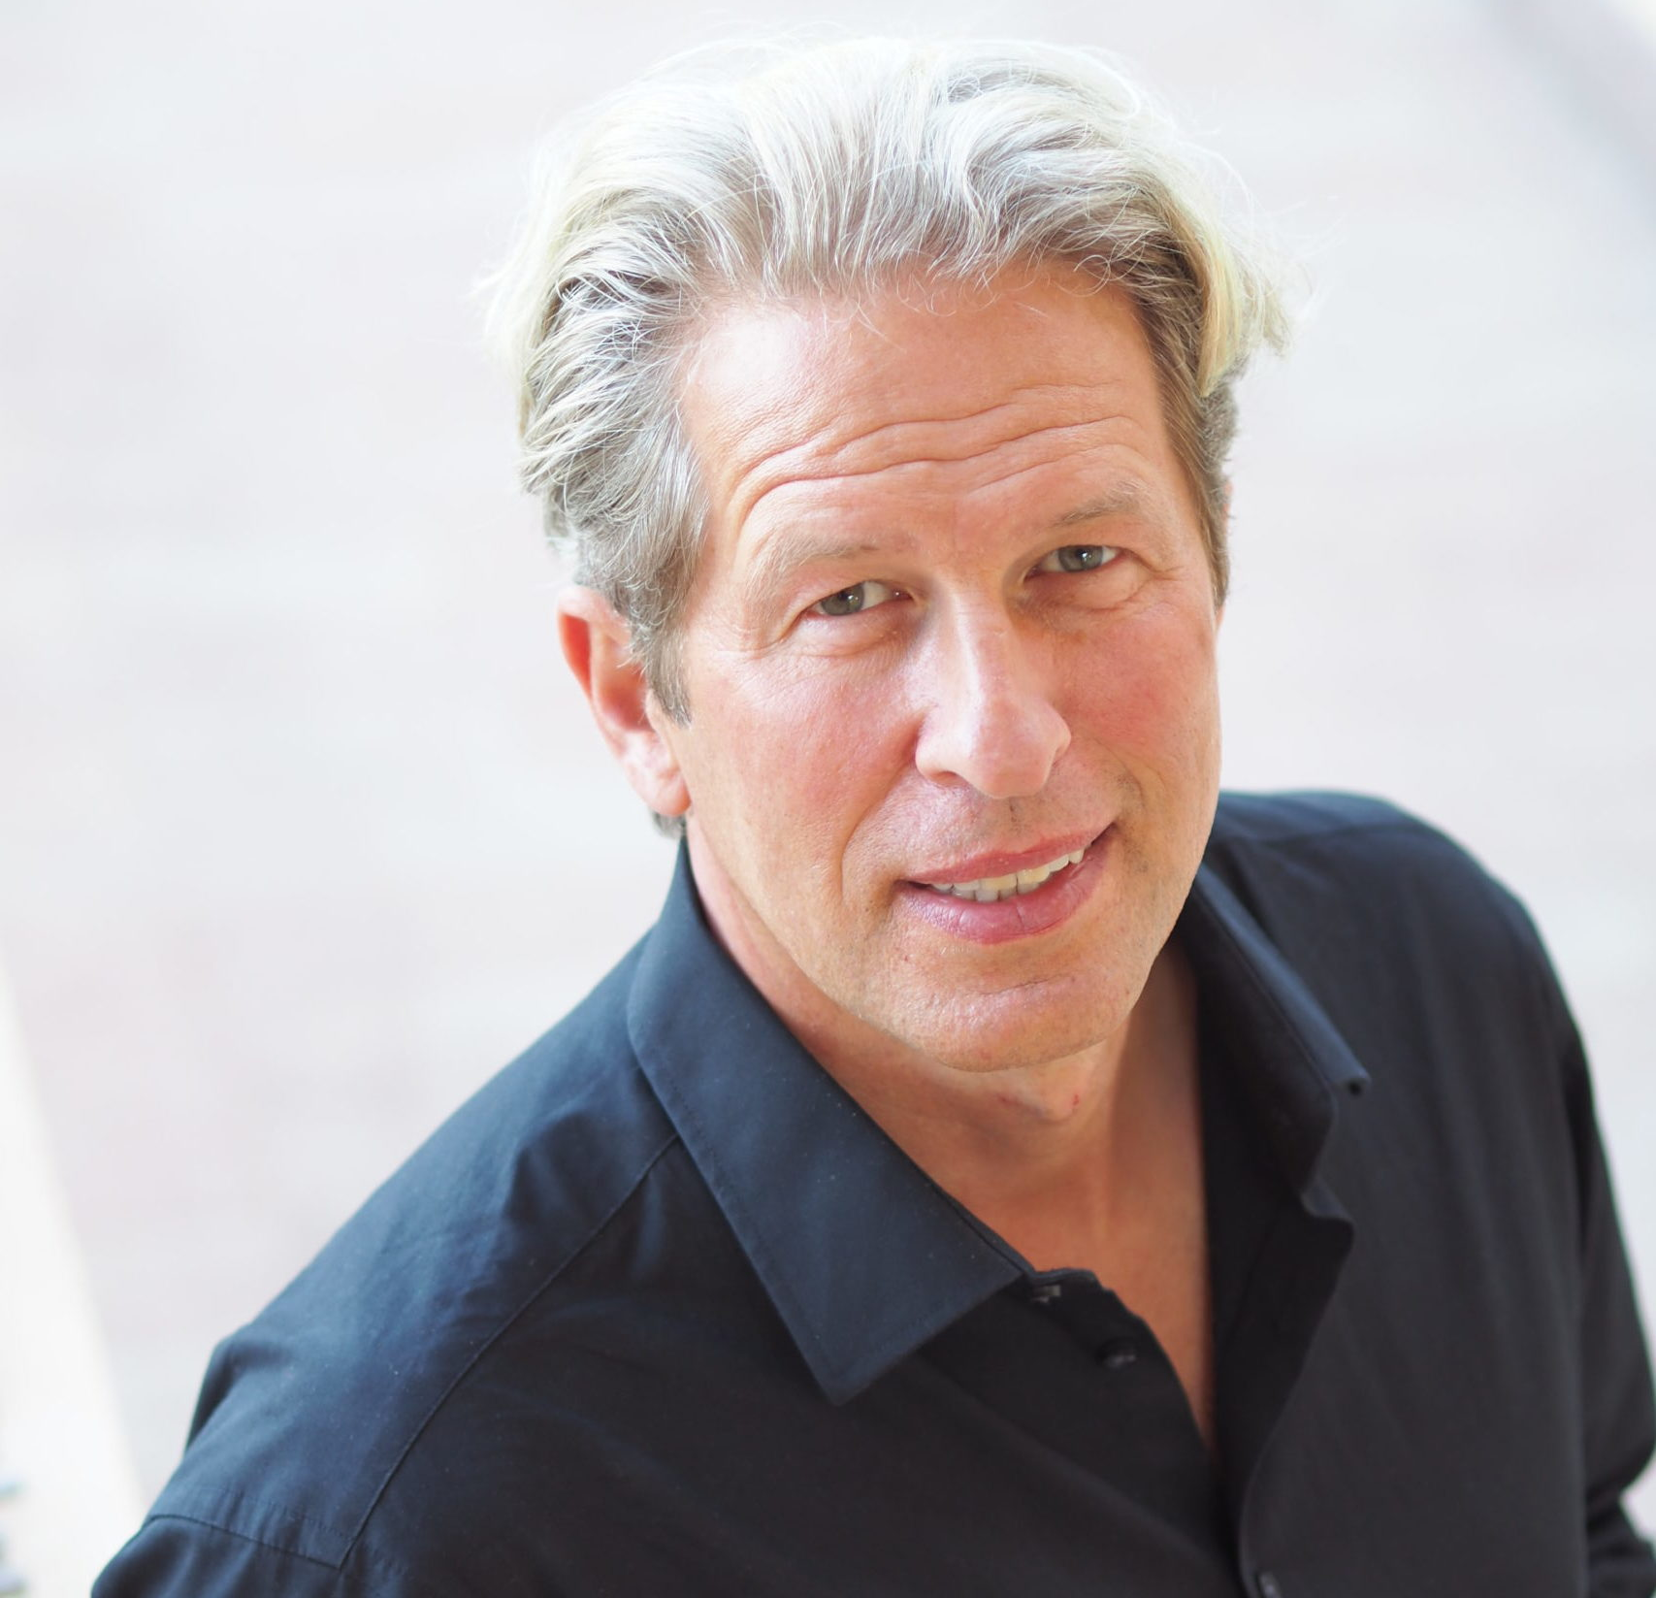
Program
Tools to support
HR Digital Transformation
Thomas Herrmann
Director Sales Enterprise, ADP
The Role of HR in Supporting Digital Transformation
Oliver Leisse
Speaker, Author, Entrepreneur, See More

Slide 3
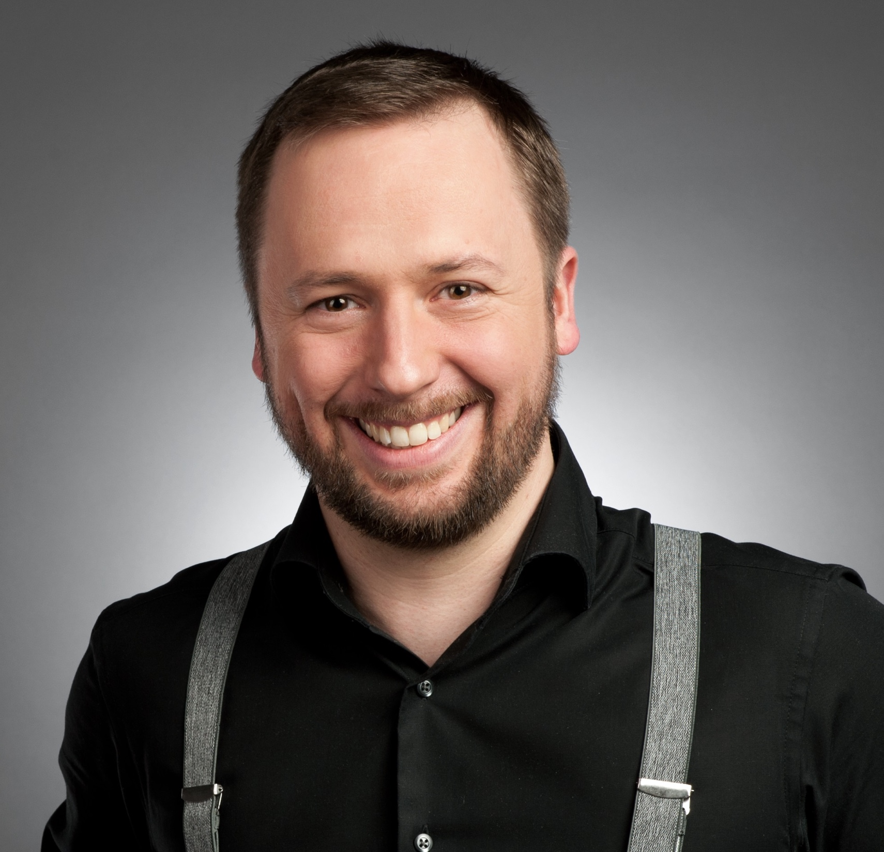
Panel Discussion
Moderator:
Discussion Leaders:
Oliver Fischer
Partner DACH,
Finn Partners
Thomas Herrmann
Director Sales Enterprise,
ADP
Oliver Leisse
Speaker, Author, Entrepreneur,
See More

Slide 4
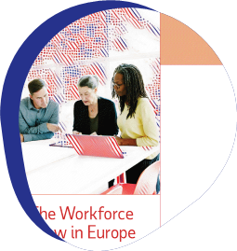
Tools to support
HR Digital Transformation
(insights from „The Workforce View in Europe 2019“
  Thomas Herrmann, Director Sales Enterprise, ADP
5th November 2019 | Frankfurt

Slide 5
Agenda
  New ways of working – going back to more traditional career paths with more flexible working environments and hours to increase productivity, improve employee work-life balance and lowering stress levels
  Technology and tools – automation, artificial intelligence, Internet of Things (IoT)
  The HR transformation needed to cope with the trends while remaining compliant, having workforce visibility and ensuring operational effectiveness

Slide 6
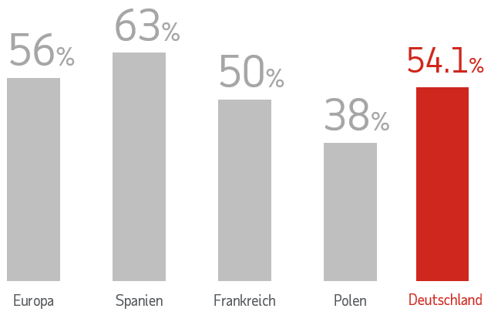
New ways of working
Going back to more traditional career paths with more flexible working environments and hours to increase productivity, improve employee work-life balance and lowering stress levels
Productivity - Doing more with less
European workplaces are continuing to experiment with new ways of working, with numerous media reports claiming that a four-day working week can revolutionise productivity, improve employee worklife balance and lower stress levels.
For example, following a six-week trial of a four-day week, one British company reported that they were able to achieve just as much in a shorter working week and even saw signs of growth.
56%
would prefer to work just four days each week
78%
would rather work four longer days to earn the same salary
22%
would prefer standard hours at reduced pay overall
Europe
Spain
France
Poland
Germany
% of employees who would prefer a four-day working week

Slide 7
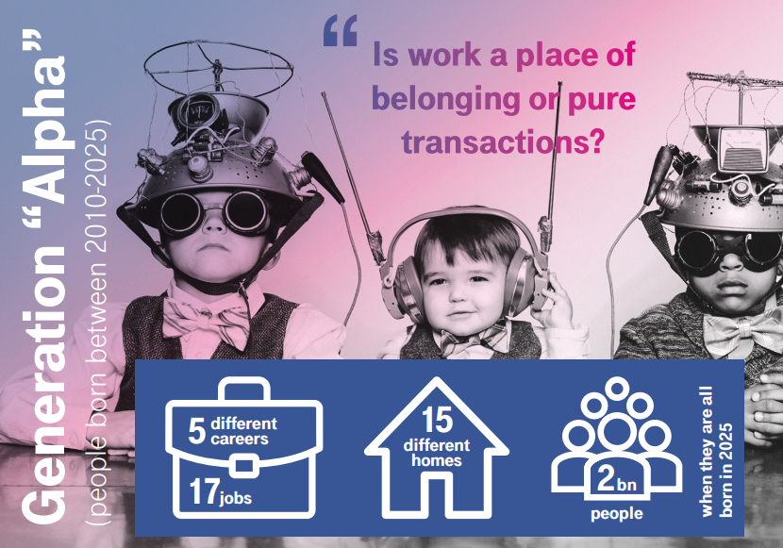
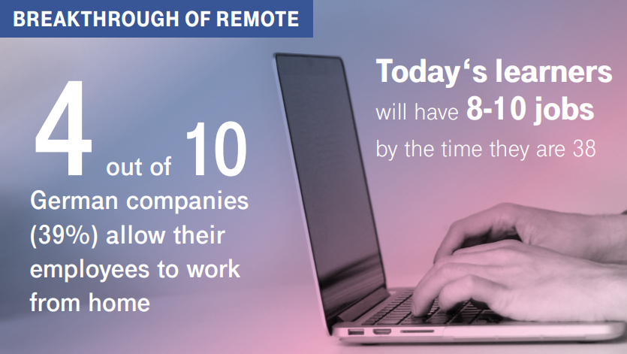
New ways of working
Going back to more traditional career paths with more flexible working environments and hours to increase productivity,
improve employee work-life balance and lowering stress levels
“Belonging”
In 2028, …
“Do organizations accept that peoples’ lives intrude on work – as they expect work to intrude on private life?”
… organizations face a balancing act between demands for control, transparency, collaboration, trust, agility and needs for data protection and security. People and organizations are temporary life companions.
… intelligent technology and people-tech interactions will be ubiquitous in peoples’ tasks, jobs and lives. Expectations about the nature of employment will rapidly change and raise controversies about the level of life-work integration, a work-income (dis-)connect, work as a positive personal stretch or life necessity.
“Work 2028 – Trends, dilemmas & choices”, Henley Business School/Detecon International/ Deutsche Telekom 2018
“Work 2028 – Trends, dilemmas & choices”, Henley Business School/Detecon International/ Deutsche Telekom 2018

Slide 8
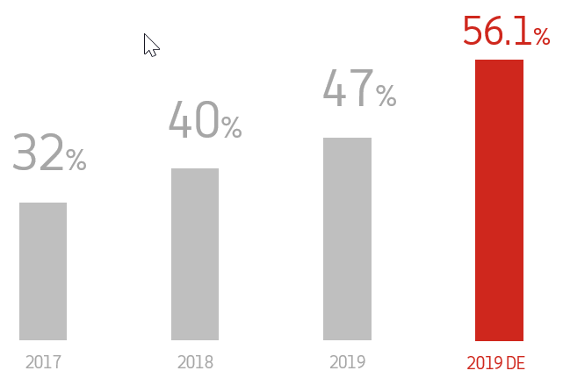

New ways of working
Going back to more traditional career paths with more flexible working environments and hours to increase productivity, improve employee work-life balance and lowering stress levels
There has been a continual increase in those who state they are not interested in self‑employment or freelancing opportunities at all. In 2017, just 32% of respondents were not interested in working independently – a figure that increased eight percentage points in 2018 (40%) and has now risen to 47% in 2019.
Lucas van Wees, President of the European Association for People Management*, commented that:
“The decline in self-employment may well be related to improved economies with more opportunities for regular employment. It’s still a fact that collective arrangements such as pensions and disability insurances are not yet well regulated for self-employed workers, although we are seeing increasing pressure and debate to resolve this.”
* Based in Germany, the European Association for People Management assembles 32 national HR Associations with a membership base of 250,000 HR professionals.
What does this mean with regards to systems & tools?

Slide 9
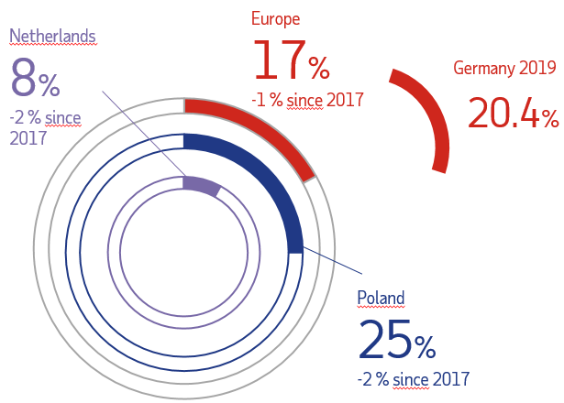
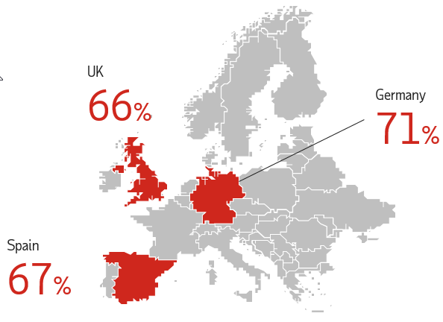
New ways of working
Going back to more traditional career paths with more flexible working environments and hours to increase productivity, improve employee work-life balance and lowering stress levels
Stress remains high - Europe’s workers remain as stressed out as ever, with more than one in six (17%) employees experiencing daily stress at work.
4h 47mins
The average extra time that employees across Europe believe they are working for free
% of ees working over-time on a regular basis
+ 1.4% since 2017
Notes:
What does that mean with regards to systems (= tools)?!
> Skills
> time & attendance
> HCM (training, development)
> unified systems, consolidated data

Slide 10
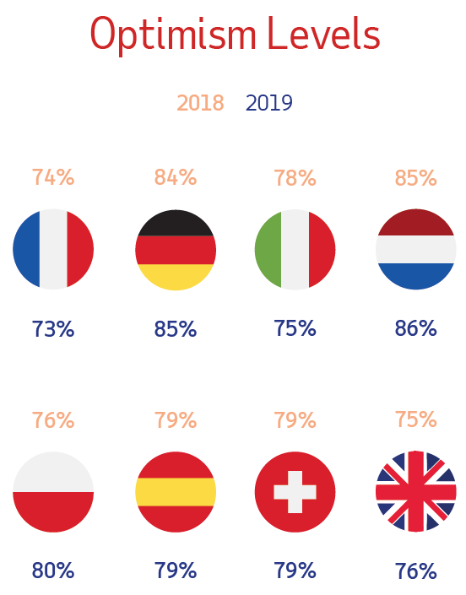
Technology and tools
Automation, artificial intelligence, Internet of Things (IoT)
Inspired? Employees in ‘wait and see’ mode
Optimism levels are unchanged since last year (79%), as it remains to be seen how political and technological shifts will play out.
Over half (56%) of Europe’s workforce are anticipating significant changes due to automation. And it’s the Millennial demographic, with their careers ahead of them, who anticipate the biggest impacts.
How would you describe your levels of optimism
for the next five years in the workplace?

Slide 11
Technology and tools
Automation, artificial intelligence, Internet of Things (IoT)
Will robots take human jobs?
Over half of European workers (56%) believe that automation will drive significant changes to the world of work in the coming years, more than any other technology, including artificial intelligence (42%), Internet of Things (39%), biometrics (35%) and blockchain (23%).
What does this mean with regards to skills you need for a job?

Slide 12
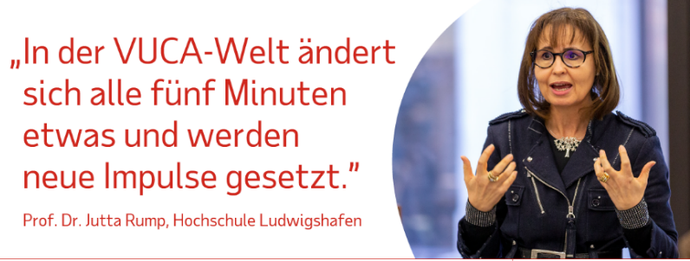
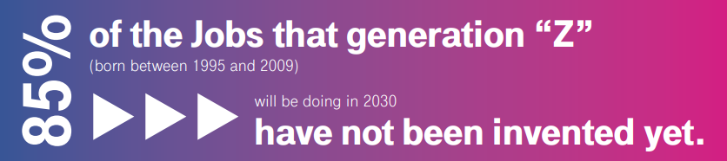
Technology and tools
Automation, artificial intelligence, Internet of Things (IoT)
In the VUCA world, we encounter changes and new impulses every 5 minutes.
Reasons for change = starters for Digital Transformation
In the VUCA world, we
Encounter changes and
new impulses every 5
Minutes.
Prof. Dr. Jutta Rump, Hochschule Ludwigshafen
Make your company „future-proof“
Outdated HR-Systems
Manual workaround
Missing transparency
Adapt to digital changes
Compliance
Lack of standardization
No connectivity
Missing interfaces
Management work
Systems that are not integrated
Legal & tax requirements
Too many HR-systems
Lack of consolidated data
“Work 2028 – Trends, dilemmas & choices”, Henley Business School/Detecon International/ Deutsche Telekom 2018

Slide 13
The HR transformation needed to cope with the trends
while remaining compliant, having workforce visibility and ensuring operational effectiveness
Uniquely valued - What do your employees expect?
Easy to handle workflows, i.e. for vacation requests, expenses
ESS-MSS
Time savings
Feedback
Attention
…
What do you do to increase the employee engagement?
Develop tools, that are definitely used
Know about digital topics
Find managers, who can actually manage
What do you know about your workforce?
Processes – how do they work? Do they work?
Improved
efficiency
Higher
accuracy
Unified
data
Increased security

Slide 14
The HR transformation needed to cope with the trends
while remaining compliant, having workforce visibility and ensuring operational effectiveness
Productive Do you provide your employees with all the tools they need to succeed?
Belonging Do you know if your employees feel like they belong to a strong team?
Inspired How do you actively inspire your employees to leverage their strengths?
Uniquely valued Could your employees identify the specific skills and contributions that you value?
Are we as employers
doing
our part?

Slide 15
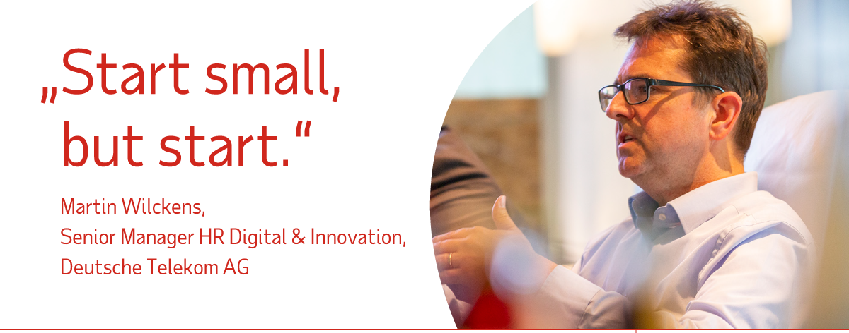
HR Digital Transformation

Slide 16
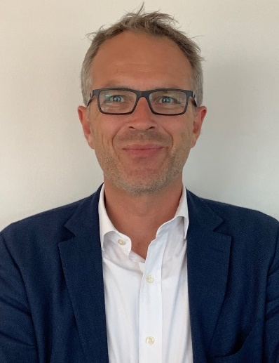
  More than 20 years of sales expertise with a focus on global, internationally operating companies, as well as locally operating companies with headquarters in German-speaking countries.
  At ADP, he is responsible for Enterprise Sales, managing several major multi-national HR projects in Europe and worldwide with his team every year.
  Thomas will be happy to answer your questions about global payroll at
  +49 (0)171 8006181 or Thomas.Herrmann@adp.com
Thomas H. Herrmann

Slide 17




  The Workforce View in Europe in 2019 explores employees’ attitudes towards the current world of work and what they expect from the workplace of the future. The findings provide important insight into business‑critical issues, such as employee optimism, organisational threats, new ways of working, mental health and discrimination.
  The research was carried out by independent market research agency Opinion Matters on behalf of ADP, in October 2018. The sample consisted of 10,585 working adults in eight territories across Europe: France, Germany, Italy, the Netherlands, Poland, Spain, Switzerland and the UK.
About the report
Download your free sample at www.de-adp.com

Slide 18
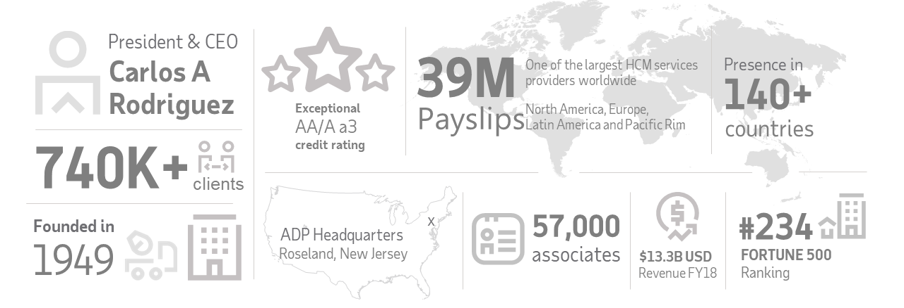



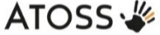
www.de-adp.com adp@de.adp.com
0800 2 37 37 33
Our service partners
About ADP
Tools to support HR Digital Transformation | 5 November 2019 | Frankfurt

