Slide 1
Open Banking Platform
Technical Deep Dive
Open Data Platform
AWS Technical Deep Dive

Slide 2
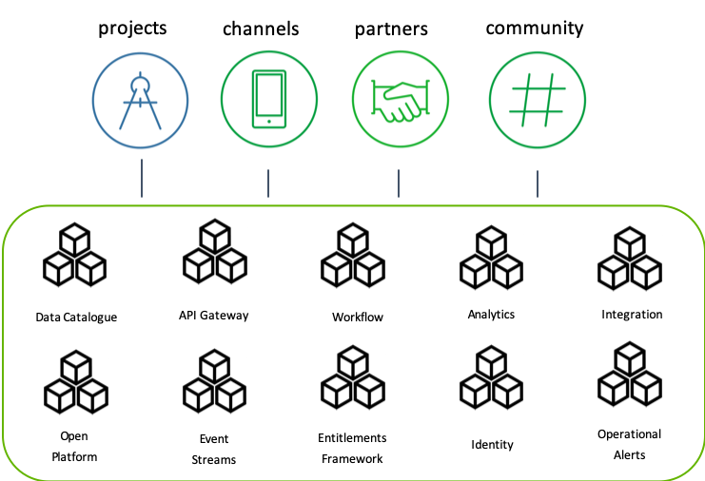
Capabilities of our Open Data Platform
Open Data Capabilities
Our open data platform is deployed at a number of clients and can be hosted on any cloud provider or on-prem. The platform provides a large set of out-of-the-box capabilities.

Slide 3
AWS Implementation
Account Structure
High Level Overview
IAM / VPN
EKS – Managed Kubernetes
EKS Upgrades
EKS Backups
Certificate Management

Slide 4
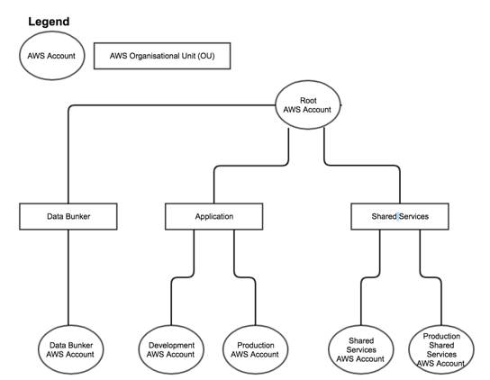
Account Structure – AWS Organisations

Slide 5
Root
AWS SSO
KMS
AWS Client VPN
Databunker
Application
Shared Services
Public
Private
KMS
AWS ECR
KMS
KMS
AWS ACM Private CA
Bastion

Slide 6
Identity Access Management
AWS Managed Active Directory
AWS Single Sign On (backed by AD)
No personal IAM users. All user authentication is through Active Directory (SSO, Bastions, Nexus, Vault), or SAML (SonarQube, Buildkite)
Possible to replace with existing AD Server if required
Need Windows instance for User management

Slide 7
AWS Single Sign On
Grant permissions to AWS Accounts by AD Group
AWS Console access and CLI Access
Integrate custom applications with SAML
Supports MFA (email), or through a RADIUS server

Slide 8
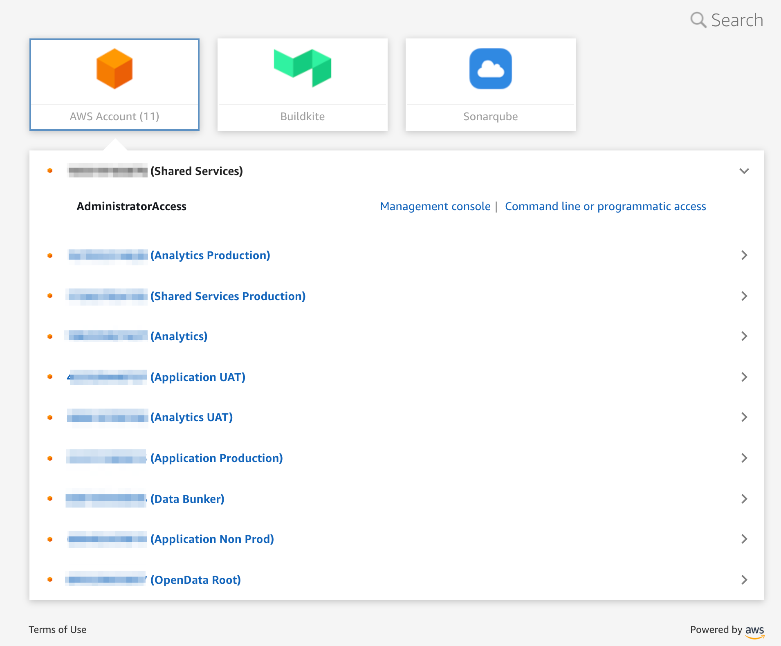

Slide 9
AWS Client VPN
Managed VPN Service (No more managing EC2 instances with OpenVPN)
Integrates with Active Directory
Restrict CIDR range by Active Directory Group

Slide 10
EKS – AWS “Managed” Kubernetes
Application
Shared Services
Managed Masters
Bring your own Worker nodes
AWS-CNI plugin
Use large subnets
IAM / RBAC auth
Calico for Network Policies
Public
Private
AWS ECR
KMS
KMS
AWS ACM Private CA

Slide 11
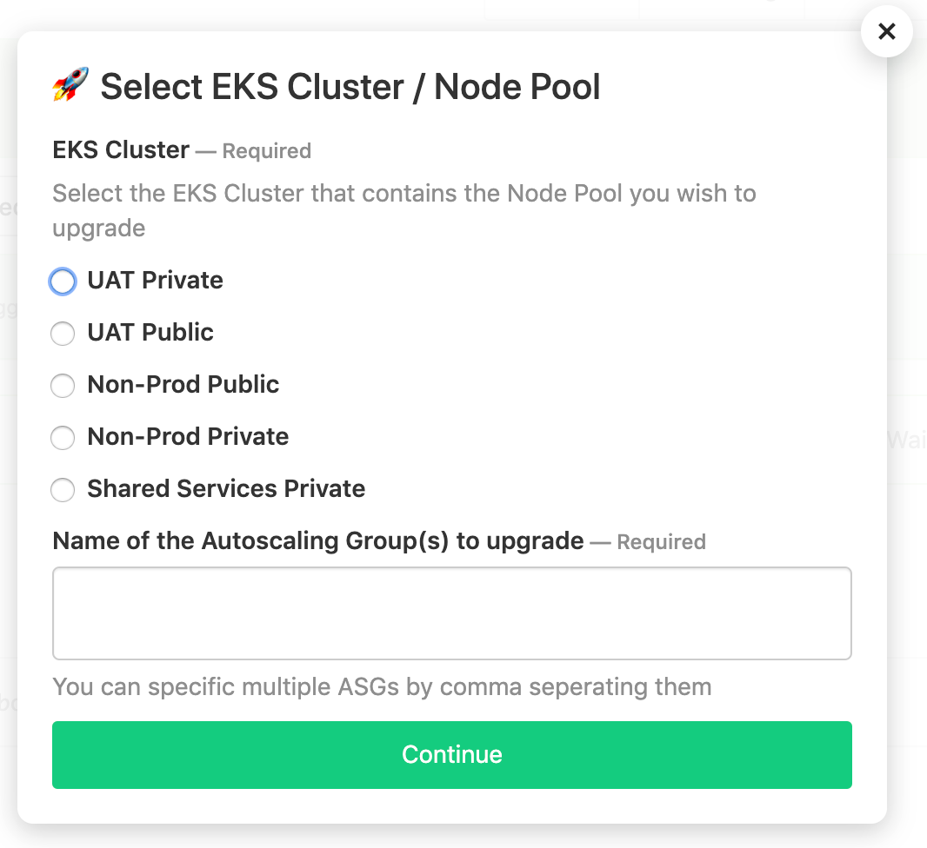
EKS – Worker node upgrades
Upgrade Autoscaling Group through a CICD Pipeline
Graceful rollout / termination of nodes
Graceful moving of Statefulsets

Slide 12
Kubernetes Backups
Velero Project (formally Heptio Ark)
Backup Kafka and Forgerock namespaces
Persistent Volumes to S3 using Restic (cross region)
Scheduled backups

Slide 13
Encryption / Certificate Management
KMS
AWS Private CA
Hashicorp Vault – PKI Engine
Kafka Consumer
Offline Root CA
TLS cert
Subordinate CA
(Private CA)
mTLS
Kafka
Broker
Certificate

Slide 14
Questions?

