Slide 1
Penn Foster High School + [Your School Name] Pathway Program
Learn more to get started
October 2019

Slide 2
Pathway Program
What Is It?
A regionally and nationally accredited high school diploma program through Penn Foster High School, sponsored by [Your School Name]
Allows you to complete high school coursework online in a classroom on our campus
Made up of short, easy-to-understand lessons with online testing that you can complete at your own pace
Lets you gain the skills and knowledge you need to be successful in school and in life
Gives you a second chance to earn your high school diploma and the opportunity to enroll in [Your School Name]
Confidential | Penn Foster 2019

Slide 3
Pathway Program
How It Works
Penn Foster evaluates your past high school transcript or GED scores to determine transfer credits to be awarded
Plan to come to our campus 2-3 times per week to work on your high school coursework
Engage with your onsite program coordinator to help you through the program
Receive additional academic support from Penn Foster instructors online or over the phone
Take [Your School Name] courses in your career field as electives
Complete the high school program while joining the [Your School Name] community on campus
Confidential | Penn Foster 2019

Slide 4
The Student Pathway
?
YOU ARE HERE…
No High School Diploma and feeling stuck
1
ENROLL
in High School Completion program offered by [Your School Name]
Complete courses and work toward your diploma…
2
GRADUATE
from Penn Foster with your High School Diploma
Choose a field that you are interested in…
3
ENROLL
Work hard and take classes in your career field of interest
in the career program that interests you at [Your School Name]
4
GRADUATE
Begin your career with confidence, motivation, and excitement!
with a degree in your specialized field
Confidential | Penn Foster 2019

Slide 5
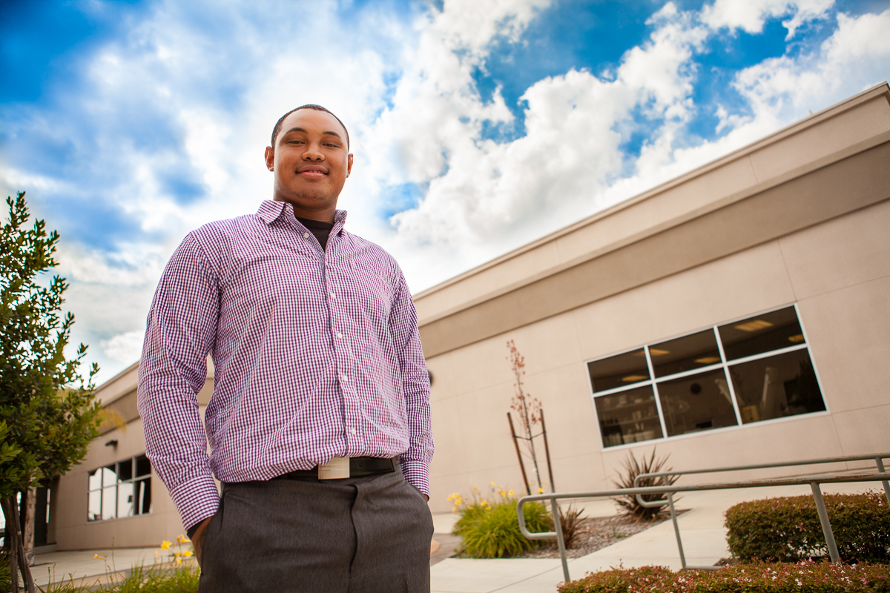
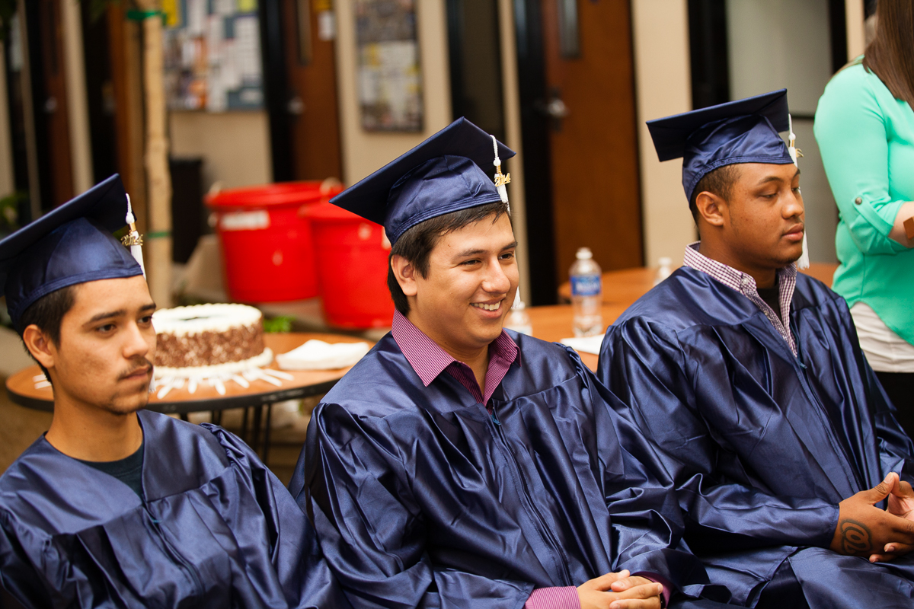
Pathway Program
Who Is It For?
Students in the Pathway Program:
Do not have their high school diploma
May have had challenges in a traditional high school setting or completing the GED
Are interested in a career program at [Your School Name]
Are looking for a second chance at a better future
Can dedicate a minimum of 12 hours per week on campus
Confidential | Penn Foster 2019

Slide 6
Pathway Program
Benefits
Receive a second chance to earn your high school diploma, at a pace that’s right for you
Work in a blended learning environment that combines online coursework with in-person guidance and support
Pathway to career and college readiness, and the ability to continue your education at [Your School Name]
Experience campus life at [Your School Name]
Form connections with your peers who are also going through the program
With over 44,000 high school graduates in 2018, you’ll be an alumnus of one of the largest high schools in the country!
Confidential | Penn Foster 2019

Slide 7
Why Penn Foster?
Accreditation
Penn Foster High School is accredited
Regional accreditation from The Commission on Secondary Schools of the Middle States Association of Colleges and Schools
National accreditation from AccreditED and the Distance Education Accrediting Commission
Penn Foster High School is also licensed by the Pennsylvania State Board of Private Licenses Schools
Confidential | Penn Foster 2019

Slide 8
Why Penn Foster?
Student Satisfaction and Outcomes
97%
Achieved their goals
98%
Would recommend Penn Foster
98%
Are satisfied with their education
“
I feel very successful and I’m eager now that I can move forward with the career goals that I have set for myself.
“
Monica Murillo
Penn Foster High School Grad
Based on responses from our 2018 Alumni Benchmark survey
Confidential | Penn Foster 2019

Slide 9
How Do I Get Started?
1
COLLECT copies of your past high school transcript(s) or GED and equivalency exam scores
2
COMPLETE all additional admissions requirements from [Your School Name]
3
RECEIVE your login information and come to campus to get started on your first course!
Confidential | Penn Foster 2019

Slide 10
Appendix

Slide 11
Frequently Asked Questions
How long does the Pathway Program take to complete?
Completion times vary depending on the student, and how many hours you can commit to studying each week. Also, because Penn Foster accepts valid transfer credits, the number of credits each student needs for graduation varies from 5.5-21.5 credits.
What is the format of exams?
Exams are typically either multiple choice or short essay. Multiple choice exams are generally in the range of 25 questions, but this is up to the discretion of the instructor.
How many credits is the high school program in its entirety?
21.5 credits. In Penn Foster’s system, a credit is essentially a class.
What is the minimum amount of credits a student needs to take with Penn Foster to earn a high school diploma?
5.5 credits. If students have taken all of their high school credits, but have not passed their state exit exam, they will still be required to complete 5.5 credit hours. Within the 5.5 credits, there is a requirement of one written assignment.
What will I receive when I finish the high school program?
When you complete the high school program, you will receive a nationally and regionally accredited diploma.
Confidential | Penn Foster 2019

Slide 12
Frequently Asked Questions (Continued)
Will Penn Foster accept my transferred credits from a different high school?
To receive transfer credits, an official transcript from an accredited institution recognized by Penn Foster must be submitted for evaluation. Transfer credits will be awarded for comparable high school subjects where a full credit has been earned. The maximum number of transfer credits allowed is 16.
Will you accept high school transcripts from other countries?
Yes. However, if the transcript is in a language other than English, we will need an official English translation of the transcript in order to evaluate it.
If I fail a course, do I have the opportunity to retake it?
Yes, students may retake a failed course.
What is Penn Foster’s high school curriculum like?
Our online high school program consists of 16.5 core credits, and 5 elective credits, ranging from academic electives, like American literature and algebra to career electives, like auto repair and vet assistant. Students are able to choose the five classes they’d like to take to fulfill the elective requirement. The core curriculum is made up of English, math, social science, science, arts and humanities, and health and physical education courses. The classes a student must take to complete the program can vary based on any transfer classes from a previous high school.
Confidential | Penn Foster 2019

