Slide 1
High School Diploma Program Copy Deck
Messaging points to help your school market the program to potential students
October 2019

Slide 2
General Copy and Messaging Points
What the Program Is and Who It Is For
General Program Description and Bullet Points
HEADER: Earn Your High School Diploma & Enroll in [School Name]
Interested in enrolling in [school name] but don’t have your high school diploma? We are now offering a Career Pathways Program. You can earn an accredited high school diploma on our campus, at your own pace, and at no cost to you, as a pathway to enrolling in one of our career programs.
Transfer in credits you have already earned from either high school or GED work, so you only take the credits you need to earn your diploma
Plan to come to our campus 2-3 times a week for high school classwork
Take the Penn Foster High School program made up of short, easy-to-understand lessons with online testing you can complete at your own pace.
Engage with your dedicated classroom facilitator to help you through the program.
Complete the high school program while joining the [school name] community on campus.
Take [school name] courses in your career field as electives.
Gain the skills and knowledge to be successful in school and in life
Receive your high school diploma after successfully completing all requirements. You’ll then be a high school graduate and can enroll in [school name]
This Program Is For People Who:
Don’t have a high school diploma
Have had challenges completing the GED
Are interested in enrolling in a career program at [school name]
Can dedicate a minimum of 12 hours on campus per week
Are looking for a second chance at a better future
Confidential | Penn Foster 2019

Slide 3
General Copy and Messaging Points
Benefits of the Program and How it Works
Program Benefits:
  100% of our graduates that applied for financial aid received it
The high school diploma program is designed to meet your individual learning needs
Students find success due to the program’s flexibility, individualized support, and ability to go at their own pace – 97% of students said they achieved their goals
Your pathway to career & college readiness and new opportunities
High track record of student success – 98% of graduates are satisfied with their education
Join the thousands of other students who have earned their diploma through this program and are achieving their dreams
Complete your high school diploma on campus while taking electives that work toward your career
How To Get Started:
Call our admissions department [insert admissions phone number] to learn more about the program
Schedule an appointment with an admissions representative
Prepare for your appointment by collecting your high school transcripts
Complete [school name]’s requirements for entering the program
Enroll in the high school diploma program. You will gain the skills you need to succeed in school and in life
Confidential | Penn Foster 2019

Slide 4



General Messaging Points
Penn Foster High School
Accreditation:
Penn Foster High School is both regionally and nationally accredited. These prestigious forms of accreditation mean that Penn Foster High School has met the high standards required by multiple accrediting bodies.
  Penn Foster High School is regionally accredited by the Commission on Secondary Schools of the Middle States Association (CSS-MSA)
  Penn Foster High School is nationally accredited by the Distance Education Accrediting Commission (DEAC) and AccreditED
Penn Foster High School is also licensed by the Pennsylvania State Board of Private Licensed Schools
Overview:
Founded in 1956, Penn Foster is one of the largest accredited high school programs in the United States
In 2018 more than 44,000 students graduated with a Penn Foster high school diploma
Confidential | Penn Foster 2019

Slide 5

Social Media Post Examples and Ideas
Benefits of a Diploma
Inspirational
General Program
Graduation Ceremony
Have you had trouble passing the GED? 98% of students who complete our high school diploma program are satisfied with their education. Visit our campus to learn more about the program
Think you don’t have time to go back and earn your high school diploma? Think again! Our high school diploma program works on your schedule
Earn your high school diploma at your own pace with <SCHOOL & CAMPUS> <link> #pennfoster #onlinelearning
Increase your income and job potential by enrolling in our high school diploma program and start on a path to success by giving us a call
Think college is out of reach? It’s closer than you think. Contact us today
“I was able to work at my own pace but was scared I wouldn’t be disciplined enough to push myself. That certainly wasn’t the case. If anything, I worked harder” – Penn Foster High School Graduate
“Being able to work at my own pace allowed me to absorb the material more so than in a traditional class setting. I really feel accomplished!” –Penn Foster High School Graduate
“I’ve always dreamed of working with animals as a veterinary technician. Now that I have my high school diploma, I can finally move on to college and achieve that dream” – Penn Foster High School Graduate
“I want to be a good role model for my kids. I wanted to show them that working hard, they too can earn a high school diploma” Penn Foster High School Graduate
Learn what it feels like to be a high school graduate [link to program graduation ceremony video]
Want to enroll in college and think your only option is a GED? Think again, ask us about how you can your high school diploma at our campus
98% of high school diploma program students were satisfied with the program. Learn what all the excitement is about. Call Us
Want to become a [insert a career] but lack a high school diploma? Pursue your dream by earning your high school diploma on our campus
This isn’t your traditional high school. We are now offering a diploma program on our campus that’s flexible to fit your lifestyle. Call us to learn more
Do you want to attend <SCHOOL & CAMPUS> but don’t have your #highschool diploma? No problem. Earn your high school diploma on campus with #PennFoster <link>
98% of high school diploma students would recommend the program to a friend. Know someone that wants to enroll in college but doesn’t have their high school diploma? Refer them to us
Congrats to our graduates! What are you doing to achieve your dreams?
Say hello to our graduating class of 2019 [include picture from grad ceremony]
These high school diploma graduates followed their dreams and are now on their way to college and career success
Say hello to our high school graduating class of 2019! Enroll now to be part of class of 2020
Confidential | Penn Foster 2019

Slide 6
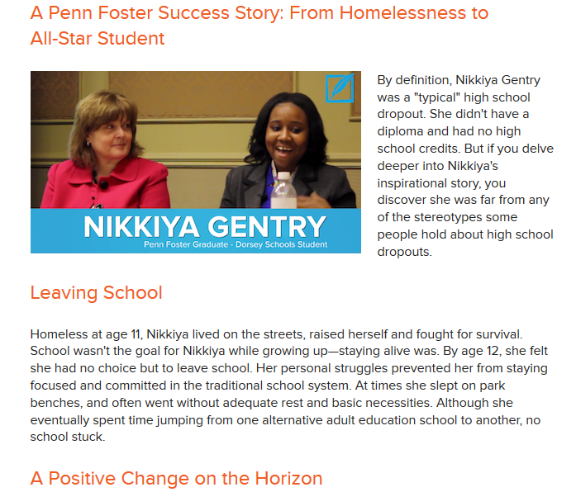

Blog Posts
Examples and Ideas
Here are some examples of Penn Foster blogs for inspiration:
  Student Success Stories
  Student Spotlight with Q&A
  Partnership Success Story
  Graduation Ceremony
Confidential | Penn Foster 2019

Slide 7
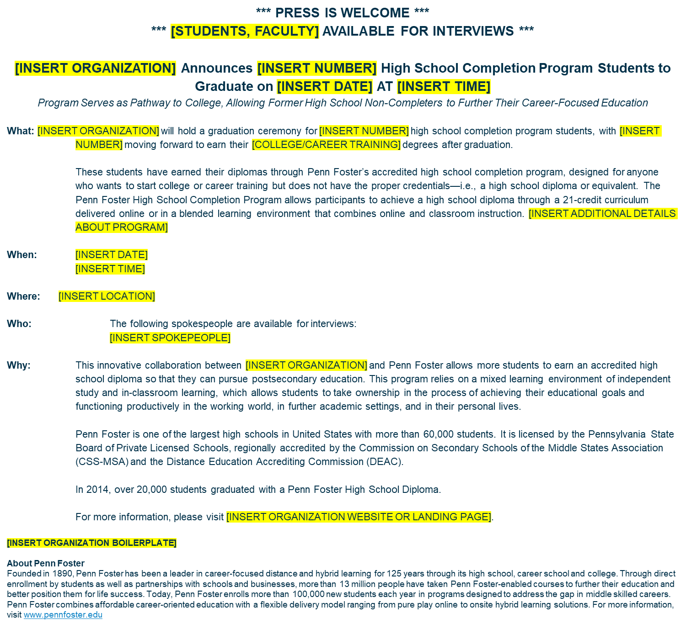
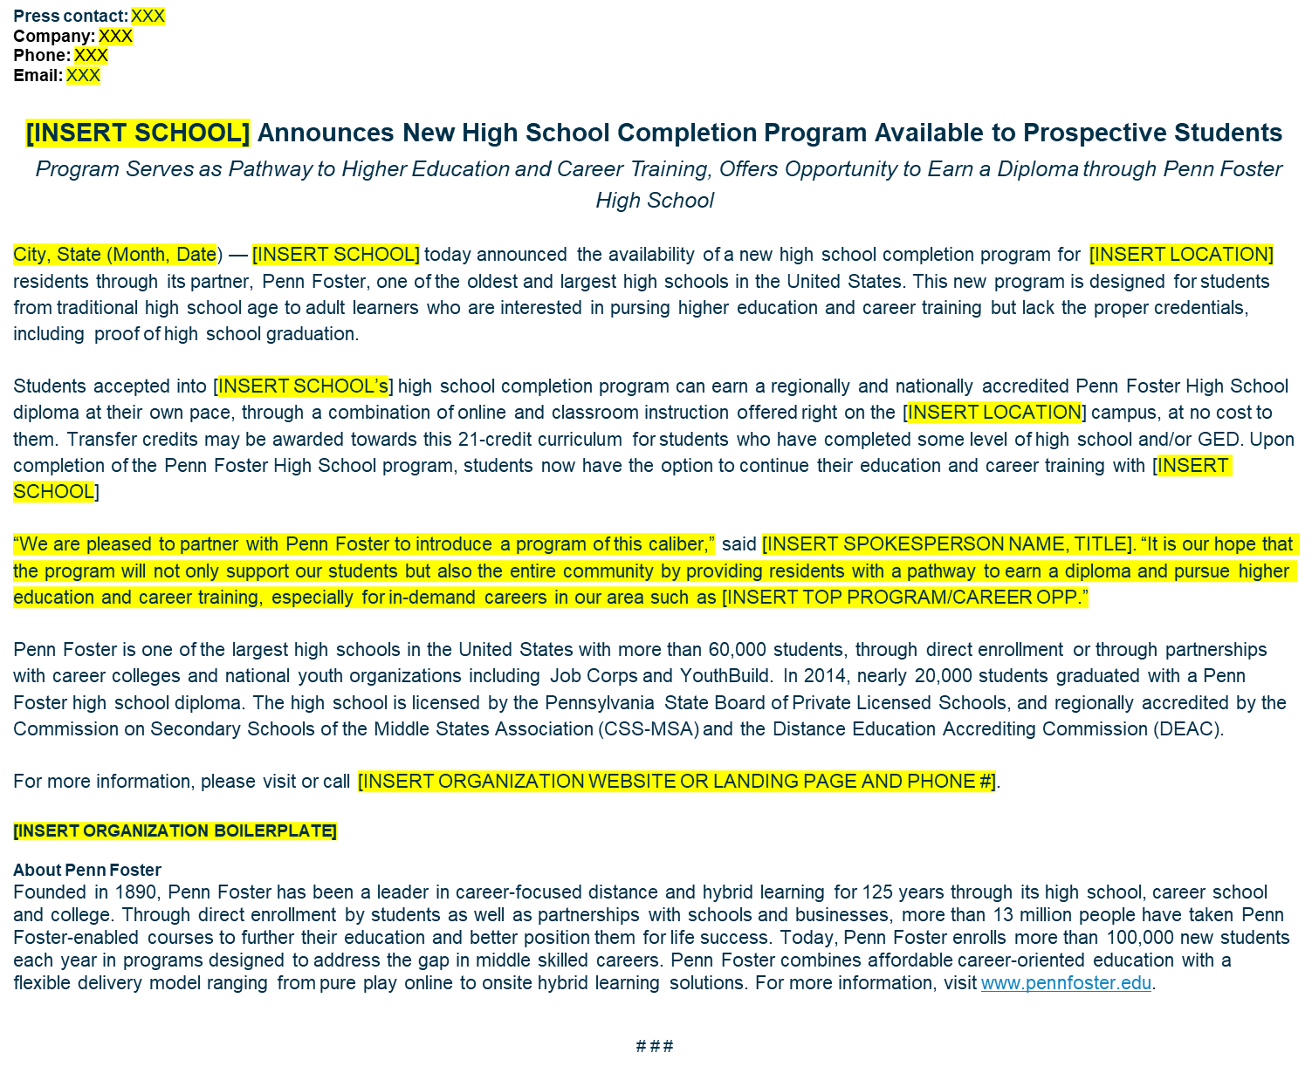
Press Release and Media Alert Templates
Confidential | Penn Foster 2019

Slide 8
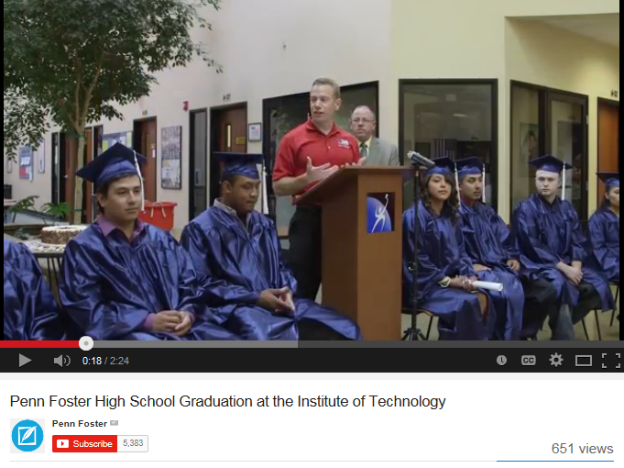
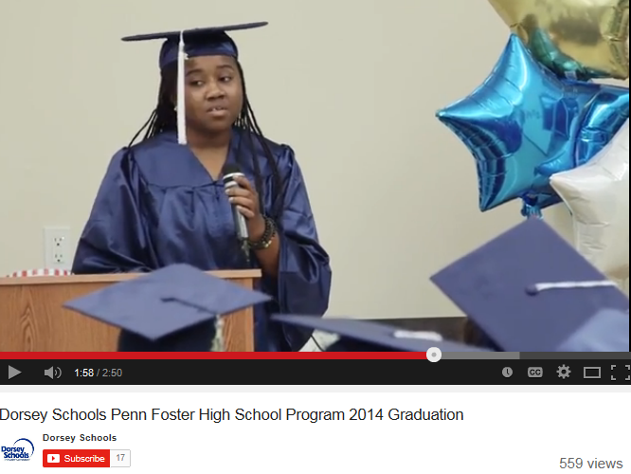
Graduation Video Examples
Confidential | Penn Foster 2019
Notes:
We’d be happy to come to your school and record your graduation ceremony, interview your students and faculty and create a graduation video for you to use. Just contact us at partnersolutions@pennfoster.edu or ask your partner solutions manager.
IOT’s graduation video: http://youtu.be/X1gnBpKerWc
Dorsey’s graduation video: http://youtu.be/qttHKO3ZPC4

Slide 9
Landing Page Copy
Header: Earn Your High School Diploma and Enroll in <SCHOOL & CAMPUS NAME>
Want to enroll in <SCHOOL’S NAME> but don’t have a high school diploma or GED? Earn your high school diploma on our campus with the Penn Foster High School Diploma program so you can gain the credentials you need to enroll at <SCHOOL’S NAME>. You can even transfer in credits you have already earned from previous high school or GED work, so you only take the credits you need to get your diploma.
HOW IT WORKS
• Call us today <ADMISSIONS PHONE NUMBER> to talk to an admissions representative and learn more about the program.
• Schedule an appointment to start the process of enrolling in our high school diploma program.
• Collect your high school transcripts to determine how many transfer credits you are awarded.
• Enroll in the program, plan to come to campus 2-3 times a week for high school classwork.
• Earn your high school diploma by going through the short, easy-to-understand lessons and online tests, which you can complete at your own pace.
• Engage with your dedicated classroom facilitator to help you through the program.
• Complete the high school program while joining the <SCHOOL’S NAME> community on campus.
• Take <SCHOOL NAME> courses in your career field as electives.
• Receive your high school diploma after successfully completing all requirements. You’ll then be a high school graduate and can enroll in <SCHOOL’S NAME>.
Confidential | Penn Foster 2019

Slide 10

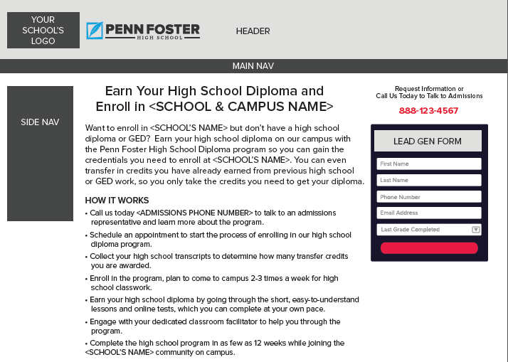
Landing Page Layout Example
Confidential | Penn Foster 2019

Slide 11



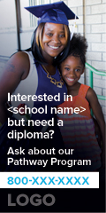


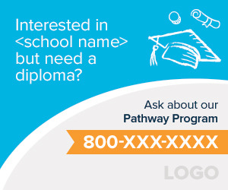

Banner Ads and Website Graphics
Confidential | Penn Foster 2019

