Slide 1

Alarm Over ip
Notes:
Title Page: Alarm Over IP

Slide 2

Communicating Alarm Signals Via IP
Agenda
Bosch: Leading Security Systems
Traditional alarm communication
Alarm over IP overview
Transmission technology
Presented By:
Ari Erenthal – Intrusion Detection Specialist
ari@midches.com
(848) 525-3399
Receiver technology
Notes:
(Presenter needs to update their name and optionally add a photo of themselves.)
Things we will be going over today:
Why Bosch is the leading Security System Manufacturer
How traditional alarm communication worked, and why it may no longer work as designed
How alarm over IP works
How

Slide 3











A Leader in Retail Security Systems
Bosch Intrusion Solutions
40 out of the top 100 US retailers use Bosch commercial panels (~80,000 locations)
  All 10 of the top 10 (~30,000 locations)
Notes:
You can find Bosch Security Systems in 40 of the top 100 US retailers. Out of the 40, the top 10 all use Bosch commercial panels. That is over 30,000 locations using Bosch Security Systems.
Listed here are the retailers: Amazon, Costco Wholesale, CVS Pharmacy, Kroger, Lowes, Target, The Home Depot, Safeway, and Walgreens

Slide 4
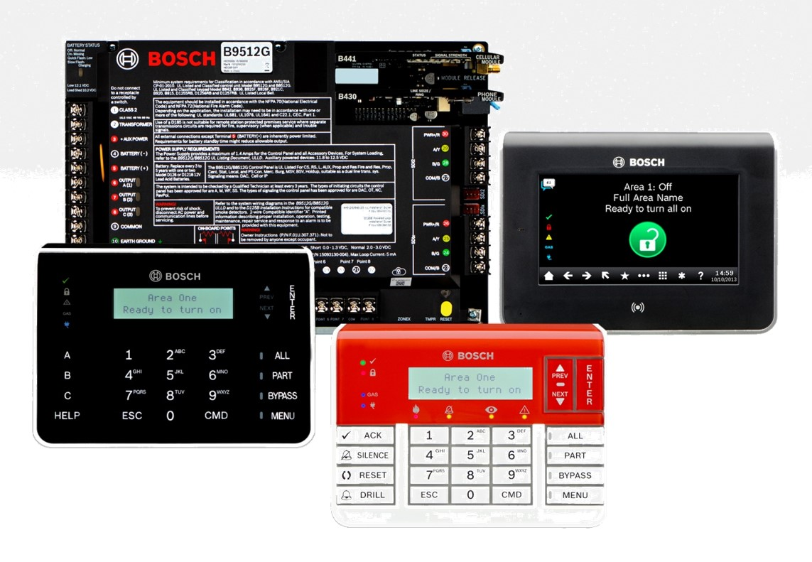
Security technology
Security technology has four jobs
Detect
Alert
Communicate
Trigger
Notes:
An intrusion detection system has four jobs: detect a problem, alert people on-site of the problem, call for help, and trigger some kind of response. Today, we will discuss the process of alerting people off-site.

Slide 5

Communicating
The security industry has used PSTN for decades
Alarm panel has built in telephone communicator
Central station has a receiver
Alarm signals transmitted over telephone
Notes:
The security industry has traditionally used public telephone networks to call for help. Alarm panels had built in telephone dialers, and central station monitoring centers had computers called gateway receivers programmed with a telephone number. Alarm signals were designed around the telephone technology of the time.

Slide 6
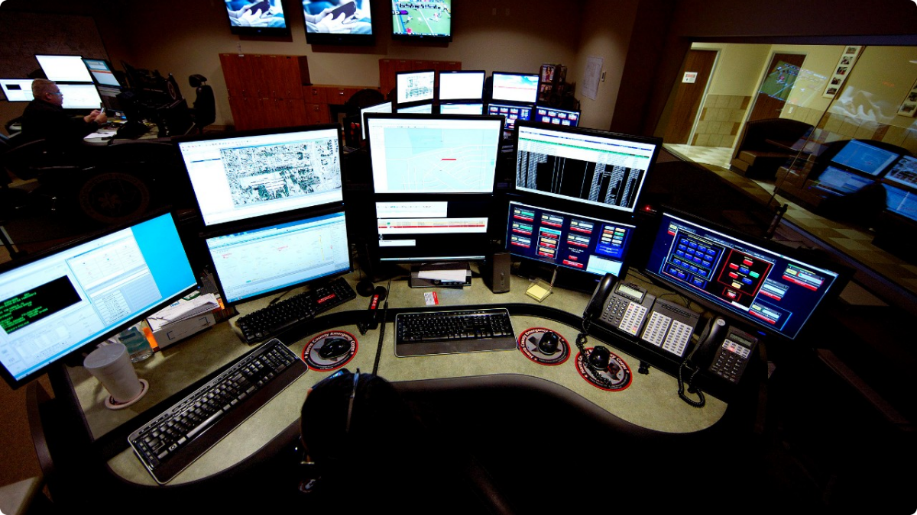
How Alarms Communicate
Alarms transmit DTMF signals over PSTN
This allows the alarm to transmit lots of information quickly.
The signal consists of subscriber information, the nature of the signal, the originating zone, and a confirmation
The signal must be sent exactly, or it cannot be decoded accurately
Notes:
Alarm signals were transmitted in the form of DTMF tones, which are the tones you hear when you press a button on the touchpad of an older telephone. Every button has its own note, which corresponds to a hexadecimal digit. The most common form of alarm communication consisted of a short burst of tones corresponding to a 13 digit code. The central station receiver had the ability to receive this signal, decode it, flash a human-readable message on a screen in front of a dispatcher for them to decide how to respond, and send a signal back to the alarm panel to let it know it had been received. If the message was not received properly or decoded properly, the alarm panel was supposed to keep sending the signal until it received an acknowledgement. The tones were sent as an extremely fast burst of information, to speed up dispatcher response time and to make it easier to resend the signal if the panel did not get the acknowledgement. The problem is, the signal must be received exactly as it was sent, or it cannot be decoded.

Slide 7
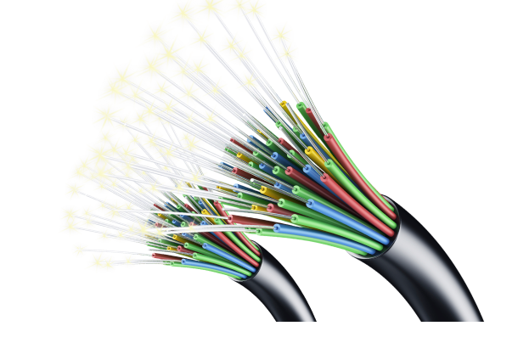
Challenges to alarm transmission
Telecom companies are replacing copper with fiber
Signals transmitted via fiber are compressed
Receiver may not be able to decode compressed signals
Difficult for subscriber to tell if they have copper or fiber
Fiber being rapidly adapted
Notes:
Before a signal is transmitted over fiber, it is digitized and compressed. This doesn’t matter much when sending a voice signal, but can have a severe affect on a DTMF burst signal, such as the ones transmitted by traditional alarm panels. A central station alarm receiver may not be able to accurately decode a compressed signal. It can be difficult or impossible for a subscriber to determine if they have an entirely copper pathway between their panel and the central station, and telephone companies are adopting fiber as fast as they can, replacing copper infrastructure with fiber infrastructure whenever copper equipment fails.

Slide 8
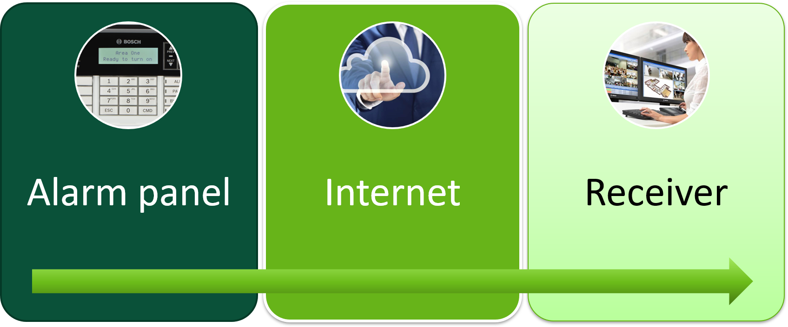
Using encrypted signals
Alarm Over IP
Transmit signals via IP
256 Bit AES Encryption
Using Cypher Block Chaining
Higher speed
Lower cost
More secure
Notes:
The solution to this problem is transmitting alarm signals over IP, via public internet, private WAN or LAN, or cellular connections. An IP enabled alarm panel, or a universal communicator, creates an alarm signal, encrypts it, and transmits it over the network to the receiver, which decodes and interprets it. The three main advantages alarm over IP has over traditional alarm transmission are:
Higher speed. Traditional alarm transmission takes about ten seconds from the time the alarm panel transmits to the time the panel initiates the signal to the time the time the information is displayed on the dispatcher’s screen. If the signal is interrupted, or was garbled in the transmission, or the receiver failed to decode the signal properly, and the panel does not receive an acknowledgment signal from the receiver, the process has to restart. In contrast, alarm over IP is nearly instantaneous. Even if the signal fails the first time, the panel can send the signal again multiple times in the same amount of time it takes a traditional panel to send a signal even once.
Lower cost. Utilizing existing networking infrastructure and internet connections eliminates the need to pay monthly charge for the telephone line required to monitor a burglar alarm or the two telephone lines required to monitor a fire alarm.
More secure. Traditional alarm signals have no authentication mechanism, making it possible to spoof. Traditional alarm signals often had very long supervision times, so the first inkling most end users had that their alarm system could not communicate was a comm failure. Because of the long supervision window, it would be possible for an adversary to cut the phone line and then break into the building undetected. IP alarm communicators are supervised more frequently than standard telephone communicators. If the connection is lost, the central station knows almost immediately. With telephone communicators, it can be days before the connection is tested.

Slide 9


Real World Application
Davidson College used to require 140 separate telephone lines to monitor alarm systems from a variety of manufacturers. By converting to IP monitoring using Bosch universal communicators, they were able to save money while improving response time.
Notes:
Davidson College has fire alarm and burglar panels of various makes, models, and dates of manufacture installed on its 450 acre campus requiring 140 separate phone lines and 140 phone bills. With IP communication modules, they can continue using their existing panels while using their existing networking infrastructure. "By eliminating the expense of the phone lines, we are experiencing a 50 percent cost savings now and expect that number to increase to 75 percent in the near future," said Brent Babb, project manager, Davidson College. On top of the cost savings, the alarm communications from the college to the central station are now received faster than those previously transmitted via a phone line, which in turn improves the central station's response time.

Slide 10
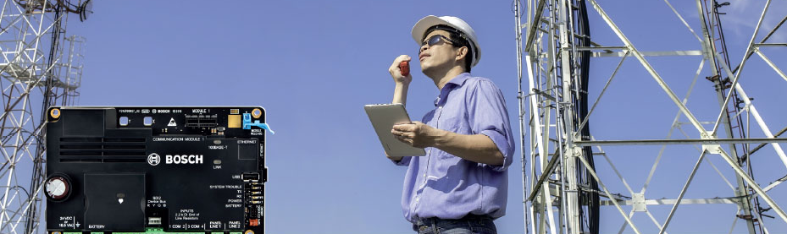
B465 Universal Dual Path Communicator
Works with control panels from other manufacturers
Replaces up to two PSTN lines with cellular or IP
Notes:
All current Bosch intrusion and fire systems can send alarm over IP. For non IP compatible panels, including panels from other manufacturers, we offer the B465 Universal Dual Path Communicator. It will work with nearly any alarm panel, and replaces up to two telephone lines, allowing it to be used for either burg or fire.

Slide 11
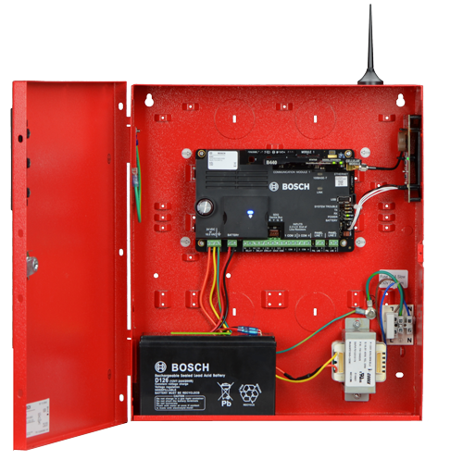


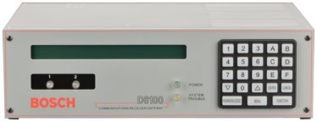
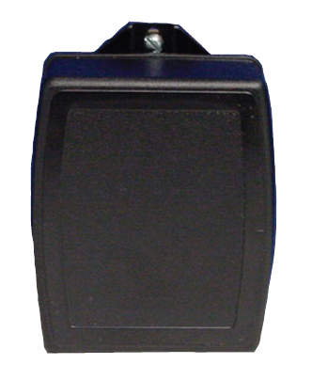
Communicator Accessories
B465 Universal Dual Path Communicator
B46 Piezo
B11R
Small Enclosure
B10R
Medium Enclosure
1640-120WI
B10R-1640-120WI
DC power from wire-in transformer
D6100IPv6 Conettix Receiver
D1640
AC power from plug-in transformer
Notes:
Here we have accessories for the B465 Universal Dual Path Communicator. The B46 is an external annunciator that shows system trouble, battery, and power status using audio and LED indicators. The B465 fits into white or red enclosures, for burg or fire applications, and can be powered using a wire-in or plug-in transformer. The communicator can be monitored using Bosch IP enabled receivers such as the D6100IPv6.

Slide 12
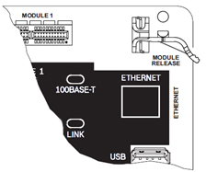
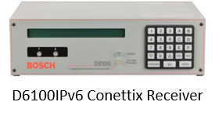
Key Features
Supports single or dual path communication
Onboard Ethernet port
Cellular via plug-in module
Reports alarms and events via encrypted pathway
Notes:
The Universal Communicator can replace up to two paths of communication, for burg or fire applications. The communicator has an ethernet port for IP communication, and has a slot for an optional cellular communicator module such as the Bosch B444 Verizon 4G LTE module.

Slide 13
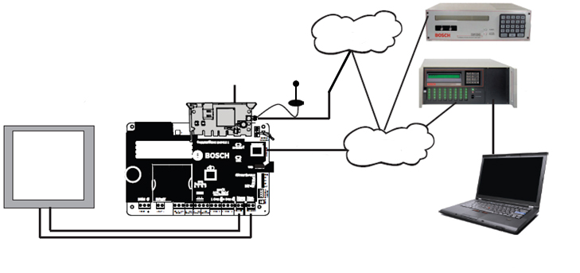
How it all works
Conettix D6100IPv6 Receiver/ Gateway
Cellular Carrier Network
B44x
Plug-in Communicator
Cellular Communication to the Carrier
Conettix 6600 Receiver
B465 Universal Dual Path Communicator
Intrusion/Fire Control Panel
Internet
Ethernet Connection
(RJ-45 Cable to LAN/WAN)
Monitoring
Center Automation
Phone Line Connectors (1 and 2)

Slide 14
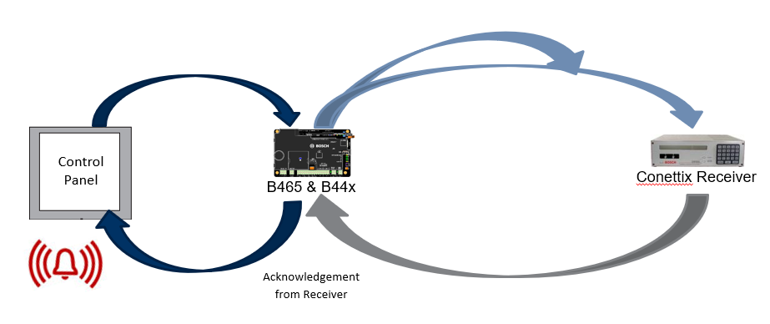
End to end supervision
Notes:
Alarm over IP offers end to end supervision, ensuring reliable communication and alerting users if the communication pathway is interrupted.

Slide 15
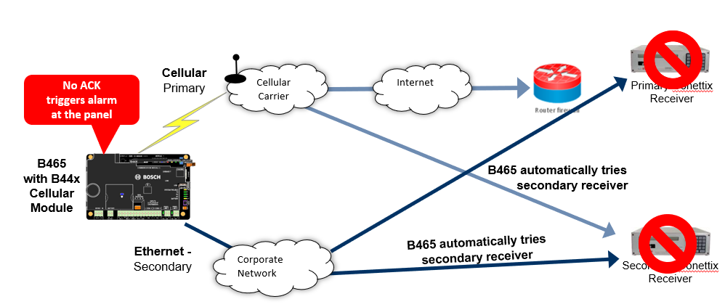
Dual receiver support
Notes:
The B465 can be programmed to transmit to two different receivers, ensuring that a signal will always get through, even if a central station monitoring center is compromised or non functional.

Slide 16
Certifications and approvals
Fully-compliant NFPA72 Editions: 2013, 2010, 2007; UL 864, 9th Ed. UL 1610, UL985, UL1023, UL 1635
NIST FIPS 197
FCC Part 15 Class B
UL 365 – Police Station Connected Burglar Alarm Units and Systems
UL 609 – Local Burglar Alarm Units and Systems
UL 864 – Control Units and Accessories for Fire Alarm Systems
UL 985 – Household Fire Warning System Units
UL 1023 – Household Burglar Alarm System Units
UL 1076 – Proprietary Burglar Alarm Units and Systems
UL 1610 – Central Station Burglar Alarm Units
SIA CP-01:2010 False Alarm Reduction
California State Fire Marshall (CSFM) 7167-1615:0247 7167
California State Fire Marshall (CSFM) 7300-1615:0232 7300
FCC Part 15 Class B
FDNY CoA 6214
CAN/ULC S303 - Local Burglar Alarm Units and Systems
CAN/ULC S304 - Standard for Signal Receiving Center and Premise Burglar Alarm
CAN/ULC S559 - Fire Signal Receiving Centres and Systems
ICES-003 - Information Technology Equipment (ITE)

Slide 17
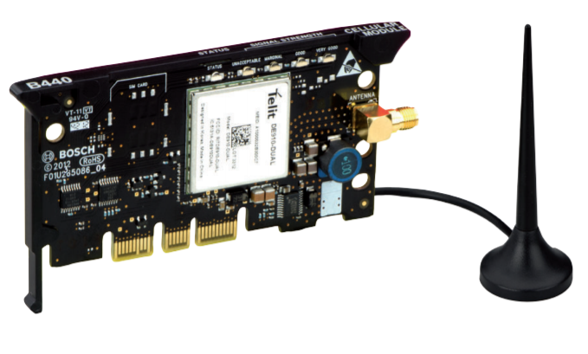
Cellular Communication Module
B444
Verizon 4G LTE
Signal strength LED
Conettix IP alarm reporting
Notes:
The B444 plug in 4G LTE cellular communicator features LED status lights, confirming signal strength.

Slide 18
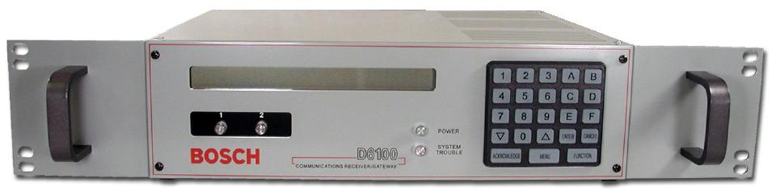
Receiver Gateway
D6100
Up to 3,200 accounts via LAN or WAN
Supports IPv6 and IPv4 networks
NIST-FIPS197 certified for 128- to 256-bit AES encryption
Notes:
The Conettix D6100i Communications Receiver/Gateway provides alarm monitoring over IP Networks using Bosch Conettix IP Technology. It has a compact, economical design that is well-suited for applications such as small central stations, gated communities, security offices, or university campuses. Digital Signal Processing analyzes the incoming signals, providing more reliable and more flexible performance. The D6100i will accept signals even if they do not match the expected acknowledge tone. This means that signals from panels that respond to the wrong handshake tone, and from systems that may be having difficulty communicating, are more likely to be received and processed.

Slide 19


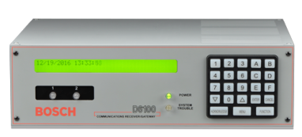
Product Overview
Receiver Gateway
Monitor alarms over IP networks
Communicates with up to IP enabled panels, universal communicators, and cellular communication modules
Higher speed
Higher security
Lower costs
18
Internal | Security Systems | ST-IN/MKK | 11/2016
© Robert Bosch GmbH 2016. All rights reserved, also regarding any disposal, exploitation, reproduction, editing, distribution, as well as in the event of applications for industrial property rights.
Notes:
Summary: what we learned.

Slide 20
Thank You!

