Slide 1
BOSCH RETAIL:
DYNAMIC
EMPLOYEE
NOTIFICATION INTELLIGENCE
Doing our part to DENI the spread of C-19

Slide 2
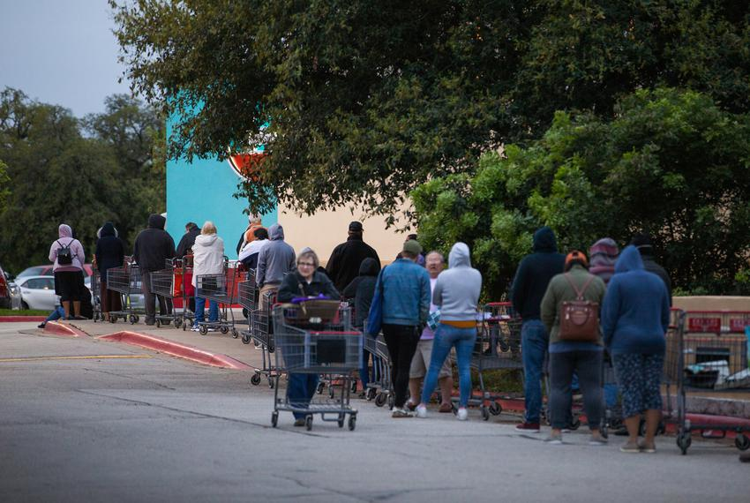
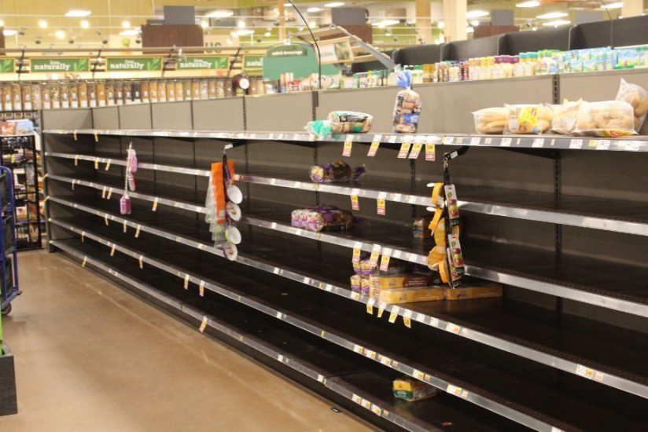
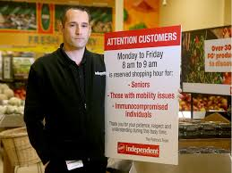
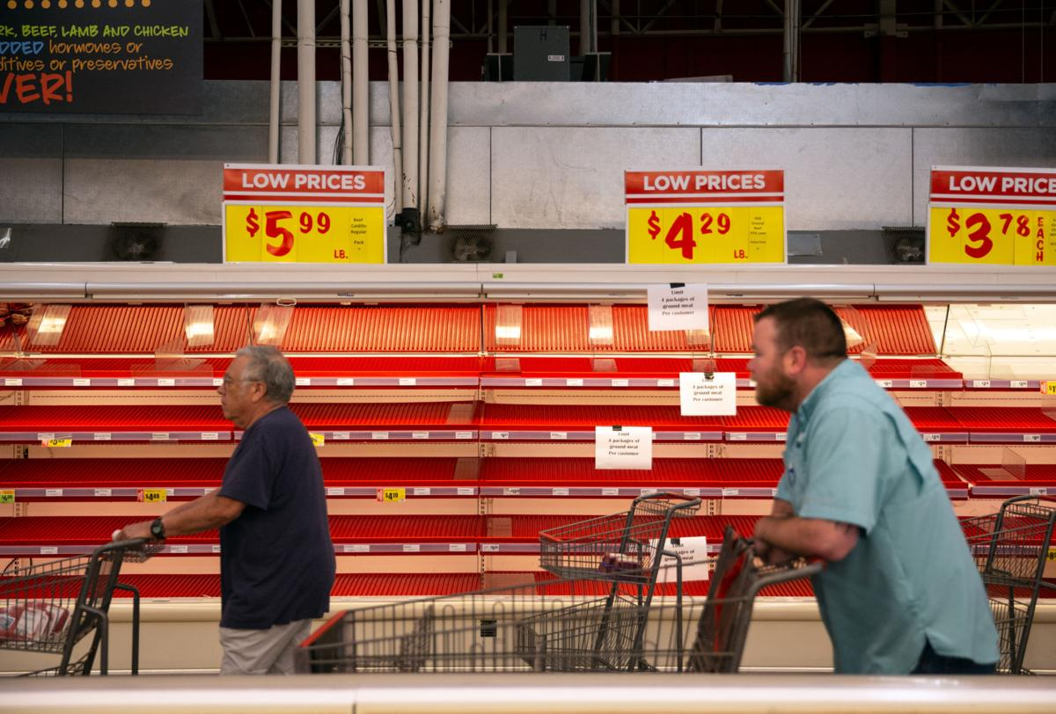
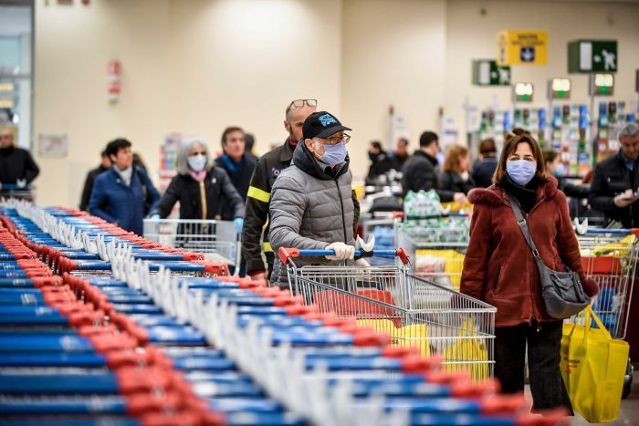
Dynamic Employee Notification Intelligence (DENI)

Slide 3
“We need to manage customer occupancy in our store while allowing staff to focus on helping customers”
Dynamic Employee Notification Intelligence (DENI)

Slide 4
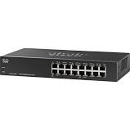
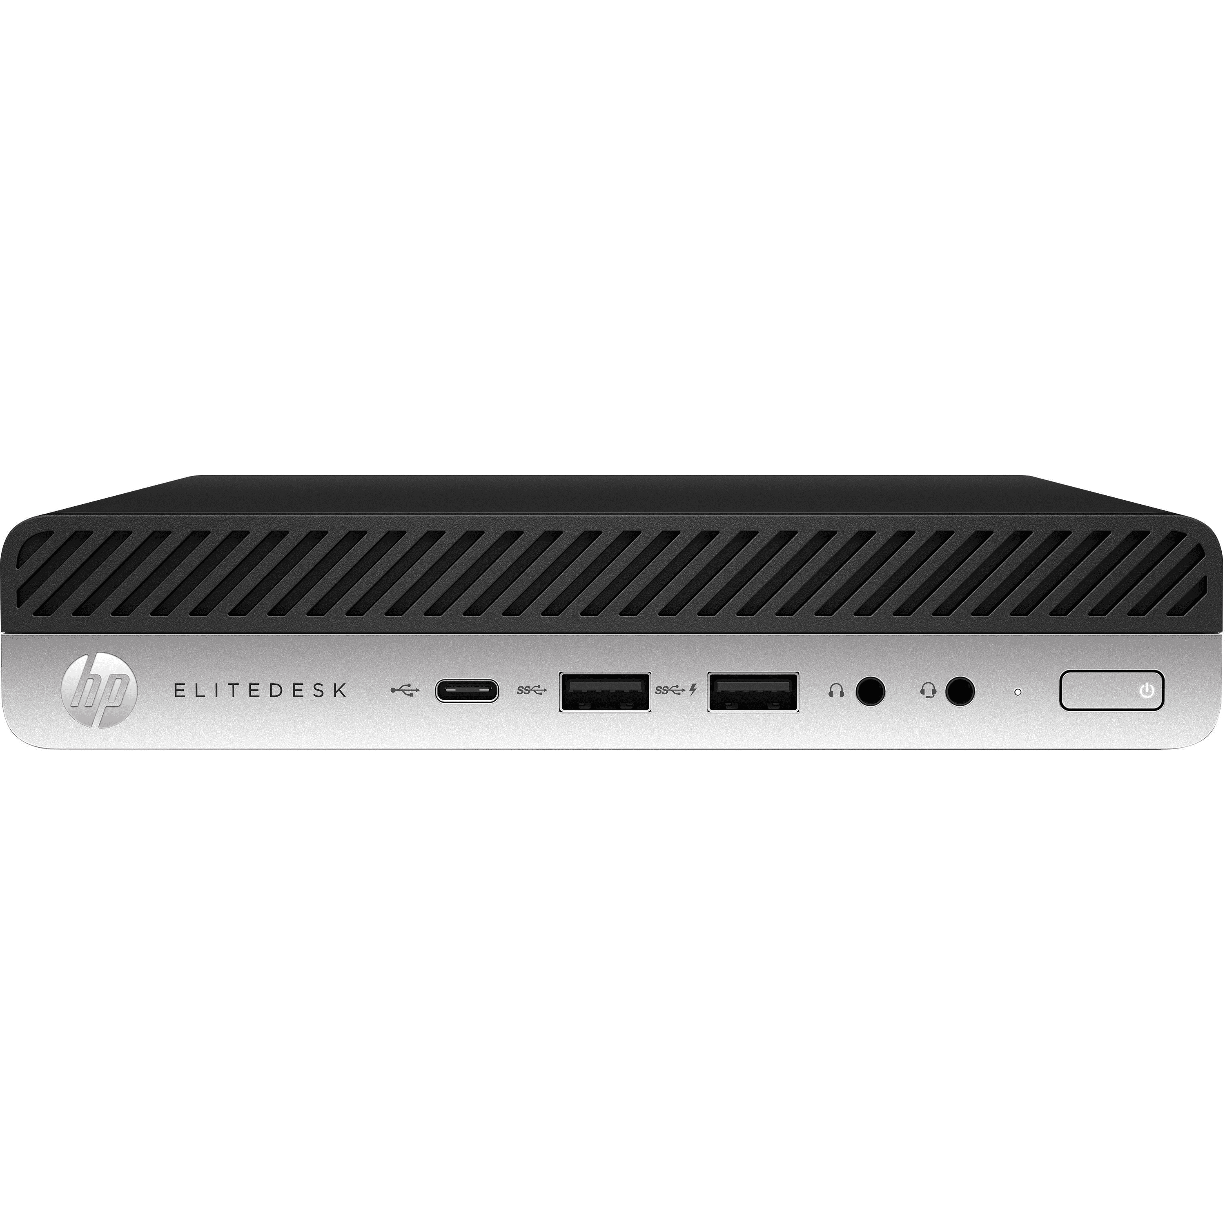

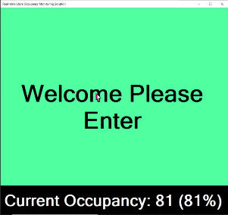
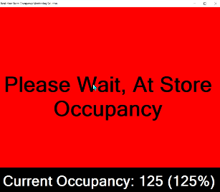
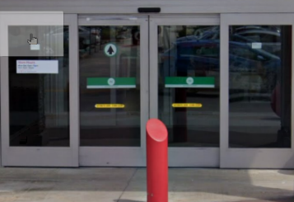
One Camera is all it takes
Bosch Retail: Dynamic Employee Notification Intelligence (DENI)
Bosch DENI App using one camera:
  Calculate live occupancy total using onboard camera IVA
  Allow UI for manual entry of total store occupancy
  Reset to zero every morning five minutes before open
  Monitor mounted by entrance shows display to signal customer
    Green to Enter
    Red to Wait
LAN/WAN
Mini PC mounted on back of any Monitor,
i.e. PVM
NIN-70122-F0A FLEXIDOME 12MP Panoramic &
SR-64VMA SD Card

Slide 5
DENI with Two or More Cameras
Bosch Retail: Dynamic Employee Notification Intelligence (DENI)
LAN/WAN
Bosch DENI App:
  Supports unlimited camera connections
  Calculates live occupancy from all camera connections
  Allow UI for manual entry of total store occupancy
  Reset to zero every morning five minutes before open
  Monitor mounted by entrance shows display to signal customer
    Green to Enter
    Red to Wait
Mini PC mounted on back of any Monitor,
i.e. PVM
NIN-70122-F0A FLEXIDOME 12MP Panoramic &
SR-64VMA SD Card
NIN-70122-F0A FLEXIDOME 12MP Panoramic &
SR-64VMA SD Card
Entrance/Exit
Entrance/Exit

Slide 6

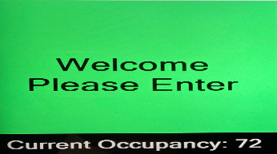
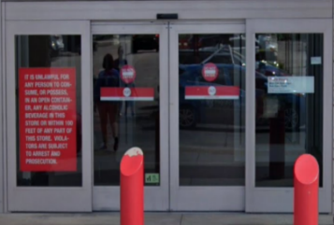
DENI with Multiple Monitors
Load each PC with an independent version of DENI
One Option for Multiple Monitors
-Dedicate one mini PC running DENI for each monitor
-Configure each DENI system with the same cameras
-Store occupancy will be displayed simultaneously on each monitor
-Use another PC in the office using a remote desktop connection to manage the PCs
Office PC with DENI managing the other PCs with Remote Desktop
DENI App
Mini PC mounted on back of Monitor (PVM?)
LAN/WAN
Office PC
Keep adding more…
Notes:
Video analytics in IP cameras can directly trigger alarms in the intrusion system
Intrusion events can trigger predefined announcements on PA system and/or messages to radios
Video Management System can be used to arm and disarm zones, and to monitor intrusion and access systems.

Slide 7
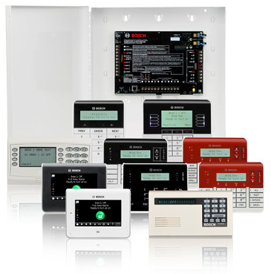
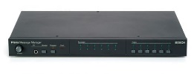

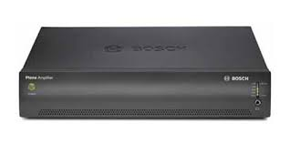
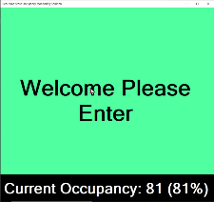
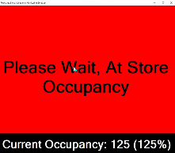
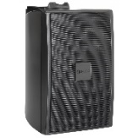
DENI Audio with Security Panel Integration
Bosch DENI App:
  Calculates live occupancy total using onboard camera IVA
  Use as many cameras as needed, i.e. Install cameras at every entrance and exit as needed
  Occupancy triggers pre-recorded messages and other outputs via security panel automation integration
DENI App Security Panel Automation Integration triggers local visual and audio notifications
DENI App
LAN/WAN
Bosch Security panel
B9512G/B8512G/B6512/
B5512/B4512
Bosch Plena Message Manager LBB1965/00-US
Mini PC mounted on back of Monitor (PVM?)
Bosch Plena Amp
PLE-1P120-US
NIN-70122-F0A Flexidome 12MP Panoramic & SR-64VMA SD Card
NIN-70122-F0A Flexidome 12MP Panoramic & SR-64VMA SD Card
Bosch Security Panel initiates either red or green light based on occupancy total managed by Bosch Camera
LB2-UC30-D1
Bosch Premium-sound Cabinet Loudspeaker
Monitor mounted by Entrance displays color to signal customer entry: Green to Enter and Red to Wait.
Entrance
Exit
Notes:
Video analytics in IP cameras can directly trigger alarms in the intrusion system
Intrusion events can trigger predefined announcements on PA system and/or messages to radios
Video Management System can be used to arm and disarm zones, and to monitor intrusion and access systems.

Slide 8


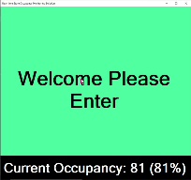
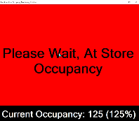
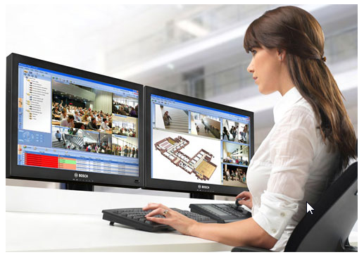
DENI and Cloud Services provides 95% Minimum Accuracy!
Bosch DENI App:
-Calculate live occupancy total using onboard camera IVA
-Reconcile local live total with Bosch Cloud Services
-Allow UI for manual entry of total store occupancy
-Power outage recovery of store occupancy total with CBS
-Reset to zero every morning five minutes before open
DENI App Security Panel Automation Integration triggers local visual and audio notifications
Bosch Cloud Based Services provides occupancy reconciliation with Bosch DENI App for 95% accuracy minimum utilizing camera meta-data
DENI App
LAN/WAN
Optional:
Cloud Based Services
Bosch Security panel
B9512G/B8512G/B6512/
B5512/B4512
Bosch Plena Message Manager LBB1965/00-US
Mini PC mounted on back of Monitor (PVM?)
Bosch Cloud Based Merchandising Module provides real time enterprise customer behavior, traffic visualizations, flow analysis, engagement and queue management.
Bosch Plena Amp
PLE-1P120-US
NIN-70122-F0A Flexidome 12MP Panoramic & SR-64VMA SD Card
NIN-70122-F0A Flexidome 12MP Panoramic & SR-64VMA SD Card
Bosch Security Panel initiates either red or green light based on occupancy total managed by Bosch Camera
Monitor mounted by Entrance displays color to signal customer entry: Green to Enter and Red to Wait.
LB2-UC30-D1
Bosch Premium-sound Cabinet Loudspeaker
Live Video Alarm Monitoring
Entrance
Exit
Notes:
Video analytics in IP cameras can directly trigger alarms in the intrusion system
Intrusion events can trigger predefined announcements on PA system and/or messages to radios
Video Management System can be used to arm and disarm zones, and to monitor intrusion and access systems.

Slide 9
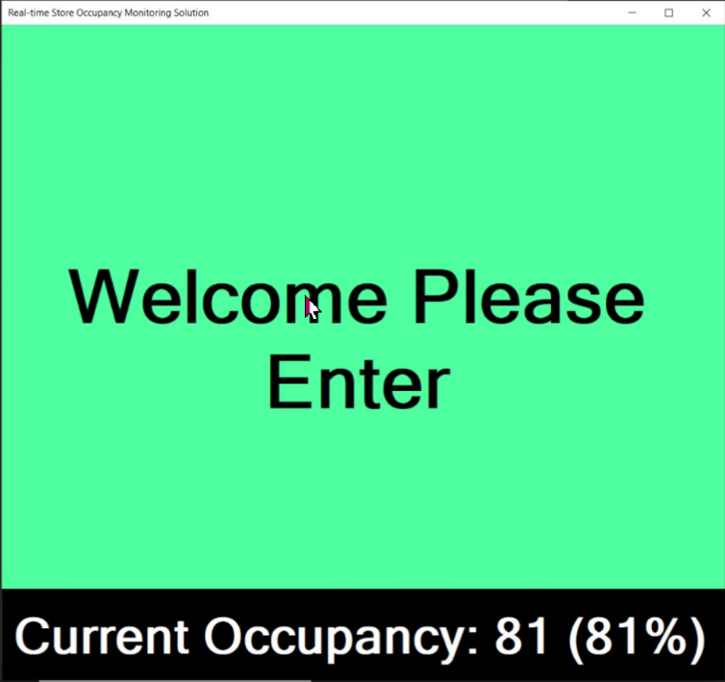
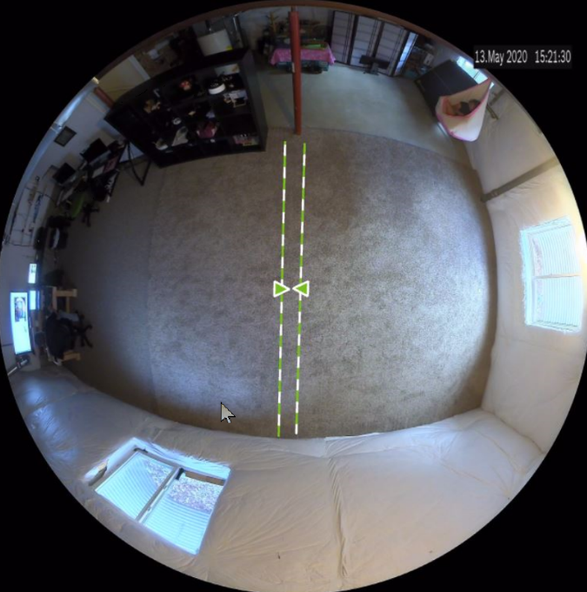
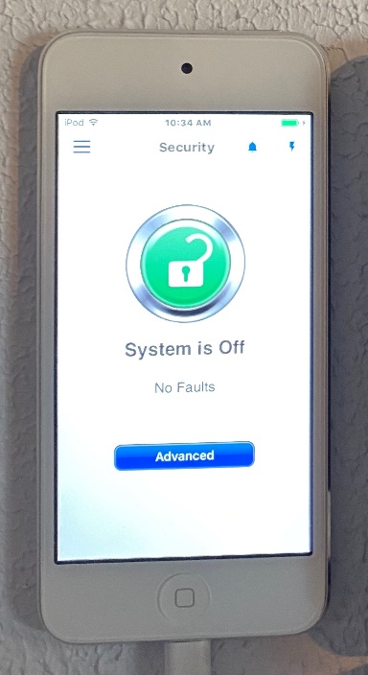
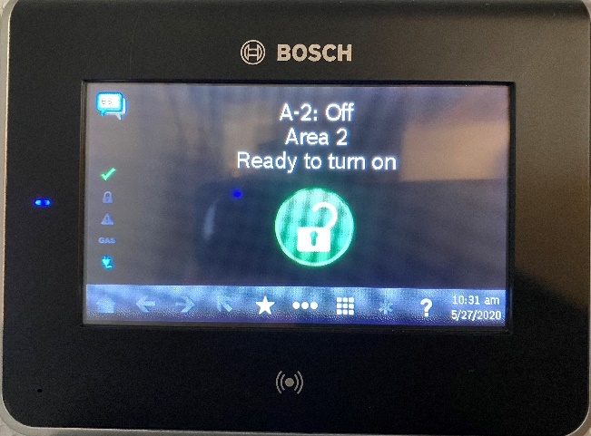
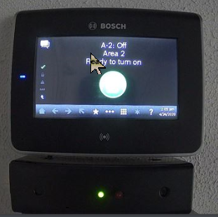
DENI Display Example – Under Customer Defined Occupancy
Green background with custom message
Onboard Video Analytics for counting each entrance/exit
Optional Bosch Security Panel Integration Keypad Display and audible Chime
Optional Remote Security Control App provides real time remote occupancy status
Optional GREEN LED activated by Bosch Security Panel Integration

Slide 10
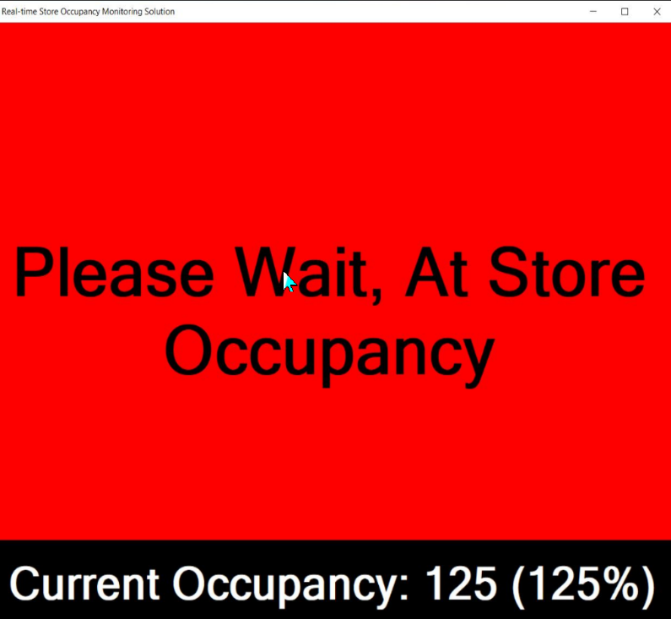
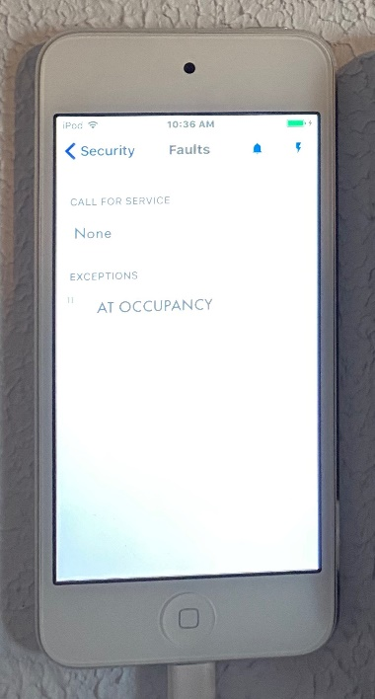
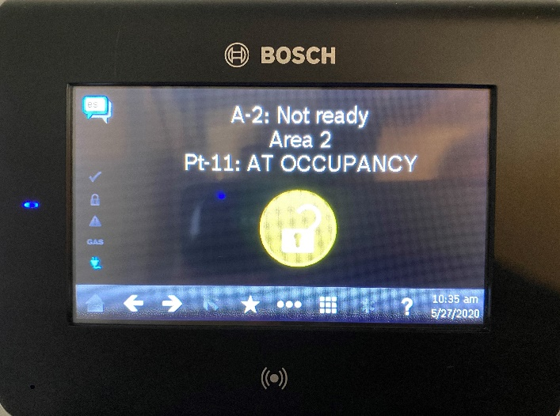

DENI Display Example – Customer Defined Occupancy Reached
Red background with custom message
Onboard Video Analytics for counting each entrance/exit
Optional Bosch Security Panel Integration Keypad Display and audible Chime
Optional Remote Security Control App provides real time remote occupancy status
Optional RED LED activated by Bosch security Panel Integration

Slide 11
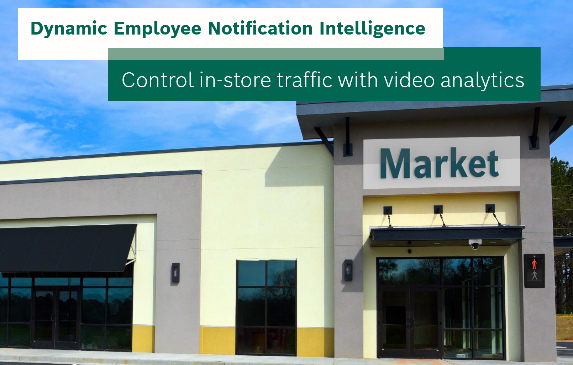
DENI Summary
Dynamic Employee Notification Intelligence(DENI)
PROS:
  Bosch equipment available today for rapid deployment
  Start with one camera and scale to immediate needs
  Leverage existing Bosch security panel that is installed in most retailers
  Bosch cameras integrate with major VMSs
Occupancy Solution Long Term Uses Include:
  Once the 12MP panoramic camera is installed, leave it in place to immediately enhance any loss prevention system.
  Bosch IP cameras integrate as Smart sensor points in Bosch security panels potentially replacing typical motion detectors; therefore, reducing overall intrusion detection costs and unwanted alarm fines.
  Video Intervention: alarm verification, monitoring, two audio communications, remote I/O control
  Generate notifications based on unwanted behavior: people on premise after hours, cars parked in fire lanes, people lying on the ground, crowds gathering, people waiting in line for a long time, loitering, wrong way movements, etc…
  In-Store Analytics Merchandising Metrics
  Provide accurate building occupancy counts for emergency management
  Cloud Based Enterprise remote camera Firmware maintenance and configuration
  Bosch Three Year Warranty on Video, Communication and Intrusion Equipment

Slide 12
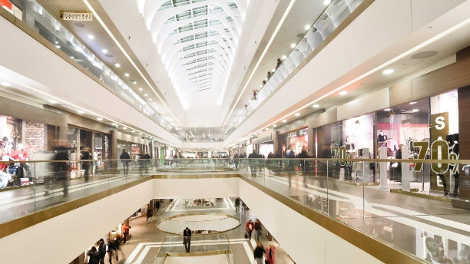

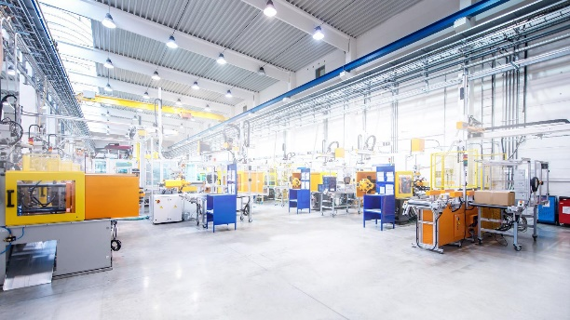




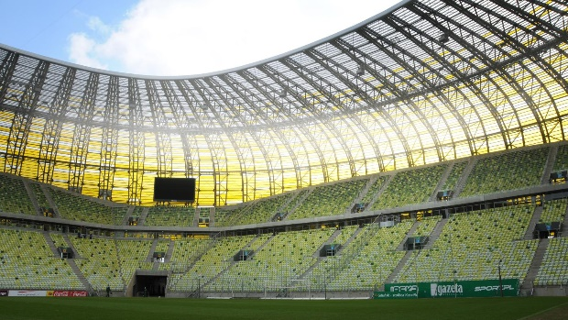

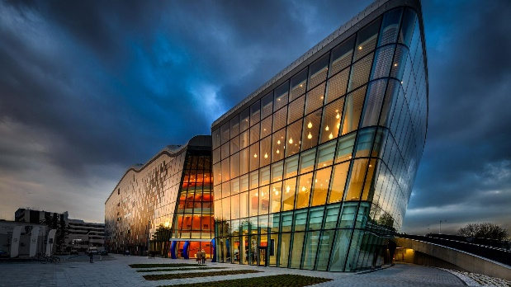
DENI Opportunities In Other Industries
Shopping Malls
Public Buildings
Manufacturing
Banking
Hospital & Health
Education
Theaters & Concert Halls
Stadiums
Religious Buildings
Exhibition Centers

Slide 13
Questions?

