Slide 1
Security-of-Security
NEW THEME that complements Unified, Open Architecture, Enterprise Security, and Multi-Site Monitoring

Slide 2
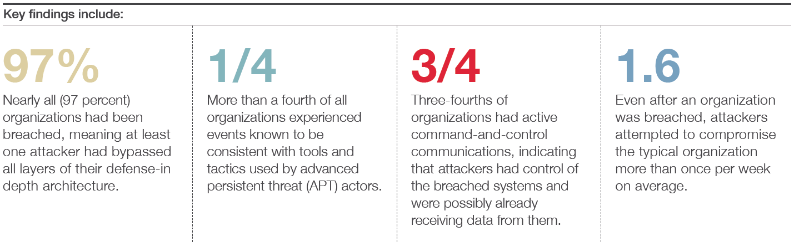
Top of Mind For Private and Public Organizations
CIOs now spending 1/3 of their time on Security SOURCE: CIO.com “State of the CIO”
97% of organizations had been breached, while three-fourths had attackers gain active control ^{SOURCE: FireEye (IT products &} ^{consulting)}

Slide 3
Ever-Present Concerns Outside of Physical Security
Cyber Threats
and Attacks
Illegal or
Unauthorized Access
Security of Data
(personal and business)
Protection of
Privacy

Slide 4
Security of Your Security System
Need for greater security driven by changing conditions
Communications across the Internet
Greater number of system users
Privacy
Concerns
Multi-site deployments
over a WAN, Citywide surveillance
Multi-organization and
public-private collaboration
crossing more boundaries
Communities and organizations worried about confidentiality

Slide 5
Great Opportunity for Channel to Change the Conversation
Evolve the narrative from physical security to one that includes IT security
Educate the market on what IT security really means for a solution
Take a leadership role in the discussion and offer insights
Get IT behind our products and vision during the sales cycle
Differentiate ourselves from competitors and position ourselves as IT savvy

Slide 6
End Users’ Definition of Security Differs
We get hints based on the questions they ask
Do your access control devices support encryption?
Are communications between
client and server apps encrypted ?
Do you support 128-bit SSL?
Overwhelming emphasis on communications security and encryption

Slide 7
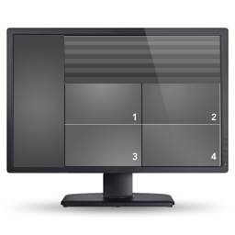



Man-in-the-Middle Attacks
Attacker reads the data and continues to pass it along
  Sender and receiver think they are on a secure communications channel
Attacker may also alter the data
Even more dangerous when data is unencrypted (no decryption needed)
Encryption protects confidentiality of data and communications
Integrity and authenticity not assured
Original Connection
New Connection
Man-in-the-middle
Encryption alone is not enough

Slide 8
Redefining What Security of a Platform Means
Expanding and evolving the conversation to include ALL the elements of a secure ACS and video surveillance system
Encryption
Authentication
Authorization
How is data protected or hidden from unauthorized users?
Who is allowed to access the system and how do they gain access?
Once users have access,
what can users see and do?

Slide 9



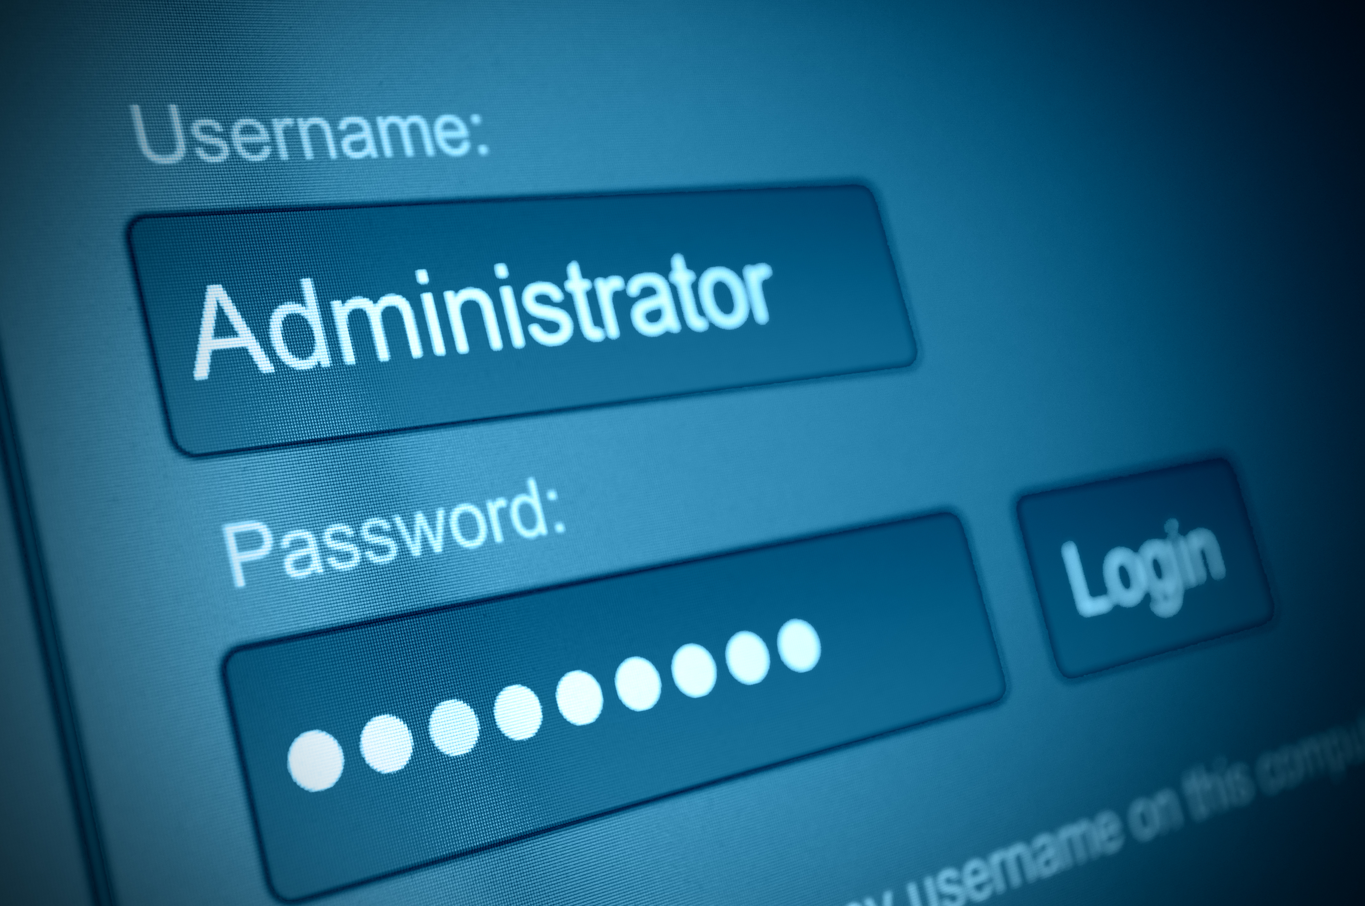
Our Vision for Security-of-Security
Further strengthen the security of our products
Leverage IT standards and best practices
Prevent unauthorized access w/ stronger authentication
Protecting Everyone’s Privacy

Slide 10
Security of Your Security System
Further strengthen the security of our products
Leverage IT standards and best practices
Prevent unauthorized access through stronger authentication
Protecting Everyone’s Privacy

Slide 11
Introduction and Overview of security measures

Slide 12
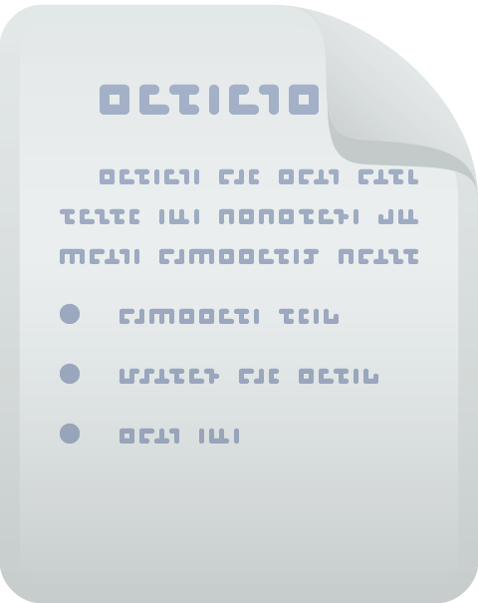

Establishing Trust - Encryption
What is it?
Process of encoding data to prevent unauthorized access
Hides data or contents of a message, only recoverable using corresponding decryption process
Why is it needed?
Secure private information
Enhance the security of outgoing data
Protects confidentiality of stored data
How does it work?
Algorithm encrypts data (plaintext) into unreadable or encrypted data (cyphertext)
Cyphertext can only be read once decrypted
Encryption keys used to encrypt and decrypt
Encryption key strength measures the effectiveness of an algorithm, eg. 128 bits
Original Data
Scrambled Data
Original Data
Encryption Key
Decryption Key

Slide 13
Establishing Trust - Encryption
Types of Encryption
Symmetric. Same key used for encryption and decryption, eg. AES
Asymmetric. Different keys used, private and public key pair, eg. RSA
Where does encryption fall short?
Hides the contents of a message but
Does not guarantee its
  Integrity. Has the message been altered?
  Authenticity. Is the sender actually who they say they are?
We should be worried about the confidentiality of data & communications
But, we should also be concerned about the integrity and authenticity of messages
Man-in-the-middle attacks
  An example of an attack where authenticity and integrity have been compromised

Slide 14
Man-in-the-Middle Attacks
User gets between a sender and a receiver and sniffs information
Attacker reads the data and may continue to pass it along
  Sender and receiver think they are on a secure communications channel
Attacker may also alter the data
Even more dangerous when data is unencrypted
  Attacker does not even have to decrypt it to read it
Original Connection
New Connection
Man-in-the-middle
Encryption alone is not enough

Slide 15
Establishing Trust - Authentication
What is it?
Process of determining whether an entity is who they claim to be
Entity could be a user, a server, or a client app
Why is it needed?
You want to provide access only to known users or entities
Prevent unauthorized access
Types of Authentication
Client-side authentication
Server-side authentication
Examples of Authentication
Client-side
  User name and password combinations
  Tokens (dual authentication)
Server-side
  Digital signatures and certificates

Slide 16
Claims-Based identity and Authentication
What is a claim?
A statement that one subject makes about itself or another subject (name, identity, privilege)
Claims are used by apps to authenticate users without having to interrogate them
How does it work?
Claims are issued by a provider and packaged into security tokens (facts about a user)
A trusted 3rd party (provider) can usually better handle identity claims
An Example of Claims-Based Identity
You just don’t walk up to a gate and present your passport
You’re authenticated (picture ID) and authorized (ticket)
Then you’re given a boarding pass (claim)
Boarding pass is a claim made about you by an airline; it streamlines the entire process for agents
Benefits
Remove the burden to develop stronger authentication
Increases our security by making authentication external
Leverage third party claims providers such as a Secure Token Service (STS), eg. Active Directory Federation Services (ADFS)

Slide 17
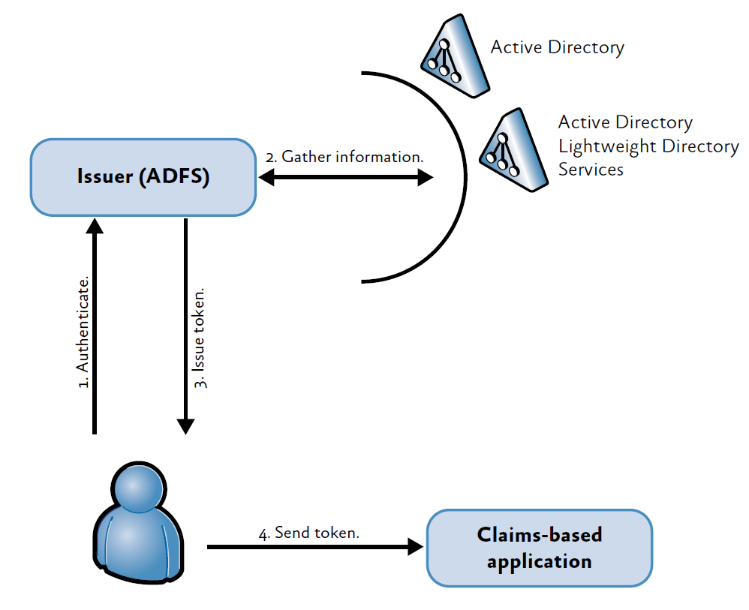

Claims-Based identity and Authentication
Active Directory Federation Services (ADFS)
What does ADFS do?
Issues claims by providing the logic to authenticate users
Supports authentication through certificates
What else can it do?
Accept security tokens from an issuer in another realm as proof of authentication
Authentication and single sign-on across domains
Streamlines authentication in multi-organization security environments, eg. citywide surveillance

Slide 18
Authorization
What is it?
The function of specifying access rights someone has over resources, data, or an app
Needed to have control and flexibility over
What users or entities can see
What users or entities can do
How does it work?
User and user group management. Restricting an operator’s scope of activities
Privileges. Determine what users can do
Partitions. Determine what users can see

Slide 19
How genetec Protects your security platform

Slide 20
Stronger Security Without Reinventing The Wheel
Leveraging the latest IT-Standard technologies
Digital Certificates & Digital Signatures
Third Party
Authentication
Server authenticates to the client app so the user is ensured he is communicating with authentic servers
Utilizing MS Active Directory for
authentication and single-sign on
Claims-Based Authentication
Latest Encryption Standards
Leveraging 3rd party claims providers to authenticate users, eg. Secure Token Service (STS)
TLS protocol leverages both certificates and encryption, Video Encryption (AES and RSA)

Slide 21





Existing Security Capabilities
User and Group Management
Incl. Active Directory Synchronization
Granular Privileges, Access Rights, and Workflows
Partitions
and Logical
Segmentation
Encrypted Communications

Slide 22



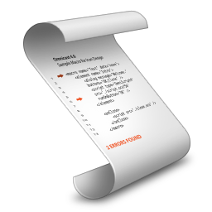
Upcoming Security and Privacy Features
Coming with 5.4
FUSION STREAM ENCRYPTION
Server Authentication with Certificates
(TLS)
Claims-Based Authentication
(ADFS)
Encrypted Video
At Rest
Encrypted Video
In Transit

Slide 23
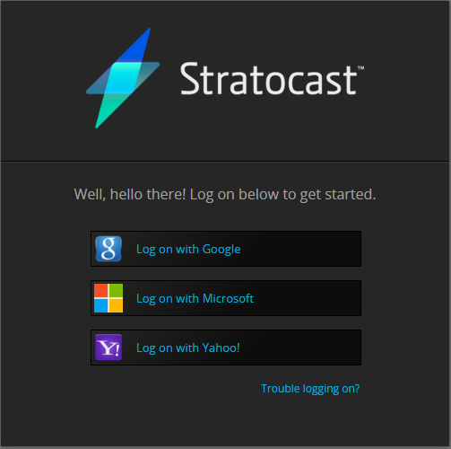
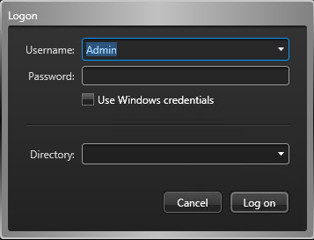

Claims-Based Authentication in Security Center
Coming with 5.4
Built-in support for an external STS (ADFS)
Users (on client apps) authenticate to ADFS and receive a token to logon
Infrastructure in place for future integrations to other claims providers
  Third parties investing heavily in stronger authentication
  Allow us to meet an organization’s meet IT policies

Slide 24



Stronger Security in Security Center
Coming with 5.4
1
STS
    Decoupling authentication and authorization
    Support for external STS (Active Directory Federation Services)
    Prevent man-in-the-middle attack
    Certificate-based (RSA)
Claims-Based Authentication
Fusion Stream Encryption
TLS Protocol
2
3
Directory Server
Archiver Server
Notes:
Transport Layer Security (TLS) and its predecessor, Secure Sockets Layer (SSL), both of which are frequently referred to as 'SSL', are cryptographic protocols designed to provide communications security over a computer network.
A Security Token Service (STS) is a software based identity provider responsible for issuing security tokens, especially software tokens, as part of a claims-based identity system
Video is encrypted in AES-256 and the key stream is encrypted with RSA-2048 (or whatever provide as the certificate)

Slide 25
Stream Encryption
More than security… It is about Privacy
Privacy protection against anyone who accesses your servers (e.g. IT, 3rd party installer)
Exporting encrypted video for greater protection
Multi-tenant applications
Stream Encryption
1
2
Encrypted video in-transit
Archiver Server
2
Encrypted video at-rest

Slide 26
Security of Your Security System
Offering Stronger Security
Relying on
IT Standards
Leveraging Advanced Authentication
Protecting Everyone’s Privacy

Slide 27
genetec.com
@genetec
© 2014 Genetec Inc. All rights reserved. Genetec, Security Center, the Genetec logo and the Genetec Mobius are either trademarks or registered trademarks of Genetec Incorporated. All other logos used herein are the property of their respective owners.

