Slide 1
Open Enrollment Shopping Guide
Insert Logo Here

Slide 2
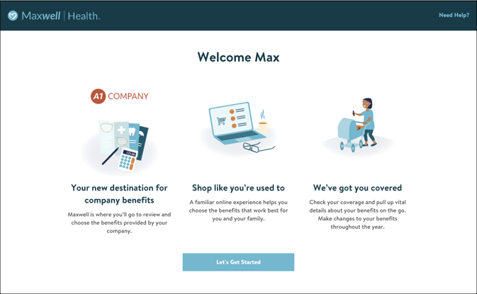
1
Review the email from your employer. You’ll receive a welcome email from your employer welcoming you to Maxwell and prompting you set up your Maxwell account. When you go to set up your account, the first screen you’ll see will welcome you to the Maxwell experience.

Slide 3
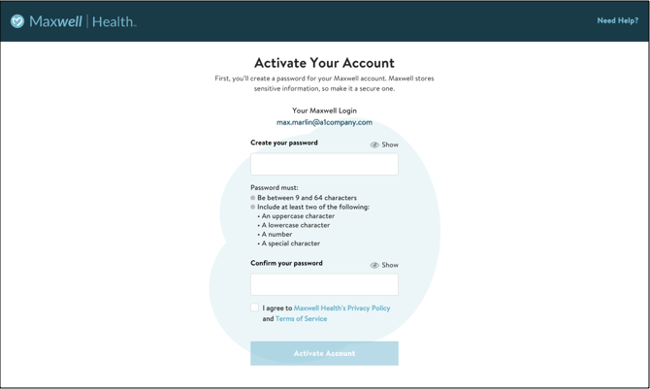
2 Activate your account. Create a password and activate your Maxwell account.

Slide 4
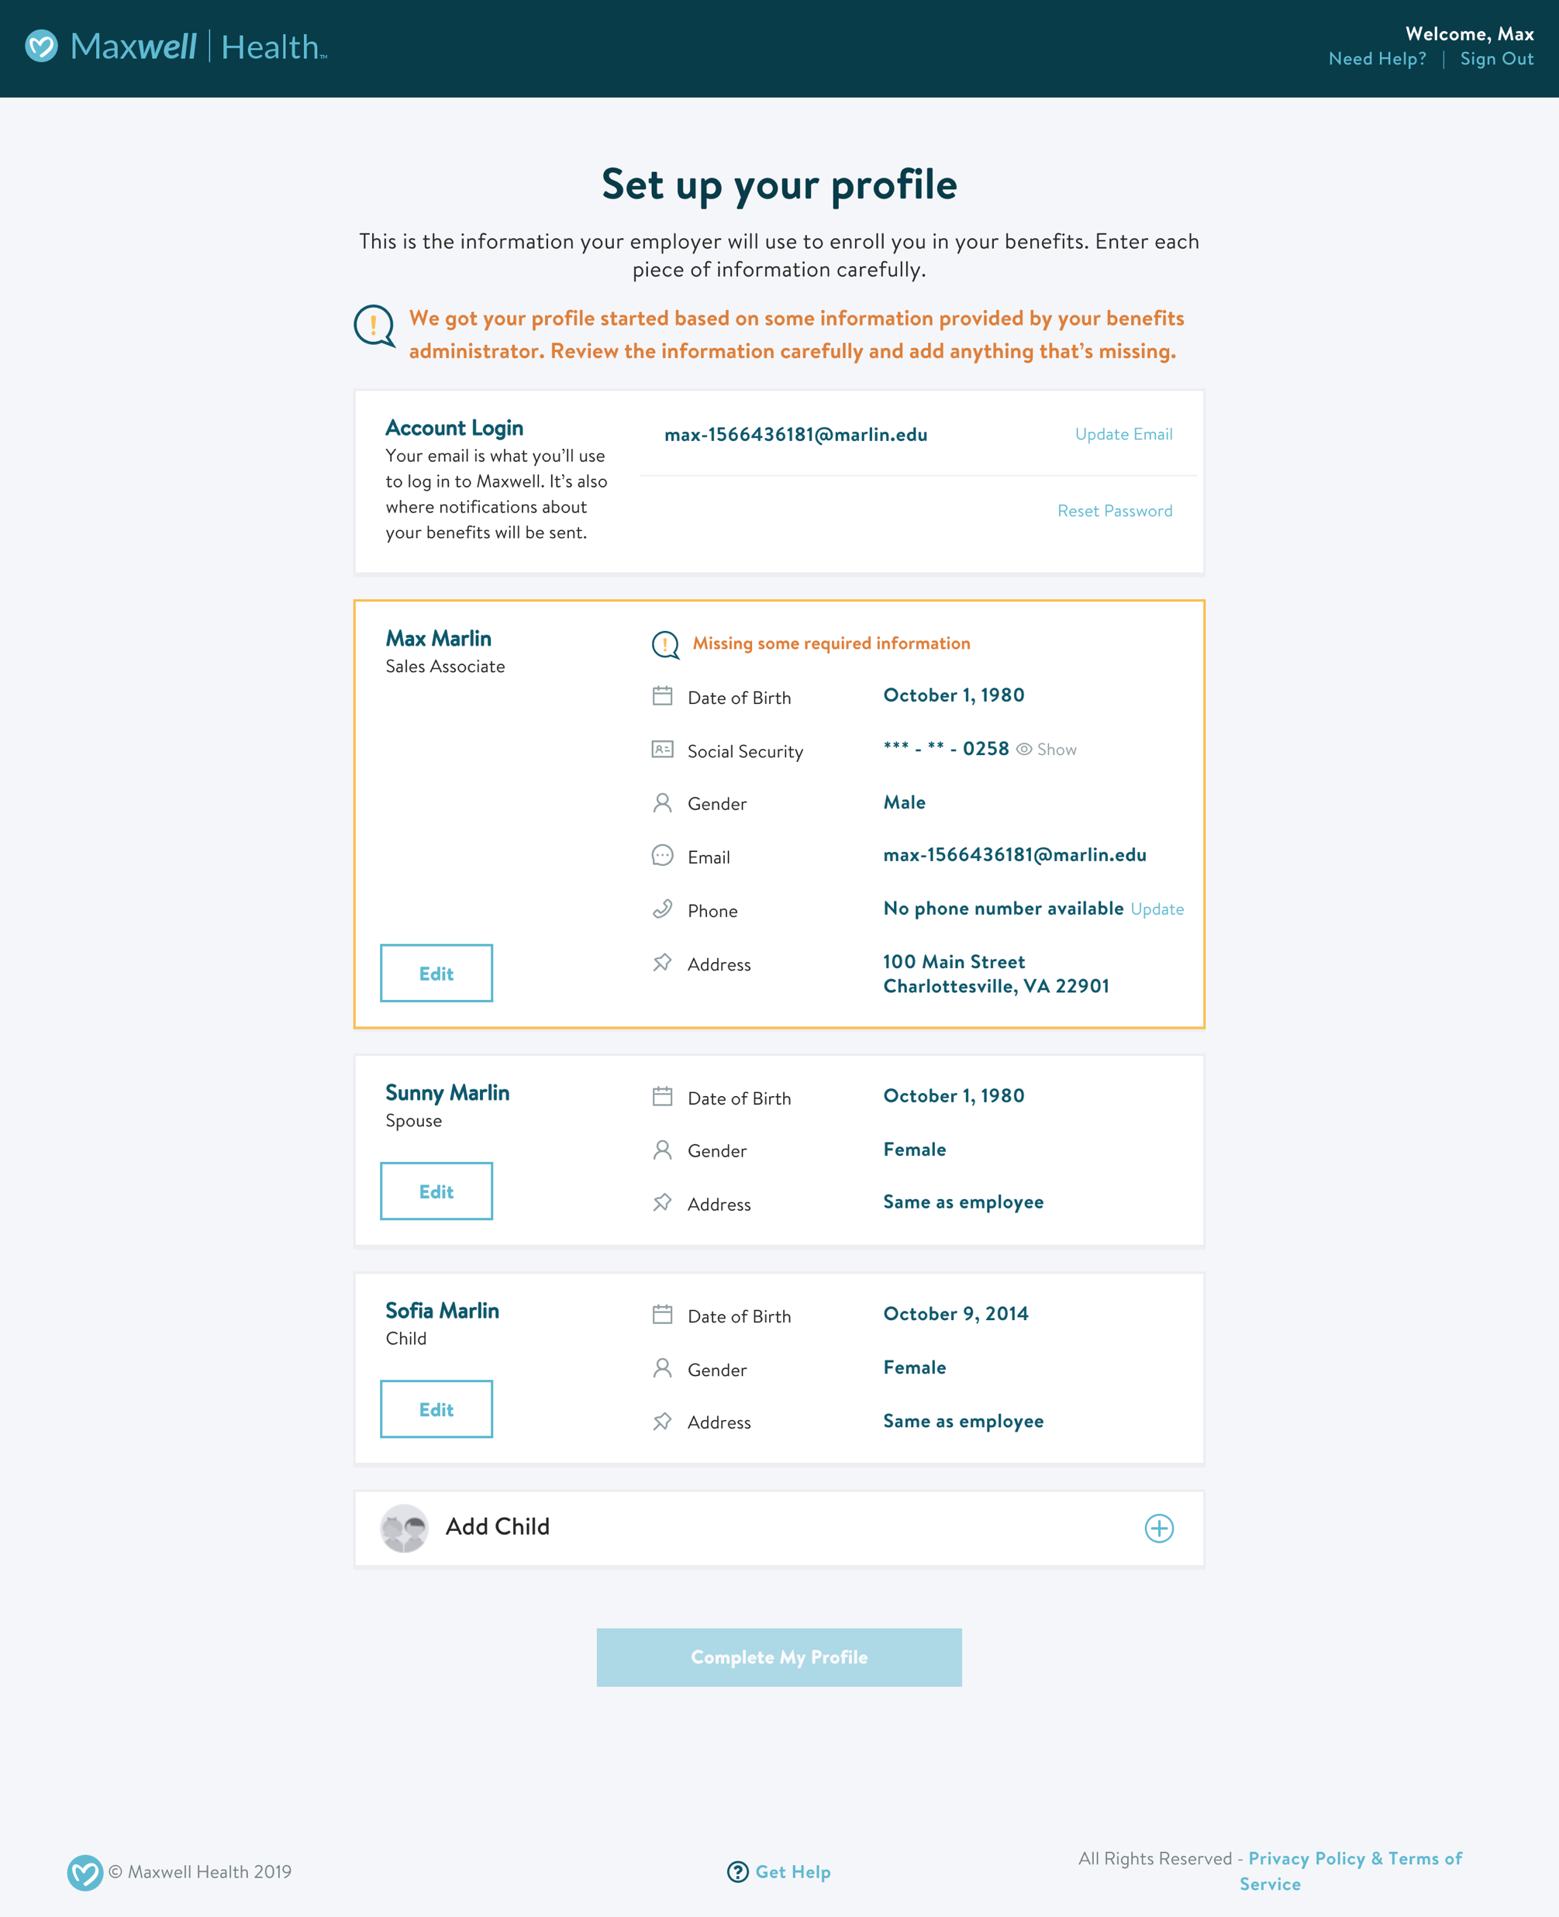
3
Set up your profile information. Be sure to enter all required information and add your family members as dependents so you can cover them on your benefits.

Slide 5
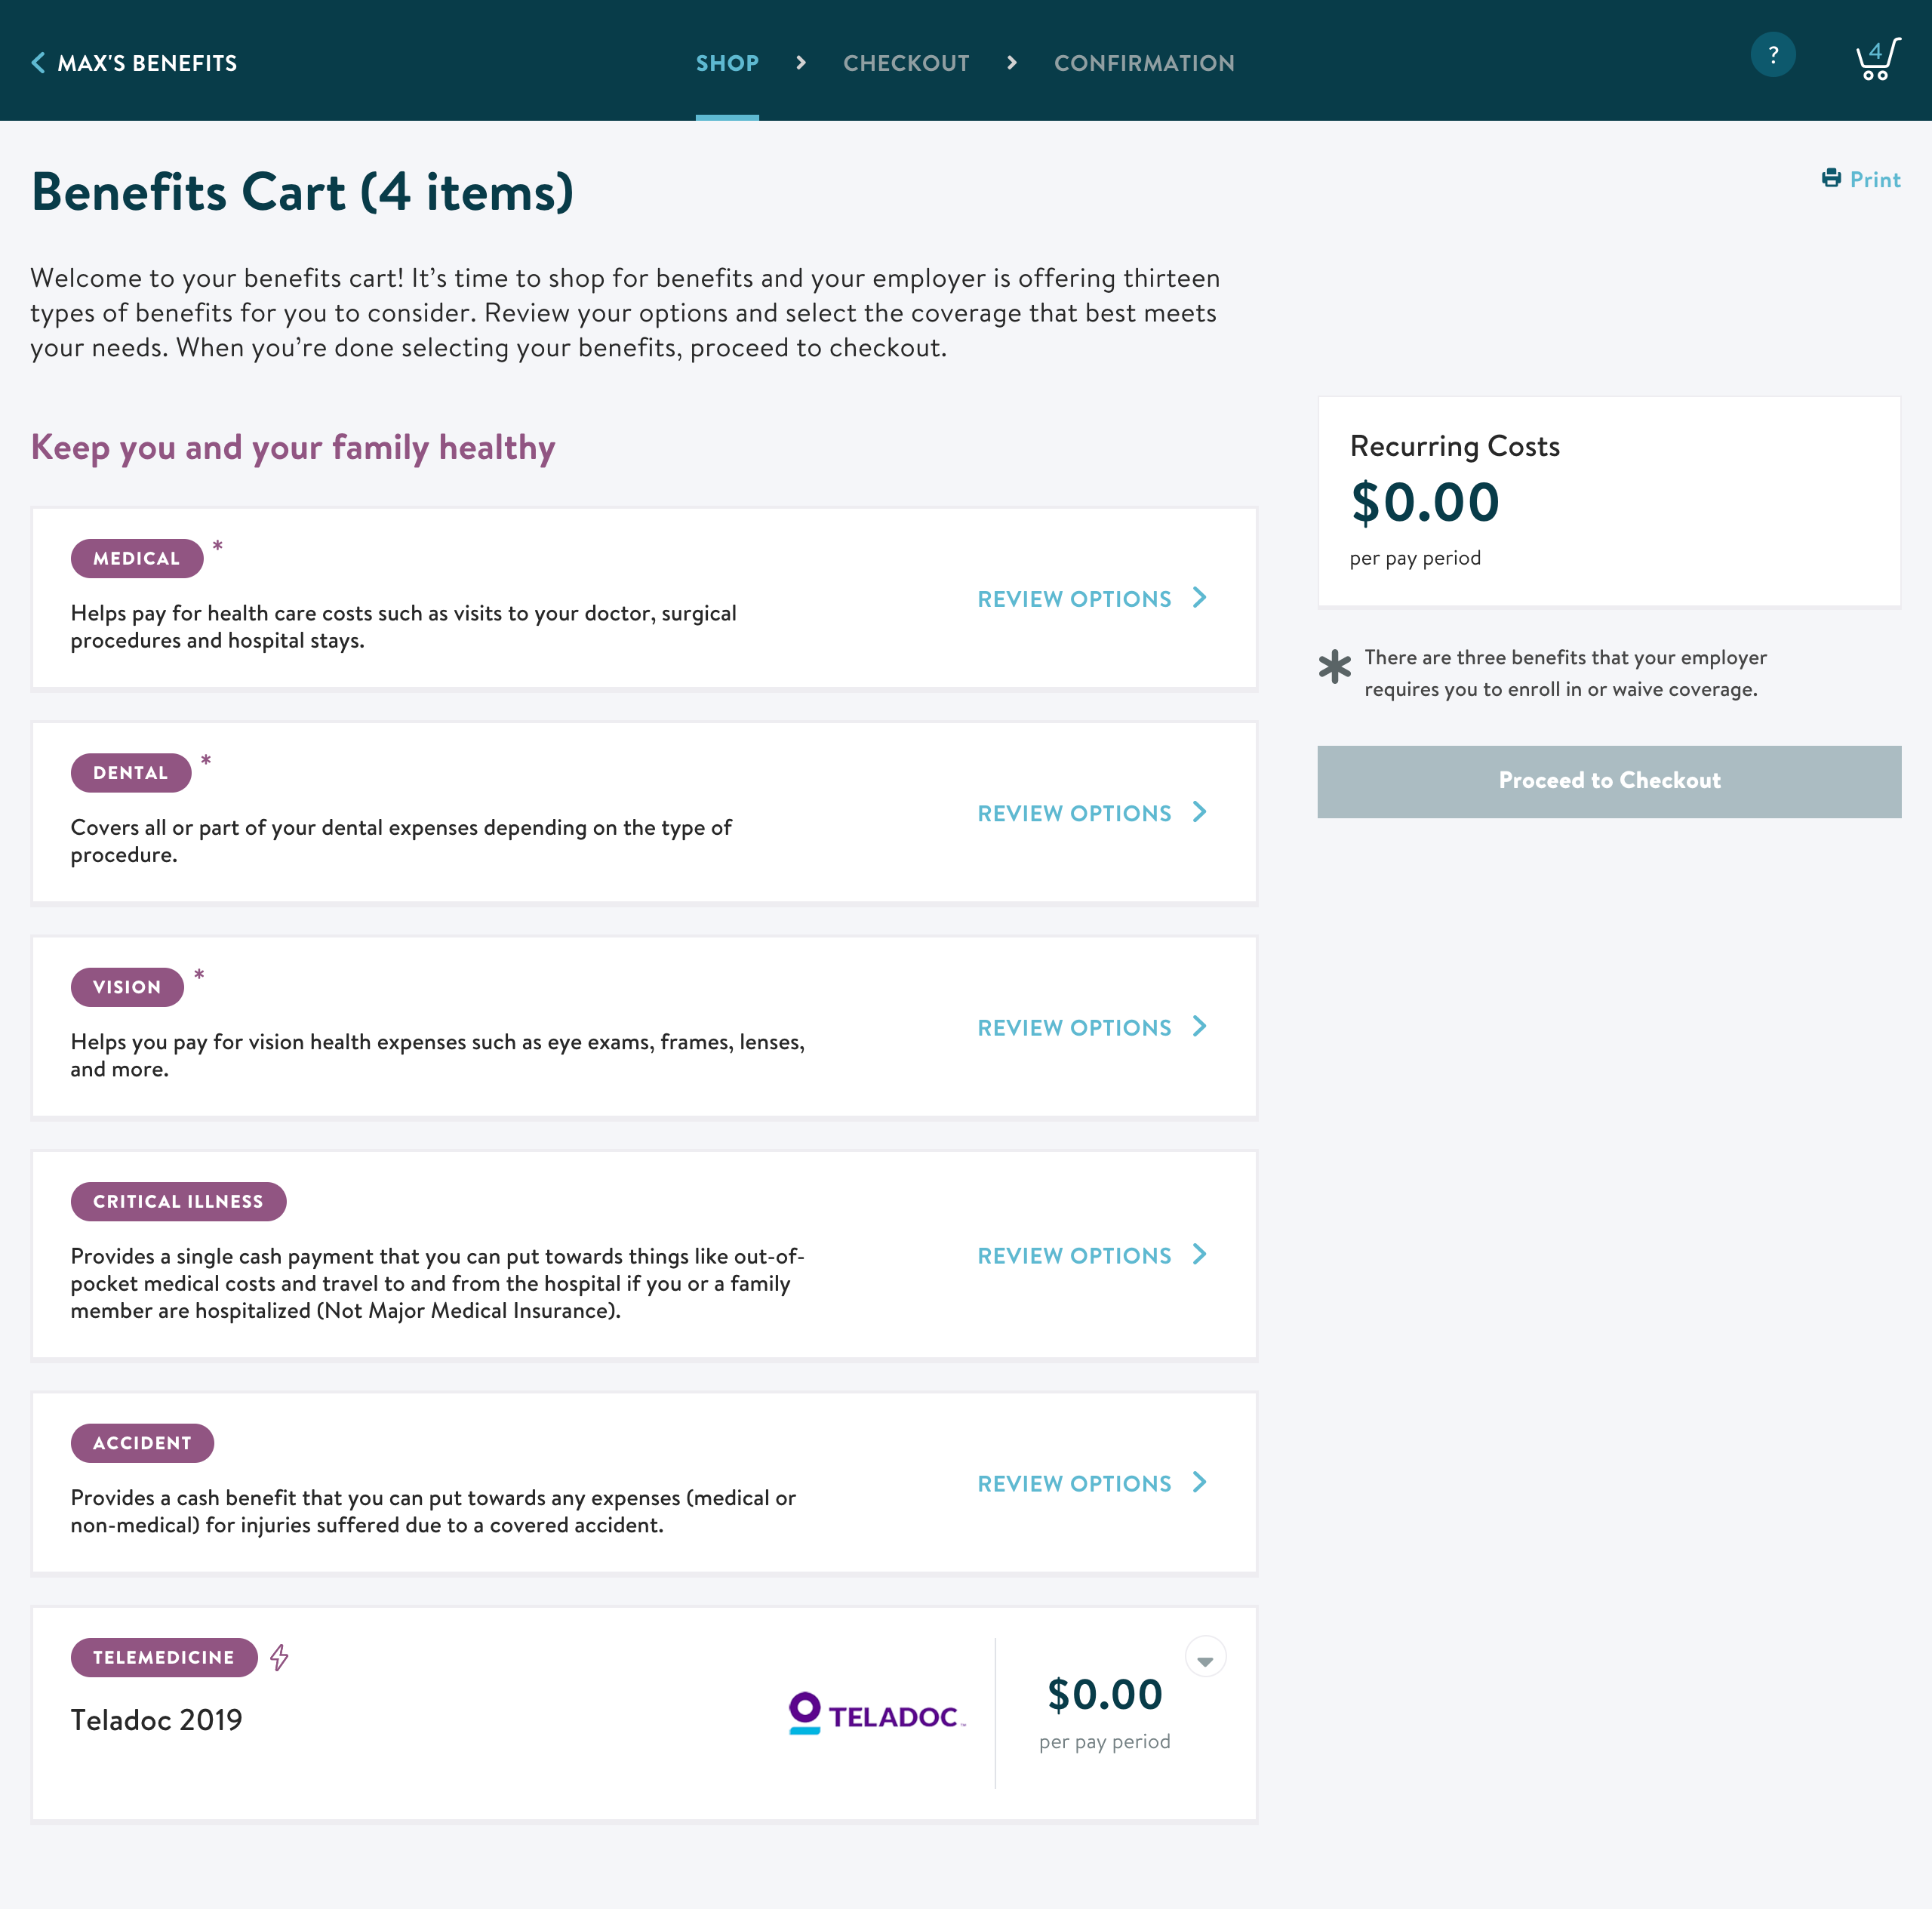
4
View your benefits cart and start shopping. All your options will be listed in your benefits cart. Scan the cart to see all the benefits available to you. You may already have benefits in your cart if your employer has auto-enrolled you in coverage, or if you’re carrying over your benefits from last year. When you’re ready, click Review Options to start shopping.

Slide 6
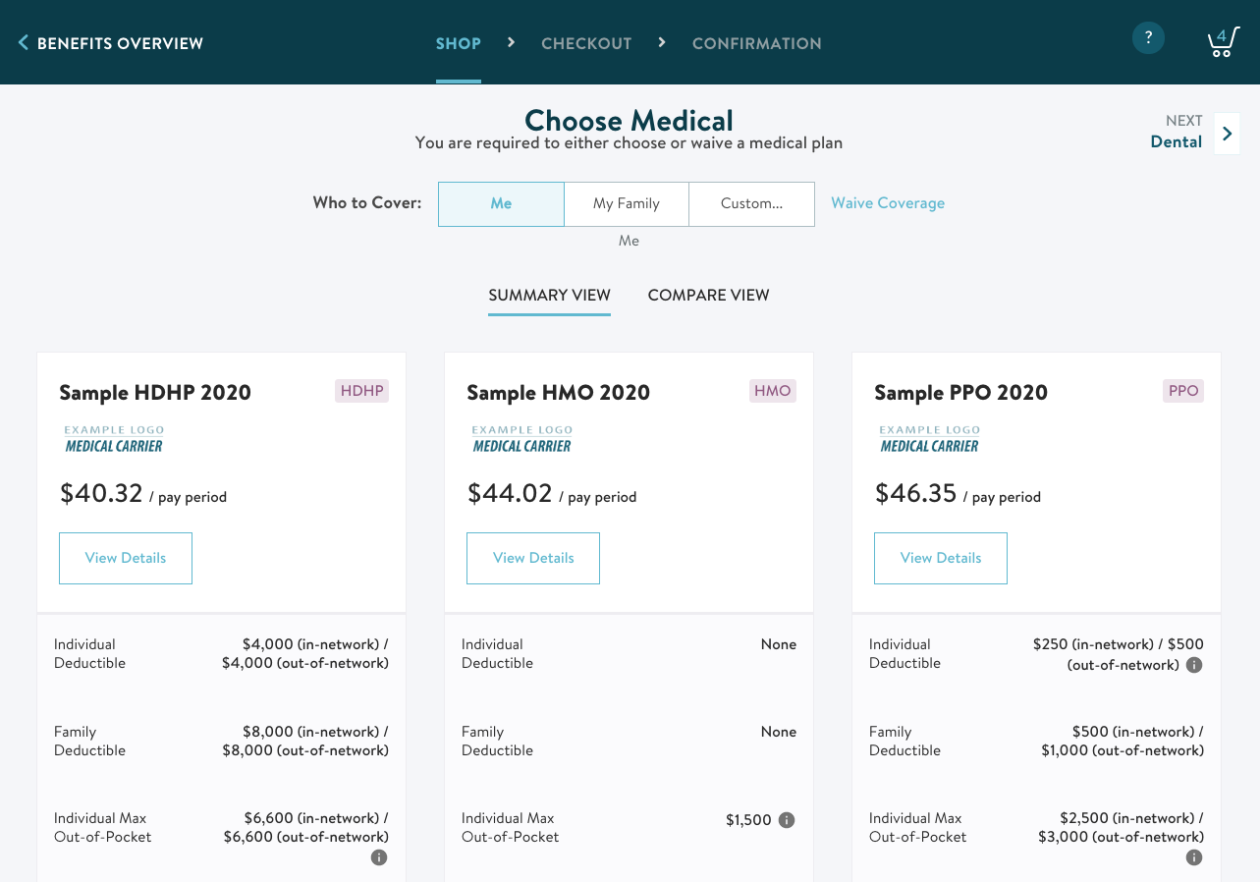
5
Make a decision about the benefit. Review the plans available to you for this type of benefit. For medical, dental, and vision plans, if there are multiple plan options, you can compare plans in a side by side view.

Slide 7
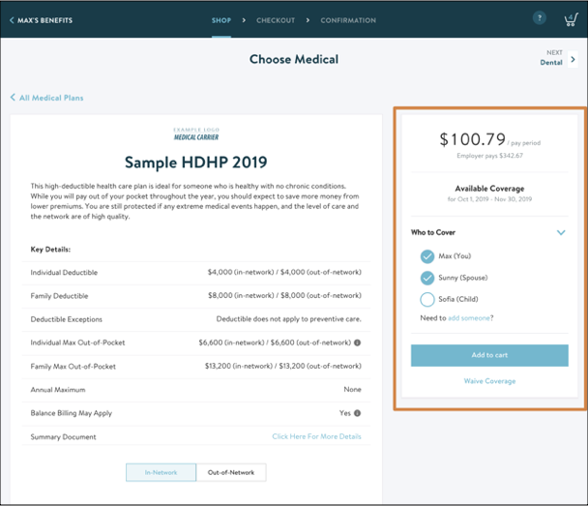
6
Select your coverage for each plan. Select which family members you’d like to cover for each plan, and (if applicable) the amount of coverage. You’ll notice that the cost will change depending on the dependents you cover and your coverage amount. When you’re confident in your choice, add the plan to your cart and navigate to the next benefit!

Slide 8
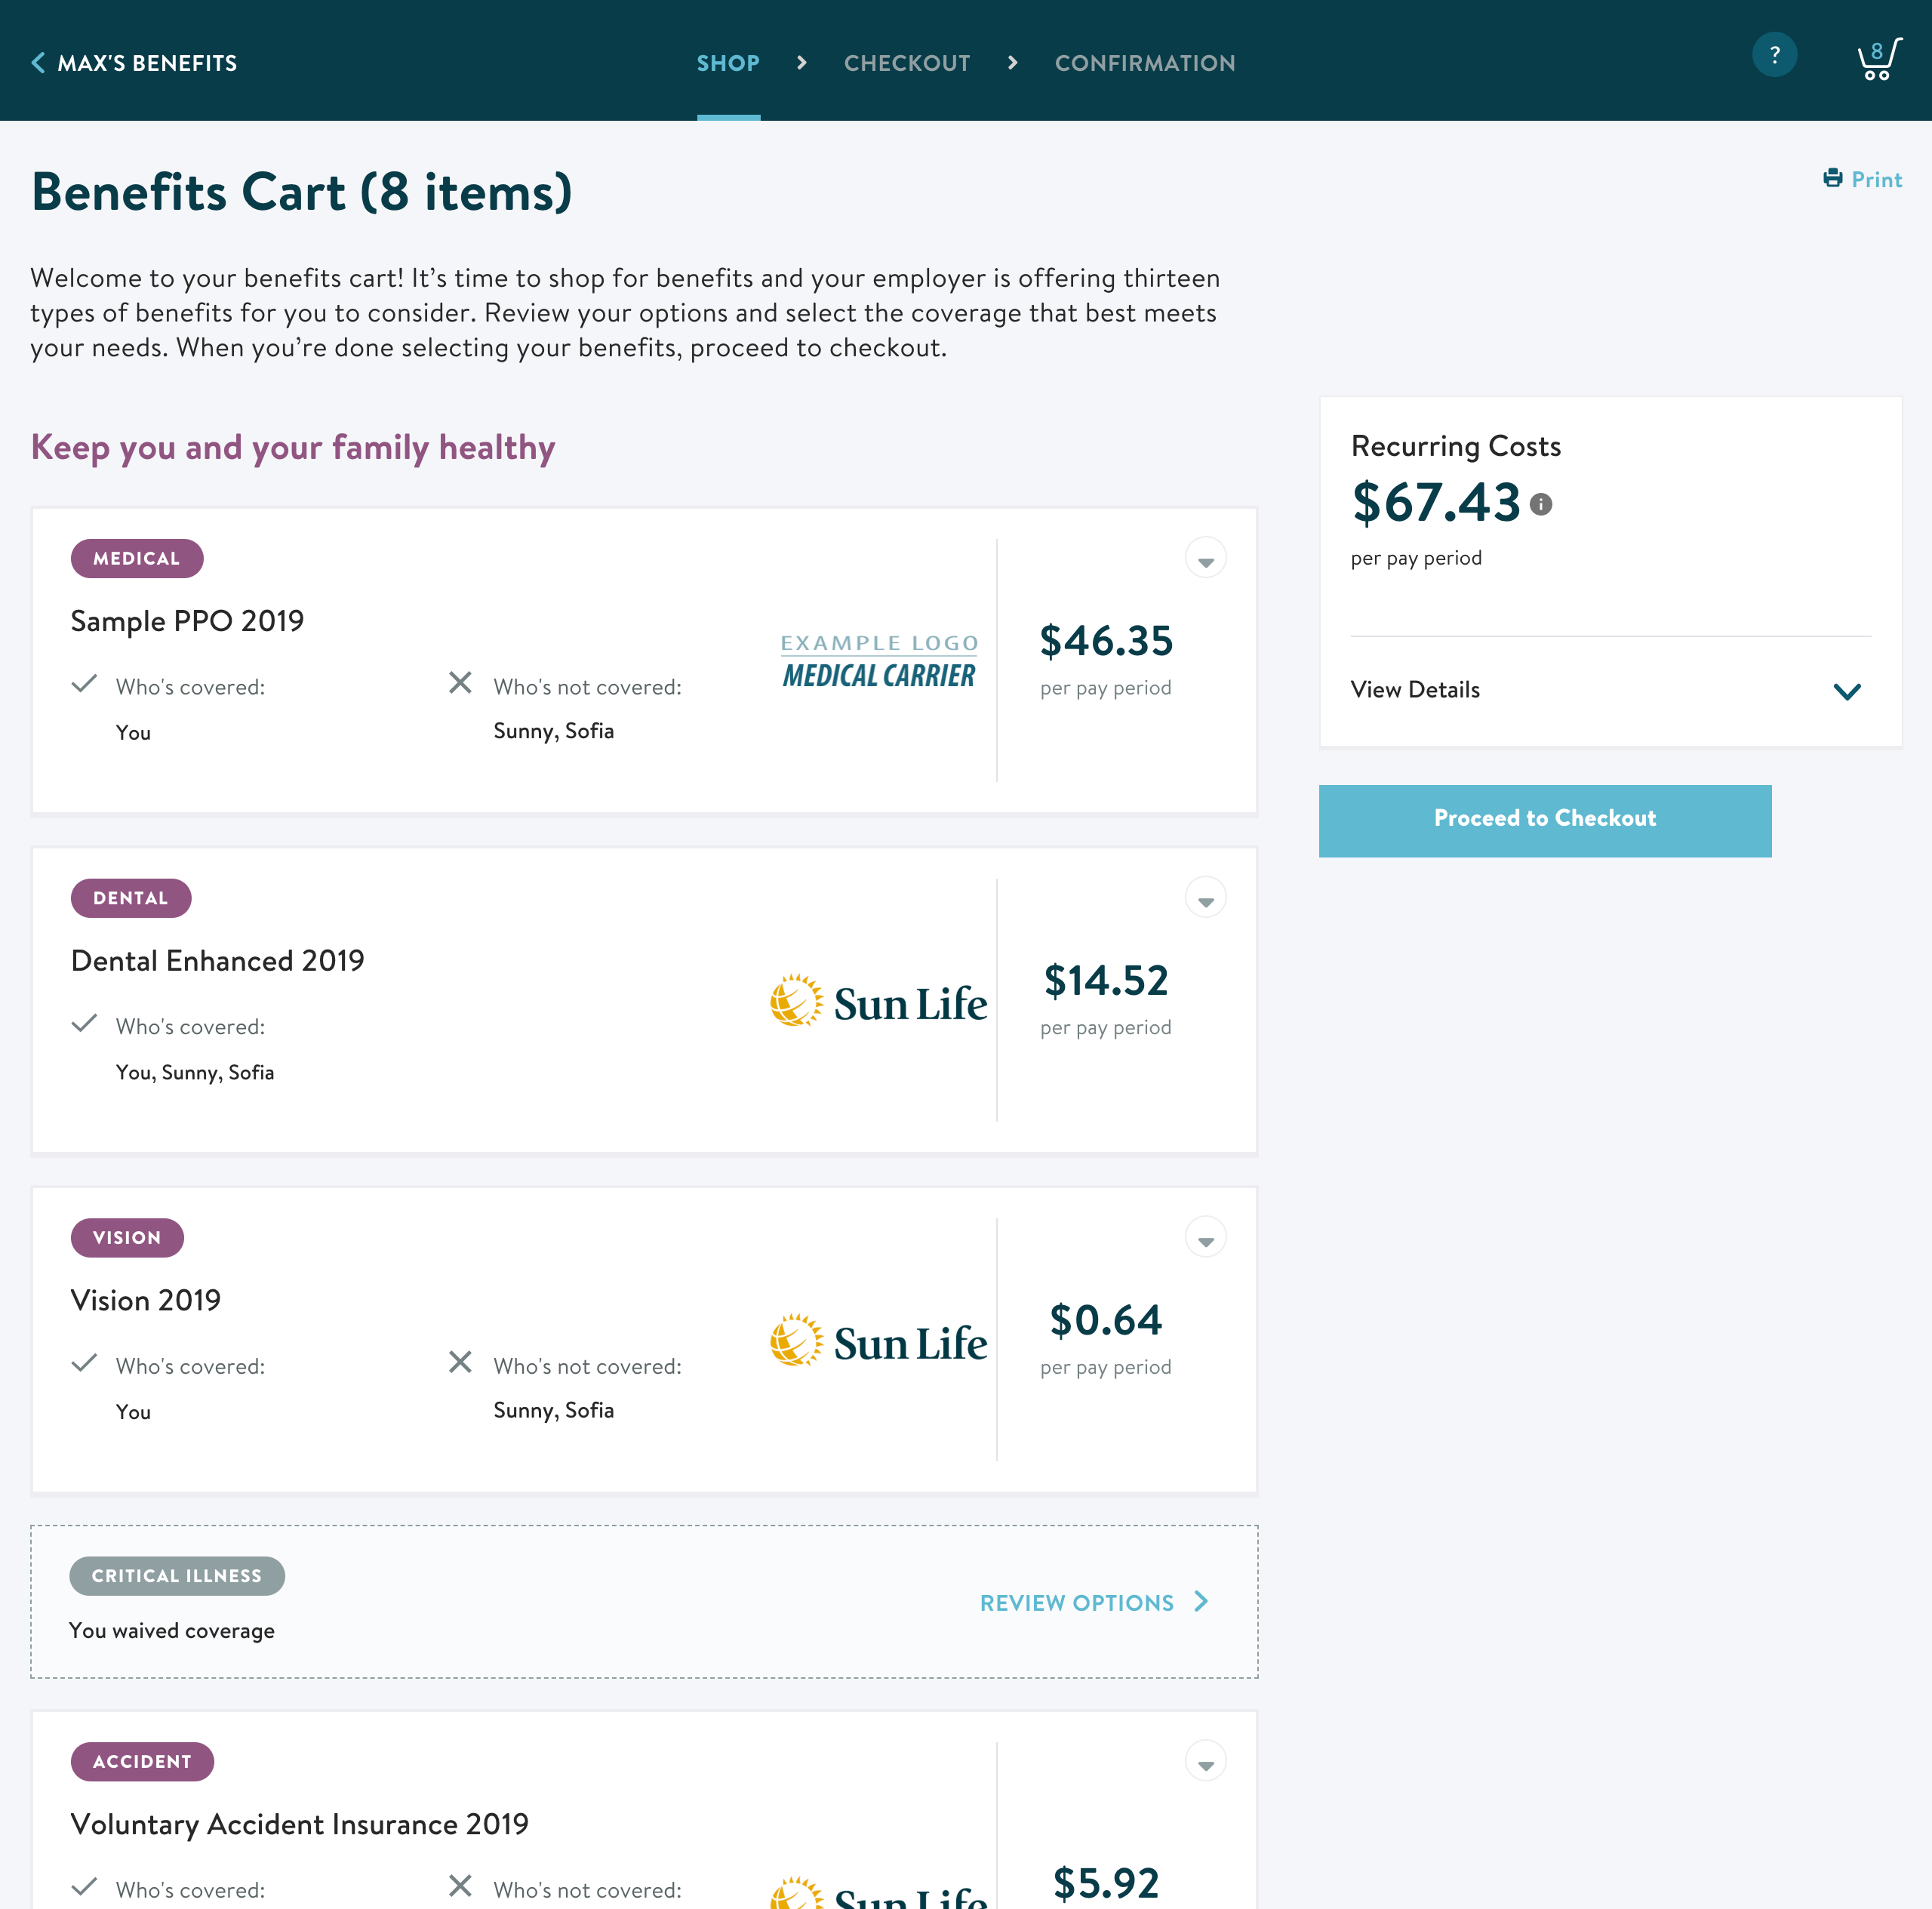
7
Return to cart and proceed to checkout. Use your cart to make sure you’ve considered all the benefits available to you and your recurring cost per pay period. When you’re ready, proceed to checkout where you’ll review your selections.

Slide 9
8
Review your benefit selections and, if applicable, add beneficiary information. If your employer offers a plan that requires beneficiary information, the Update My Beneficiaries button will appear at the bottom of your summary screen. You’ll need to add beneficiaries before you can submit your enrollment. Beneficiaries are the individuals or entities who should receive money from the benefit if you pass away.

Slide 10
9
Submit enrollment! Once you’ve reviewed your benefits, including the recurring costs per pay period, and entered your beneficiaries (if applicable), click Submit Enrollment . Note: You can always make any changes by clicking Back to Shopping.

Slide 11
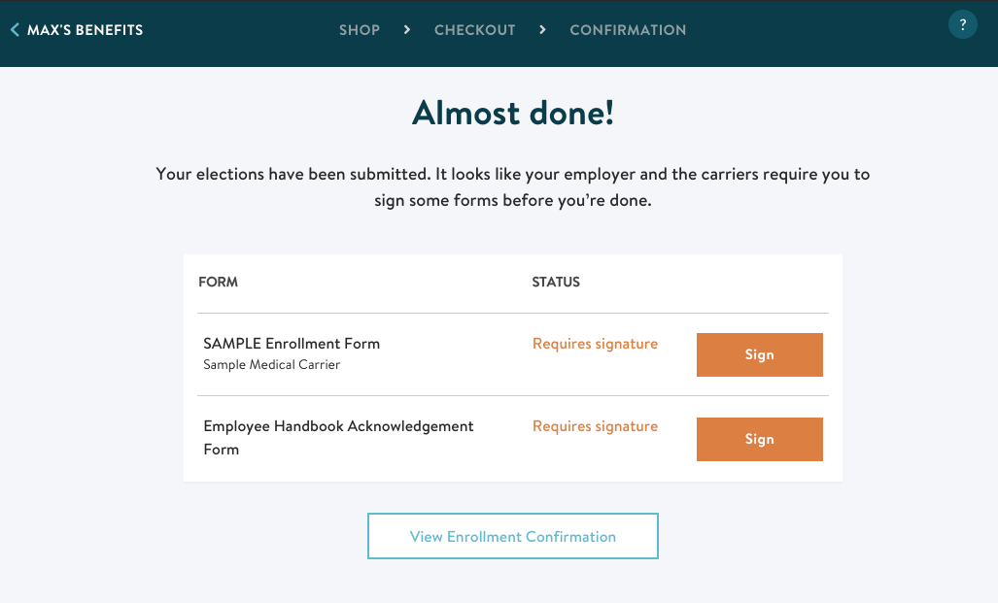
10
Congratulations, you’ve submitted your enrollment!
If you’ve selected plans that require forms, you’ll be asked to sign them. Click Sign to complete these forms and you’ll be on your way.
10

Slide 12
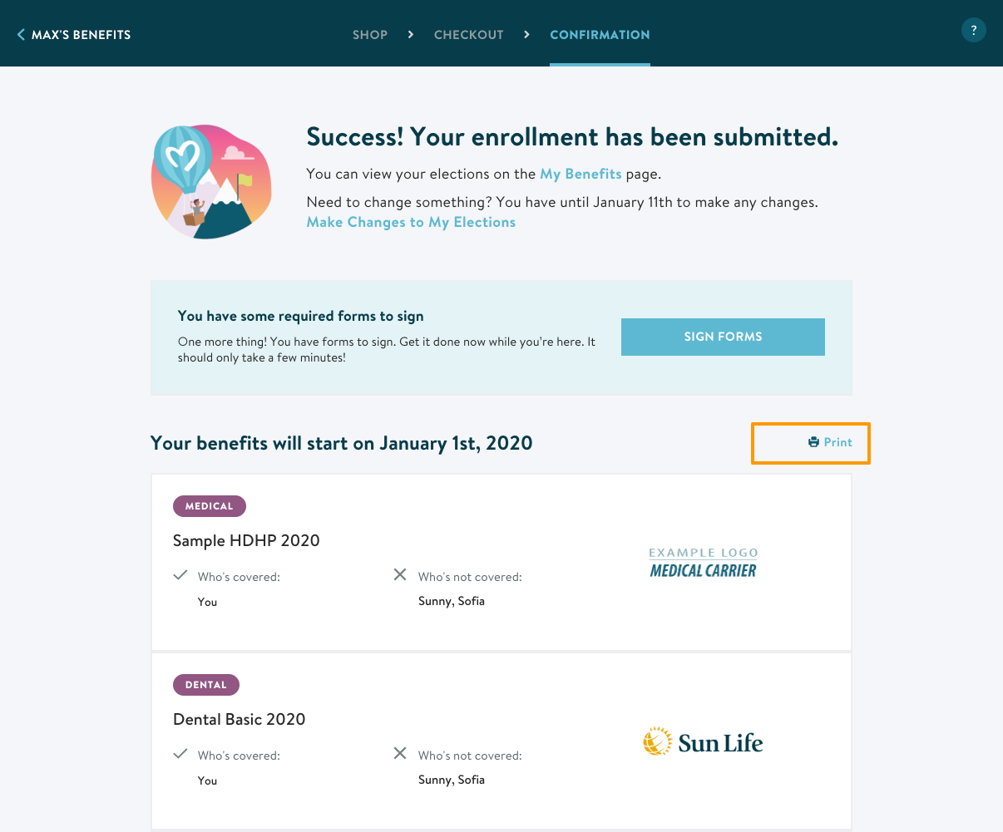
Way to go! You just submitted your benefits selections. You can print a summary of your benefits by clicking Print.
13

Slide 13
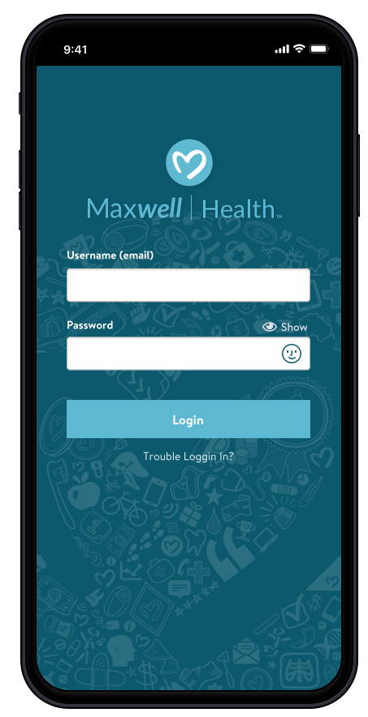
MAXWELL MOBILE APP STEP-BY-STEP GUIDE
1
DOWNLOAD
Download the mobile app on your iPhone or Android by searching for “Maxwell Health Mobile” in the iOS App Store or Android’s Google Play Store.
2
LOG IN
After downloading, sign in using the same credentials you used to log into Maxwell Health online.
Quick Tips:
Make sure you’ve already created a password online before trying to sign into the mobile app.
Click Trouble Logging In? if you forgot or need to reset your password.
If supported, you can use “Face ID” or “Touch ID” to avoid having to enter your password in the future!

Slide 14
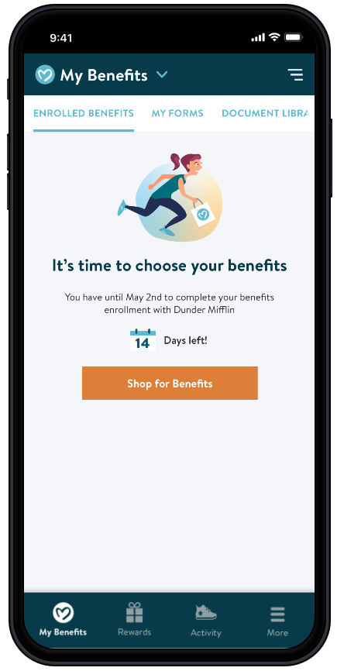
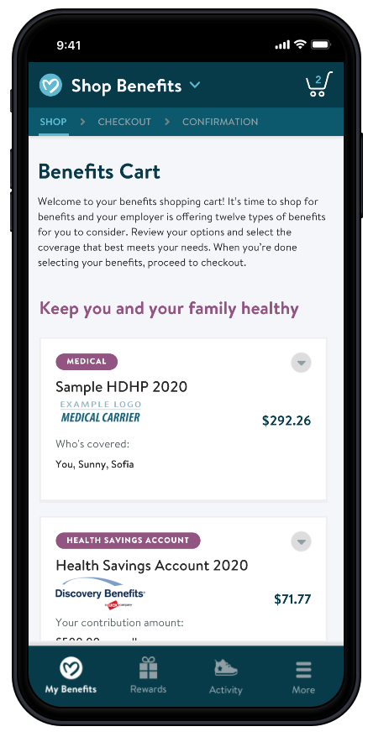
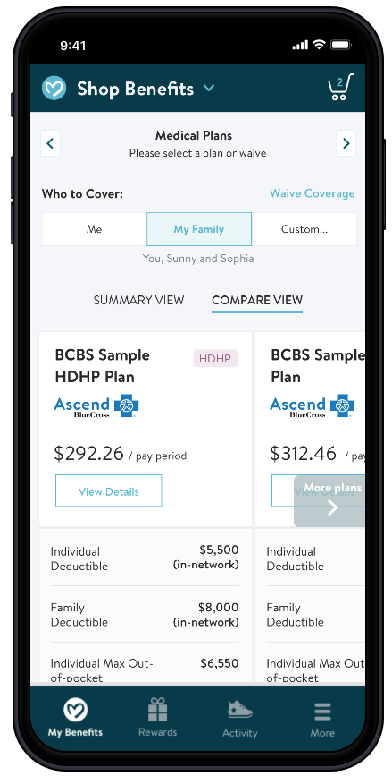
3
SHOP BENEFITS
If it’s time for your benefits enrollment, you’ll see the option to Shop for Benefits.
Tap each benefit in your Benefits Cart to see more plan details, compare coverages and choose who to cover. You’ll also see the cost per pay period or monthly cost for each benefit.

Slide 15
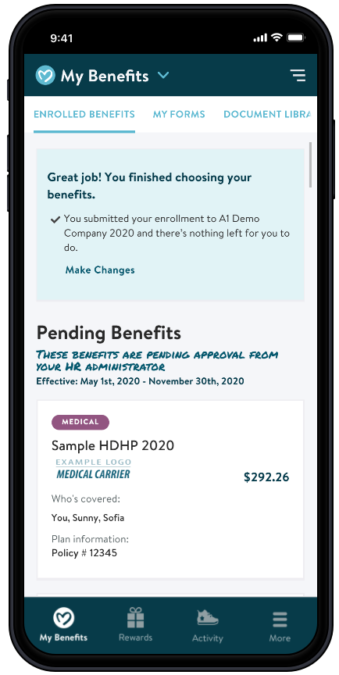
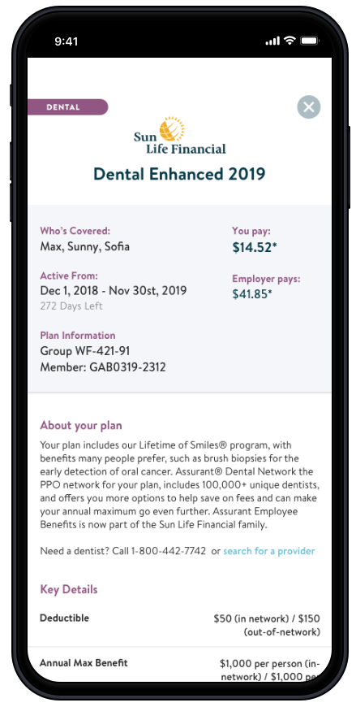
4
MY BENEFITS
If you’ve completed your benefits enrollment,
My Benefits shows you all the benefits you’ve elected.
You can see any benefits that are pending approval by your benefits administrator, along with any benefits you are currently enrolled in.
Quick Tips:
Tap each benefit to see more details, including policy numbers, effective dates, and covered services.
Click the total cost amount to see the per pay period cost broken down for each benefit.

Slide 16
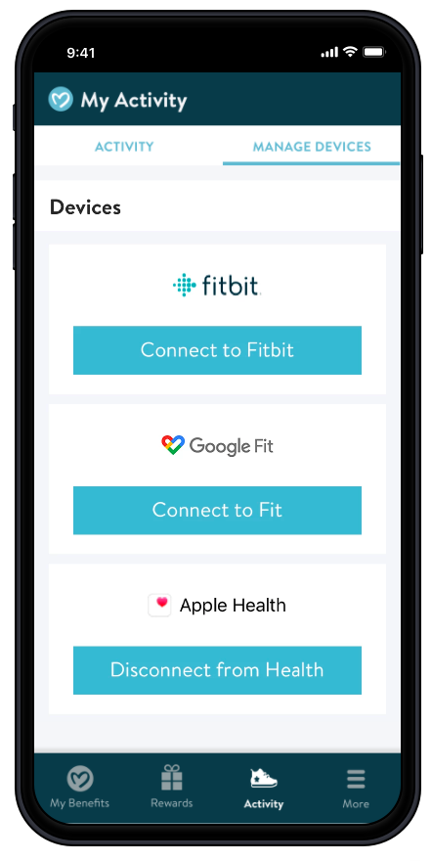
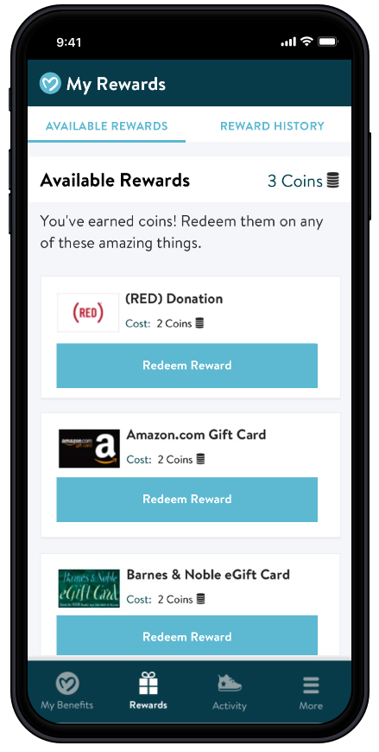
5
MY ACTIVITY
Link your fitness device under Manage Devices
Available for Fitbit, Google Fit, or Apple Health
You’ll be prompted to approve the data sync. Once you’re connected, your steps will tracked in the Maxwell app.
6
MY REWARDS
If your employer offers rewards and you’ve connected the app to a Fitness Device, you can redeem your coins for a reward by tapping Redeem Reward.
Shortly after you’ve redeemed your reward, a digital gift card will be emailed to the email address you use to log into Maxwell.

Slide 17
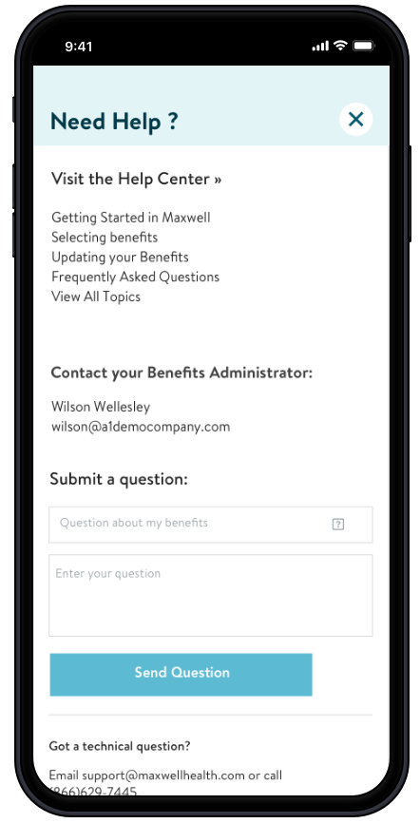
7
HELP
Tap Help to find out where you can get your questions answered.
Quick Tips:
For questions about the Maxwell Mobile App, contact the Maxwell Customer Support team.
For questions about your benefits, contact your Benefits Administrator.

Slide 18
Any questions during this process can be directed to your Benefits Administrator or Maxwell Health at 1(866) 629-7445 and support@maxwellhealth.com.

