Slide 1
Hipaa & covid-19 update
June 23, 2020
Margaret Scavotto, jd, chc

Slide 3
Hipaa & covid-19

Slide 4
Hipaa reminders
During a public health emergency, providers may STILL disclose protected health information without authorization including the following:
Treatment: as necessary to provide treatment
Notification: as necessary to identify, locate and notify family members, guardians, or anyone else responsible for the individual’s care or the individual’s location, general condition, or death
Imminent Danger: as necessary to prevent or lessen a serious and imminent threat to the health and safety of a person or the public - consistent with applicable law and the provider’s standards of ethical conduct
Facility Directory: if maintaining a directory of individuals, providers may tell people who call or ask about individuals whether the individual is at the facility, their location in the facility, and general condition

Slide 5
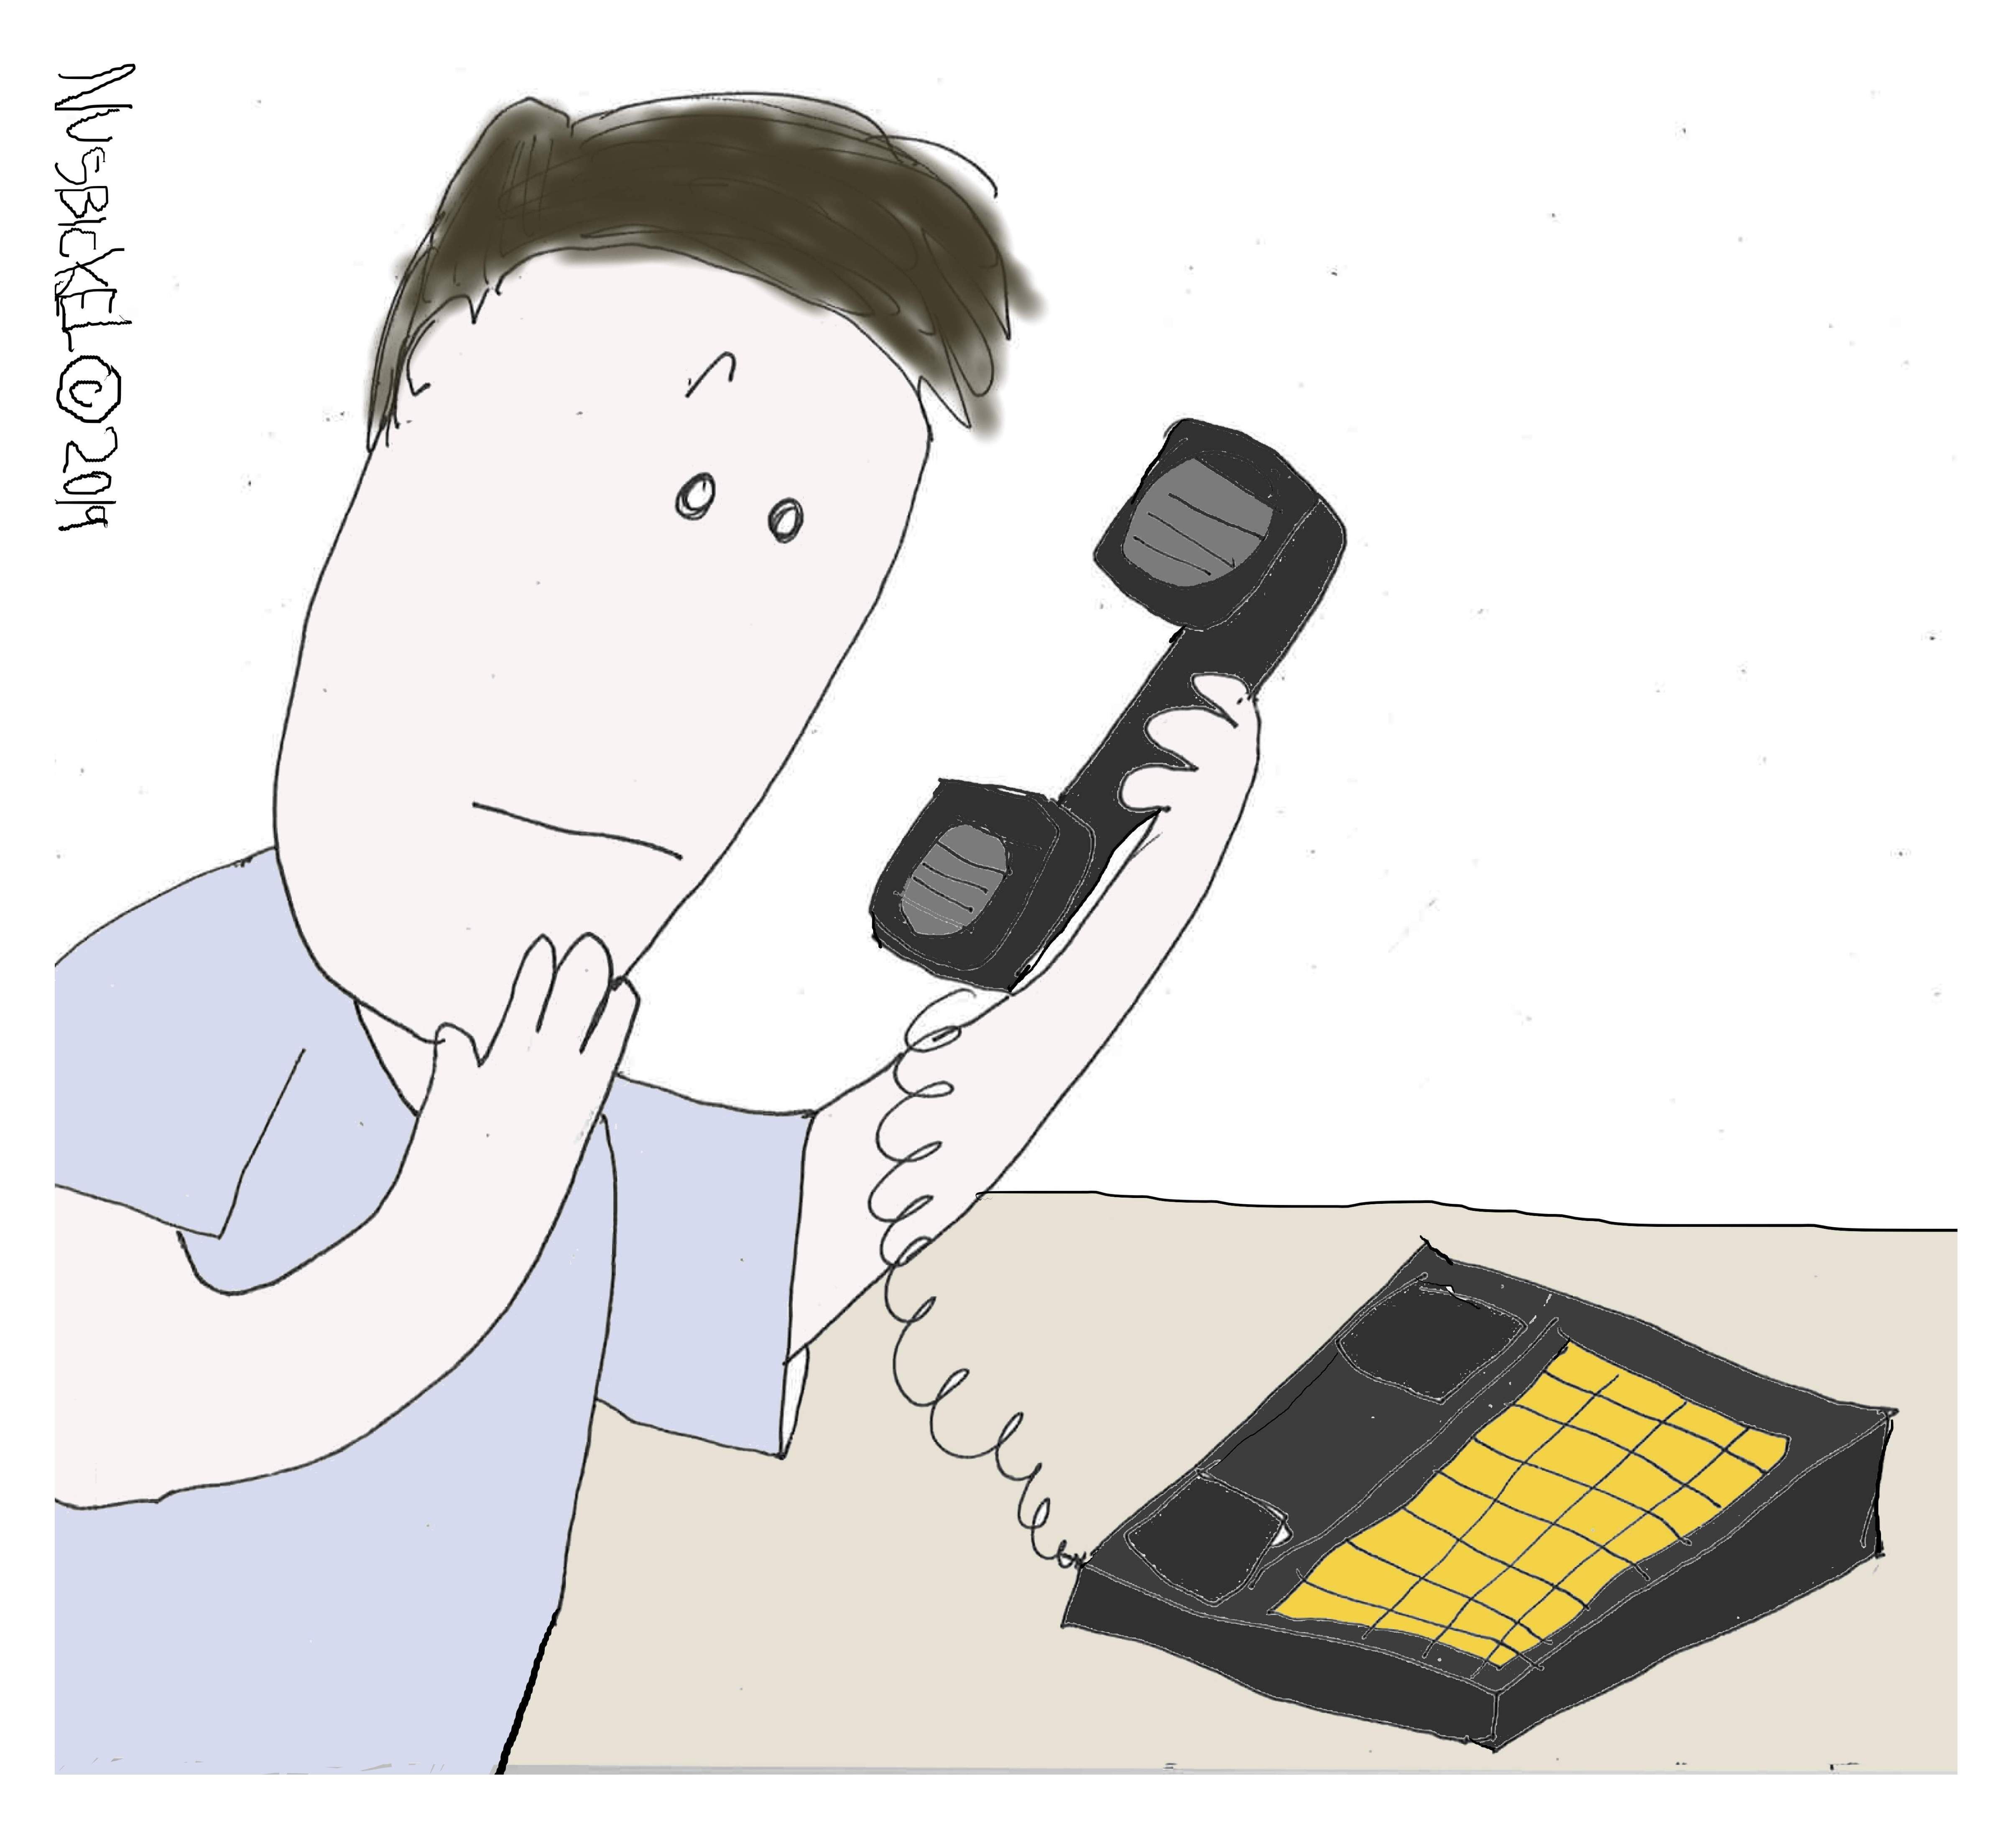
General guidance & the waiver
In February, the OCR issued guidance addressing HIPAA and COVID-19.
https://www.hhs.gov/sites/default/files/february-2020-hipaa-and-novel-coronavirus.pdf
The OCR issued a limited waiver of HIPAA sanctions and penalties FOR HOSPITALS. The waiver only applies for 72 hours from the time a hospital implements a disaster protocol. https://www.hhs.gov/sites/default/files/hipaa-and-covid-19-limited-hipaa-waiver-bulletin-508.pdf

Slide 6
Covid-19 and telehealth
“OCR will exercise its enforcement discretion and will not impose penalties for noncompliance with the regulatory requirements under the HIPAA Rules against covered health care providers in connection with the good faith provision of telehealth during the COVID-19 nationwide public health emergency. ”
OK: FaceTime, Facebook Messenger video chat, Google Hangouts video, Skype
NOT OK: Facebook Live, Twitch, TikTok, other public-facing applications
Notify patients of privacy risks.
Enable encryption.
Get a BAA.
https://www.hhs.gov/hipaa/for-professionals/special-topics/emergency-preparedness/notification-enforcement-discretion-telehealth/index.html

Slide 7
Covid-19 and telehealth
OCR Issues FAQ on Telehealth and HIPAA during COVID-19:
What is a “non-public facing” remote communication product?
If a covered health care provider uses telehealth services during the COVID-19 outbreak and electronic protected health information is intercepted during transmission, will OCR impose a penalty on the provider for violating the HIPAA Security Rule?
Where can health care providers conduct telehealth?
https://www.hhs.gov/sites/default/files/telehealth-faqs-508.pdf

Slide 8
First responders, paramedics
The OCR issued guidance on communicating with law enforcement, paramedics, other first responders, and public health authorities.
Covered entities may disclose the PHI of someone infected with or exposed to COVID-19 to
1) law enforcement; 2) paramedics; 3) other first responders; and 4) public health authorities, without obtaining patient authorization, in some circumstances, such as:
Treatment: Telling emergency transport personnel that a nursing home resident has COVID-19
When required by law: A hospital can report COVID-19 cases to public health as required by state infectious disease law
To notify public health to prevent or control spread of disease: Providers may disclose PHI to the CDC or the local health department to prevent or control COVID-19
When a first responder is at risk of infection: Telling a first responder who may have been exposed to or at risk of contracting or spreading COVID-19 (when authorized by state law)
In response to a request for PHI by a correctional institution or law enforcement official having lawful custody of an inmate or other individual: A doctor at a prison medical center an tell guards that an inmate tested positive for COVID-19
https://www.hhs.gov/sites/default/files/covid-19-hipaa-and-first-responders-508.pdf

Slide 9
Community-based testing sites
The OCR announced enforcement discretion for community-based testing sites.
Implement reasonable safeguards – use the minimum PHI necessary
https://www.hhs.gov/hipaa/for-professionals/special-topics/hipaa-covid19/index.html

Slide 10
Dealing with the media
OCR Issues Guidance on Covered Health Care Providers and Restrictions on Media Access to Protected Health Information about Individuals in Their Facilities
Get a HIPAA authorization BEFORE granting media access
CANNOT require a patient to sign a media authorization as a condition of receiving treatment
Masking/blurring voices/faces NOT ENOUGH
Implement safeguards to protect PHI
https://www.hhs.gov/hipaa/for-professionals/special-topics/hipaa-covid19/index.html

Slide 11
Blood and plasma donation
Contacting COVID-19 Patients about Blood and Plasma Donation
Covered entities (or their business associates) CAN, under HIPAA, use PHI to identify and contact patients who have recovered from COVID-19 to provide information about donating blood and plasma that could help other COVID-19 patients.
Use the minimum necessary.
Do not cross over into marketing.
https://www.hhs.gov/sites/default/files/guidance-on-hipaa-and-contacting-former-covid-19-patients-about-blood-and-plasma-donation.pdf

Slide 12
More guidance
The OCR issued guidance about disclosure by business associates for public health and health oversight activities.
The OCR has issued Spanish versions of its recent Notifications, Guidance, and Bulletins related to COVID-19.
https://www.hhs.gov/hipaa/for-professionals/special-topics/hipaa-covid19/index.html

Slide 13
Has your workforce changed?
Workforce means “employees, volunteers, trainees, and other persons whose conduct, in the performance of work for a covered entity or business associate, is under the direct control of such covered entity or business associate, whether or not they are paid by the covered entity or business associate.” 45 CFR 160.103
Workforce members MUST BE TRAINED ON HIPAA

Slide 14
Privacy issues with no-contact temperature taking
Many healthcare providers are taking temperatures of employees using no-contact devices. Devices include infrared scanners, facial recognition/thermal scanning devices, and wearables. This technology comes with privacy risks that need to be evaluated.
HIPAA: HIPAA will not apply to employee information unless the covered entity is functioning as a Group Health Plan. But, other privacy laws potentially apply to collected employee information. If no contact temperature devices are used on patients, HIPAA protections should be addressed.
Americans with Disabilities Act: This law requires employers to keep medical information confidential
Illinois’ Biometric Information Privacy Act (BIPA): Facial recognition devices could violate BIPA if not done properly (with consent and other procedures).
State breach notification and security statutes: Some of these laws include medical information and biometric information.
Check with your legal counsel regarding applicable laws in your state before using no-contact temperature devices.
Source: https://www.bakermckenzie.com/en/insight/publications/2020/03/employer-and-visitor-screenings-a-privacy, https://www.bytebacklaw.com/2020/04/u-s-privacy-law-implications-with-the-use-of-no-contact-temperature-taking-devices/

Slide 15
Covid-19 and security: working from home
Department of Homeland Security Cybersecurity and Infrastructure Security Agency (CISA) issued an Alert encouraging employers to use VPNs for teleworking employees.
https://www.us-cert.gov/ncas/alerts/aa20-073a

Slide 16
Covid-19 and cyber scams
*COVID-19 is an opportunity for hackers – attacks have skyrocketed*
Where to look for guidance:
Department of Homeland Security Cybersecurity and Infrastructure Security Agency (CISA)
The FBI
DOJ
OCR
OIG

Slide 17
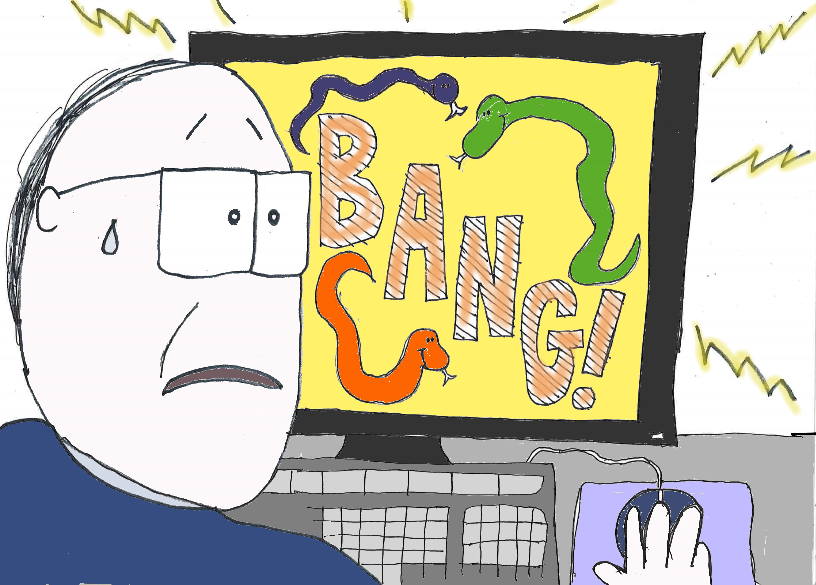
Covid-19 and cyber scams
Other scams & risks:
PPE scams – phony seller wants payment up front (business email compromise attacks)
Phishing and malware disguised as COVID-19 updates or offers
Free meals and coupons in response to COVID-19
Emails impersonating the WHO
Emails luring users working from home
Phony websites about charitable donations, stimulus payments, etc.

Slide 18
Fbi warns about fraud risks in social media trends
The high school photo trend prompts users to post their high school photo in support of the class of 2020, which is unable to attend their graduations. Hackers can gain valuable information from these posts, such as your name of high school, high school mascot, and year of graduation – information that often corresponds to financial security questions and can be used to gain access to accounts. Nursing homes might want to warn their residents about the risks of these and other social media trends.
https://www.fbi.gov/contact-us/field-offices/sanfrancisco/news/press-releases/fbi-warns-popular-social-media-trends-can-lead-to-fraud

Slide 19
Oig covid-19 Fraud alert
The OIG published a COVID-19 fraud alert warning that “scammers are offering COVID-19 tests to Medicare beneficiaries in exchange for personal details, including Medicare information.” These individuals then use Medicare beneficiary information to commit identity theft and healthcare fraud.
Medicare beneficiaries should be careful of unsolicited phone calls or in-person inquiries about COVID-19 tests, as well as social media solicitations.
https://oig.hhs.gov/coronavirus/fraud-alert-covid19.asp?utm_source=web&utm_medium=web&utm_campaign=covid19-fraud-alert

Slide 20
Hipaa, social media, & covid-19

Slide 21
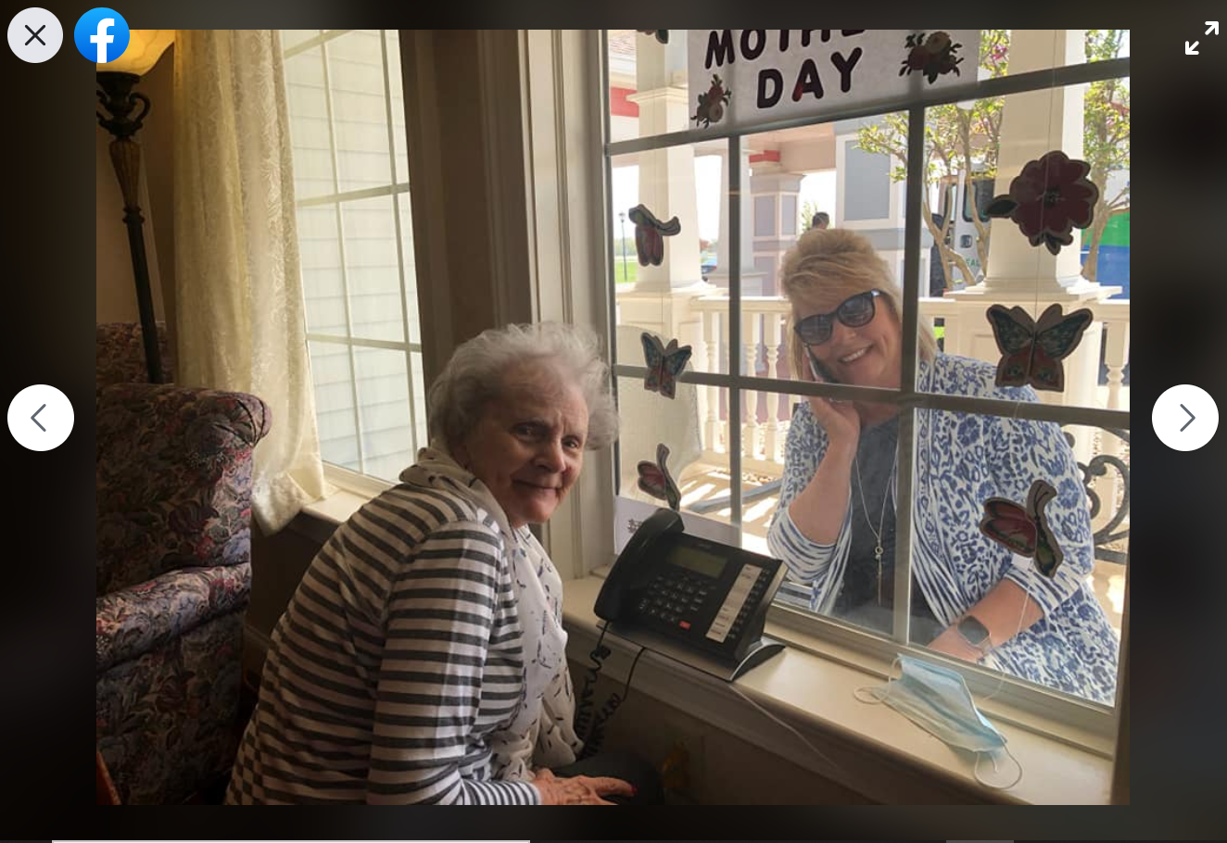
Window rendezvous

Slide 22
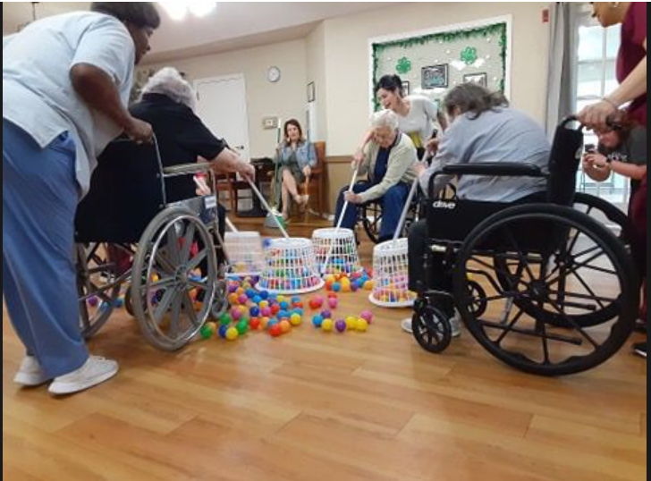
Game night

Slide 23
Tiktok turmoil

Slide 24
Cms 16-33
Pictures or recordings that demean or humiliate nursing home residents are mental abuse.
CMS Survey & Certification Memo 16-33 NH, Protecting Resident Privacy and Prohibiting Mental Abuse Related to Photographs and Audio/Video Recordings by Nursing Home Staff, August 5, 2016, available at
https://www.cms.gov/Medicare/Provider-Enrollment-and-Certification/SurveyCertificationGenInfo/Downloads/Survey-and-Cert-Letter-16-33.pdf

Slide 25
Employee posts
“Hey you guys the rumors are true, our floor is becoming the COVID floor.
Be careful.”

Slide 26
Proceed with caution
THE BEST WAY TO AVOID THESE SITUATIONS IS TO TRAIN PEOPLE ON WHAT NOT TO DO
REMEMBER: if it goes on social media, it could end up in the news.

Slide 27
HIPAA & COVID-19 Toolkit
www.healthcareperformance.com/store
Includes:
COVID-19 HIPAA Update
HIPAA COVID1-9 Telehealth Policy
HIPAA & Social Media Policy (updated for COVID-19)
Limited COVID-19 HIPAA Waiver Policy for Hospitals
COVID-19 Permitted Disclosures Policy (incorporates COVID-19 guidance about disclosures to public health, first responders, family and friends, and law enforcement into the following HIPAA Privacy policies)
Remote Access Policy & Policy Acknowledgment
HIPAA & Media Access Policy
Three printable flyers/posters or email content for your workforce:
Stay Smart with Social Media During COVID-19
Stay Smart while Working from Home During COVID-19
Watch Out for Cyber-scams During COVID-19

Slide 28
Phase 3 enforcement udpate

Slide 29
What’s required now: ACA
ALL nursing homes must have:
Policies and procedures
Screening
Oversight and leadership
Policy communication
Taking steps to achieve compliance: Auditing, reporting, and data
Enforcement and discipline
Corrective action
Annual review
Required as of November 28, 2019!

Slide 30
What’s required now: ACA
Chains of 5+ SNFs must also have:
Mandatory annual compliance training
Compliance officer who reports to the governing body
Compliance liaisons at each facility
Required as of November 28, 2019!

Slide 31
What might change
In July 2019, CMS issued a PROPOSED rule that might change/eliminate some of the Phase 3 requirements.
The proposed rule has not yet been made final.
The OIG recommends EVERYTHING CMS proposes taking out.

Slide 32
Enforcement update
On November 22, 2019, CMS issued a memorandum with an update on the Phase 3 Requirements of Participation. In this memo, CMS advised:
CMS will not release updated Interpretive Guidance and training addressing Phase 3 until the second quarter of 2020.
But... nursing homes are still expected to comply with Phase 3 by November 28, 2019.
CMS has shifted the focus of its surveys due to COVID-19.

Slide 33
Survey update
April 24: Nursing Home Five Star Quality Rating System Updates, Nursing home Staff Counts, and FAQ, CMS QSO-20-28-NH
“During the COVID-19 pandemic, CMS is prioritizing the types of surveys that state and federal surveyors conduct.”
Focus: Intermediate Jeopardy; and infection control assessment survey.
“If an onsite survey is conducted, surveyors may ask facilities for their self-assessment, but they will still conduct their own assessment using the focused survey process…State agencies may call facilities to ask if they’ve completed the self-assessment” …but the results are NOT entered into the CMS system as an official survey.
“Otherwise, surveyors should not be spending time onsite investigating noncritical or routine issues.”
https://www.cms.gov/files/document/qso-20-28-nh.pdf

Slide 34
https://us02web.zoom.us/webinar/register/WN_F5vRZQioRvmscQV_l3gJFw

Slide 35
Margaret Scavotto, JD, CHC
President
314-394-2222 ext. 24
mcs@healthcareperformance.com
Blog: www.healthcareperformance.com/blog
Store: www.healthcareperformance.com/store
Questions?
(c) 2019 Management Performance Associates
This presentation does not constitute legal advice

